Slide 1

NNIP Ignite
Thoughtwell’s Rebranding
October, 2017
Notes:
Hello
Thanks to Leah for the invitation to share our rebranding story. I am old enough to remember (and loved!) the artist formerly known as Prince, so I am amused at all the times I get introduced as the lead for “Thoughtwell, formerly known as Community Research Partners”.
We thought it might be useful to share the story of our rebranding process, in case any of you are considering such a move. I think it’s particularly relevant for any of you who may be considering how to generate earned income streams, because to have that sort of business model I think you do need to have the look and feel of a business. But I also think it’s something that shouldn’t be undertaken lightly, and certainly not something you can expect to do in a year or less. (fair warning)

Slide 2

How do you feel about
CHANGE?
  COMMUNITY RESEARCH PARTNERS’ JOURNEY
Notes:
The interesting thing about change is that it doesn’t matter whether you love it or hate it. Change is inevitable. So maybe consider being proactive.
And. Several factors helped push us in this direction.
Leadership transition (staff) in 2013. I might just actually be able to do this job after all, so what’s next? I was ready to talk about possibilities, and our team is comprised mostly of young, high achieving go-getters who want to build something amazing.
Last remnants of initial Board about to transition off (12 year term limits that had some exceptions made); motivated to make sure they’re leaving the organization in good shape to survive. So the Board seemed ready.

Slide 3
AWARENESS
PARTNERS
BUSINESS DEVELOPMENT
Examine what partner means
Deepen partnership with founders
Strengthen relationship among partners
Deepen relationship with existing clients
Refine successful products; identify new products
Develop & implement social enterprise
Segment audience
Refine “brand identity”
Develop communications plan
STRATEGIC PLAN 2015 – 2017
Notes:
The current strategic plan, which wraps up in December, unknowingly planted the seeds.
CRP was started as a partnership of our local UW, the City of Columbus, Franklin County, and the Ohio State University. When we started, they each made a financial commitment to the organization and appointed 3 Board members (per). The Board commitment is still there, but the finances have changed – and changed differently for each partner. Hence the “examine what ‘partner’ means”, and perhaps an opening to other funding models (‘business development’).
As they collectively recognized that they want us to continue, to be successful, but they don’t want to “fund” us, they’ve warmed up to the idea of us actively pursuing more clients. Hence the awareness piece of the strategic plan.
In Columbus, everybody and their brother is talking about social enterprise. Somehow, it’s the [next] thing that’s going to save us all. So when I started at CRP and the finances were shaky at best, everybody said “Create some product, sell a ton of it, and then go back to doing what you do.” In the process of trying to create a product, we talked to lots of investors. They all said “What you do is custom. Way higher value. You don’t have a business model problem, you have a marketing problem. Do some market research, then implement your marketing plan.”

Slide 4
By our clients
By our partners
By funders & other
“key stakeholders”
HOW ARE WE PERCEIVED?
Notes:
This was a lengthy process.
The initial stages we did ourselves. We send a “satisfaction” survey to every client 3 to 6 months after the fact, but we don’t always have a good response rate. So we were intentional with follow-up calls, emails, etc to make sure we got some feedback.
Interestingly, the pro bono projects had nearly 100% response rate and while very complimentary, they gave really great food for future thought. Our pro bono work is limited to what we can do for someone within about 15 – 18 hours. In the feedback, these folks all say they wanted to talk to us more. Specifically they said that the wanted us to reserve a couple of hours for a “debrief” at the end of the project to tell them what we thought about their results. It was the conversation, the knowing what we think, that they wanted most.
Good feedback just in terms of customer service and project management. But it’s also something that has informed the way we try to engage with our community. I hired a “Development Coordinator” – he’s fantastic and would be an asset to any team – but aside from his personal skill sets, it’s about someone who is dedicated to making our voice in community conversations heard. We started a blog, we are way more active in social media, we do more with our “DataBytes”, anything and everything we can do to be talking to folks about data. Theirs, ours, somebody else’s. Any (well almost) topic

Slide 5
Who we are:
We are a trusted source of information.
What we do:
We unmuddy the waters for partners to take effective action to fulfill their purpose.
Why we do it – Our Mission:
Our Mission is to strengthen communities through data, information and knowledge.
Notes:
The Board and staff first had to get clear on our purpose.
(This was an unusual experience, especially for a very data driven, analytical group. But it was good for us, and helped bring the passion back).

Slide 6
Can we afford to work with a marketing team?
Notes:
When we realized that we wouldn’t want one of our clients to do a survey, logic model or a neighborhood profile one their own so we shouldn’t do our own marketing research, marketing plan, the light bulb went off.
We had absolutely no idea how much it would cost, so we totally guessed. Not gonna lie, it was partly because we were just starting to put the 2017 budget together, and $15,000 was the amount we had budgeted for in 2016 for “social enterprise development”, and if we timed it right, I could expense at least some of that in 2017. For 2017 we budgeted $45,000. I don’t think we’ll use it all, but we’ll come pretty close. For 2018 we’re budgeting $10,000 and that will mostly be “boosts” on our social media.
I think we got off lightly, because our firm is intentional about the nonprofit sector.

Slide 7
Fulcrum Creative
We looked at other nonprofits in the area, and frankly, didn’t love any of their brands.
We looked at for-profit competitors, realized we needed to look like a business, not a nonprofit and not a research institute.
But we wanted a team that understood being mission driven.
We knew of their Cause Collaborative, so we checked them out.
AND, I took a Marketing Seminar (online) with Seth Godin.*
*Researchers tend to do well with “formal” instruction.
OUR MARKETING TEAM
Notes:
How we picked Fulcrum?
We started looking at other “brands”. None of our local nonprofits (without a national affiliate) were particularly “Wow” so we looked at small businesses. We also knew that we wanted to work with a marketing/branding firm that cares about the social sector. “Social entrepreneurism” is still a “hot topic” in Columbus right now, so there are several events geared toward those audiences. One is Cause Collaborative, which happens to be lead by the people at Fulcrum.
I should also share that I happened across the beta version of Seth Godin’s “The Marketing Seminar”, and he had a nonprofit, introductory rate of $275. It was 90 days on online videos and interaction with hundreds of people across the globe. He made me think in a totally different way about what we are trying to do.

Slide 8



You care, you do good work, but wow your image is stuck squarely in the 1980’s.
WHAT WE HEARD
Notes:
Pretty solidly consistent feedback, and there were some comments that really stood out.
Across the board, respondents were complimentary about the quality of our work, and about the commitment of our team to the “community” (even with differeing opinions about the definition of that community). One comment about needing a new image was a bit like a gut-punch. But it’s good to hear the truth, from people we still believe mean well.

Slide 9
Aack. We’re data geeks. We know nothing about branding.
Notes:
Working with Fulcrum has been enlightening, because it’s help us see the difference between what we want to say and how others might hear it.:
I think the Seth Godin marketing seminar has also made it ok for us to acknowledge that we’re not the right data partner for everyone, and that’s ok. For example, I went to a school board meeting for one of the 16 discricts in our county, and a national competitor was there. They offered a year of UNLIMITED research for just under $50,000. They have 200 analysts and an online, interactive search engine with all of the research they’ve done over the last x numbers of years.
I can’t compete with that. But the school district asked us in too because they want someone to do focus groups with their key stakeholders, and they didn’t want the market research approach that the big guy seems to be offering. Don’t get me wrong; my “pitch” was second, and the first words out of my mouth were “I think you have a win-win here tonight, because $50,000 for unlimited research is an amazing bargain. You should definitely consider that.”

Slide 10
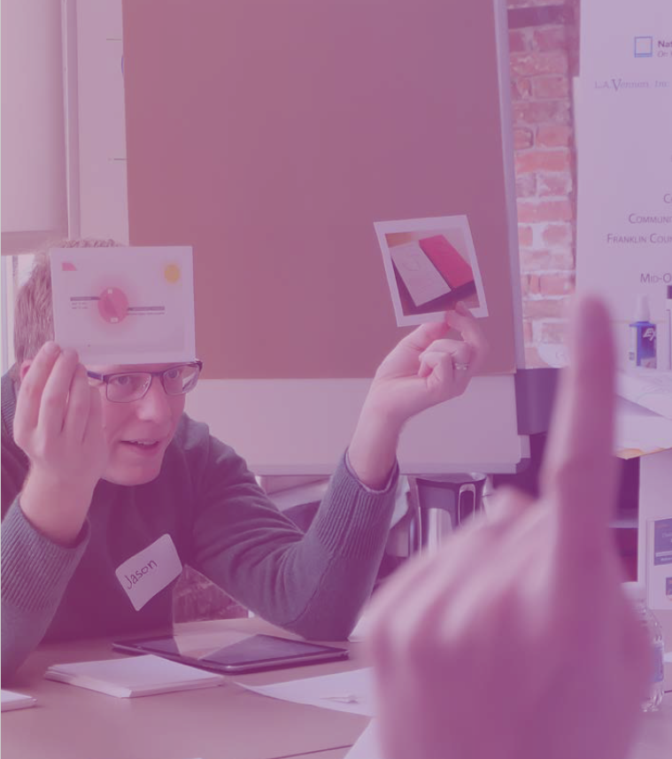
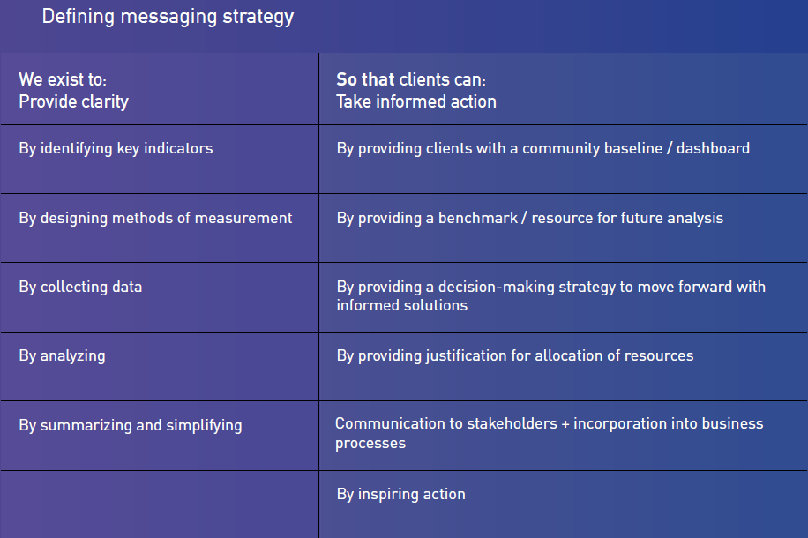
Notes:
We got down to two names . . . Two images.
Thoughtwell vs Metricity

Slide 11
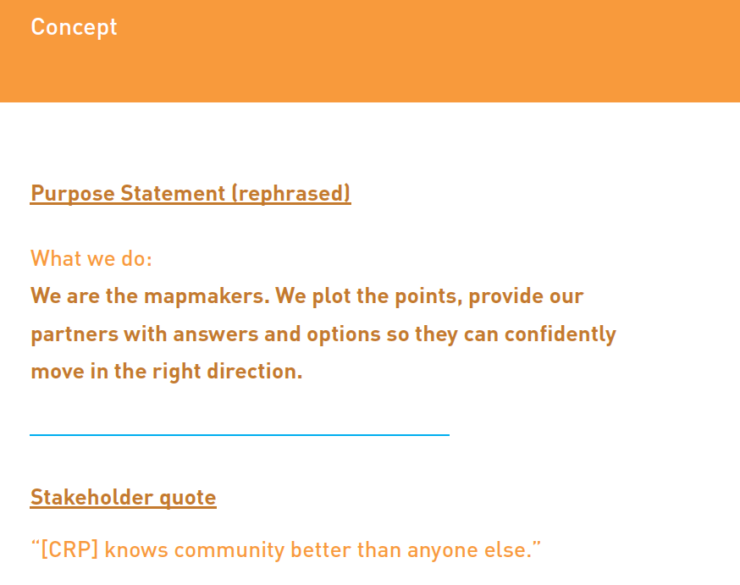
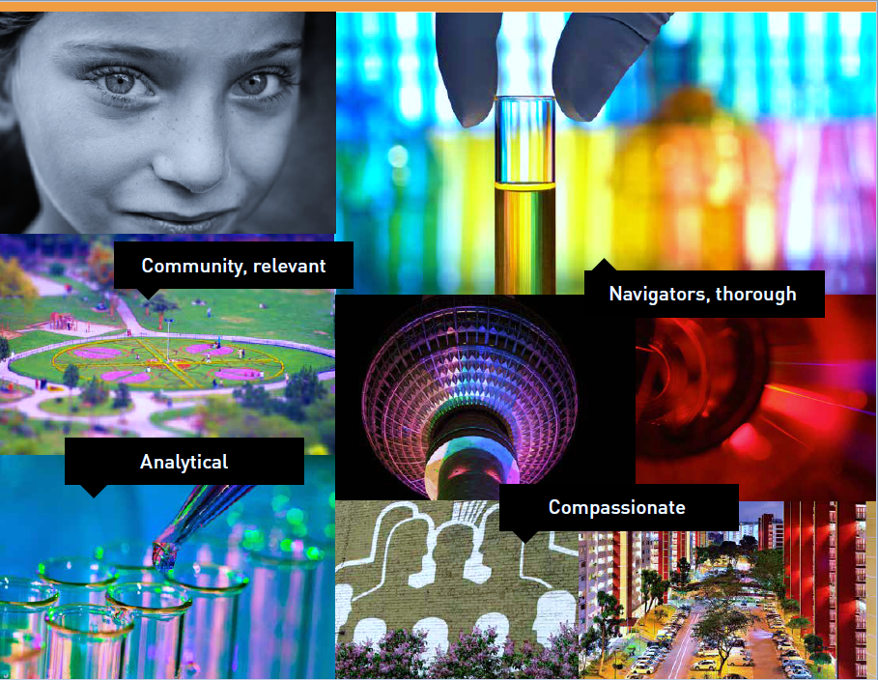
Notes:
Experiment with how to say what you’re saying.
We found that we have a tendency to get very literal. The ARC GIS lovers on the team were worried that everything would have to be mapped. The non-ARC GIS lovers were also worried that everything would have to be mapped.

Slide 12
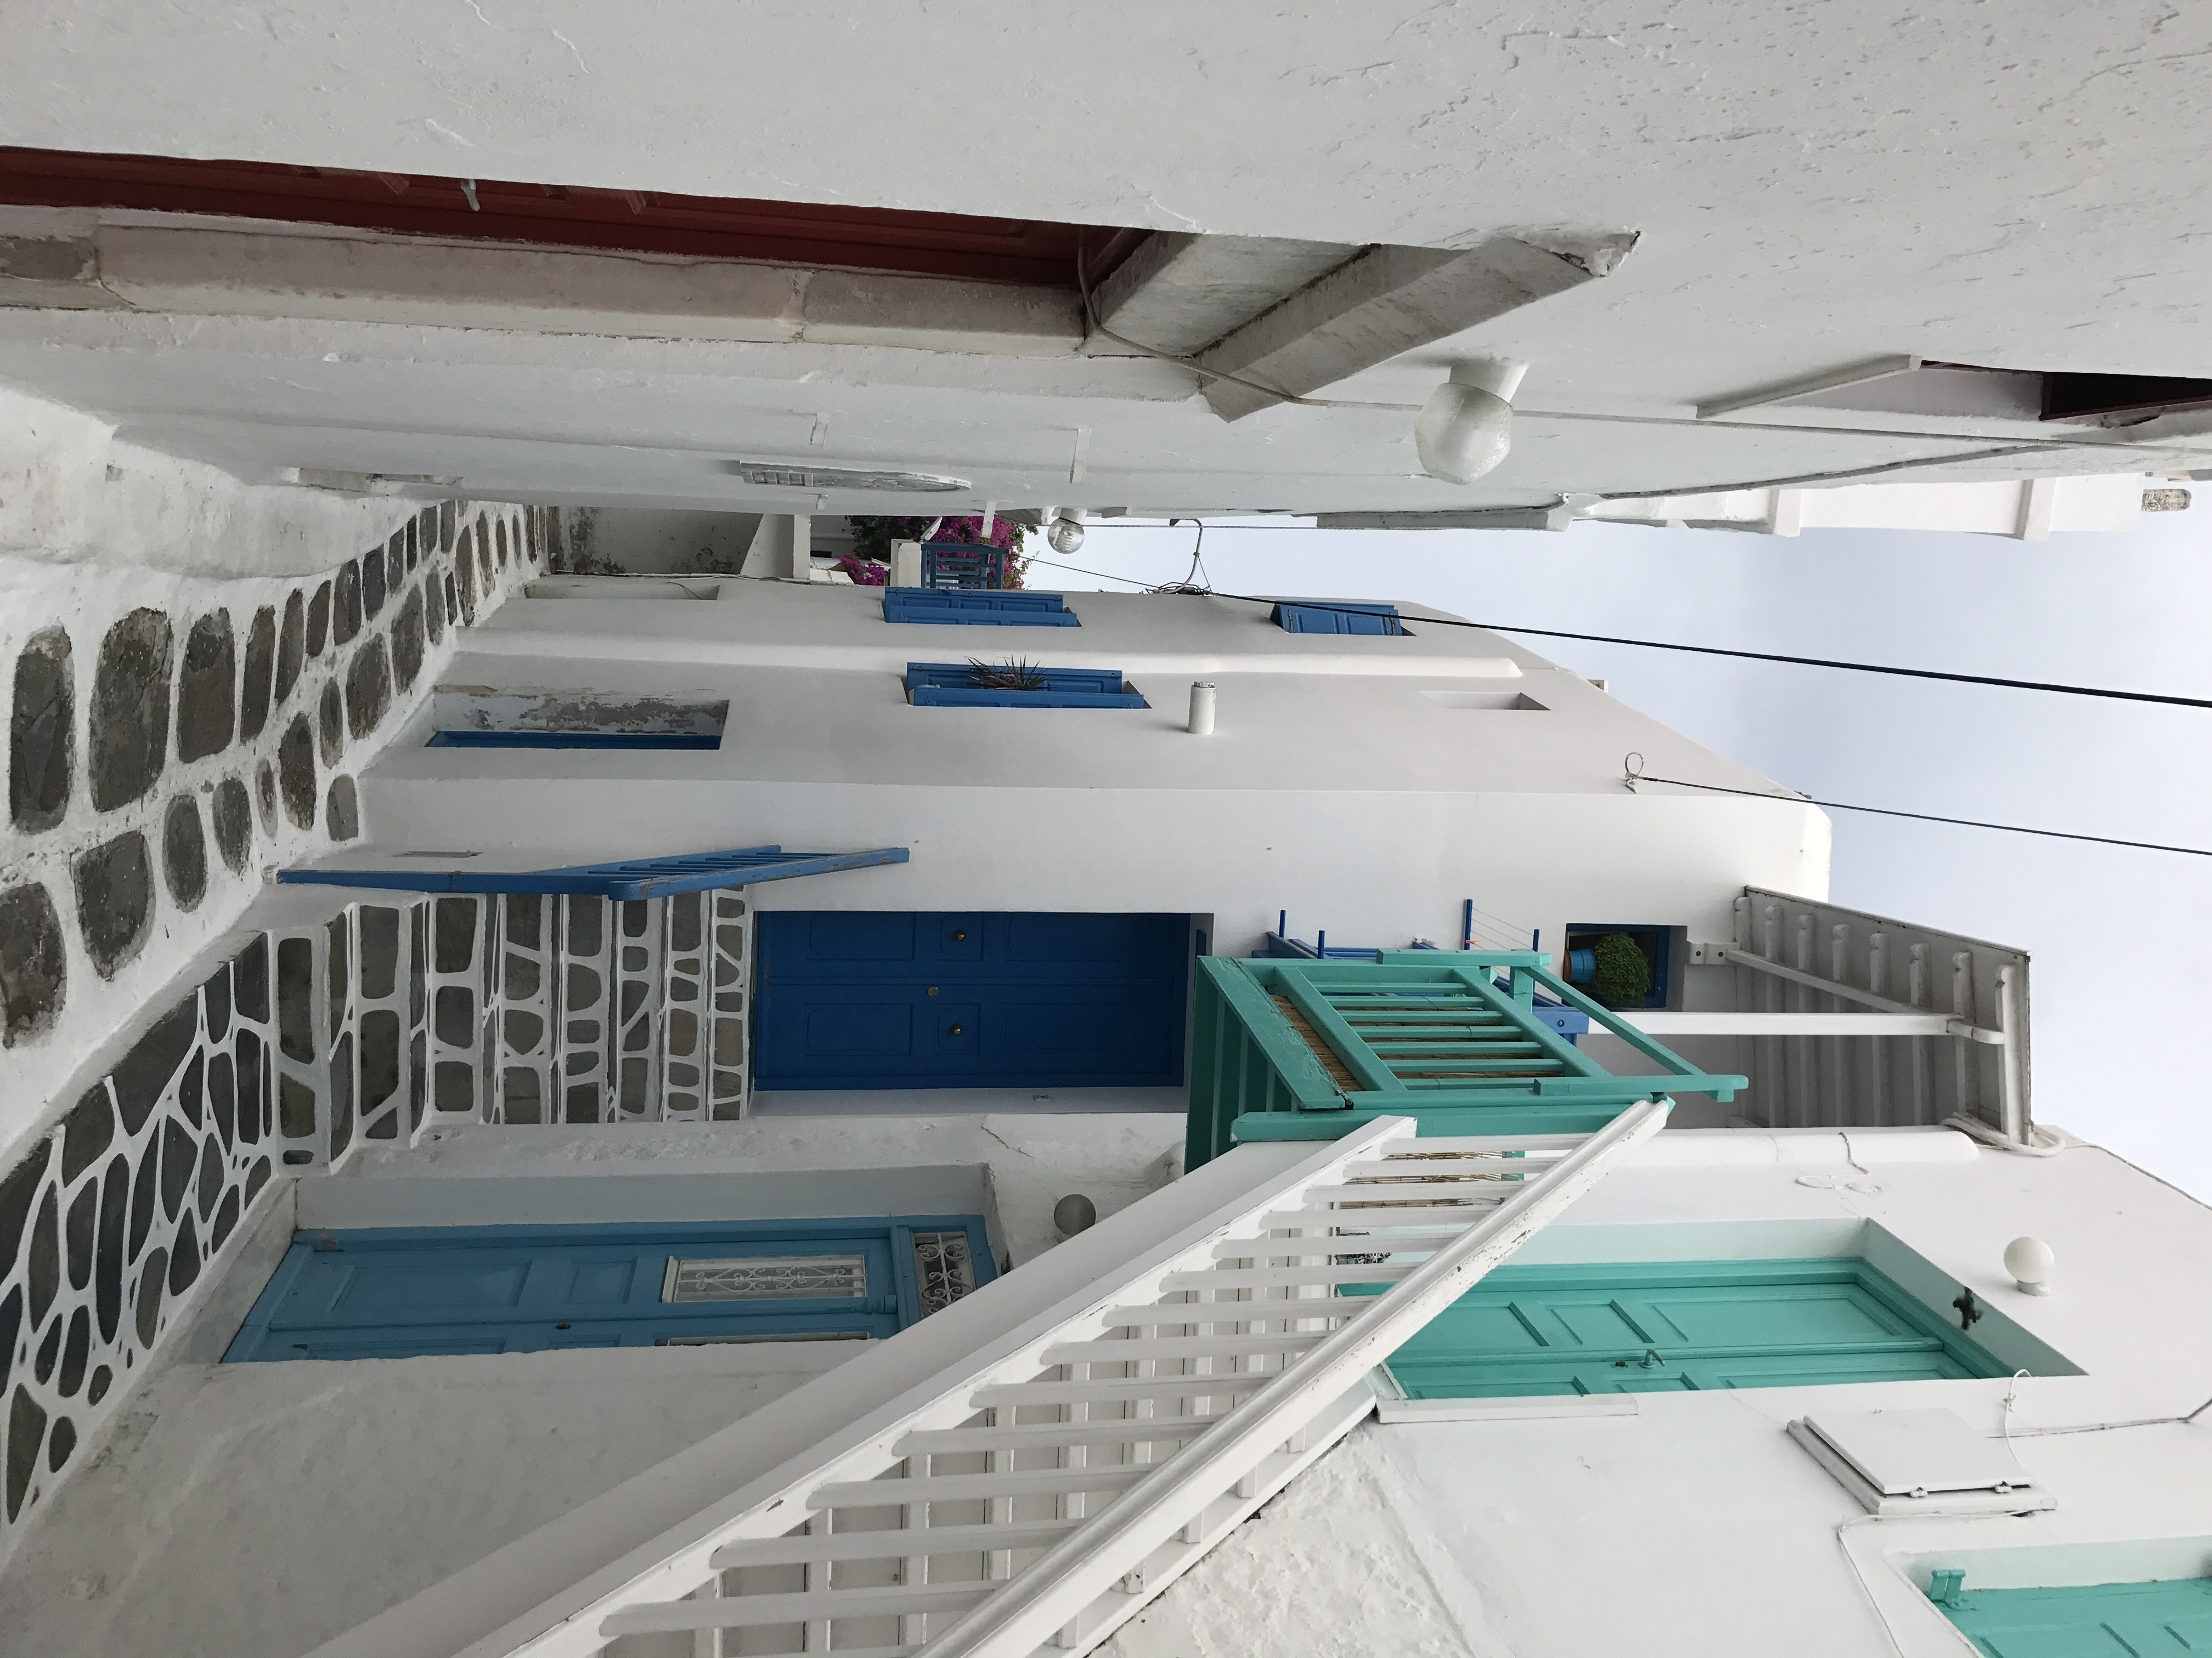
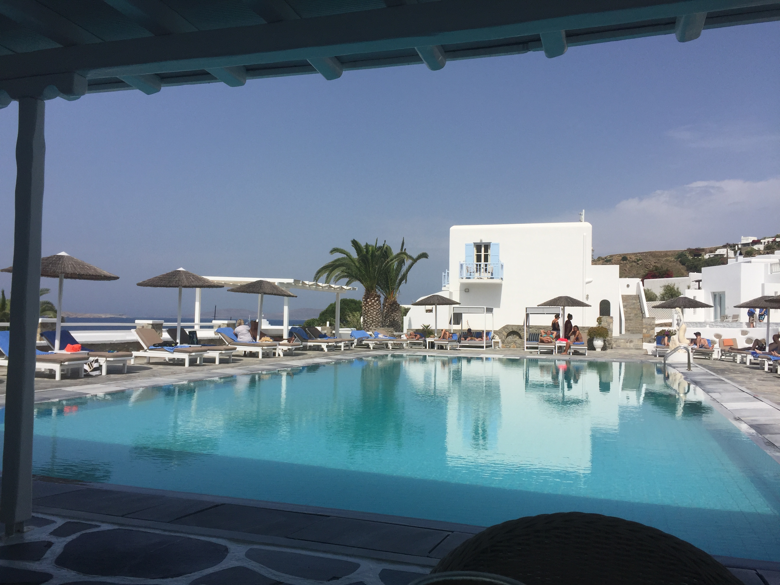
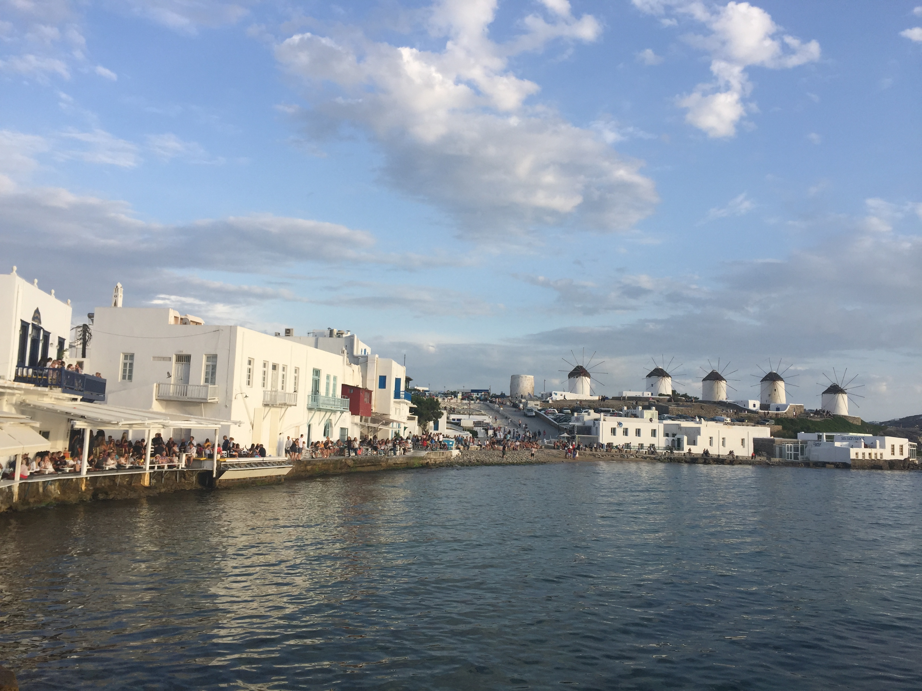
Notes:
These pictures are from the island of Mykonos. Thoughtwell blue is better know as Mykonos blue (the official Pantone color name)
Yes, yes I did sneak vacation pictures into my Ignite presentation. I suppose the point is to take your inspiration from your environment.

Slide 13
You CANNOT imagine the decisions you’ll need to make:
report covers
letterhead
signage
Should the W be capitalized?
end notes vs side notes
etc.
50M
NUMBER OF TEDIOUS DECISIONS YOU’LL MAKE
Notes:
I want people to care about data.
Apparently, that means I have to care about the packaging of those data. If I could tally up the time we’ve spent talking about whether the graphic on the report cover should go on the bottom or the top of the page. . . . Our designers do a great job of making recommendations, but they’re also trying to help this be a “living” brand, so we have to talk about it so when unexpected things come up, we can formulate a response.

Slide 14
Tasks | Sub-Tasks | Cost
Project Launch | Kickoff meeting | $1,350
 | Finalize scope, project plan, indicators
Data Collection and Analysis (up to 15 indicators) | Create and implement data collection plan | $14,138
 | Data collection
 | Data analysis
 | Visualization
Report | Draft report | $11,760
 | Revise & finalize report
Project Administration | General project management | $2,700
TOTAL |  | $29,948
Tasks | Subtasks | Cost | Alt Timeline
Project Launch | Kickoff meeting | $2,500 | Month 1
 | Finalize WBS and work plan
Literature and Document Review | Develop search protocol | $5,000 | Month 1-2
 | Collect and review documents
 | Summarize findings
Secondary Data | Create and maintain data collection plan | $13,600 | Month 1-4
 | Collect data
 | Analyze data
 | Create maps
Fair Housing Activities | Collect data on resources and services | $3,000 | Month 1-2
 | Consolidate and format activities
Focus Groups (up to 3) | Develop protocol | $3,550 | Month 2-3
 | Coordinate locations and recruitment
 | Conduct meetings
 | Incentives and refreshments
 | Analyze and summarize data
Report | Draft report | $12,500 | Month 4-5
 | Finalize report
Communication | Team phone calls | $1,400 | Ongoing
 | Planning meeting
Project Administration | General project administration | $3,500 | Ongoing
Total |  | $45,050
WHICH ONE?
Notes:
Which table do you like better?

Slide 15

WHAT’S NEXT?
Notes:
We’re dreaming big.
It’s been hard and weird and not at all what we expected.
We have to keep coming back to it.
And it was totally worthwhile. For us.

