Slide 1

Tactical Data Engagement
A practical and conceptual overview for data intermediaries
Notes:
DATA INTERMEDIARIES + USE CASES
Data use → Democratizing information

Slide 2
Overview (of the overview)
What is Tactical Data Engagement? (conceptual background)
But really, what is it? (practical background)
And how can you use it?
Notes:
Data intermediaries can either do this themselves or help cities do it.

Slide 3
What is TDE, conceptually?
A way for city halls to get more impact out of open data by proactively helping community members use it in impactful ways.
  “What information do community members need?”
  “Which people need what information to do what specific things?”
  “How can we support those specific users in doing those specific things with open government data?”
Notes:
OFTEN OVERLOOKED QUESTIONS

Slide 4
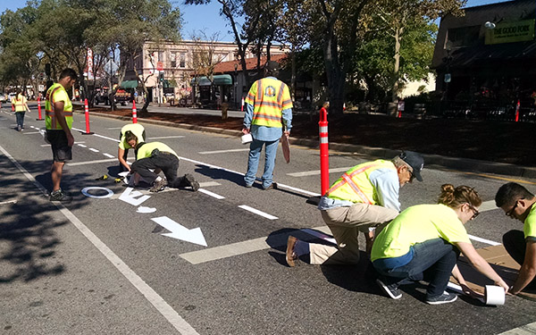
TDE’s inspiration
Source: Street Plans
Notes:
Human-centered design
and tactical urbanism for open data
Focus on people
Focus on iteration

Slide 5
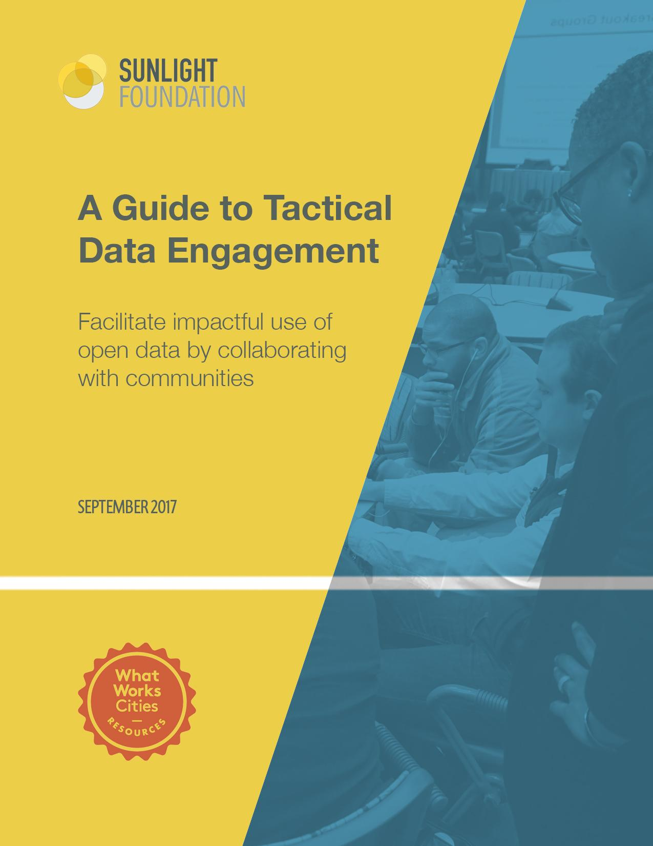
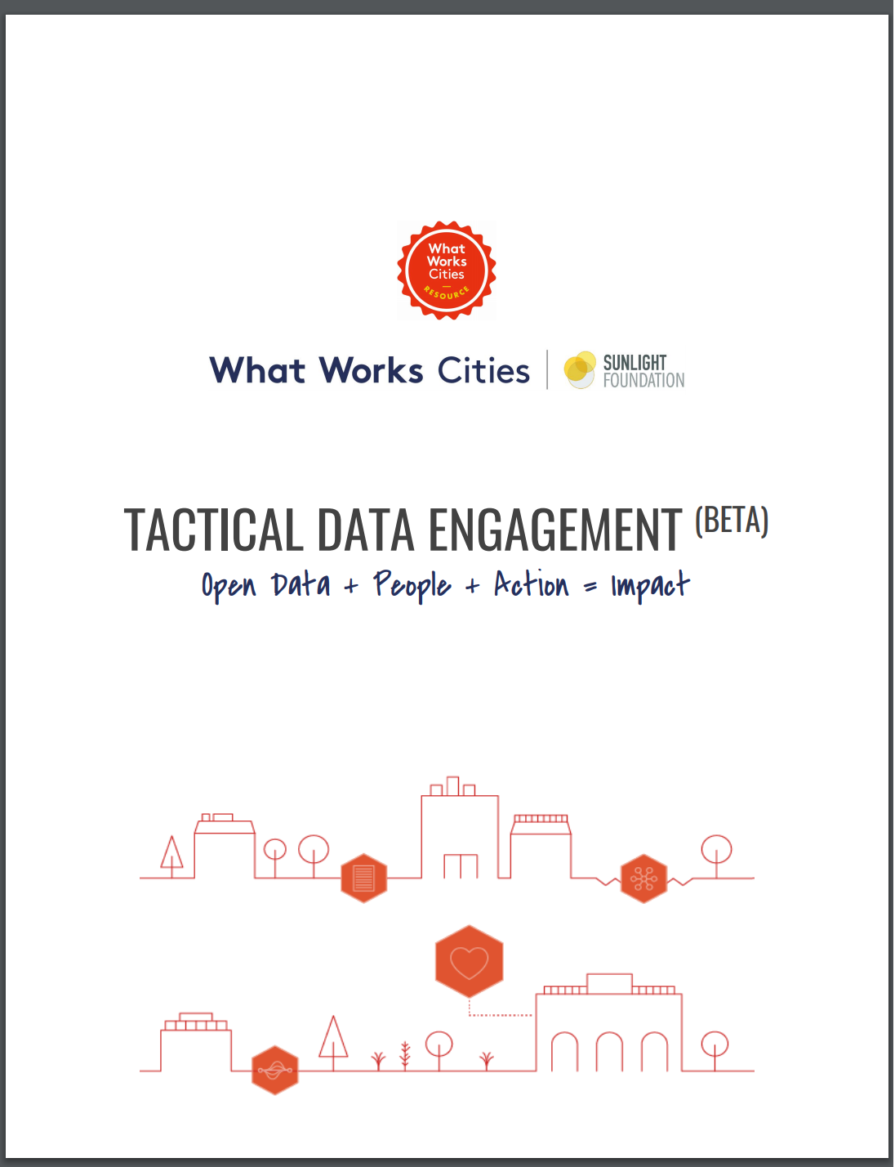
The guide: from Beta to 1.0
Notes:
Put it up on Google Docs with public comment
Feedback is important to our process

Slide 6
But really though, what is TDE?
Practically speaking…
  It’s a four-step process with clear tactics and instructions
  It’s the result of research and piloting
  It’s a guide written by Sunlight with public feedback

Slide 7
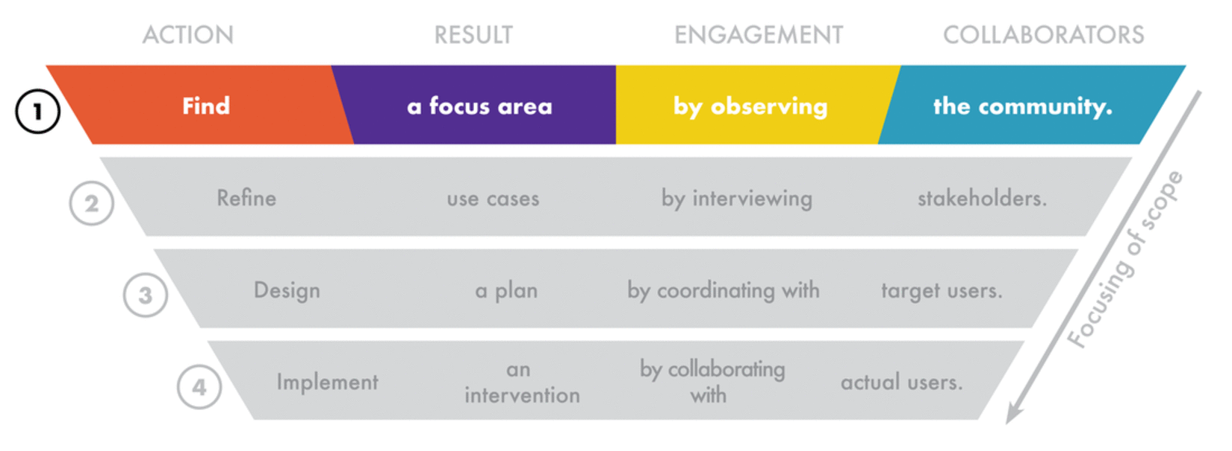
TDE: The four-step process
Notes:
4-step process
The result is the use of open data
Key is specificity

Slide 8
A few things to note about the TDE process
Ingredients - action, result, engagement, collaborators
Each step feeds into the next
End result has been ground-truthed
Tactics - more than one way to skin a cat
Lightweight, low-cost, and modular
Use realistic tactics that fit your capacities and needs.

Slide 9

Step 1: Find
Notes:
Focus on an issue: public safety, parks and recreation, or economic development
Don’t get too hung up on it
One way to do this:
analyze public records requests
dataset downloads
311 requests
As an NNIP partner you can
Analyze your own data
Speak to members of the community
Show a pressing need for information
To demonstrate that a focus area has community relevance and that there are opportunities to close information gaps.

Slide 10
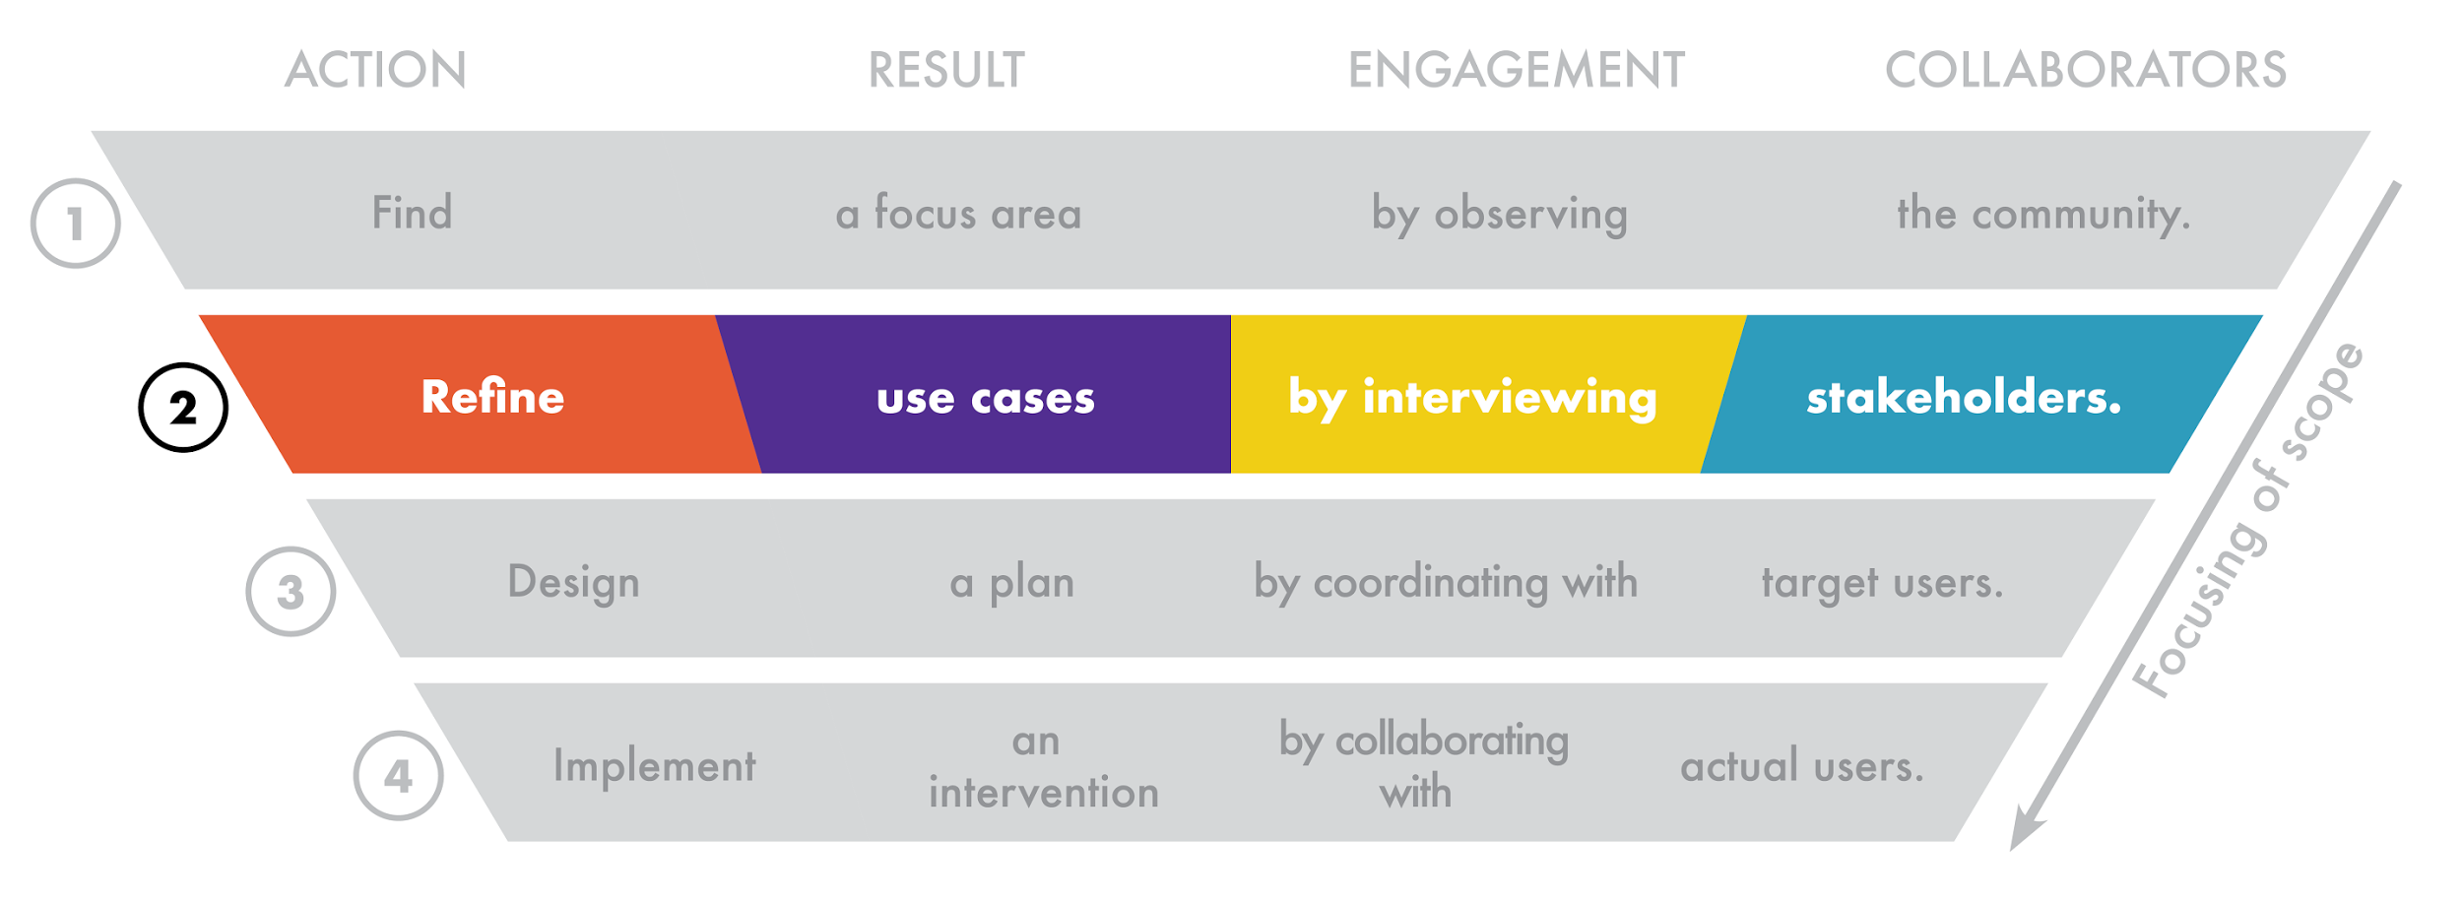
Step 2: Refine
Notes:
The result from step one will yield a focus area. In the “Refine step” the goal is to better understand and segment out the different uses of information relevant to that focus area by interviewing and having conversations with stakeholders from that focus area.
Example tactic: Ethnographic interviews
In Exampleville, USA, after analyzing information demand channels like public records requests, we might have uncovered that there are lots of requests for planning and development information from community members.
The goal of these interviews would be to find out who needs what information, for what purposes, and are there any barriers to that?
The output would then be user personas (the who) and user journeys that explain how information is used within the planning/development focus area in Exampleville.
As a data intermediary, you can:
Interview data users to inform your own data sharing program
Provide value to city gov’t by facilitating those interviews

Slide 11
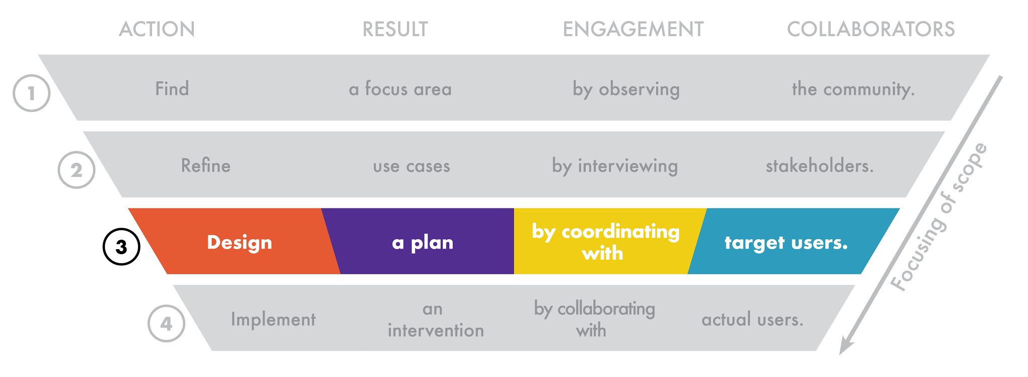
Step 3: Design
Notes:
Some use cases will be more promising than others in terms of for either you or the city you’re assisting: alignment with city goals, capacity of the city to support, and potential for positive impact.
During the Design phase the goal is to pick one use case—
Use case. Appraisers need information about building permits to verify new construction and include built improvements in appraisals for collecting tax revenue & for loan providers
Data Problem: only shared as part of a monthly pdf report, and not searchable by address, and that they would like a mobile interface to access permit information while they’re appraising properties.
For the Design phase, Exampleville officials might work with appraisal companies to plan specific things that can be done to support this use case:
Providing guidance
releasing structured permit data=
build a search by address tool
As a data intermediary you can:
Be more efficient - process information for which there is a demonstrated need
Continue adding value to public data

Slide 12
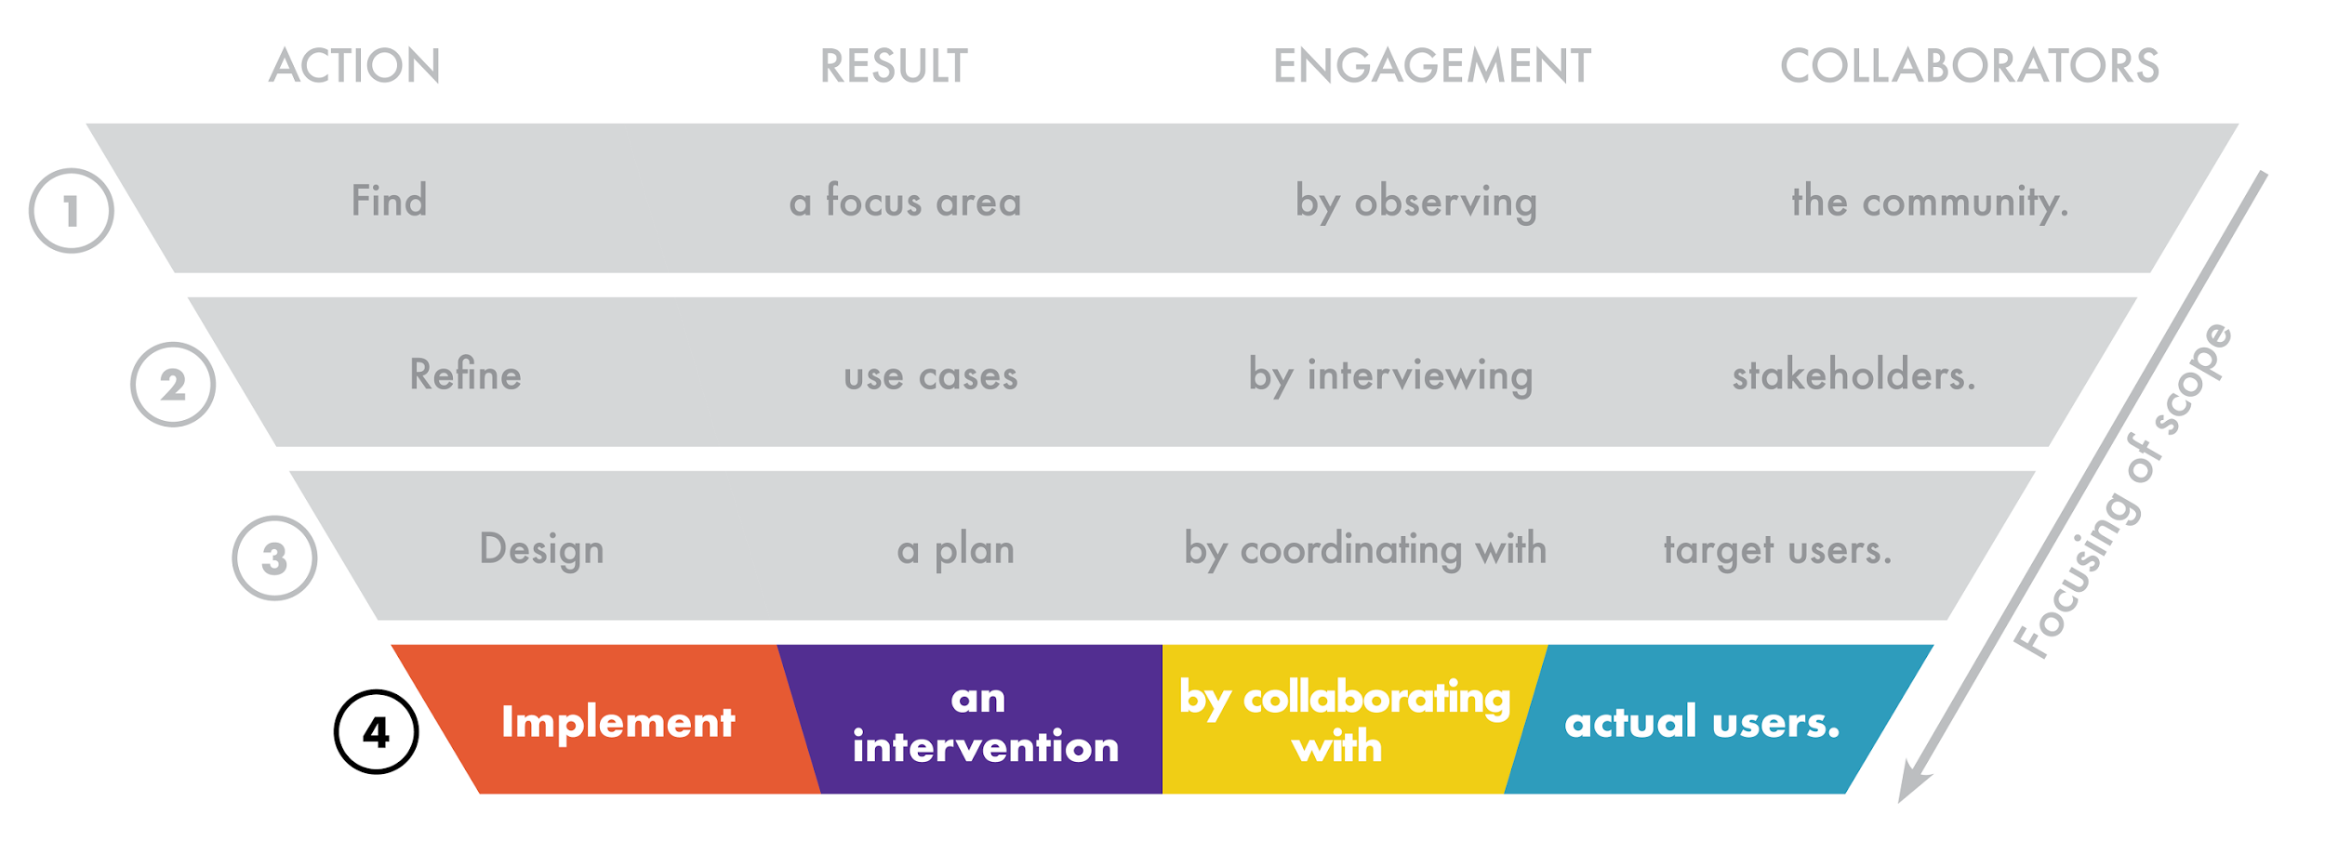
Step 4: Implement
Notes:
A critical aspect of prototyping a less than ideal solution is that the city can continue to get feedback from users
We’re happy to have April Urban from the Poverty Center in Cleveland.
Poverty Center has experience implementing alongside community orgs

Slide 13
Why do YOU need TDE?
Cities need it to:
Ground open data programs
Implement real solutions
Think with an equity lens
Data intermediaries need it to:
Make a case for open data
Create value out of local knowledge
Unify community partners
Find project opportunities
Notes:
How this applies to NNIP partners:
Make a stronger case for open data; Answer your city’s questions about how open data creates impact
Use that local knowledge that you have about key players, important data users, and local needs
Unify partners in the community around a framework that allows people to plug in
Put your data inventories to use

Slide 14
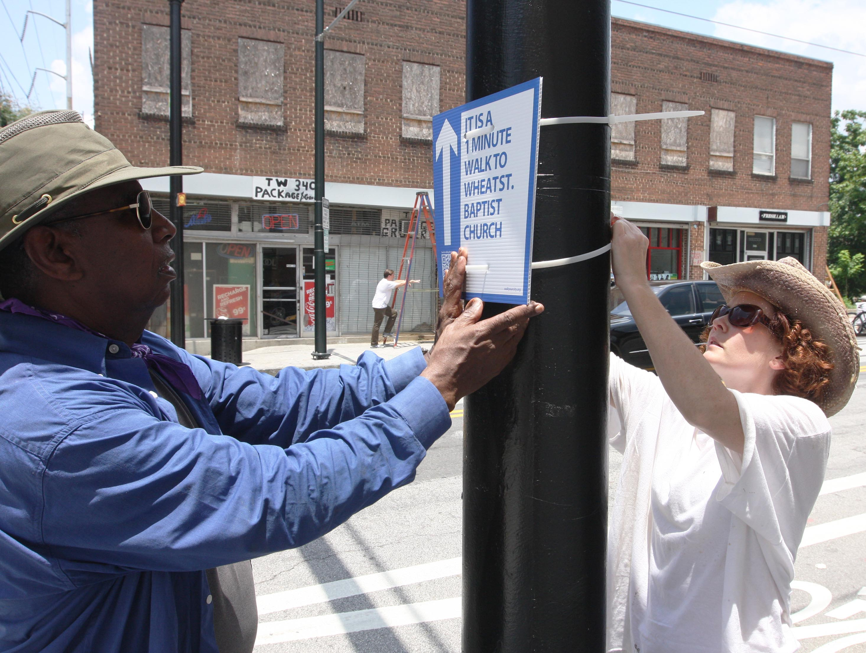
Why we do this
Source: Street Plans
Notes:
…To democratize data
…To make transparency more effective
…To connect people to government

Slide 15
Interested? Keep in touch!
Follow @SunFoundation on Twitter
Sign up for Sunlight’s Open Cities newsletter at bit.ly/opencitiesnews
Read more about TDE at sunlightfoundation.com/tde
Email me at kabazajian@sunlightfoundation.com

