Slide 1
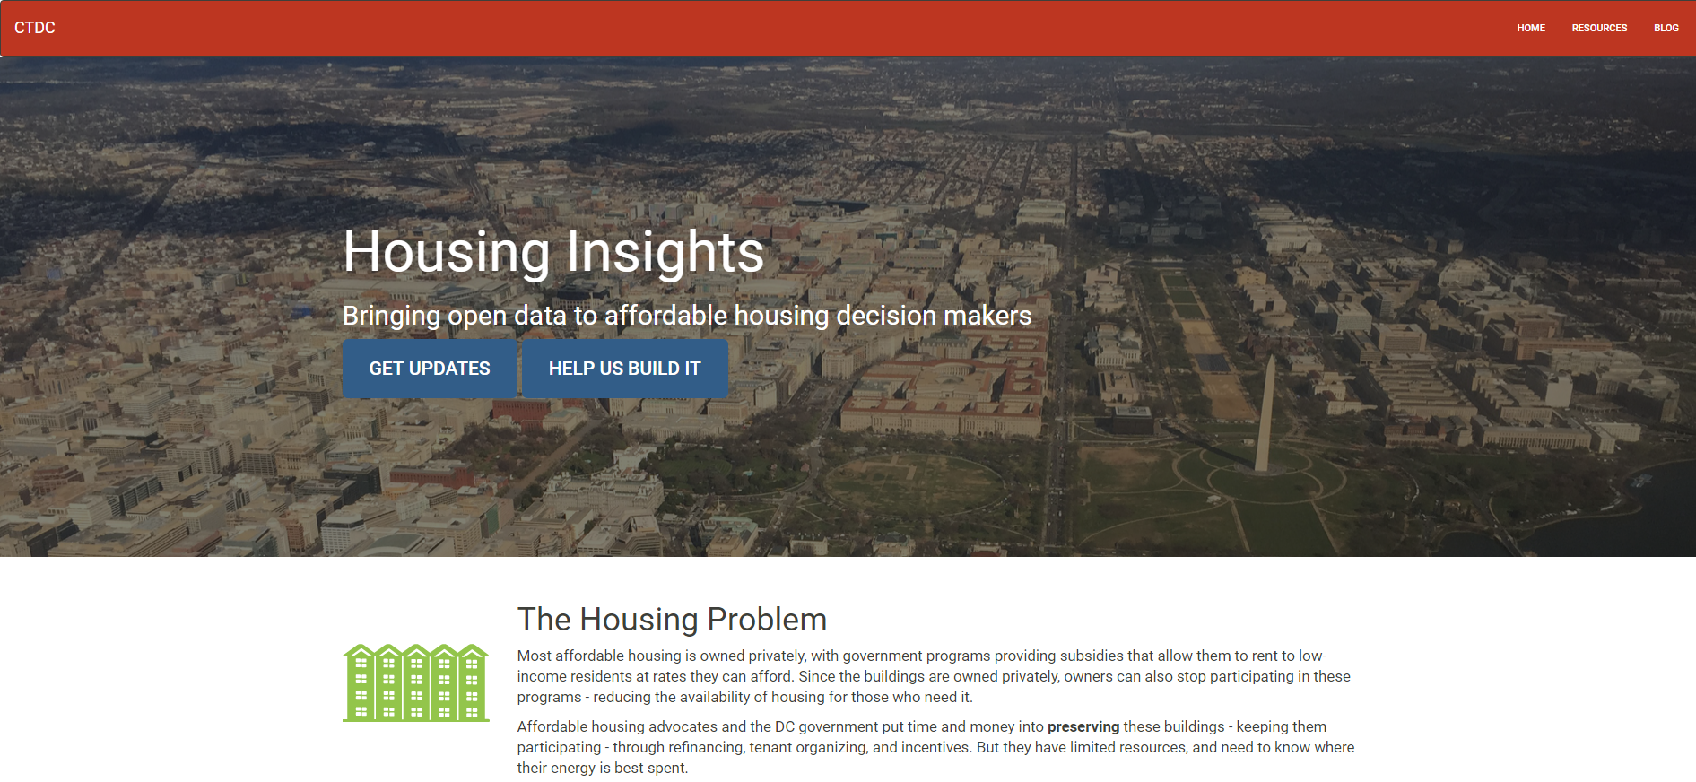
Our Project
www.housinginsights.org

Slide 3
The Problem
Affordable Housing
Data
Most is privately owned; government provides incentives
Owners can choose to stop receiving incentives (under certain circumstances)
Advocates and government agencies can often intervene – spending time and money to preserve these buildings
Need to know how to prioritize preservation efforts.
Dozens of overlapping programs (Section 8, tax credit, DC gov, etc.), data isn’t centralized
Neighborhood info is relevant – demographics, transit locations, nearby economic development, other affordable options in the neighborhood.
City-wide analysis can reveal tradeoffs not apparent at building level.

Slide 4
Why tech is part of the solution
Do it once – use often. Barrier to use is lowered.
Less reactive – earlier warnings and planning of potential issues
Add transparency to prioritization process
Data driven decision making

Slide 5
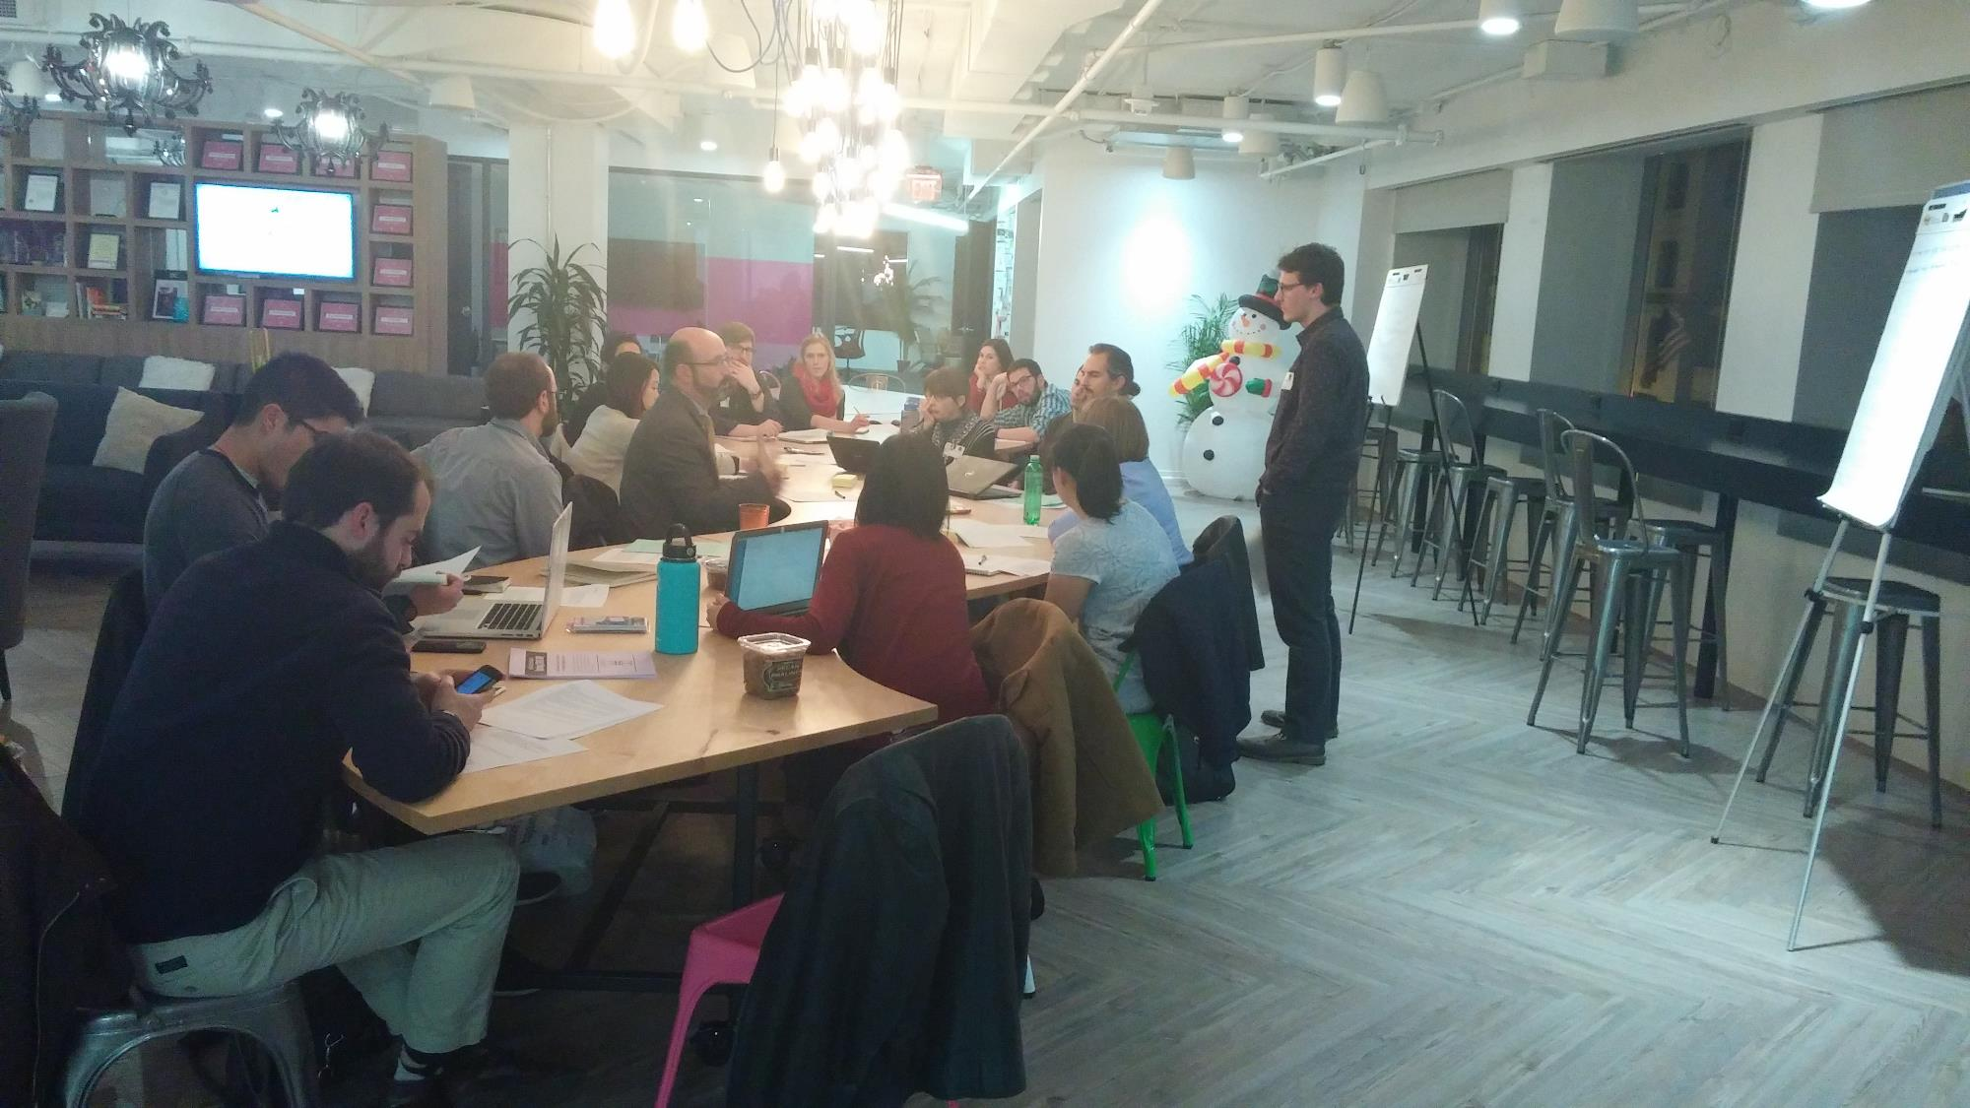
Notes:
In presentation prompt: “How did working together with government, data, and tech folks change the way you approached the problem?”
How did it change depends on whose perspective you’re looking from
User interviews, designing, testing, iterating is standard in tech – this informed a lot of our development process
Pic is of design session with volunteers and reps from housing community

Slide 6
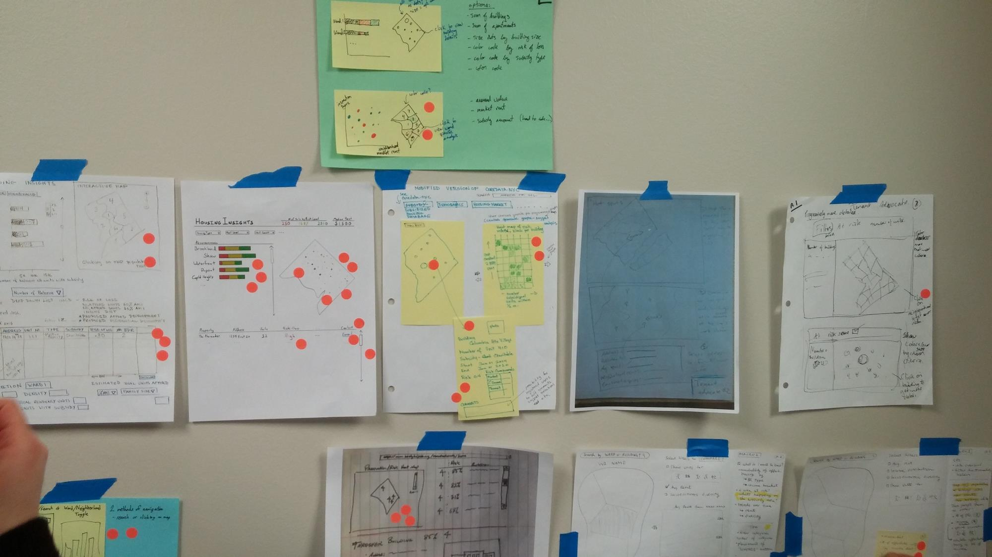
Notes:
We made sketches of ideas

Slide 7
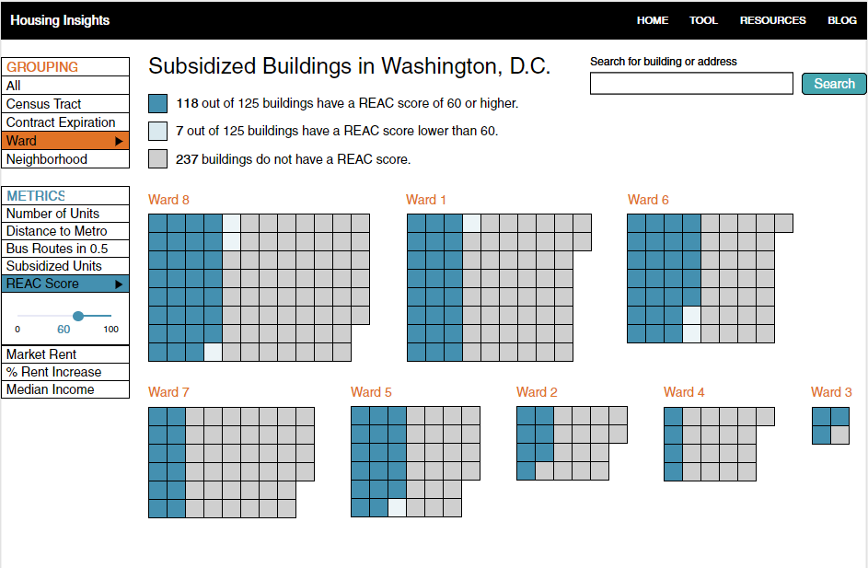
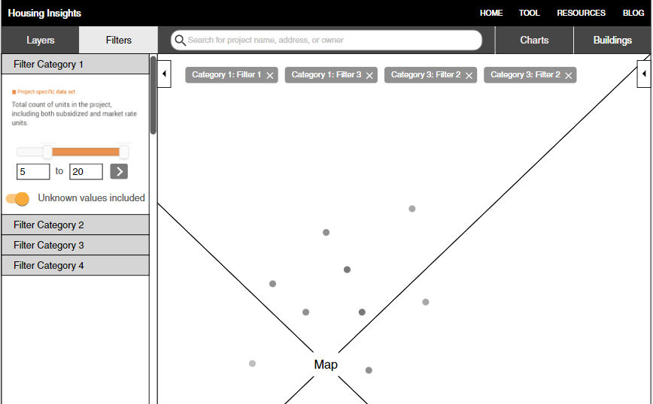
Changing our design based on user tests
Notes:
We made clickable mockups and tested them. Our first design wasn’t well understood by users so we changed it.

Slide 8
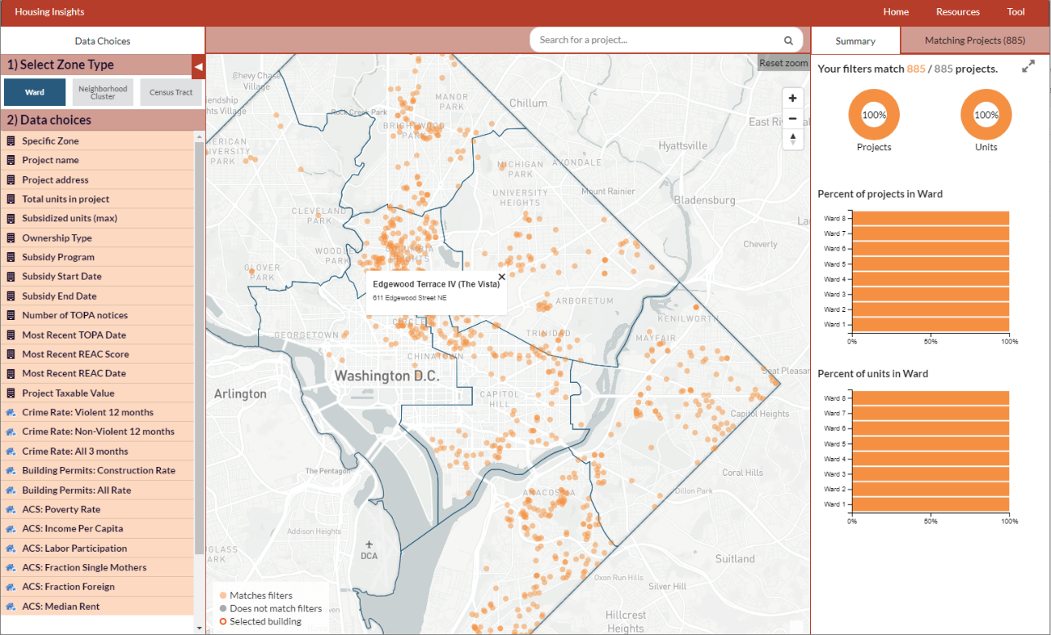
More design changes after V1 testing
Notes:
We also tested two real versions of the website with one-hour user testing sessions. These informed the latter phases of our development.

Slide 9
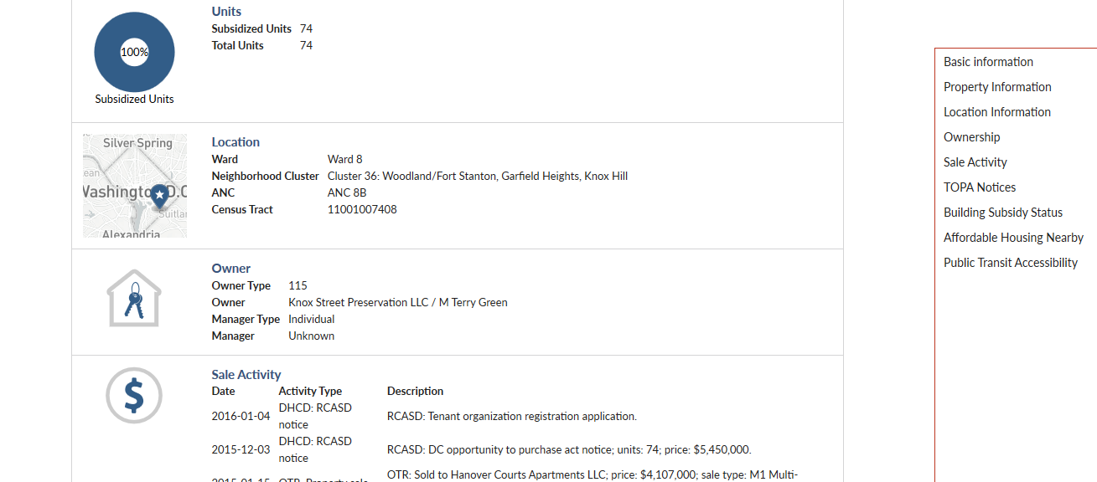
More design changes after V1 testing
Notes:
We also tested two real versions of the website with one-hour user testing sessions. These informed the latter phases of our development.

Slide 10
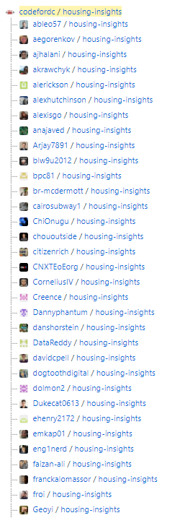
Working with volunteers
100+ volunteers involved (40+ wrote code)
½ of the commits were by volunteers (other half by PM)
Volunteer development has a speed limit
Reliability is a real concern
Blog post has some volunteer management lessons learned
Notes:
610 total commits, 359 by Neal
Some volunteers put in 100’s of hours (leadership team), some don’t follow through. Often hard to predict which is which
See blog post re: reducing time to hello world that covers some of the management strategies.
Key points:
Lots of volunteers involved, several key volunteers made it possible to do more, but still used lots of PM time on coding especially late in the process

Slide 11
User Testing and Iteration
3 design iterations
Verified need and solved big usability problems
Not enough time to iterate on the big question – will people use it in the real world?
Scope was a challenge – exploratory data tool
Notes:
- Good that we got three iterations, but also not enough to answer all our questions
- Would recommend having a “finished” tool half way through the project, instead of at the end. In our case there just wasn’t time for that given the scope

Slide 12
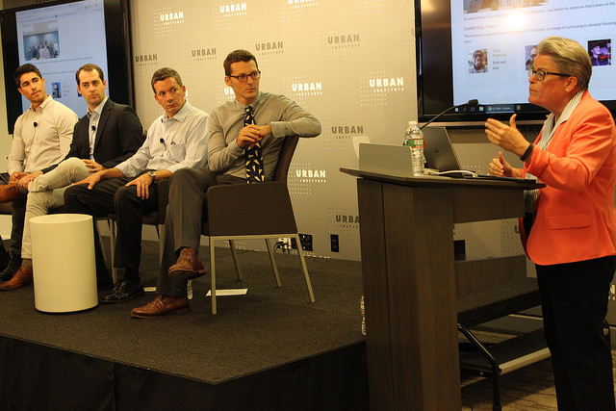
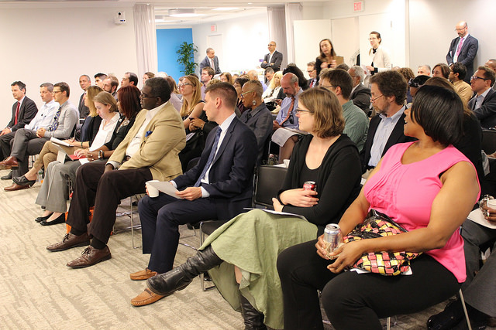
Launch of the tool
Notes:
October 2017

Slide 13
Phase 2 of the project started Jan 2018
Technical Leadership Team
Advisory Committee
CNHED, DHCD (new DC Preservation Officer), Urban Institute

Slide 14
Thank you

