Slide 1
Data Mapping With Free & Open Source Tools
November 19, 2015
Peter Tatian
NeighborhoodInfo DC

Slide 2
Data Mapping With Free & Open Source Tools
November 19, 2015
Peter Tatian
NeighborhoodInfo DC

Slide 3
Objectives
Gain a basic understanding of how presenting data geographically can help inform planning and practice.
Learn about free mapping tools and data resources.
See a demonstration of how to map locations of clients/service locations/etc. over a thematic map of small area data.

Slide 4
Why present data geographically?
To tell a visual story about your neighborhood/services.
To understand spatial disparities of client and community needs.
To identify areas to locate or direct services.
To combine information based on location.

Slide 5
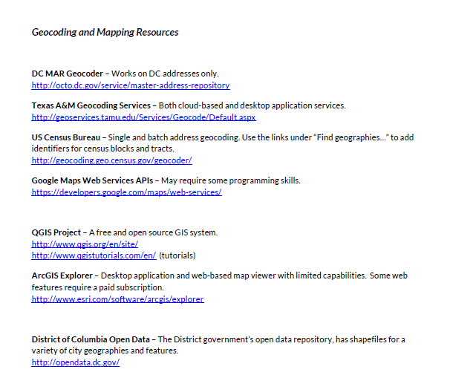

Slide 6
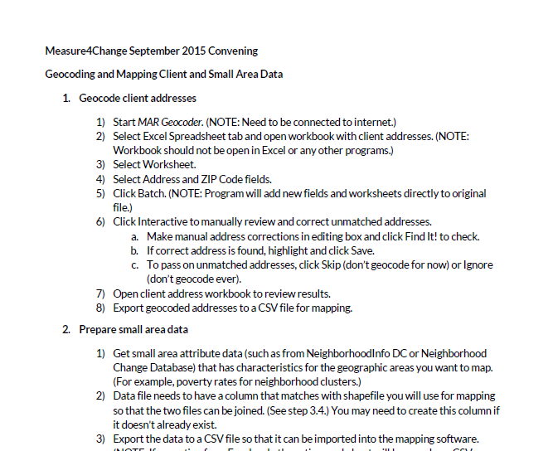

Slide 7
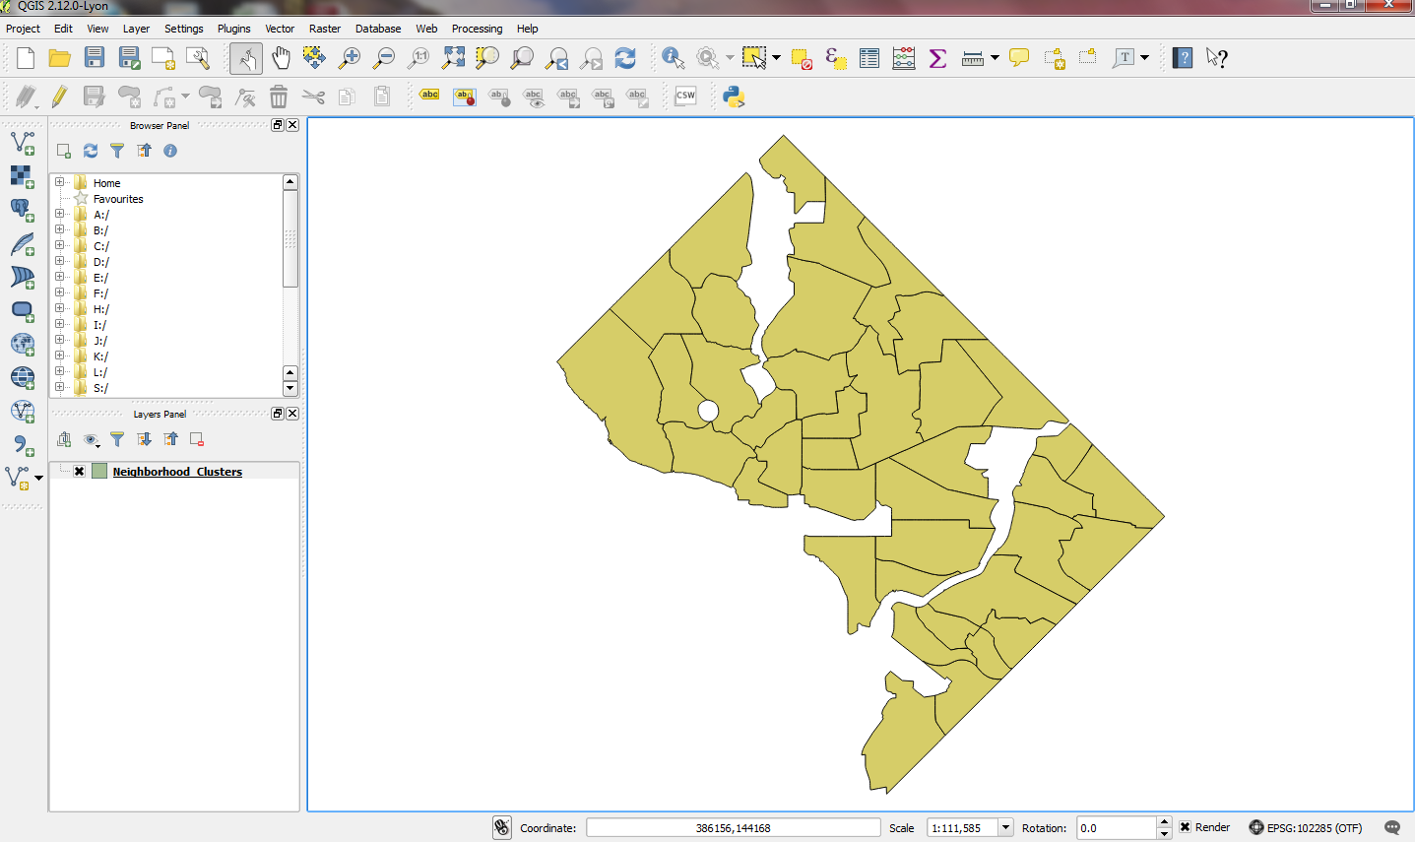
QGIS

Slide 8
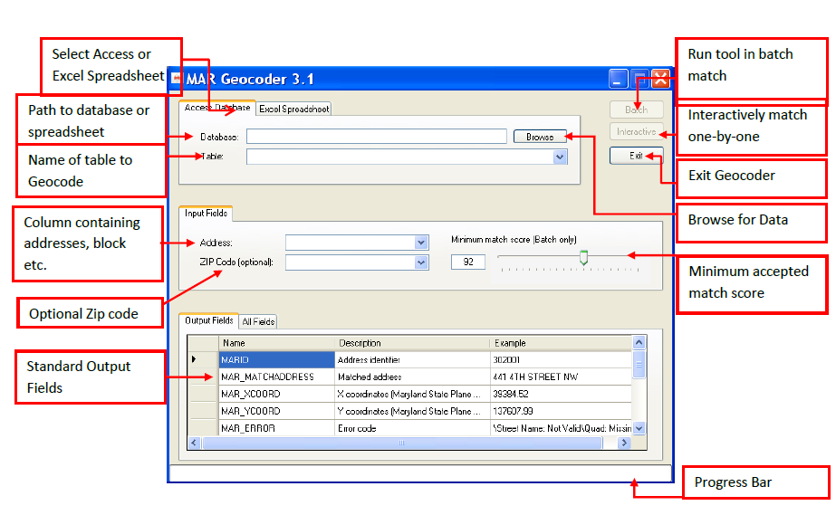
DC MAR Geocoder

Slide 9
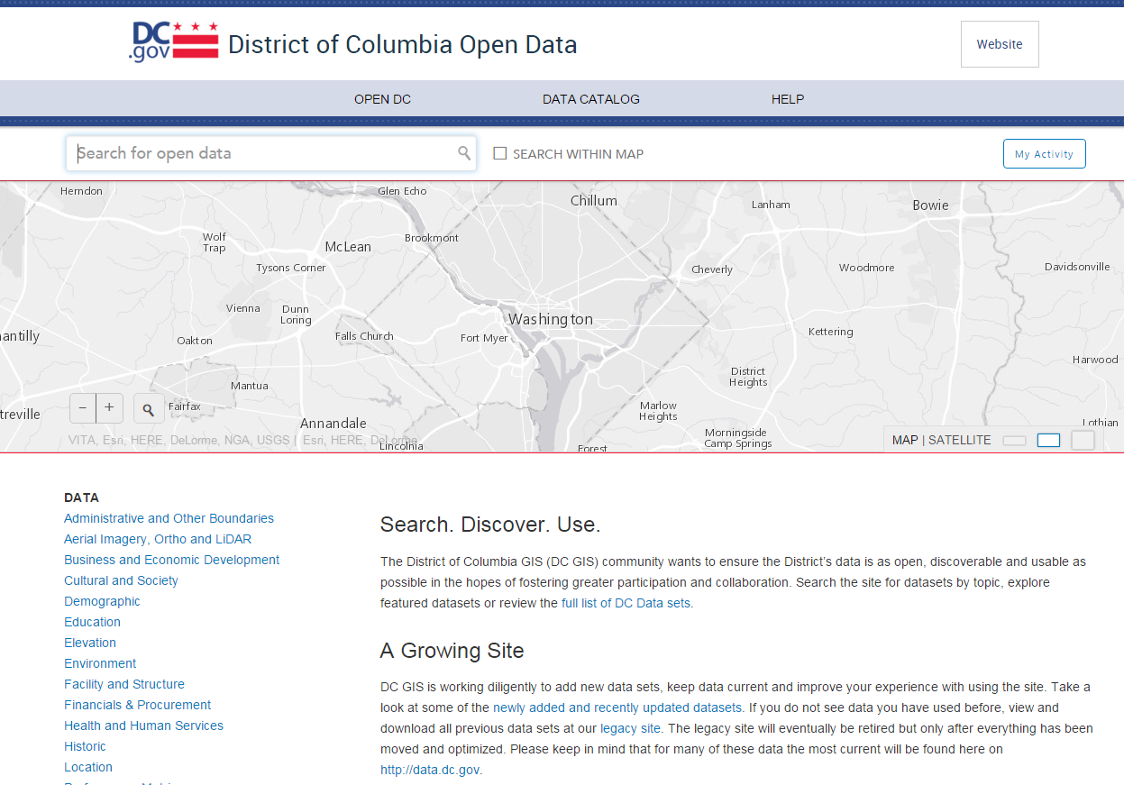

Slide 10
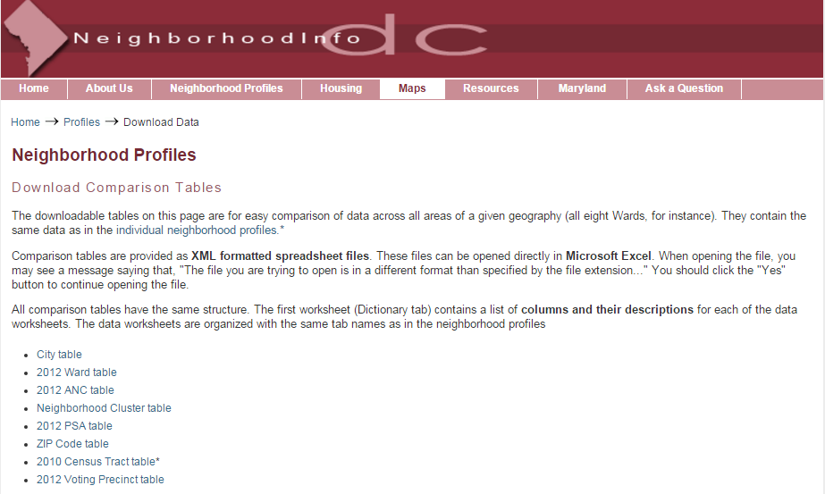

Slide 12
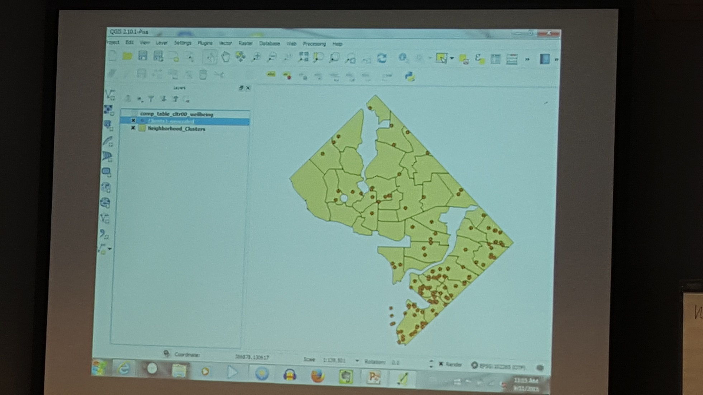

Slide 13
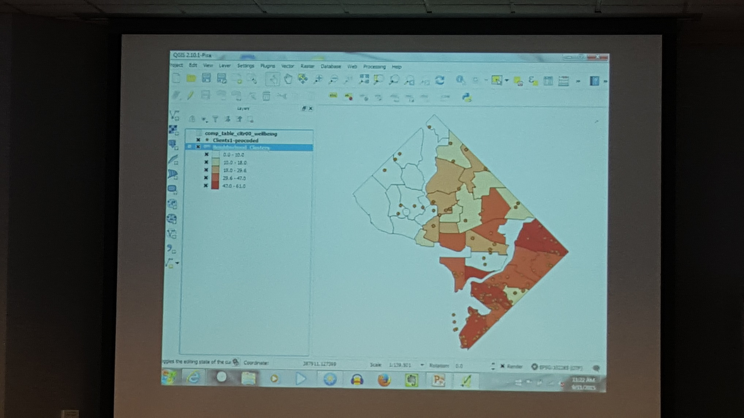

Slide 16
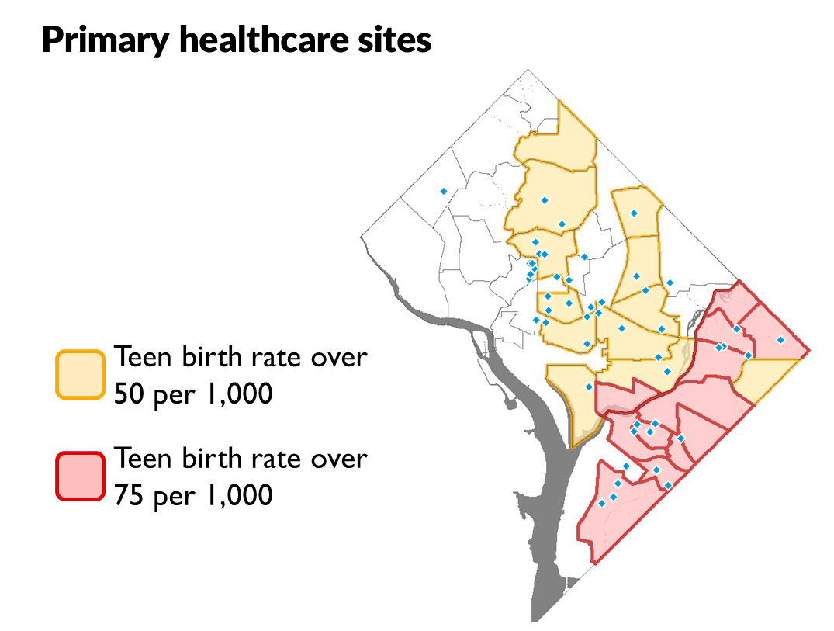
Lessons for next time
Show an example upfront…

Slide 17
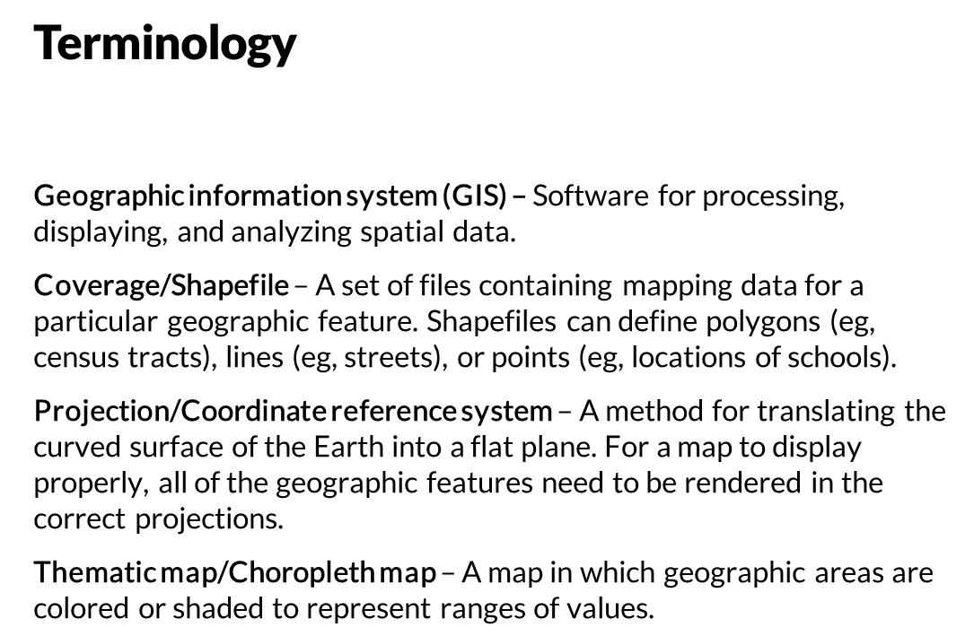
Lessons for next time
Show an example upfront…
And explain some terms…

Slide 19
?
?
?
?

Slide 20
?
?
?
?

