Slide 1
Displacement and Neighborhood Change: Research and Practice
New Partners for Smart Growth, St. Louis
February 2, 2017
Notes:
Introduce myself –

Slide 2
Introductions and History
Julie Seward
Notes:
Wanted to take the last part of the presentation to share some experiences from the larger NNIP network.

Slide 3
Today’s agenda
Introductions and History
Market and Policy Context
  Discussion
Turning the Corner Project
Local Perspectives – Detroit and Twin Cities
  Discussion
Small Group Discussion
Report Out and Wrap-up

Slide 4
History of Turning the Corner
Originated as FPI discussion about post-recession changes in gentrification and displacement
How can local communities could better use data to make informed neighborhood growth decisions?
Funded by Kresge Foundation for the cross-site work starting in January 2016
Funded by a number of local funders for the city-specific work
Notes:
JULIE
1. talked with researchers across the country to confirm what data was currently in hand and identify gaps
2. clearly understood that displacement patterns in neighborhoods had shifted and a research lens was needed
3. linked with Urban Institute as the architect of the research and project partner
4. committed to pursuing research in up to five cities who would design projects that best benefited the community within standard protocols
5. received funding for national work and support local projects through local funder
6. Then, to date interest from multiple cities but rather complex to put together – we are finalizing sites over the next couple weeks & then we expect all local projects will be undersway

Slide 5
Market and Policy Context
Kathy Pettit
Notes:
Wanted to take the last part of the presentation to share some experiences from the larger NNIP network.

Slide 6
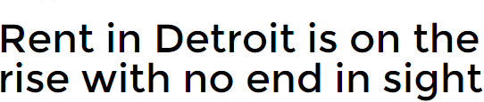
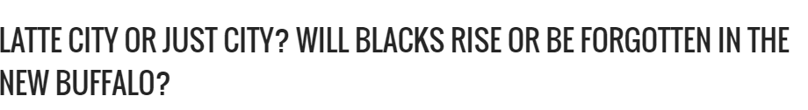
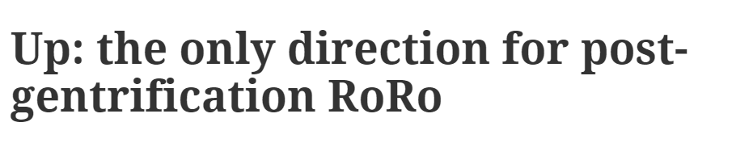
Emerging growth in weak and moderate markets
Notes:
Observations/experience - Places like Detroit and Cleveland and Minn. had been seeing fruits of their investment - ground-level concern and interest in proactive policies and strategies.
question about whether ngh dynamics are working differently post-recession - tighter credit markets, some cities have vacant properties registration from the fc crisis
question about quantifying the changes in neighborhood, even if it is not at the level of coastal markets. How much is hype and how much is real? How

Slide 7
Concerns about displacement
Physical: Current low-income households forced to move (not all moves)
  Indirectly, by new low-income households shut out by loss of affordable housing options
Cultural:
  Change in social connections and norms
  Commercial stores or institutions forced to move
Political: low-income residents are excluded from neighborhood development decisions
Notes:
Different aspects of displacement

Slide 8


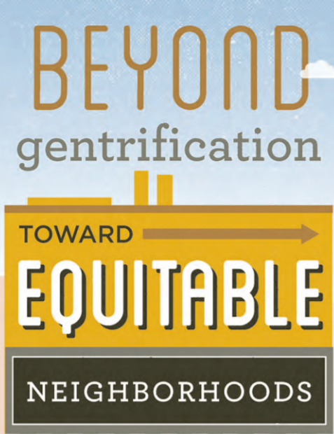

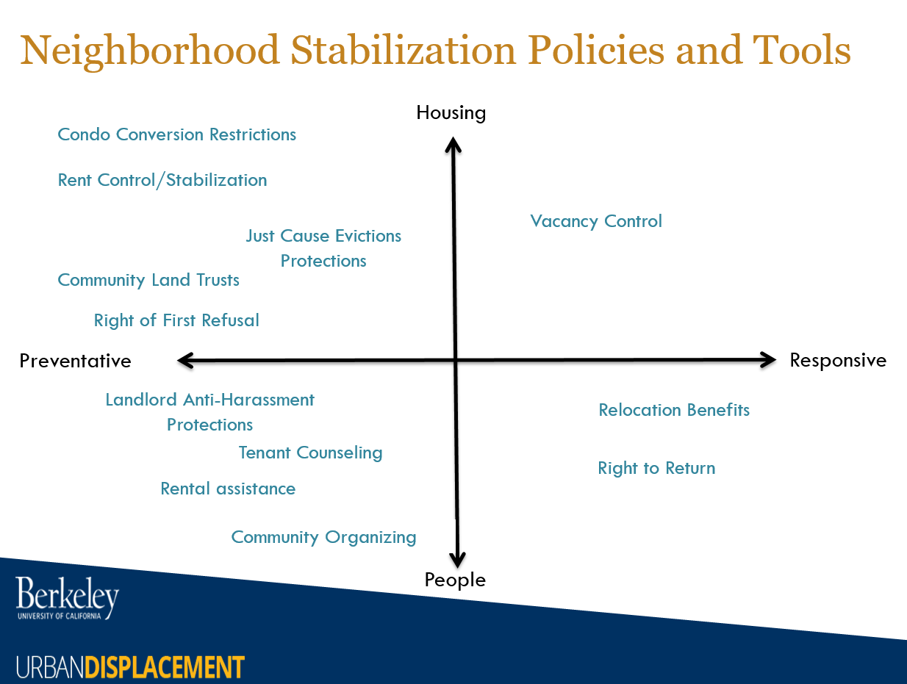

New local action and measurement
Notes:
New efforts across sectors – government, developers, philanthropy, ngh groups
MAPC (Boston) – Sustainable Communities project [FILL IN]
Central Corridor Funders Collaborative – Organized around Green Line light rail. Housing, Economy, Culture and Place. Monitoring with Central Corridor Tracker
Philly: - Fill in
Detroit – Capital Impact Partners (CDFI) – great report on estimating the risk of displacement and thinking about responsible relocation as part of their
Urban Displacement Project – UCLA and Berkeley – great because it has a neighborhood typology crossing income levels with stage of displacement, PLUS maps/tracks policies like just cause eviction or community land trusts PLUS case studies of particular neighborhoods
11th st – (Expected to open in 2019, now in preconstruction phase.) DC LISC helped underwrite BP dir’s salary, assigned ½ time program officer to assist BP w/mgt, research, and TA
Baseline data looked at conditions and disparities, west vs east BP
Workforce Development Strategies (hiring); Small Business Development Strategies; Housing Strategies (aff housing, policies)
Follow up with NeighborhoodInfo DC to measure implementation of the plan
Measurement
NNIP partner in Cleveland updating algorithm to flag if a home sale is from an investor
Karen Chapple documented “Early Warning Systems”
Lisa Bates – several stages of gentrification

Slide 9
Project Details
Notes:
There is research going on but one missing piece will be filled by TTC - a specific project we will discuss in this session

Slide 10



Project steering committee
Notes:
Urban - lead research design, peer learning, cross-site products
Funders network and Fed reserve – engage local counterparts and connect to related projects and initiatives.

Slide 11
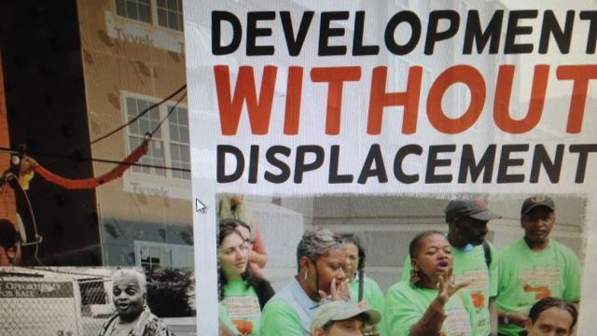
Goals for participating cities
Produce meaningful and more frequent measures of neighborhood dynamics
Facilitate informed community conversations to prevent displacement and equitably restore neighborhoods
Notes:
Develop measures for in-depth and broad understanding of neighborhood dynamics, especially in neighborhoods at risk of becoming unaffordable. We think things might be different that earlier efforts in the postrecession economy (Qual/Quant)
Most gentrification research looks over the long-haul, is retrospective, and not feeding into decisions, not action-oriented.
The important part of the project is sharing the data to Inform discussions across sectors about how to use the data and analysis to develop creative local policies and programs for equitable development.
Data can foster a common understanding of what’s happening and help to direct and mobilize action.
***
Urban will provide a framework for local research and engagement which each local coalition will adapt
Core components.
Qualitative data collection that captures various perspectives including residents, private and public stakeholders as well as traditional indicators (sales price, crime)
Exploration of various types of displacement including but not limited to residential displacement, cultural displacement and commercial displacement
Embedded practical application of research through local advisory groups –
They’ll ensure that the analysis is relevant to local questions and priorities

Slide 12
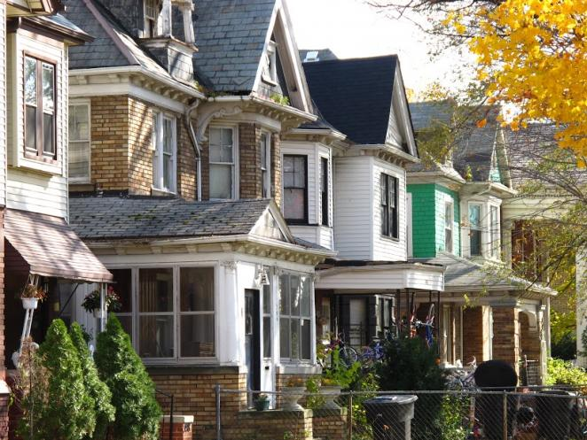
Goals for the field
Share:
findings on monitoring change and incorporating analysis into local decisions
policies and programs from places with varying housing markets
protocols and methods that can be adapted by other places
Notes:
Across sites,
- we plan to do a summary of local findings on the results of the measurement and how it was used locally.
- through the advisory groups, we expect to share strategies on local policies and programs in different kinds of places
- produce protocols and methodology that can be adapted by other cities

Slide 13
Framing
Focus for cross-site on continuum of neighborhood revitalization rather than one definition of gentrification
Defer to local coalitions on framing and communications
Supply facts from local research on changing neighborhood conditions for informed discussion
Notes:
Emphasize common project goal of inclusive development for all stages of revitalization

Slide 14
Participating cities
Work Underway
Detroit
Twin Cities
Late planning stages
Buffalo
Cleveland
Hartford
Milwaukee
Phoenix

Slide 15
Project timeline
Project launch and design (January–December 2016)
Local implementation and early learning (January–December 2017)
Cross-site summary and dissemination (January-June 2018)
Notes:
Project design
Review lessons from research and practice
Develop research guidance and protocols
Local implementation and early learning
Plan and implement engagement process for local stakeholders
Conduct local data collection activities
Share local progress and early lessons
Phase 3: Cross-site summary and dissemination of findings
Synthesize lessons and experiences across the participating sites
Disseminate to local and national audiences

Slide 16
Local perspectives
Tom Woiwode, Erica Raleigh and
Michael Grover
Notes:
Wanted to take the last part of the presentation to share some experiences from the larger NNIP network.

Slide 17
Detroit
Funders’ perspective

Slide 18
Detroit
Planning ahead for equitable development
Data Driven Detroit, Jan. 2017

Slide 19
Detroit Context
2010-2014 mortgage/tax foreclosures: 110,000+
2016 properties eligible for tax foreclosure: 20,000
Q3 2015 vacant/no stat addresses: 110,000 (30%+)
Dec. 2016 speculator-owned properties: ~80,000
Dec. 2016 Detroit Land Bank Authority-owned properties: ~95,000

Slide 20
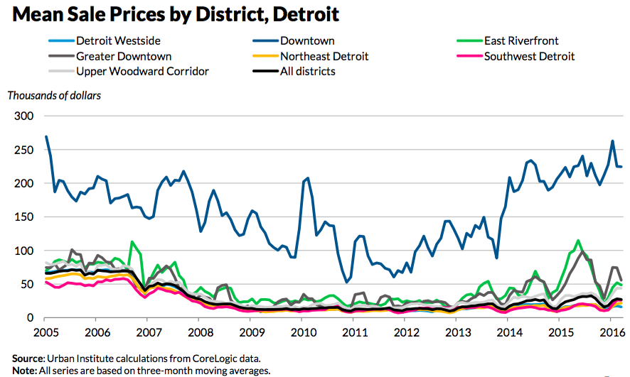

Slide 21
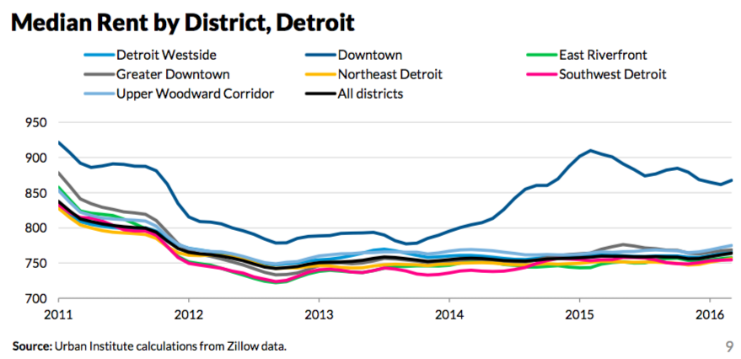

Slide 22
Detroit Context
2014 purchase mortgages: < 500
Urban Institute noting:
  44% corporate buyers in 2014
  54% quit claims (land contracts?) in 2014

Slide 23
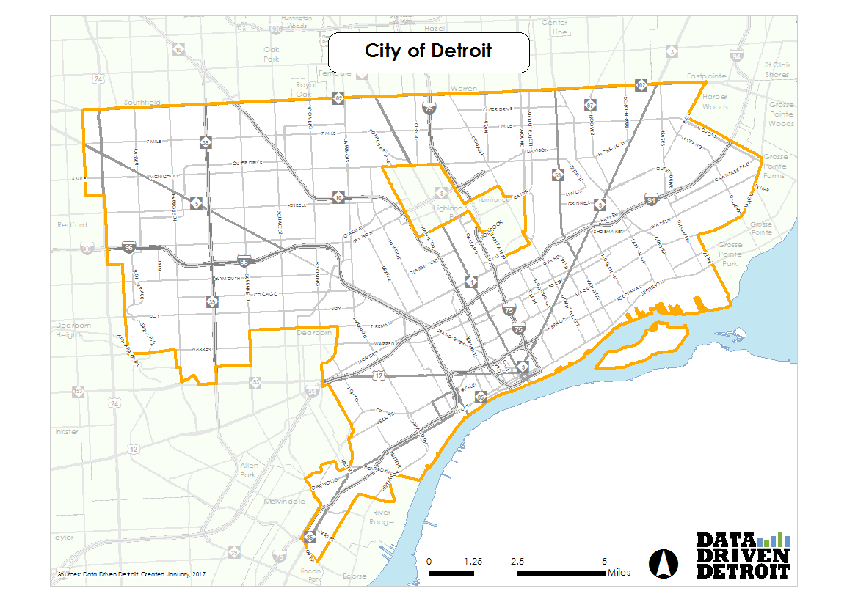

Slide 24
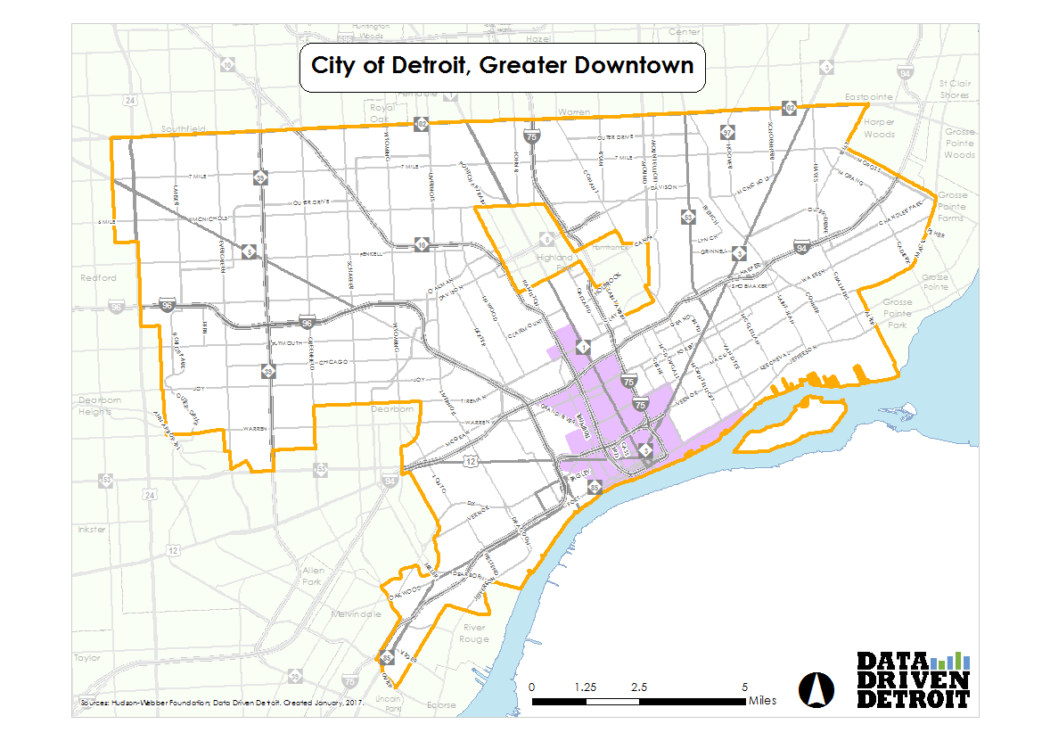
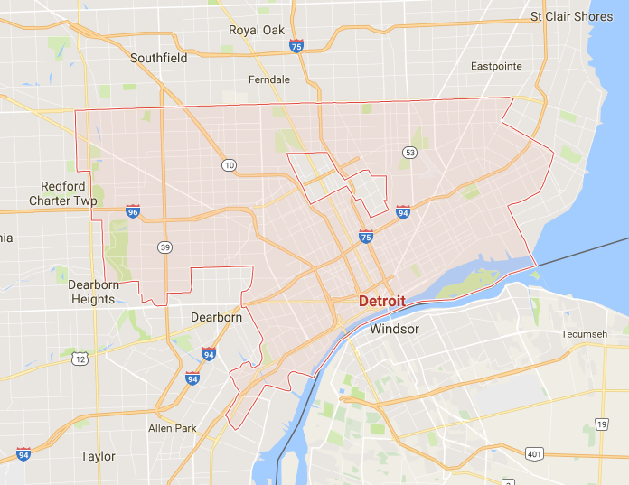

Slide 25
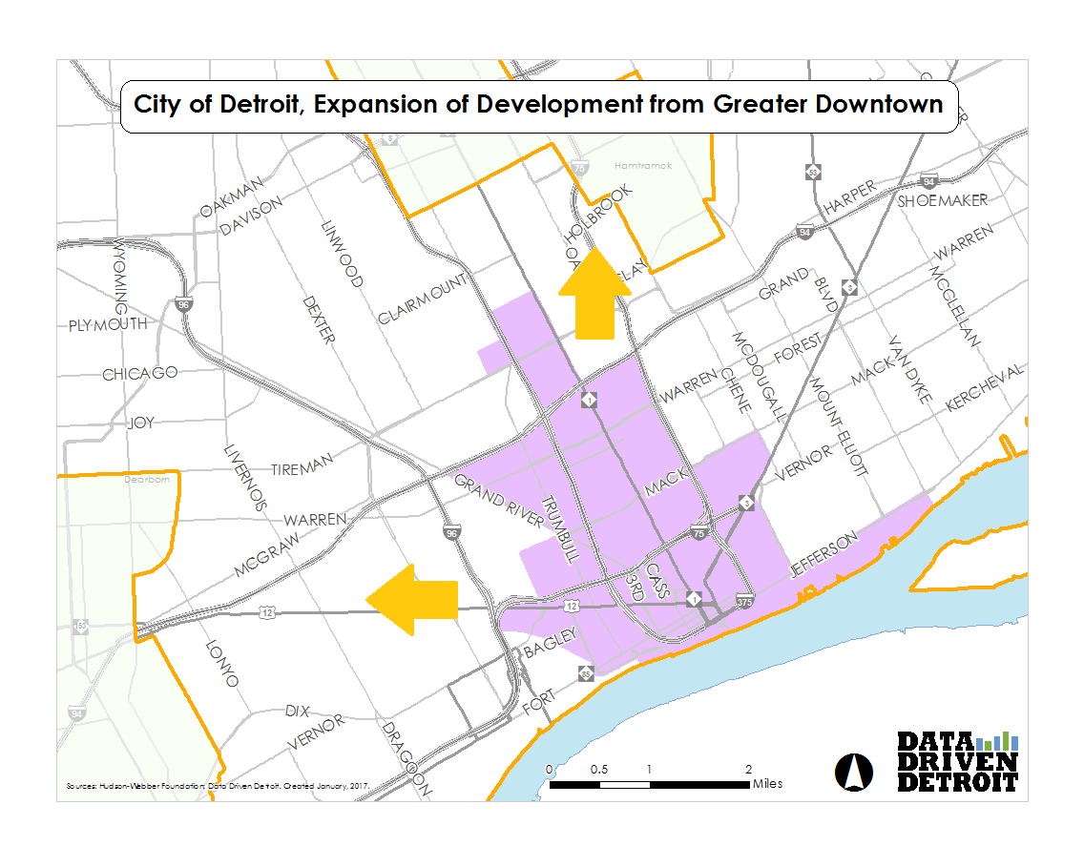
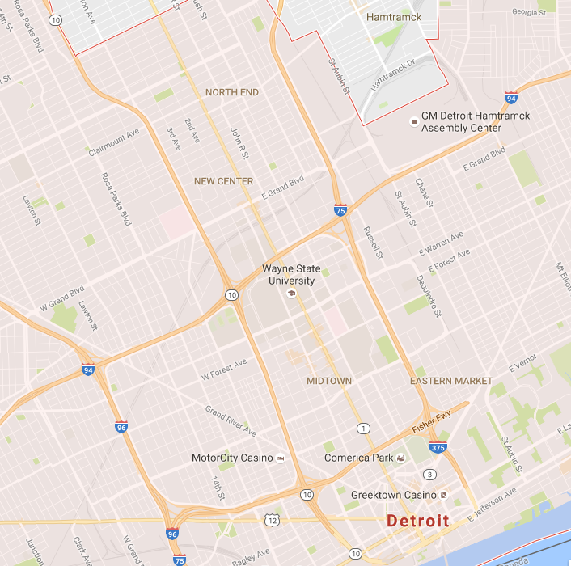

Slide 26
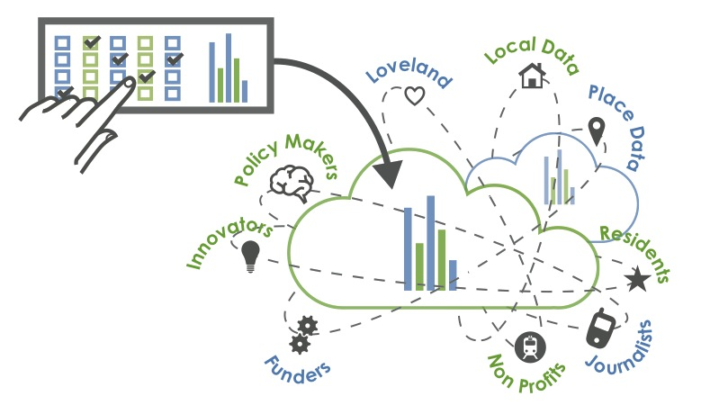
How can we monitor neighborhood change closer to real time, understand how people feel about it, and provide the information to people who can do something about it?
Our answer: Turning the Corner
Notes:
So how do we…
It was precisely this thought that led to the formation of D3 nearly eight years ago
Planned to be a one-stop-shop for all things data about Detroit and the region

Slide 27
Our Local Work
Cross Site Learning
Citizen Advisory Board
Quantitative Sources Research
Qualitative Research
Communications and Dissemination

Slide 28
Quantitative Research
Detroit advantages:
  Motor City Mapping project
  City’s move toward open data
Disadvantages:
  Despite better property data, lacking “people” data

Slide 29
Quantitative Progress
Researched over 50 potential data exhaust streams
Ideal seems to be a combo:
  Utility shut offs / transfers
  Property value & rent levels
  Business opens / closes by type
  Credit card spending
  Tax Auction Bids
May have enough to test causal model and identify leading indicators

Slide 30
Qualitative Progress
Interviews (Ongoing)
  Established business owners in neighborhoods anecdotally experiencing neighborhood change
Focus groups (Testing Protocols)
  Residents in those same target neighborhoods

Slide 31
Initial Experiences
Resident Protocols
  Seems best to ask the “big picture” questions up front, because residents are eager to answer them
  Residents want to maintain political and cultural relevance and are concerned about the changing atmospheres
Business-owner Protocols
  Hopefulness and concern reveal complex relationships with neighborhood change
  Branching, detail-oriented questions yield clear and discrete answers

Slide 32

Resident Storytelling
Newly-funded expansion of the project will center resident storytelling.

Slide 33
Thanks!
Erica Raleigh
Erica@DataDrivenDetroit.org
www.datadrivendetroit.org
@D3detroit

Slide 34
Turning the Corner Project
Twin Cities Case Study
Michael Grover, PhD
Community Affairs Officer, Federal Reserve Bank of Minneapolis

Slide 35
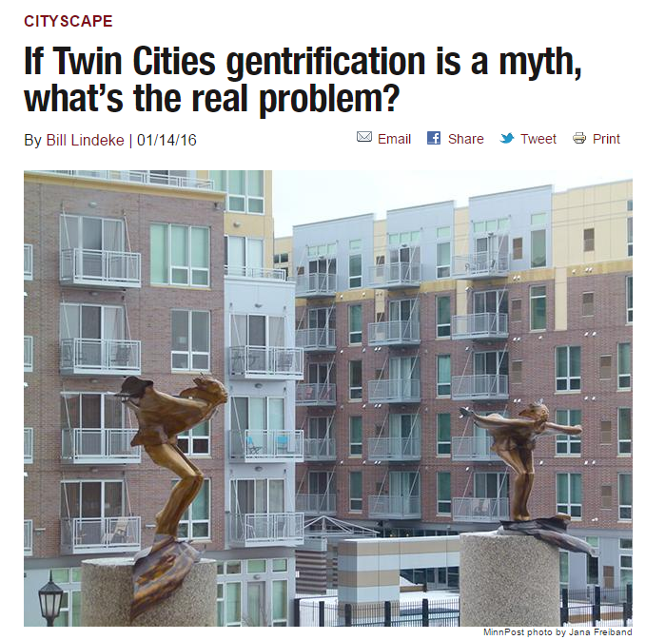
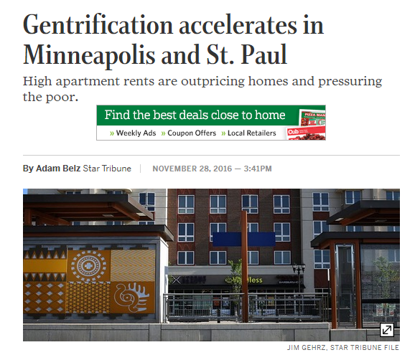
Neighborhood change in the Twin Cities – myth or reality?

Slide 36
Overview
Project background and objectives
Roles and responsibilities of local partners
Scope of work
Timeline

Slide 37
Project background and objectives
Gain a better understanding neighborhood dynamics
  Employ both quantitative and qualitative data
Inform community stakeholders and policymakers
Cross-site analysis that will produce protocols and methodology for others to use
Notes:
Overarching Goals for the Project
Develop holistic metrics for in-depth and broad understanding of neighborhood dynamics in the postrecession economy, especially in neighborhoods at risk of becoming unaffordable.
Facilitate informed community conversations among stakeholders, who can use the data and analysis to develop creative local policies and programs to equitably restore neighborhoods.
Advance the field through a cross-site summary of local findings on monitoring neighborhood change and strategies for incorporating analysis into local decisionmaking.
Share strategies on local policies and programs from places with varying economic and housing market strength.
Produce protocols and methodology to monitor neighborhood revitalization that can be adapted by other cities.

Slide 38
Roles and responsibilities of local partners
Center for Urban and Regional Affairs (CURA) at the University of Minnesota– quantitative analysis
Wilder Research – qualitative analysis
Twin Cities LISC – project administrator
Federal Reserve Bank of Minneapolis – contribute to all facets of the study and link to national analysis
McKnight Foundation – study funder

Slide 39
Scope of work
Employ quantitative data to identify neighborhoods experiencing change
Gather local and regional stakeholder perspectives on gentrification at the local neighborhood level in the Minneapolis-Saint Paul metropolitan area
Gather neighborhood stakeholder and resident perspectives in three local neighborhoods about how gentrification is impacting and changing their neighborhoods
  Key informant interviews (N=10-12)
  Neighborhood stakeholder interviews (N=5 x 3 neighborhoods)
  Neighborhood resident focus groups (N=1 x 3 neighborhoods)
  Neighborhood convening (N=1 x 3 neighborhoods)
Analyze and interpret the findings and provide data monitoring and policy considerations
Engage community stakeholders and policymakers in post-report forums

Slide 40
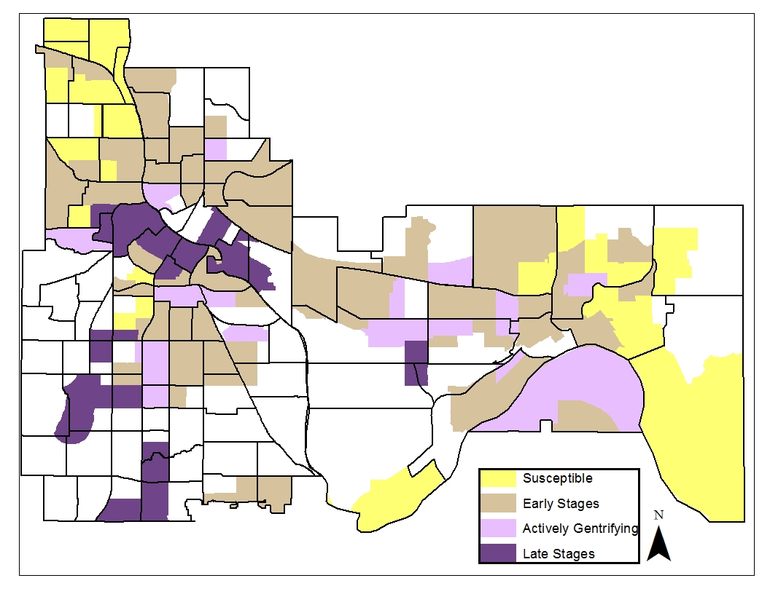
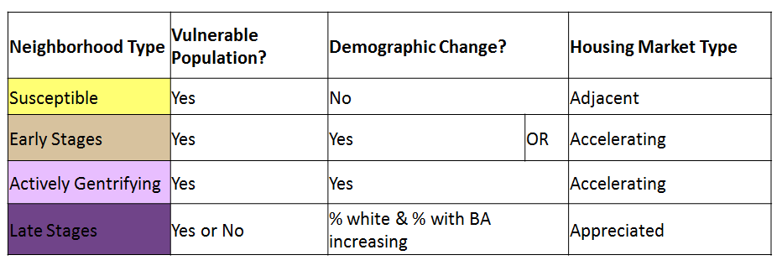
Identifying neighborhoods
Notes:
Using Lisa Bates methodology to identifying where gentrification is happening in the core cities of Minneapolis and St. Paul:
Key Metrics:
Median Home Value
People of Color
Renters
People without Bachelor’s Degree
Median Household Income
Vulnerability Score = Presence
Demographic Change = Increase greater than Metro average

Slide 41

Contact information
Michael Grover, PhD, Community Affairs Officer
michael.grover@mpls.frb.org
Federal Reserve System Community Development Research Conference—March 23–24, 2017
For details and registration, click the conference link at
minneapolisfed.org

Slide 42
Discussion
Notes:
Wanted to take the last part of the presentation to share some experiences from the larger NNIP network.

Slide 43
Potential topics
Framing the issue
Partnership building
Approach to research and data
Community and resident engagement
Working with institutions (Federal Reserve and others)
Funding the work

Slide 44
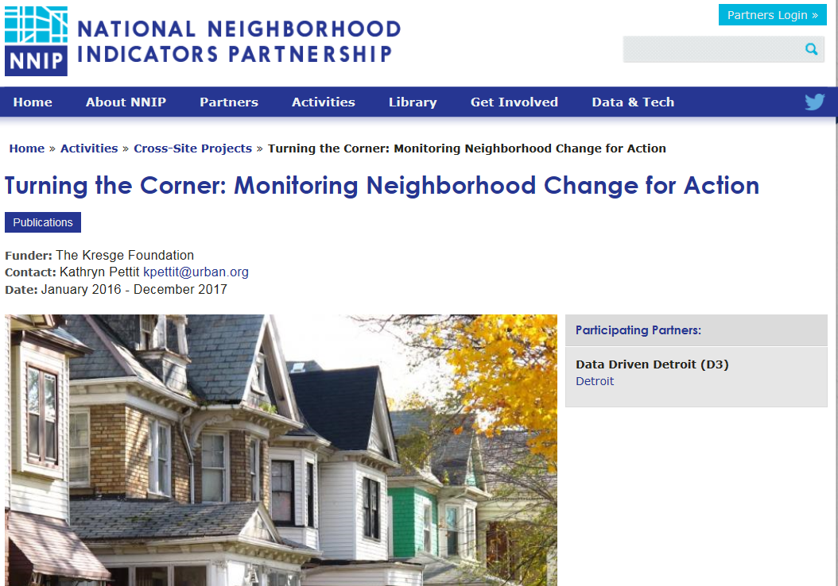
www.neighborhoodindicators.org
Notes:
Many other examples on our website. We’ll be excited to share the TTC progress with you as we go along. Here is the project page.
Mention listserve and Twitter

Slide 45
Resources
Berkeley-UCLA Urban Displacement Project (Bay Area)
MAPC Anti-Displacement Toolkit (Boston)
Displacement & Relocation Tied to Multifamily Redevelopment (Detroit)
Equitable Development Policy Platform (Philadephia)
Central Corridor Collaborative (Twin Cities)
11th Street Bridge Park (DC)
Inclusive Development Strategy in the context of Gentrification (Portland)
Early Warning Systems for Gentrification

Slide 46
Kathy Pettit, Urban Institute kpettit@urban.org
Julie Seward, The Funders Network for Smart Growth and Livable Communities, juliawseward@gmail.com
Tom Woiwode, Community Foundation for SE Michigan twoiwode@cfsem.org
Erica Raleigh, Data Driven Detroit erica@datadrivendetroit.org
Michael Grover, Federal Reserve Bank of Minneapolis michael.grover@mpls.frb.org
Notes:
Any of us would be happy to talk further.

