Slide 1
We need systems indicators for equity
NNIP Webinar
April 19, 2022
Notes:
The ask from Urban:
How have folks been measuring systems change?

Slide 2
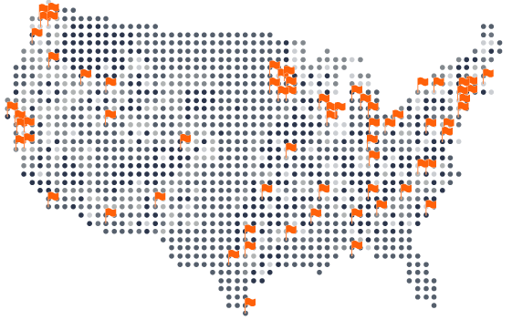

StriveTogether Cradle to Career Network
OUR IMPACT
14+
Million Children
One Community at a Time
8+
Million Children of Color
OUR REACH
68
Cradle-to-Career Partnerships
© 2021.
, Inc. All rights reserved. | 2

Slide 3
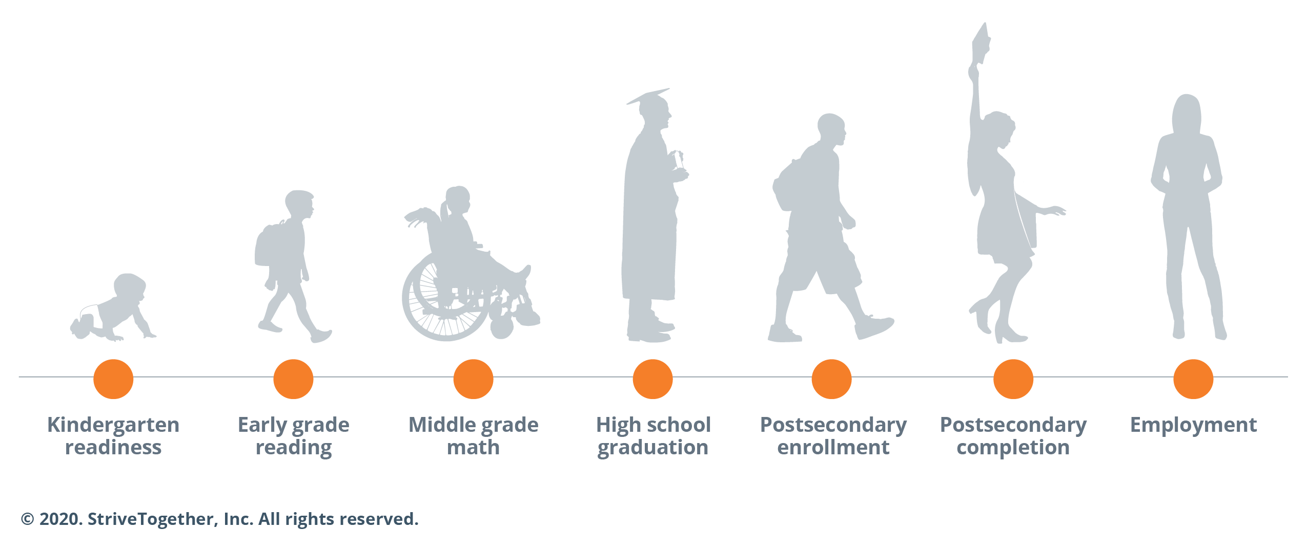
Ultimate goal: every child, cradle-to-career
Disaggregated by race, income, gender

Slide 4
Defining systems transformation
“In Systems Transformation communities, the civic infrastructure exists where all Black, Indigenous, Latinx and Asian youth and families and those experiencing poverty have the opportunity to reach their fullest potential, from cradle to career. This is a result of partnership with system leaders in making fundamental and institutionalized shifts in policies, practices, resources and power structures to eliminate structural racism and advance equitable outcomes.​”

Slide 5
Definition of systems indicators
A measurement (both qualitative and quantitative) that reveals inequities in how resources, decision-making power and opportunities are distributed to inform policies and practices within institutions, organizations and programs that are interdependent and/or related.

Slide 6
Genesis of systems indicators
In 2019, the Racial Equity Planning Team identified that singularly focusing on outcomes at the individual level leads us to ignore the role that complex systems and structures play in creating racialized disparities in education and enables placing blame on students rather than systems. The team recommended complementing outcomes data with systems data.
Tracking and reporting systems indicators
Organizations and institutions are held accountable to create conditions for success
Better, more equitable cradle-to-career outcomes are achieved
Adoption of the indicators was a multi year process.
Notes:
SLIDE DONE!

Slide 7
Journey to integrating systems indicators
Race Equity Planning team members recommend complementing outcomes data with systems data
Race Equity workgroup members identify a list of over 100 potential systems indicators the Network could use
Over 500 attendees at the StriveTogether National Convening engage with the proposed indicators at learning stations through out the convening. Additionally, 70 members engage in in-depth TEGA interviews
A workgroup for 10 Network partners engage in literature review and study systems indicators already in use across the Network and make a recommendation for 17 potential indicators to use
Systems Indicators Guide is released and a pilot group of 7 partnerships is launched
Pilot sites test systems indicators implementation
Systems indicators are incorporated in the StriveTogether Theory of ActionTM revision.
84% of the Network submits at least one systems indicator data in the annual Civic Infrastructure Assessment data and
Technical Assistance to Network data managers in accessing systems data is launched
Plans to launch adaptive supports for the Network are underway
April 2019
Summer 2019
Fall 2019
2020
Spring 2021
Apr-Oct
2021
Oct
2021
Jan
2022
2022

Slide 8
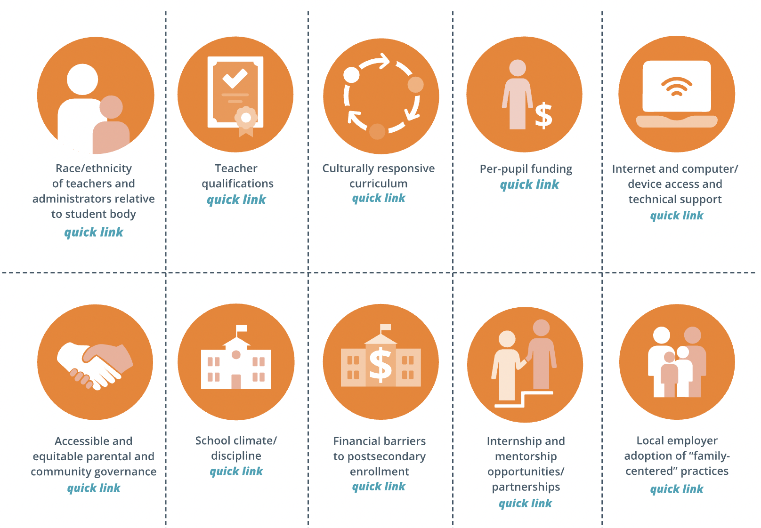
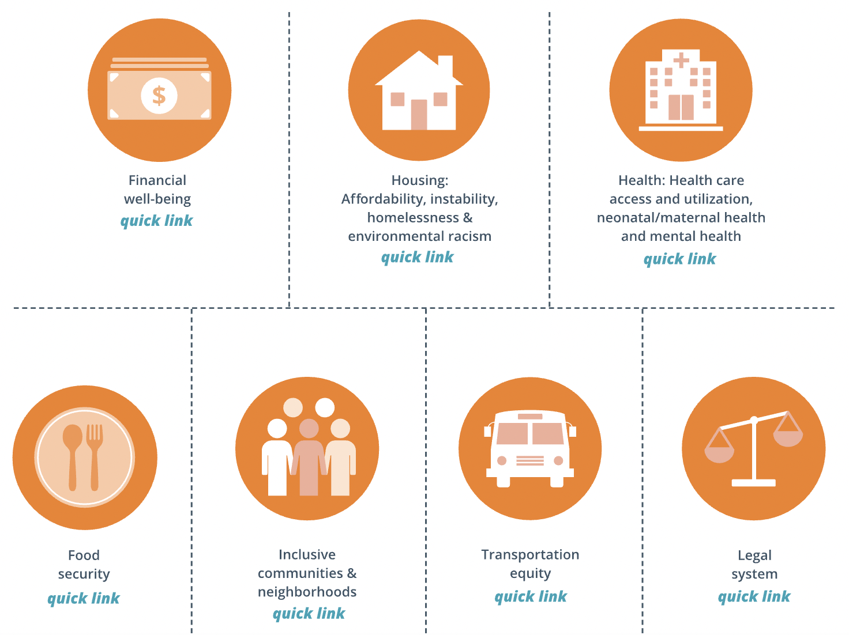
Indicators that hold systems, and not individuals, accountable
Education
Adjacent Sectors
Notes:
Explain what systems indicators are

Slide 9


systems indicators: teacher race/ethnicity
Systems indicator
Impacted outcomes
Why it matters
Same-race student-teacher pairings positively impact student learning and development. Longitudinal studies have shown lasting impact on same-race student-teacher pairings in grades K-3 on graduation and college enrollment outcomes, particularly among Black students.
Race/ethnicity of teachers relative to student body
High school graduation and postsecondary enrollment
1. Gershenson, S., Hart, C.M.D., Hyman, J., Lindsay, C. & Papageorge. N.W. (2018). The long-run impacts of same-race teachers. The National Bureau of Economic Research, Working paper 25254. https://www.nber.org/papers/w25254
Notes:
Not sure if we need this

