Slide 1
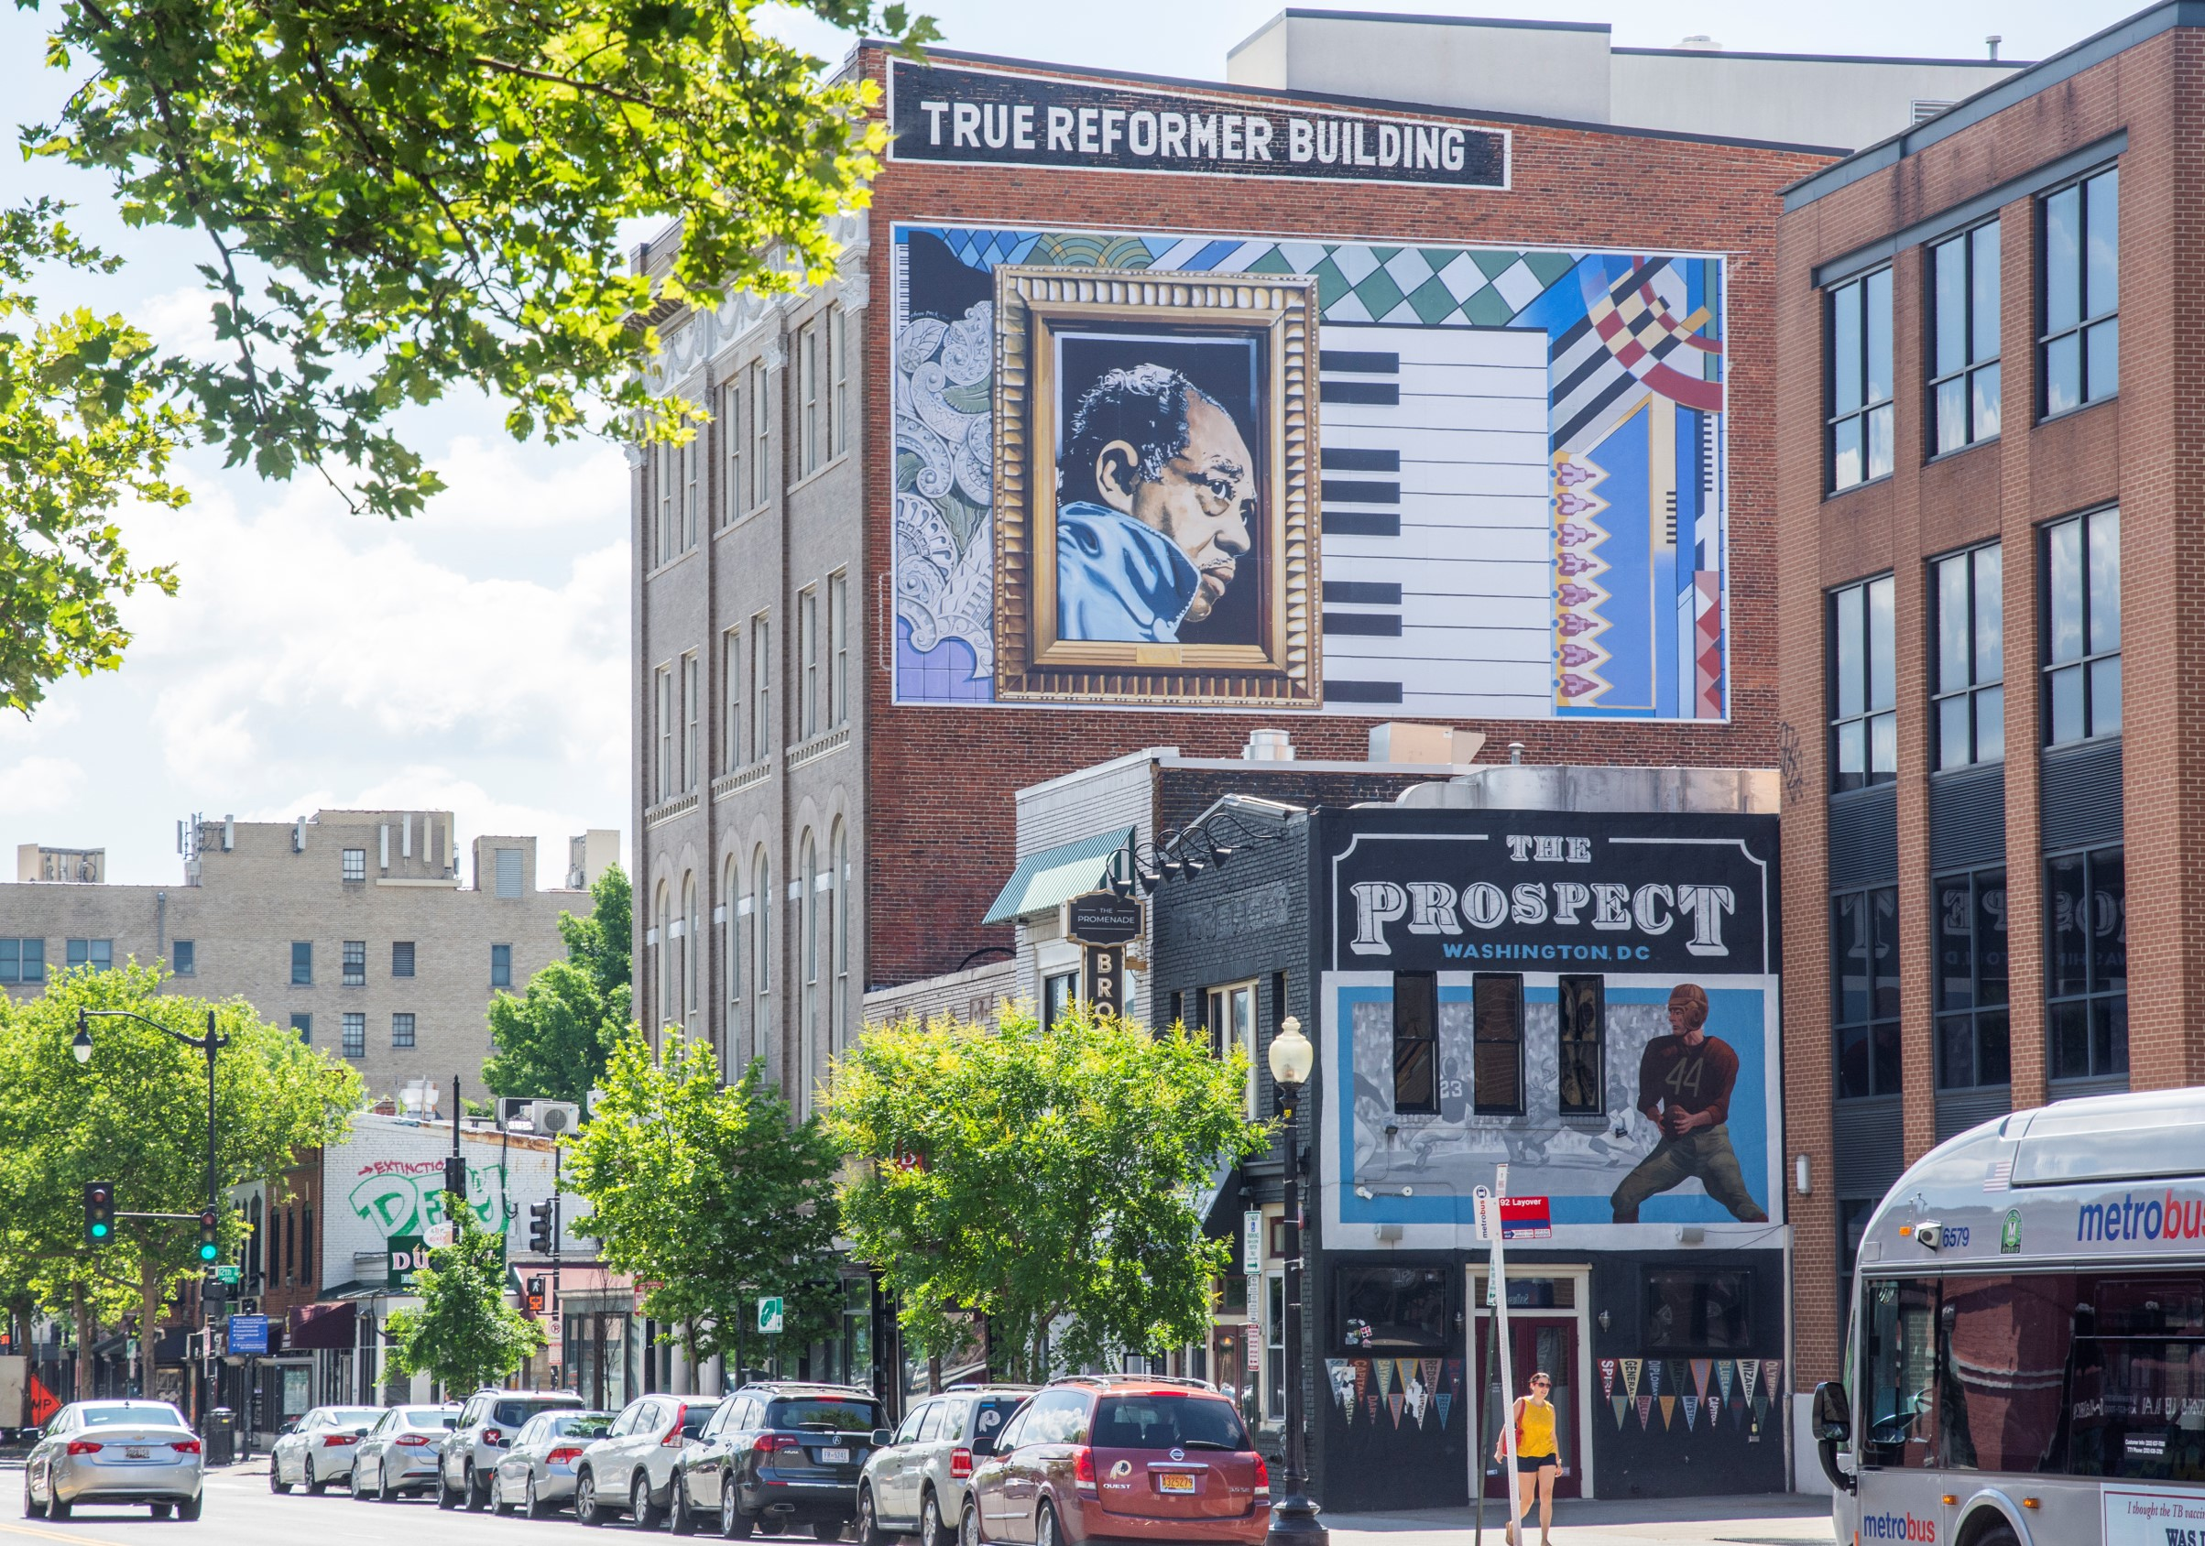

#NNIP Partners’ Meeting
DC 2022

Slide 2
Enhancing the Impact of the NNIP Network
October 27, 2022

Slide 3
Today’s session
Introduction and Brief Q&A (20 minutes)
Move to breakout rooms (10 minutes)
Breakouts (60 minutes)
Return to Anacostia (10 minutes)
Report out (20 minutes)
Notes:
Note limited time - camp session afterwards and

Slide 4
CSR Communications Stakeholder Discovery
Purpose
To understand perceptions of NNIP as context as we articulate our unique value proposition and increase visibility/correct misperceptions among stakeholders.
Data Collection (Summer 2022)
Interviews with 6 people from foundations and 6 people from related data groups
Focus group with 8 NNIP partner staff
Notes:
Thank you to Chris Kingsley at Casey for supporting and encouraging this – caring deeply about NNIP's future.
And to the folks at CSR - Nancy Murphy and Jennifer Hart
- go through bullets
Note data collection was with a range of knowledge about the network and its partners

Slide 5
Key Takeaways
NNIP is trusted and highly regarded but not broadly known or understood.
  “I love that they are doers not talkers. Not flashy and care deeply about the work.”
  “Amazing group of people who are warm, talented, skilled, open and sharing.”
Partners and stakeholders believe that NNIP has the potential to have greater impact but needs a clear vision and plan to achieve this.
Notes:
Not using this time for detailed findings. See handout and happy to share detailed materials with anyone interested.

Slide 6
CSR Recommendations
Explore Strategic Crossroads
  Needs of people that local partners serve/problems we solve
  Needs of local partner organizations
  Deepening commitment to and action for equity
  Size and scale of the network
  Business model and fundraising
Notes:
With support from the Casey Foundation, we decided to move forward with the next phase of strategic planning with CSR. In this phase we will be tackling their recommendations.
Explore Strategic Crossroads
Needs of people that local partners serve/problems we solve (note starting today’s session)
Needs of local partner organizations
Deepening commitment to/action for equity
Size and scale of the network
Business model and fundraising

Slide 7
CSR Recommendations (continued)
Craft clear, compelling messages; communicate consistently with key audiences.
Chart a sustainable, compelling strategic path for the future.
Notes:
Slide 4: Recommendations from CSR (continued)
Craft clear, compelling messages; communicate consistently with key audiences.
Chart a sustainable, compelling strategic path for the future.
Encouraged us to experiment and think about quick wins while we are sorting through long-term issues

Slide 8
Phase 2 Deliverables
3-year strategic plan
Implementation Plan Framework
Key message framework
Implementation Tools
Notes:
3-year strategic plan
·Refreshed vision, mission values
·Goals, strategies, tactics
·Early wins + 12-month priorities
·Recommendations re: business model/revenue streams
Implementation Plan Framework
·Key initiatives & Resources needed to achieve goals
Rollout strategy (membership, other key stakeholders)
·Recommended key audiences
·Key message framework and initial product
·Outreach timeline

Slide 9
Partner Participation
Strategic Planning Committee
  Amy Carroll-Scott, Philadelphia
  Lamar Gardere, New Orleans
  Katie Pritchard, Milwaukee-Alumna
  Noah Urban, Detroit
Executive Committee 2023
Periodic report-outs and gatherings of all partners
Informal feedback through office hours and ad hoc

Slide 10
Breakout Guidance
Notes:
Have people go around with name and org?

Slide 11
Part 1: Local value of community data services
What benefits or value do you think your organization providing community data services brings to your community?
If resources were unlimited, what would you do differently to enhance that value in the future?
Notes:
Breakout discussion Part 1 (30 minutes) – Local value of community data services.
For current and prospective partners, we would like you to focus on the impact of your organization’s work and its aspirations rather than the services or products, such as training or reports. For those who are not partners, from your experience of local stakeholders trying to improve their community how would they know and benefit from working with a community data organization?

Slide 12
Part 2: Value of the NNIP network
What benefits or value do you think NNIP brings to its members?
If resources were unlimited, how could communities without an NNIP partner benefit from our work?
Notes:
Breakout discussion Part 2 (30 minutes) – Value of the NNIP network
Please think about the value of the network and the impact it can have achieving its mission of equity and well-being across neighborhoods.
What WON’T change/be different 10 years from now?”

Slide 13
Enhancing the Impact of the NNIP Network
October 27, 2022

Slide 14
#NNIP Partners’ Meeting
DC 2022

