Slide 1

Who Owns Durham
NNIP, July 25, 2019
Notes:
We’re a 501 c 3 community data intermediary in Durham, North Carolina. Our work is for local neighborhoods, community organizers, local government, with a priority for empowering people historically excluded from processes of power…

Slide 2
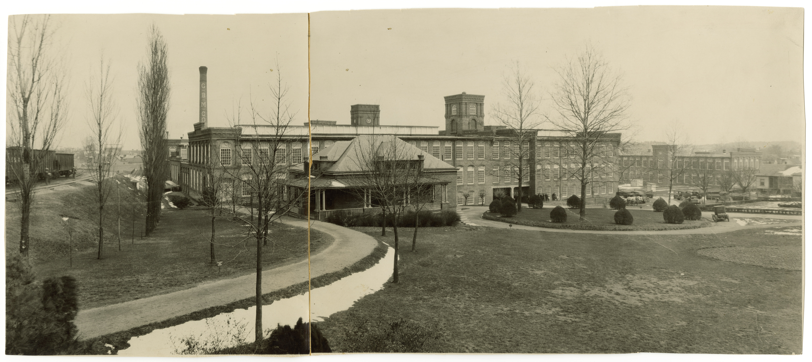
Image source: Digital Durham
Notes:
Referencing history is an essential element of our presentations. Neighborhood data are the product of neighborhood history. Durham came to prominence as a city as a mill and factory town with most people renting homes, often from companies that employed them.

Slide 3
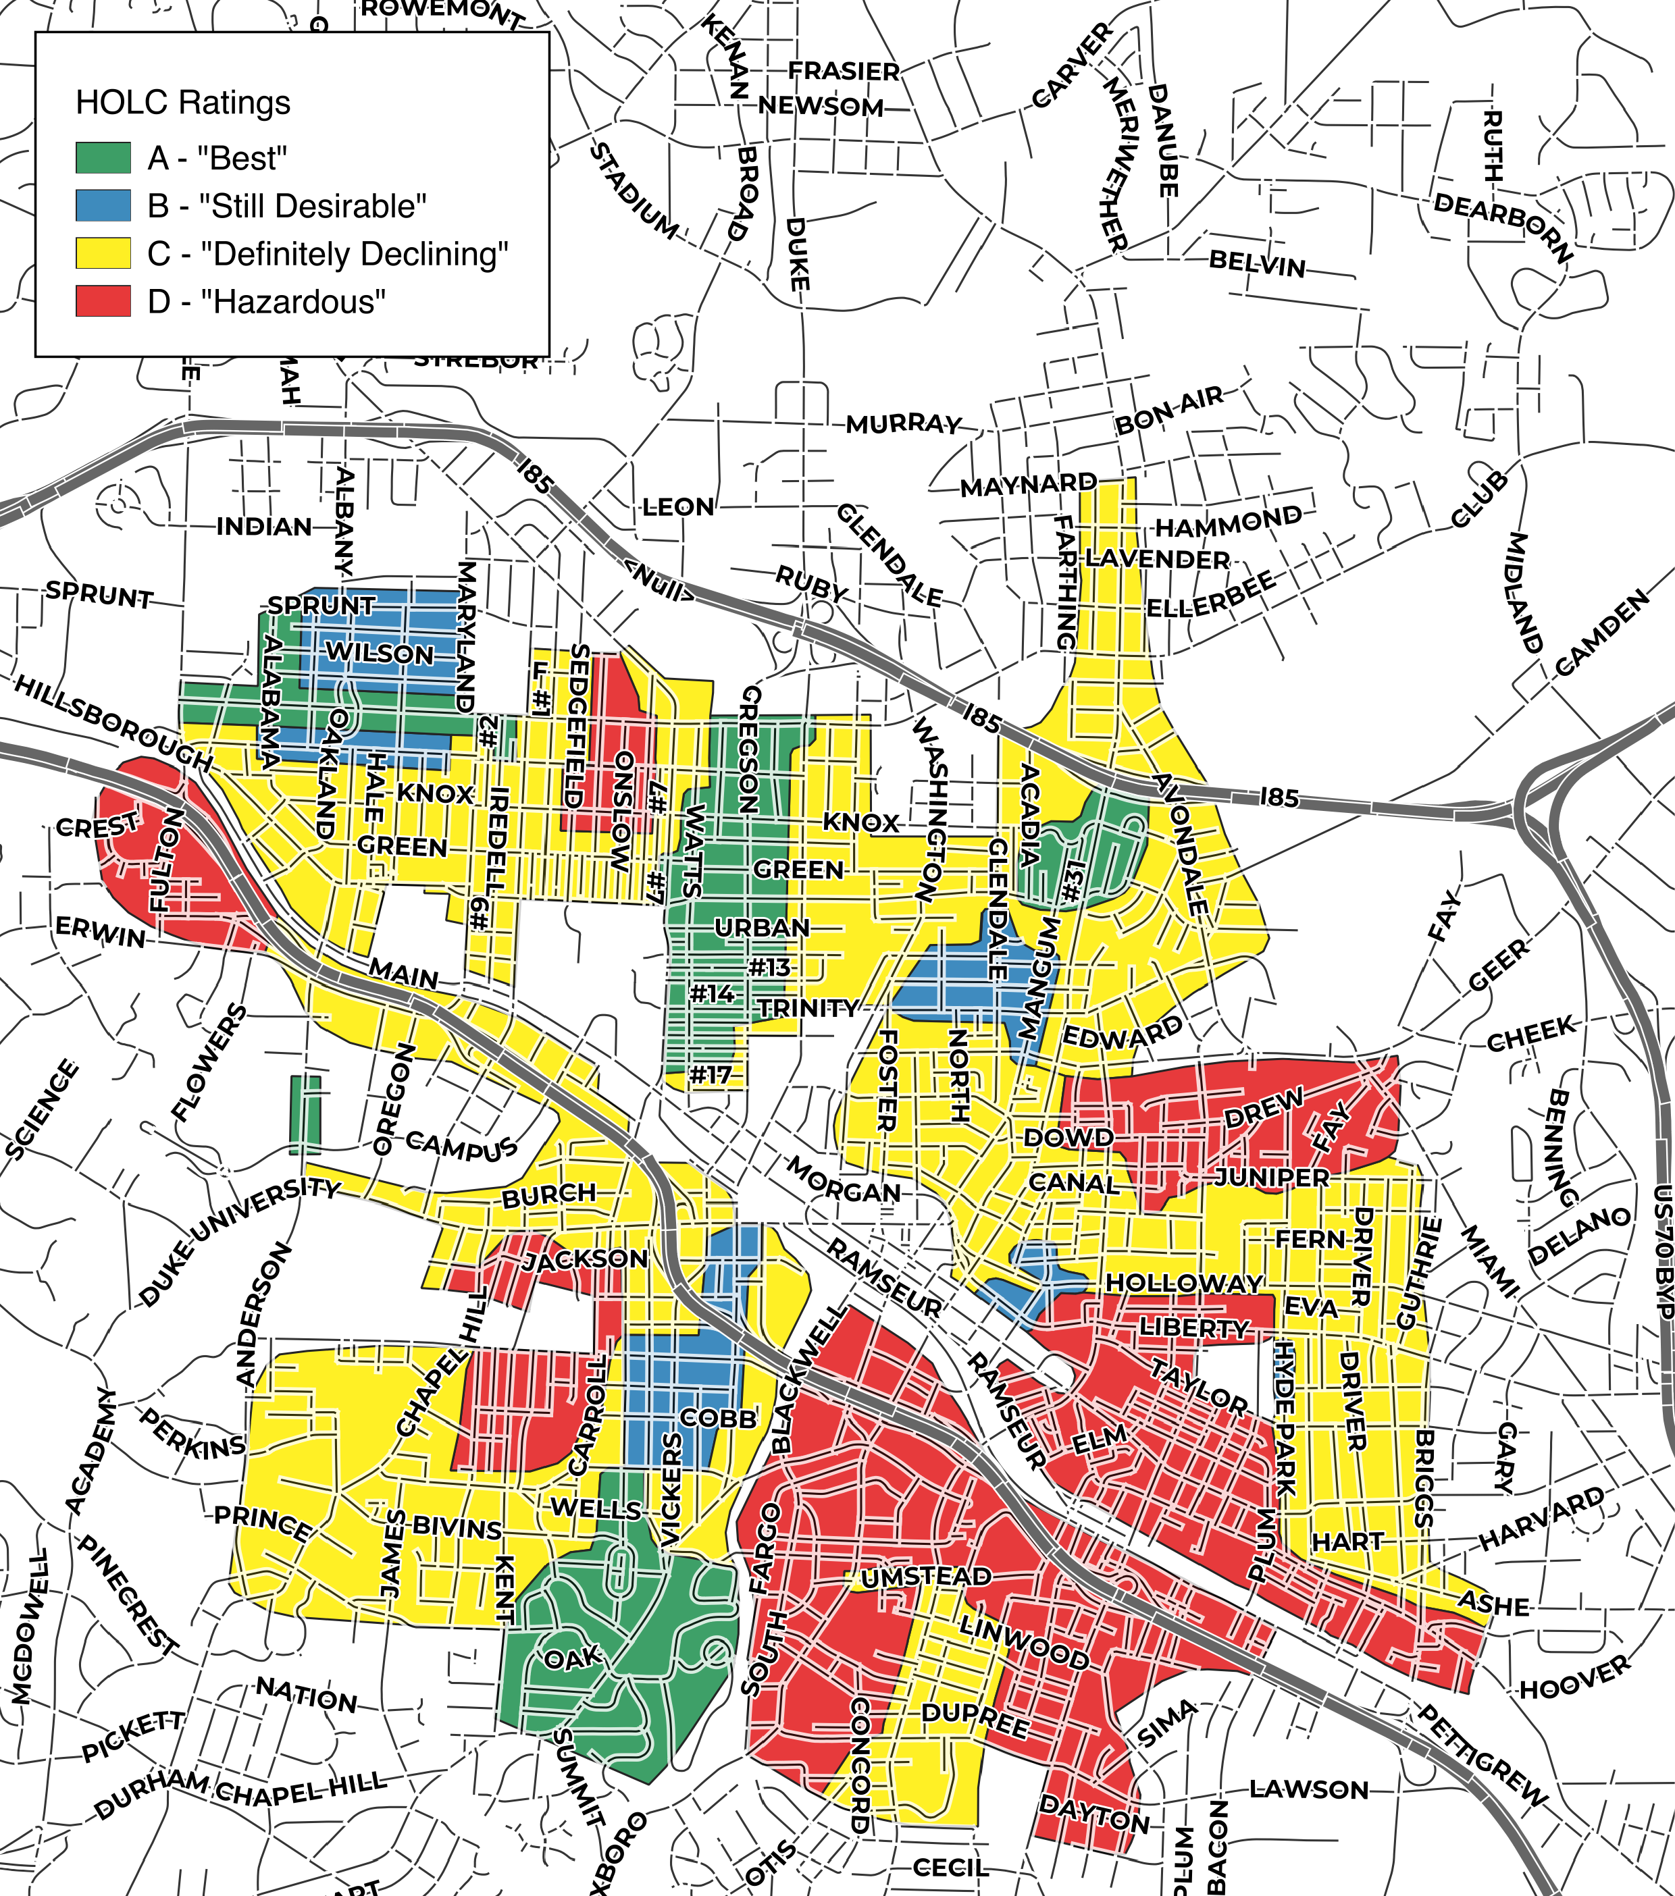
Image source: DataWorks; redline geography from Mapping Inequality, University of Richmond
Notes:
One of the most indelible ways we see the influence of history is in how rating neighborhoods for real estate investment risk by race and ethnicity has influenced measurements of neighborhood economic activity, housing tenure and conditions…

Slide 4
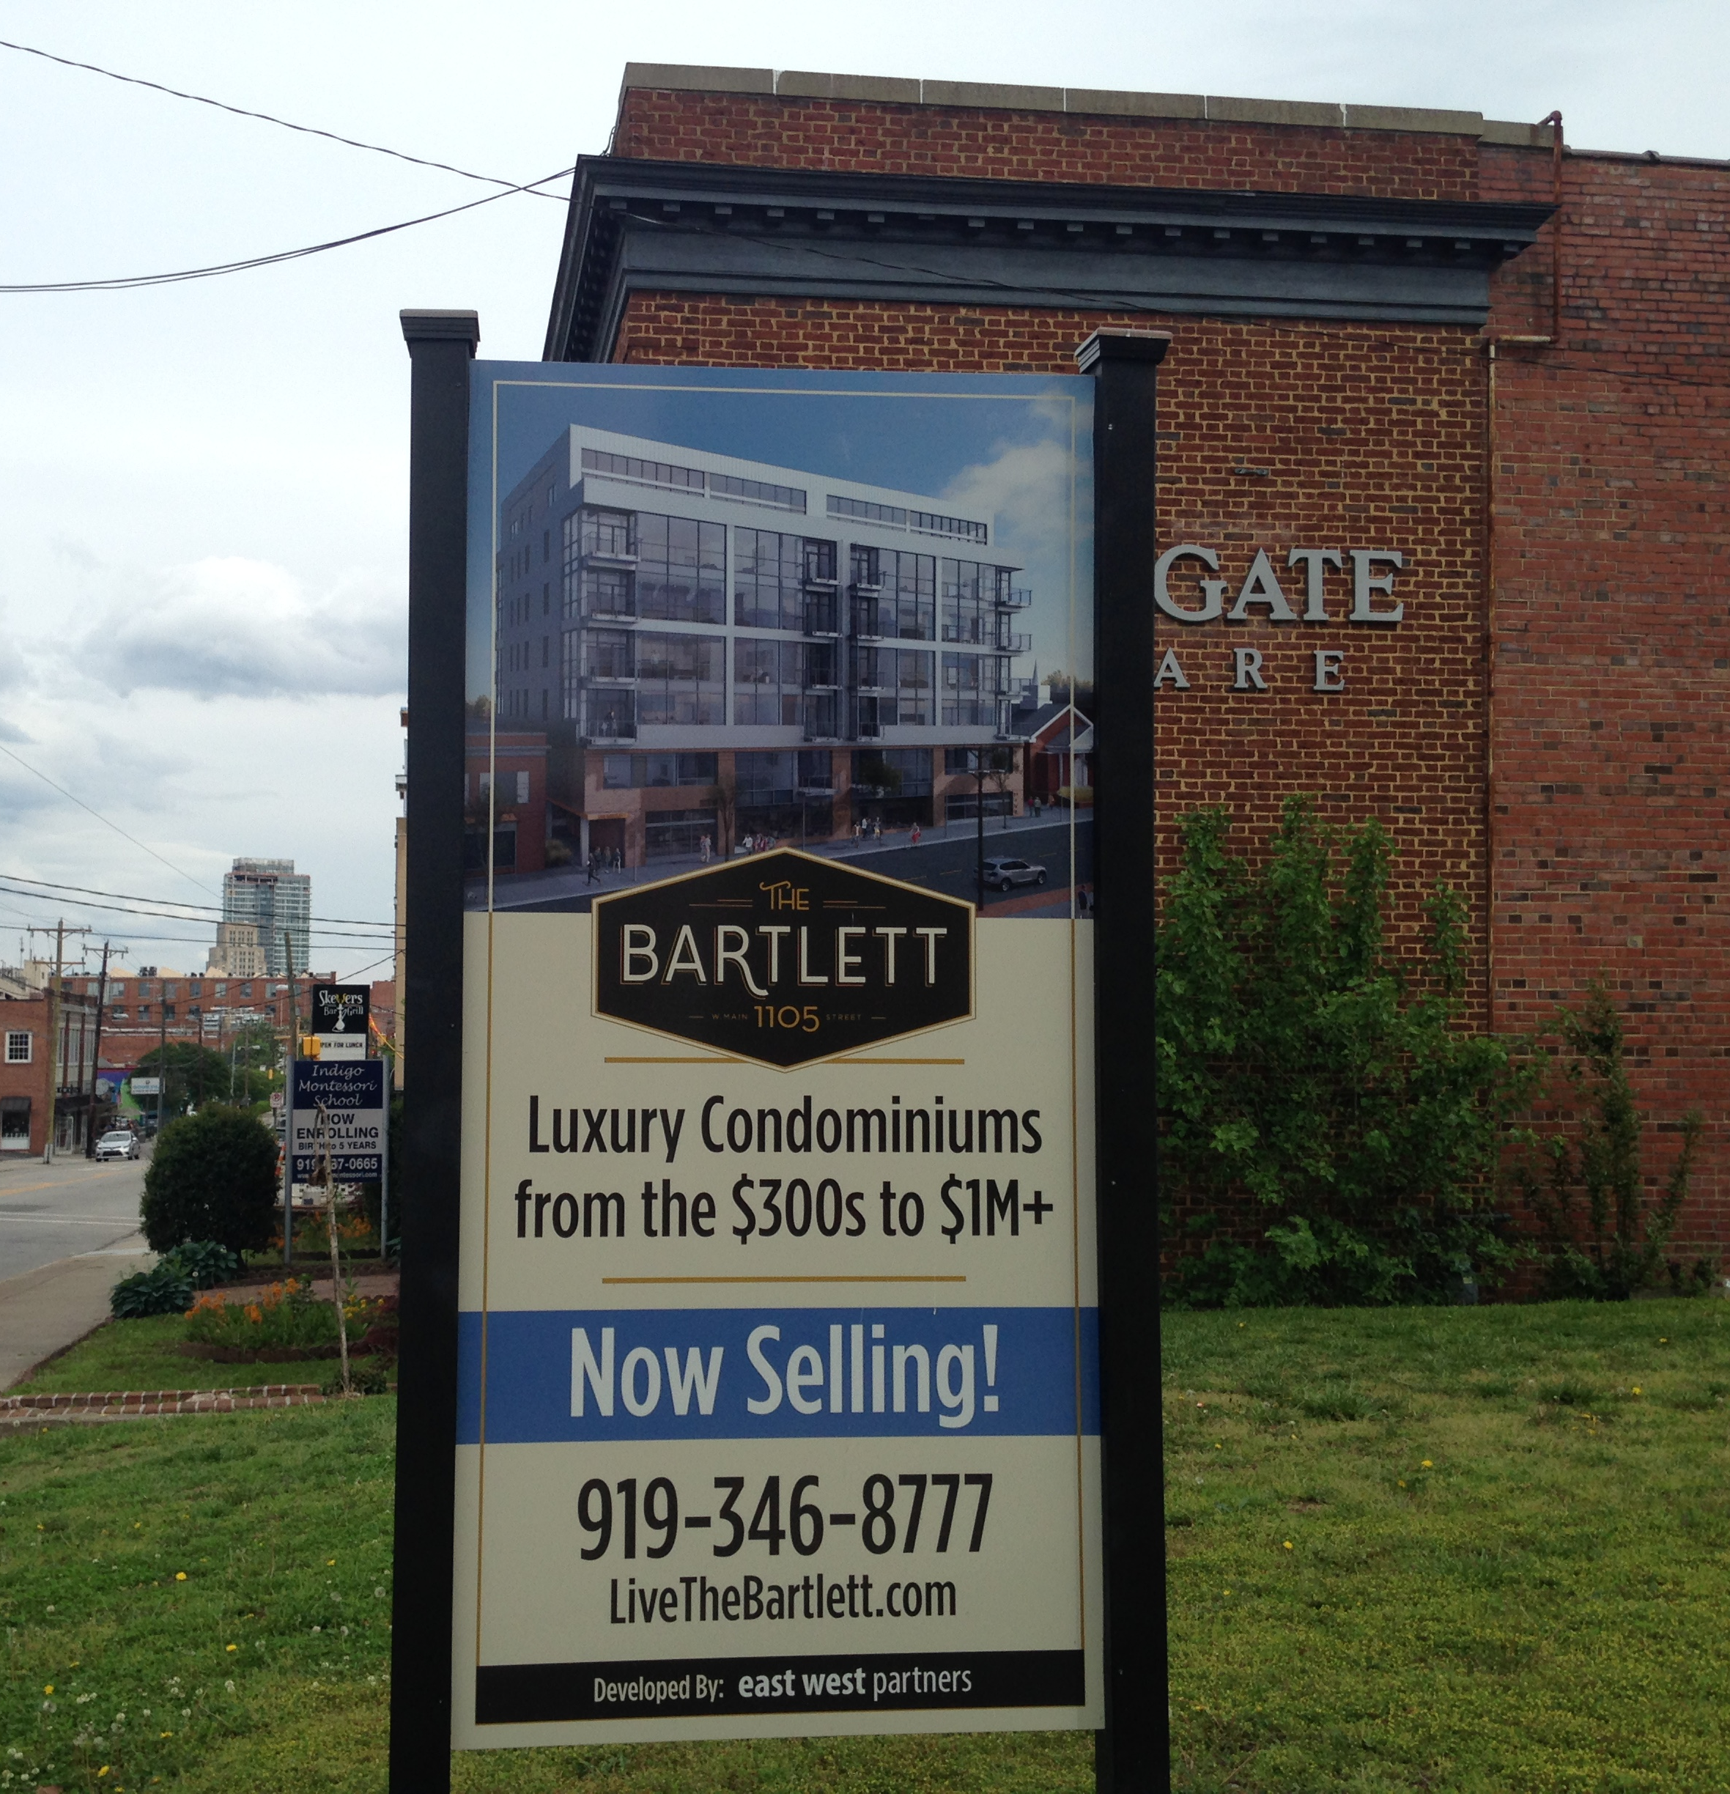
The opportunity to acquire inner city property for permanently affordable homes is rapidly vanishing.
Notes:
Recognizing the time to acquire inner city property for permanent affordable unit was quickly passing…
Of the corporate landlords that own multi-family complexes in Durham, a larger proportion are based out of state. Since 2000, across all property units with the exception of the tiniest complexes, the proportion of corporates based out of state as opposed to being based in North Carolina has increased dramatically. Example:

Slide 5
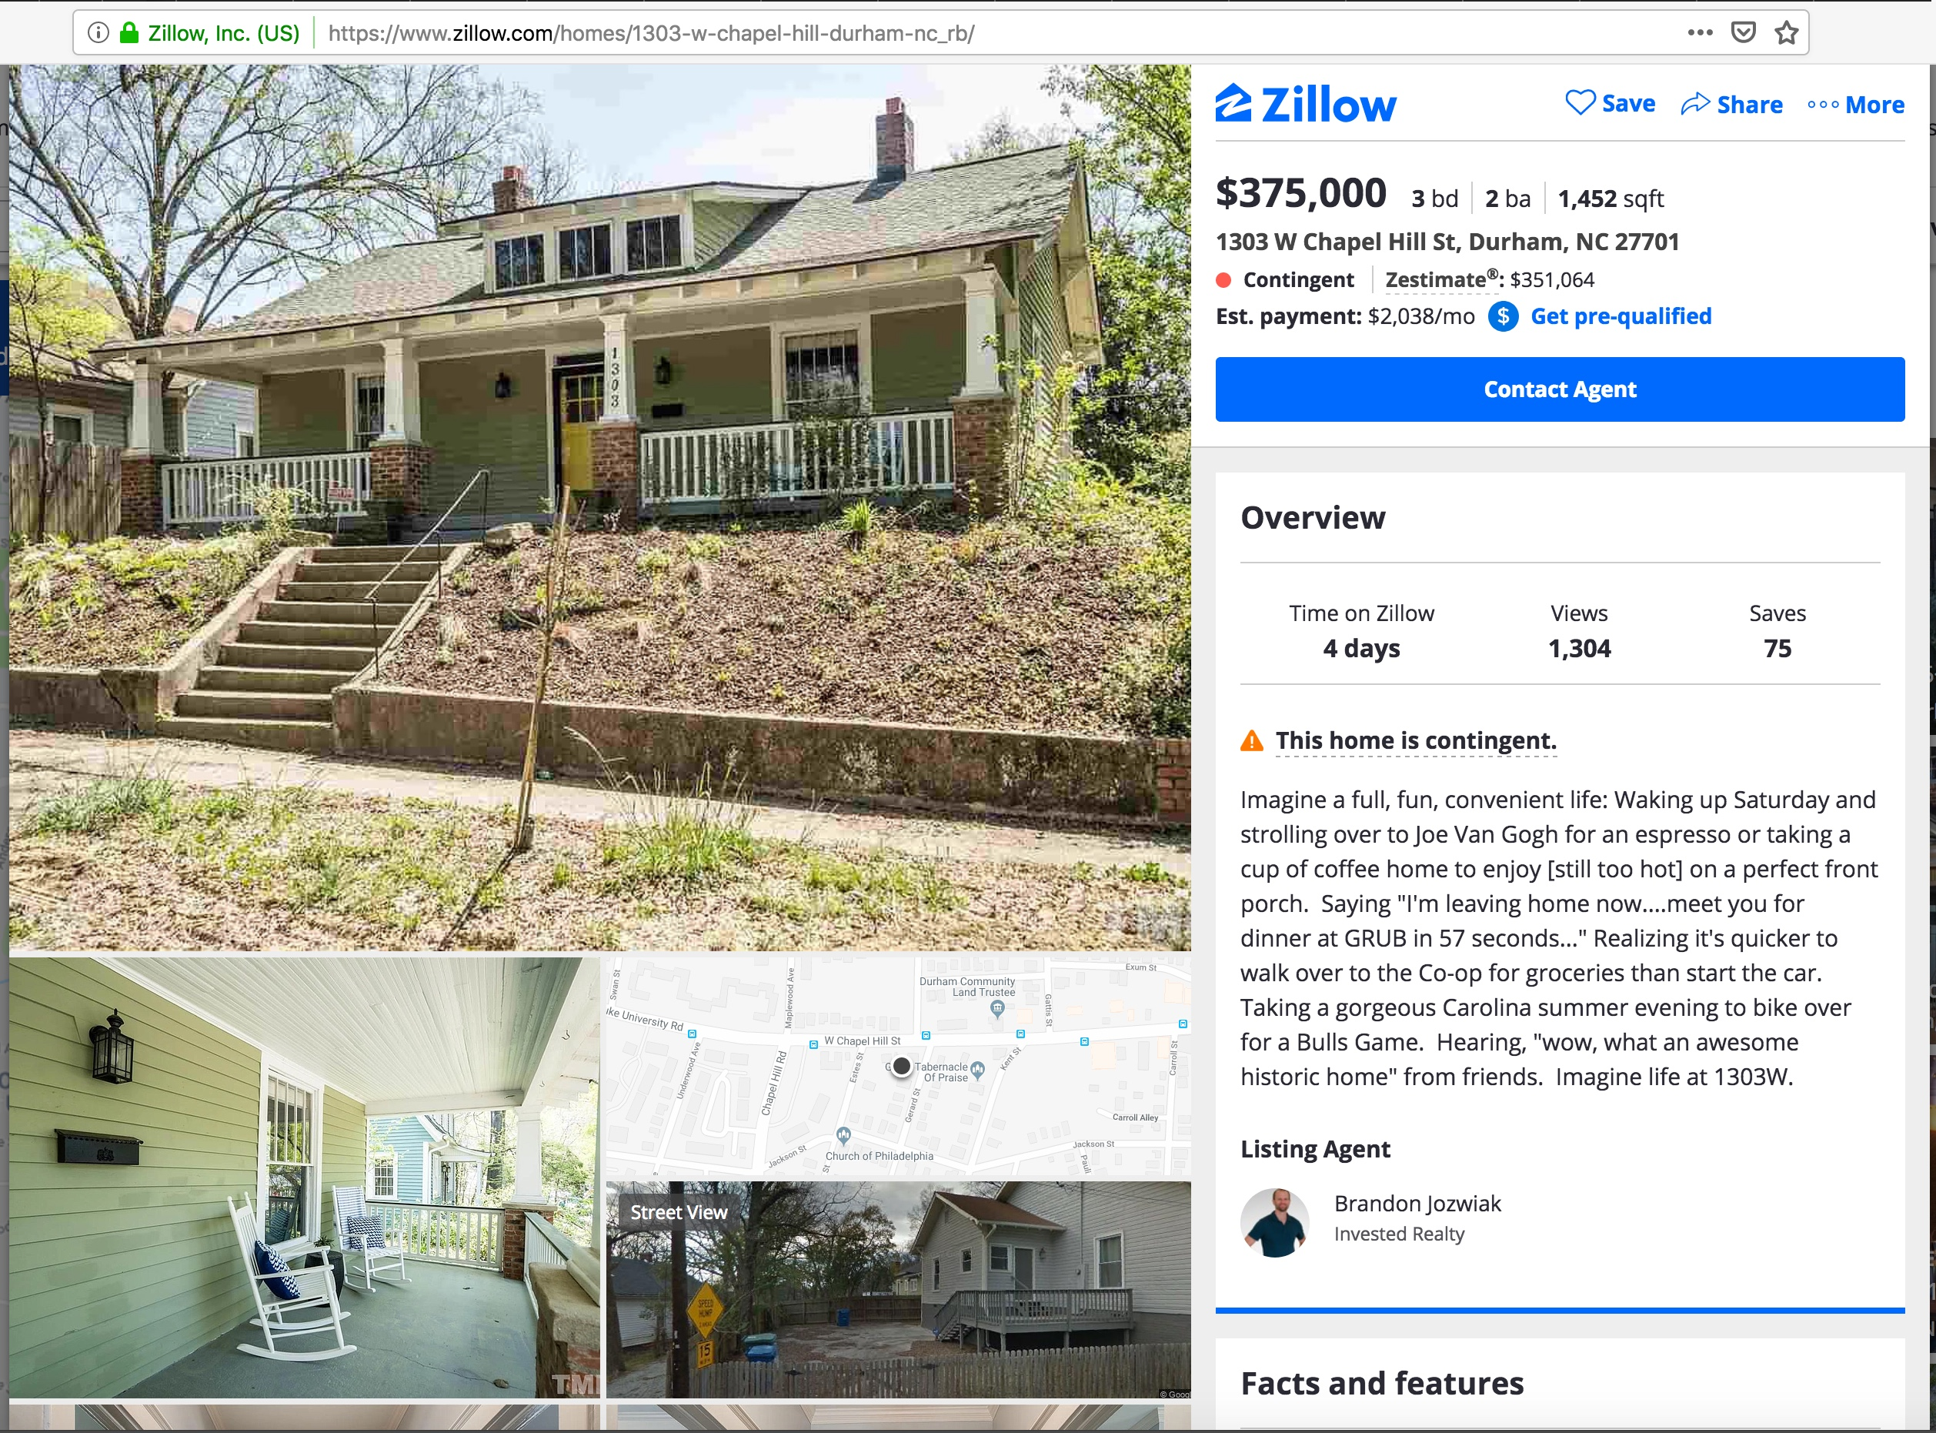
Notes:
Acquiring homes for permanent affordability in neighborhoods was not going to yield scale and would come with lots of deferred maintenance…
By one standard who owns Durham is the result of who buys Durham - and that has a lot to do with who can afford our property. But who owns Durham also has a lot to do with who we target with our marketing, the language we use and the opportunities we present to future owners. This ad seems to include it all - but who is being left out and why?
And shouldn't we all, current and future residents, have the opportunity to imagine a full, fun, and convenient life?

Slide 6
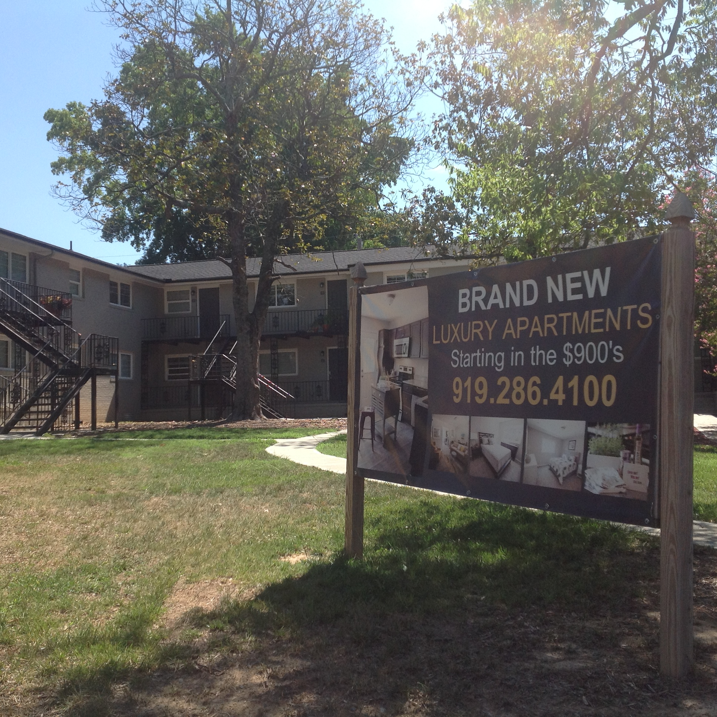
Properties like this one could have been great opportunities for permanent affordability – older, brick construction mid-size apartment buildings.
Notes:
Properties like this one came to be seen as a great opportunity for permanently affordable housing at scale – older, well built but less maintained mid-size apartment buildings. A certain amount of scale at a potentially lower cost, often at the edges of downtown or at least not far from it…but as you can see something was going on there too…

Slide 7
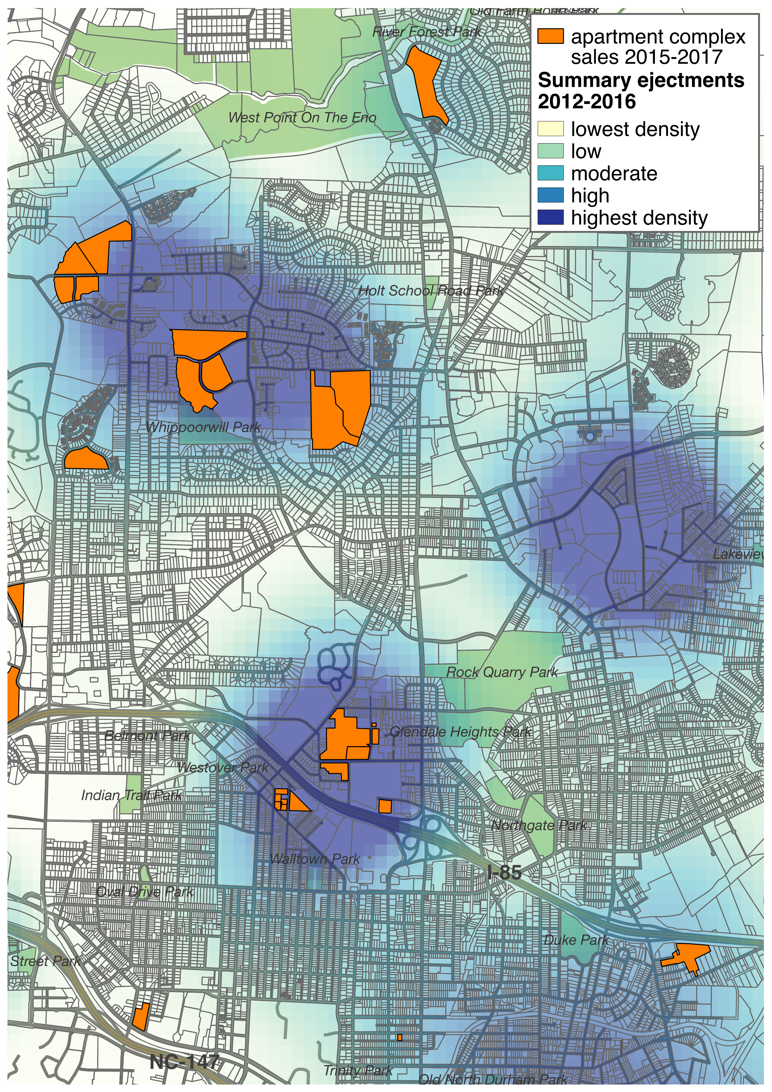
“ ... identifying assets which generate healthy in-place cash flow and strong returns through value-add enhancements characterized by cosmetic upgrades, increased property management oversight, accretive financing, capital improvements, and property repositioning/rebranding.”
http://jemreholdings.com/strategy
Notes:
As we developed a query that could identify these properties we also identified that they have a strong relationship to the volume of evictions happening…then we identified that many of them have been sold in recent years, and to whom…
Inflation-protection through rent appreciation

Slide 8
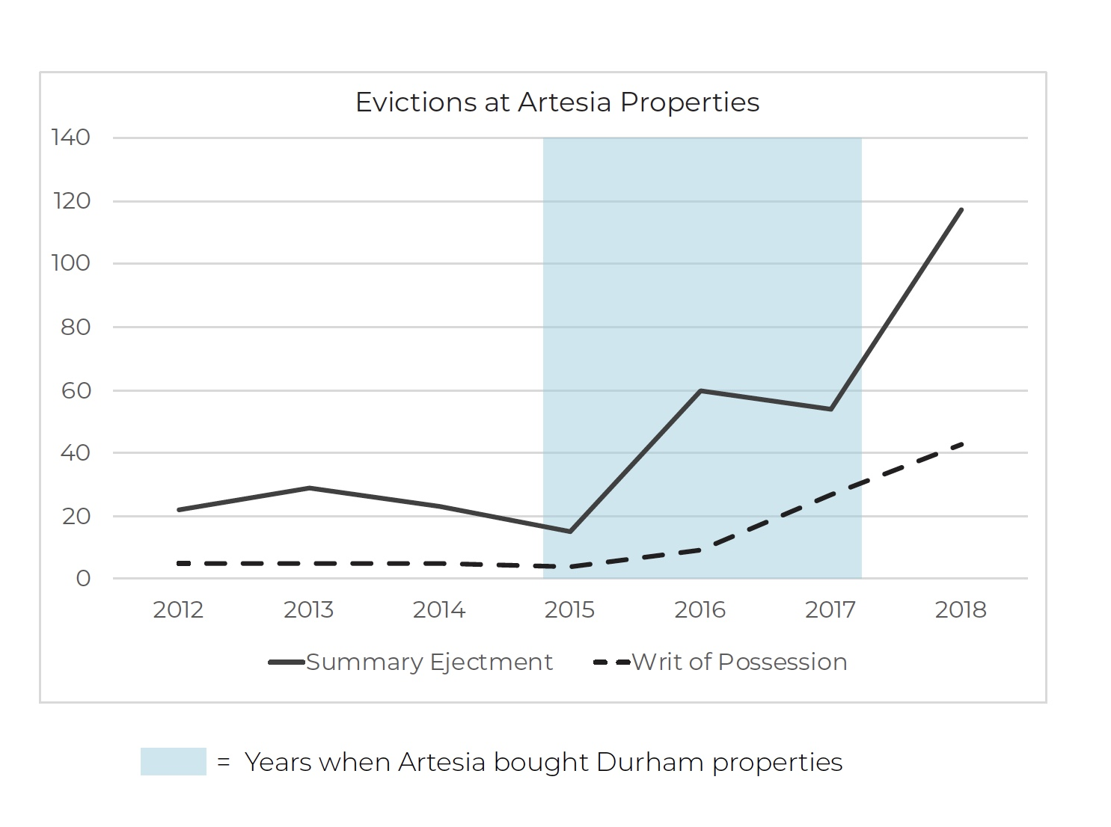
“Our primary focus is Austin, a strong real estate market due to its imbalance of supply and demand fueled by consistent job and population growth.
Our local operating experience allows us to leverage our network of relationships to acquire commercial real estate at attractive pricing and execute quickly.”
http://www.artesia-re.com/

Slide 9
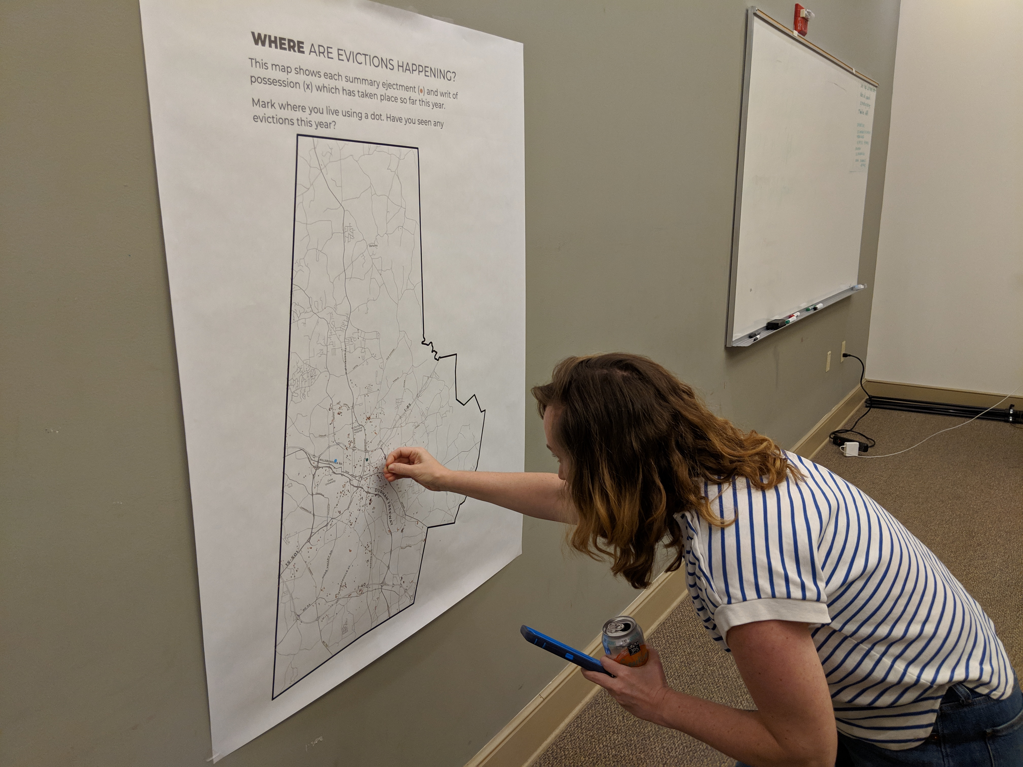
Notes:
The process includes gallery walks featuring maps, charts, new stories and other pieces like what we just saw…

Slide 10
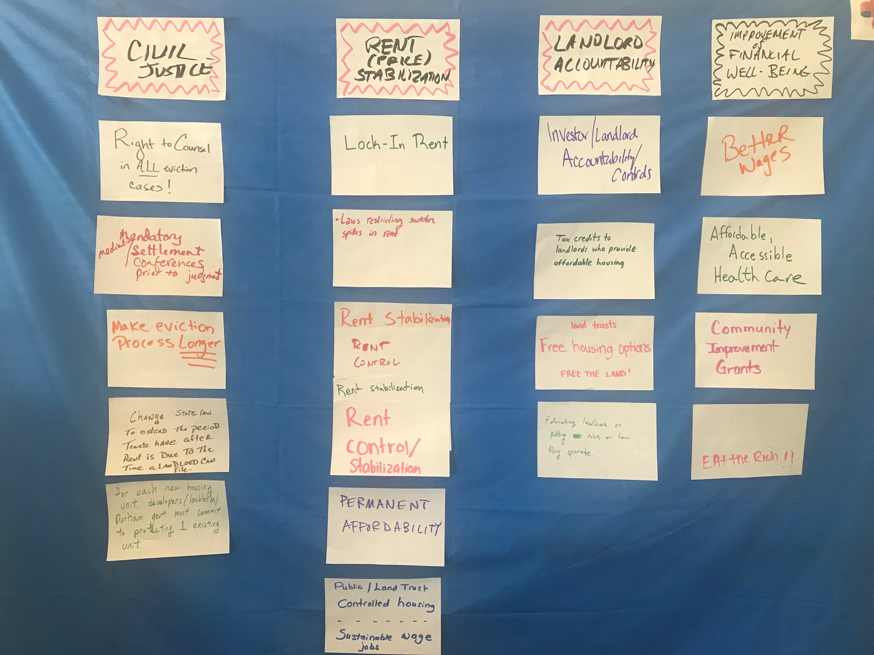
Notes:
Followed by facilitated discussion and small group work on the content and folks’ personal experiences. Technology of Participation (ToP)

Slide 11
“15% of the neighborhood residents surrounding this church work in accommodation and food services. This graph helps us understand how, over time, the wages in this industry have decreased while rents have increased rapidly.”
Notes:
This is an image and text from a recent gallery walk/discussion. The closest we can get to root causes in these conversations the better, which then helps us measure close to root causes on these topics for specific neighborhoods when we work with them…

Slide 12
What Comes Out of This Work?
Articulation of most urgent aspects of housing crisis to our community collaborators;
Knowing what to measure in indicators and other data tools;
Awareness of what visualizations touch people the most (those we’ll start building into data tools);
Opportunity for supporting community members as they develop shared knowledge and strategies.

Slide 13
John Killeen | L’Tanya Durante | Libby McClure | Tim Stallmann
https://www.dataworks-nc.org
919.681.2063

