Slide 1
NNIP Data Inventory & SNIP Score Update
SONIA TORRES RODRÍGUEZ
DECEMBER 2020

Slide 2
Local data is central to the NNIP mission
Local data should be…
Small Geography Tract, Block Grp, Zip, Parcel
Recurring & Up-to-Date
2

Slide 3
Value of the Data Inventory
Self-assessment for partners
Improve the network
Identify cross-site opportunities
Further the NNIP mission
Health
Vital Stats
Crime
Housing
Notes:
We have done the data inventory for 24 years !!! (back to 1996)

Slide 4
Thank you partners for updating your inventories this year!
Atlanta
Austin
Baltimore
Boston
Cleveland
Chicago
Dallas
Denver
Detroit
Durham
Grand Rapids
Houston
Indianapolis
Kansas City
Los Angeles
Miami
Milwaukee
Minneapolis
New Haven
New Orleans
New York
Philadelphia
Pinellas County
Pittsburgh
San Antonio
Seattle
St. Louis
Washington, DC
4

Slide 5
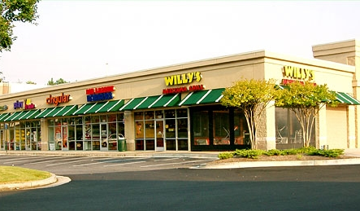
What is SNIP?
Small-geography Neighborhood Indicator Performance (SNIP) Components:
Vital Stats
Crime and Public Safety
Distressed Property
Child Health
School Enrollment
Adult Health
Property Data
Business Licenses
Home Sales
Public Assistance

Slide 6
Methodology
Neighborhood Data Must Be…
Held “in-house”
Small geography
Parcel, Block Grp, Tract, Zip, other “neighborhood”
Recurring & recent as of at least the year →
Point awarded when all conditions are met
Recent As Of… | Data Element
2019 | Part 1 Crime
 | Property Characteristics
 | Home Sales
 | Distressed Property
2018 | Child Health
 | Adult Health
 | Public Assistance
 | Business
 | Schools
2017 | Vital Stats

Slide 7
How NNIP Partners Score
Max Score = 9

Slide 8
NNIP’s most common up-to-date neighborhood data

Slide 9
Crime and Public Safety Snapshot
Opportunities:
Prison population
Jail population
Sentencing
Complaints about police conduct
Notes:
New Inventory Updates were added last year, and a few of those indicators were in crime and public safety

Slide 10
Nice job D3!
Highest SNIP Score (9)
Notes:
Monument to Joe Louis in Detroit’s Hart Plaza

