Slide 1
Coding to Create 100+ Visualizations with the click of a button
Paulina Cano McCutcheon

Slide 2
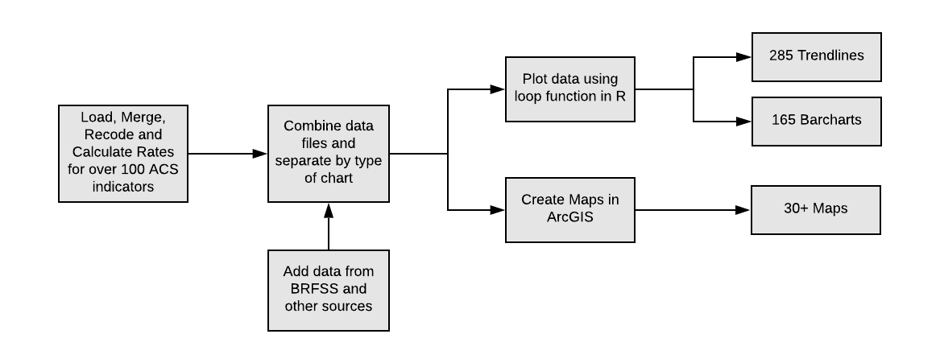
Integrating Automation into ACS Processing

Slide 3
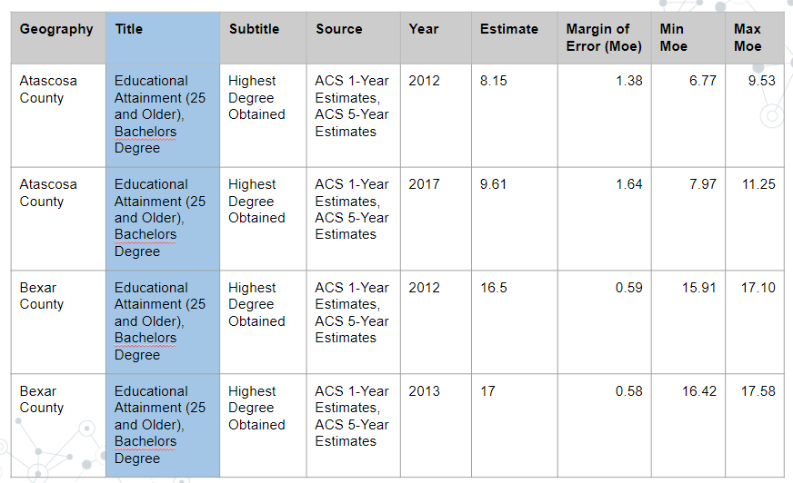
Example of File Generated for Trendlines

Slide 4
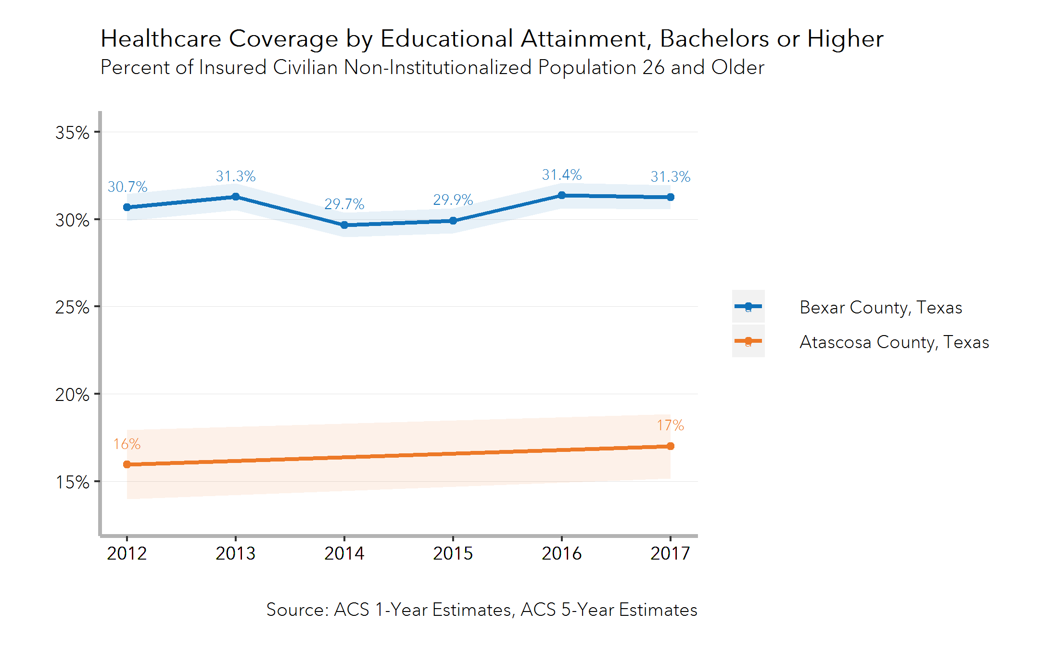
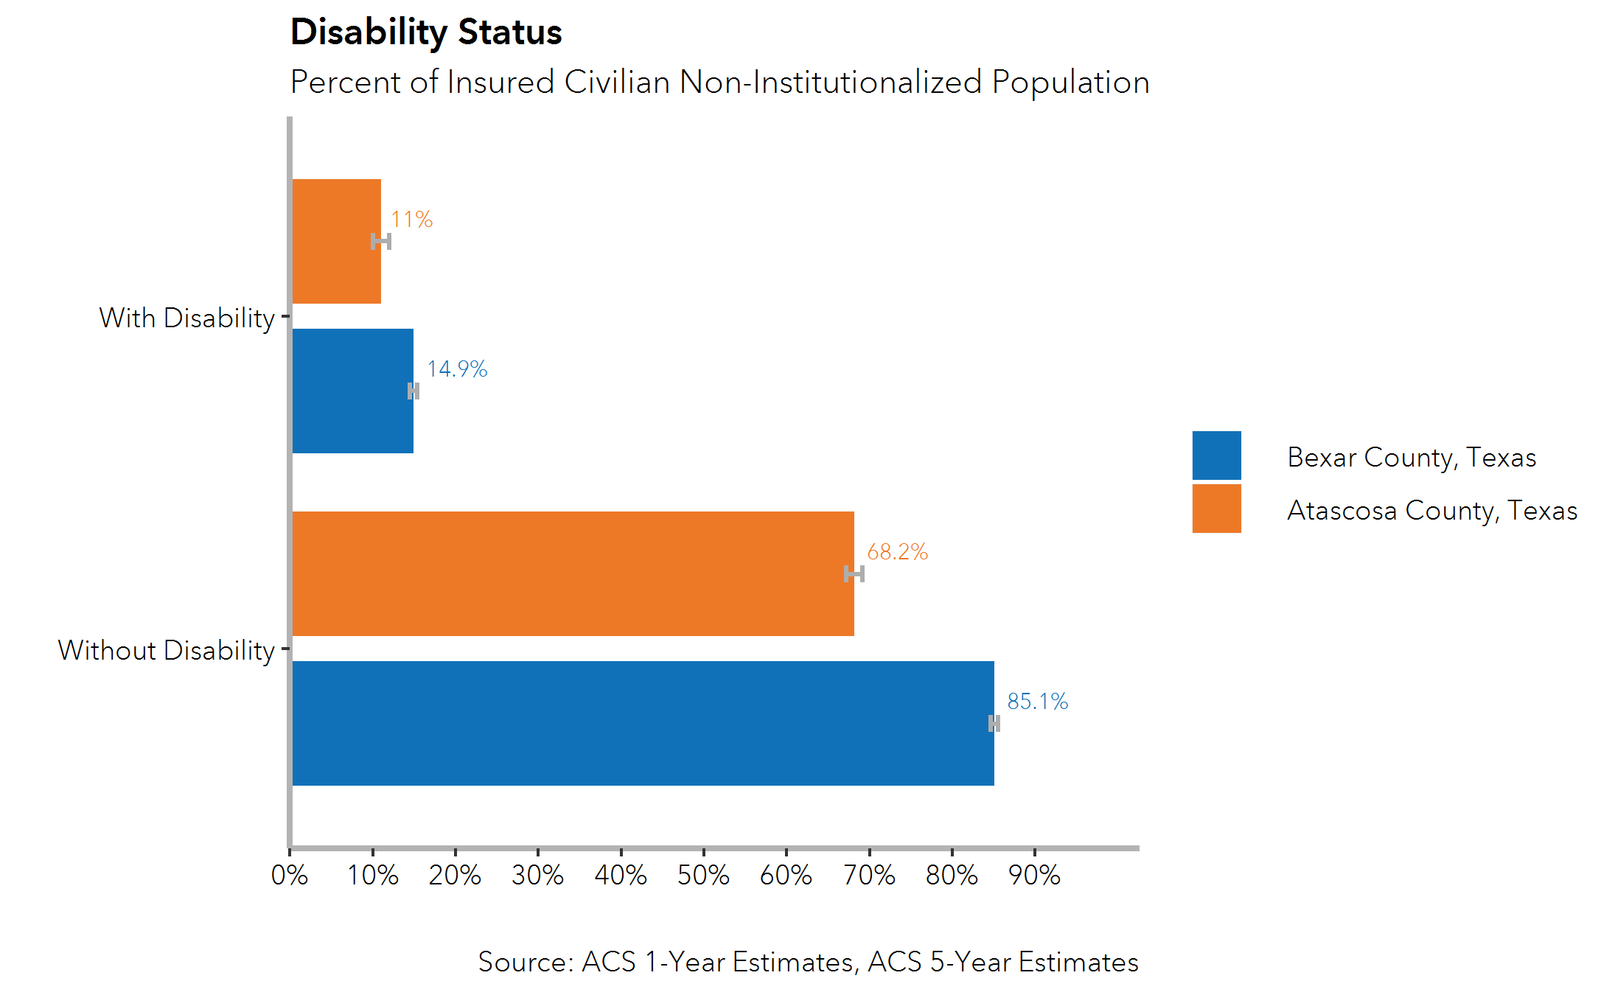
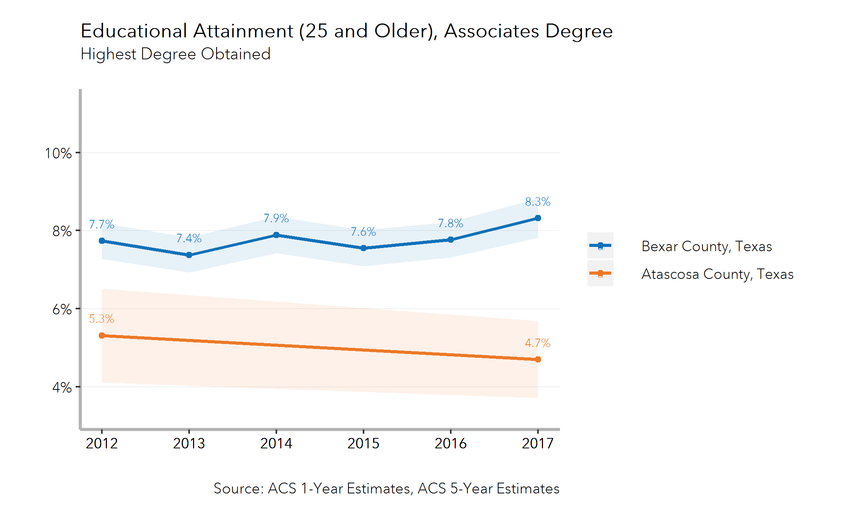
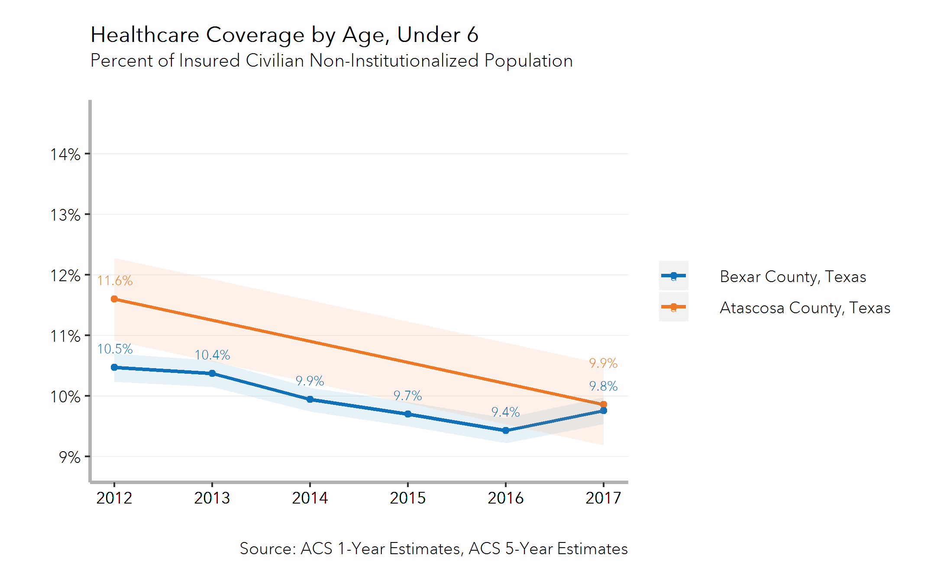
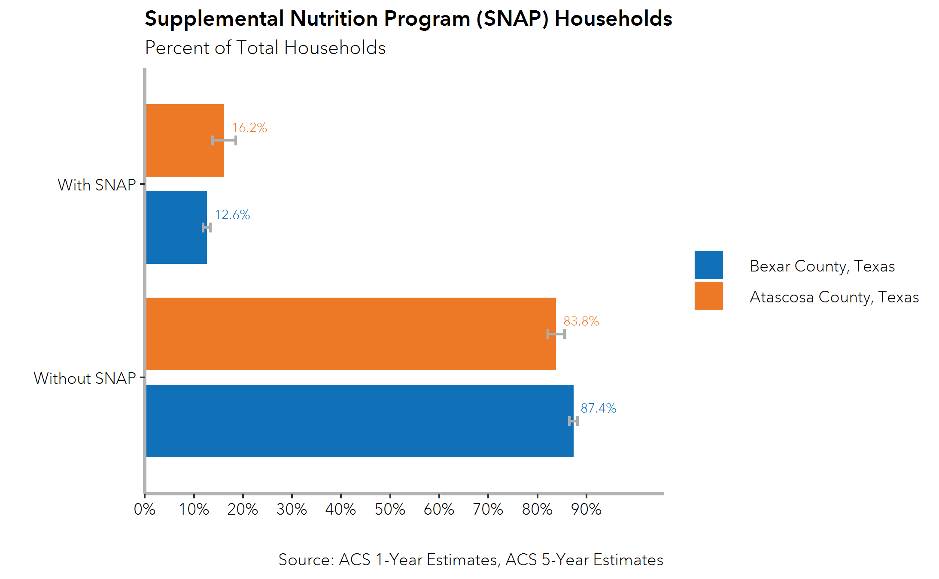
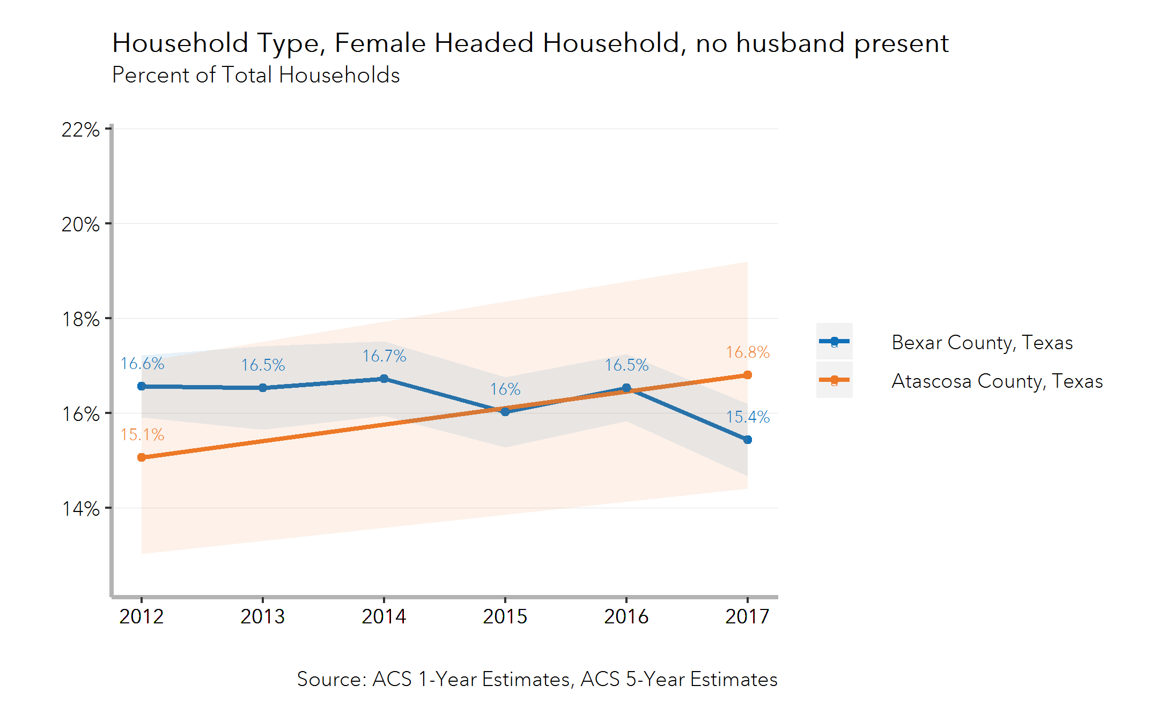
Output

Slide 5
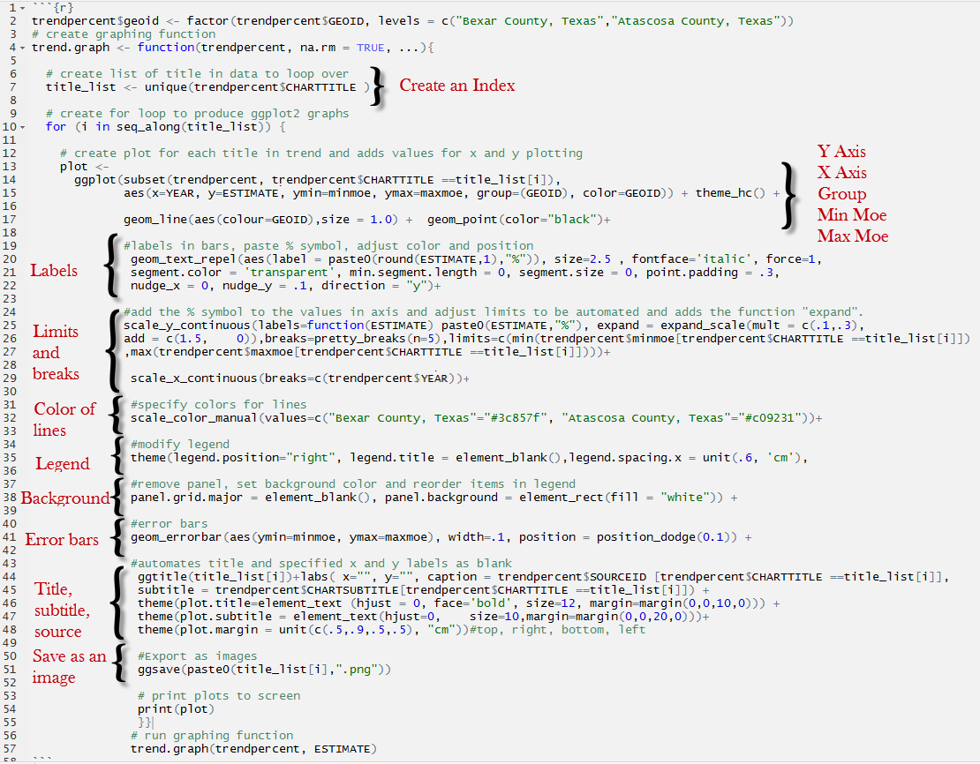
R Loop
Create Index
Add R function “for” to generate a loop
Customize:
X and Y axis, labels, limits and breaks, colors of the lines, legend, background, error bars, title, subtitles and source

Slide 6
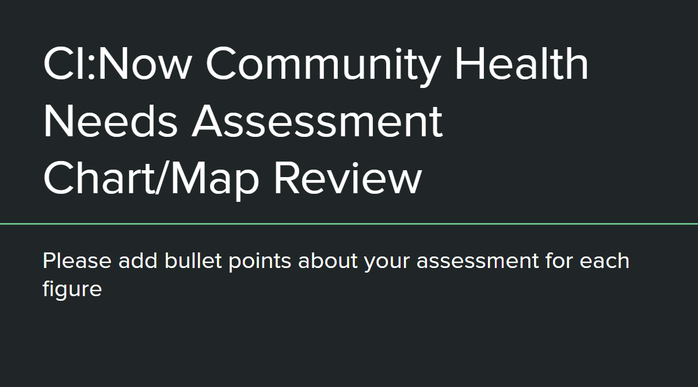
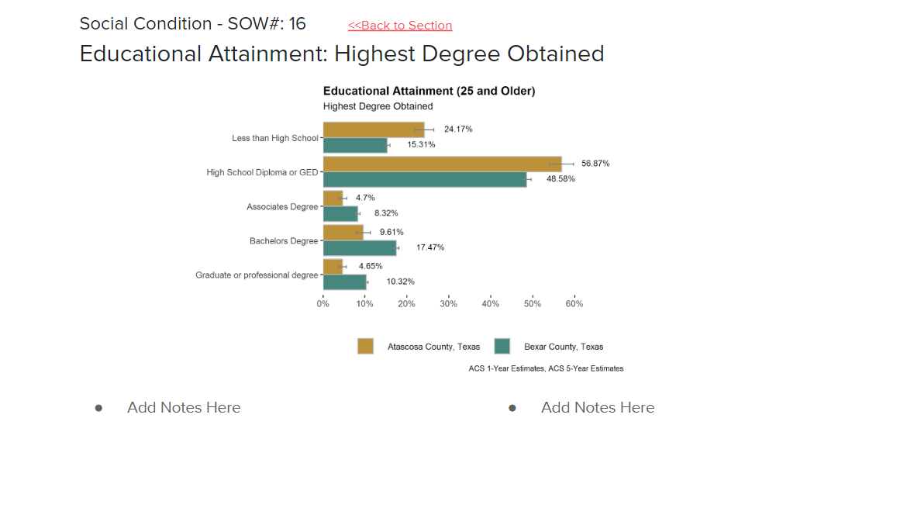
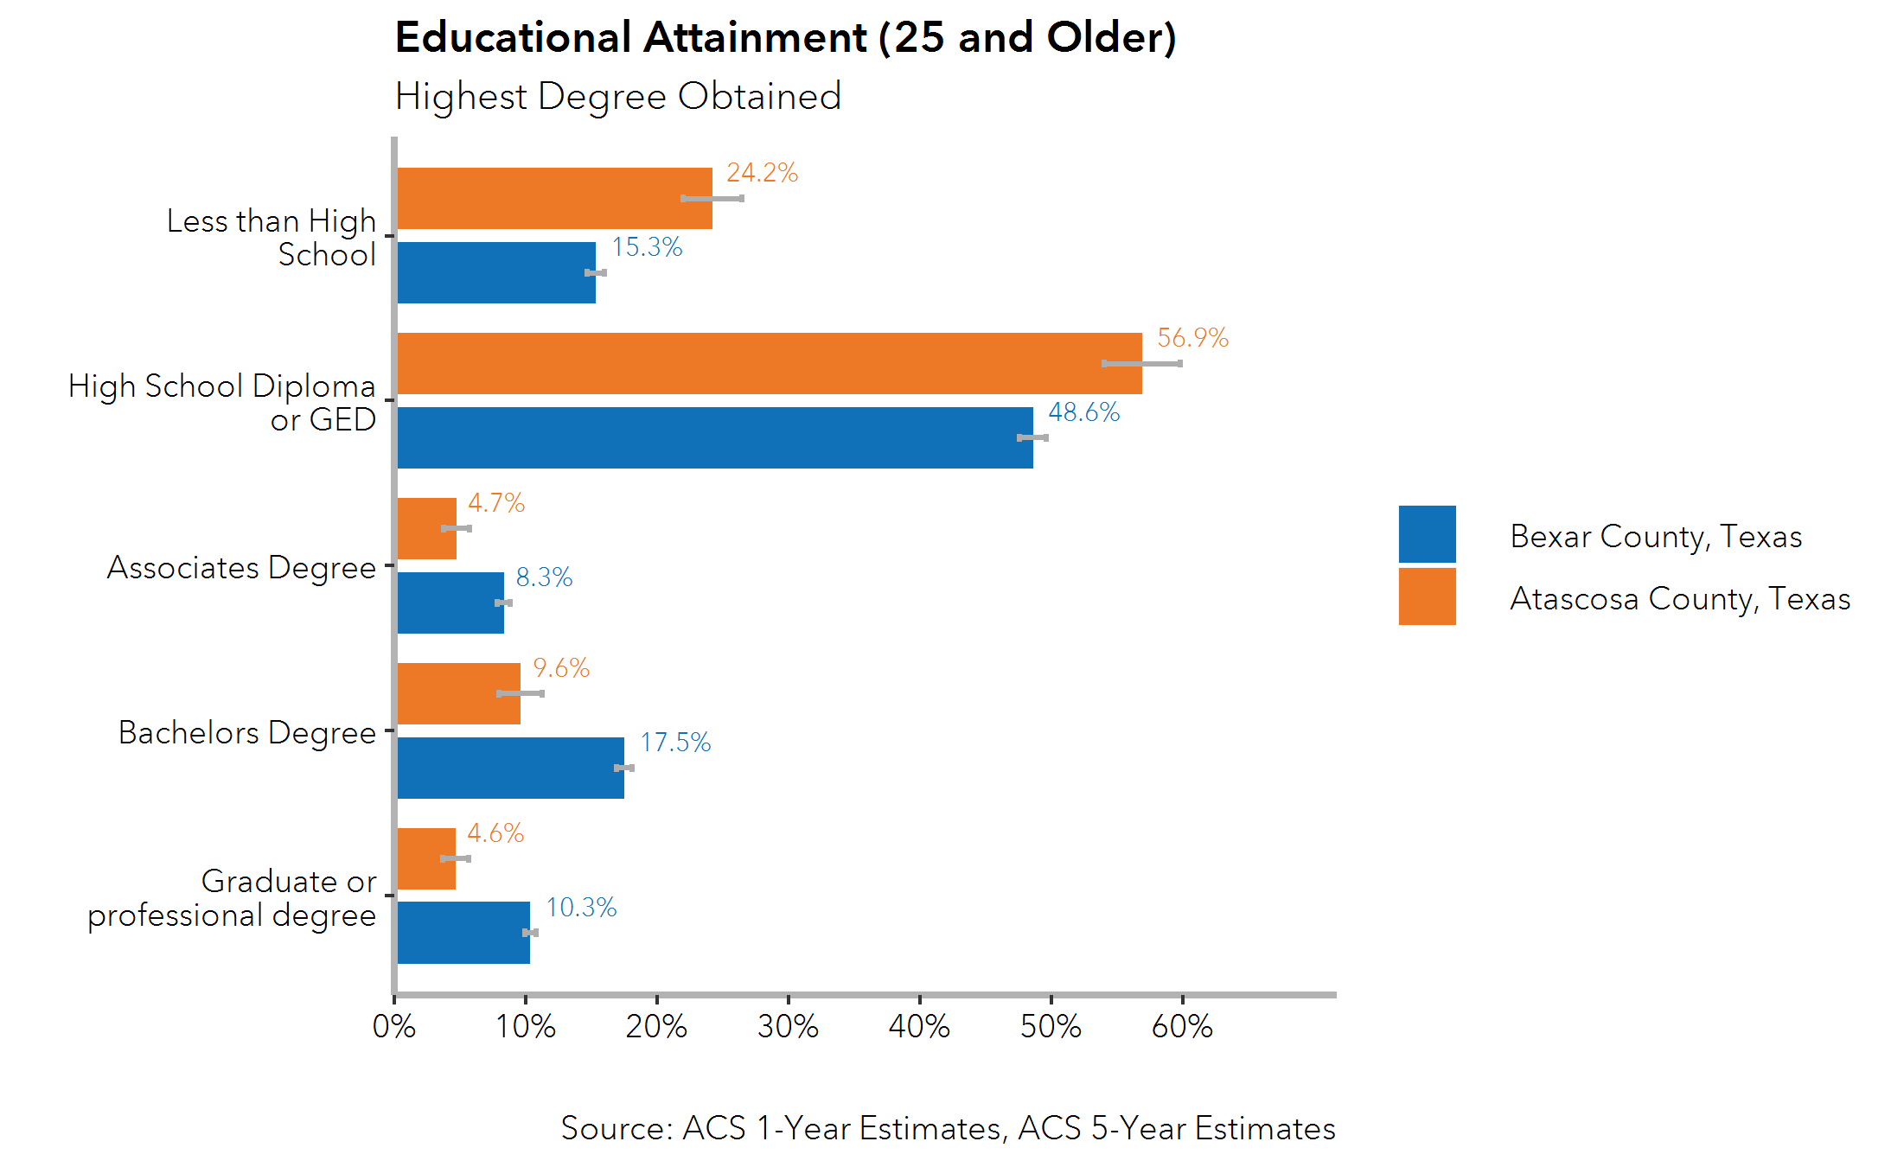
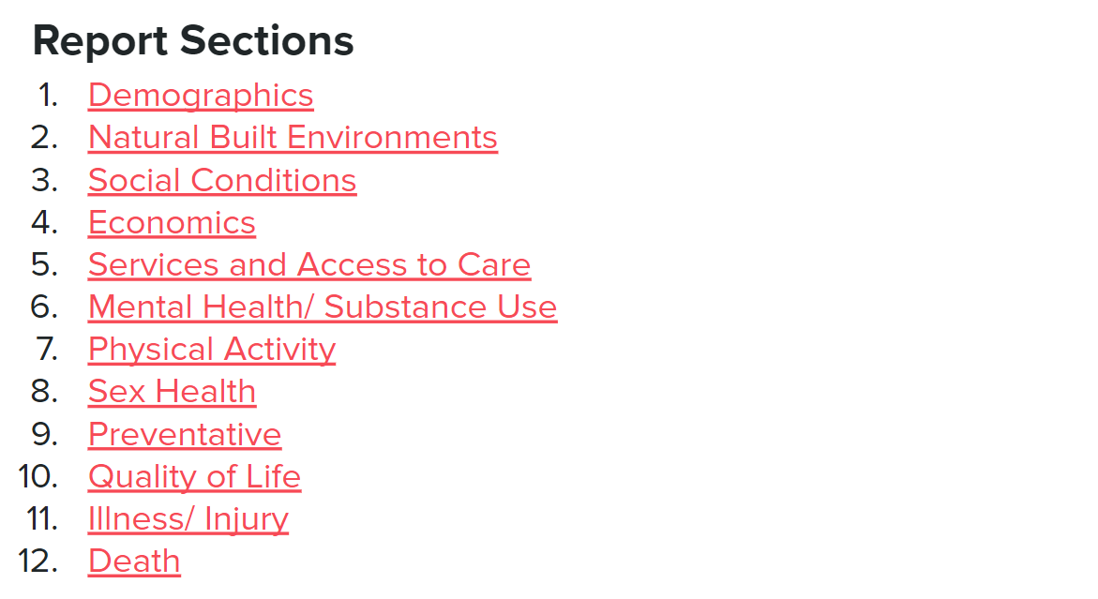
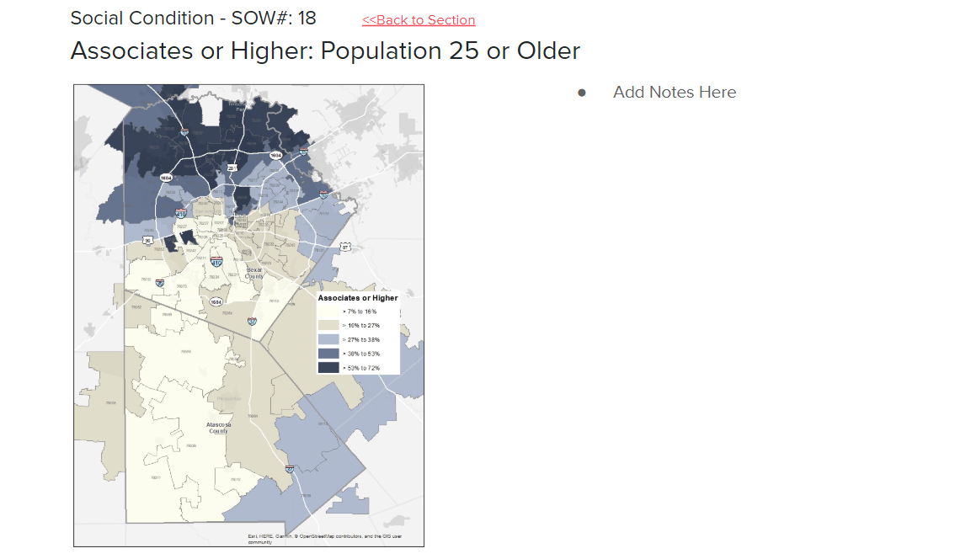
Reviewing Plots and Maps using Google Slides

Slide 7
Thank you
Paulina Cano McCutcheon
Email:
Paulina.CanoMcCutcheon@uth.tmc.edu
Twitter:
@CINow @PaulinaCMcC

