Slide 1
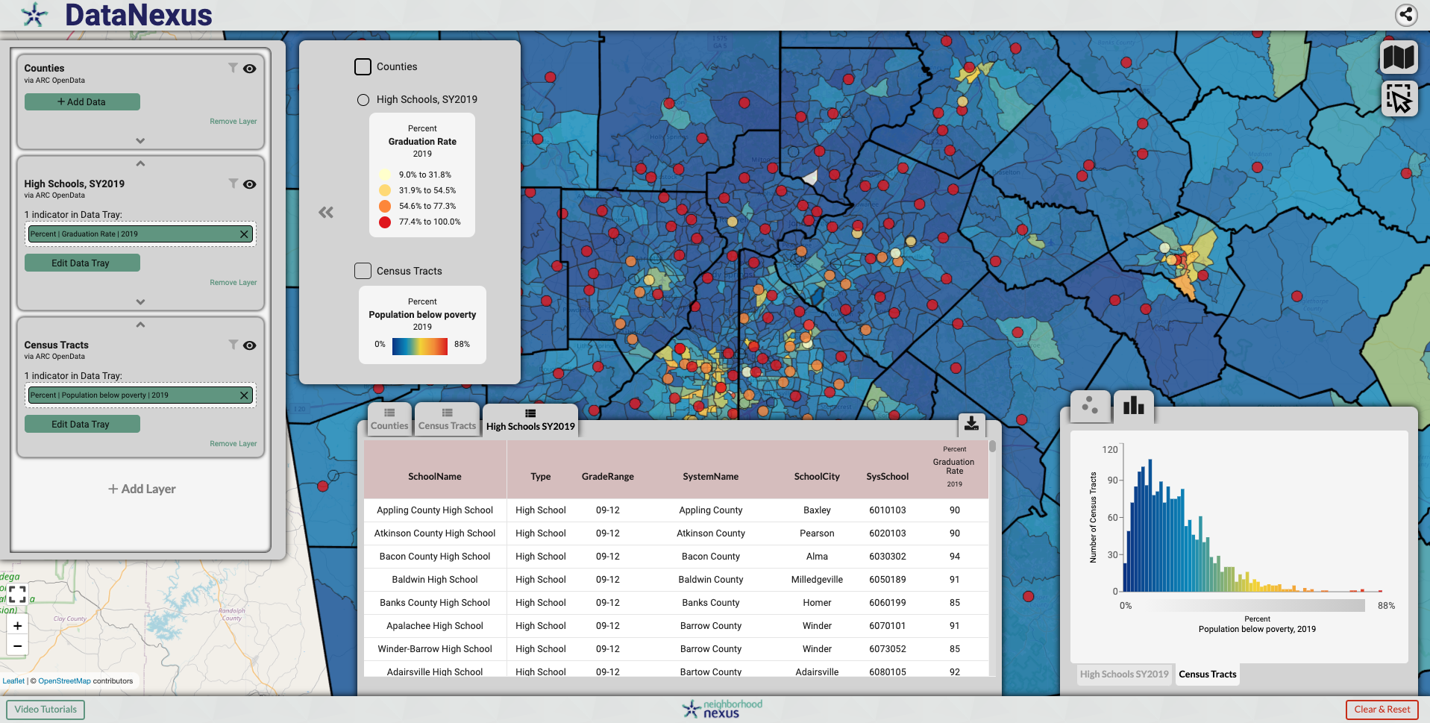
Making Mapping and Data Visualization Free, Easy, and Accessible
Presented by Erik Woodworth Research & Application Development Lead Data Scientist, Neighborhood Nexus
ewoodworth@atlantaregional.org
NNIP Showcase
May 25th, 2021
data.neighborhoodnexus.org

Slide 2
A Matter of Necessity
Usability and cost barriers to existing mapping and data visualization tools like Tableau and ArcGIS Online
Need for nonprofits, community stakeholders, and advocates to tell their stories using accurate, current, and easily customizable maps and data visualizations
Our previously reliable (albeit somewhat cumbersome) application, Weave, has been made obsolete by the fact that Flash, upon which it was built, is no longer supported by modern browsers

Slide 3
Our options
Pay a consultant to build a new application which can do all the things that the previous application could along with some additional features, keeping in mind that the previous application cost $250K to build and was paid for by consortium of organizations with philanthropic money
Leave a huge gap in our data empowerment work and the toolset we’ve built for various partners
Build it ourselves!

Slide 4
How we (are) buil(ding) DataNexus
Expanded our internal capacity by putting me through a 6- month full-stack coding bootcamp at Georgia Tech in winter of 2018
Built a number of small mapping and data visualization applications
Built a larger prototype mapping and data visualization application
Compiled feedback on the prototype
Spent the next year or so building the non-prototype application from the feedback
Released a beta version to partners and other users
Compiled more feedback
Hired some assistant developers to expand on development capacity
Released a full version in February 2021
Continue to add features, make upgrades, and fix bugs

Slide 5
How we (are) buil(ding) DataNexus
Expanded our internal capacity by putting me through a 6- month full-stack coding bootcamp at Georgia Tech in winter of 2018
Built a number of small mapping and data visualization applications
Built a larger prototype mapping and data visualization application
Compiled feedback on the prototype
Spent the next year or so building the non-prototype application from the feedback
Released a beta version to partners and other users
Compiled more feedback
Hired some assistant developers to expand on development capacity
Released a full version in February 2021
Continue to add features, make upgrades, and fix bugs

Slide 6
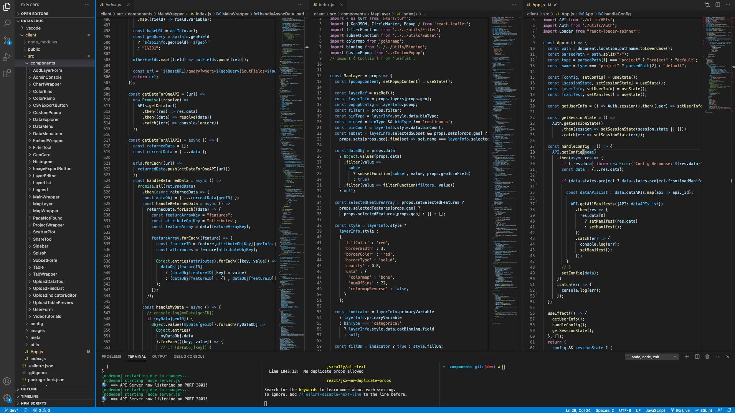
React
Notes:
With the exception of the cost of hosting the application and database, all of these technologies, frameworks, libraries, and languages are free to use!

Slide 7
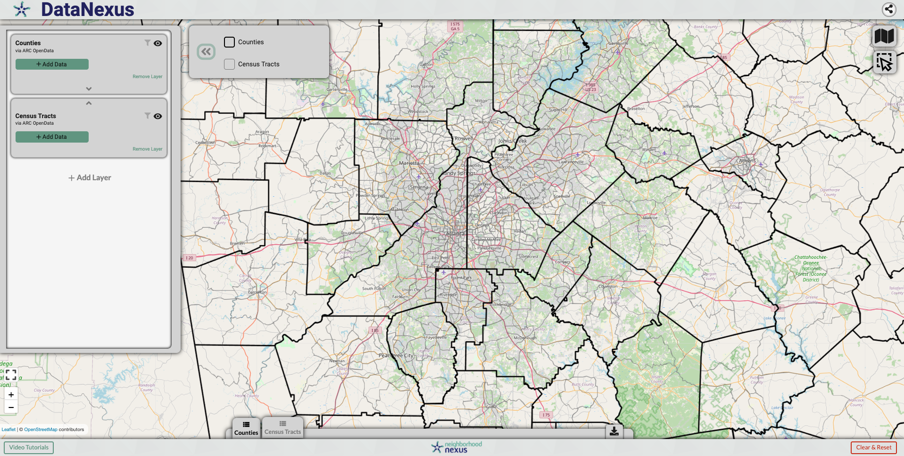
Notes:
Database configuration

Slide 8
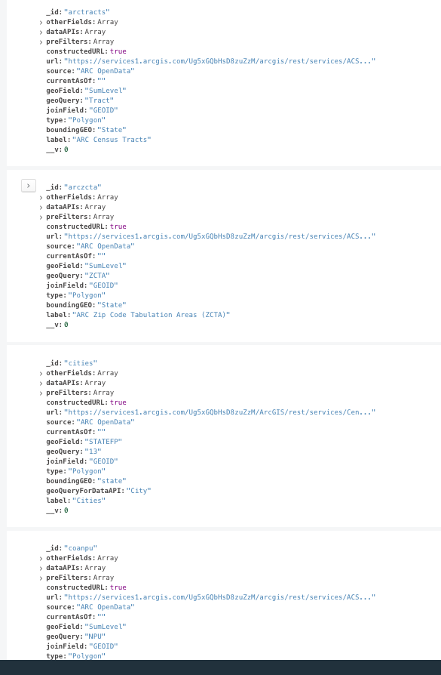
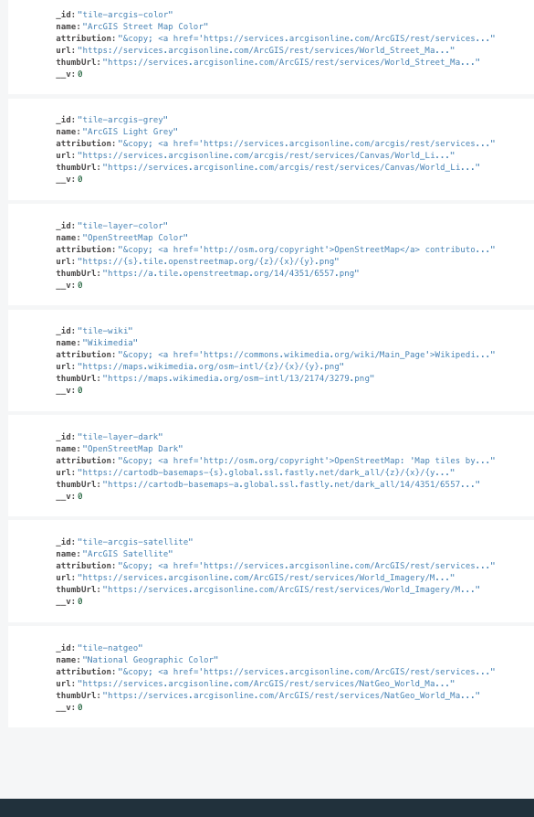
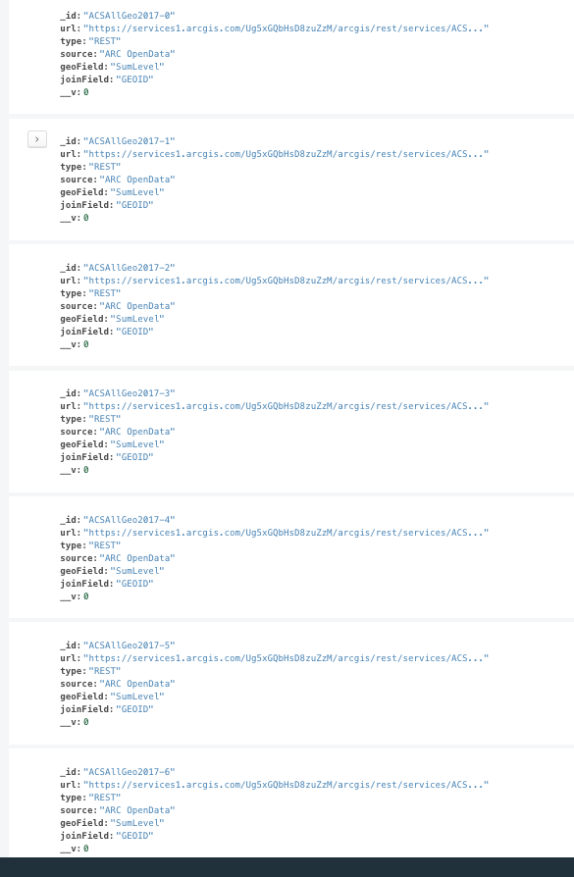

Slide 9
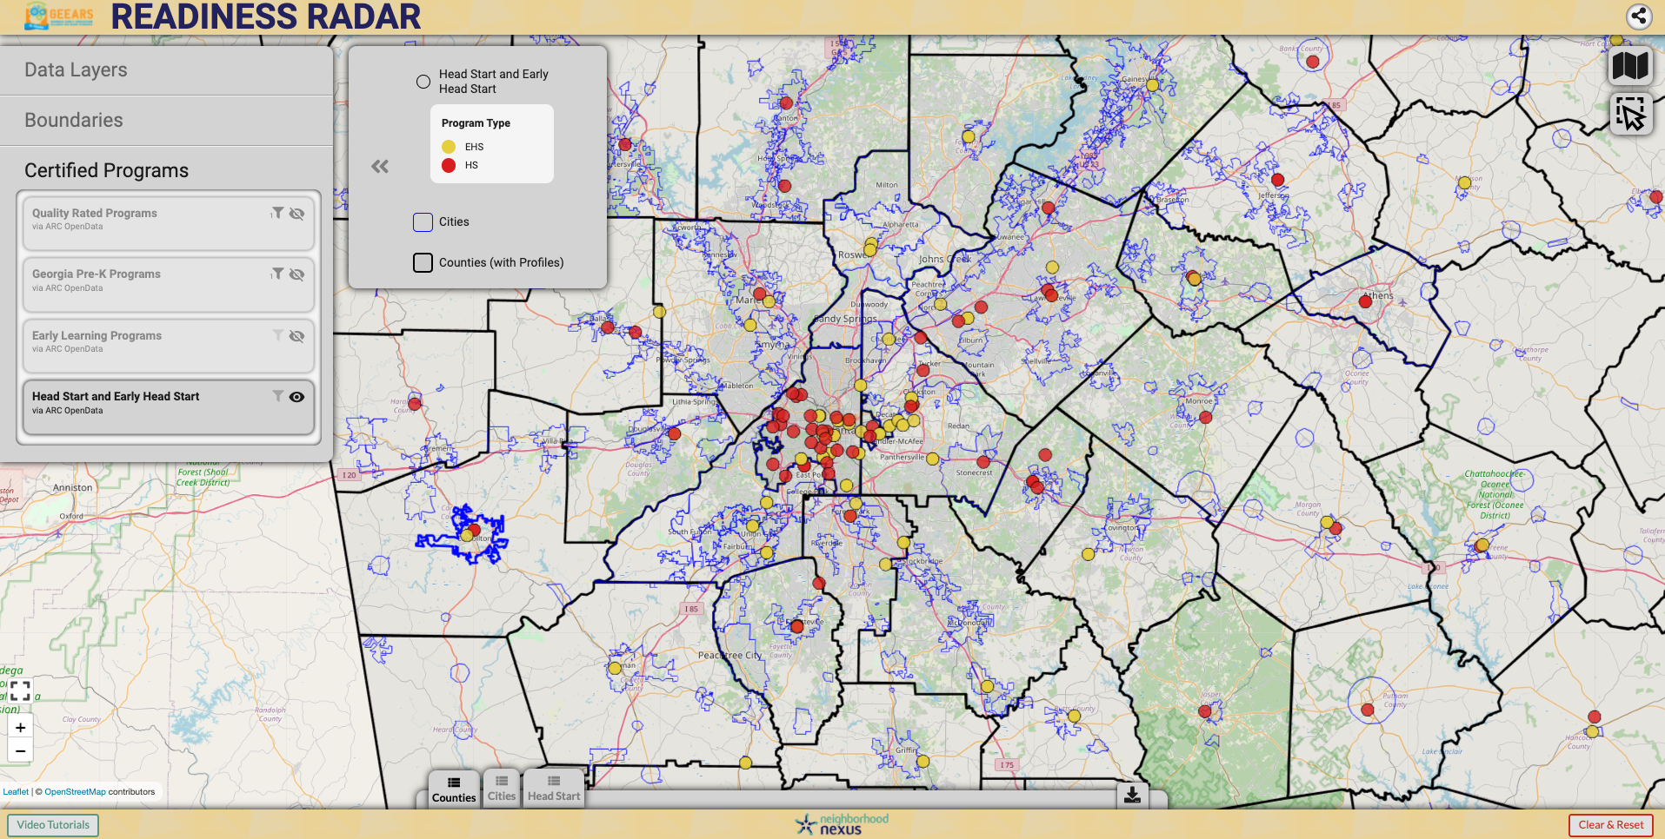

Slide 10
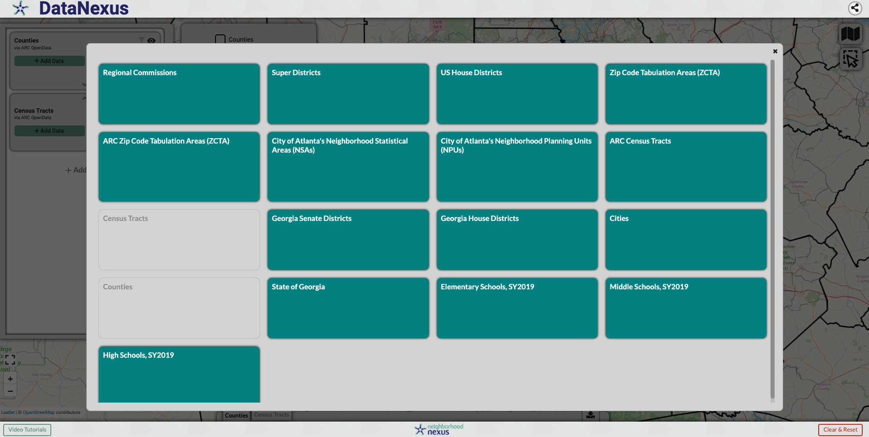
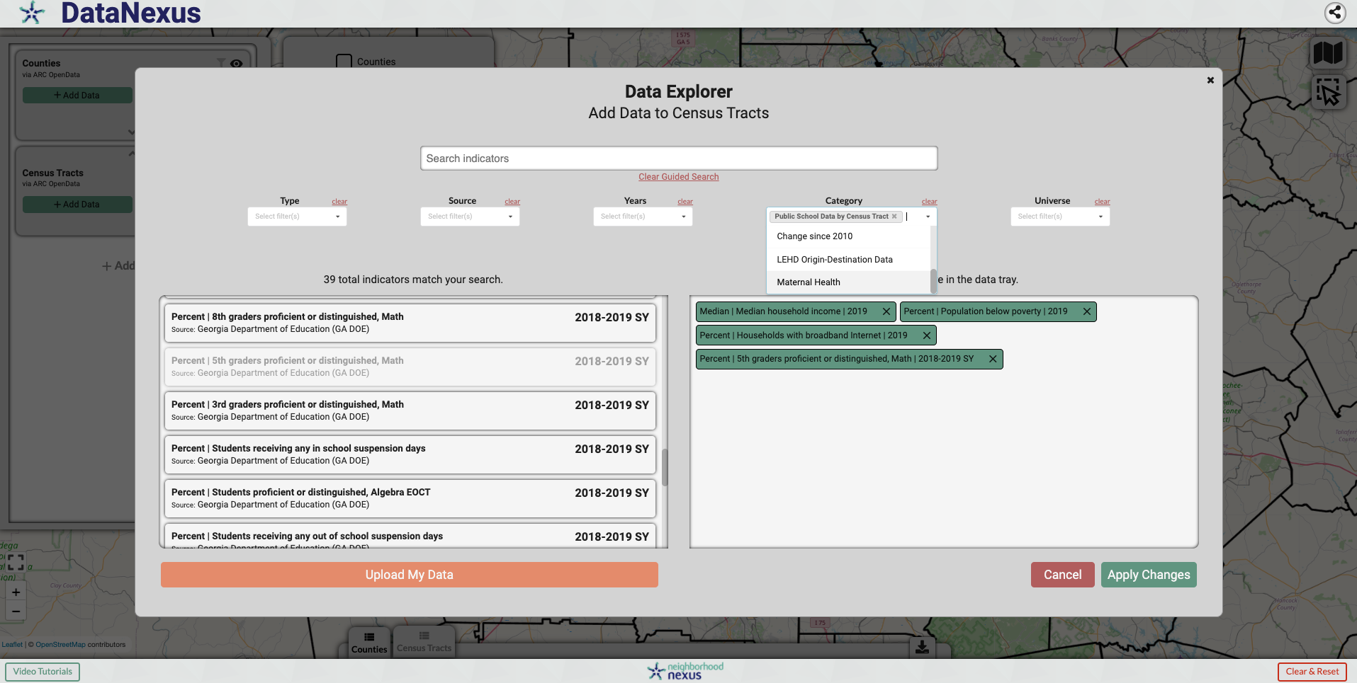
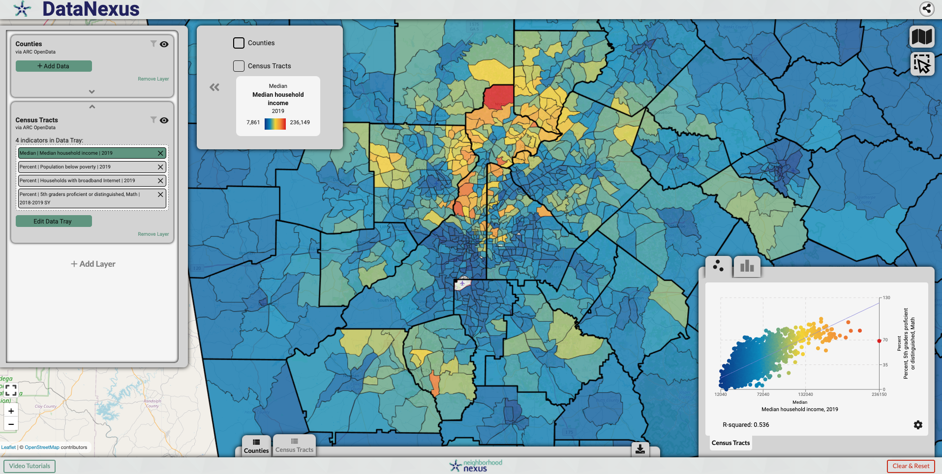
Adding
Layers & Data
data.neighborhoodnexus.org

Slide 11
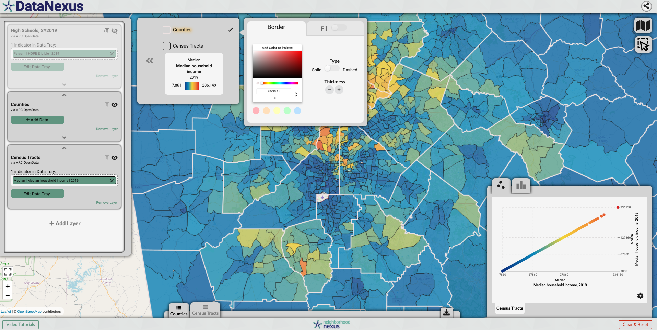
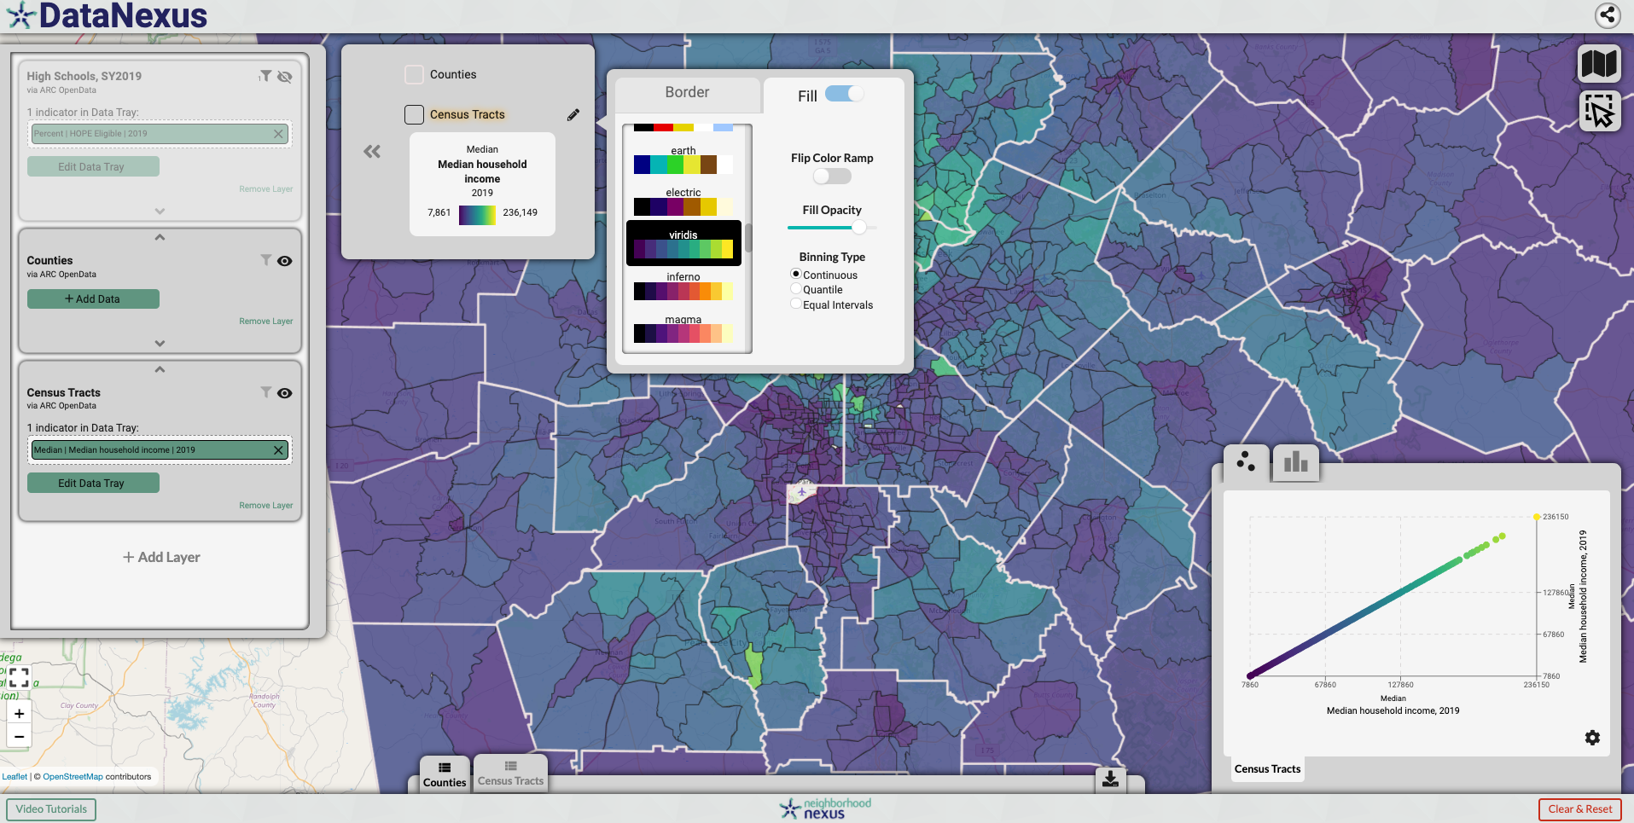
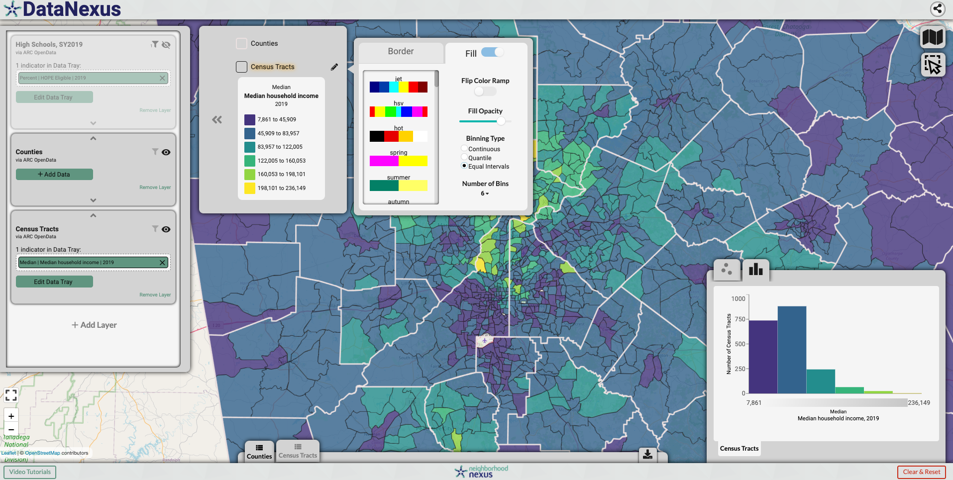
Styling Layers
data.neighborhoodnexus.org

Slide 12
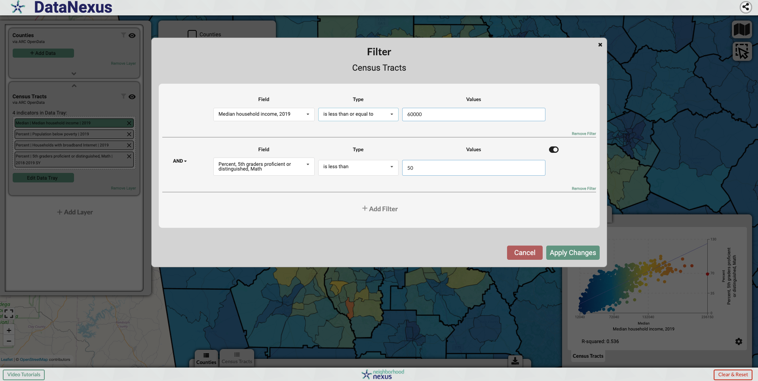
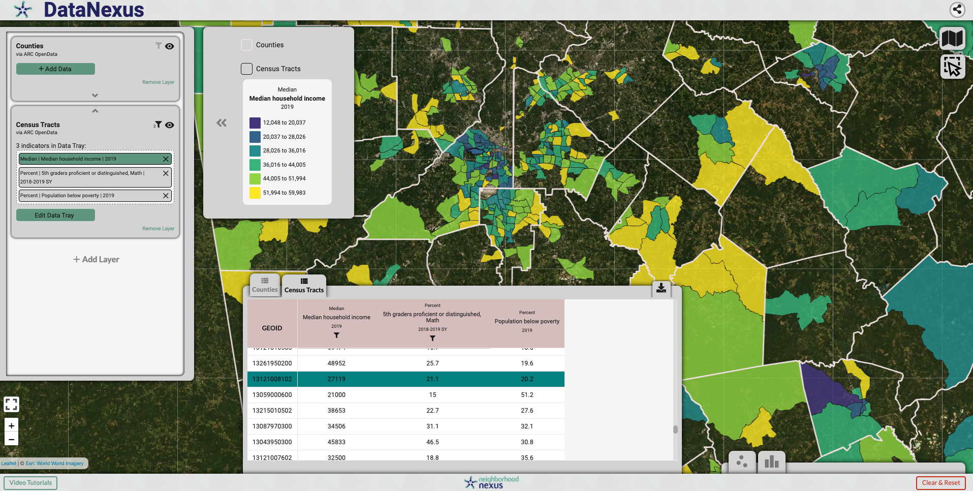
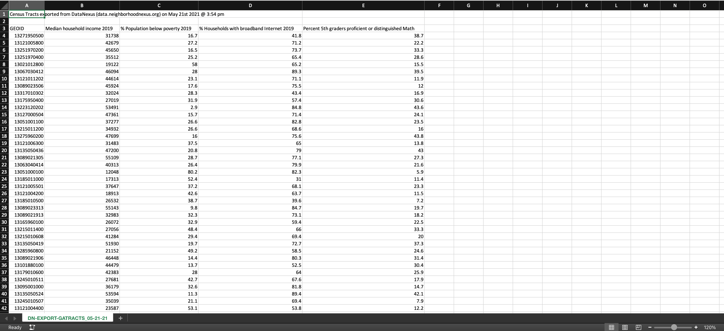
Filtering
& Exporting
data.neighborhoodnexus.org

Slide 13
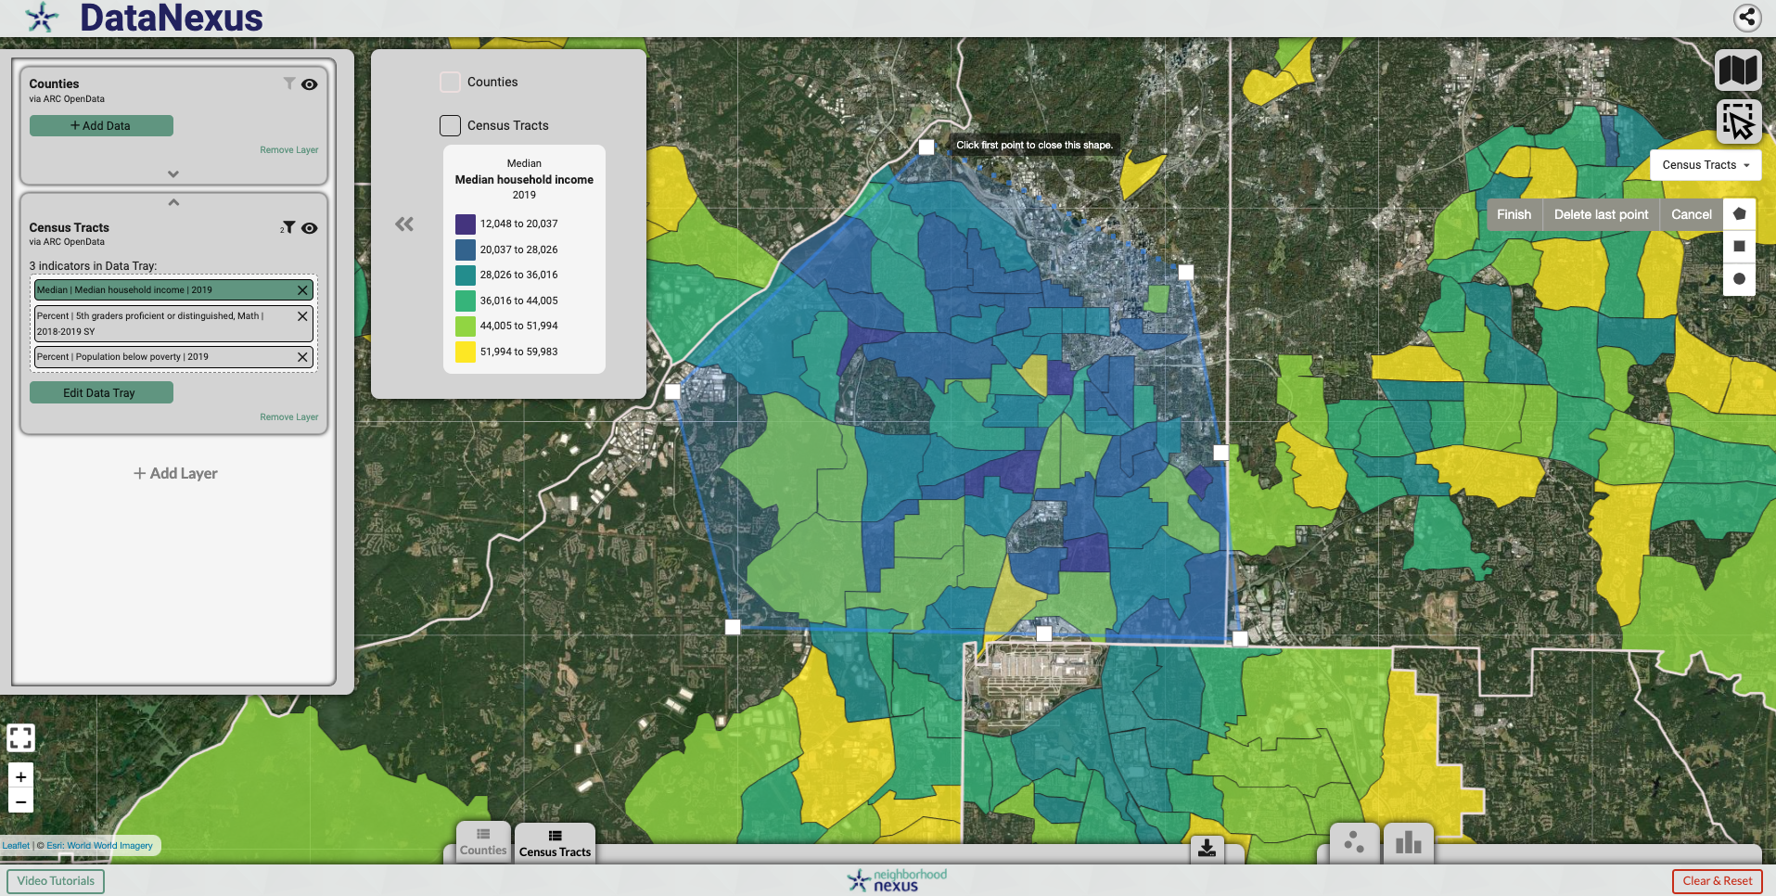
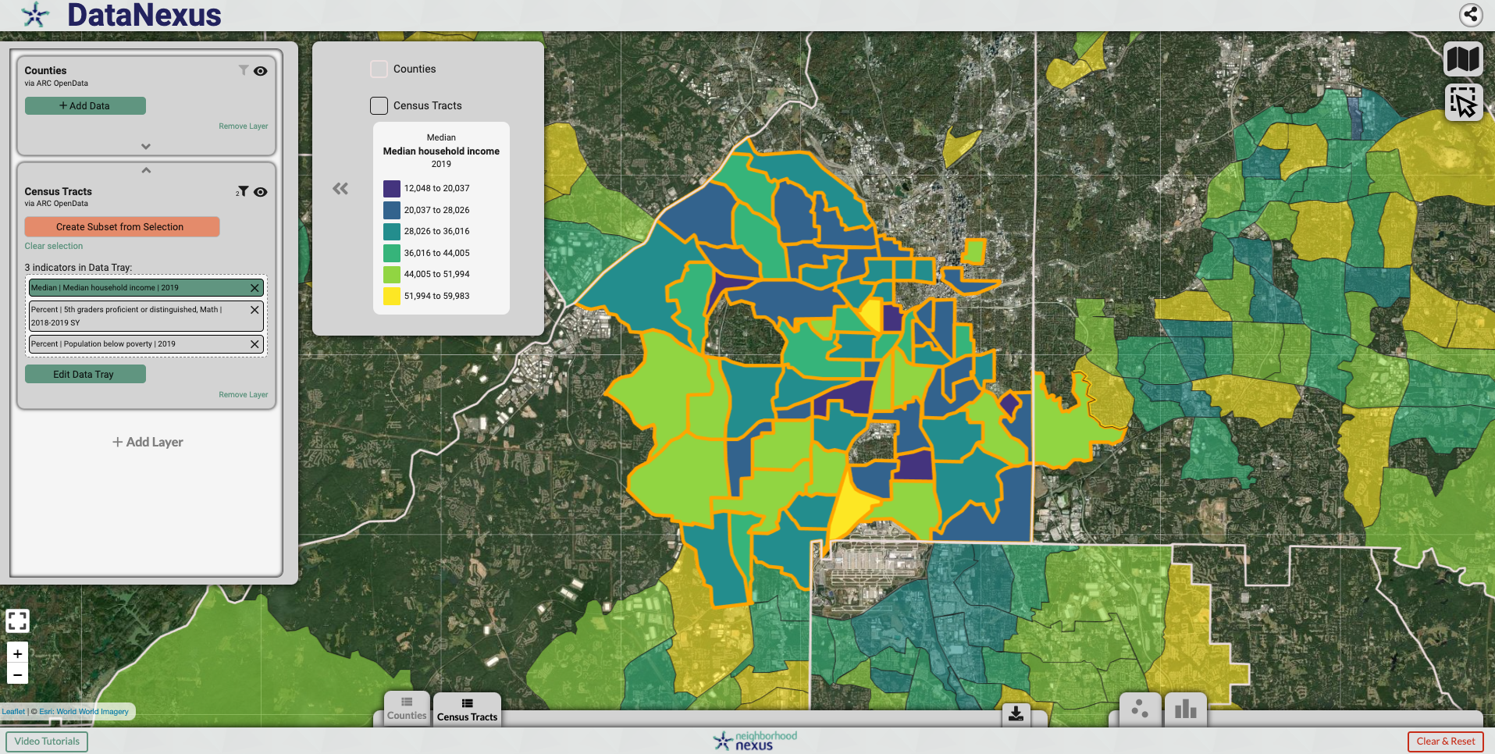
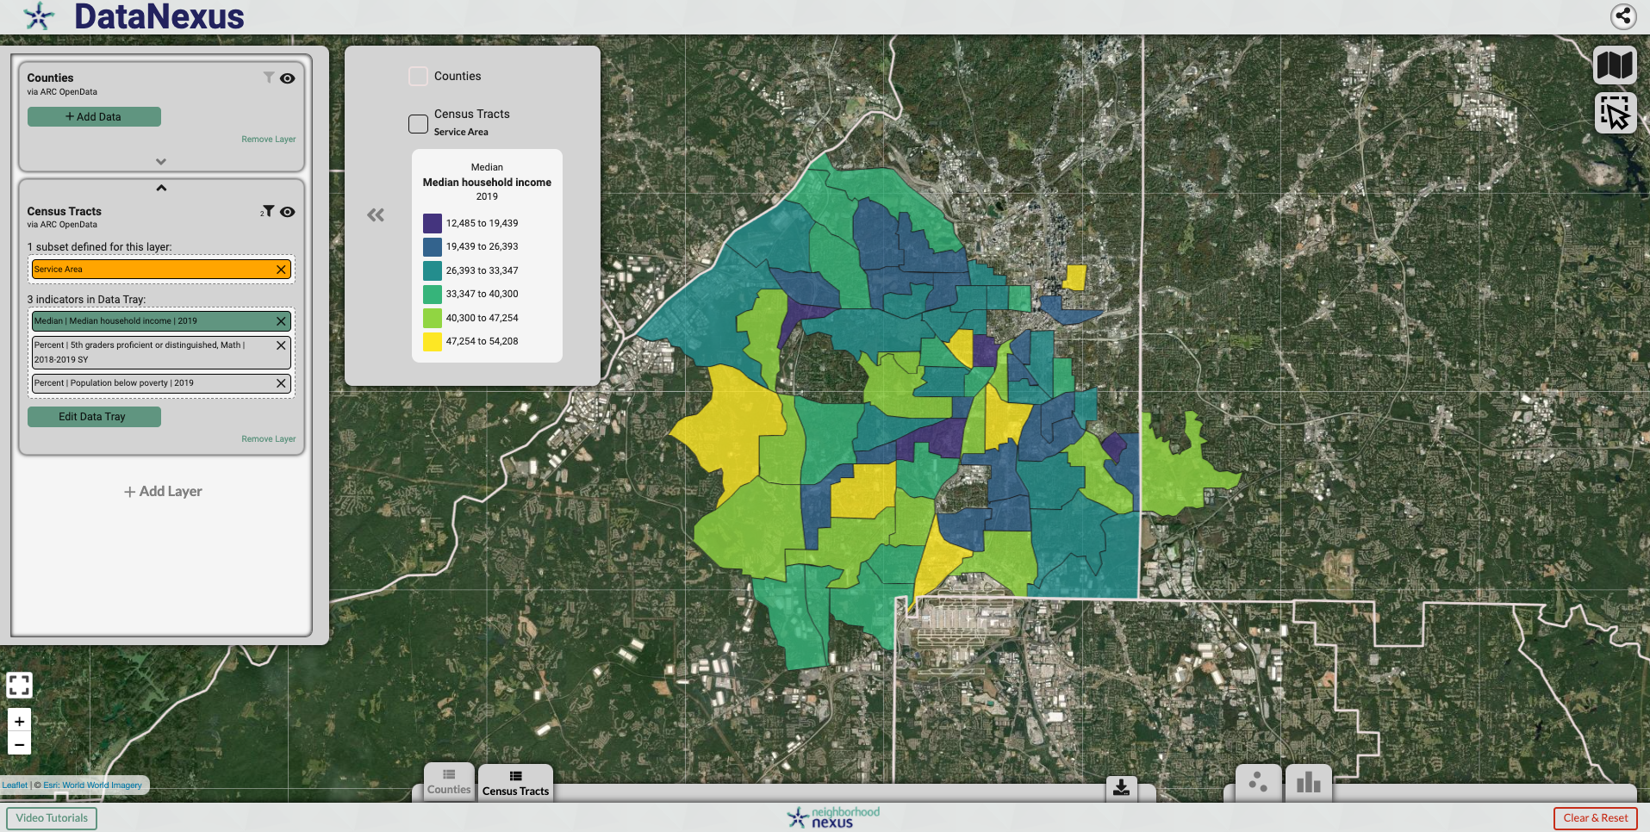
Creating Subsets
data.neighborhoodnexus.org

Slide 14
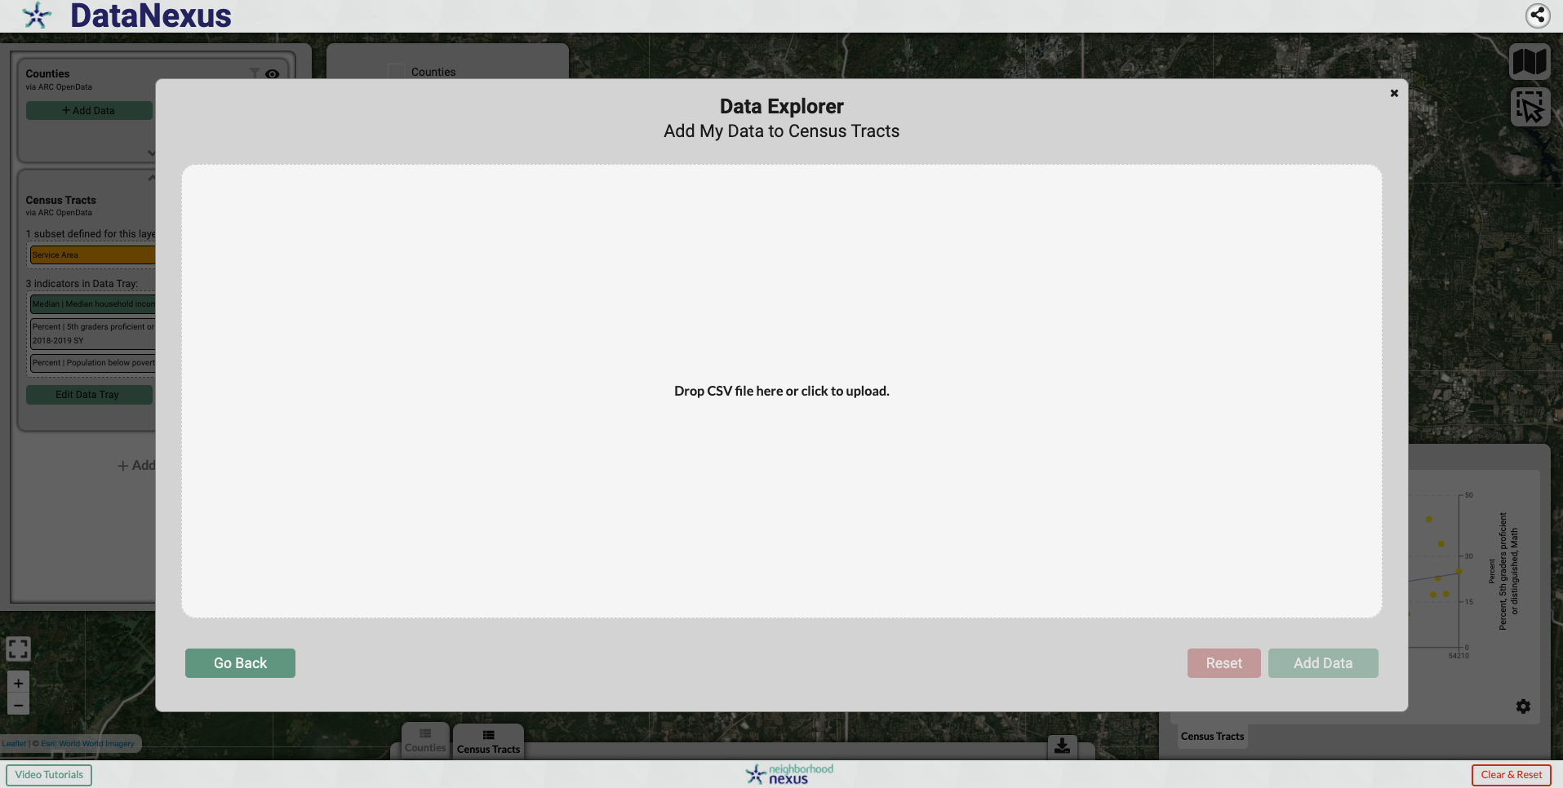
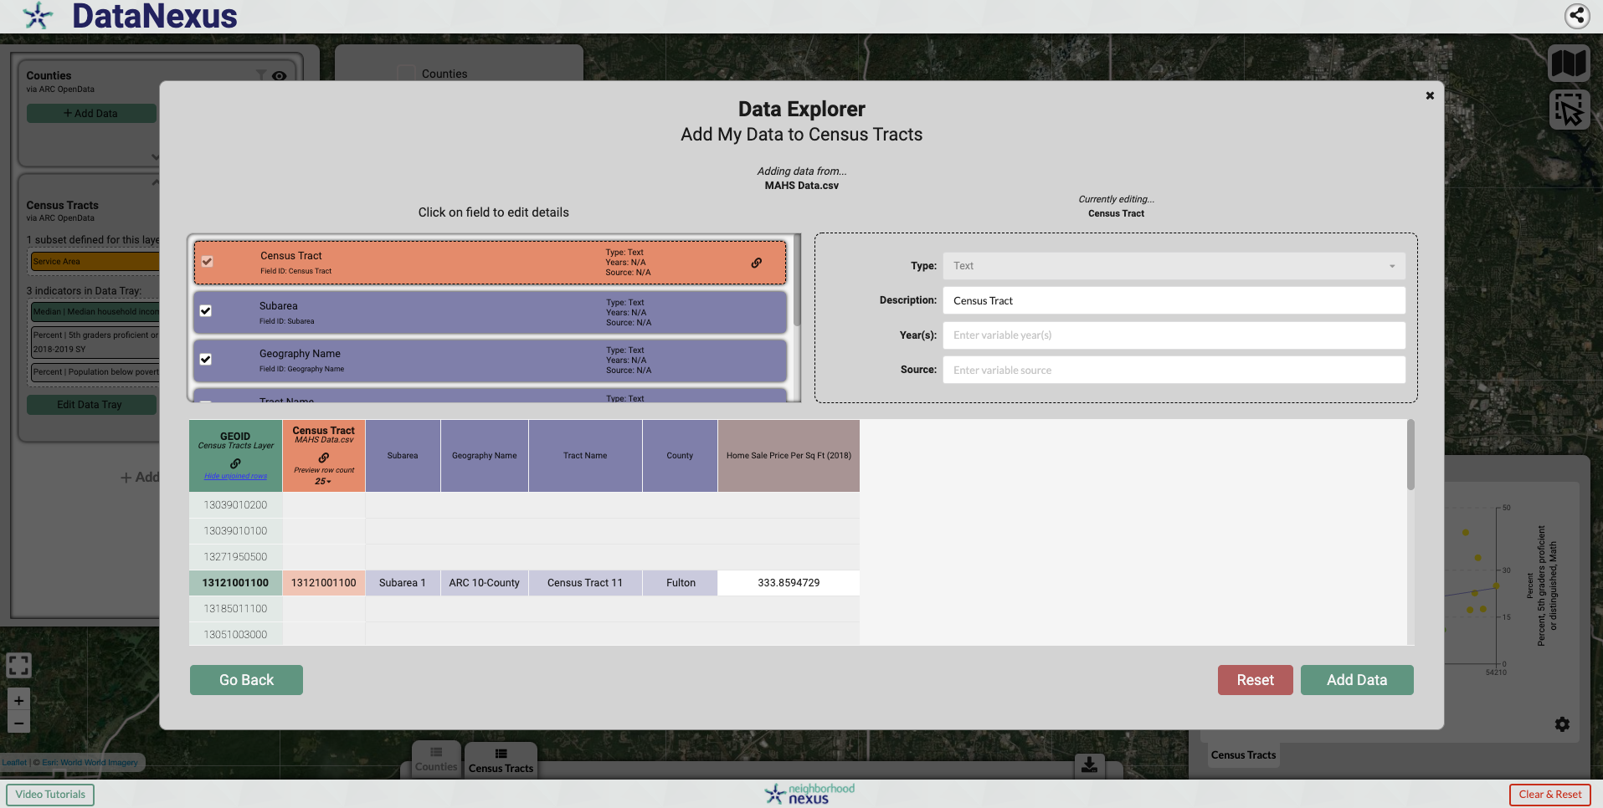
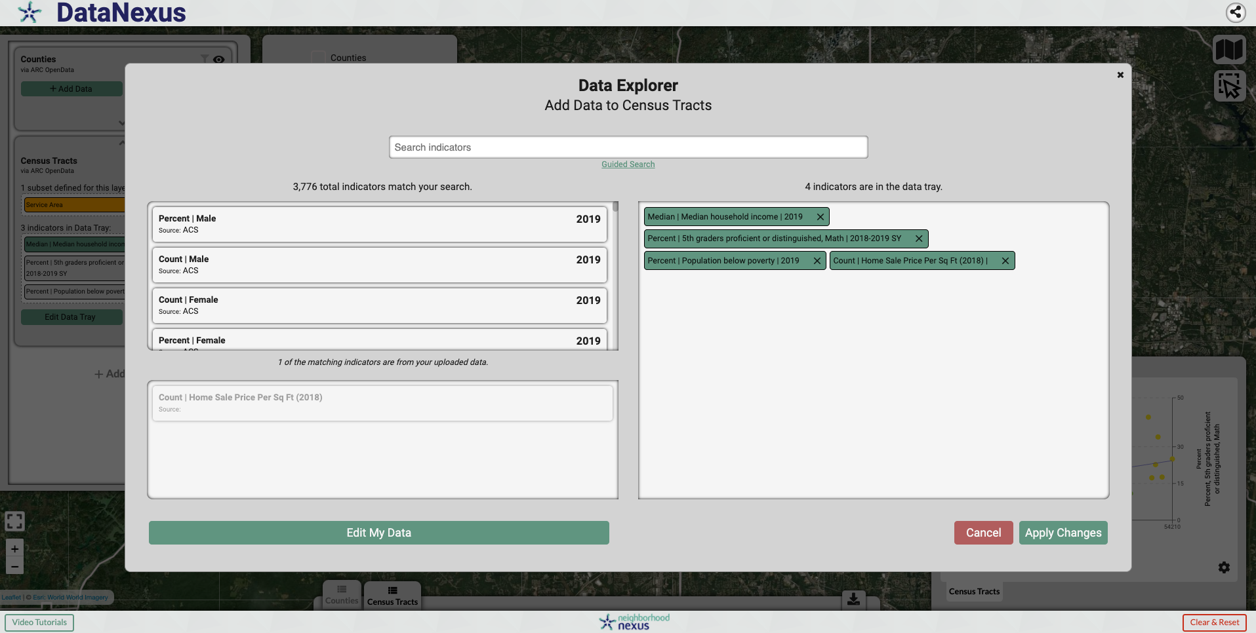
Uploading Data
data.neighborhoodnexus.org

Slide 15
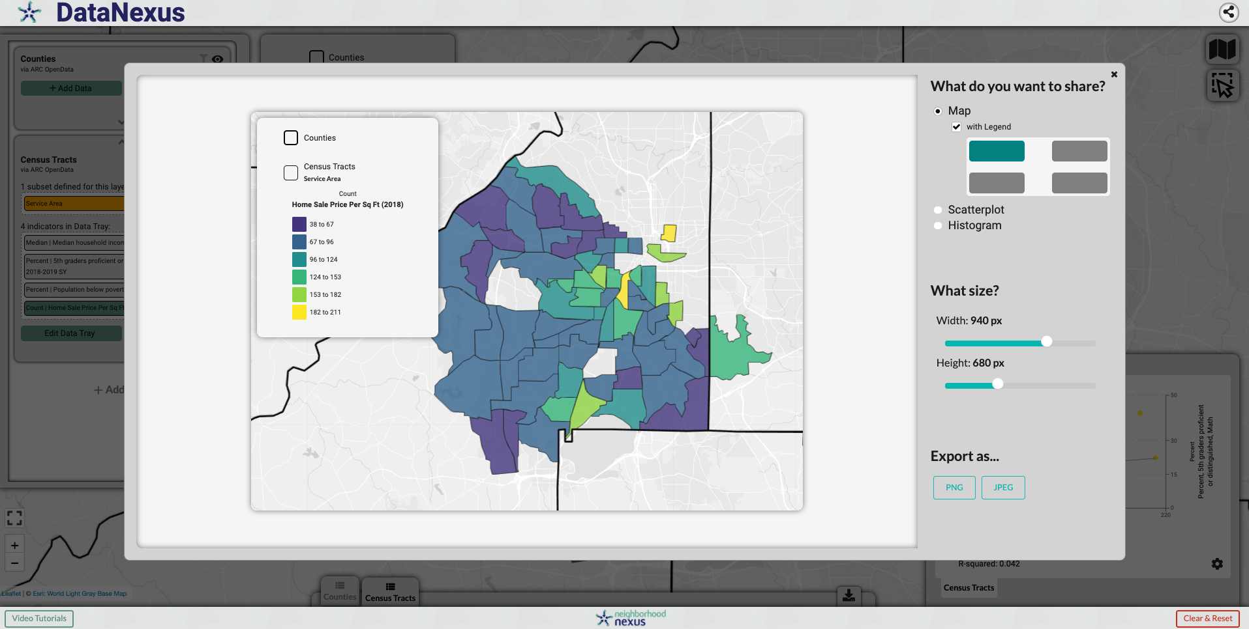
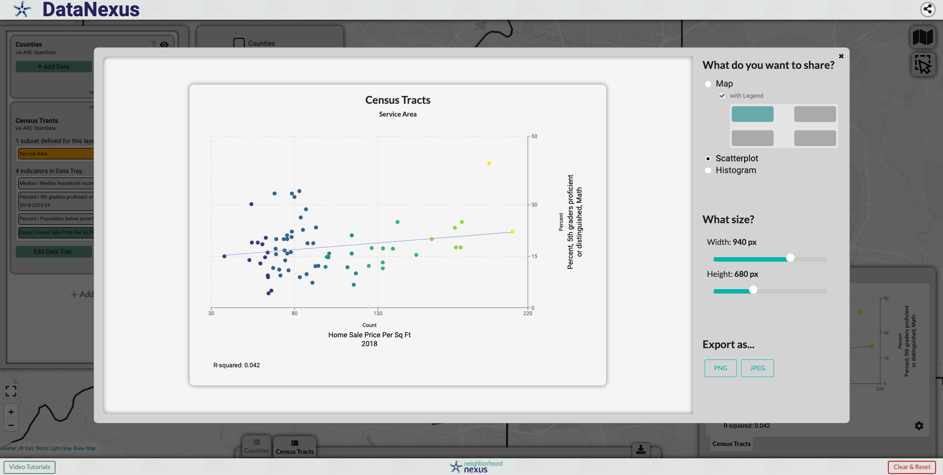
Sharing
Map & Visualizations
data.neighborhoodnexus.org

