Slide 2
The Eviction Crisis
Eviction Settlement Program
State Justice Initiative Eviction System
Q & A

Slide 3
From 2016 to 2020 there were 138,527 FED Filings in Shelby County, TN
-Average of 27,700 per year
According to the Eviction Lab, Memphis is Ranked 41st out of 100 Major Cities in the United State for Evictions
From 2016 to 2020 there were
48,795 FED Judgments in Shelby County, TN.
-Average of 9,700 per year
YR-2019
YR-2020
20.1%
EFR
11.3%
EFR
Eviction Filing Rate (EFR)
Year-over-Year data reveals the Eviction Filing Rate in Shelby County TN has declined by -43.7% from 2019 to 2020.
-43.7%

Slide 5
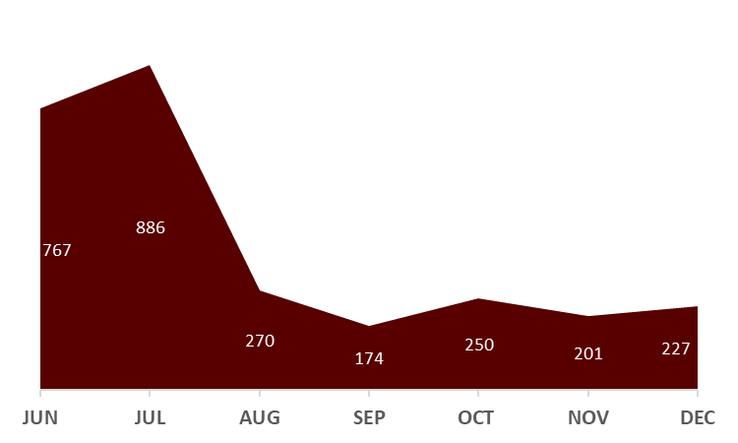
Applicant Profile
Individual Household Settlements
214
PROGRAM DATA
The majority or 81% of applicants were Female
ESP Program Impacts
Household Settlements Part
of Bulk Portfolio Settlements
Saved 1,155 households from
facing eminent Eviction
The majority or 62% of applicants were African American
941
Paid out $1,796,088 in Eviction Settlements as of December 31st 2020
The majority or 69% of applicants were between
19-39 years of age
ESP Applicant Intake by the month
1,155
The majority or 86% of applicants lived in a household with 2 or more persons
The highest numbers of applicant intake occurred
during the months of June and July 2020.
A total of 2,775 applicants were process between
June 20th and December 31st 2020
Households received Assistance through ESP

Slide 6
Partnership between University of Memphis Law School, Innovate Memphis, and Rhodes College to coordinate three months of regular court observations to better understand the Eviction Process in Shelby County
In addition to court observation, analysis of existing administrative data will also be leveraged to look at the following questions
What percentage of tenants do not have representation in eviction court cases?
What are motivations for eviction and is there evidence to suggest landlord are retaliatorily evicting tenants for submitting code requests for example?
Are there incremental and meaningful ways to make the eviction process in Shelby county more equitable, efficient, and just?

Slide 7
2,487
Tenants do not have any representation in eviction cases 96% of time
Cases have been observed by law school students so far
The majority of the 4% that are represented is through ERA/ESP
70% of observed hearings were finished in under 1 minute
Landlord is legally represented 89% of the time
82% of cases the tenant did not even appear in court

Slide 8
QUESTIONS?

