Slide 1
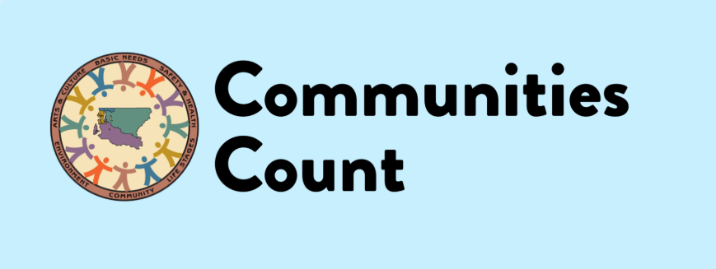
Racism as a Public Health Crisis:
What is the Role of Data?
A workshop series
Mariko Toyoji, MPH
Public Health Seattle and King County
Notes:
Sara Jaye
Communities Count is a resource that supports King County communities in the use of data in promoting and achieving equity. Communities Count does this by: Providing data support and trainings to King County communities & Highlighting data on disparities, inequities and strengths in our community.
We are a public – private private partnership, with staff based in Public Health – Seattle & King County. INTROS
Session Title: Racism as a Public Health Crisis: What is the Role of Data?
Session Description: In 2020, Public Health-Seattle & King County acknowledged what many have long known: racism is a crisis that impacts the health and wellbeing of our communities. We’ll host a dialogue about the role of data in naming racism as a public health crisis and how data can be used to address the crisis. Join us to share your thoughts on:
How can we change the legacy of data being used “against” communities?
How can data be used to address racism?
What additional data, tools, or resources do you wish you had to address the impacts of racism? How can we change current data practices to meet these needs?
Discussion will be hosted by Communities Count. We’ll share a presentation that spotlights local inequities and examples of underlying systems and policies that contribute to them before moving into dialogue.

Slide 2
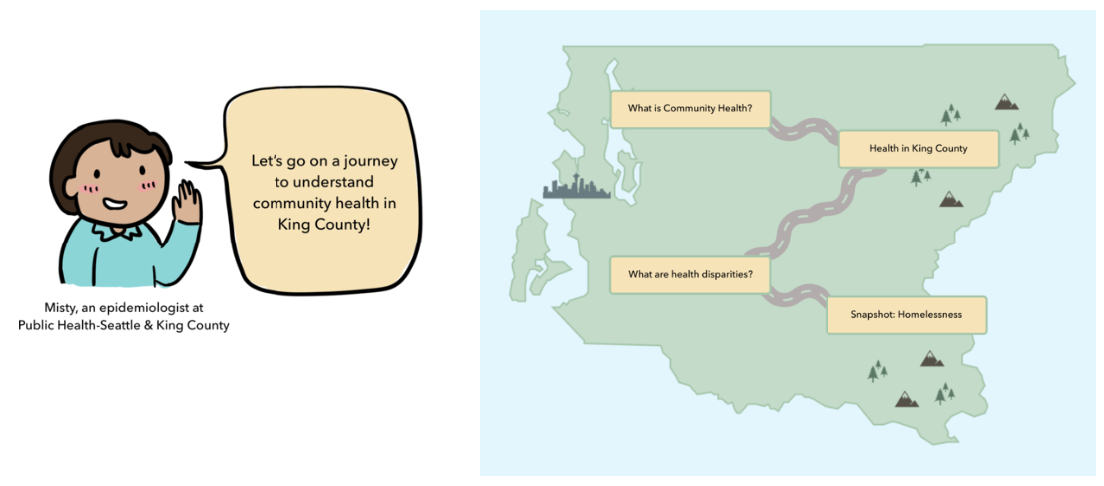
Communities Count: A very brief history
Communities Count is a resource that supports King County communities in using data and evaluation to support equity work.
Partnership between Public Health - Seattle & King County and the Seattle Foundation
Started over 20 years ago as a population based survey providing indicators on health and social well being in King County
Engaging with stakeholders, community based organizations, students and other partners is a key part of the program
Provides data and evaluation trainings and technical assistance to build capacity and further equity work in King County

Slide 3
Communities Count supports our community with the use of data in promoting and achieving equity by:
Providing a platform for King County data & stories
Highlighting data on disparities, inequities and strengths in our community
Complementing existing civic, social, economic, and health indicators
Providing data support, technical assistance and trainings to King County communities
3

Slide 4
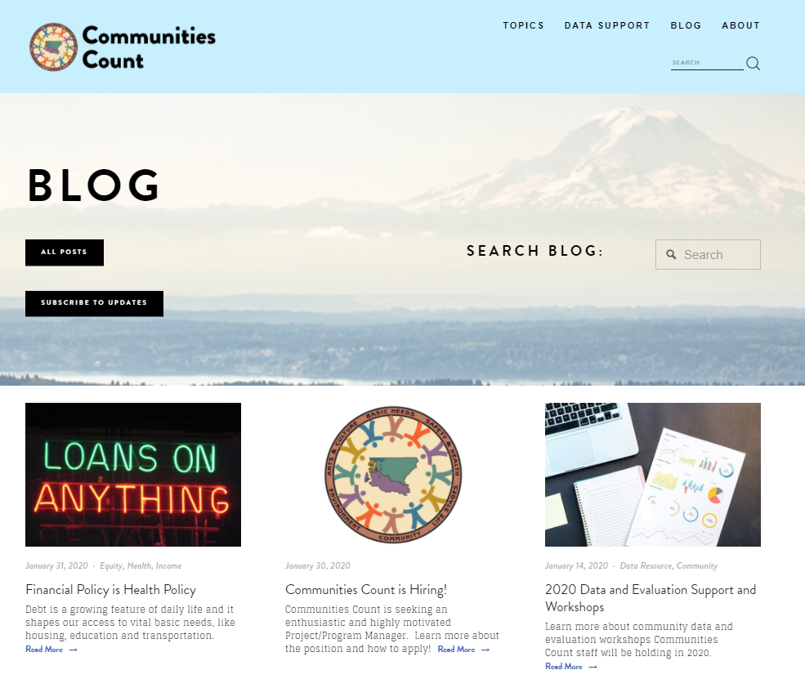
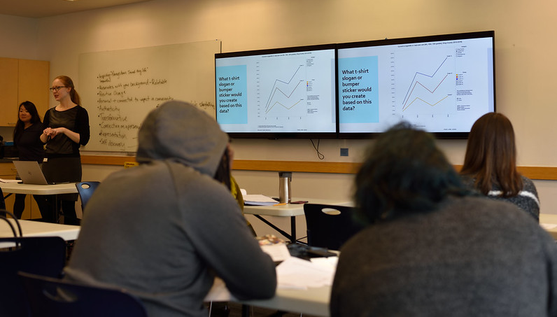
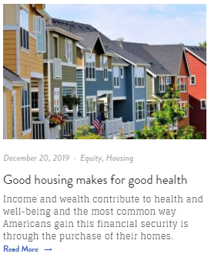
Providing Context, Building Capacity
While data dashboards and visualizations can be powerful tools for disseminating public health data, additional supports to build capacity to access, interpret, understand the context of health disparities and use data for action should be considered in the development and dissemination of equity centered data tools.
Communities Count Blog: A space where we provide context and “deeper dives” on health disparities and their root causes
A (pre-COVID) Communities Count Data Workshop
4

Slide 5
Racism as a public health crisis
In June 2020, Public Health Seattle and King County declared Racism as a Public Health Crisis:
Commitment to implementing a racially equitable response to crisis, centering on community and the following values
Anti-racist
Focus where negative impacts have been most harmful
Center on Black, Native & Brown experiences and voices
Responsive, adaptive, transparent and accountable
Focus on addressing root causes
Carrying out community engagement to collect input and provide direction on King County’s anti-racist policy agenda and budget priorities
2021-2022 Budget makes investments to support engagement and anti-racist policy agenda
Notes:
Hani
Oppressive systems and racism continue to create disparities in access to services, education, economic attainment, and life expectancies for communities of color. In 2020, COVID-19 intensified this spotlight to highlight how communities of color are disproportionately impacted by COVID-19 - often driven by underlying disparities, including the degree to which communities of color experience higher rates of underlying health conditions and are less likely to have access to quality health care.
The presentation will highlight 4 different snapshots across the lifespan including: infant mortality, educational attainment, housing, and life expectancy as well as a few policies that impact each though we know in reality policies, discrimination, systemic racism, and access to resources do not occur in isolated moments but rather occur dynamically and often simultaneously throughout the entire lifespan and across generations drive these inequities.

Slide 6
Workshop Series Scope
In 2020, Public Health-Seattle & King County acknowledged what many have long known: racism is a crisis that impacts the health and wellbeing of our communities.
Hosting a dialogue about the role of data in naming racism as a public health crisis and how data can be used to address the crisis.
In 2020, COVID-19 intensified this spotlight to highlight how communities of color are disproportionately impacted by COVID-19
Systemic racism continues to create disparities in access to services, education, economic attainment, and life expectancy that impact health
The presentation highlights 4 different snapshots across the lifespan including: infant mortality, educational attainment, housing, and life expectancy
Notes:
Hani
Oppressive systems and racism continue to create disparities in access to services, education, economic attainment, and life expectancies for communities of color. In 2020, COVID-19 intensified this spotlight to highlight how communities of color are disproportionately impacted by COVID-19 - often driven by underlying disparities, including the degree to which communities of color experience higher rates of underlying health conditions and are less likely to have access to quality health care.
The presentation will highlight 4 different snapshots across the lifespan including: infant mortality, educational attainment, housing, and life expectancy as well as a few policies that impact each though we know in reality policies, discrimination, systemic racism, and access to resources do not occur in isolated moments but rather occur dynamically and often simultaneously throughout the entire lifespan and across generations drive these inequities.

Slide 7
What influences health & wellbeing?
Policies
Equity & justice
Programs
Notes:
Hani
This presentation will cover some elements related to socioeconomic factors, physical environment, health behaviors, and healthcare. It is also important to note that policies, equity/justice, and programs all impact an individual’s experience and access to these resources.
Image source: https://noahhelps.org/sdoh/
Percentages from County Health Rankings model: https://www.countyhealthrankings.org/explore-health-rankings/measures-data-sources/county-health-rankings-model

Slide 8
Data Cycle
Translation
& interpretation
Data sovereignty: the right to govern the collection, ownership, and application of one’s own data
Data collection
Data dissemination
Data
analysis
Data equity should be incorporated in funding, motivation, project design, data collection & sourcing, analysis, interpretation, and communication & distribution
Policies
Programs
Community voice
& engagement
Data justice: examples include culturally adapted surveys & tools, translation, centering community voice & knowledge
Equity & justice
Notes:
Vanessa
We see this conversation as part of this never ending feedback process where data collection and dissemination changes as as of community engagement. Before going into the data itself, we want to make sure to take some time to actually address the role of data in general in perpetuating inequities.
We have often heard that existing racial and ethnic categories do not necessarily correspond to the identities of groups. This is actually in policy. And we and community continue to push back against those- which we will show in a couple slides.
How do you use data poll?
Community engagement is NOT done by the institutions in charge of data collection and policy: this has been a key driver of data that has harmed communities.
Vanessa
We see this conversation as part of our overall data cycle. We are hoping to engage in conversations around decolonizing traditional data collection standards, collecting community stories, disaggregating data are all important components.

Slide 9
Life Expectancy: Data
Life Expectancy: Summary
In King County, Black, Native Hawaiian Pacific Islander, and American Indian Alaska Native residents have a life expectancy of at least four years less than White adults.
Life Expectancy (years), King County average (2012-2016)
Source: WA State Department of Health, Center for Health Statistics, Death Certificates
Notes:
Vanessa
Not just deficit based -
In King County,
Asian infants have a life expectancy that is 4 years higher
American Indian Alaska Native infants have a life expectancy that is 9 years lower
Black infants have a life expectancy that is 4 years lower
Hispanic infants have a life expectancy that is 2 years higher
Native Hawaiian Pacific Islander infants have life expectancy that is 9 years lower
…than the average King County infant

Slide 10
Life Expectancy: Summary
The chronic stress that accumulates over a lifetime for BiPOC individuals results from generational and lifetime experiences of racial discrimination.
Government sanctioned policies and practices including education, homeownership, and employment have created an environment that hinders upward mobility.
These pervasive and daily systemic disadvantages disproportionately impacts the health, social and mental well-being for BiPOC communities and takes a toll on the body.
Notes:
Vanessa

Slide 11
Discussion Questions
How can we change the legacy of data being used “against” communities?
How can data be used to address racism?
What additional data, tools, or resources do you wish you had to address the impacts of racism? How can we change current data practices to meet these needs?
What does data justice look like?
Notes:
Sara Jaye

Slide 12
What we are hearing
How can we change the legacy of data being used “against” communities?
“Create a practice of reviewing the data and analyzing what stories/narratives are being told with the data. What is the harm of such stories and how do we reframe them”
“Highlight community beauty, strength, & resilience alongside community needs. Communities have many answers.”
“ Engage communities in data interpretation and developing the data "story“”
“Engage stakeholders in all aspects of the research- use approaches such as Community-Based Participatory Research “

Slide 13
What we are hearing
How can data be used to address racism?
“Allow community to define the indicators and measures of impacts of racism”
“Disaggregate racial and ethnicity and allow for intersectional identities”
“Use more qualitative data and narratives of lived experiences”
“Demonstrate / quantify extent of impacts to policymakers “
“Explore questions related to sense of belonging, experiences of racism, social-emotional health”
“Support BIPOC communities in in writing the policies for lawmakers.”

Slide 14
What we are hearing
What additional data, tools, or resources do you wish you had to address the impacts of racism? How can we change current data practices to meet these needs?
“Capture data about ways that systems perpetuate racism”
“Data advocates for families experiencing discrimination to join in meetings”
What does data justice look like?
“Challenging our assumptions of the "story" and being transparent in the bias, assumptions and culture that we bring”
“When impacted communities have a intentional and consistent voice in developing & determine data and defining what data justice benchmarks are”
“Change the definition of "rigorous research" from academic to local, community based knowledge”

Slide 15
Next steps
Expanding and continuing the conversation with internal and external partners
Data for equity and actionable steps on our teams
Workshop 2: Deeper dive into how existing social/root causes impact health esp. through COVID-19:
COVID-19 data & reports: Race and ethnicity data dashboard, vaccines, testing)
Workshop 3: How to supplement existing quantitative data or missing data with community stories:
Hoping to partner with 6 Community grantees of COVID-19 Storytelling project

Slide 16
Keep in Touch!
Thank you!
Visit us at: communitiescount.org
Contact us: communitiescount@kingcounty.org
Mariko Toyoji: mtoyoji@kingcounty.gov
Notes:
Thank you so much and visit our website for more data resources, trainings, and more. If you have other questions or want to connect feel free to reach out

