Slide 1
COVID-19 & Place-based Disparities
NNIP Showcase
May 25, 2021
Presented by:
Cristina Martinez, MPH
Research coordinator II, CI:Now

Slide 2
https://www.cdc.gov/coronavirus/2019-ncov/covid-data/investigations-discovery/hospitalization-death-by-race-ethnicity.html

Slide 3
https://covid.cdc.gov/covid-data-tracker/#vaccination-demographic

Slide 4
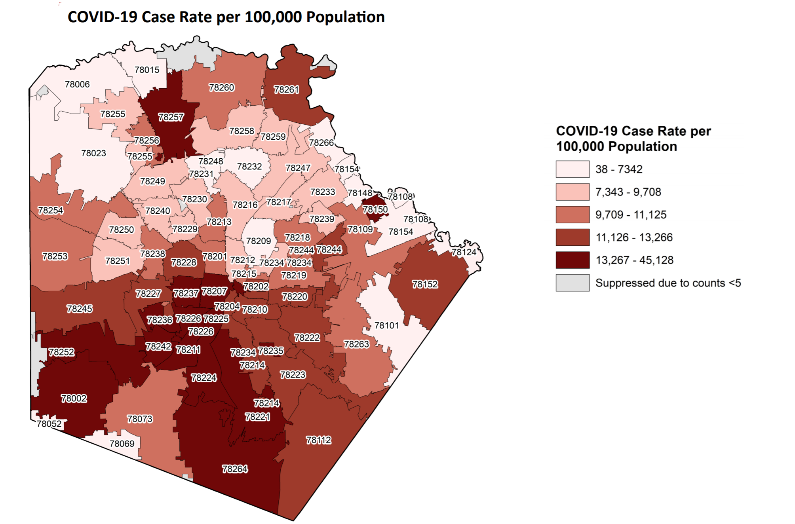
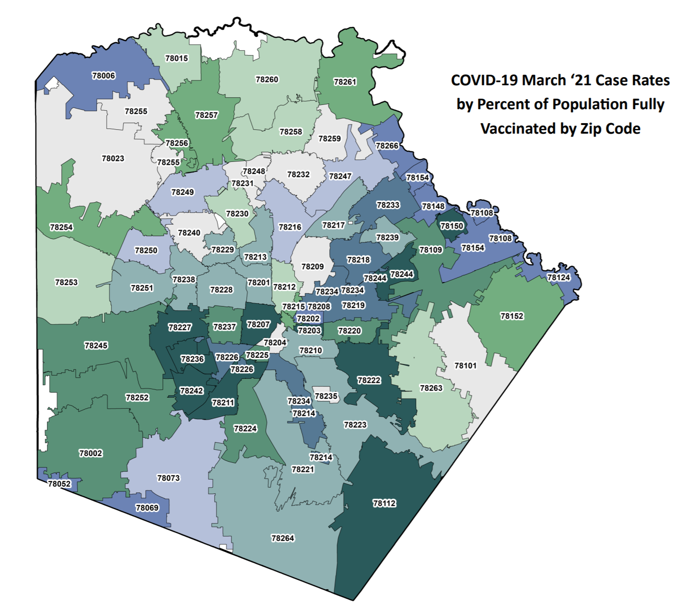
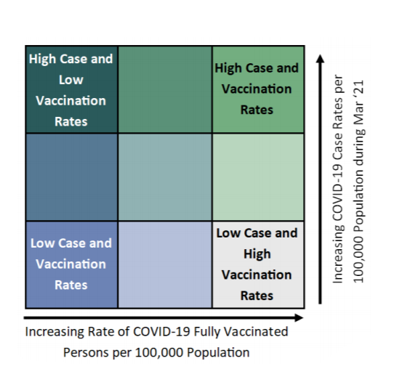
Source: COVID-19 Monthly Epidemiological Report, City of San Antonio, March 2021

Slide 5
Source: COVID-19 Monthly Epidemiological Report, City of San Antonio, March 2021

Slide 6
What did we do?

Slide 7
Scatterplot Indicators
COVID-19 Rates
Cases/10k
Hospitalizations/10k
Community Indicators
ACS 5 Year Data
Unemployment Claims
Deaths/100k
Vaccine Rates
Total Doses/10k
One Dose/10k
Fully Vaccinated/10k
Business Data

Slide 8
Scatterplot Indicators
COVID-19 Rates
Cases/10k
Hospitalizations/10k
Community Indicators
ACS 5 Year Data
Unemployment Claims
Deaths/100k
Vaccine Rates
Total Doses/10k
One Dose/10k
Fully Vaccinated/10k
Business Data

Slide 9
How did we do this?
R studio – Shiny
Hosted on free server shinyapps.io

Slide 10
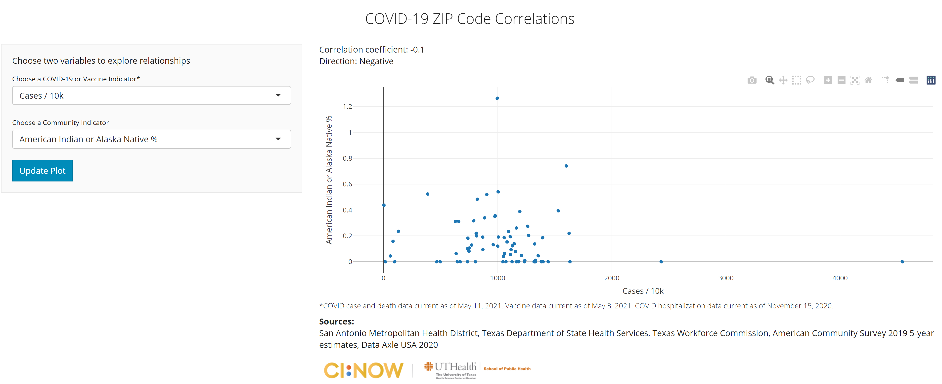
https://cinow.info/covid-zip/

Slide 11
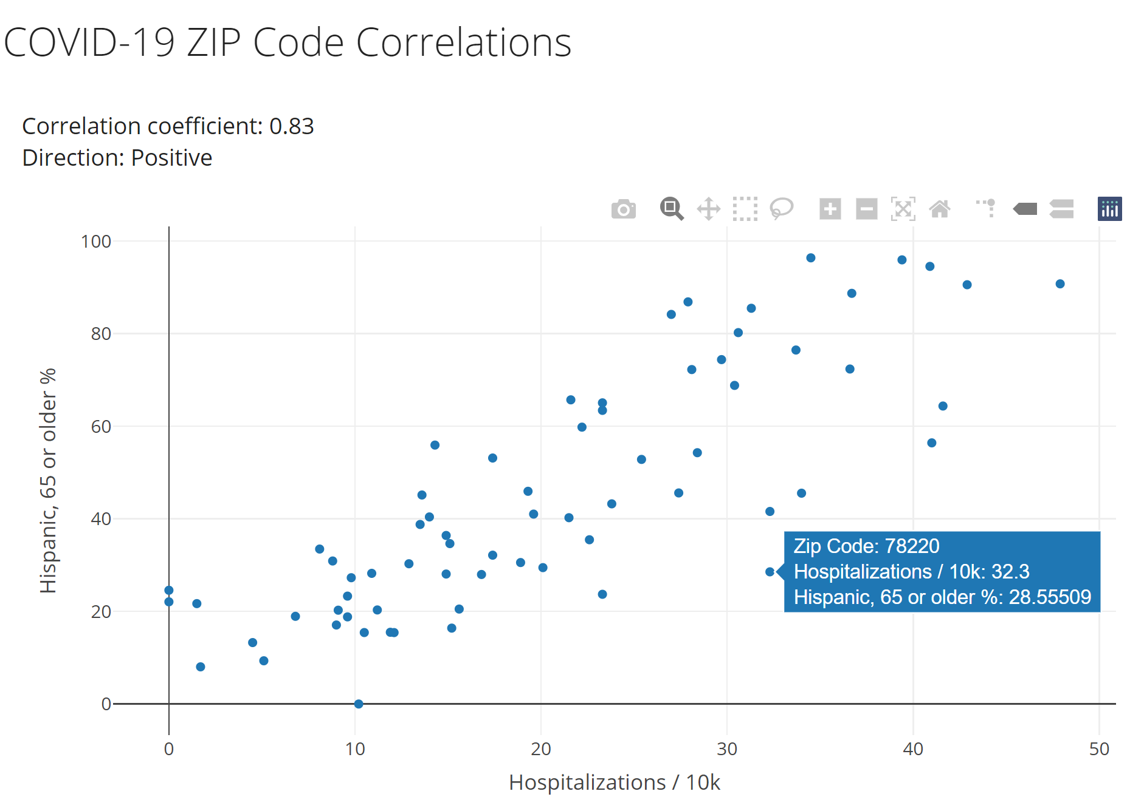
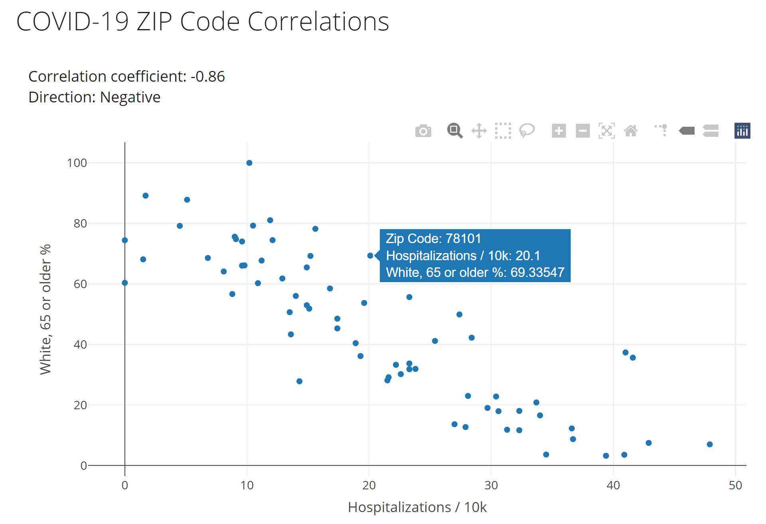
Zip code: Hospitalizations & Population 65+
https://cinow.info/covid-zip/

Slide 12
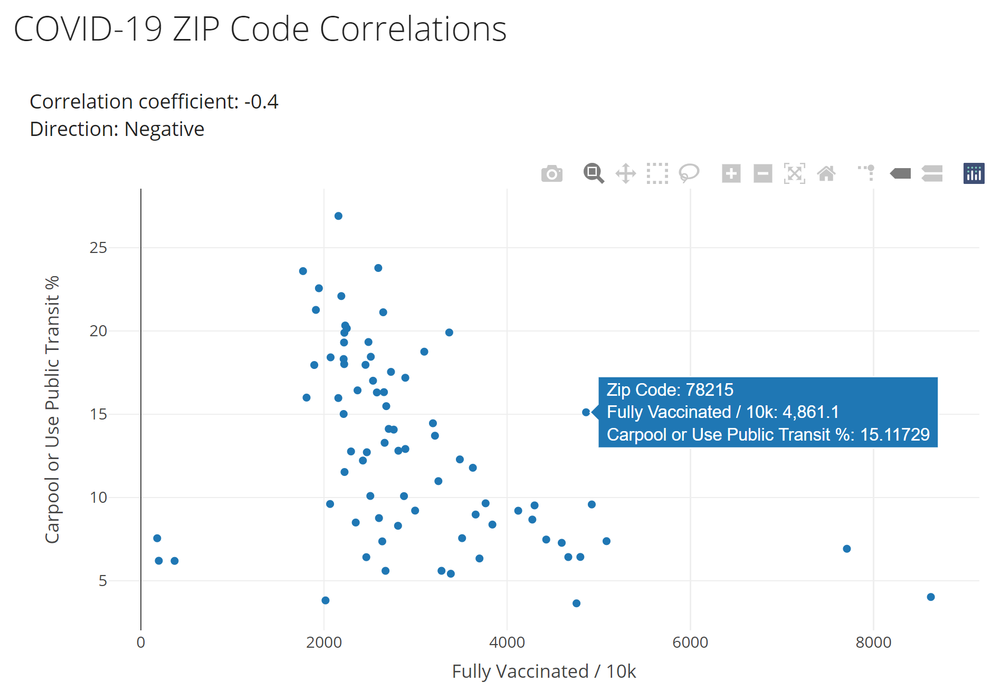
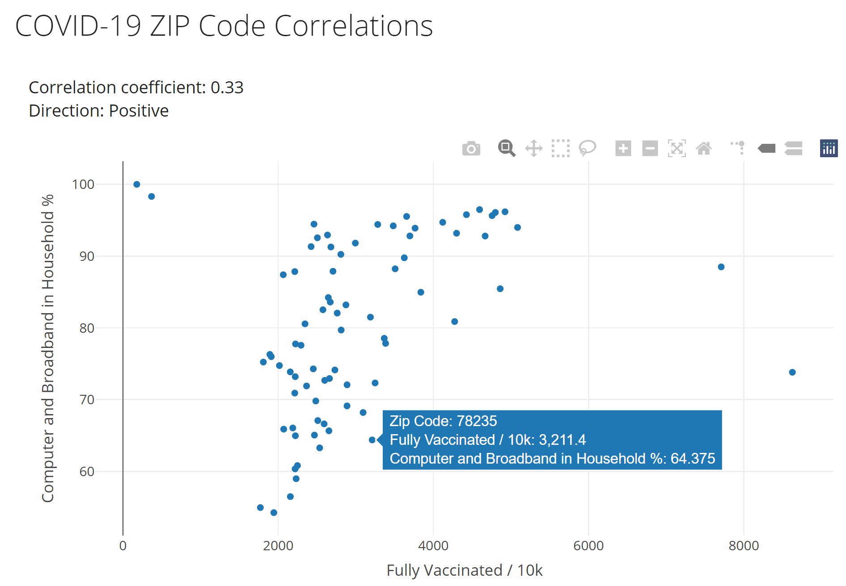
Zip code: Vaccine Access
https://cinow.info/covid-zip/

Slide 13
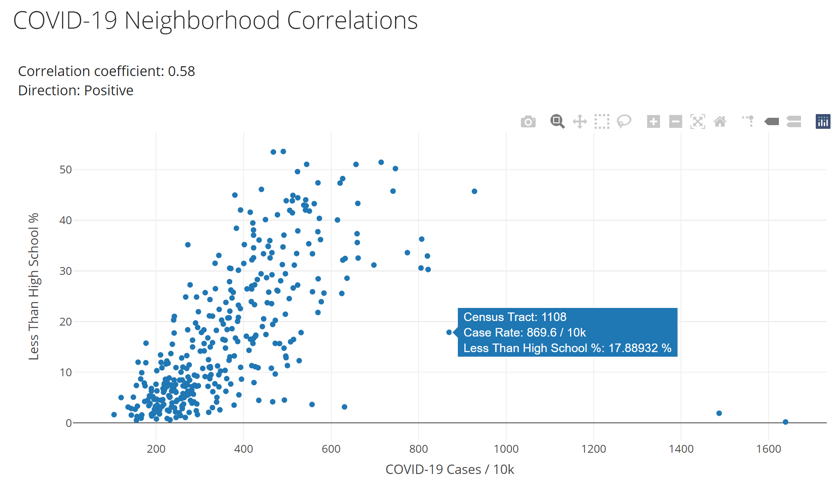
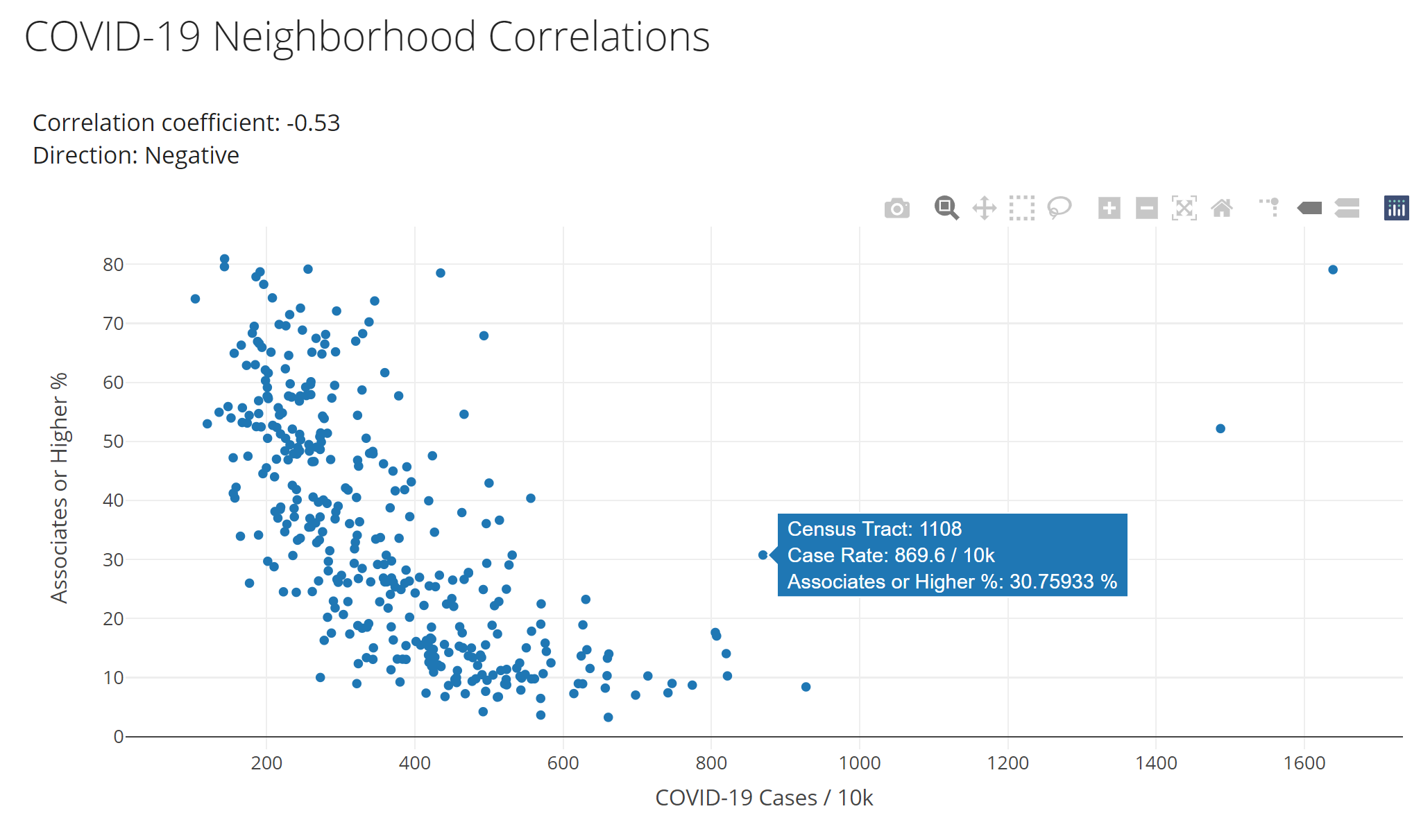
Census Tract: Education
https://cinow.info/covid-tract/

Slide 14
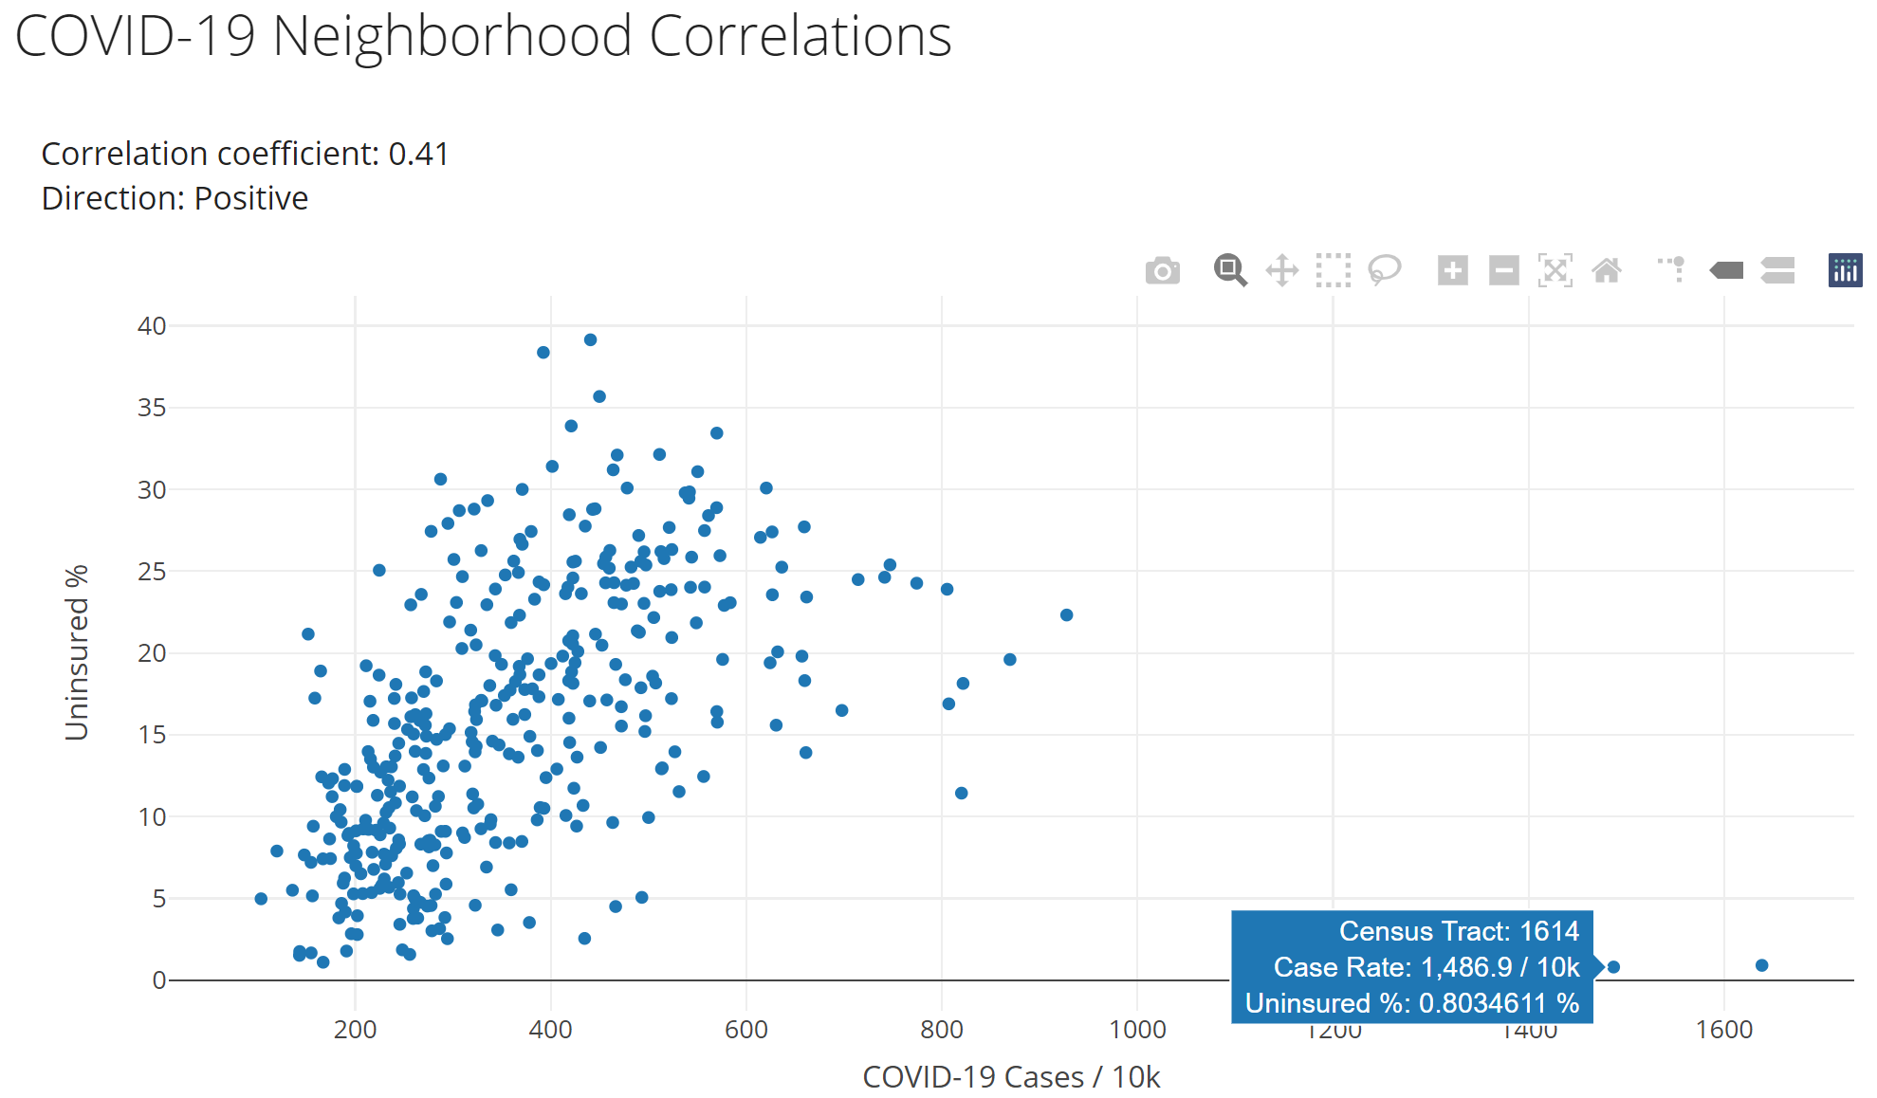
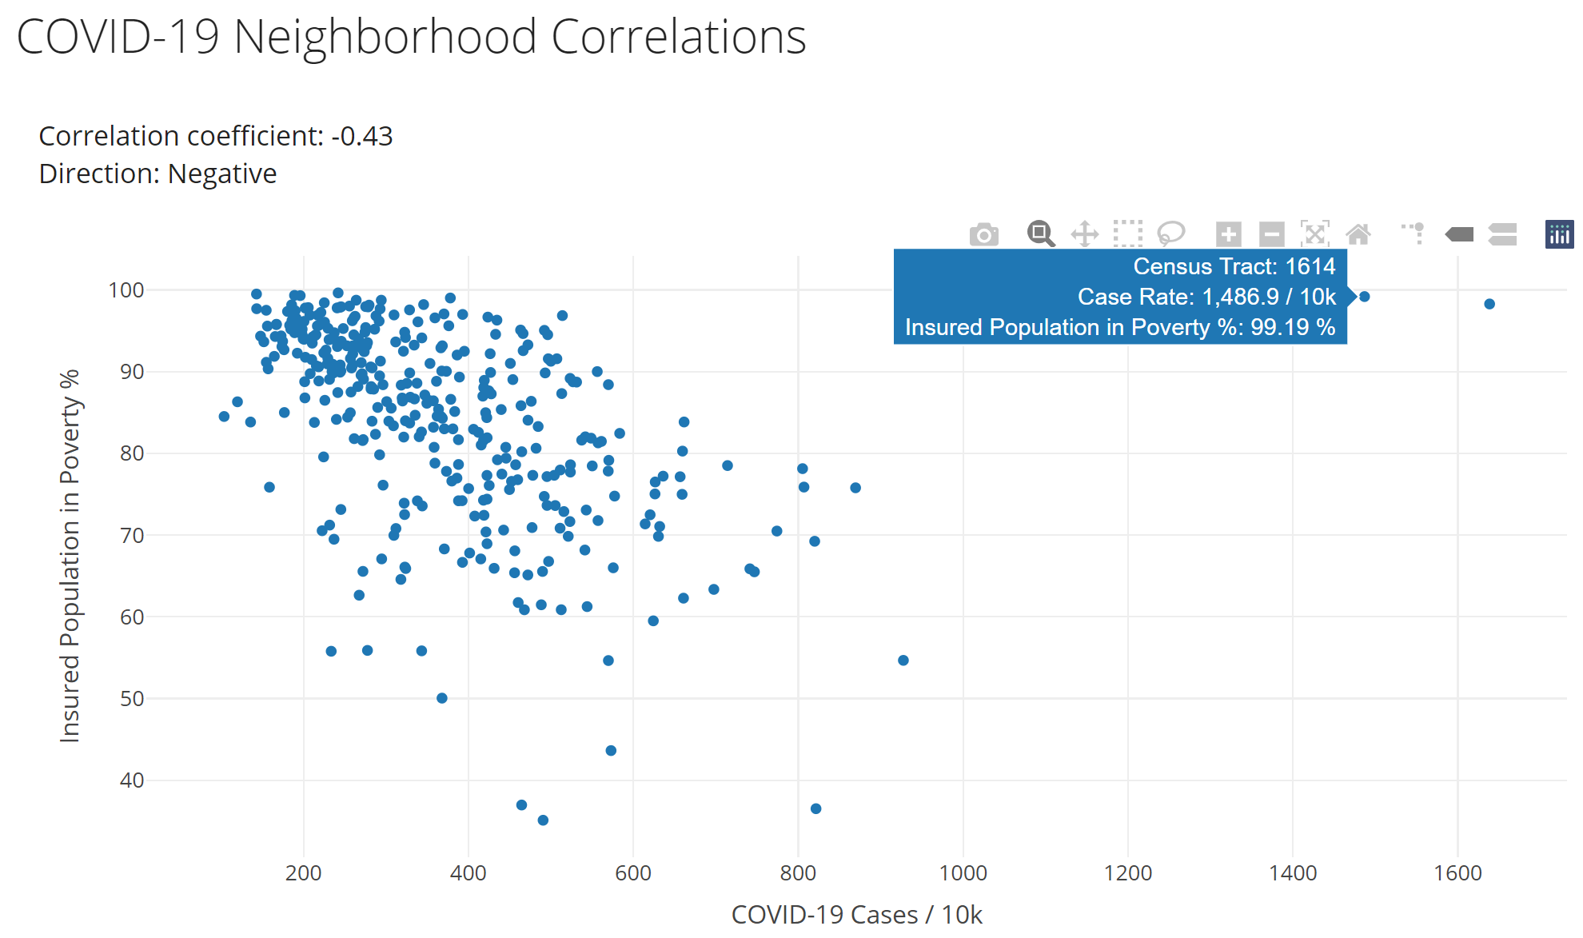
Census Tract: Insurance Coverage & Poverty
https://cinow.info/covid-tract/

Slide 15
Acknowledgements
Funders
The Health Collaborative
San Antonio Metro Health
COVID-19 Data by Zip Code and Census Tract
Dr. Golareh Agah
San Antonio Health Informatics team

Slide 16
Thank you!!!

