Slide 1


Visualizing COVID19 and Community Indicators
Cheryl Knott
Research Manager
May 25, 2021

Slide 2

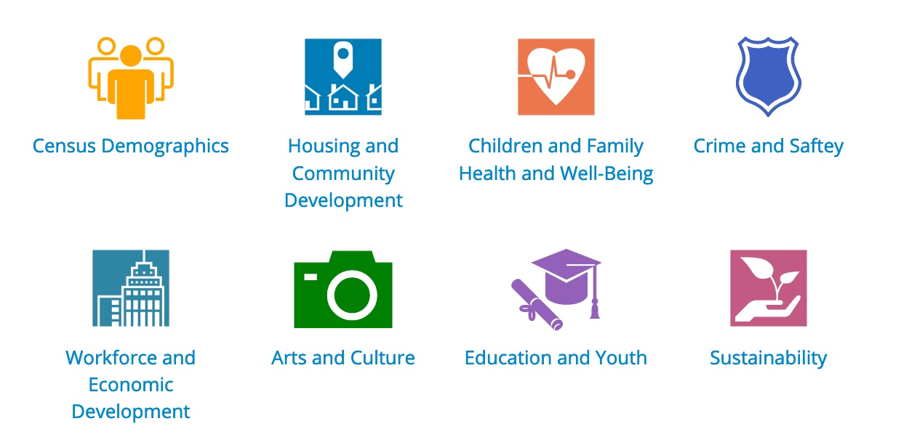
About BNIA-JFI
Bniajfi.org
@bniajfi
Non-profit started about 20 years ago by local stakeholders, now housed within Jacob France Institute at University of Baltimore
“One-stop-shop” for comprehensive, non-partisan data indicators and training

Slide 3
COVID-19 Questions
Bniajfi.org
@bniajfi
What populations (people) are vulnerable to coronavirus?
What are the implications of the stay-at-home order?
What do people need help with?

Slide 4
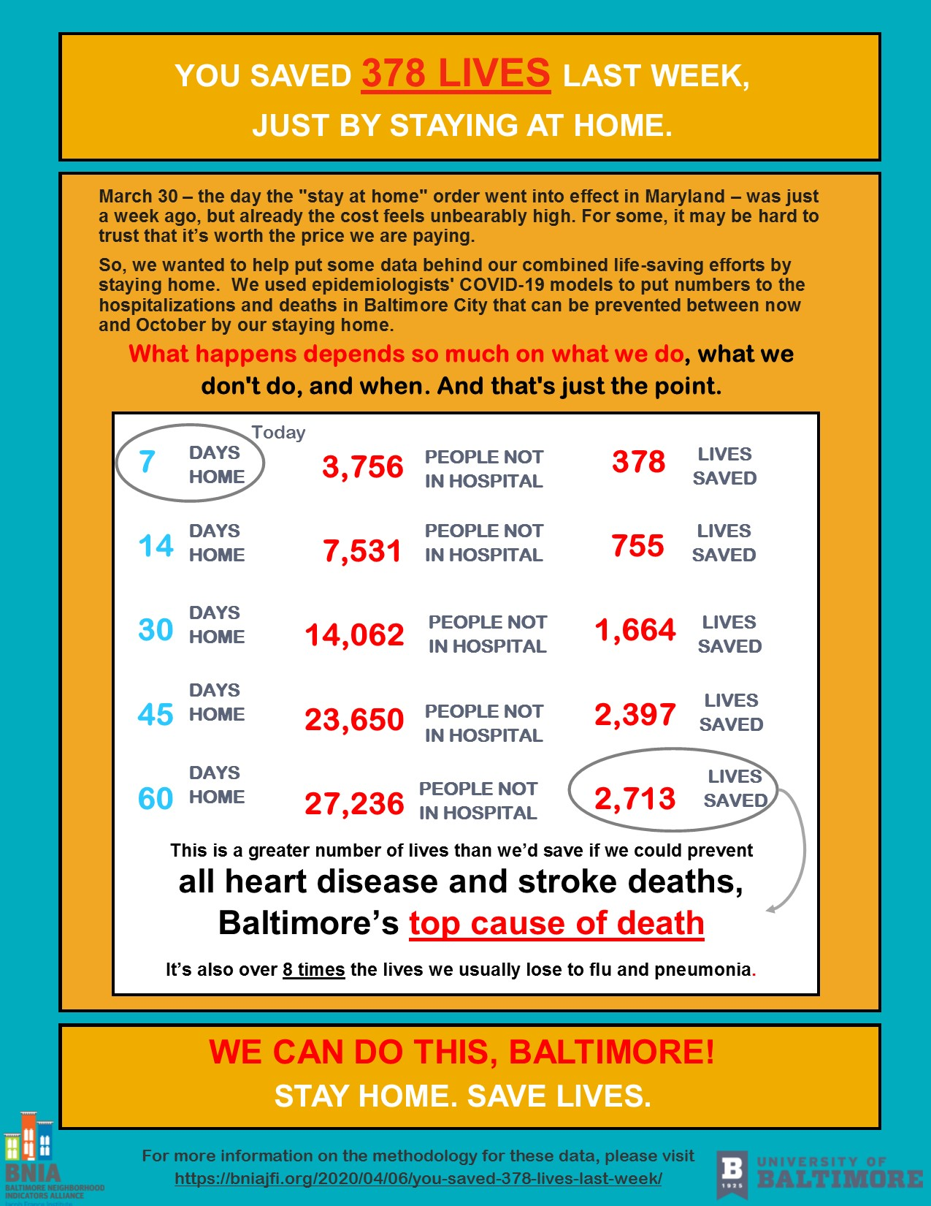
Infographic:
Lives Saved
Bniajfi.org
@bniajfi

Slide 5
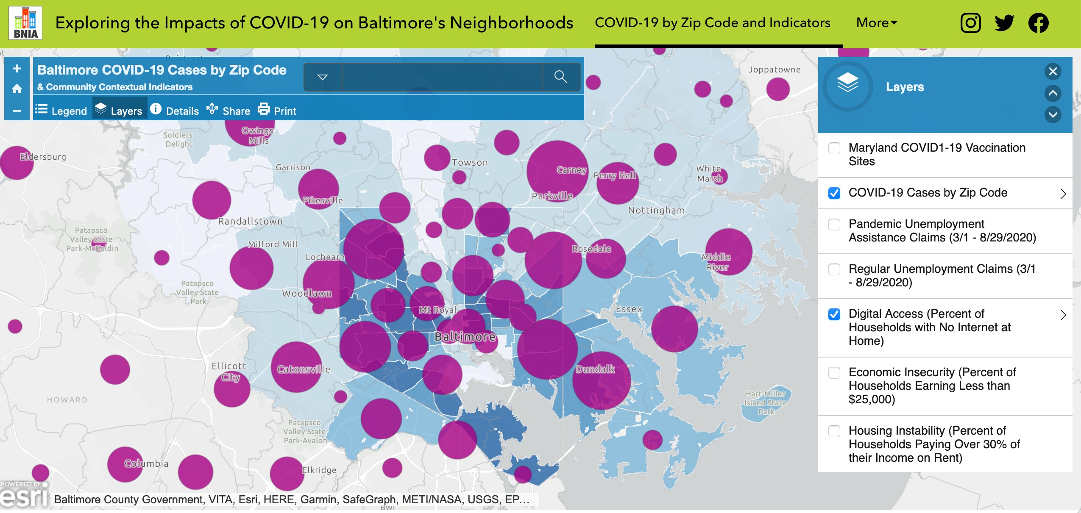
Web Map:
COVID-19 Cases and Indicators
Bniajfi.org
@bniajfi

Slide 6
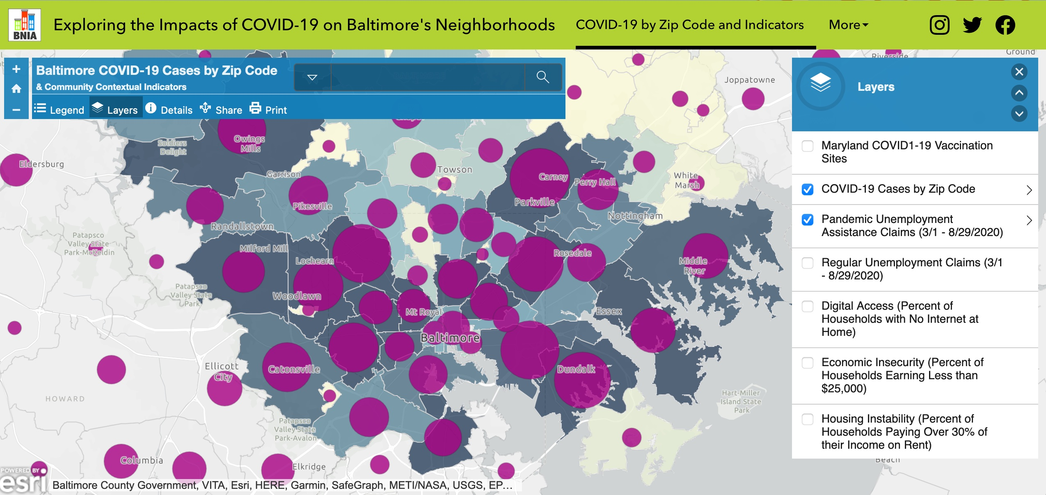
Web Map:
COVID-19 Cases and Indicators
Bniajfi.org
@bniajfi

Slide 7
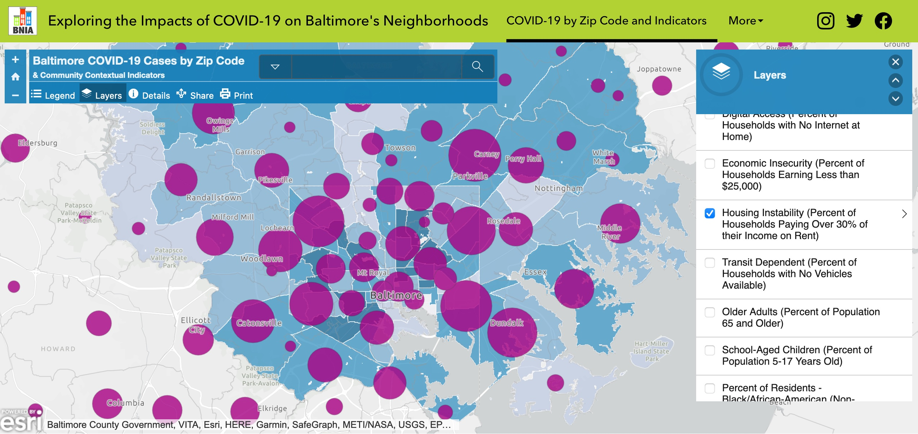
Web Map:
COVID-19 Cases and Indicators
Bniajfi.org
@bniajfi

Slide 8
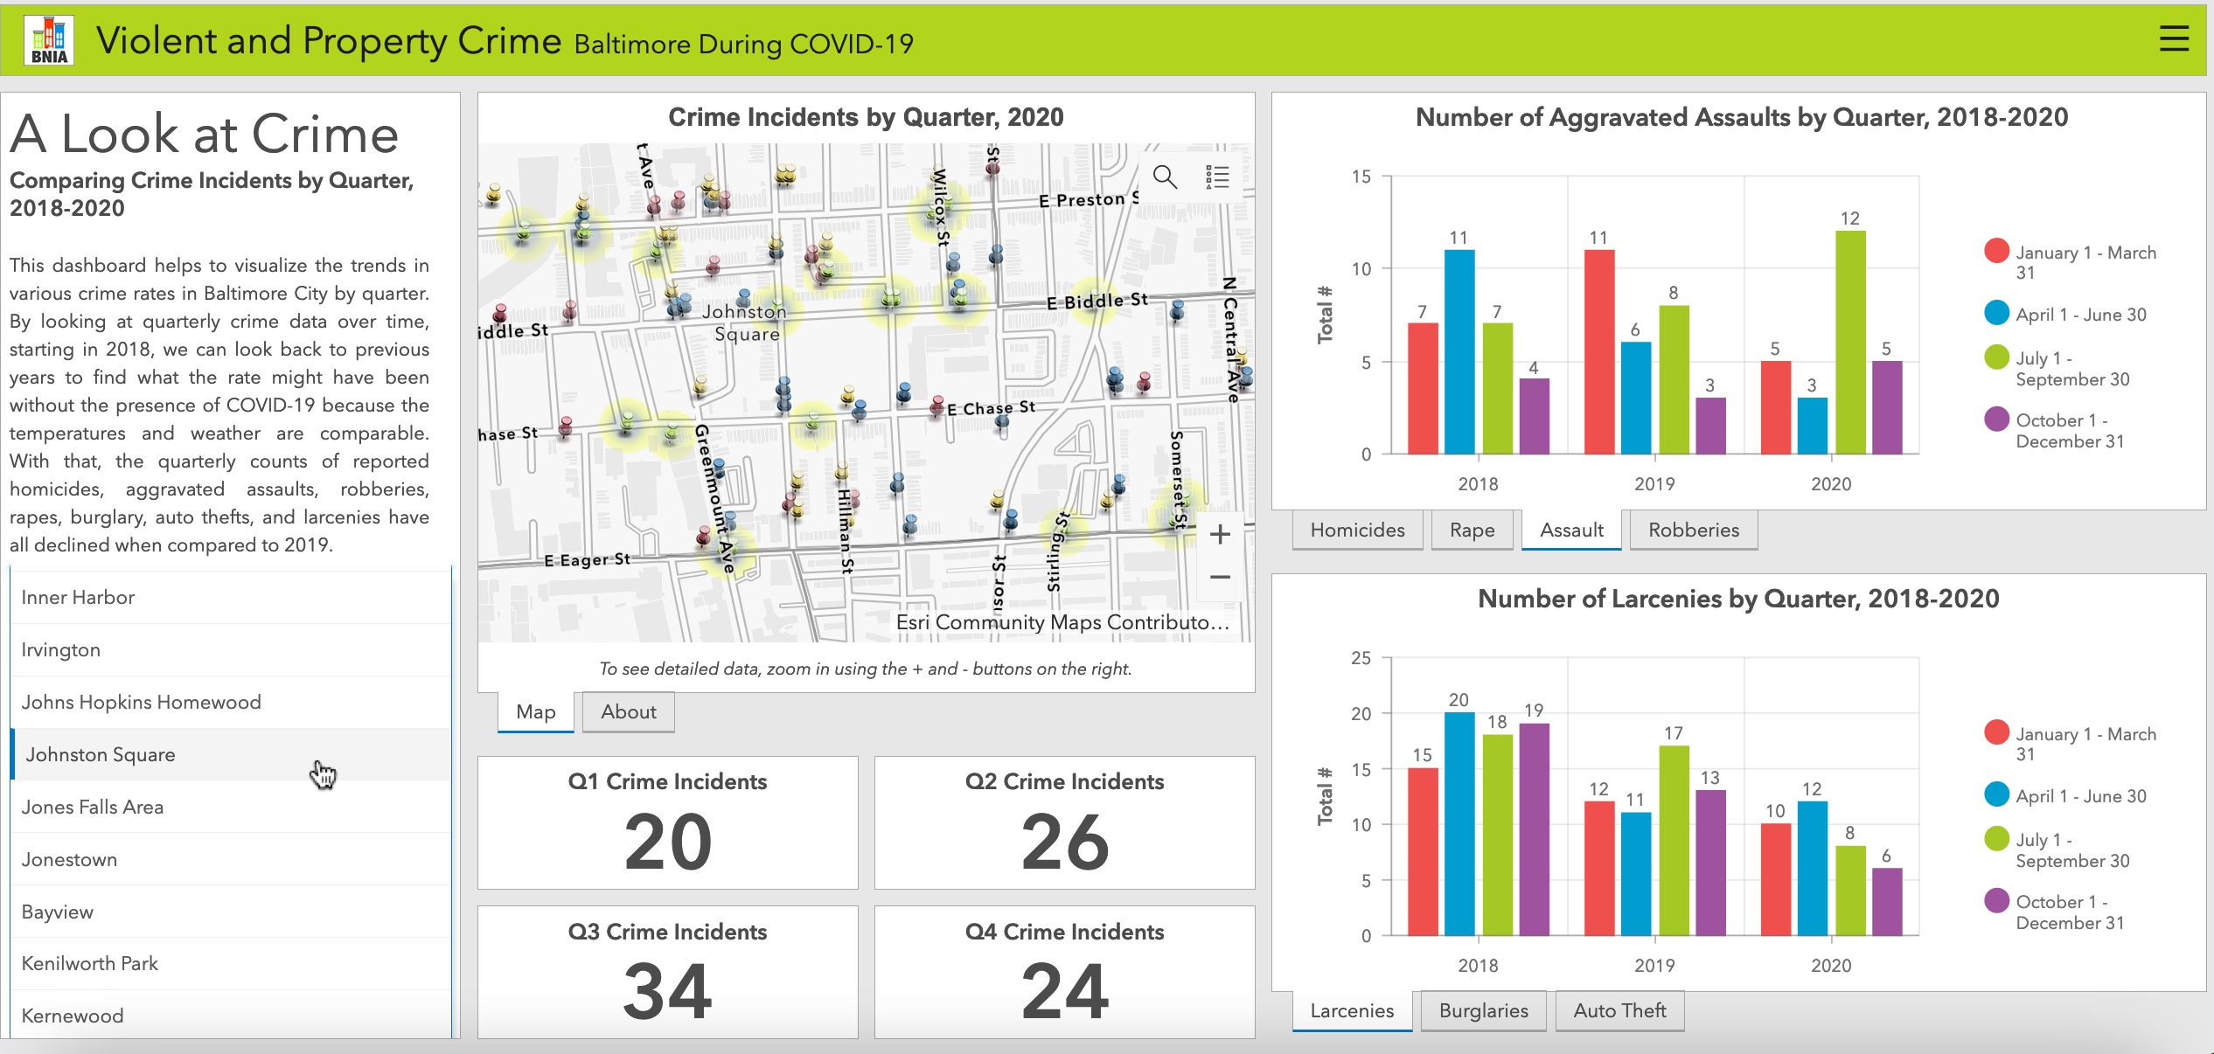
Dashboard:
Crime Incidents by Quarter
Bniajfi.org
@bniajfi

Slide 9
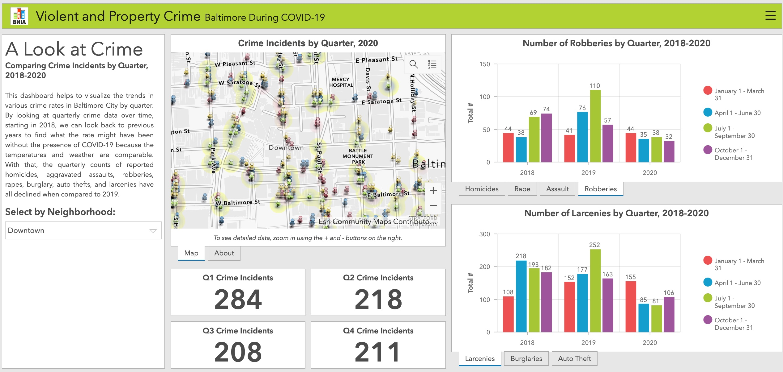
Dashboard:
Crime Incidents by Quarter
Bniajfi.org
@bniajfi

Slide 10
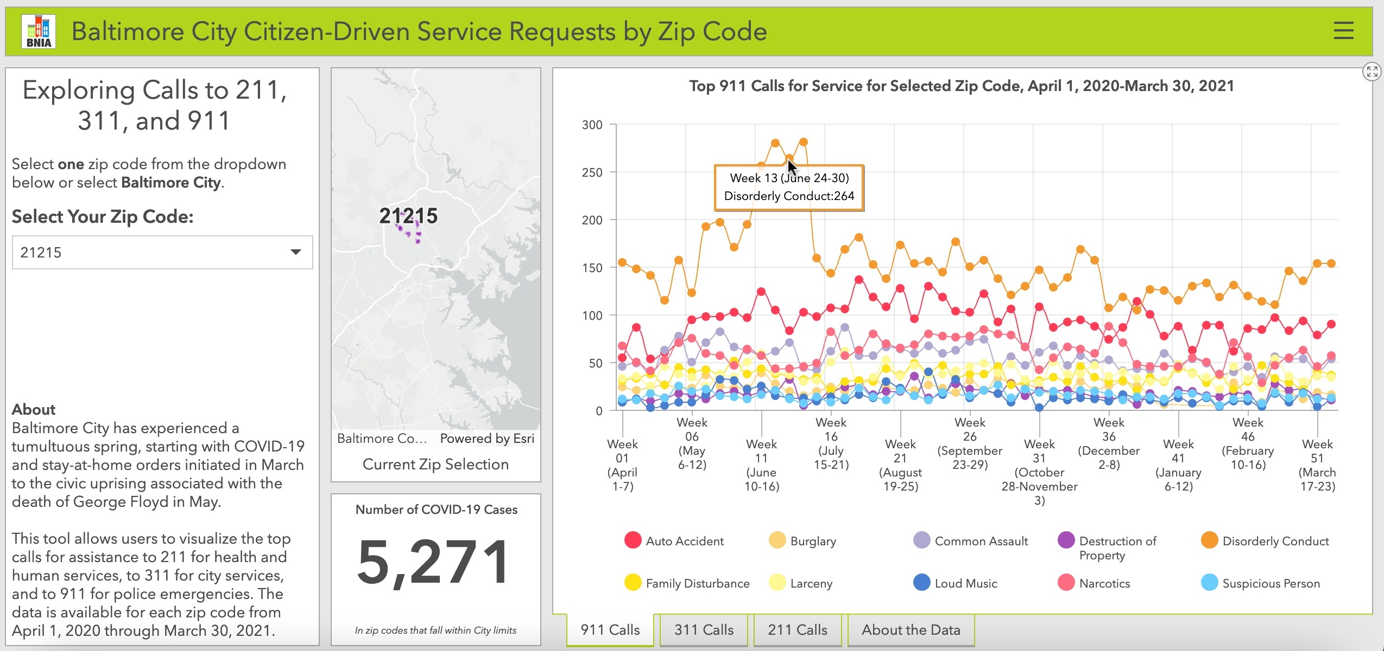
Citizen-Driven Service Requests Dashboard
Bniajfi.org
@bniajfi

Slide 11
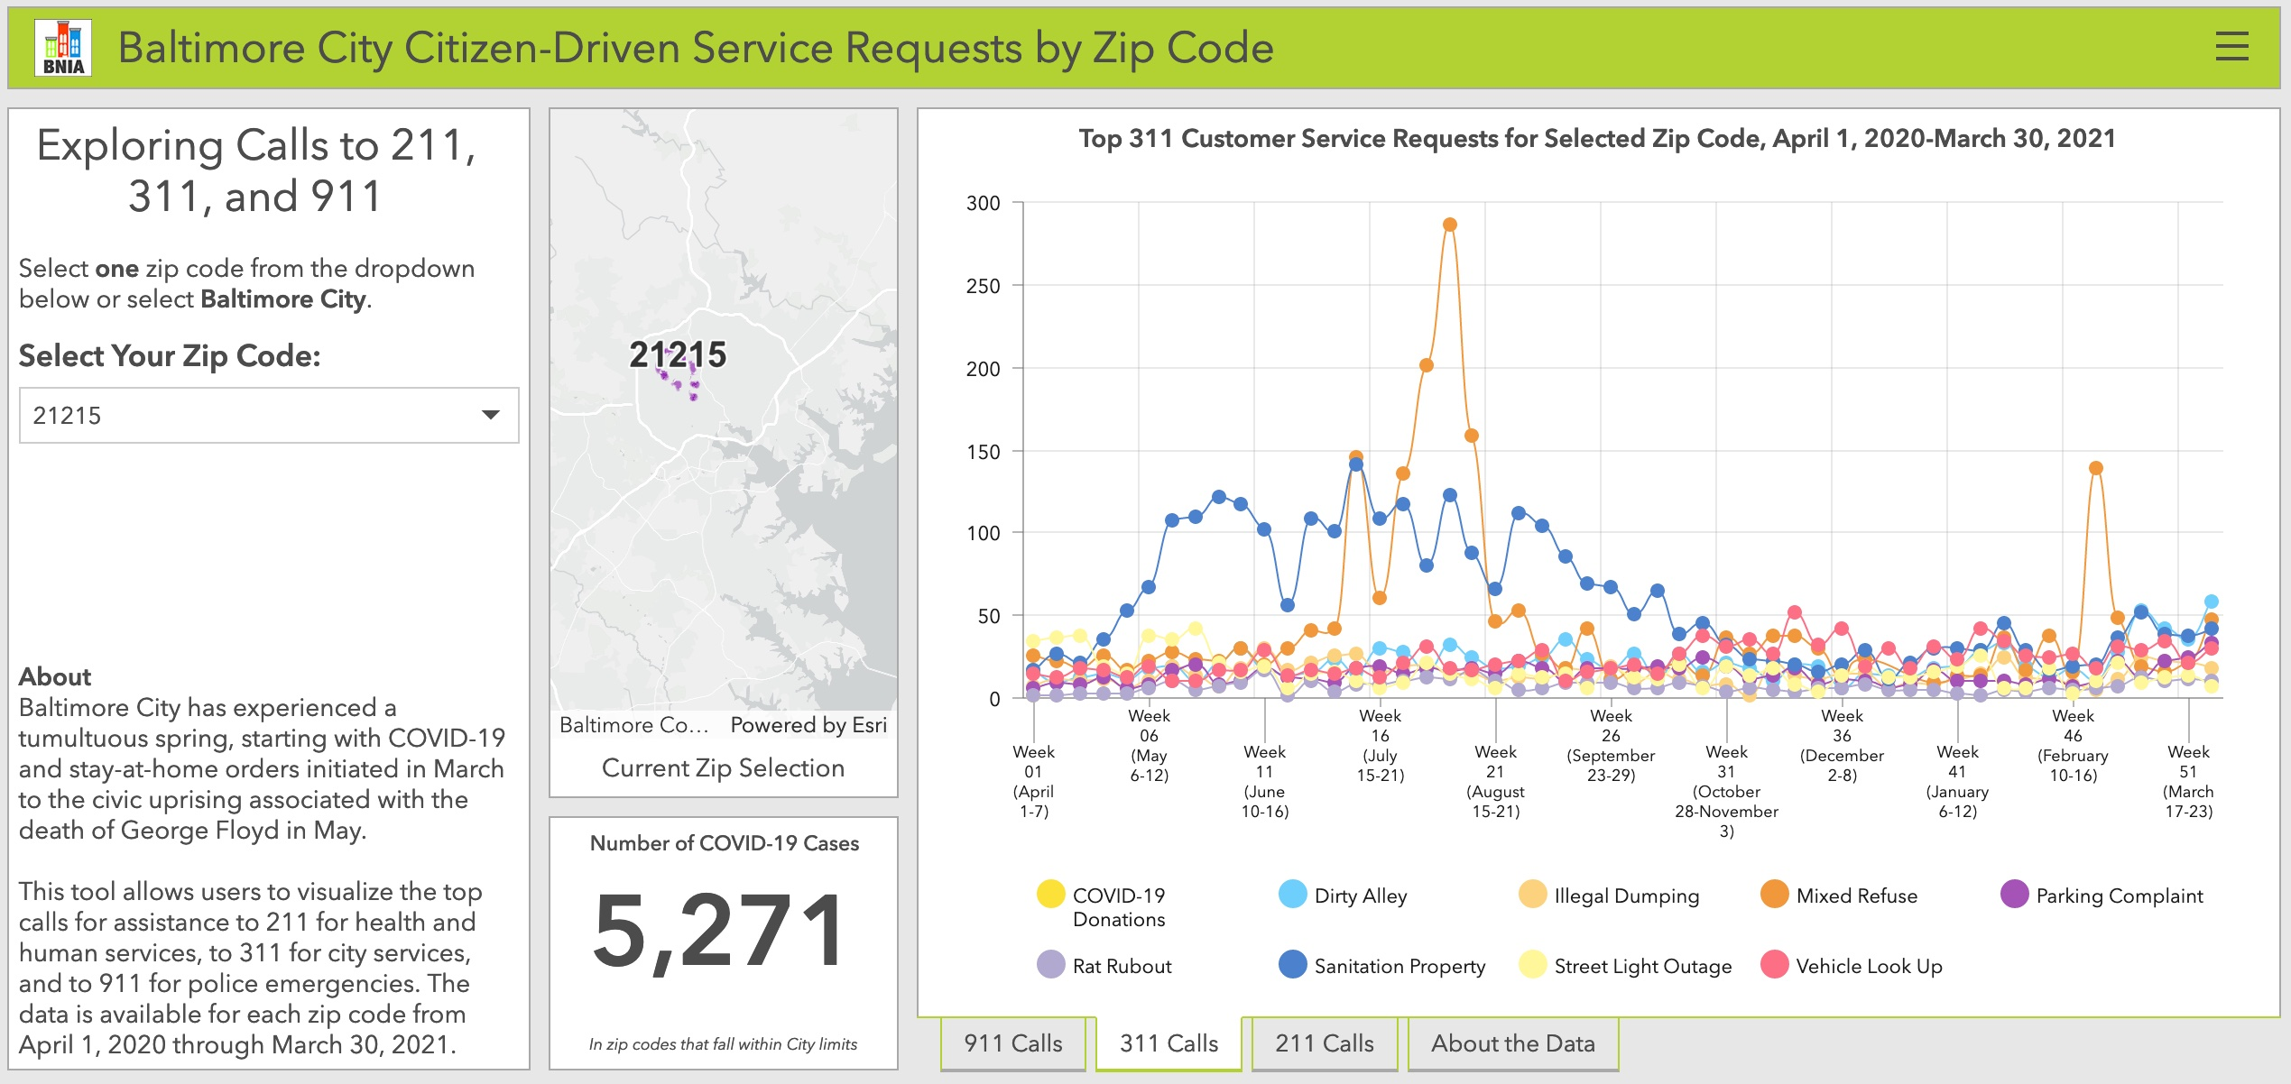
Citizen-Driven Service Requests Dashboard
Bniajfi.org
@bniajfi

Slide 12
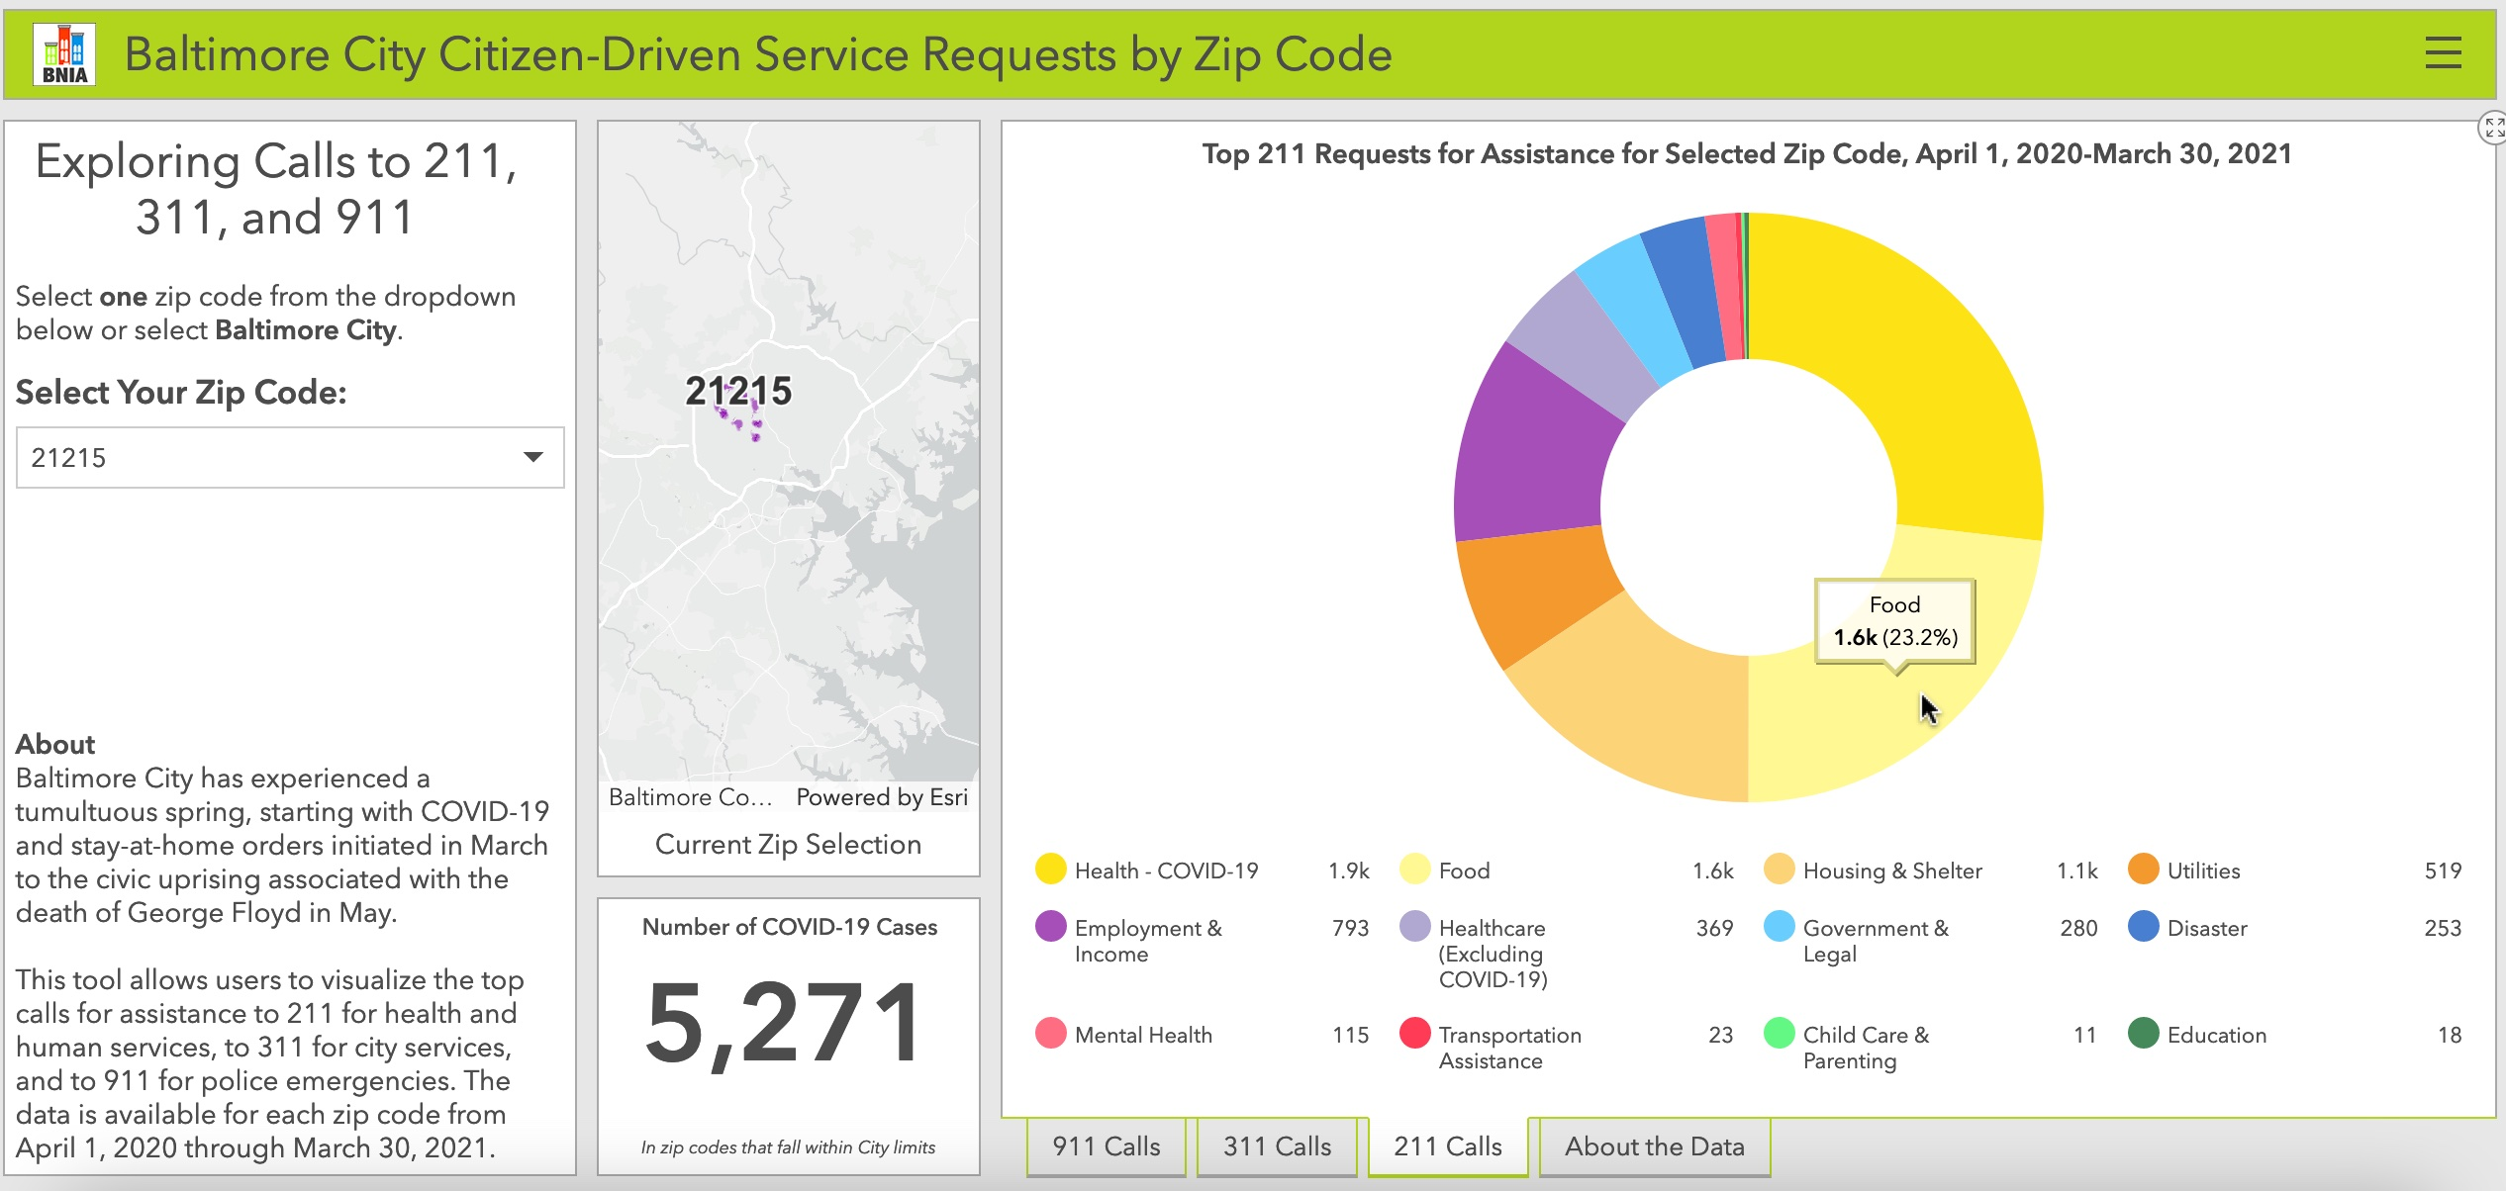
Citizen-Driven Service Requests Dashboard
Bniajfi.org
@bniajfi

Slide 13
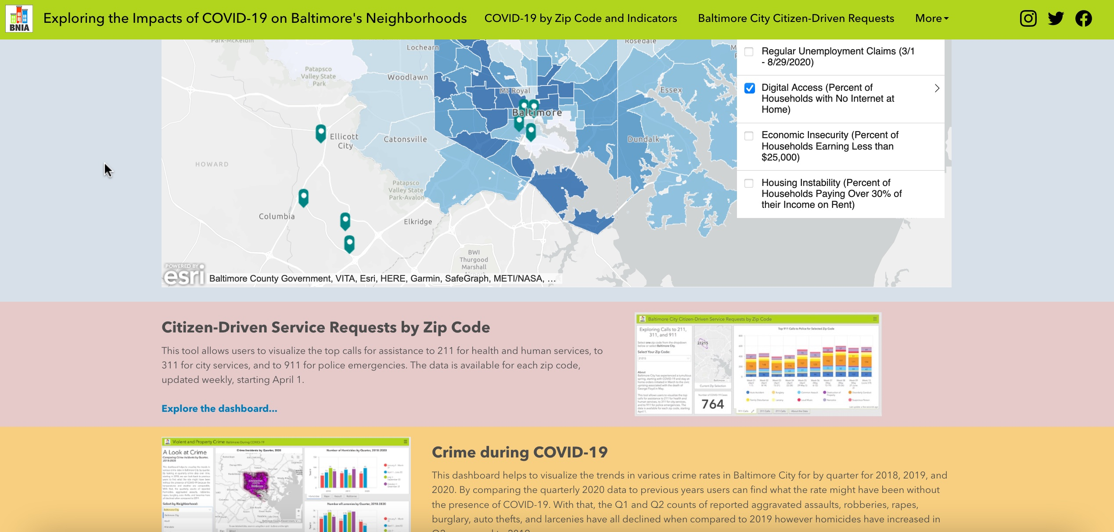
COVID-19 Data Hub
Bniajfi.org
@bniajfi
https://coronavirus-bniajfi.hub.arcgis.com

Slide 14
Contact
Bniajfi.org
@bniajfi
Cheryl Knott
Research Manager
cknott@ubalt.edu
https://www.bniajfi.org
@bniajfi on social media

