Slide 1
Data Driving Social Change

Slide 2
who we are
About Our
Rebrand
Why the name change and new look? As we reflected on the work the Data Initiative has done over the past 20 years, we realized that we are more than just an “initiative.” It was time to create a name—and identity—that
more clearly communicates who we are and what we do. Moving forward we are focused on expanding our reach and impact so we can further our mission of pioneering a data-driven culture within Colorado's social sector.

Slide 3
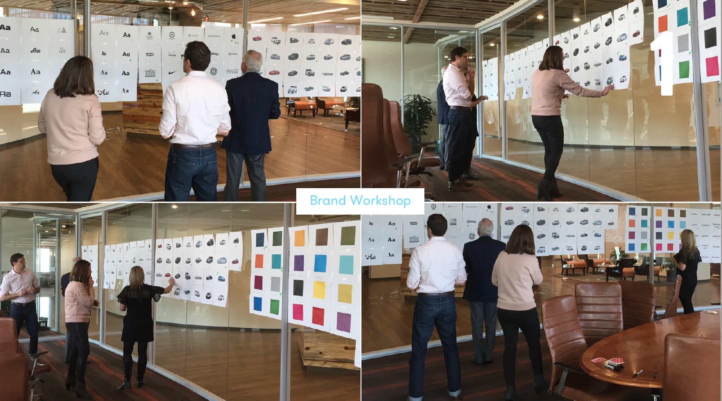

Slide 4
Stakeholder Interviews
We interviewed 13 external
stakeholders
6 Phone Interviews - Kathy Pettit
- Aaron Miripol
- Rebecca Arno
- Chris Watney
- Bill Fulton
- Alyson Shupe
7 Online Interviews - Paul Rosswork
- Sara Reynolds
- Carol Bush
- Kirk Bol
- Dace West
- Lisa Montagu
- Luis Duarte

Slide 5
What We
Heard
“No, "Initiative" sounds time
limited, and not as rich as the
products that DI provides.”
“Yes, but if it was going out on its own
I would rename since it wouldn’t really be
a Piton/GCI initiative anymore.”
“The name doesn't convey what
they're doing. I keep wanting to
ask ‘initiative of what?’”
Does the name Data Initiative communicate the product / services?
“Makes sense as one element underneath the
Piton name but if it's a stand alone brand, in
new markets, it might need some super
charging."
“No. Too generic, could mean anything. I'm attracted to the word data (that's what i do.) I'm expecting data, but I would never connect the suite of products with the name ‘Data Initiative.’”

Slide 6
Conclusion
Brand Equity / Name Affinity:
There is very little to no equity in the name “Data Initiative.” The majority of respondents not only support a name change, they see it as a necessity.
Looking Beyond The Name
The current name and brand or lack-there-of leads to confusion around what the Data Initiative is. There is poor understanding of the breadth and depth of the services and tools that Data Initiative provides. This was surprisingly pervasive even among your closest partners. This confusion isolates you from taking advantage of additional opportunities and limits your ability to maximize impact.

Slide 7
Choosing
a Name
1. Data for Social Change
2. People-Centric Data
3. Reliable & Un-biased Data
We explored 20+ different name & tagline combinations
Throughout the exploration process the name Shift resonated above all others as it most clearly reinforced the mission and vision of the Data Initiative. The new name provides answers/context vs. prompting questions.

Slide 8
LOGO + TAGLINE
Data Driving Social Change

Slide 9
our clients
Cost Recovery
Rationale
As we focus on becoming self-sustaining and expanding our reach and impact, we are moving to a partial cost recovery model that matches our partners' ability to pay for our services, making us a more affordable option
than for-profit data and research consultants. In addition, we will continue to offer our free community information tools and provide limited, free technical assistance to
nonprofit partners.

Slide 10
lines of service
OPEN DATA TOOLS
RESEARCH
COMMUNITY
ASSESSMENT
CAPACITY BUILDING
10￼

Slide 11
Thank You

