Slide 1


A Report on Public Schools in
Oakland, CA
By:
Rania Ahmed &
Sarah Marxer

Slide 2
Context
Long data-sharing partnership with Oakland Unified School District
Emerging Issue
Increasing numbers of charter schools

Slide 3
District-Run and Charter Public Schools
District -Run
Charter
86 District-Run Schools
36 Charter Schools (19 in CMOs)
1 Data System
19 Data Systems
75% of public school students
25% of public school students

Slide 4
Data Challenges in Charter Schools
Data Collection
Missing Data
Tough Decision
Student Level
Capacity & Infrastructure
Transparency & Privacy
Not Collected & Un-usable
Student Records
Missing Indicators
20% Threshold
Breaking Down by Ethnicity
Review (May 2016)
Main Report (Sep 2016)
Public Data from State ..... School Level
Getting Around
Addendum (Nov 2016)

Slide 5
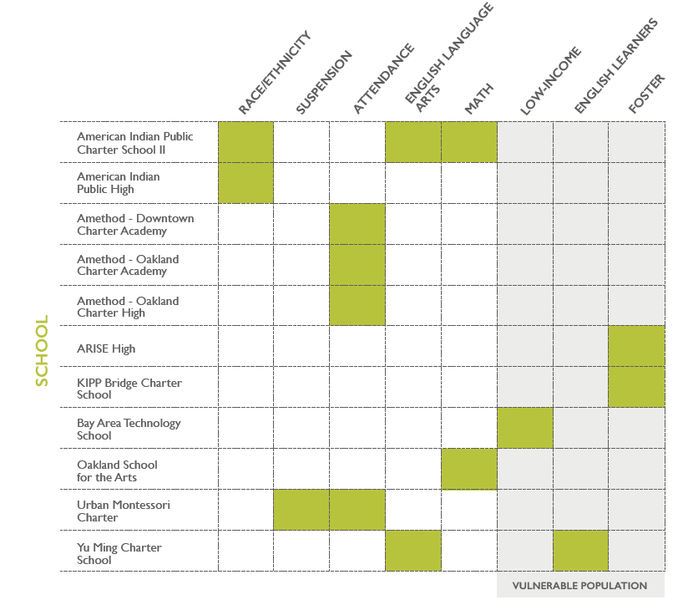
Data Challenges in Charter Schools
50% of charter schools had no issues
30% initially unable to deliver some or all portions of data
20% had data issues resolved along the way

Slide 6
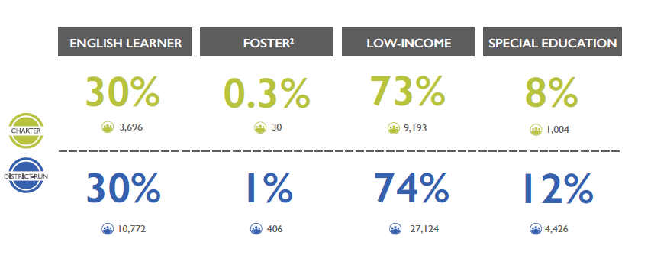
Demographics

Slide 7
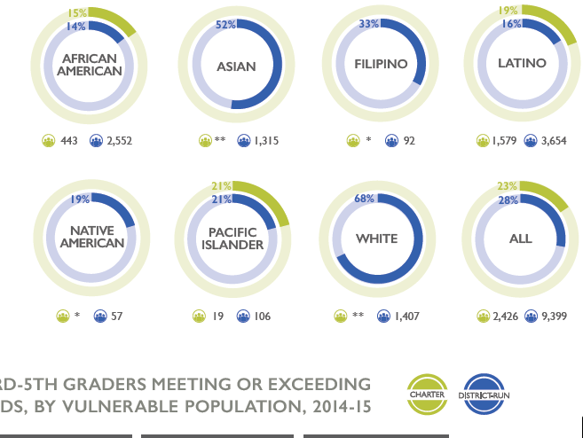
3rd-5th Grade Met/Exceeded ELA Standards, 2014-15

Slide 8
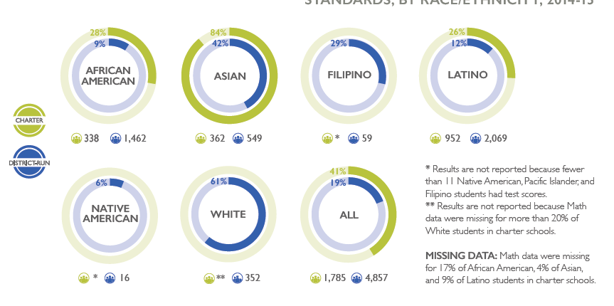
7th-8th Grade Met/Exceeded Math Standards, 2014-15

Slide 9
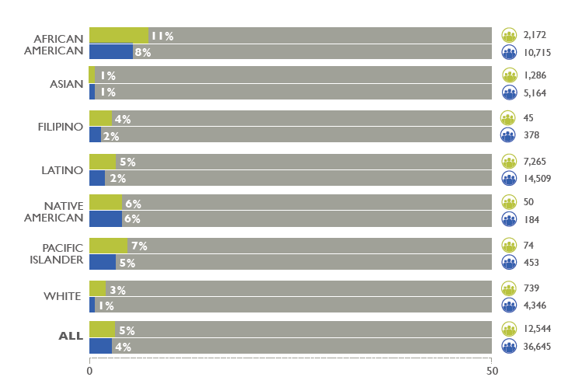
Suspension by Ethnicity, 2014-15

Slide 10
Conclusion
Action Items
OUSD …… Equity Pledge/Performance Working Group
Hopes and Expectations ...... What is Next?
Increased interest around suspension rates overall and by ethnicity
Acknowledged lack of data capacity in charters
About to start collecting 2015-16 data
More Transparency in Data Sharing
Data 101 Training Day
Spatial Analysis

Slide 11
Thank you
Rania Ahmed raniaa@urbanstrategies.org
Research Associate
Sarah Marxer sarahm@urbanstrategies.org
Senior Research Associate

