Slide 1
Community Data & Technology Training: Survey Results
Maia Woluchem
NNIP Cleveland Pre-session
September 13, 2016

Slide 2
Expanding Training on Using Data and Technology to Improve Communities
Project Goal: To expand the quantity and quality of training available to help resident leaders and staff in nonprofits and government agencies better use data and technology to benefit their communities.
Stages so far
  Survey of NNIP partners and a few external contacts
  Today’s workshop
Notes:
As you may have heard at last conference, we’re embarking on a project with Microsoft called “Expanding Training on Using Data and Tech to Improve Communities”
We’re working with the Technology and Civic Engagement or TCE division on this work, which has 5 local offices around the country, including Adam’s Chicago office
As you heard from Adam, the TCE team understand the importance of building local capacity to use data and technology to improve community outcomes. (can be tweaked or dropped based whatever Adam says)
Read project goal
Stages:
Scanned the field with our survey of NNIP partners and external folks
Today’s workshop is a part of the data collection for that project

Slide 3
How Did That Survey Go?
27 partners responded
As did 5 friends!
From those 32 respondents, we have a grand pool of over 60 trainings.
Notes:
So we got a much stronger response than we imagined.
Nearly all of our partners responded, with 27 total.
All but 4 had done some training before, and only 1 of those didn’t want to build training into their services
We also have responses from five external contacts brought to us by the TCE team at Microsoft.
Between all the responses, we have a grand pool of 59 trainings. You guys have been very busy, much to our delight. The handout lists all of the trainings and descriptions that we received so far.

Slide 4
What Does Training Look Like for the Network?
Generally, most of our partners are already training their communities
  Only five have not yet done it, but most are looking to start
For those who do, we have a wide range:
  How to identify need and interest when starting a social enterprise
  Data Analysis with R
  Machine learning
Notes:
The vast majority of our partners conduct training, only five don’t currently.
Of those five, most would like to start training in the future, barring issues of financial or staffing capacity

Slide 5
What’s the Field Look Like?
Most of you do trainings on the following:
  How to use a local data website to access data
  Using data/tech to complete a work-related task
  Using data related to a specific issue area
  Using a tool to manipulate or visualize data
  Using a local data source
Notes:
Most everyone falls into one or more of the following categories – definitely a pleasant surprise for us!
How to use a local website (like many of your own data dashboards or open data portals)
Work-related tasks (grantwriting or storytelling)
Specific issue area (housing, or environment, etc)
Tools (like GIS, Excel or Tableau)
Data sources (ACS, local crime data)

Slide 6

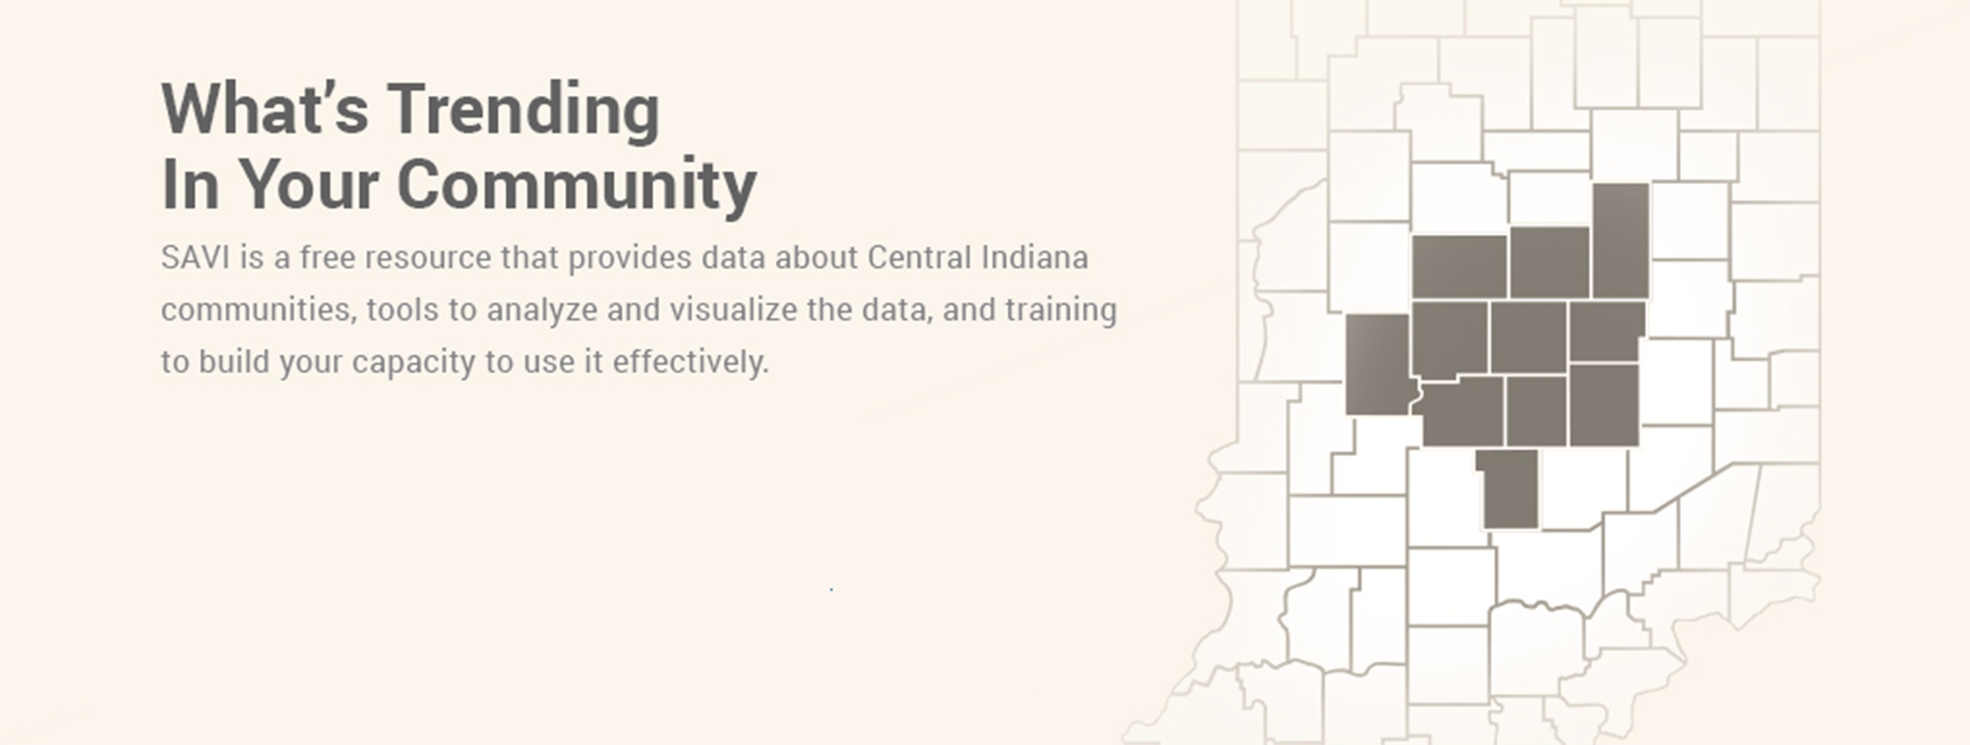
What Sort of Trainings Do We Mean?
Savi
Notes:
We found that these trainings ranged from those that were highly structured to some that were just beginning as pilot projects or as pieces of other larger events.
On the formalized side, our partner in Indianapolis (IUPUI) has some amazing examples of structured training courses for their data portal SAVI.
They have a course-based training model, with five skill levels and two different certifications. In addition, there are demonstrations and hands-on trainings offered as well.

Slide 7


What Sort of Trainings Do We Mean?
Notes:
On the other end of the spectrum, we have things that are a bit more informal. A few of you mentioned offering small trainings on a number of tools or data sources during your Data Days, including on things like ArcMap, ACS, or other topics of interest. (KP: Baltimore, MAPC)

Slide 8
Reach Matters
Through these trainings we’re all reaching important audiences:
  Nonprofit staff
  Government staff
  Funders
  Resident leaders
Almost all trainings can be given to those at “beginner” levels
Notes:
Besides the nonprofit audience intended by this project, many of you are reaching incredibly important individuals, including government staff, funders, and interested residents. An important takeaway is that by doing so, many of you are really democratizing these data concepts, particularly since the vast majority of this work can be given to people new to using data.

Slide 9
Where Would You Like to Go?
Gaps:
  Using technology tools to manipulate or visualize data
  Understanding data concepts
  Completing work-related tasks
  Data related to specific issues
  Using a local data source
Notes:
One of the most revealing points from the survey was noting the gaps that many of you hope to fill by additional training. By a large margin, the most sought-after trainings were those that pertained to understanding new technology tools or data concepts. Close contenders were the ever-popular “data as it can be used for work-related tasks”, “data for specific issues”, or using local data sources like ACS.
As it turns out, there’s significant overlap in the gaps and the offerings elsewhere in the network. We hope that the handout we shared help you locate partners who are already training in the areas you see as gaps ☺
Additionally, many of you are looking to tweak or adjust your trainings to fit your audiences more closely or try new subject areas. Things we heard were “I’d like to target my training to a particular level of expertise” or “I’d like to think more about funding”. Hopefully this workshop will allow you guys to trade ideas and learn from your partners.

Slide 10
Next Steps in Project
Debrief from the workshop
Interview key external informants
Draft Guide on Training (Fall/Winter)
Develop Materials for Catalog (Fall/Winter)
Notes:
Please answer the evaluation we’ll send you to improve any future editions of this workshop and pre-sessions in general
Interview key external informants, such as people from Bloomberg’s What Works and MIT Media Lab. If you have recommendations of others we should talk to, let us know.
Guide: We’d love input on what you think should be in the guide, and will be contacting many of them about being included in the catalog.

Slide 11
Follow us on Twitter @NNIPHQ or on NNIPNews Google Group
For more information about NNIP, visit www.neighborhoodindicators.org or email NNIP at nnip@urban.org

