Slide 1

NNIP Data Inventory
& SNIP Score Update
ROB PITINGOLO
October, 2015
Notes:
First presented last year in Denver. We’ve used your feedback and improved the methodology.

Slide 2



Local data is central to the
NNIP mission
NNIP local data should be…
Small Geography
Tract, Block Grp, Zip, Parcel
Recurring & Up-to-Date
2
Notes:
Local data is central to NNIP.
We care about data that is at small geographies and regularly updated.
NNIP partners agree to collect data:
across topics since problems and solutions rarely fall within silos
across time to reduce effort/costs of acquisition and processing over time, to look at trends, and to be responsive to quick requests
at the neighborhood level – because we know issues are not the same across the city

Slide 3
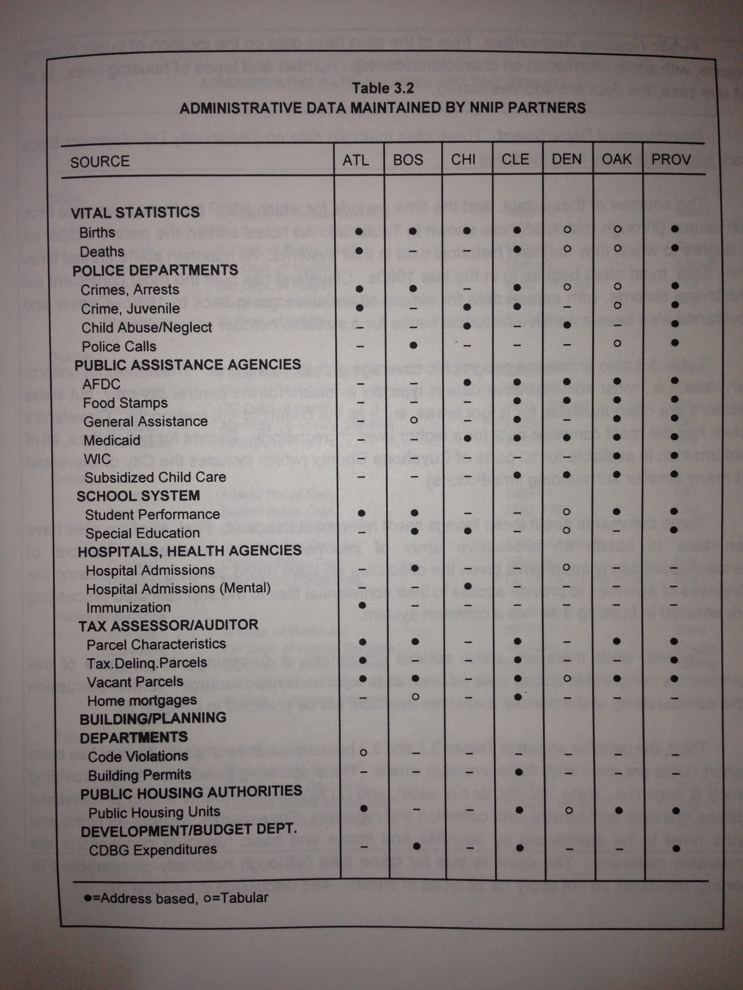
What is the Data Inventory?
First published1996 →
Became machine readable in 2007
Geography & coverage level
Age & Race tabs
Notes:
Data inventory goes back almost 20 years.
Covers the most common types of data, but not everything.

Slide 4

Value of the Data Inventory
Neighborhood data is central to NNIP
Self-assessment for partners
Identify cross-site opportunities
Improve the network
Health
Vital Stats
Crime
Housing

Slide 5
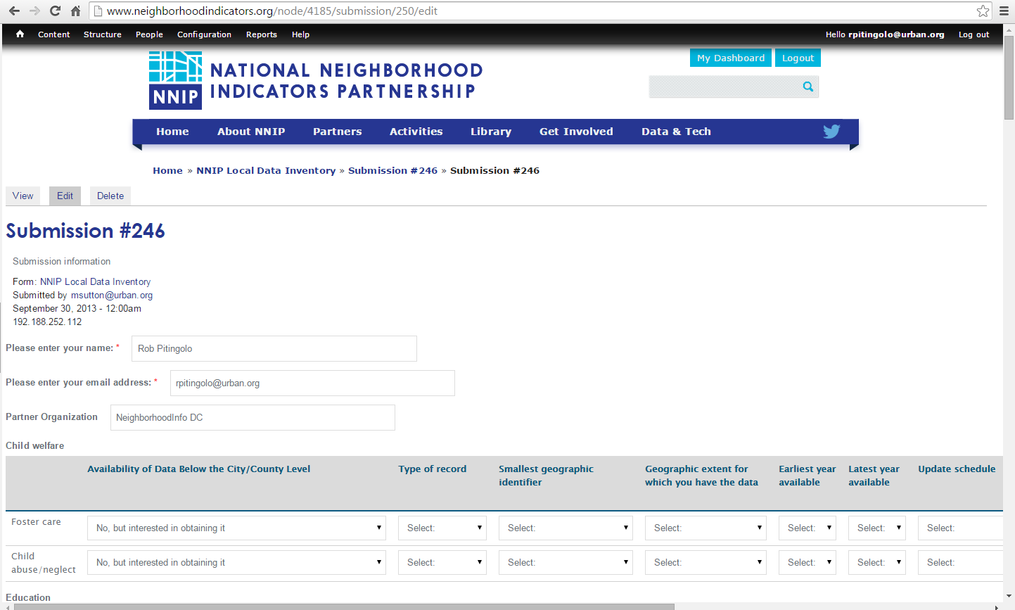
Revamped Data Inventory on
the NNIP Website
5
Notes:
Now online, much easier to use!
We no longer are asking if you have data that’s not at the neighborhood level – major change.
If you have any additional feedback about the new system, please let us know.
Going to get back on schedule for updates.

Slide 6
Thank you partners for updating your inventories!
Atlanta
Camden
Charlotte
Cleveland
Columbus
Dallas
Denver
Detroit
Grand Rapids
Indianapolis
Milwaukee
Minneapolis
New Haven
New Orleans
New York
Oakland
Pinellas
Pittsburgh
Providence
San Antonio
Seattle
St. Louis
Washington, DC
6
Notes:
Thank you to all the partners who updated on-time!
We know it was short notice, it’s helpful.
Acknowledge that some of the scores aren’t based on up-to-date inventories.

Slide 7


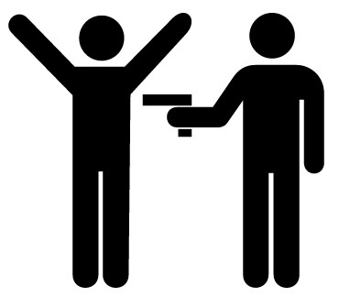




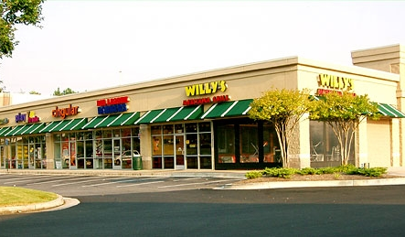


New & Improved SNIP Score
Small-geography Neighborhood Indicator Performance (SNIP) Components:
Vital Stats
Pt1 Crime
Distressed Property
Child Health
School Enrollment
Other Health
Property Data
Business Licenses
Home Sales
Public Assistance
Notes:
SNIP is a summary score to give us a snapshot of the extent of the data each partner has.
A few key changes from last time…
Prisoner re-entry is gone.
Business licenses is now part of SNIP.
A few small changes about how vital stats and distressed property indicator is calculated.

Slide 8
Methodology
Neighborhood Data Must Be…
Held “in-house”
Small geography
  Parcel, Block Grp, Tract, Zip, other “neighborhood”
Recurring & recent as of at least the year →
Point awarded when all conditions are met
Notes:
Here’s how SNIP works….

Slide 9
How NNIP Partners Score
Max Score = 10
Notes:
These are the scores this time around.
Average is a little lower than last year, expected since we tightened up the date requirement.
We think it should look better and will once all the inventories are up-to-date, specifically, few zeros.

Slide 10

Let’s Dig Down Into the Stats
Range: 0-10
Mean: 3.8
Median: 4
N: 28
Notes:
Some stats.

Slide 11
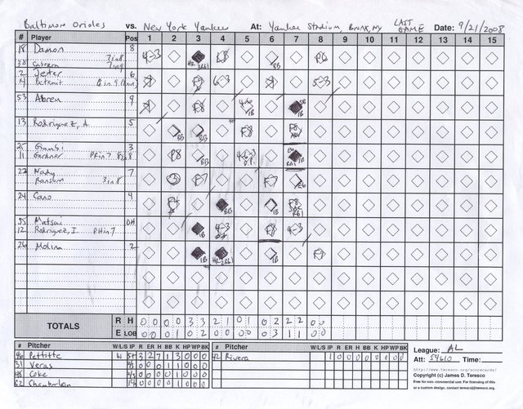
Find out how well you scored this year
Example SNIP scorecard…
City: [Example City]
SNIP Score: 5/10
SNIP data in inventory:
Schools
Vital Stats
Property Sales
Crime
Public Assistance
Notes:
I have simple SNIP scorecards run for each partner city.
Please find me and I can tell you how your city did.
I’m emailing everyone their score. Check for it during lunch!

Slide 12
NNIP’s most common up-to-date neighborhood data

Slide 13

Goals for 2016
All partners with up-to-date inventory
No partners with zero SNIP score
More data brought up-to-date

Slide 14
Low-hanging fruit… bring data up-to-date!
Notes:
Average score improves to 6 if everyone simply brings the data they already have up-to-date.

Slide 15

Back-to-back Champs!
Oakland!
ALMOST PERFECT SCORE 9/10
Notes:
Runner ups Cleveland and Columbus!

