Slide 1
Urban Policy and Program Surveillance Project
Monitoring policies and programs in select U.S. Cities
Amy R. Confair, MPH
Outreach and Training Manager, Drexel UHC
Philadelphia NNIP Partner

Slide 2
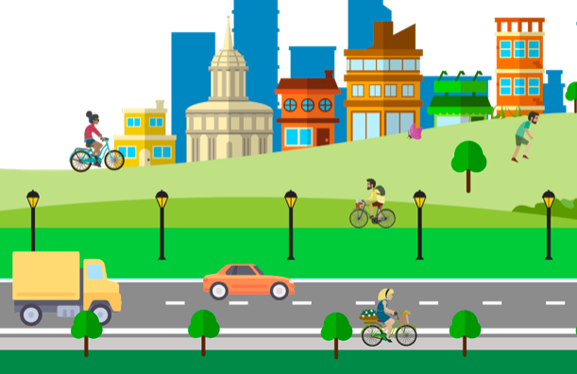
Purpose
Cities play an important role in developing and implementing policies and programs that impact health equity, but few (if any) systems exist to understand these practices across cities.
Understanding the role and potential impact local governments have on health is especially important in times when the federal government is less focused on public health.
Notes:
Why did we decide to do this

Slide 3
Goals
Identify best practices
Create a monitoring system
Synthesize & Disseminate information
Notes:
At first it was a challenge - can we create a system to monitor, document, and disseminate local policy actions that can impact population health and improve health equity
We want to identify the best practices that select U.S. cities are using, whether policy, programmatic, or budgetary initiatives to promote health equity.
Our goal is to synthesize this information and disseminate in useful formats to stakeholders who can act on it.

Slide 4
Scope
UHC Policy Surveillance
Four cities to start:
Philadelphia
New York City
Washington DC
Los Angeles
Three topics to start:
Housing
Environment
Education
Traditional Policy Surveillance
Notes:
We started this in March 2017, so about 2.5 years ago
Traditional Policy Surveillance
Ongoing systematic surveillance of public health laws and policies
UHC Policy Surveillance
Expanding on this to include policy, programmatic, and budgetary initiatives that promote health equity (explicitly or implicitly) and target social determinants of health
We chose these 4 cities because they’re active policies centers, have information available online, regional spread and size range
We chose to look at topics that are likely actionable at the local level regardless of action or inaction at the federal level
Housing
e.g. affordable housing, gentrification, homelessness, homeownership, real estate
Environment
e.g. urban revitalization, land use, transportation, food environment, sustainability initiatives
Education
e.g. early childhood ed., socioeconomic gaps in educational achievement, college readiness, school safety

Slide 5
Methods
Surveil news sources for new policies and programs
Monitor policies and programs for updates monthly
Record findings in a database (excel spreadsheet)
Create reports summarizing findings for external dissemination
Notes:
Six general types of news sources
General news sites (google news or local paper)
Social media
e.g. councilmember’s twitter
City government agencies
e.g. news rooms and press releases
Advocacy organizations
City legislation databases
e.g. mayoral executive orders, school board resolutions, and city council bills
Other websites
e.g. NNIP partner

Slide 6
Results and Dissemination
We have documented over 300 policies and programs
Walkable neighborhoods
Completed
Methods brief
Environmental report
Housing report
Education report (drafted)
Planned
Infographics
Social media
Dashboard, interactive searchable website, or other online tool for the public
Develop manuscript on process and outcomes
Suggestions?
Notes:
I’m not going to get into the results here, but it’s been interesting to look at the trends (like everywhere has sustainability/environment goals) and many US cities have a commitment to equity, and the places where cities focus on different issues, and we can hypothesize the reasons why (political leadership, historical ties, etc.)
Lessons learned:
Regardless of action or inaction at the federal level, cities can have an impact on population health in urban areas.
Cities are active in urban health at the policy, program and budget levels – much is missed if you narrowly focus on big “P” policy.
Through transitions in administration, some initiatives stay intact and some do not– determining ways to have sustained effect is important

Slide 7
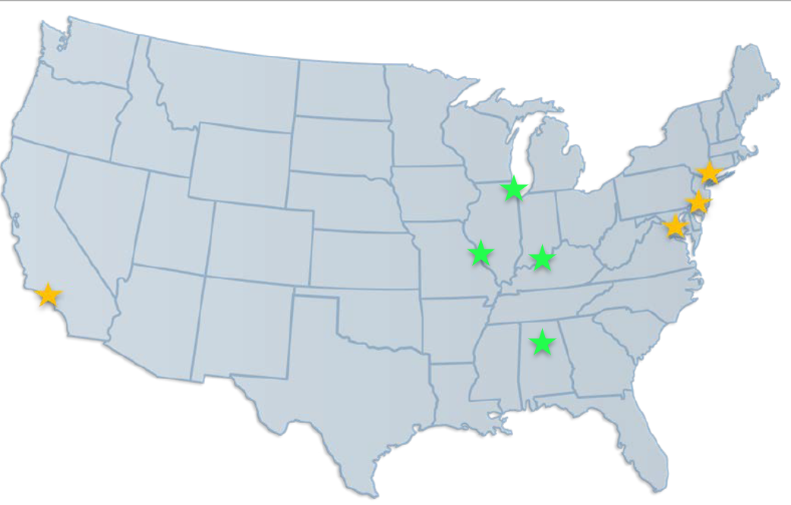
Next Steps
Expand project to additional cities
Expand project to additional topic areas
Continue synthesizing and disseminating our findings in a variety of formats
Seek additional funding to expand this work
Chicago
St. Louis
Louisville
Birmingham
Current cities
New cities
Notes:
We’re working with faculty in the schools of public health in each of these cities.
School of Public Health at the University of Alabama at Birmingham (Lisa McCormick)
College for Public Health and Social Justice at St. Louis University (Darcy Scharff)
School of Public Health at the University of Illinois at Chicago (Linda Forst and Susan Kaplan)
School of Public Health & Information Sciences at the Commonwealth Institute of Kentucky (Liza Creel)
Since they’re only doing 1 city we’re curious what other topics they’ll look at

Slide 8
Thank you! Questions? Contact Amy Confair, MPH arc333@drexel.edu

