Slide 1
Turning the Corner:
Monitoring Neighborhood Change to Drive Action
Kathryn Pettit
Symposium on Gentrification and Neighborhood Change
May 25, 2016
Notes:
Introduce myself –
My presentation is a little different from the ones you heard. I represent a team of different organizations to tell you about a project just in the beginning stages.

Slide 2
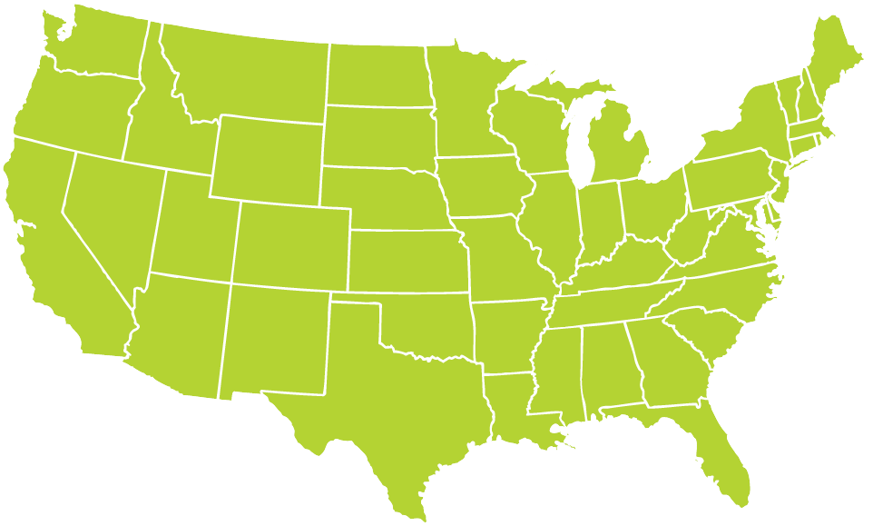
National Neighborhood
Indicators Partnership
Better Data. Better Decisions. Better Communities.
Notes:
At the Urban Institute we coordinate the National Neighborhood Indicators Partnership (NNIP) is peer-learning network of local data intermediaries in 30 cities, NNIP partners collect neighborhood data over time and across topics in order to help local actors use the data to improve communities. Furman Center is our partner in NYC. Urban also helps new cities gets started.
. MODEL is not the focus today, but happy to answer questions or talk after the session.

Slide 3




National project partners
Lead project design
Facilitate cross-site learning
Communicate local progress
Synthesize experiences across sites
Federal Reserve/Philanthropy Initiative of The Funders’ Network for Smart Growth and Livable Communities
Link to their respective audiences
Engage funders in potential cities
Support Urban’s national role
Participate in the Detroit advisory group
Notes:
Turning the Corner is designed in the model of a NNIP cross-site project . The project was developed in collaboration with the Federal Reserve/Philanthropy Initiative (FPI) of the Funders Network for Smart Growth, Older Industrial Cities Working Group. Walk through:
Urban: Lead project design and cross-site learning
FPI - Link to their external audiences and engage funders in potential cities
Kresge – funding national role

Slide 4



Detroit project partners
Participate on project design
Conduct local research and analysis Coordinate local engagement activities
Communicate with local audiences
Financially support the research
Participate in the advisory group
Participate in the advisory group
Link to other Federal Reserve Bank research and audiences
Notes:
The design and implementation of this project relies on the combined expertise of local and national organizations.
Detroit is the first city to participate. Our NNIP partner, Data Driven Detroit, is assisting in the project design as well as leading the local research and communication
Walk thru list – mention Kresge will also participate in local work
Model for other cities – local research partner, local funders, regional Federal Reserve bank

Slide 5
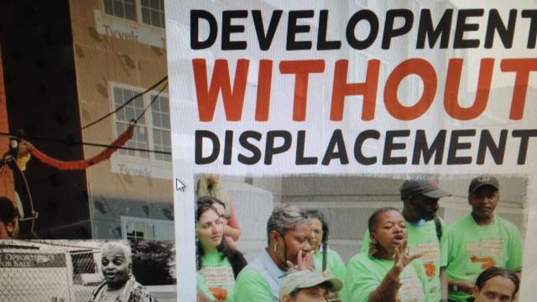
Goals for participating cities
Produce meaningful and more frequent measures of neighborhood dynamics
Facilitate informed community conversations to prevent displacement and equitably restore neighborhoods
Notes:
Develop measures for in-depth and broad understanding of neighborhood dynamics, especially in neighborhoods at risk of becoming unaffordable. We think things might be different that earlier efforts in the postrecession economy
The important part of the project is sharing the data to Inform discussions across sectors about how to use the data and analysis to develop creative local policies and programs for equitable development.
Data can foster a common understanding of what’s happening and help to direct and mobilize action.

Slide 6
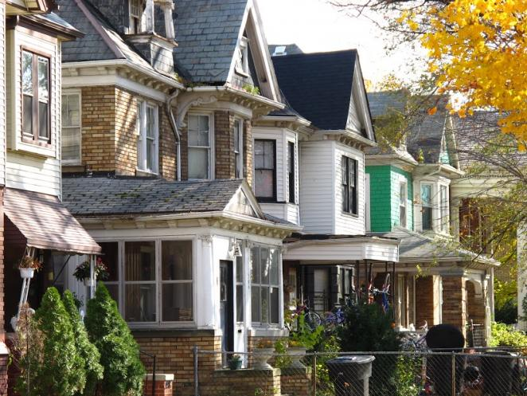
Goals for the field
Share:
findings on monitoring change and incorporating analysis into local decisions
policies and programs from places with varying housing markets
protocols and methods that can be adapted by other places
Notes:
Across sites,
- we plan to do a summary of local findings on the results of the measurement and how it was used locally.
- through the advisory groups, we expect to share strategies on local policies and programs in different kinds of places
- produce protocols and methodology that can be adapted by other cities

Slide 7
Key design elements
Qualitative and quantitative data collection
Topical exploration of various types of displacement – physical, cultural, commercial
Practical application of research through advisory committee and ongoing communications
Notes:
Urban will provide a framework for local research and engagement which each local coalition will adapt
Core components.
Qualitative data collection that captures various perspectives including residents, private and public stakeholders as well as traditional indicators (sales price, crime)
Exploration of various types of displacement including but not limited to residential displacement, cultural displacement and commercial displacement
Embedded practical application of research through local advisory groups –
They’ll ensure that the analysis is relevant to local questions and priorities

Slide 8
Project timeline
Project design (January–June 2016)
Local implementation and early learning (June 2016–May 2017)
Cross-site summary and dissemination (June–December 2017)
Notes:
Project design (January–June 2016)
Review lessons from research and practice
Develop research guidance and protocols
Local implementation and early learning (June 2016–May 2017)
Plan and implement engagement process for local stakeholders
Conduct local data collection activities
Share local progress and early lessons
Phase 3: Cross-site summary and dissemination of findings (June–December 2017)
Synthesize lessons and experiences across the participating sites
Disseminate to local and national audiences

Slide 9
Local requirements for city participation
Local Participants (including post-industrial)
    NNIP/research partner with existing data and convening capacity
    Local philanthropy to fund local efforts and facilitate engagement
    Regional Federal Reserve Bank
    Local advisory group members
  Contribute to cross-site activities
Notes:
Check post-industrial language
We actively seek local interest and sponsorship from additional cities.
FPI have been leading outreach to other potential participating cities are exploring cities in a wide geographic footprint?
Talking to stakeholders in Twin Cities, Pittsburgh, Buffalo, Interest from NOLA. Milw, San Antonio

Slide 10
Examples from NNIP
Notes:
Wanted to take the last part of the presentation to share some experiences from the larger NNIP network.

Slide 11
Raise expectations for actionable data
Access
  Need raw material of multi-faceted and frequent data
Analysis
  Need to select indicators, flag warning signs, dig into trends, understand local context
Application
  Need built-in links to government and civic actors who have the tools and processes to respond
Notes:
Solomon Greene and I have a blog coming out in a couple weeks imagining what it would take to regularly monitor ngh change to inform decisions and promote equity
Walk through slide
All has to be implemented with the principles of equity and participatory

Slide 12
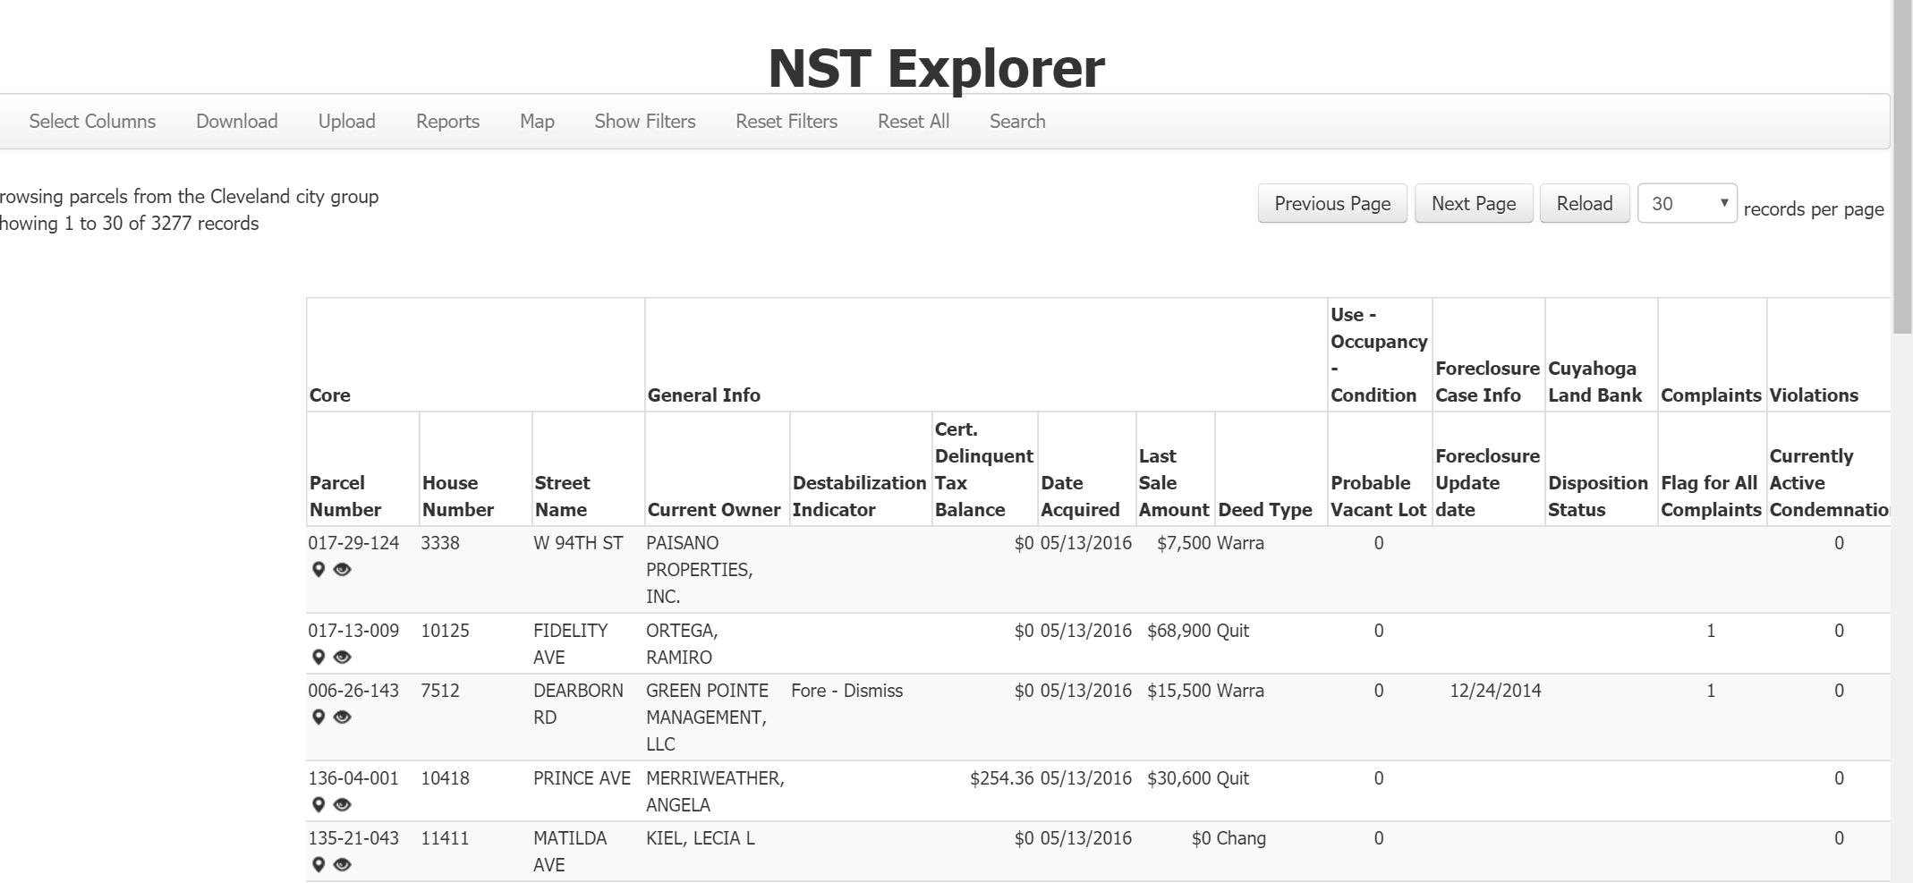
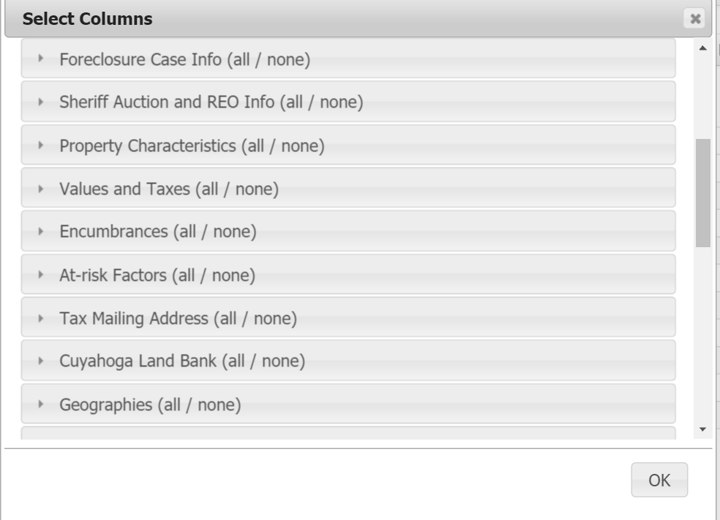

Cleveland
Notes:
We don’t have all the answers, but I want to share some specific examples from the network.
Access: dozen Code enforcement, property deeds, foreclosure, tax arrears linked at the address level. Some weekly updates. Not common now, but very city could have this system.
Analysis: Multiple levels – within processing every week: scanning across indicators to identify vacancy, or possible speculator purchases
Long-term on neighborhood indicators, trajectories of types of properties
Application: People who are ready to use the information – all working off the same facts. Build in on-the-ground knowledge from uses too.
Cuyahoga County Land Bank, CDCs, and City of Departments of Building and Housing and of Community Development

Slide 13
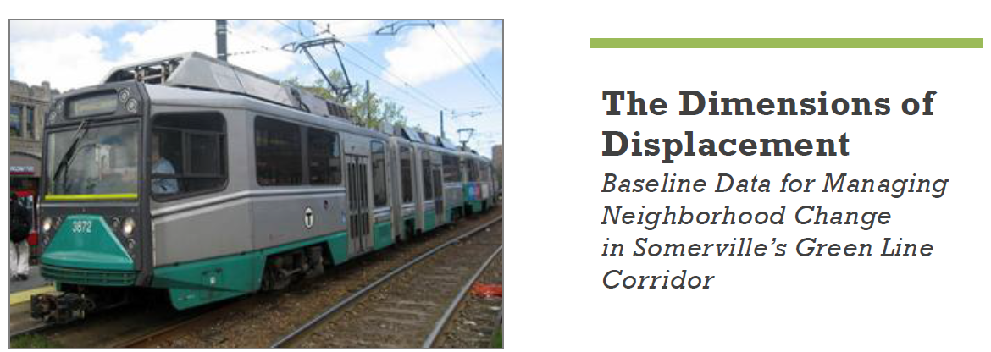


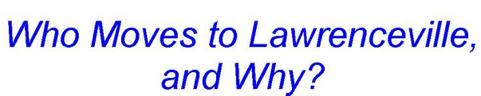
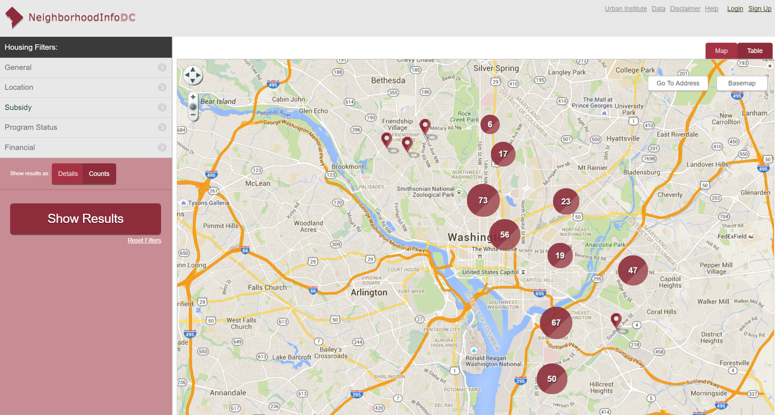
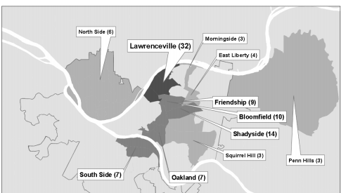

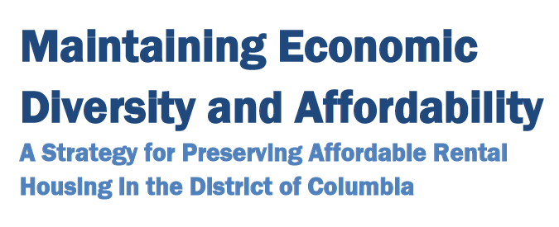
Other NNIP examples
Notes:
The Metropolitan Area Planning Council (MAPC) prepared this analysis in partnership with the City of Somerville, Somerville Community Corporation, Somerville Transportation Equity Partnership, Friends of the Community Path, and Massachusetts Smart Growth Alliance. Illuminated the magnitude of displacement risk associated with the Green Line extension (GLX) in order to help focus action on the strategies with the best potential to mitigate that risk Findings: Increases in residential rents near new transit stations pose the greatest risk of displacement. Other factors: Condo conversion, expiring public subsidies, tax bills.
Also qualitative, in May 2016, MAPC, the True Story Theater, and the Irish International Immigrant Center hosted a dialogue to explore belonging, affordability, and displacement in our region. On the spot, actors from True Story Theater will portray the heart of what is being heard using music, movement, and dialogue. The intent is to create a respectful atmosphere where every voice can be heard and any story told
DC Preservation Network meets monthly – CDC, city govt, HUD all looking out a year about buildings with expiring subsidies. Share information about landlords, who’s working with which tenant associations, etc. Work on individual properties as well as use the data/experiences to create set of policy recommendations for the mayor
In Pittsburgh, conducted a movers survey – interviewed newcomers and people who left. Worked well in an area where lots of movers were captured in credit data. Really understood dynamics of change and behavior just as it started to happen. Results spoke to importance of Main Street strategy in attracting residents.
All of these are results of embeeded institutions working in partnership over time to understand how ngh are changing and prioritize actions together.

Slide 14
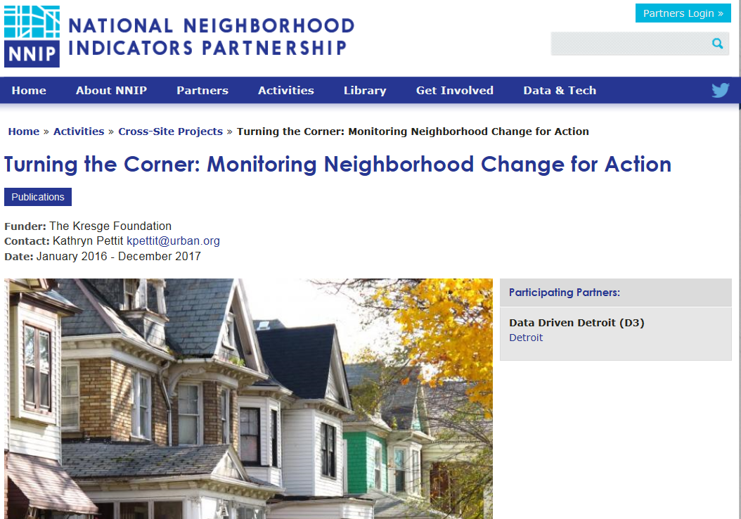
www.neighborhoodindicators.org
Notes:
Many other examples on our website. We’ll be excited to share the TTC progress with you as we go along. Here is the project page.
Mention listserve and Twitter

Slide 15
Kathy Pettit, Urban Institute kpettit@urban.org
Julia Seward, The Funders Network for Smart Growth and Livable Communities, juliawseward@gmail.com
Tom Woiwode, Community Foundation for SE Michigan twoiwode@cfsem.org
Michael Grover, Federal Reserve Bank of Minneapolis michael.grover@mpls.frb.org
Notes:
Any of us would be happy to talk further.

