Slide 1
Using Data for Community Action
Kathy Pettit
February 17, 2016
Open Places Initiative
Notes:
Introduce myself – thank you for inviting me. We will post our presentations for you to access later.
Urban is dedicated to elevating the debate on social and economic policy through rigorous research and engagement.
We believe in the power of evidence to improve lives by
Reducing hardship amongst the most vulnerable
Expanding opportunities for all people
Strengthening the effectiveness of the public sector

Slide 2
National Neighborhood Indicators Partnership
Collaborative effort of Urban Institute and 30+ local data intermediaries since 1995.
NNIP partners help local actors use neighborhood data to improve communities through policy, planning, and advocacy
Trusted and engaged institutions
Relevant and high-quality data across topics
Notes:
MODEL is not the focus today, but happy to answer questions or talk after the session.
Mention Terri as one of the founding partners in Denver and Spike
Mission:
The point is to get the information used - whether for policymaking, community building, program planning.
At the start, the founding NNIP partners recognized that not everyone had equal access to information. Focus began with and remains on low-income nghs that have traditionally not had access to data or training to use them.
Institutions:
The partners are housed in various types of institutions – universities, independent nonprofits, local funders.
But whatever the home, they are all respected organizations with a long-term stake in their community. People believe the data and analysis that is published.
Data: at the core of the work…
Partners all agree to assemble and organize local government data that is
1) Ngh-level
2) On a range of issues (need to understand ngh issues and interventions holistically)
3) Over time (to understand trends and be responsive when issues arise).

Slide 3
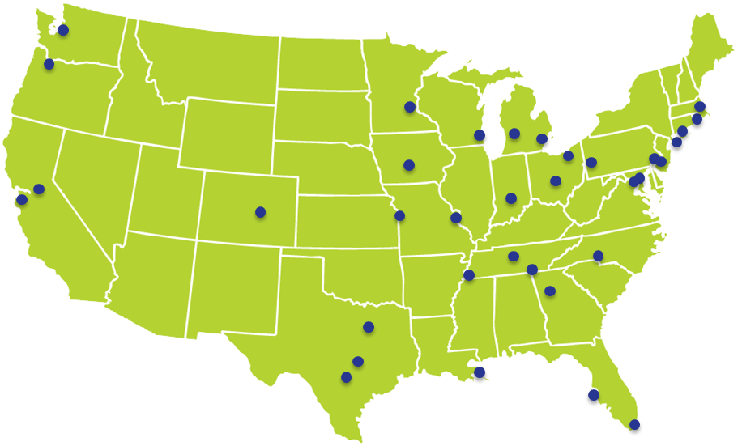
Translators, navigators, connectors
Notes:
Take a moment to acknowledge the amazing people behind the institutions – several of which helped with the examples I’ll share today
skip
NNIP partner staff are the types of people who can cross disciplines and sectors.
Mix of skill sets: Conversant with government operations, politics, community concerns, and the technical data side

Slide 4
From Data to Information to Action
Steps | Examples
1. Collecting Raw Data | Administrative Data Open Data Household/ Property Survey
2. Enhancing Data | Integrated Data Systems Neighborhood Indicators
3. Interpreting Data | Analysis Local Knowledge
4. Communicating Data | Visualization Storytelling
5. Building Capacity to Use Data | Training Technical Assistance
6. Engaging with Data | Organizing and Advocacy Policy and Planning
7. Measure Impact | Interim Outcomes Community Change
Notes:
Together we think a lot about what information infrastructure is needed to help a community gather and use data. Not going to go through all of these today, but impt to understand all the steps that are needed to get data shared, understood, used in decisionmaking & see how you or your org might fit in.

Slide 5
Collecting Raw Data
Notes:
A few comments just accessing the data
Raw data can come from government, academic, nonprofit, community. Often too much focus on the first step, having the data in hand is not enough.

Slide 6
Get started with national data and tools
National data and mapping websites
PolicyMap
Community Commons
Diversity Data
Tackle the data yourself or with your local data/research partners
Small-Area Data List includes housing, employment, environment, etc.
Notes:
We are going to spend most of the day on local data, but I want to flag that there’s a number of national mapping websites, data and tools that can be accessed to get started.

Slide 7
Advancing to local data
NNIP Lessons on Local Data Sharing
Advice for negotiating data agreements
Catalog of Administrative Data Sources for Neighborhood Indicators (Claudia Coulton)
List of available local data and sample indicators
Summary of current NNIP data holdings
Notes:
The core of NNIP is local neighborhood data, and Spike and I have a lot of experience in how to access and use it – here’s 2 of the resources we have.
Local data – usually more-fine-grained geography, more recent, more topics.

Slide 8
Benefits of Open Data
Effective public policy
Effective planning/programs outside of government
Efficient delivery of government services
Transparency and accountability
Informed public engagement
Business development
Notes:
Principles
Increase transparency to help citizens hold government accountable and promote engagement
Enable access to a public good funded by taxpayers
Practices
Portals (mostly government examples so far)
Re-packaging of data (value-added data, apps, etc.)
Data standards (Transit, Open 311)
Policies: formal adoption of open data
In the beginning, primarily driven by the last three goals…
the first three goals are as important outcomes of open data and should be used in judging its success.
Example: In DC, our open data portal helps to populate our PerformanceStat system, Track DC (also public)
Example: Hartford’s GIS manager Brett Flodine had been working on publishing to their new open data portal for 6 months driven by the goals of good government practices. But when it came time for the city to apply for a federal Promise Zone grant, his job in supplying information was much easier because the data was already organized.

Slide 9
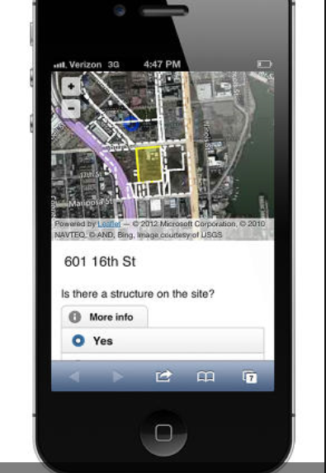
Community Collected Data
Notes:
While there’s been community collected data for a long time – maps done by Hull House of neighborhood characteristics – technology makes it a lot easier. More thinking about crowd-sourcing and how to combine more current or fine-grained citizen science data with “official” data sources.

Slide 10
Using Data for Action: Examples from the Field
Notes:
Potpourri - Enhance, Analyze, Communicate
Happy to share more information on these examples during or after the session.

Slide 11
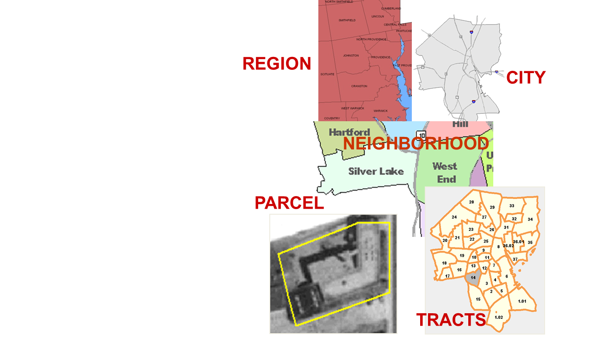
Neighborhood Indicators
Problems are not evenly distributed across cities.
Priority issues vary across neighborhoods.
People can relate to data analysis at the neighborhood level.
Notes:
Put the data into relatable forms – indicators of quality of life or opportunity – into neighborhood geographies that people can identify with.

Slide 12
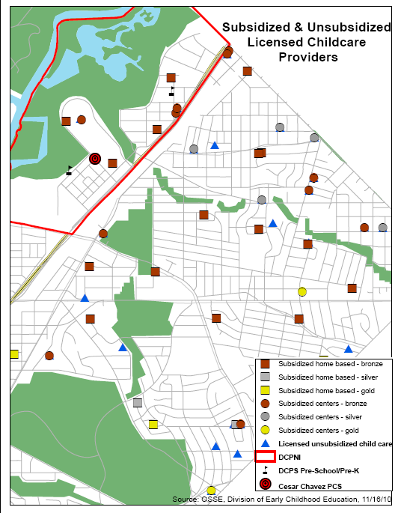
Uncover new patterns
Source: NeighborhoodInfo DC
Notes:
Example from the NeighborhoodInfo DC work to support the DC Promise Ngh, which won Dept of Ed. grants.
Goal is high-quality early education, so needed to know what was already available near the ngh.
This map was a first step showing location, type and quality rating (total capacity of 22 infants and 102 older children)
Admin data not enough, More work to be done using qualitative methods
Are these used by families in the neighborhood (surveys and focus groups)
How strong are the curriculums? What kinds of programs do they offer?
Did manage to get funding/support to open new high-quality child care center
12

Slide 13
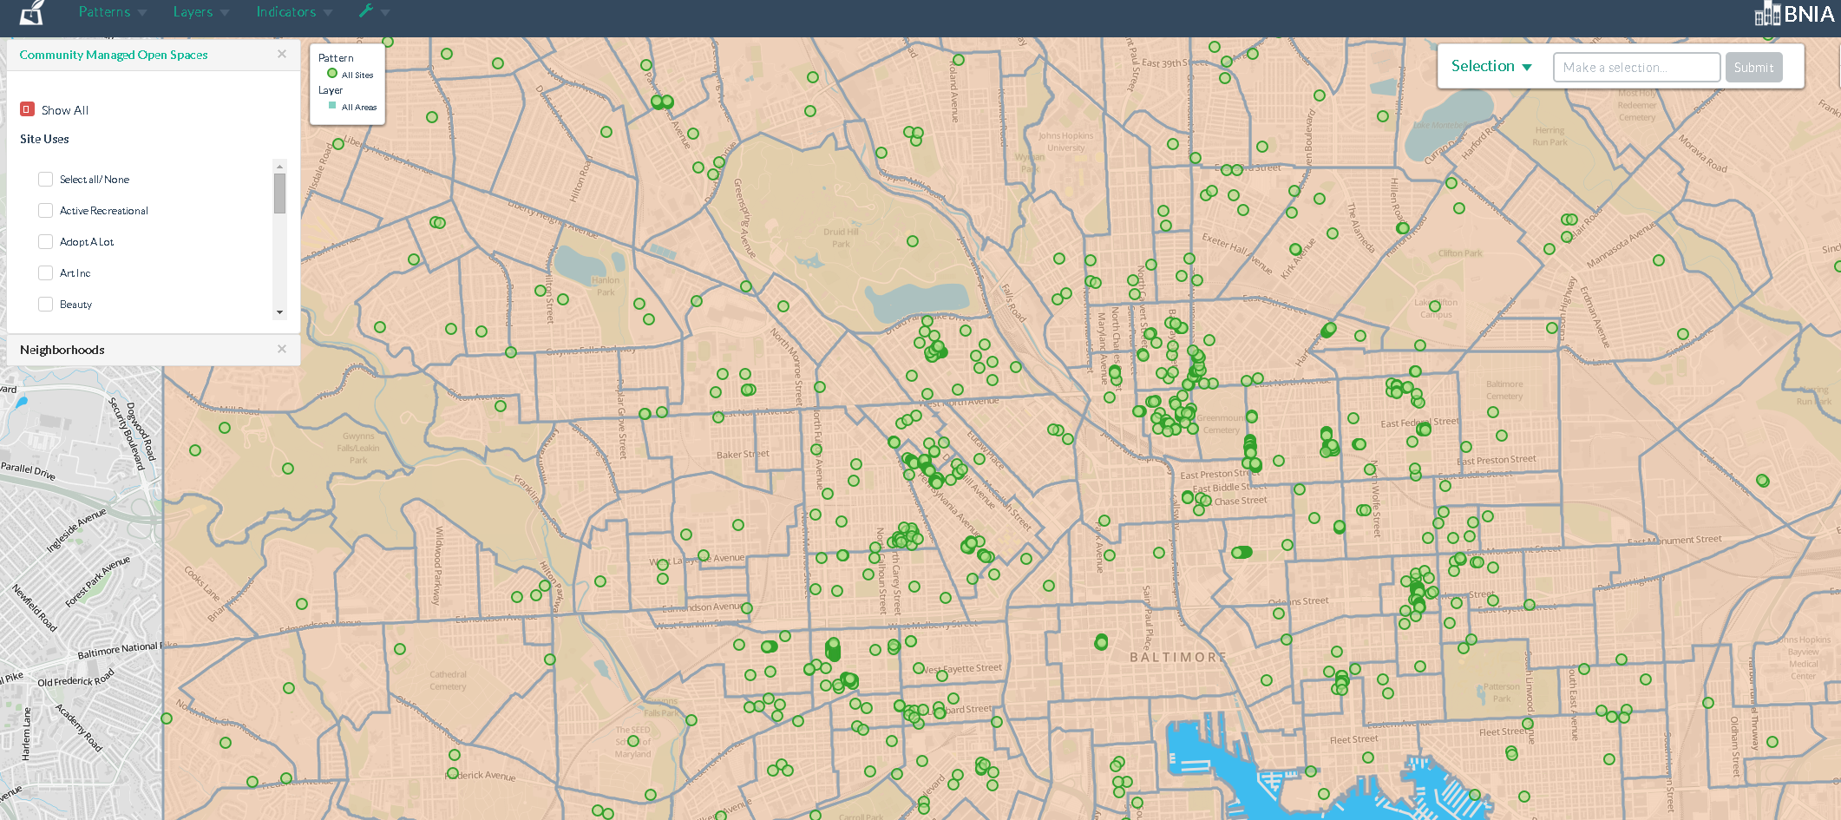
Baltimore Green Registry: Community Controlled Open Space
Active Recreational
Adopt a lot
Schools
Gardens
Food Grown Coop
Memorial
Schoolyards
Trees
Wildlife
Map resources & analyze gaps
Notes:
Collaboration of Baltimore Neighborhood Indicators Alliance (BNIA) and Baltimore Urban Waters Partnership
Interactive map - Mapped against stormwater backups
BNIA: interested in developing indicators of sustainability for Vital Signs community indicator project and policy tracking
Urban Waters: interested in help with assembling primary data and in neighborhood context
Connected with Mayor’s Environmental Initiative
When the city is thinking about how to dispose of vacant land, or make infrastructure investments

Slide 14
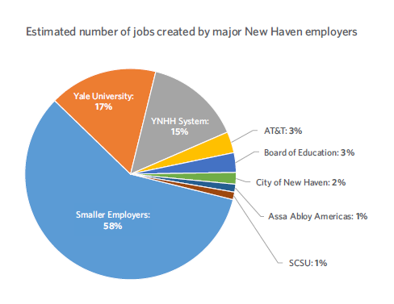
New Haven: Combining Stats and Stories
DATAHAVEN
Notes:
NHR is a dues-based community organization of residents committed to winning economic, racial, and social justice through collective action.
Access to good jobs campaign in late 2014
Used data from national and local sources, from our partner DataHaven – Feb 2016 report – organizing, media

Slide 15
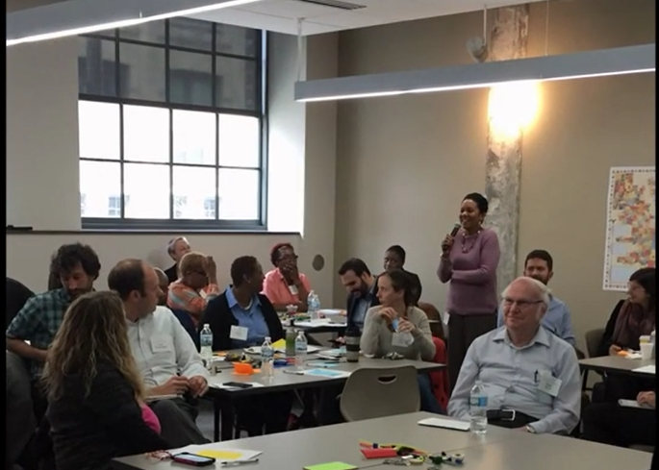
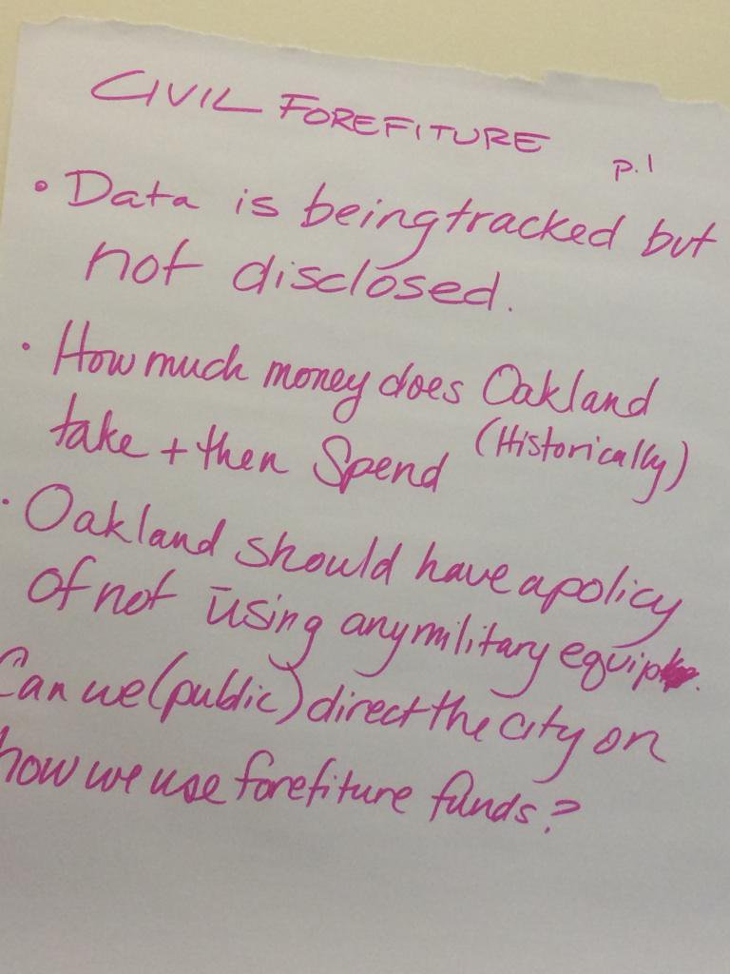
“Data” Days, City Camps, Summits
Milwaukee
Austin
Notes:
All kinds of different formats and content, but they all build capacity to work with data and begin to form a community of peer support, and bring diverse stakeholders together to share ideas. Some are more explicit about set an agenda.
Austin: “Leave your title at the door.” Fostering common understanding of the problem and start to brainstorm solutions. Beginning of the collaborative action needed to address complex issues.

Slide 16
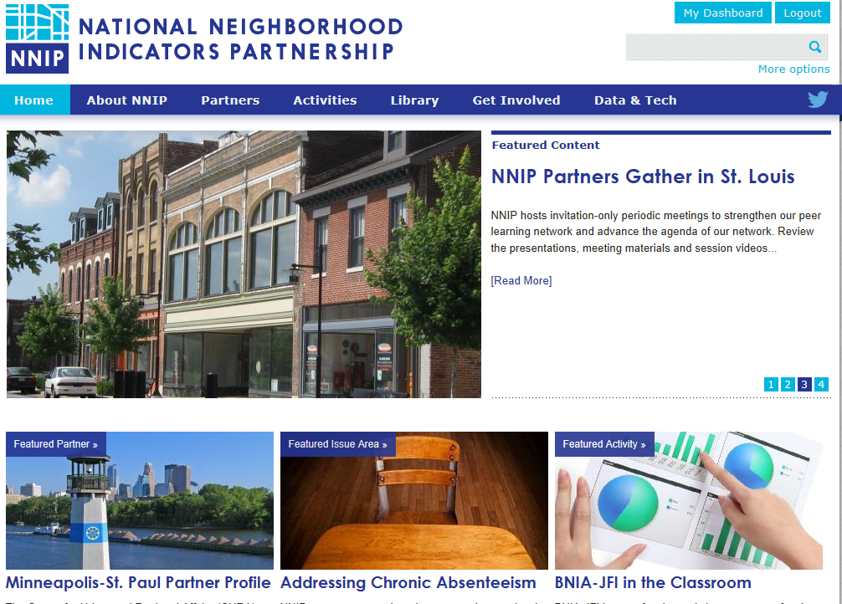
www.neighborhoodindicators.org
Notes:
Mention listserve and Twitter

Slide 17
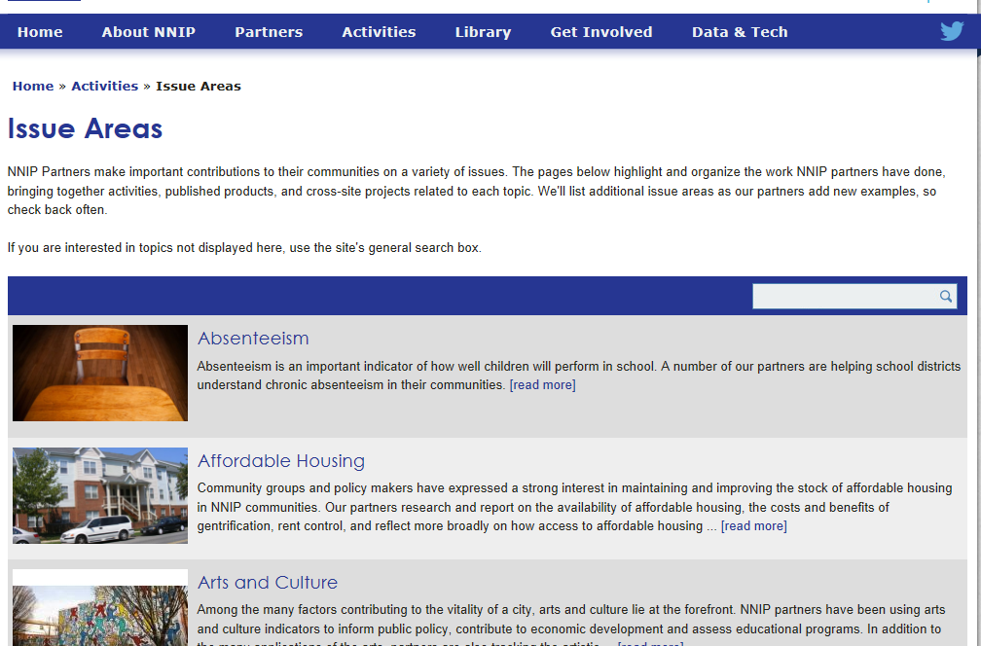

Slide 18
Follow us on Twitter @NNIPHQ or join our listserve NNIPNews
For more information about NNIP, visit www.neighborhoodindicators.org or
email Kathy Pettit at kpettit@urban.org

