Slide 1
Using Data for Community Action
Using Data for Community Action: Lessons from the National Neighborhood Indicators Partnership
Kathy Pettit
Urban Health Collaborative Research Seminar
Drexel University
June 3, 2016
Notes:
Introduce myself – thank you for inviting me.

Slide 2
Urban Institute
Urban is dedicated to elevating the debate
on social and economic policy through
rigorous research and engagement.
We believe in the power of evidence to improve lives by
Reducing hardship amongst the most vulnerable
Expanding opportunities for all people
Strengthening the effectiveness of the public sector
Notes:
Urban was started in 1968 to be an outside evaluator for War on Poverty programs. Today, we do a broader array of research for governments and foundations - our work is grounded in our original research.
Motivations for getting our work into the public debate, particularly around helping low-income households and communities
10 centers – health, justice, tax policy, etc.

Slide 3
National Neighborhood Indicators Partnership
Collaborative effort of Urban Institute and 30+ local data intermediaries since 1995
NNIP partners collect and organize neighborhood data to help local stakeholders improve their communities
Trusted and engaged institutions
Relevant data across topics and over time
Notes:
[walk through text]
Urban coordinates the the National Neighborhood Indicators Partnership or NNIP. NNIP is a peer learning network of moe than 30 local organizations.
Currently general operations are funded by Annie E. Casey Fndn and MacArthur Foundations.
MODEL is not the focus today, but just want to share the basics.
Mission:
The point is to get the information used - whether for policymaking, community building, program planning.
Institutions:
The partners are housed in various types of institutions – mainly universities, independent nonprofits.
But whatever the home, they are all respected organizations with a long-term stake in their community. People believe the data and analysis that is published.
Data: at the core of the work…
Partners all agree to assemble and organize local government data that is
1) Ngh-level
2) On a range of issues (need to understand ngh issues and interventions holistically)
3) Over time (to understand trends and be responsive when issues arise).

Slide 4
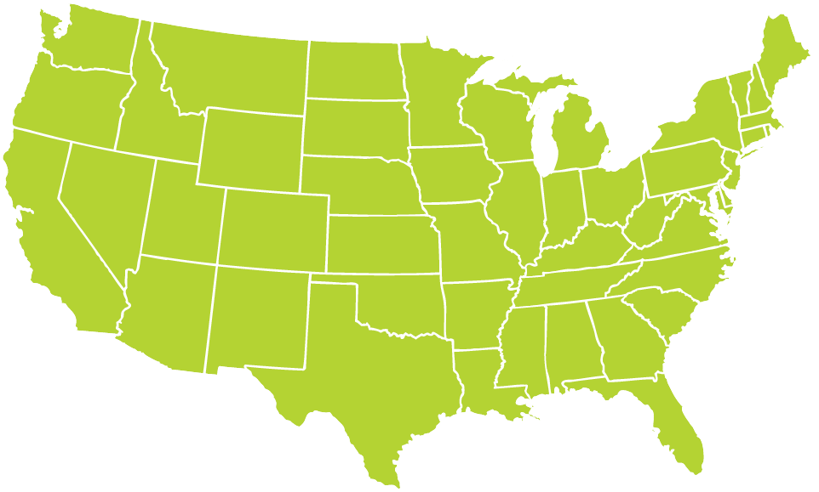
Translators and Navigators
Notes:
Behind the institutions are a host of inspirational people who spend all their time working alongside local organizations to use data to improve conditions for residents. I have them to thank for their generosity in sharing their experiences.

Slide 5
From Data to Action
Steps | Examples
1. Collect Raw Data | Administrative Data Household/ Property Surveys
2. Enhance Data | Integrated Data Systems Neighborhood Indicators
3. Interpret Data | Analysis Local Knowledge
4. Communicate Data | Visualization Storytelling
5. Build Capacity to Use Data | Training Technical Assistance
6. Engage with Data | Organizing and Advocacy Policy and Planning
7. Measure Impact | Interim Outcomes Community Change
Notes:
So this all sounds easy on paper – moving from data to action…
Important to unpack the stages of what is needed, especially today when many people are talking about data – open data, big data, crowdsourced data, data from smart cities, etc.
We think these are the steps to go from raw data to getting them used in decisionmaking. From the inputs of high-quality data (include open and confidential) to using the data, and circling back to measuring impact.
You may see the steps differently, but it’s just to jog ideas about what pieces are needed to achieve your goals, what capacities you and your community partners have in-house and what gaps need to be filled.

Slide 6
NNIP Principles
Build local, multipurpose institutional capacity for the long-term.
Use short-term projects to advance broader vision and relationships.
Bring talent from across silos to the table to understand and address issues together.
Be a voice for equity and empowering low-income neighborhoods.
Notes:
Those steps can be done to accomplish any goal, but in NNIP, our value system is the glue that binds us together.
Local capacity is the core of NNIP – investing in the local organizations ability to collect and use data has dividends beyond any one project. We think its key to have trusted and engaged institutions as the messenger and helper.
2. Most of our partners funding (70%) comes from projects, but they weave the work together to fulfill their larger mission.
3. NNIP partners have used data to bridge sectors from the very beginning. We are generally working on long-term problems that need all perspectives to figure out solutions. More recently, we had a cross-site project on “NNIP and open data” which expanded our horizons to explicitly include civic tech groups.
4. Finally, we focus on leveling the playing field – making sure that groups that have not traditionally had the data or skills to use it have access and illuminating disparities that exist in ngh conditions within a city.

Slide 7
Examples from the field
Notes:
What does this look like on the ground? First go through a series of quick examples and then more in-depth into 2 others.

Slide 8
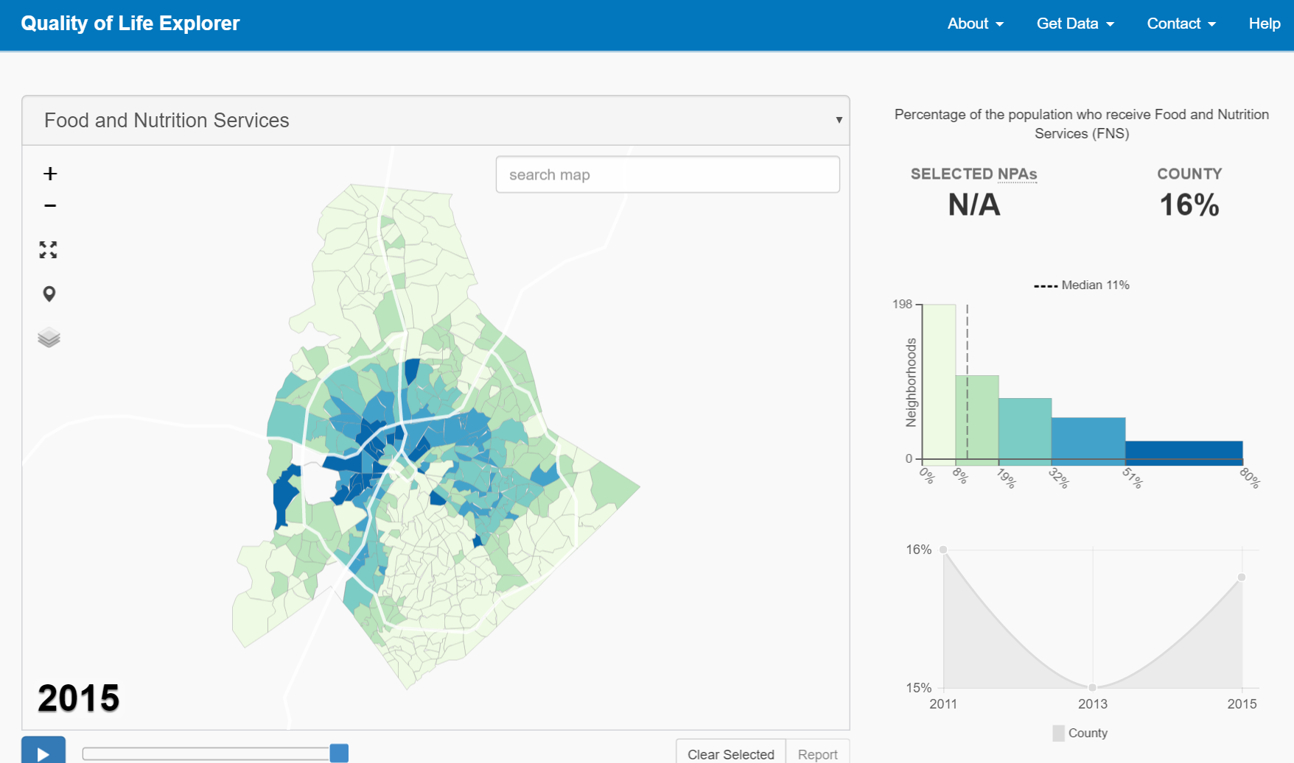
Charlotte Quality of Life Explorer http://mcmap.org/qol/
Frame, choose, and track community goals
Notes:
One key role is to describe conditions and trends in ngh across the city/region.
Almost all partners have neighborhood profiles – easy-to-look up stats on various conditions in their neighborhoods.
About 1/3 of the partners have indicator projects, like Charlotte’s here. They have a deliberate process to select and review community goals, like the one you see here – the percent of households receiving food stamp benefits.
You can see from this indicator that on average, 16% of the city household receive food stamp benefits. The dark bar on the far right shows the need to look beyond the average - 23 neighborhoods have more than ½ of their HH receiving food stamps.

Slide 9
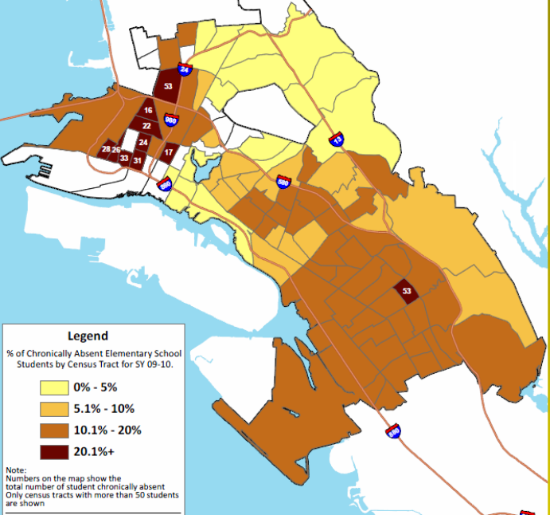
Share of Elementary Students who Were Chronically Absent
Highlight Effects of Foreclosure on Children
Forced mobility can put kids behind academically and socially.
Foreclosure prevention counselors should connect families to student services.
Schools need to understand the how their students are affected by foreclosure to design appropriate responses.
Assist school district with analysis
and operations
Source: NeighborhoodInfo DC
Notes:
9
Here’s an example from Oakland.
Map of the share of chronically absent elementary school students by census tract of where the student lived – not by school location.
Darkest shade had 20% of more of their children chronically absent in this school year.
Looking at the home address is Impt b/c Root of the problem may differ ngh by ngh. By understanding the patterns, interventions can be tailored to fit the neighborhood context (transportation, childcare health)
Developed tools for the teachers and principals to monitor attendance weekly. Also worked through community action plan – parents, teachers, comm groups, service agencies

Slide 10
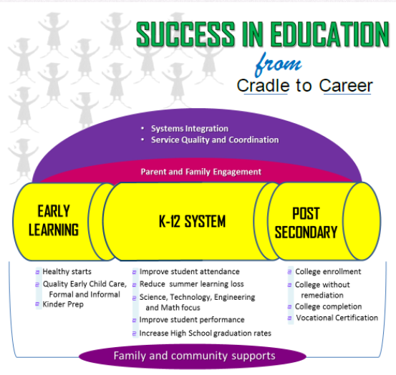
Support performance management in place-based initiatives
Notes:
Our NNIP partner in San Antonio Community Information Now or C: Now is the data partner for the EastPoint area where all the federal place-based initiatives are.
For the Eastside Promise Neighborhood, CI:Now is supporting partners in meeting reporting requirements and create data systems that can be used as management tools. They are also working to identify options for how the various systems from partners could be tied together into one integrated data system.
Community Information Now works with out-of-school time service providers and Eastside Promise staff to improve how participant data is shared and integrated across organizations and to explore patterns in students’ academic outcomes. Community Information Now also ensures that their partners understand and follow data privacy policies.
C:Now helped PaCT leadership and partners to select shared indicators to track the high-level shared goals within PaCT’s vision of the collective impact of these investments.

Slide 11
Kindergartners with positive lead tests and highest exposure to neighborhood distress score 15 percent lower on readiness test
Use integrated data to demonstrate impacts of neighborhood conditions
*
Notes:
The earlier examples were descriptive indicators. Partners also do more advanced analysis
Our Cleveland partner has two integrated data system – where records are linked at the indiv level for data on education, housing, child welfare, Medicaid, etc. They wanted to understand the influence of housing and neighborhood conditions since birth on school readiness of all children entering kindergarten over a four-year period in Cleveland.
This is a chart of average predicted test scores for levels of housing and neighborhood distress
Dashed line represents children who have been lead poisoned. They found that children exposed to problematic housing and disadvantaged neighborhoods have lower kindergarten readiness scores after accounting for other factors, which was not surprising (so the dashed line is lower overall).
But within the group of kids who were lead poisoned, children with the highest exposure to 38 bad housing and neighborhood conditions (i.e. 90th percentile) and positive lead tests are estimated to score 15 percent lower on KRA-L than those living in the best conditions (10th percentile) with negative lead tests. (the point designated by an asterisk (*) )
Communities are advised to pay more attention to distressed housing as a cause of disparities in early child development and school readiness. IDSs that incorporate detailed housing and property information, especially for the youngest children, can be used to target areas where there is elevated risk and coordinate local efforts to prevent the adverse effects of distressed housing stock on early child development.

Slide 12
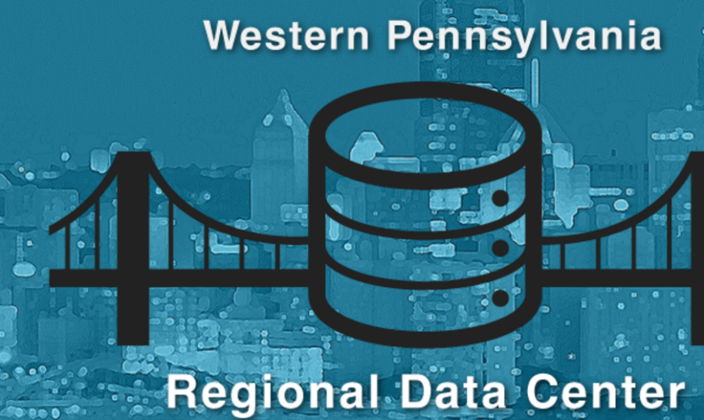
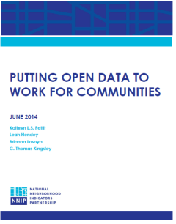
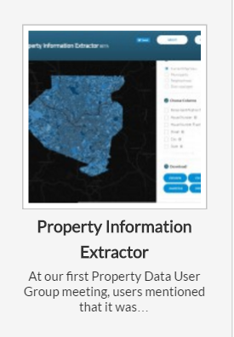
Open Data
Promote open data and civic tech
Notes:
The open data field has moved beyond measuring progress by only how many thousands of data sets you have published, or turnout at 1 day hackathons
NNIP completed a project on open data thinking about what the new trends meant for our 20 year old network.
We published a white paper on what our partners should be thinking about and ways for us to engage with new open data and tech groups.
Inspired by NNIP, our partner at the University of Pittsburgh now is the home to the WPRDC most innovative and community-oriented open data system which serves government agencies in the city and suburbs, as well as community groups. I encourage you to take a look.
Our partners have also thought a lot about events like hackathons and how they could be leveraged to focus on issues facing low-income communities. (like CURA in Twin Cities)
Finally, we’re doing a cross-site project on how civic tech, data orgs, and city agencies can work together with Living Cities and Code for America in 7 cities.

Slide 13
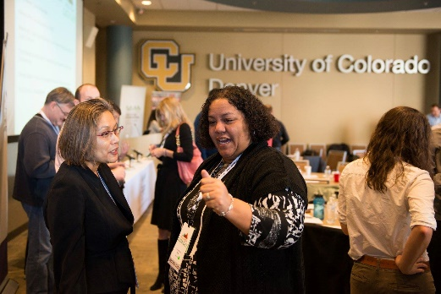
Strengthen civic life and governance
Notes:
Final – beyond any one issue area, our partners do general training and several host annual “Data Days” Examples from Indy, Baltimore, Piton – mix of skill-building, storytelling, and peer sharin.

Slide 14
Data-Driven Organizing in Pittsburgh’s Homewood Children’s Village
Thanks to Samantha Teixeira & Dr. John Wallace, Jr.
and Bob Gradeck for slides and story
Notes:
Story from our Pittsburgh partner – most of the work was in 2010 – give credit to PNCIS and individuals.
Dr. Wallace led the HCV at the time of this work in 2010.

Slide 15
The Village Approach
Follows the Promise Neighborhood model
Began with “1,000 conversations” to hear residents’ concerns
Learned that vacant and abandoned properties were one of Homewood’s key challenges.
Notes:
Homewood Children’s Village is modeled after the Harlem Children’s Zone, which inspired the Promise Neighborhood movement.
The model emphasizes: engage residents and build community, use proven programs, touch all the children in the neighborhood, and evaluate how things are going along the way.
Homewood is a neighborhood on the far eastside of Pittsburgh, with about 9,200 residents. In addition to a child poverty rate that exceeds 50%, [http://www.homewoodchildrensvillage.org/aboutus/missionvision/]
Began with listening to the parents about what they wanted to change in their community. Spoke with more than 1000 people to help prioritize their actions.
Housing conditions may not be the first thing that comes to mind for a child intervention, but the Village leaders recognized that their children and families need healthy neighborhoods to thrive.
On a neighborhood level, abandoned and problem properties attract crime and squatters. They also send an overall message that the neighborhood isn’t kept up.

Slide 16
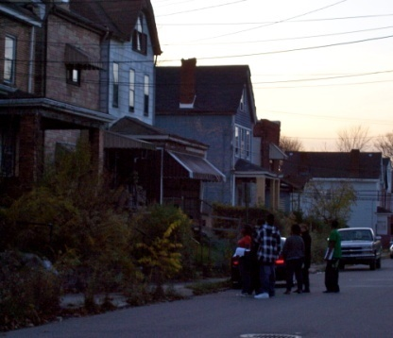
PNCIS Partnership in HCV Neighborhood Assessment
Research Review & Design
Data Collection & Integration
Data Visualization: MAPS!
Training
Analysis
Policy Action
Notes:
Once they identified the issue, the leaders reached out to our partner in Pittsburgh and came up with this plan.
Research Design: Contacted NNIP partners to review and ID existing property survey instruments including building inspection protocols and neighborhood assessment surveys
Data Integration: data integration strategy (Setting data collection and entry process up so that it could easily be integrated into the PNCIS system). They could them create maps that integrate the community-collected data with other PNCIS data like crime info and code violations
Training: Trained students and community organizing staff to use the results, got into the data driven mindset.
Data Analysis/Community Action: Look at patterns and identify policy mechanism to take action

Slide 17
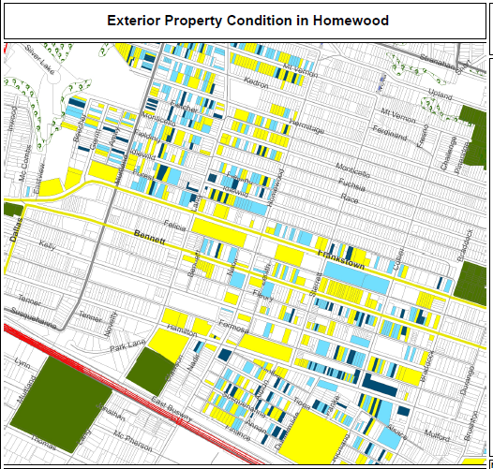
Legend
Exterior and Paint
Good
Fair
Poor
N/A
Notes:
Here’s the result of the first 3 steps…
They used the assessors file as the backbone of the system (with property ID, basic characteristics, ownership, and tax delinquency )
Student and residents implemented the property survey, noting the condition of each home.
Here is a map of the resulting data - Yellow is good, light blue is fair, dark blue is poor.
Map was shared and used for data driven organizing and presenting to block clubs.
[check with PNCIS – this is hypothetical or actual? Before and after assessments (does a block club affect the physical condition of a block? etc. ]

Slide 18
Data Driven Organizing
Homewood’s Dirty Thirty:
Used joint database to identify worst properties in the neighborhood
Mobilized residents to call the 311 Response Line and advocate for boarding up the properties
23 of 30 properties were boarded up, torn down, or otherwise improved within about a month
Notes:
Together they came up with a collective action plan. Their data identified properties that were vacant and open to entry. They worked with residents to agree on the worst 30 properties in the area. Determined by community priorities - a brand new school had been built, but kids had to walk by unsecured homes or detour into the street when the sidewalk was overgrown.
Residents in neighborhoods like Homewood have reasons to be skeptical about receiving good city services.
But as the group and armed with the data, they were willing to engage with the system. Within 1 month, more than ¾ of the properties had been attended to.

Slide 19
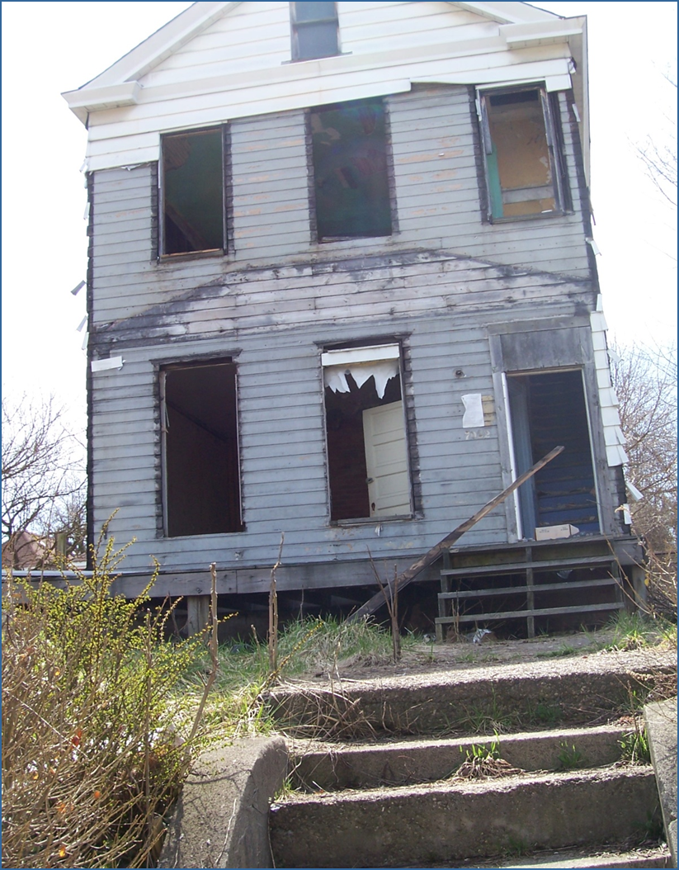
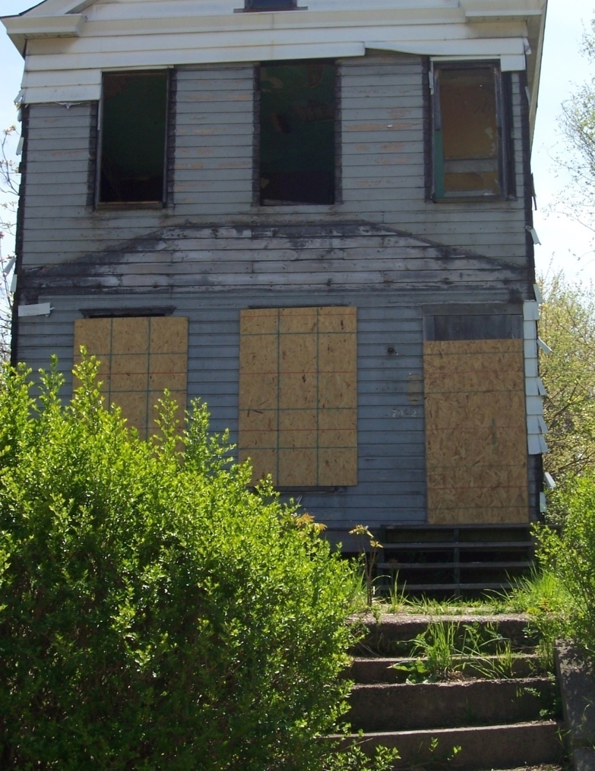
Before
After
Notes:
Here is an example of a property secured by the city

Slide 20
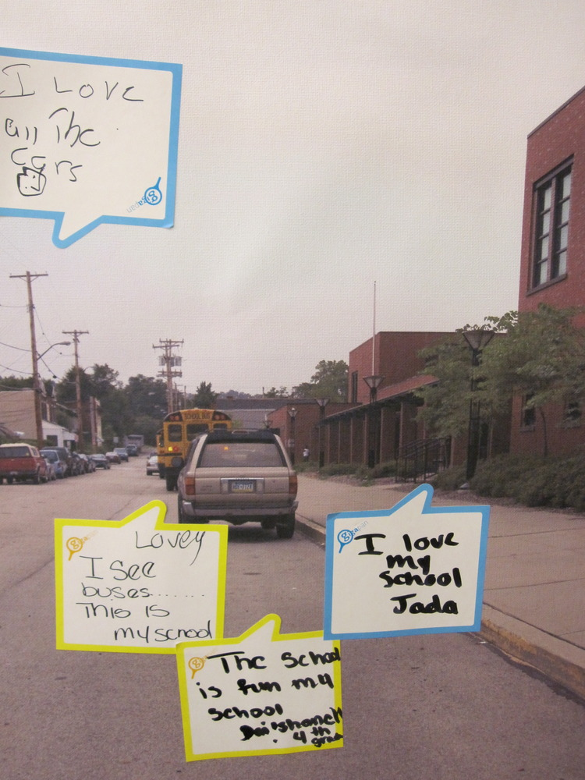
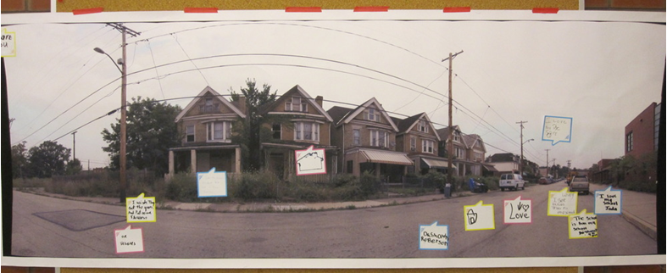
Gigapan
Document neighborhood conditions
Collect input from residents
Notes:
PNCIS recognizes that quantitative data does not capture everything that is important. They use photos to document baseline conditions and the neighborhood as it changes.
They engaged school children to talk about what is good and bad about their neighborhood

Slide 21
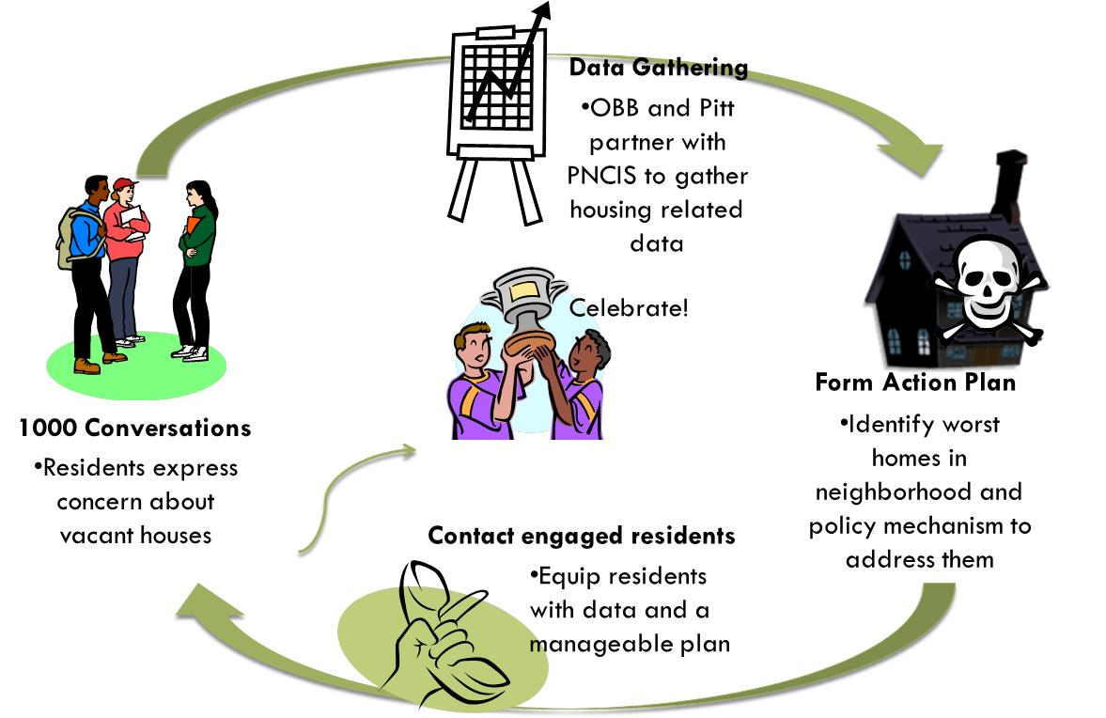
Notes:
So here’s a recap of their process - began at the bottom with residents.
[walk through steps on slide]
PNCIS partnered with them in all the stages, but the data was nested in a change initiative and directly relevant to their work.
IMPACT
Short-term – bring city investment into the ngh and secure the individual properties so that its safer for children (both physical safety and less crime)
Long-term - improving abandoned homes helps image and raises property values
Just as important, residents learned they could take collective action to improve their neighborhood
This is not just a one-time project.
Update as of 9-2014
They're using our property data standard created earlier this year and using local data as a collection tool. Our partner is operation better block. Our standard is designed to allow for easy code enforcement referrals
They will use the data to do block-level organizing and planning with residents. Vacant land is a huge issue. They're also using data to identify owners needing home repair assistance and partnering w rebuilding together Pittsburgh to perform work. Also social service referrals identified through door to door resident surveys.
Well also use property survey data to understand property influence on chronic absenteeism in the high school. This project will have a connection w the Homewood children's village and john Wallace. Well look at interventions w them and Operation Better Block. Geocoding student data to parcels will be finished tomorrow.
Meeting with OBB in early October. More to come then.

Slide 22
Interpreting, Communicating, and Engaging with Data: Example from Austin
Notes:
Next example from Austin…
Going to describe how our Austin partner structures their work on big health challenges. Child obesity is this example – also have tackled infant and maternal health and pedestrian safety.

Slide 23
COH Approach to Presenting Data
Use multiple sources to understand the problem and potential solutions.
Include community needs and assets.
Admit imperfections and limitations.
Enlist participants to fill out the picture (including tangible and intangible).
Notes:
Begin with HOW they approach analysis
Use multiple sources – for obesity, they mapping the physical fitness scores, but also the parks, health food outlets, and fast food restaurants.
Balance negative indicators with recognition of assets - Examples depending on the topic, but include Playgrounds, Libraries, Faith Communities, but also individuals that serve as community leaders and supports.
Admit the administrative data are incomplete and imperfect – ask the participants to contribute to the data collection process.

Slide 24
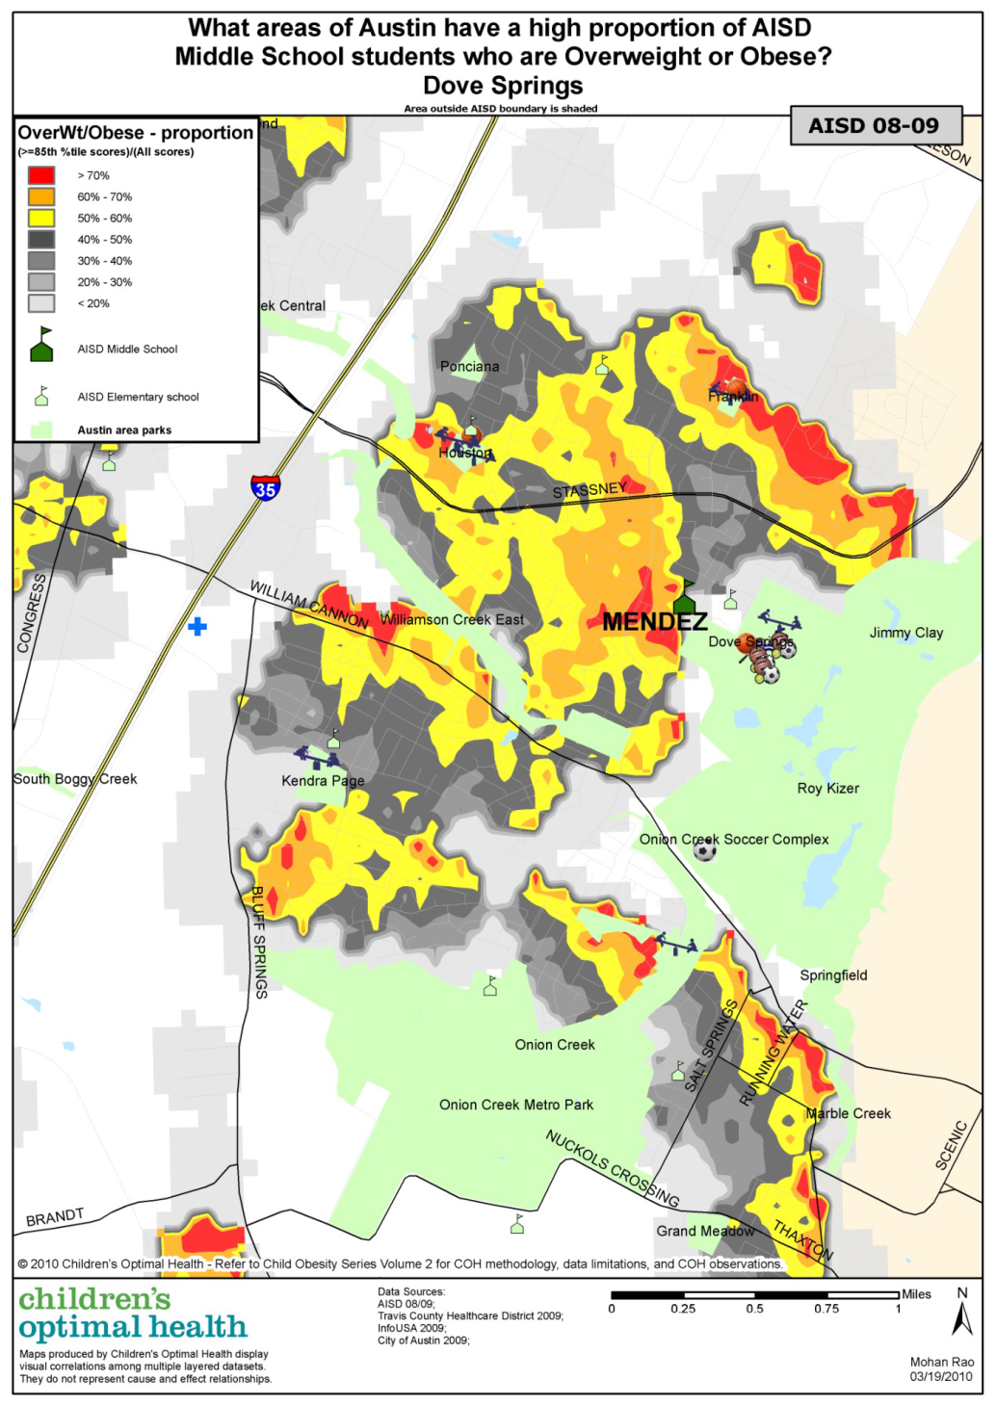
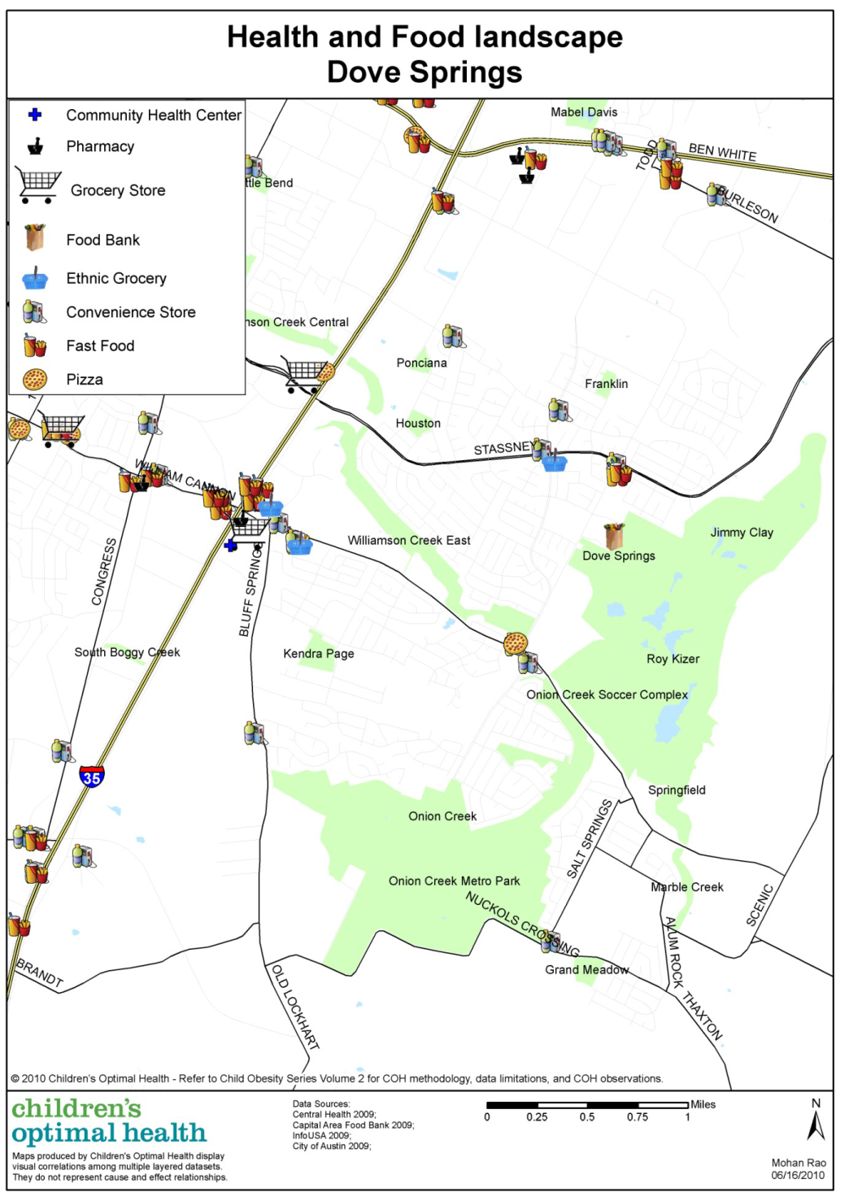
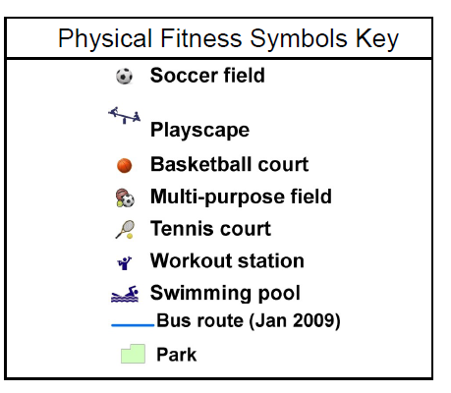
Understanding
the Problem
Notes:
[Taken from the Austin COH website]
Add in rates…
COH also zoomed in on neighborhoods (this is Dove Springs) and looked at other related issues like cardiovascular health (proportion map on left) and the health and food landscape in the area (map on right).
1) There appear to be very few food outlets located close to where families live.
2) There are only a few food establishments in the Dove Springs area that supply both fresh meat and fresh fruits and vegetables.
3) There appears to be a large amount of green space in this area but not all of it may be accessible for recreational use and appropriate for children to play in.

Slide 25
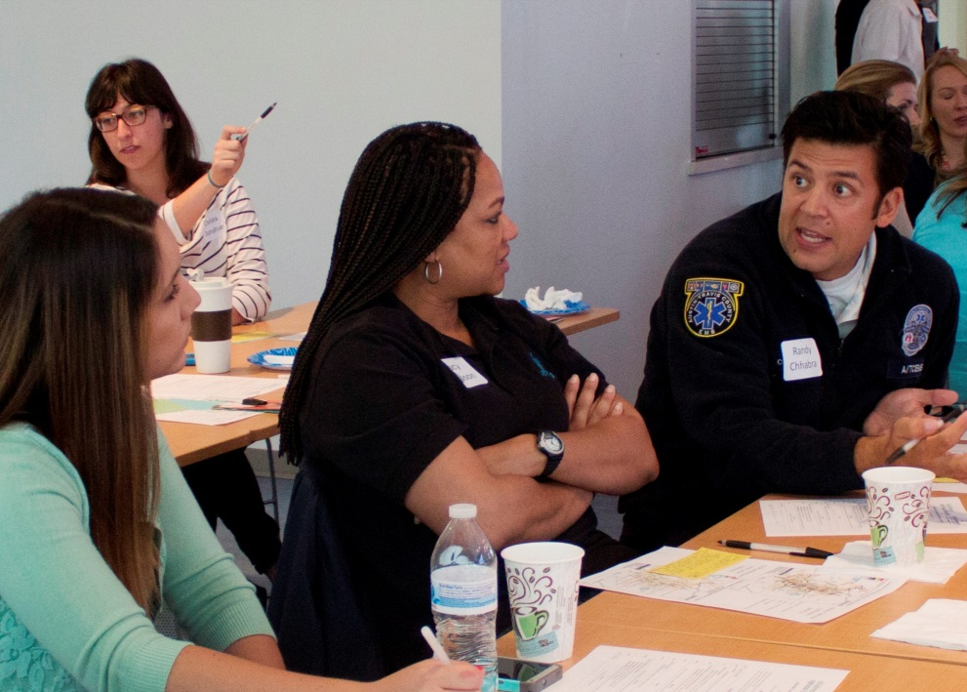
COH Community Summit
Notes:
Photos from the obesity and other summits
One way they get the information into the hands of stakeholders is Community Summits – lots of planning and input months in advance
Rule: “Leave your title at the door.” Fostering common understanding of the problem and start to brainstorm solutions. Beginning of the collaborative action needed to address complex issues.
**
Guest speaker – experts like medical doctor
Presentation of analysis - also bring in different voices (parents, teachers)
Small group discussion (4 to 8 people)
Breakout groups – also planned with thought – thematic tables (note “access to alcohol” tent in pic), neighborhood tables, etc. but always the ability to create your own group.
No assignment, but encourage mixing (EMS person in pic)
Time afterwards to network – informal space to debrief and plan next steps
**
Notes from infant/maternal health:: Panel that brings in different voices (juvenile justice people, advocacy and service groups). For example, in the session on maternal and infant health, an advocacy group help identify a panel of Hispanic and African-Amer. women who had bad experiences with the formal health care providers and talk about why they did not seek OB care. This also helps foster cultural sensitivity.

Slide 26
Operational & Policy Changes
Targeted allocation of resources by City and County to neighborhoods of highest need
City planning to include sidewalks and hike/bike trails in targeted neighborhoods
AISD School Board included student health as a core value
Improved physical education and health curriculum in schools
Improved awareness and advocacy around importance of school recess
Notes:
Here are some outcomes from their obesity initiative
Shows how different players used their levers to contribute solving the problem
[walk through slide]
Public resources to the neighborhoods – focus on built environment
School system explicit recognition that kids need to be healthy to learn
- Need for PE, recess and health education

Slide 27
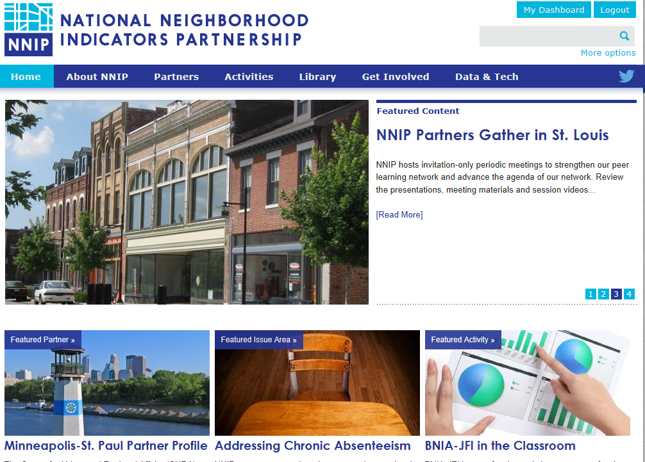
www.neighborhoodindicators.org

Slide 28
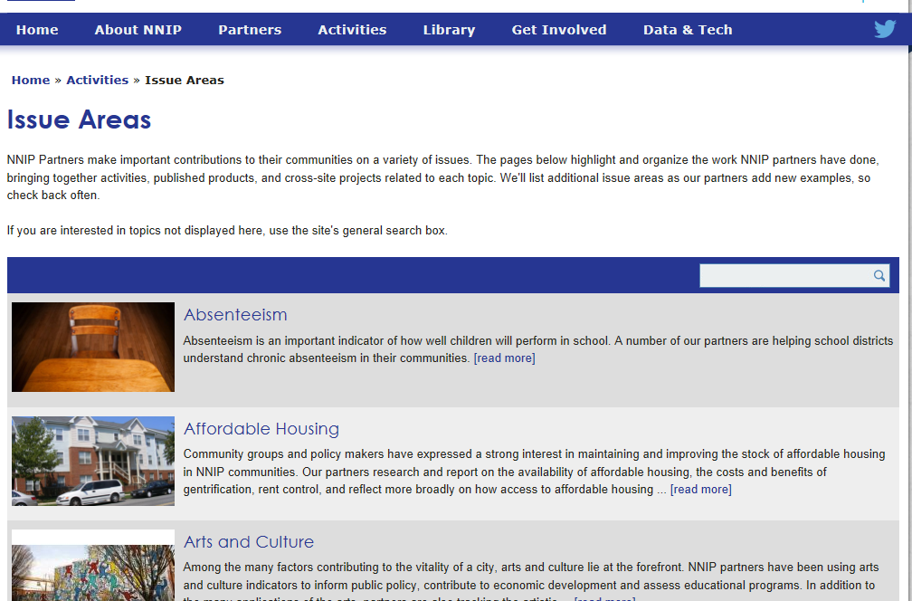

Slide 29
Follow us on Twitter @NNIPHQ or on NNIPNews Google Group
For more information about NNIP, visit www.neighborhoodindicators.org or
email Kathy Pettit at kpettit@urban.org

