Slide 1
2020 Census Update
Mobilizing Data-Driven Local Outreach
APPAM November 10, 2018
Kathy Pettit, Urban Institute
Notes:
Ask for people to raise hands – academic, govt, other researchers

Slide 2
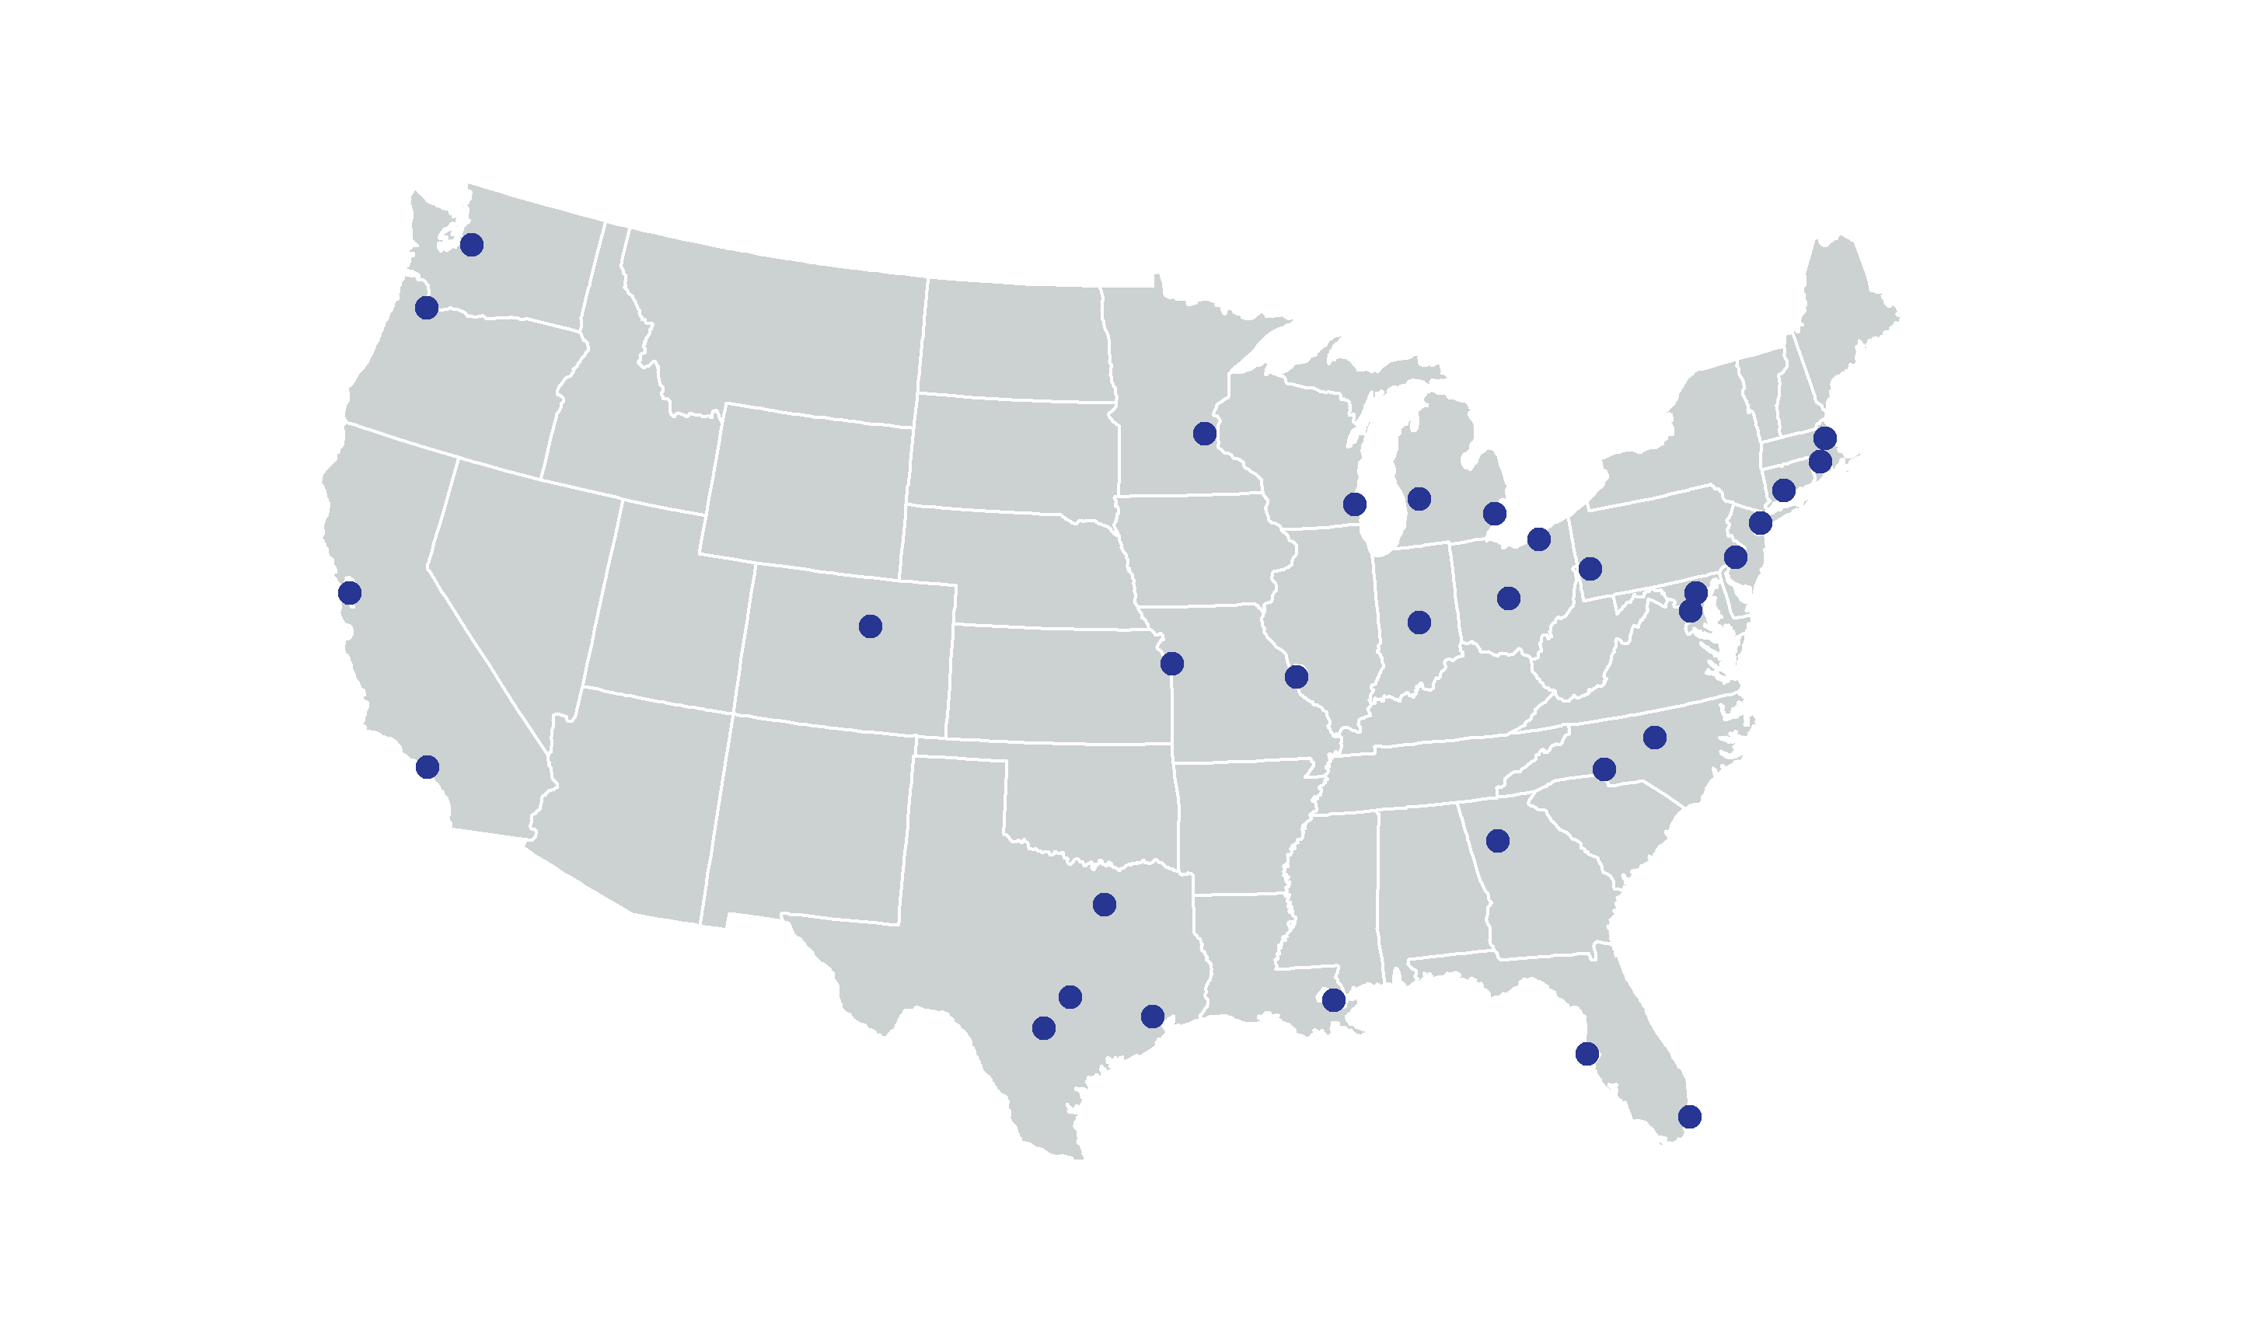
National Neighborhood Indicators Partnership (NNIP)
Notes:
We are working on supporting local GOTC efforts through the National Neighborhood Indicators Partnership (NNIP). Coordinated by the Urban Institute, consists of independent organizations in 32 cities that have a shared mission to help community stakeholders use neighborhood data for better decisionmaking, with a focus on working with organizations and residents in low-income communities.
As the network’s home, the Urban Institute plays 4 roles: 1) organizes peer learning activities, 2) elevates NNIP’s collective experience to inform local and national policy 3) helps new partners get started, and 4) develops cross-site projects to explore topics in depth.

Slide 3
NNIP 2020 Census Project Goals
Encourage local organizations with data and technology skills to support Get Out the Count efforts
Offer examples of using neighborhood data to improve Complete Count strategies
Notes:
NNIP's new project promotes data-driven planning for 2020 Census local outreach to ensure a complete count of young children and people of color, starting with a resource list for communities and pilots in Baltimore and San Antonio.
We will be pursuing two main strategies – see slide.
We’ve collected a set of resource links already. A forthcoming brief will outline the ways that local data and tech organizations can contribute to strategic planning and mobilization for outreach.

Slide 4
We need you!
Your organizations can be trusted messengers that:
Know the people and neighborhoods
Know local priority issues and concerns
Collaborate with key players in public and nonprofit sectors
Notes:
The census won’t be successful without everyone playing a role. Groups like you on the ground can serve as TRUSTED MESSENGERS about the importance of the Census to your communities.
There’s a variety of ways to get involved - you can determine what activities make sense for your organization.

Slide 5
National Activism
A successful Census requires
adequate Congressional appropriations
for operations and communications.
Resource: Census Project
Notes:
So, what can you do –
First, there’s actions you can take at the national level to ensure the best implementation possible.
The Census needs to be fully funded to ramp up operations over the next year. Congress people listen to their constituents and you can share the impt of the Census. For FY19 – the president and house budget are $3.8 billion – $1 billion short of the Senate number and what stakeholders believe is needed.
There is support from Democrats and Republicans, but they need to hear from their constituents.
The Census Project is a great organization that tracks appropriations bills and provides sign-on letters and opportunities to weigh in. Encourage you to sign up for their notices.

Slide 6
Local Activism: Get Started
What’s happening locally?
z
Civil rights and other advocacy groups
State and local funders’ collaboratives
University offices
Complete count committees
Notes:
So what should you do locally?
INFORMATION GATHERING: First is to find out what activities are happening locally. It varies a lot across the country where localities are in getting organized.
Talk through slide…
**
EXTRA:
FUNDERS: You also can help educate your local funders.
The Funders Committee on Civic Participation has prepared a toolkit for Funders (persuasive, but also factsheets, milestone dates)
– participate – share the information among their peers and grantees
- convene – create spaces to exchange information and ideas
- invest – fund organizations – yours or other community organizing groups – to plan and implement outreach or fund a hub to help with information-sharing/coordination
Some local govts have also funded efforts in the past.

Slide 7
Complete Count Committees
Volunteer committees established
to increase awareness and motivate residents to respond to the Census.
Resource: Complete Count Committee website
Notes:
CCC can be tribal, state, or local government or community based. CCCs serve as “census ambassadors” - like everywhere – range of participation and capacity
University representatives…
Increase responses through a focused, structured, neighbor-to-neighbor program.
Design and implement an awareness campaign targeted to the community.
Bring together community members focused on 2020 Census awareness.
https://www.census.gov/content/dam/Census/newsroom/press-kits/2018/ccc-guide-d-1280.pdf

Slide 8
Local Activism: Think Strategically
What neighborhoods and groups should be prioritized?
Who are the trusted organizations and voices?
Notes:
Once you have a lay of the land, you can determine where your org fits in.
1 example of where your insights can make a difference is helping to think about priorities – either for your organization or contributing to broader efforts.
There will not be enough time and resources to do intense outreach to everyone or even all the ngh and groups at risk of being undercounted.
Overall, grassroots organizations and folks with boots on the ground are critical, so making sure that they are connected to efforts, educated and ready is critically important.

Slide 9
Reaching College Students
Only 54% of people age 18-34 said they were likely to respond to the 2020 Census, compared to 67% of all respondents.
Source: Census Barriers, Attitudes, and Motivators Survey
Notes:
The 2010 Census operates on the idea that people should be counted at their usual address – i.e. where they spend more time than any other place they might live or stay.
That means most college students should be counted at their college address, either on campus or off campus. They should be counted at their parents’ home only if they live and sleep there most of the year.
Students likely won’t know that they should answer the questionnaire for their current home. Complicated by moving around a lot and group houses.
Universities can contribute to raising awareness among their students

Slide 10
Local Activism: Educate and Connect
How can you educate key stakeholders?
z
University officials, local governments, business leaders
How can you spread the word?
z
z
Newsletters, blogs, media
Presentations, Events
How can you link residents to jobs?
z
More than 500,000 field postings now and throughout 2019
Notes:
What are the concrete actions you can take?
DAY-TO-DAY: updates in your newsletters, social media, materials at events – blogs
JOBS: The Census Bureau is already recruiting for many field positions. Starting in Spring 2019, they will be hiring 76,000 people for address canvassing and in Fall 2019, they will begin recruiting for 450,000 field staff to support 2020 operations. Current field jobs are listed on the Census Bureau website and you can also sign up for email updates on recruitment efforts. (will provide links in the resources). A dedicated website is scheduled to be live in Sept 2018.
Good for individuals for workforce development, but also better if people from hard-to-count neighborhoods are doing the outreach.

Slide 11
Local Activism: Access Resources
Sign up to be a Census partner organization
Website includes:
Census 101 Fact Sheets
Audience Outreach Toolkit
Mapping Tools
Census Solutions Workshop
Resource: Census Partnership Website
Notes:
There’s a lot of resources out there to help you engage.
The census bureau released its official website with some basic resources – outreach messages and fact sheets – We’ll be talking more about the mapping tools and workshop in a moment.
I encourage you to sign up to be a Census partner organization so you can get updates as they post more resources.

Slide 12
Census Solutions Workshop
Event with structured process to brainstorm, prioritize and propose action steps
Communicating the importance of Census data
Reaching hard to count populations
Encouraging participation in Census Bureau surveys
Notes:
A creative, collaborative, problem-solving event to bring together diverse thinkers

Slide 13
Census Solutions Workshop
Empathize:
Get to know your users
Define:
Articulate the problem clearly
Ideate:
Generate Solutions
Prototype:
Test an idea with users
Iterate:
Revise based on feedback
Design
Thinking
Approach

Slide 14
Census Solutions Workshop Toolkit
1 | OVERVIEW | Why host a Workshop? What it looks like and who benefits from it
2 | LOGISTICS | How to host a Workshop: Roles and responsibilities, planning timeline
3 | ACTIVITIES | What to do at a Workshop: Sample agendas, step by step guide to the activities suggested
4 | CASE STUDIES | Lessons from pilot workshops
5 | RESOURCES | Tools and Materials worksheets, checklists, and printable handouts

Slide 15
Mapping and Data Tools
Response Outreach Area Mapper (ROAM)
Engagement Navigator
Hard-to-Count Map
Notes:
National resources are great – but you know which neighborhoods have changed since the 5 year ACS

Slide 16
INSERT MAPPING SLIDES
Notes:
Response Outreach Area Mapper (ROAM) from the Census Bureau
Shading is based on a modeled score called the Low-response score (taking characteristics that predicted the 2010 mailing response rates and applying them to more recent data). The darker the color, the less likely that the households in that area will self-respond.
Snapshot of Chicago – it’s a little hidden by the tract near the top with the aqua boundary.
Hispanic: 86%
Foreign Born: 25%
Population 5+ Who Speak English Less Than "Very Well" and Speak Spanish: 30%
No One in Household Age 14+ Speaks English "Very Well": 21 %
The information from this and the next 2 mapping tools should just be used as a starting point.
The concern is that they rely on 5 year national data that is already a few years out of date. So – this information needs to be interpreted through the lens of your local knowledge about neighborhood change – maybe a new large mixed use redevelopment has gone up displacing former residents OR maybe gentrification is pushing low-income households to areas farther from downtown OR maybe there’s been an influx of new immigrant families into a neighborhood.

Slide 17
Notes:
Here’s another view from the Census Bureau which has more friendly design.
In this case, the shading is based on the 2010 percent of households who mailed their census form back. You can start from the county level and then zoom in.

Slide 18
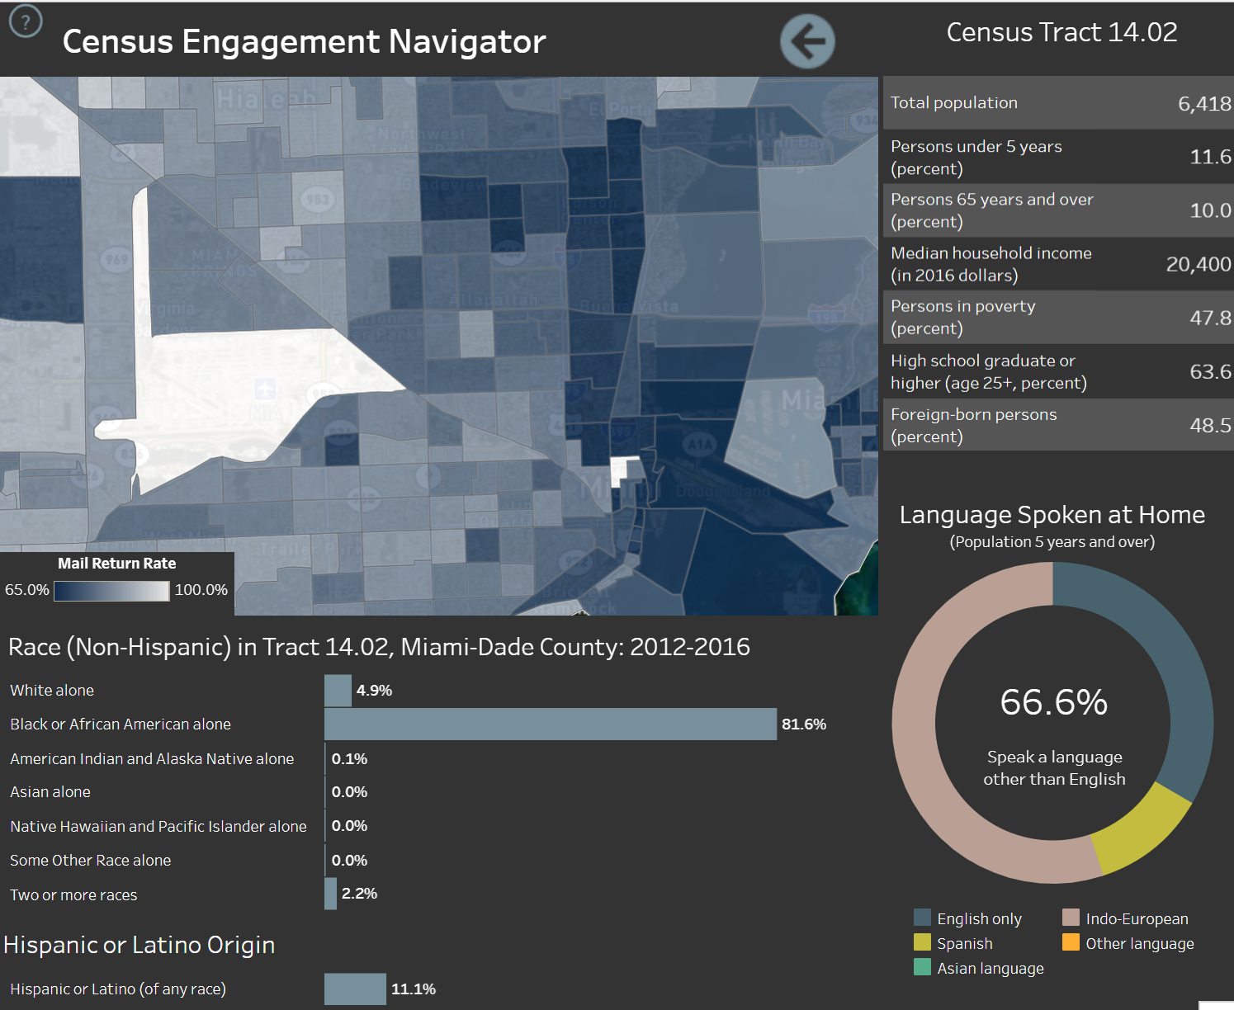
Mapping Resources
Notes:
Here’s a tract level map from the same system of Miami…
In this ngh, ½ are immigrants and 2/3 of the residents do not speak English at home (Haitian community).
The medium income is only $20,000 with 48 percent poverty rate.

Slide 19
Notes:
Source: CUNY Center for Urban Research, funded by a philanthropic collaborative.
This is a screenshot of LA – shaded by the mail return rate like the previous one. It includes stats for the various groups likely to be missed – people of color, renters and those in multifamily units, crowded households, young children.
The advantage of this is that it has good narrative text on the left panel explaining the importance of the different indicators.
It also has statistics in the narrative from the FCC about internet connectivity. In this case more than 60% of the households did not have an adequate upload/download speed (200 kilobits per second. In 2014, intro dsl speeds are 1500 kbps)
Another unique feature of this one is that This has congressional and state legislature districts.

Slide 20
2020 Census Timeline
Date | Action
Summer/Fall 2018 | Launch of Complete Count Committees
Fall 2018 | Barriers, Attitudes, and Motivators Survey results
Spring/Summer 2019 | Hire ~76,000 people for address canvassing
Spring/Summer 2019 | Finalize electronic/paper versions of questionnaire
Fall 2019 | Open and staff 248 Area Census offices
Fall 2019 | Recruitment starts for ~450,000 staff
January – April 2020 | National advertising campaign
April 1, 2020 | Census Day!
May – July 2020 | Non-response follow-up efforts
December 31, 2020 | Publish state population totals and congressional apportionment
Notes:
Plug for NNIPCamp session

Slide 21
Additional Resources
NNIP’s 2020 Census Resource List
www.neighborhoodindicators.org/2020census
APPAM 2020 Census Session Presentations
www.neighborhoodindicators.org/APPAM2020census
Contact: kpettit@urban.org
Notes:
Plug for NNIPCamp session

