Slide 1
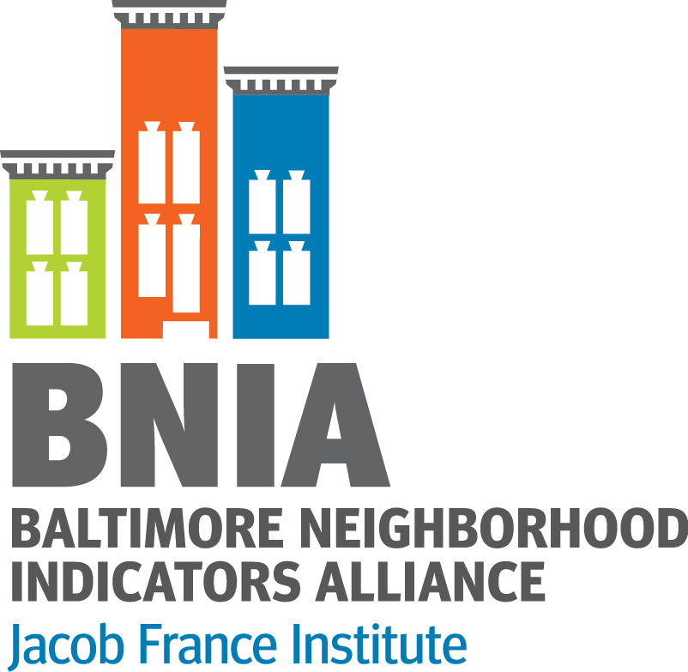
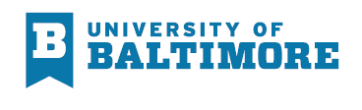
NNIP Ideas Showcase
BNIA-JFI’s ARPA Impact Indicator Dashboard
June 26, 2024
Amanda Phillips de Lucas, PhD Cheryl Knott
aphillipsdelucas@ubalt.edu cknott@ubalt.edu
www.bniajfi.org
@bniajfi

Slide 2
Measuring the Impact of ARPA Funds in Baltimore
BNIA-JFI, along with other partners at the University of Baltimore, is working with Baltimore City’s Mayors Office of Recovery Programs (MORP) to evaluate select American Rescue Plan Act (ARPA) funded projects.
As a part of this project, BNIA-JFI was tasked with developing ‘Impact Indicators’ to track how funded projects are improving outcomes for key quality of life measures.
    We worked with the team to create a framework to where ARPA investments have been made and anticipate how conditions will change in the coming year.

Slide 3
Guideposts for Selecting Indicators
Measurability
  To what extent does the ARPA investment demonstrate tangible impact at the neighborhood or city level?
Data Availability
  How readily available is data for this investment?
  Is geospatial data available to allow mapping?
Relationship
  Is there a clean, logical relationship between the ARPA investments and the proposed Impact Indicator?

Slide 4
https://arpaimpactindicators-bniajfi.hub.arcgis.com/

Slide 5
Lessons Learned
Definitions
  The bulk of the project took place behind the scenes as the team identified measure concepts, indicators, calculations, and data availability.
  Having clear definitions of what could and could not be an indicator has helped keep the project on scope.
Data Quality
  The quality of the StoryMaps are tied to the quality of the data – and what is being collected varies widely from agency to agency.
  While we try to use tract level data for all of the maps this has not always been possible for all measures.
Consistency
  ARPA funding is very visible in Baltimore City. The Impact Indicator StoryMaps are a way to promote transparency and enhance storytelling around this funding opportunity.
  As a team, we’ve needed to do a lot more work to make sure our StoryMaps are consistent with the data that agencies or organizations make public about their funded programs.

