Slide 1

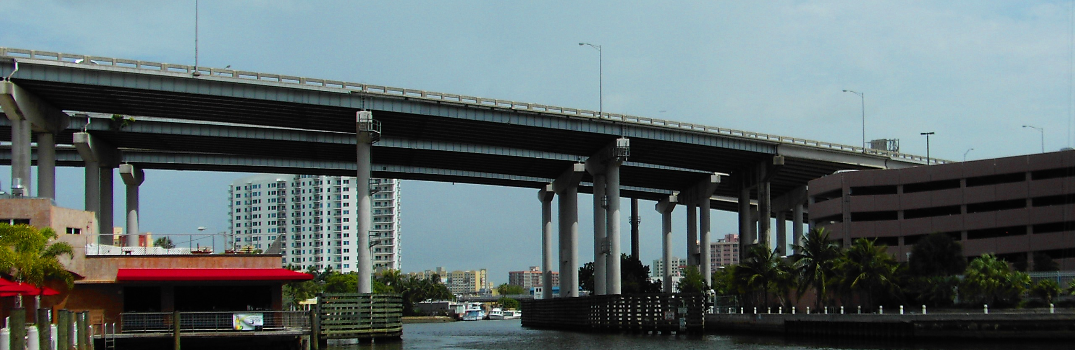
Opportunity Zones Overview
Brett Theodos
June 2019

Slide 2
Steps to making an Opportunity Zone investment
Fund makes equity investment in Opportunity Zone Business (up to 31 months+ under proposed regulation)
Taxpayer invests in Qualified Opportunity Fund (up to 180 days)
Taxpayer realizes and recognizes a capital gain
$
$
$
Fund holds 90% of assets in Zones

Slide 3
Opportunity Zones tax benefits
Temporary deferral of taxes on previously earned capital gains
Not taxed until the end of 2026 or when the newly-invested-in asset is disposed of, whichever is earlier
“Discount” (basis step-up) of previously earned capital gains invested
At least 5 years in Opportunity Fund = 10% discount
At least 7 years in Opportunity Fund = 15% discount
Permanent exclusion of taxable income on new gains
At least 10 years in Opportunity Fund = no taxes on capital gains produced through their investment

Slide 4
Opportunity Zones are different
Large segment of the US qualified (56% → 12% designated)
Not an intermediary like a NMTC CDE or HFA
Not a cap on total taxpayer subsidy
Not a competitive application process
Lots of possible use cases (but RE heavy)
Not likely an even distribution of investment across Zones
Incentive, not subsidy
Speculative back end value, relatively shallow up front value
How many more deals will pencil out?

Slide 5
Proposed Opportunity Zones regulations
Funds can be retroactively self certified
Opportunity Funds have 31 months (+ more if government delays) to invest; clock restarts with each contribution
Opportunity Funds can be multi-asset investment vehicles that dispose of assets and distribute or reinvest gains; 1 year to redeploy
At least 40% of intangible property used in the active conduct of a trade or business in the opportunity zone
At least 50% of business income from active trade or conduct in the Zone, but with “safe harbors” for hours worked, salaries paid, and tangible property

Slide 6
Proposed Opportunity Zones regulations (cont’d)
Leased property treated as business property, w/o substantial improvement requirement . Triple net leases alone don’t quality as active trade or business.
Owned property must either meet “original use” or “substantial improvements” tests
Vacant structures (>5 years) are “original”
No substantial improvement needed for unimproved land
Substantial improvement requires doubling basis within 30 months, but land – doesn’t count in basis
Other questions still unanswered, most notably, reporting requirements

Slide 7
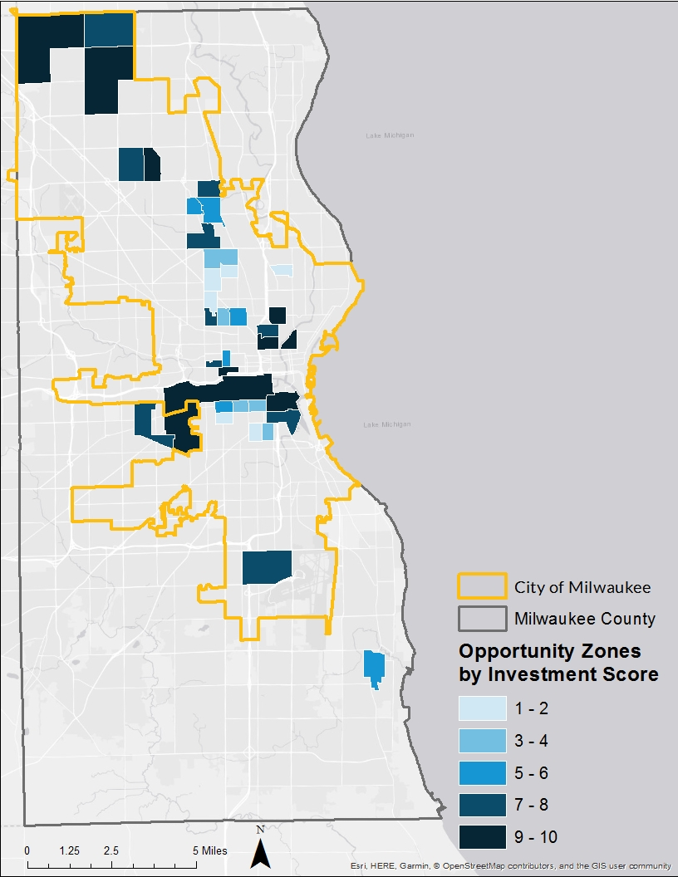
Milwaukee Opportunity Zones

Slide 8
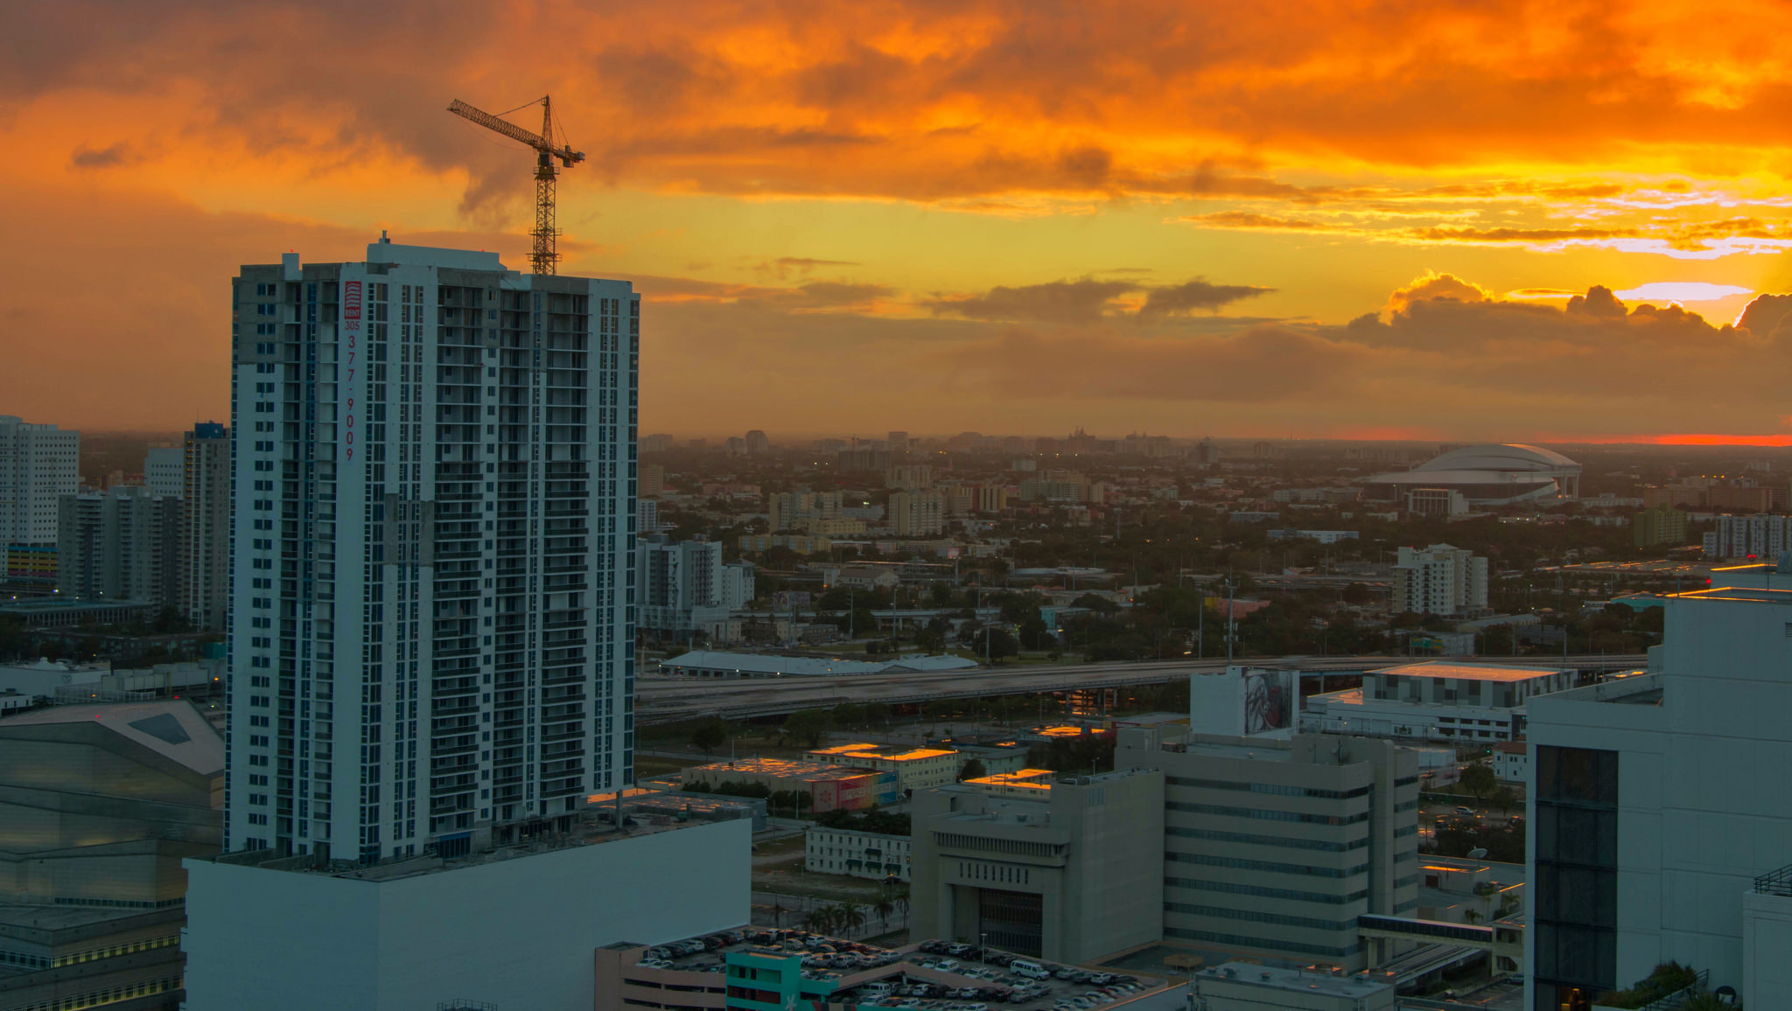
Resources
Research briefs, data and state-level summaries, blogs, public comments, and event summaries are at:
https://www.urban.org/policy-centers/ metropolitan-housing-and-communities-policy-center/projects/ opportunity-zones
Photo by Allyssa Black/Flickr

