Slide 1
Using Urban’s Mobility Metrics in Your Community
Wednesday, February 7, 2024
Presentation to National Neighborhood Indicators Partnership (NNIP)

Slide 2
Agenda
Agenda
Overview of the Upward Mobility Framework, Mobility Metrics, and a Planning Guide for Local Action
Building Cross-Sector Partnerships for Systems Change
Demo of the Data Tables
Debrief and Q&A
Notes:
Will leads housekeeping

Slide 3
American Dream
Today’s Reality
Place matters
Work hard,
get ahead
Hard work isn’t enough
You do well, your children do better
Children less likely to do better
Everyone has access to the same opportunities
Disparities by race, gender and immigration status persist

Slide 4
Disparities by race, gender, immigration status, & other marginalized groups persist
Notes:
(Greg)

Slide 5
What would it take to dramatically increase mobility from poverty?

Slide 6
Three-Part Definition
Economic
Success
When a person has adequate income and assets to support their and their family’s material well-being.
Mobility
When a person feels the respect, dignity, and sense of belonging that comes from contributing to and being appreciated by people in their community.
When a person has the ability to have control over their life, to make choices, and to influence larger policies and actions that affect their future.
Being Valued in Community
Power and
Autonomy

Slide 7
Why the Metrics? How Did We Get from a 3-Part Definition to the Need for Metrics?
Substantially increasing all three dimensions of upward mobility requires a long-term commitment
For communities to become “launch pads,” they need intermediate-term measures of conditions they can influence
Our charge: a comprehensive but concise set of metrics local leaders can use to plan strategy and monitor progress

Slide 8
Breaking down the Upward Mobility Framework
The Three-Part Definition
The Pillars
Focus on Racial Equity
The Predictors

Slide 9
Breaking Down the Upward Mobility Framework: 5 Essential Pillars

Slide 10
Breaking Down the Upward Mobility Framework: The Predictors

Slide 11
Breaking Down the Upward Mobility Framework: The Metrics

Slide 12
Framework: Criteria for the Metrics
Valid
Widely available
Repeated at regular intervals
Geographically mindful
Consistent over time and space
Structurally relevant
Structurally equitable and inclusive of important subgroups

Slide 13
Breaking down the Upward Mobility Framework: What are the Mobility Metrics?
Ratio of affordable and available housing units to households with low, very low, and extremely low-income levels
Share of children enrolled in nursery school or preschool
Employment-to-population ratio for adults ages 25 to 54
Ratio of population per primary care physician
Share of the voting-age population who turn out to vote

Slide 14
Using the Metrics
Compare
Prioritize
Set Targets
Reveal
Monitor
Highlight Interconnections

Slide 15
Building Cross-Sector Partnerships for Systems Change

Slide 16
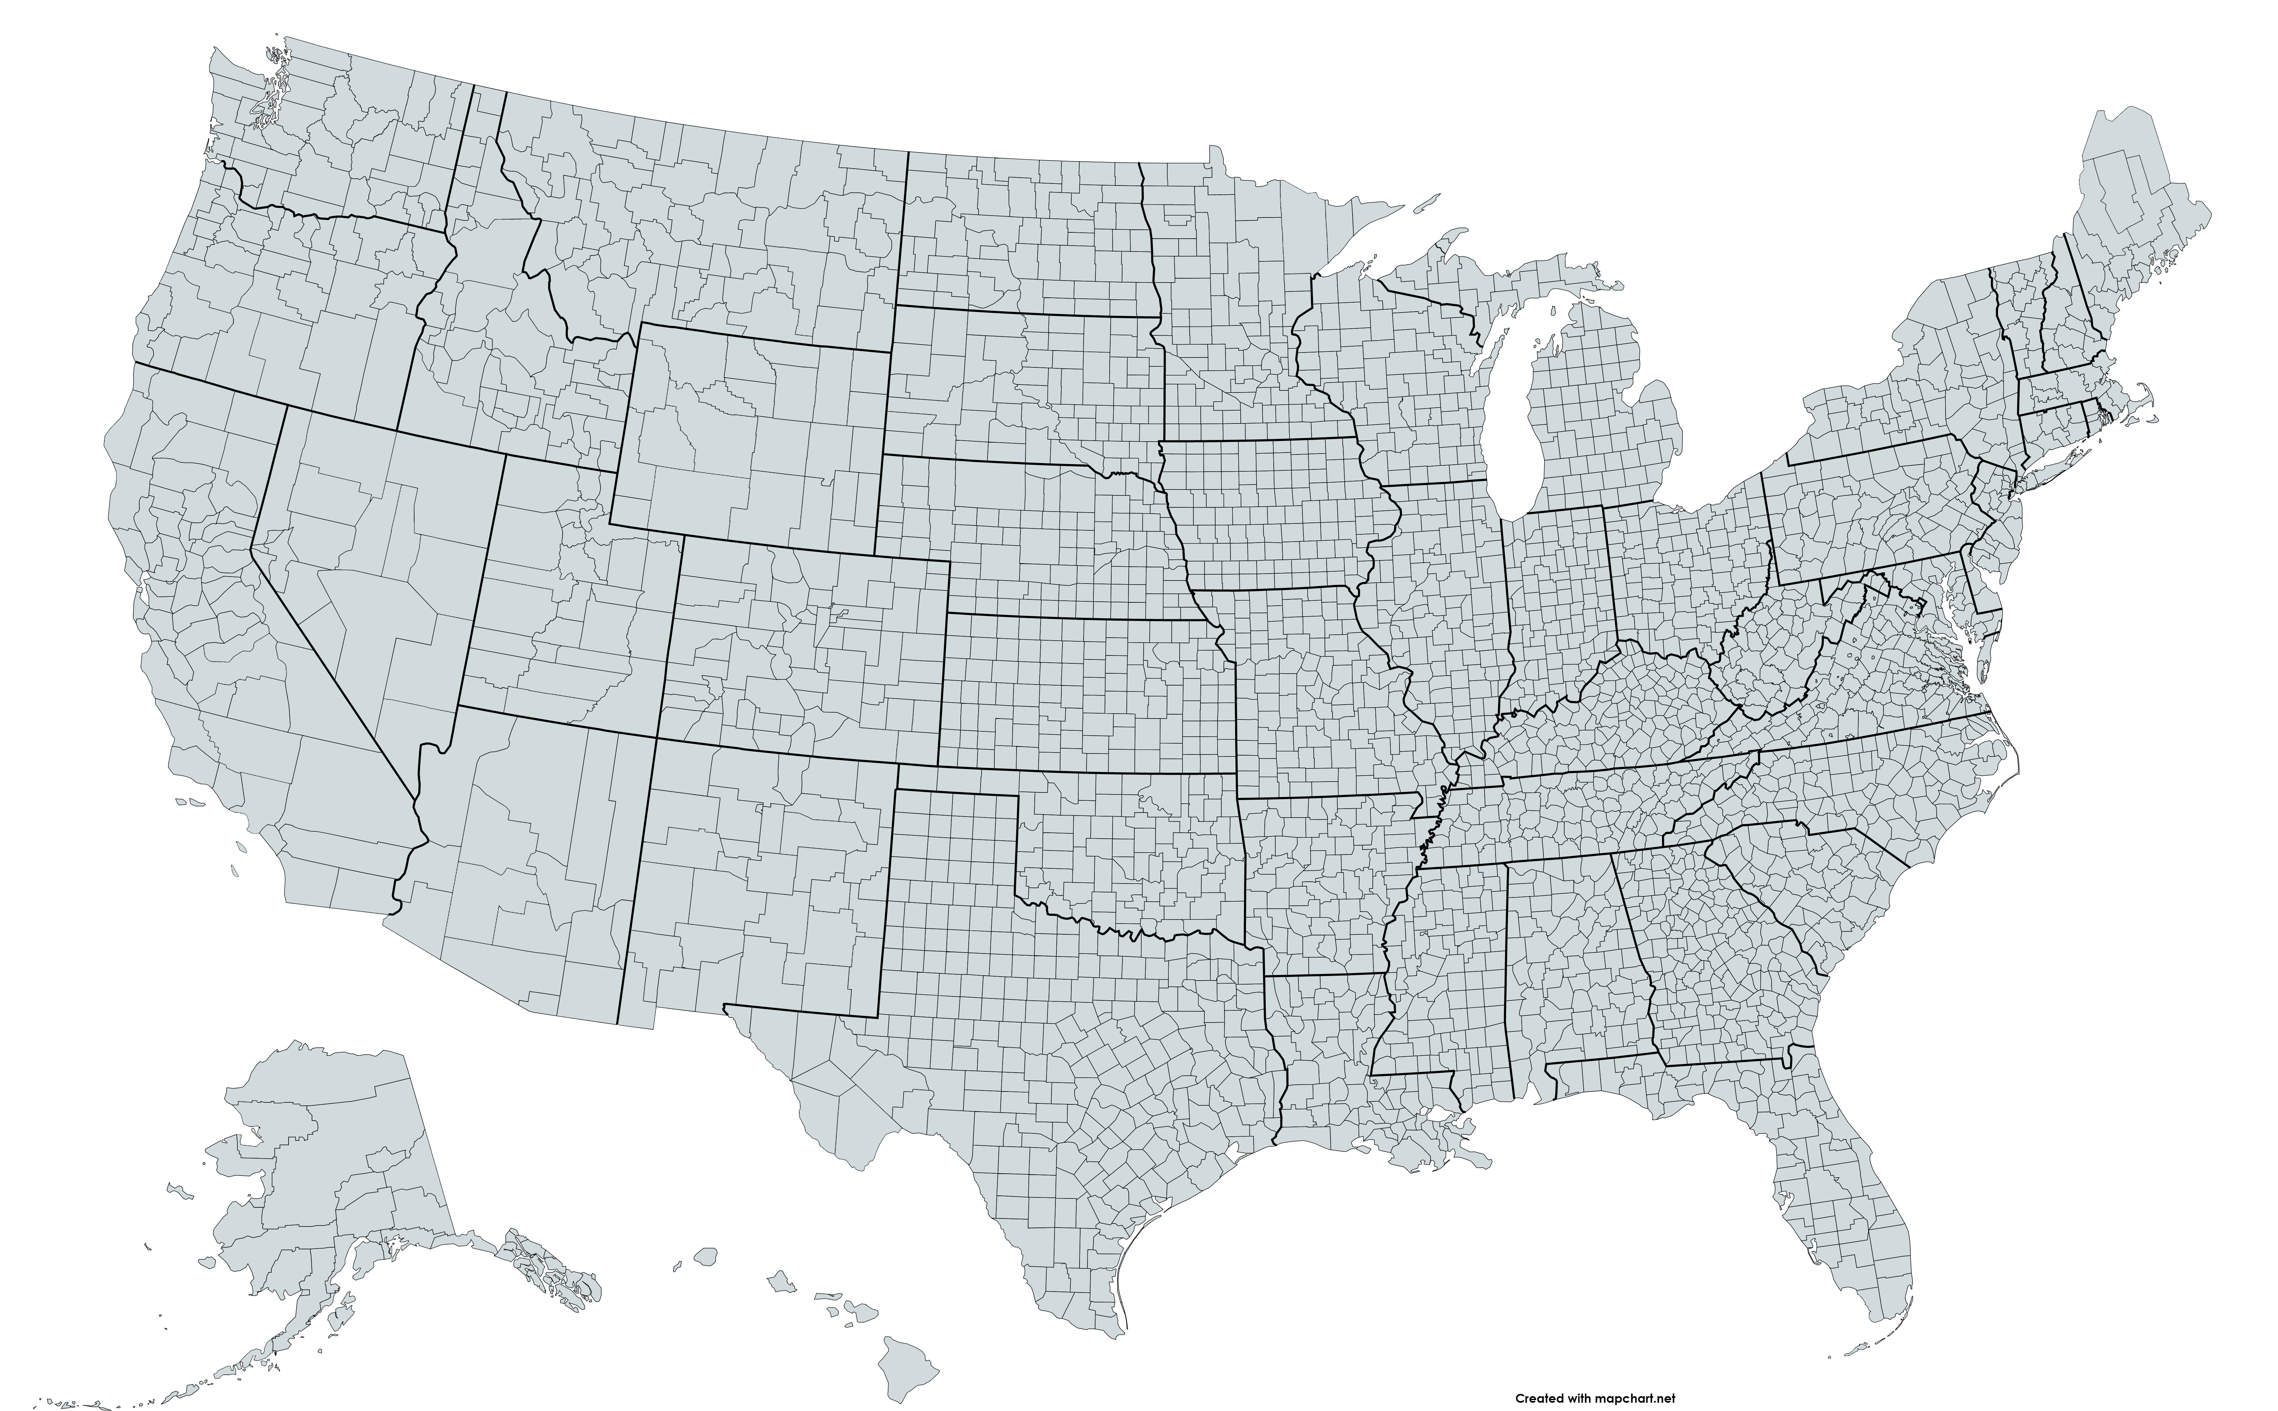
Upward Mobility Cohort TA Awardees
Ramsey
Summit
Philadelphia
Alameda
Boone
Washington, DC
Riverside
St. Lucie

Slide 17
Upward Mobility Cohort
Data Analysis
Program, Plan, & Policy Analysis
Mobility Coalition develops, implements, and sustains Mobility Action Plan.
Stakeholder Engagement
The Mobility Metrics show key challenges and opportunities. Local data provide granularity about the people and communities impacted and efforts underway.
Inventory programs and plans to understand what is currently being done, what data are being are being collected to understand effectiveness, and what gaps exist.
Community Engagement
External and internal organizational partners help to understand the data, learn more about current community conditions and efforts underway, and identify possible solutions.
Community members provide insight on needs, priorities, and solutions.

Slide 18
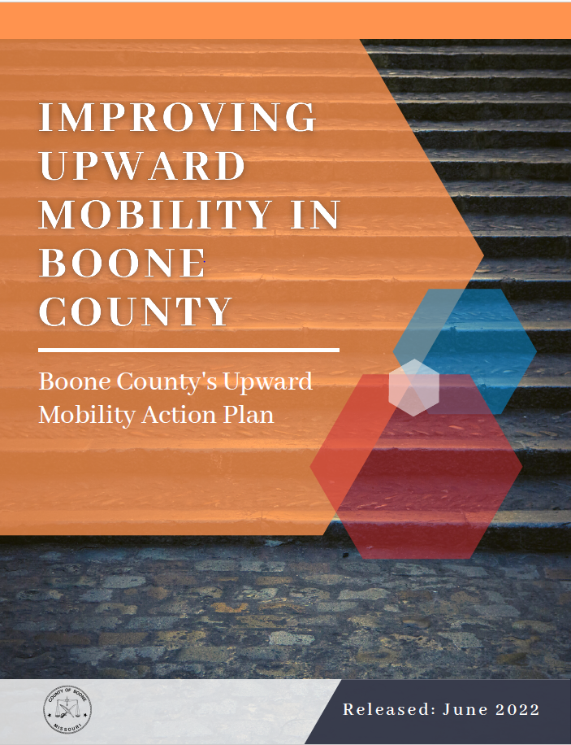
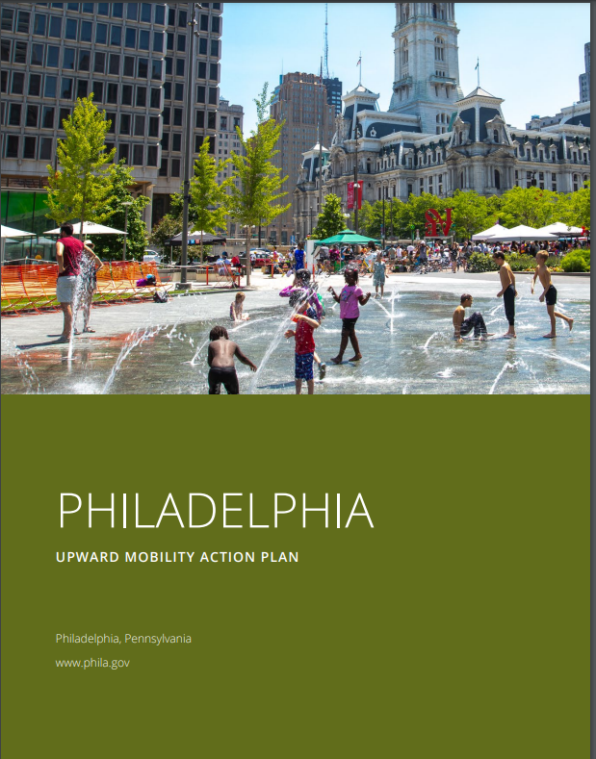
Mobility Action Plans

Slide 19
Upward Mobility Planning Guide
A guide to help local leaders better understand impediments to upward mobility and how to build a cross-sector team that can plan, advocate for, and implement a set of systems changes focused on bringing all members of your community out of poverty and creating more equitable results.
Provides practical advice for people driven to boost mobility from poverty and asking, “Where do I start?”
Informed by the Boosting Upward Mobility cohort that beta-tested the metrics.

Slide 20
The Planning Guide for Local Action
Step 1: Our Approach to Upward Mobility
Step 2: Use Mobility Metrics to Surface Insights
Step 3: Ensure Your Local Government is Ready to Undertake this Work
Step 4: Build Your Coalition for Systems Change
Step 5: Develop an Initial Understanding of Local Mobility Conditions
Step 6: Build a Fuller Picture of Mobility Conditions
Step 7: Determine Your Strategic Actions
Step 8: Develop Your Measurement Plan and Consider Sustainability
Step 9: Finalize and Release Your Mobility Action Plan
Step 10: Sustain Momentum

Slide 21
Step 3: Ensure Your Local Government/Community is Ready to Undertake this Work—Readiness Conditions
A clear commitment from local government leadership
Preparedness for cross-sector partnerships across policy domains
Sufficient organizational capacity to undertake this work
An organizational culture that can support large-scale change
Buy-in from staff across departments
A desire to build a shared understanding of structural racism and racial equity
Knowledge of the skills and capacity necessary for data gathering and analysis
Dedicated resources for meaningful community engagement
A commitment to ongoing learning and improvement.

Slide 22
Step 4: Build A Coalition for Systems Change
Aligned initiatives
Assets
Partnership
Motivation
Roles

Slide 23
Example Jurisdiction: Fresno’s Developing the Region’s Inclusive & Vibrant Economy (DRIVE)
Fresno DRIVE is a 10-year investment plan for a more inclusive and vibrant economy.
The plan was created with input from a 300-person steering committee.
DRIVE is investing in a more inclusive economy in the region by funding civic infrastructure, affordable housing, and other initiatives to catalyze neighborhood and economic development.
To track its progress toward upward mobility, the coalition uses Urban’s mobility metrics framework to measure local population-level changes, such as the share of residents experiencing poverty and the amount of affordable housing stock

Slide 24
Example Jurisdiction: The City of Philadelphia’s Department of Planning and Development
Philadelphia created a mobility action plan in 2022 with TTA from Urban.
Using mobility metrics data, Philadelphia created a public, informational storytelling resource that captures key insights that emerged during the planning process.
As part of its upward mobility data collection efforts, Philadelphia contracted a local nonprofit to conduct focus groups and survey people who were previously incarcerated and have significant housing needs.
These insights have enabled government stakeholders to recommend more accessible housing support programs.
The city plans to use the mobility metrics to further solicit insightful feedback from residents that can help improve the city’s programs and foster upward mobility.

Slide 25
Data Tables Demonstration

Slide 26
Understanding the Data Tables
Suite of 26 mobility metrics
Mobility Metrics Data Tables
3,143 county & 482 city data tables
“City” refer to large Census Places (pop 75,000+)
viewed online, shared via link, downloaded/printed

Slide 27
Other Data Resources
Resources mentioned:
Mobility Metrics Data Tables
A Planning Guide for Local Action
Other resources:
Download raw data to import into a community dashboard or pair with other local data sources
Data Dictionary
Evidence Resource Library
Public GitHub repository
Upward Mobility Blog
Understanding Local Opportunities for Upward Mobility Requires Pairing Data with Community Engagement (November 20, 2023)
Mobility Action Plans (MAPs)
Forthcoming additions:​​
Data dashboard and support tools​
Future workshops
Notes:
People might ask for local examples on how to move the needle on these metrics. Results for America just recently linked the mobility metrics as a resource which is focused on policies and has case studies on what policies exist that work.
A further development is to compile this as an FAQ document that you can add questions to as you get ones that stump you. And we could look to make some of these available on the website as a tool.

Slide 28
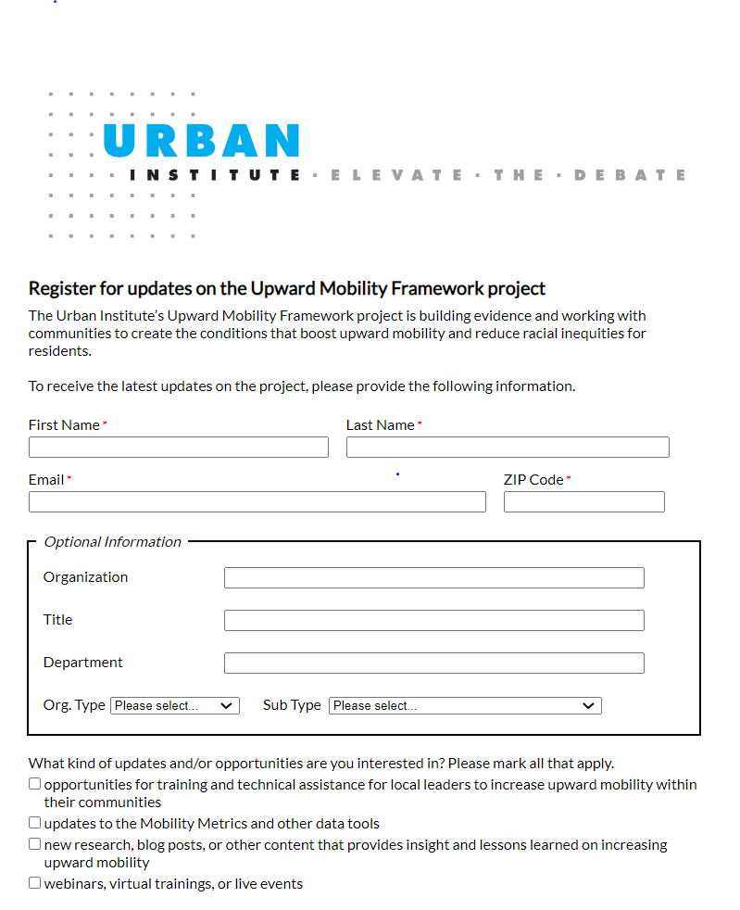
Receive Updates
To register for updates on the Upward Mobility Framework Project, please use the following link: https://urbn.is/upwardmobilityupdates

Slide 29
Questions?

Slide 30
Thank you!

