Slide 1

Displacement in Denver:
A New View on Residential Moves
NNIP Idea Showcase | February 23, 2023
PROCESS SUMMARY | select findings

Slide 2
Inquiry
Developed an adjusted measure of movement that better identifies involuntary displacement across the City.
What is the volume of movement in areas across the City that exhibit the greatest association with vulnerability to displacement?
What are the variables that demonstrate the highest association with an adjusted movement measure?

Slide 3
Hypothesis related to involuntary displacement
The working hypothesis of this research is that mobility is due to involuntary displacement if it is happening in the presence of high levels of socioeconomic stress.
  Correlates are of socioeconomic stress, such as:
    Propensity of investors
    Doubling-up
    SES variables (e.g. changes in income, employment)
    Property condition (cost of replacement ratio – CRR)
    Large increases in property values
    Controls (tenure and age)

Slide 4
Place
Socioeconomically stable & relatively unmobile
Socioeconomically stable & relatively mobile
Socioeconomically unstable & relatively unmobile (vulnerable to involuntary displacement)
Socioeconomically unstable & relatively mobile (involuntary displacement)
Focus of this inquiry

Slide 5
Variable development: mobility
Run mobility rates/counts separately (students vs. voters)
  This is due to the two data sources not being mutually exclusive – only longitudinally comparable, not compare cross-sectionally.
  Stable vs mobile (remain in City vs. left entirely)
  Student records will be treated as a population (families must be estimated)
  Voter records potential household construction
    Could stratify by age (phase in life vs. economic/housing pressure – consider how to treat the very young voters 17-21? Movers could be for school reasons.)
    Sub-household analysis – churn within the HH
  Rates are a share of the data source’s total base
New housing development (new movers offset)
  Back-in demo permits

Slide 6
A unique lens on mobility: registered voters vs. student enrollment
DPS Students
Voter Households
A Note of Caution
These data are not mutually exclusive so they should not be aggregated. For this reason, they have been intentionally presented in different units (students/families vs. households).
There is certainly overlap between these files (registered voters who have children enrolled in DPS), but the extent to which this occurs is unknown at this time.
???

Slide 7
SWOT analysis: registered voters vs. student enrollment
Student Enrollment Records | Voter Registration Records
Strengths Student enrollment files enable us to look at the moves of students in Denver Public Schools since 2010. These records include free and reduced lunch (FRL) status, a proxy for income. | Strengths Voter registration files enable us to look at the moves of voter since 2012. Files cover the entire state. Records include the home address which enables us to combine into households and join to housing property records. Age of voter is included. Voter household counts represent over 82% of ACS household estimates in 2014 and over 80% in 2019. These data are considered public information, are readily available from the Colorado Secretary of State for a nominal fee, and do not require a data sharing agreement.
Weaknesses We do not know what happens to students who move outside the district. These records are not available at the address level and did not enable a way to reliably combine into a household. Due to FERPA requirements, these data require a robust data sharing agreement with DPS. | Weaknesses Lack an economic variable. Unknown if the “move” was due to death. Does not include undocumented residents.

Slide 8
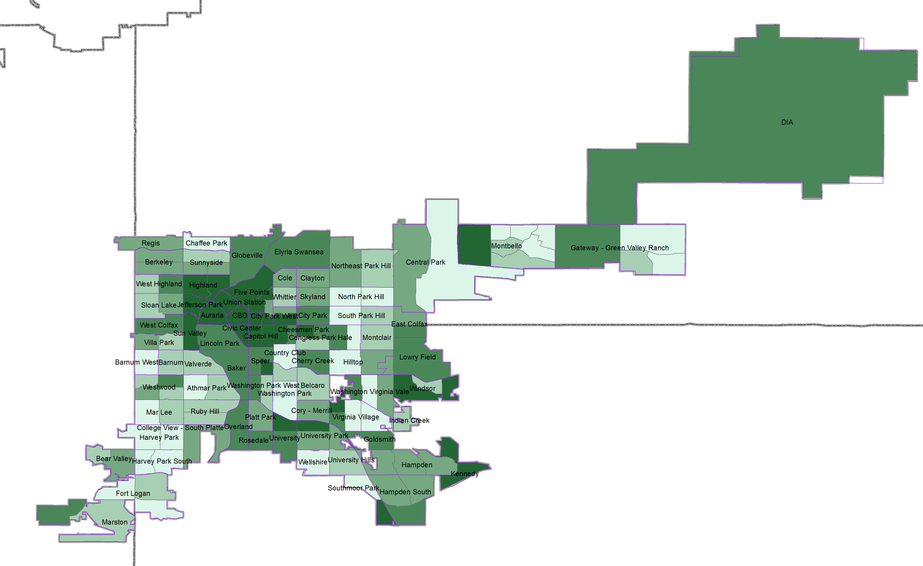
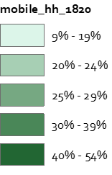
Voter mobility 2018-2020
Extensive analysis of the voter data confirmed straight mobility simply mirrors share of renters
Source: CFC Analysis of Secretary of State voter records 2018-2020

Slide 9
Preliminary insight – straight mobility highly correlated with renters
Source: CFC Analysis of Secretary of State voter records 2018-2020, American Community Survey 2019 5-year estimates

Slide 10
Preliminary insight – straight mobility negatively correlated with income
Source: CFC Analysis of Secretary of State voter records 2018-2020, American Community Survey 2019 5-year estimates

Slide 11
Preliminary insight – straight mobility negatively correlated with home values
Source: CFC Analysis of Secretary of State voter records 2018-2020, Legislative Counsel Property Abstracts

Slide 12
Involuntary displacement approach
Standard Score Overview
Objective criteria (by census tract by 2 year period) to create a “risk/stability” score: the higher the overall score the higher risk of involuntary displacement
  Unstable_kids – as share increases zscore is higher (+)
  Unstable_HH – as share increases zscore is higher (+)
  Median Valuation (opposite sign) – as value increases zscore is lower (-)
  Median HH Inc (ACS) (opposite sign) – as value increases zscore is lower (-)
  Share of renters – (opposite sign) as share increases zscore is lower (-)
Notes:
Complement Blueprint Denver’s cross section of community indicators (lower income, education, renters as compared to the city overall)
Overlay/context with race/ethnicity

Slide 13
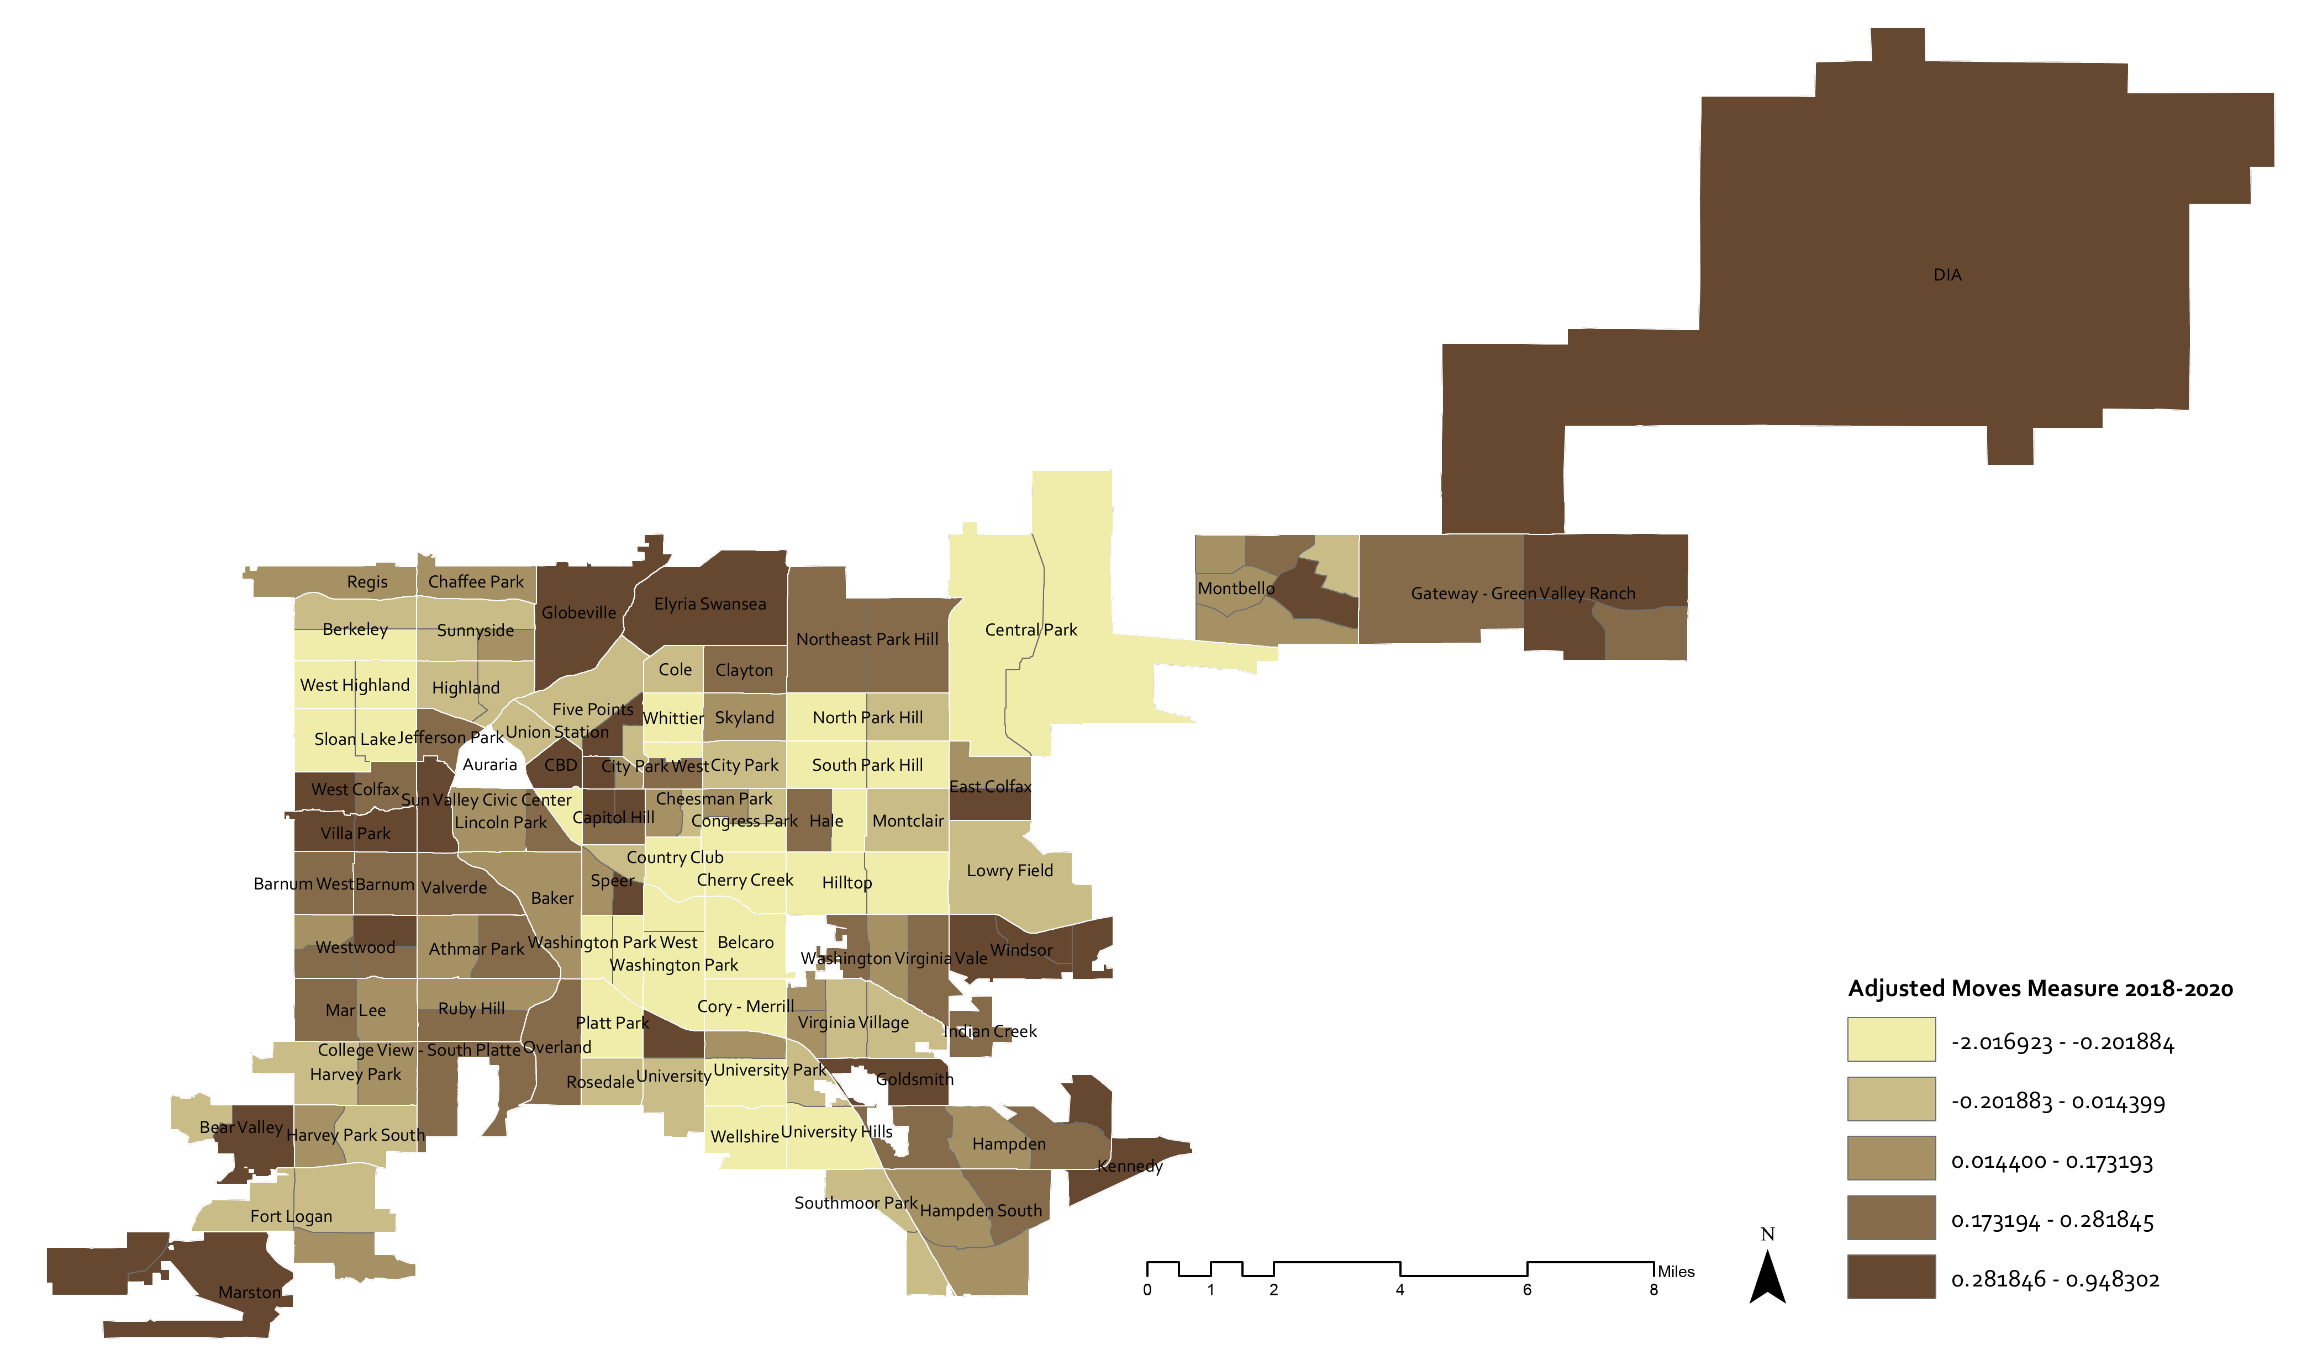
Adjusted moves measure 2018-2020
Source: CFC Analysis of Secretary of State voter records 2018-2020, American Community Survey 2019 5-year estimates, Legislative Counsel Property Abstracts

Slide 14
After incorporating correcting variables there is no longer a strong relationship between the measure and share renters
Source: CFC Analysis of Secretary of State voter records 2018-2020, American Community Survey 2019 5-year estimates, Legislative Counsel Property Abstracts

Slide 15
Select Findings
Moves measure insight

Slide 16
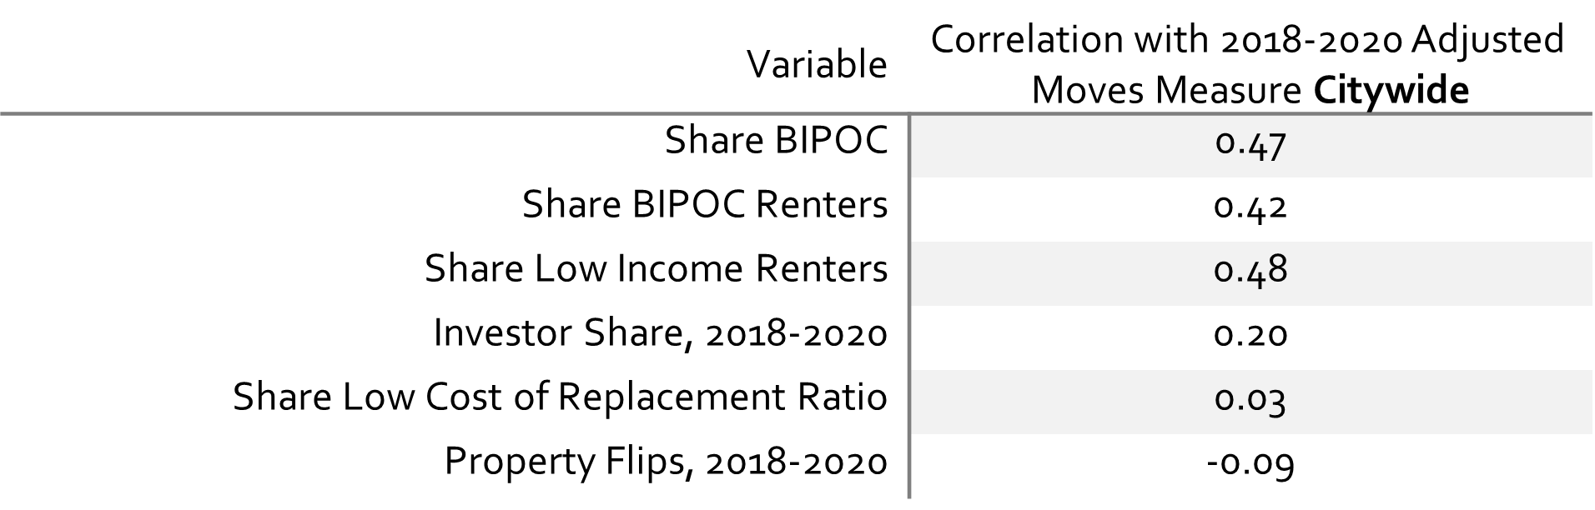
Adjusted moves measure 2018-2020 citywide correlation findings
Source: CFC Analysis of Secretary of State voter records 2018-2020, American Community Survey 2019 5-year estimates, Legislative Counsel Property Abstracts

Slide 17
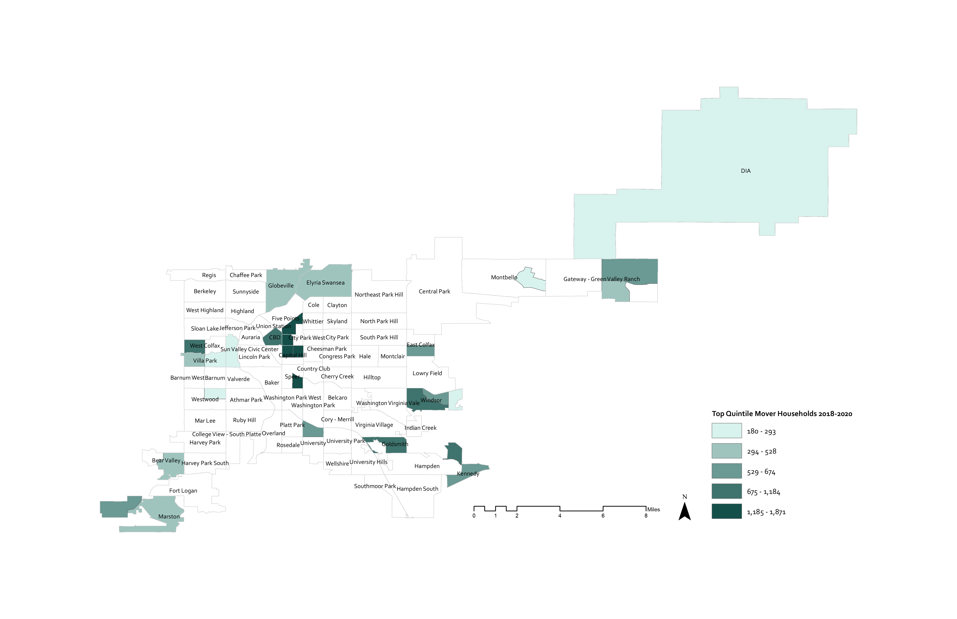
Adjusted moves measure 2018-2020 top quintile by density of moves
Source: CFC Analysis of Secretary of State voter records 2018-2020, American Community Survey 2019 5-year estimates, Legislative Counsel Property Abstracts

Slide 18
Adjusted moves measure and top quintile moves over time
Source: CFC Analysis of Secretary of State voter records 2012-2020

Slide 19
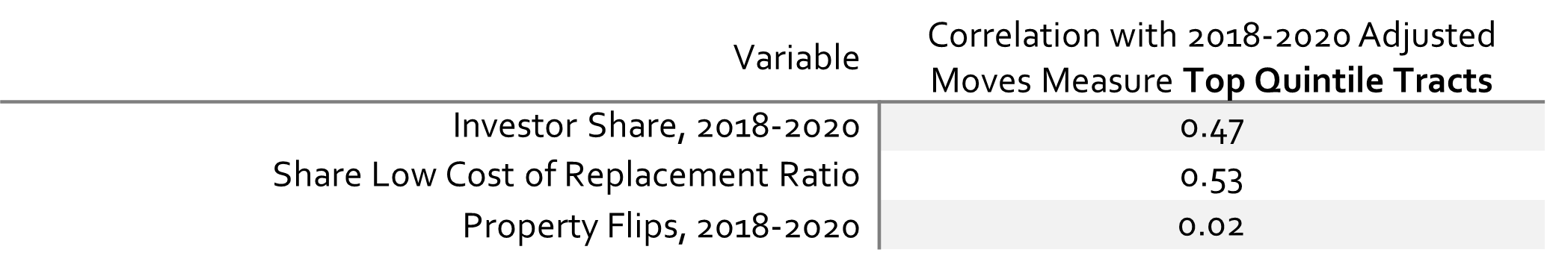
Adjusted moves measure 2018-2020 top quintile correlation findings
Source: CFC Analysis of Secretary of State voter records 2018-2020, American Community Survey 2019 5-year estimates, Legislative Counsel Property Abstracts

Slide 20

Further inquiries | more insight
Jennifer Newcomer, PhD Student
Research Director, Colorado Futures Center
jennifer@coloradofuturescsu.org
www.coloradofuturescsu.org/
The Colorado Futures Center is a 501c3 organization dedicated to informing about economic, fiscal and public policy issues impacting community economic health and quality of life.
Phyllis Resnick, PhD
Executive Director, Colorado Futures Center
phyllis@coloradofuturescsu.org
www.coloradofuturescsu.org/
@colofutures

