Slide 1
Introducing Neighborhood Pulse Learning to Sustain the General and the Particular
Meg Merrick, Ph.D., Institute of Portland Metropolitan Studies

Slide 2
A Balancing Act
Geography
Time (change over time)
Data disaggregation
2 states
7 counties
25 cities
Unincorporated areas
35 school districts
Monthly
Yearly
5 years
10 years
Populations of interest
Race
Ethnicity
Age
Cost!!!

Slide 3
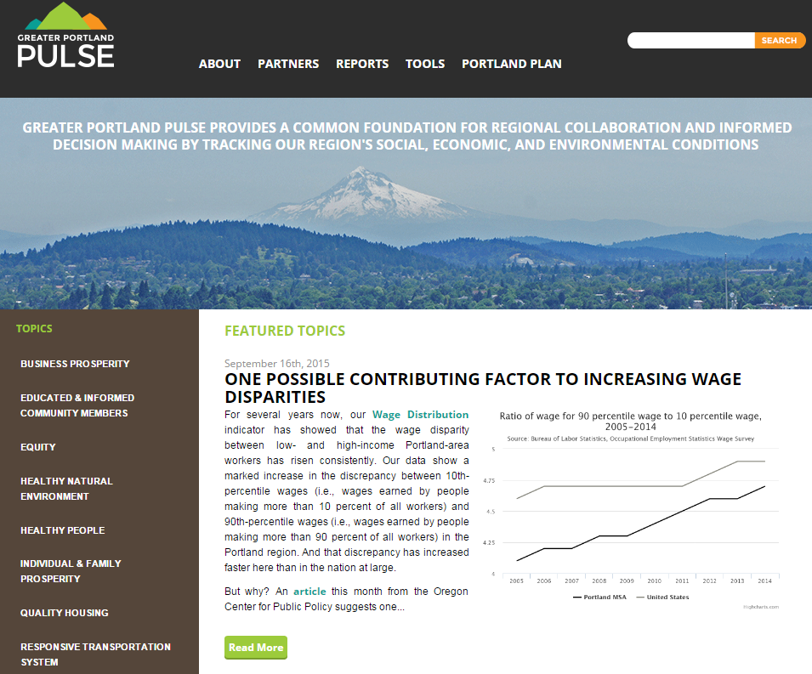
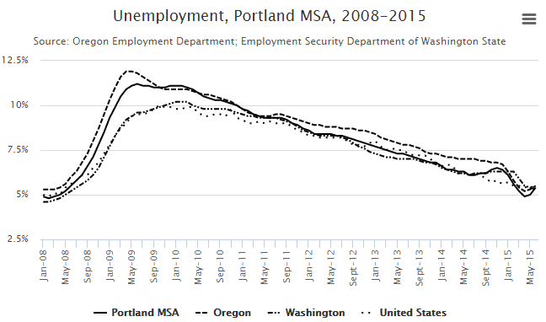
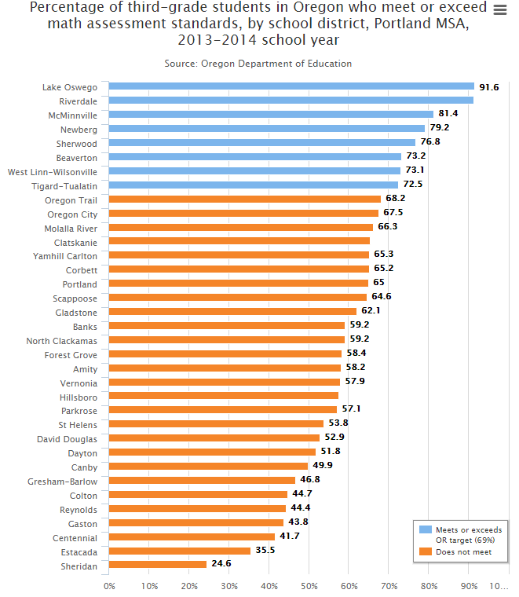
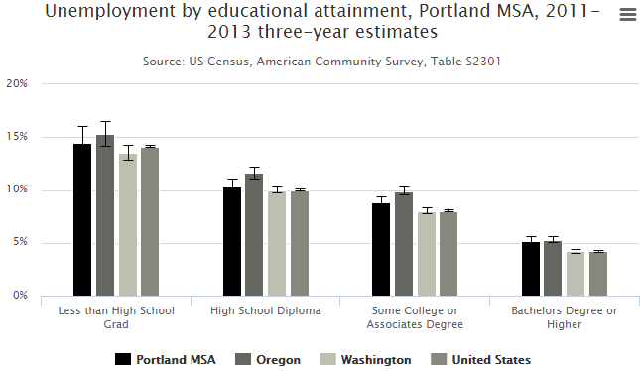
Prioritizing time over space

Slide 4
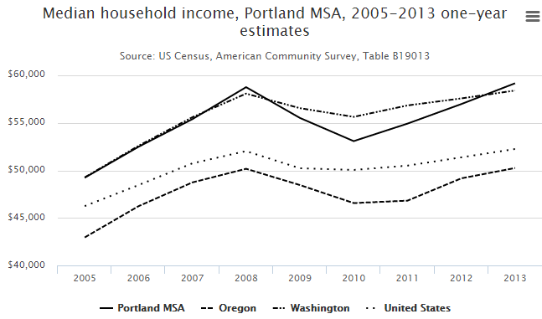
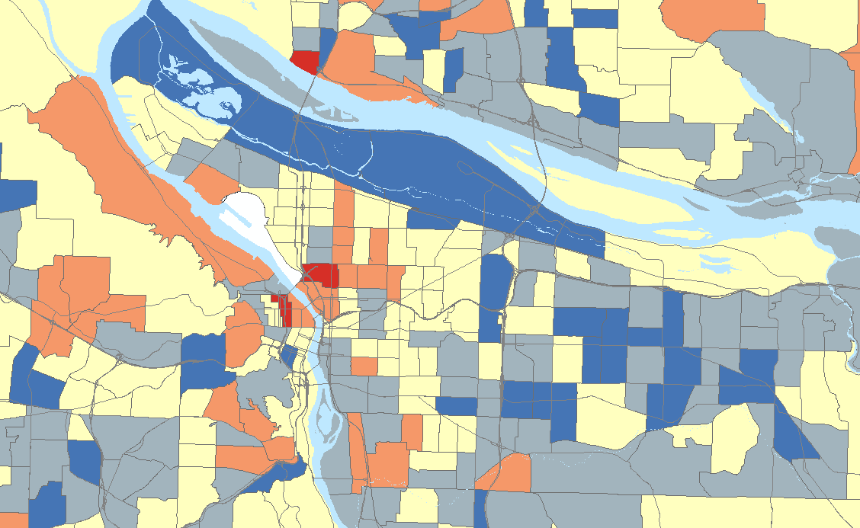
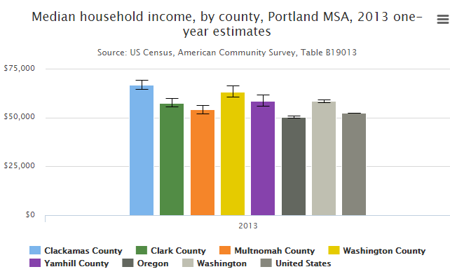
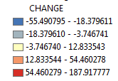
But the neighborhood dynamics are missing
Change in Median Household Income 2000 and 2006-2010 est.

Slide 5
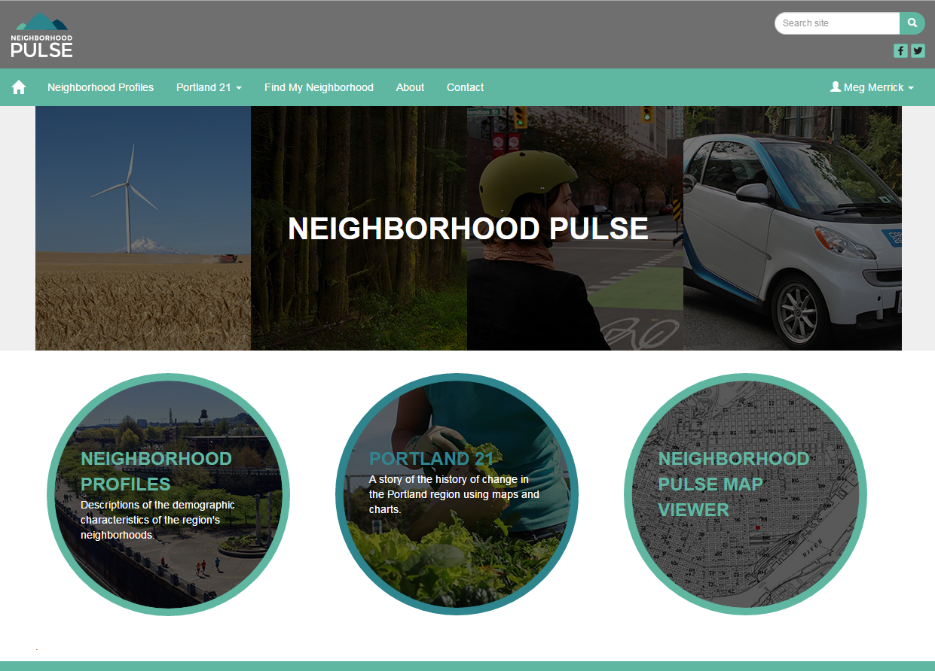
INTRODUCING

Slide 6
Neighborhood Pulse Funding Model
Neighborhood profiles:
Decennial Census, data aggregated to neighborhood boundaries – once every 10 years, fee for service
Portland 21:
Periodic stories/chapters – internally funded and contracts
Neighborhood Pulse Map Viewer:
Tool funded primarily by Metro
Base tax lot level datasets and Census/ACS data – internally funded
Custom high resolution data – contracts, grants
Grassroots datasets

Slide 7
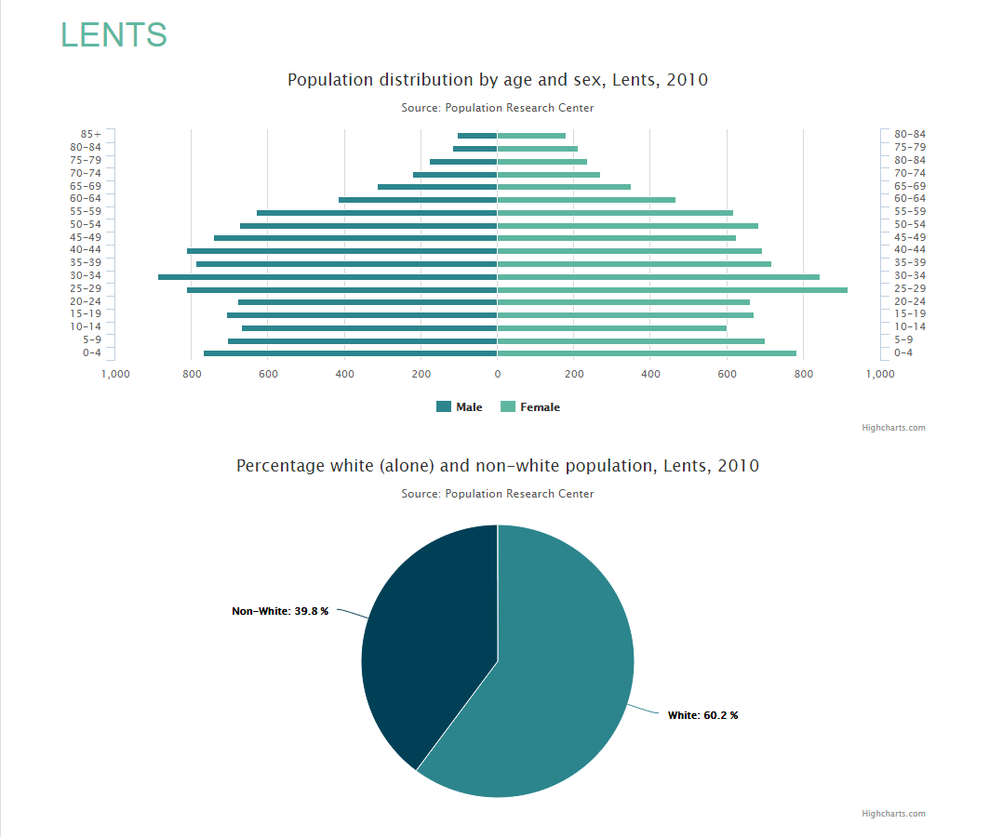
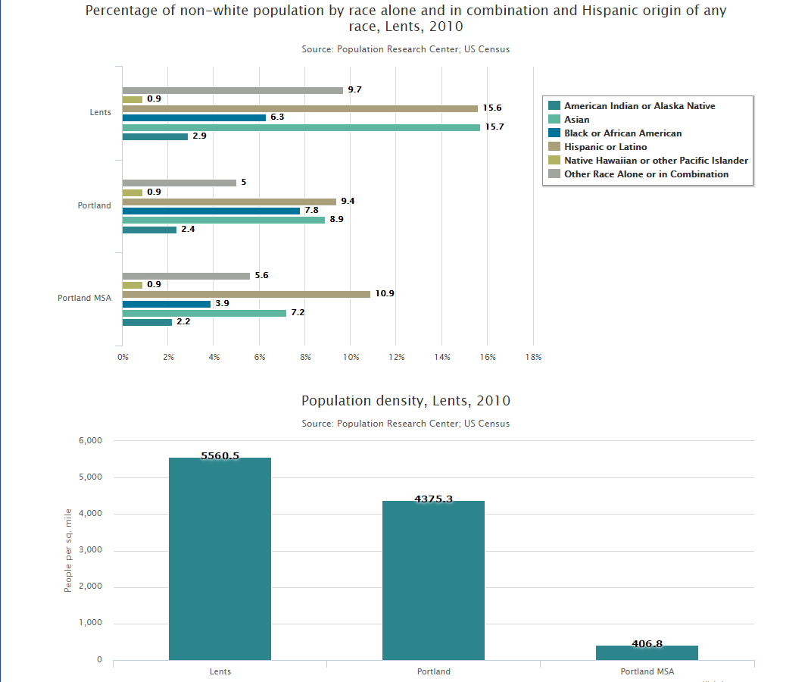
Neighborhood Profiles

Slide 8
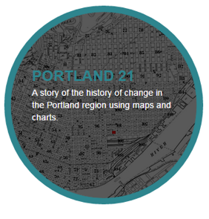
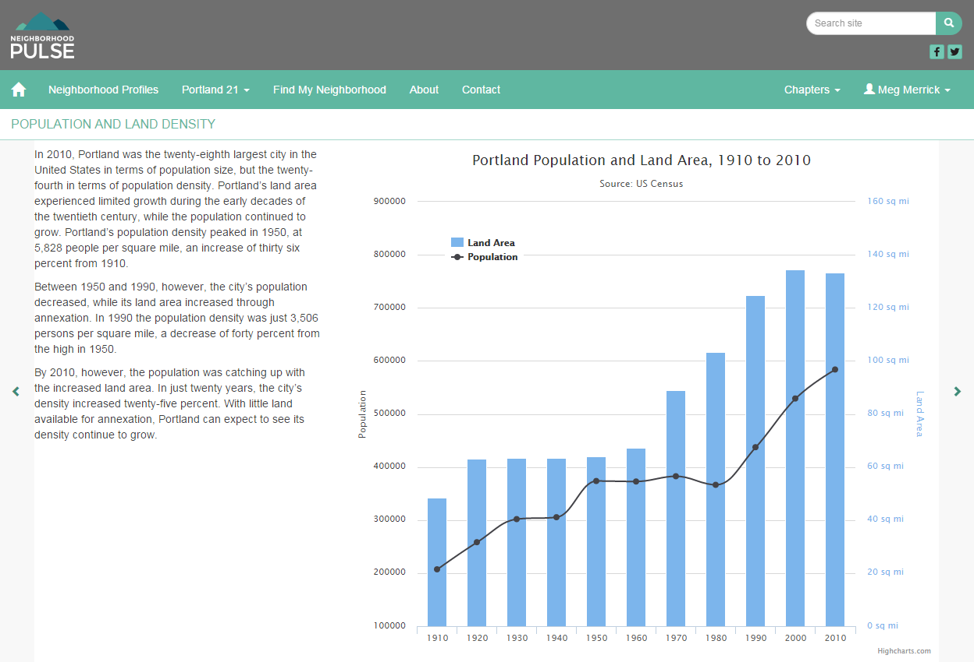
Story-telling
http://neighborhoodpulsepdx.org/portland21/growing-portland/does-portland-have-room-to-grow

Slide 9
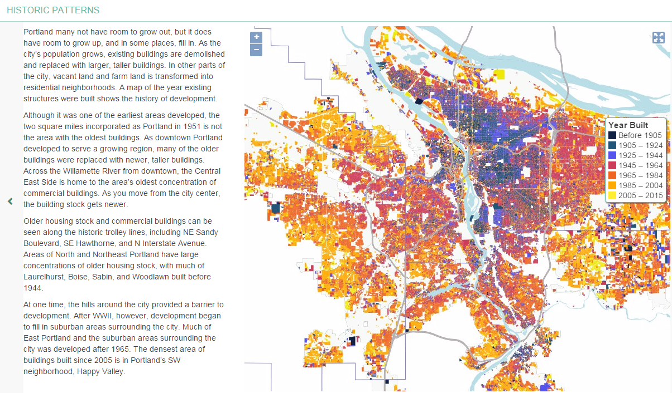
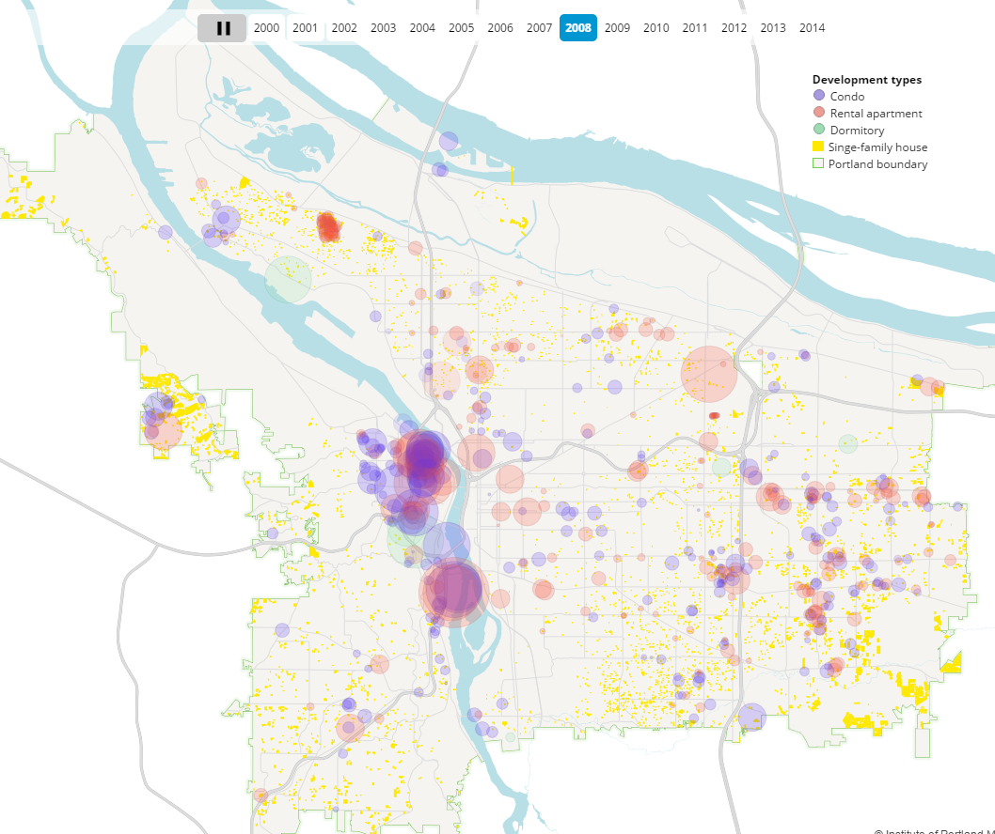

Slide 10
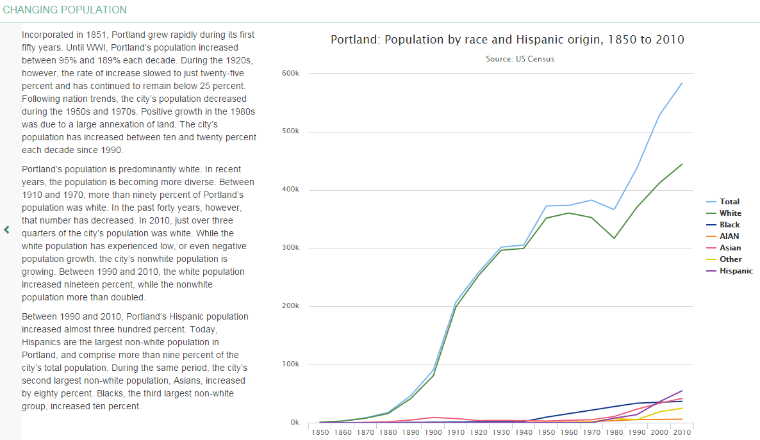
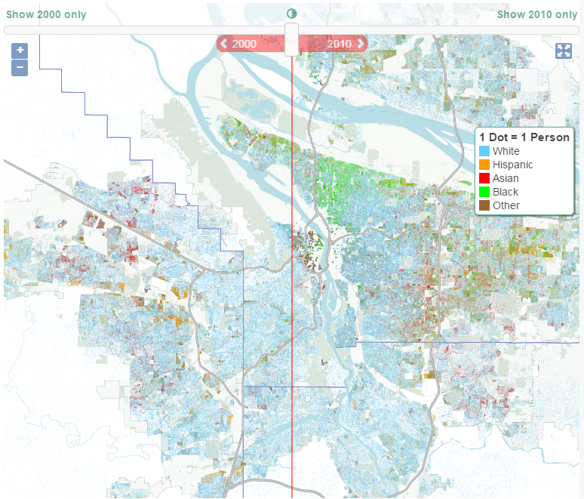

Slide 11
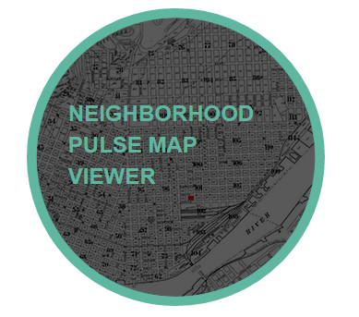
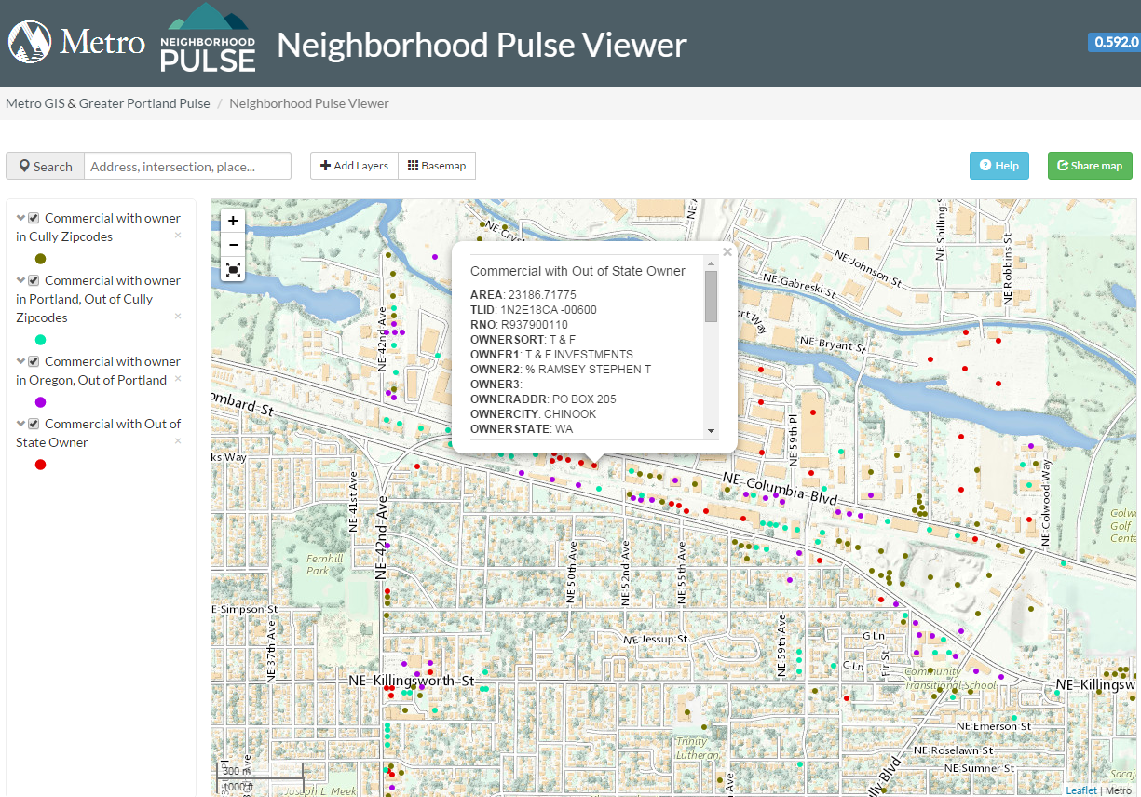
Tax lot level data
and interactive mapping
Degrees of local ownership
Lead paint hazard potential
Tree inventories
Change in property value
Locations of graffiti

Slide 12
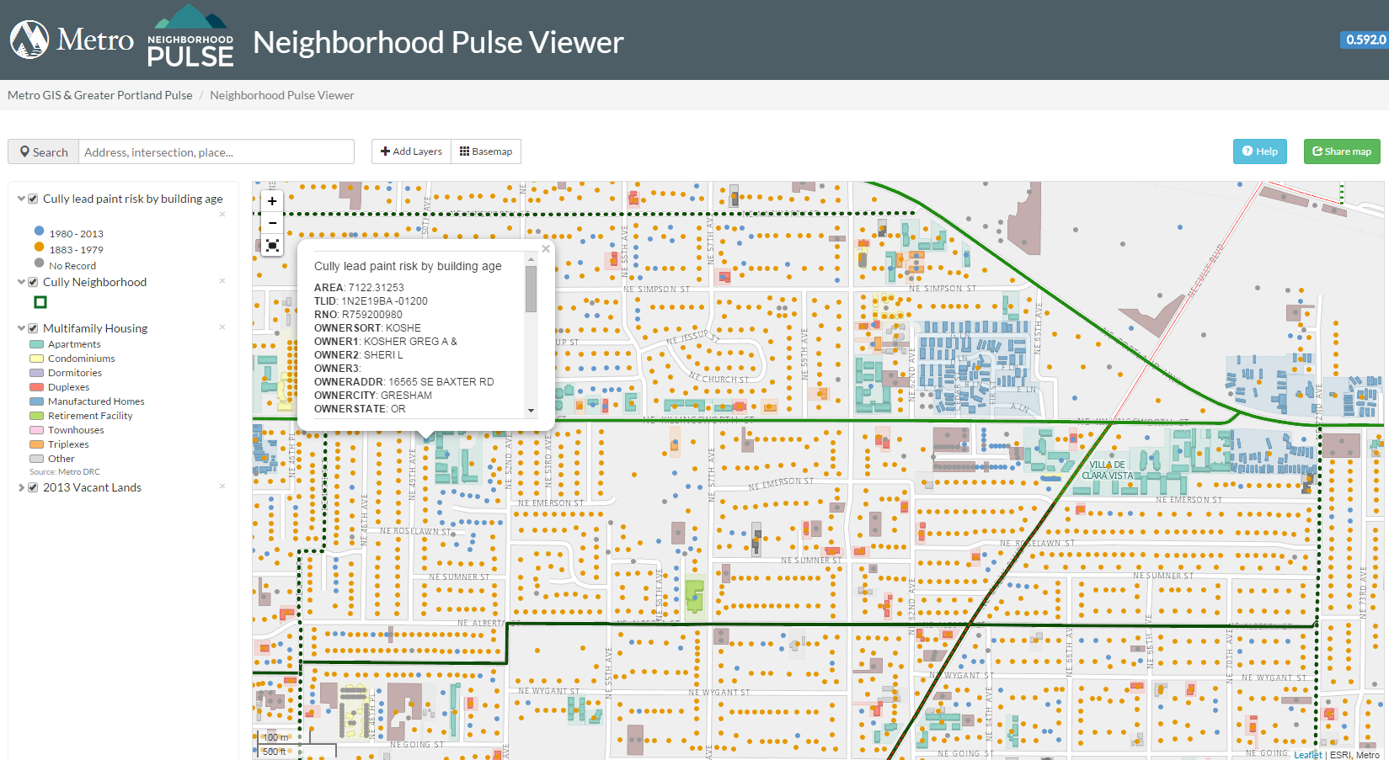

Slide 13
www.neighborhoodpulsepdx.org
Portlandpulse.org

