Slide 1
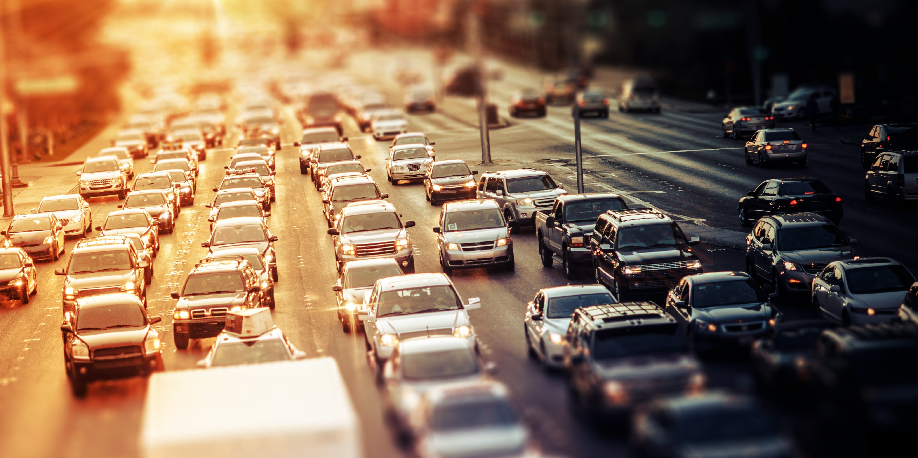
Racial Disparities in the Proximity to Vehicle Air Pollution in the MAPC Region
Conor Gately, Land Use and Transportation Analyst, MAPC
May 14, 2021

Slide 2
Disparities in COVID-19 Risks and Outcomes
“Long-standing systemic health and social inequities have put some members of racial and ethnic minority groups at increased risk of getting COVID-19 or experiencing severe illness, regardless of age.”
Source: https://www.cdc.gov/coronavirus/2019-ncov/need-extra-precautions/racial-ethnic-minorities.html

Slide 3
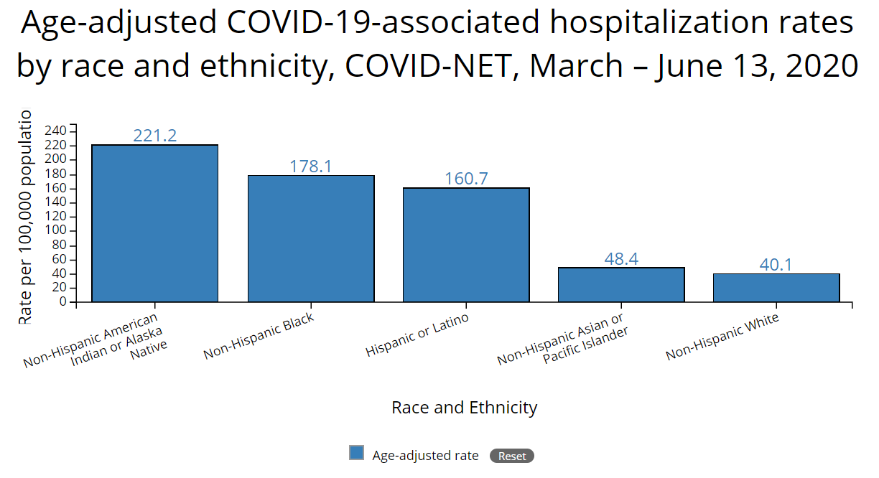
Source: https://www.cdc.gov/coronavirus/2019-ncov/need-extra-precautions/racial-ethnic-minorities.html

Slide 4
Disparities in COVID-19 Risks and Outcomes
Correlation of pre-existing conditions with increased risk of severe or fatal COVID-19 cases:
Chronic kidney disease
COPD (chronic obstructive pulmonary disease)
Immunocompromised state (weakened immune system) from solid organ transplant
Obesity (body mass index [BMI] of 30 or higher)
Serious heart conditions, such as heart failure, coronary artery disease, or cardiomyopathies
Sickle cell disease
Type 2 diabetes mellitus
Source: https://www.cdc.gov/coronavirus/2019-ncov/need-extra-precautions/people-with-medical-conditions.html

Slide 5
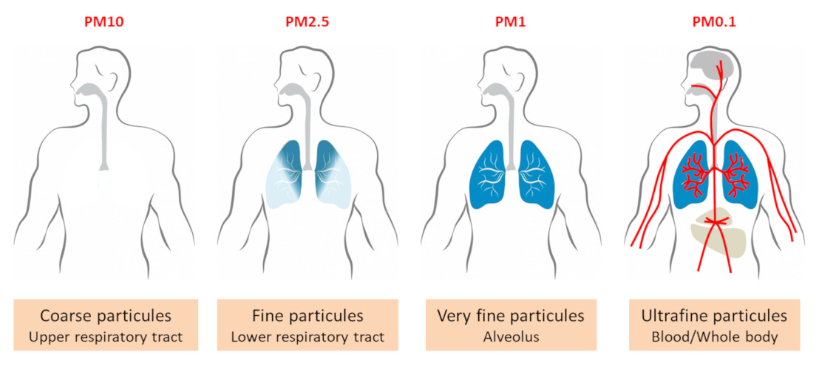
Disparities in COVID-19 Risks and Outcomes
Correlation of pre-existing conditions with exposure to ultra-fine particulate air pollution.
Ultra-fine particulates (UFP, PM_{0.1}) are very small particulates emitted by a variety of human and natural processes, including the combustion of diesel and gasoline fuels in vehicle engines.

Slide 6
Disparities in COVID-19 Risks and Outcomes
Due to the small size of UFP, they are able to penetrate deeper into the lungs, causing inflammation and damage to lung tissue and blood vessels.
Exposure to UFP is associated with increased risks of pulmonary and cardiovascular disease, asthma, diabetes, systemic inflammation and cancer.

Slide 7
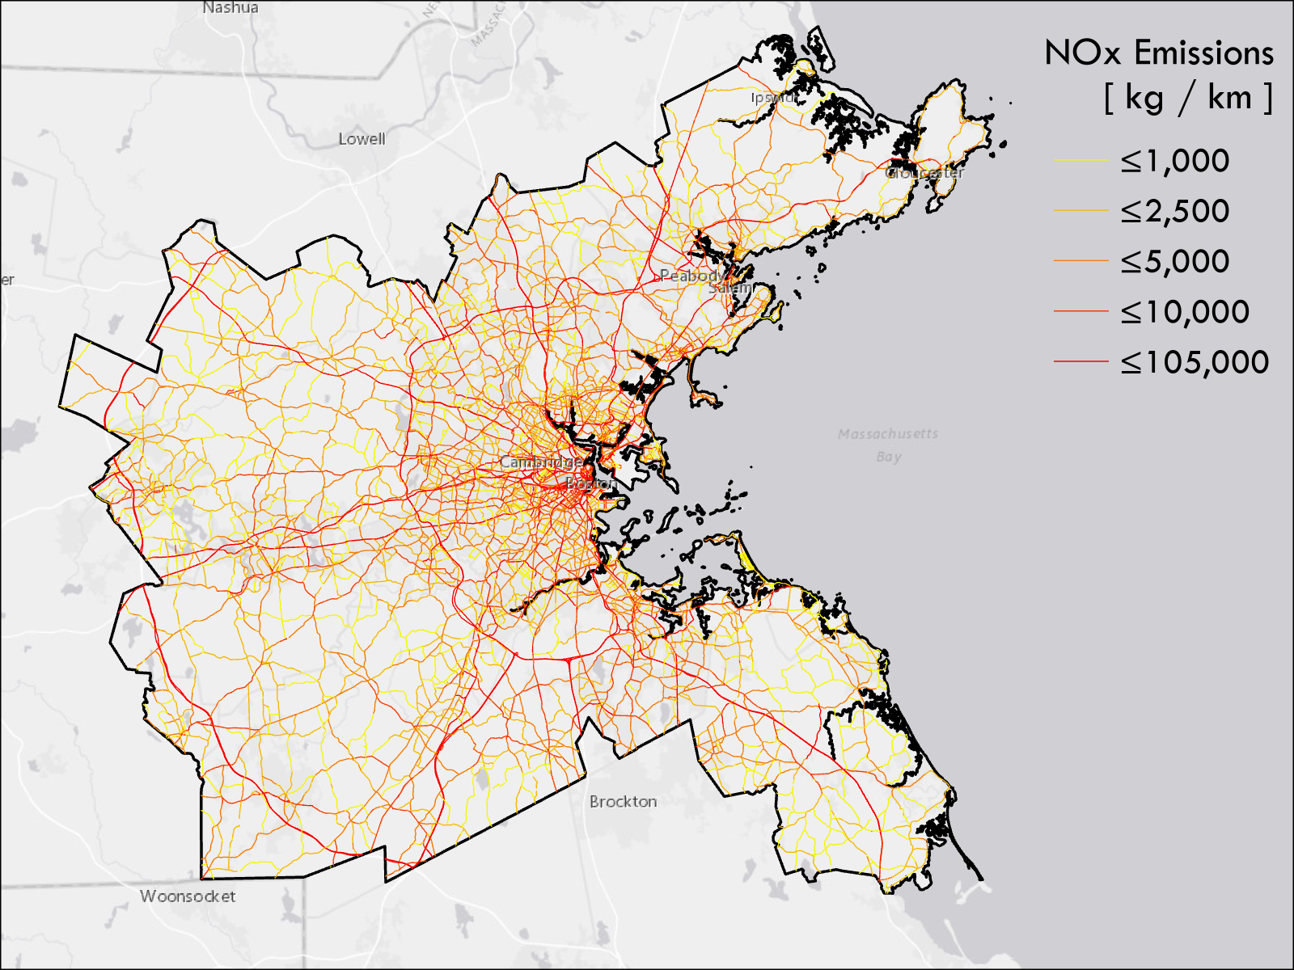
Emissions from road vehicles
MAPC Region – Pop. 3.4 Million.
39 billion vehicle miles travelled (VMT) in 2017.
Emissions of nitrogen oxides (NOx) are strongly correlated with emissions of UFP.
UFP concentrations are highest within 0 – 150 meters of the roadway edge

Slide 8
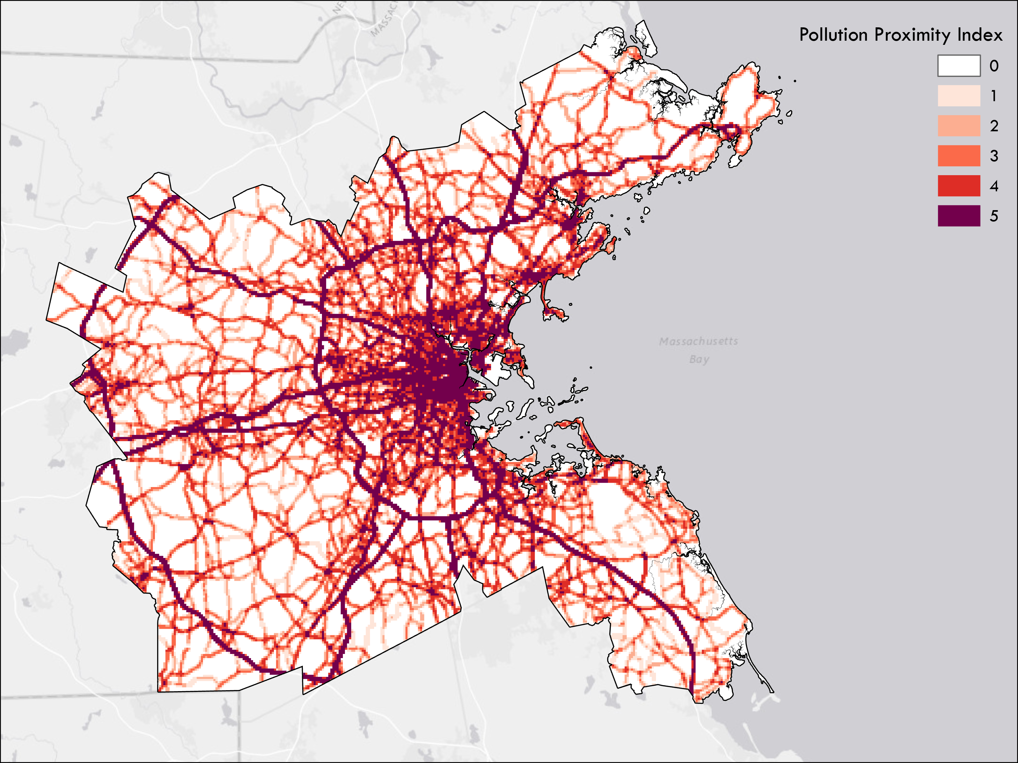
Pollution Proximity Index (PPI)
Pollution Proximity Index (PPI) evaluates the intensity of pollutant emissions with the number of households living within 150 meters of the road.
MAPC 250m² gridded population layer of 2010 Census demographic data.
PPI scores reflect relative pollution intensity – the highest score of 5 is where the highest 20% of emissions occur.

Slide 9
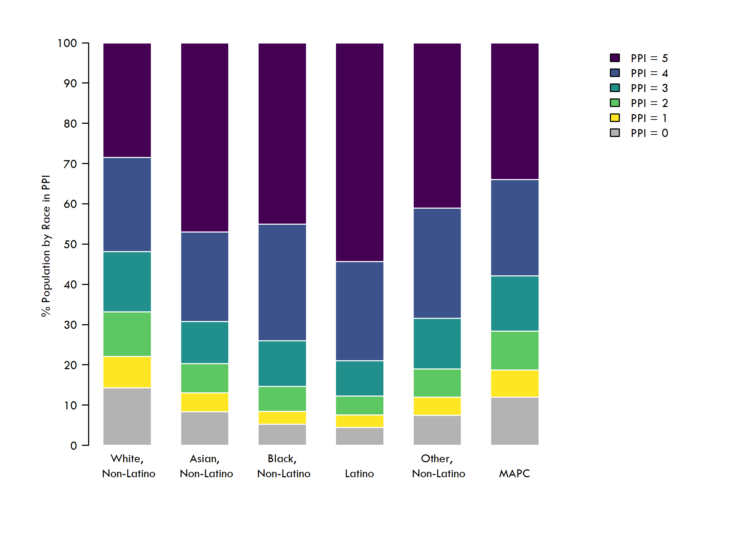
Population by Race / Ethnicity in each PPI category
Relative to the demographics of the region, we observe significant disparities in the shares of residents of color living in the highest pollution areas
28% of White residents live in the top PPI areas
46% of Black, 48% of Asian, and 54% of Latino residents live in the highest pollution areas

Slide 10
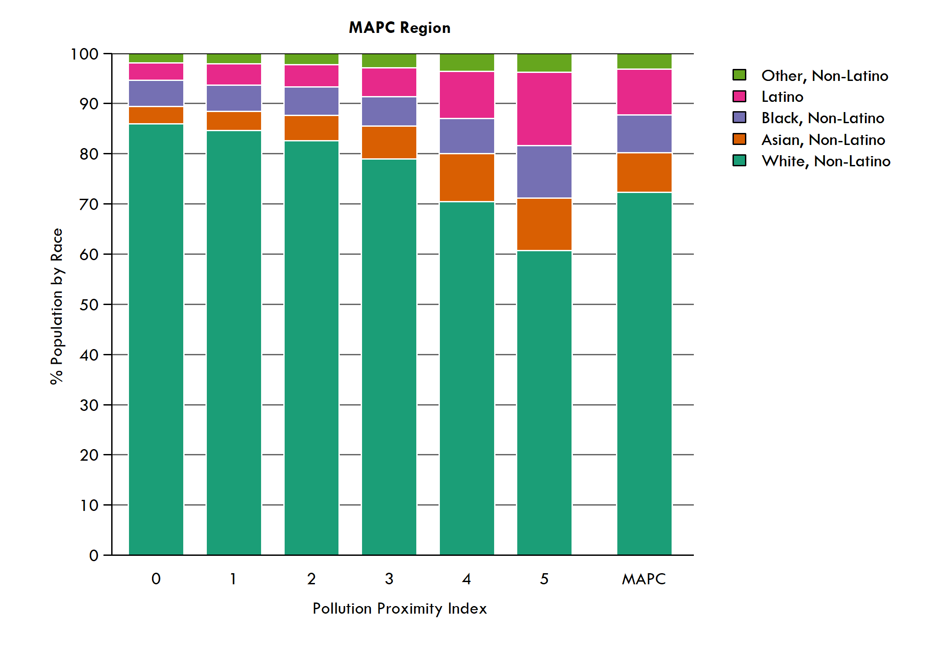
Moving from low PPI to high PPI areas, we see a clear trend: the share of residents of color increases with increasing PPI.
In the top PPI group, the percent of Black and Asian residents is 30-40% higher than their share of regional population, and the percent of Latino residents is 60% higher.

Slide 11
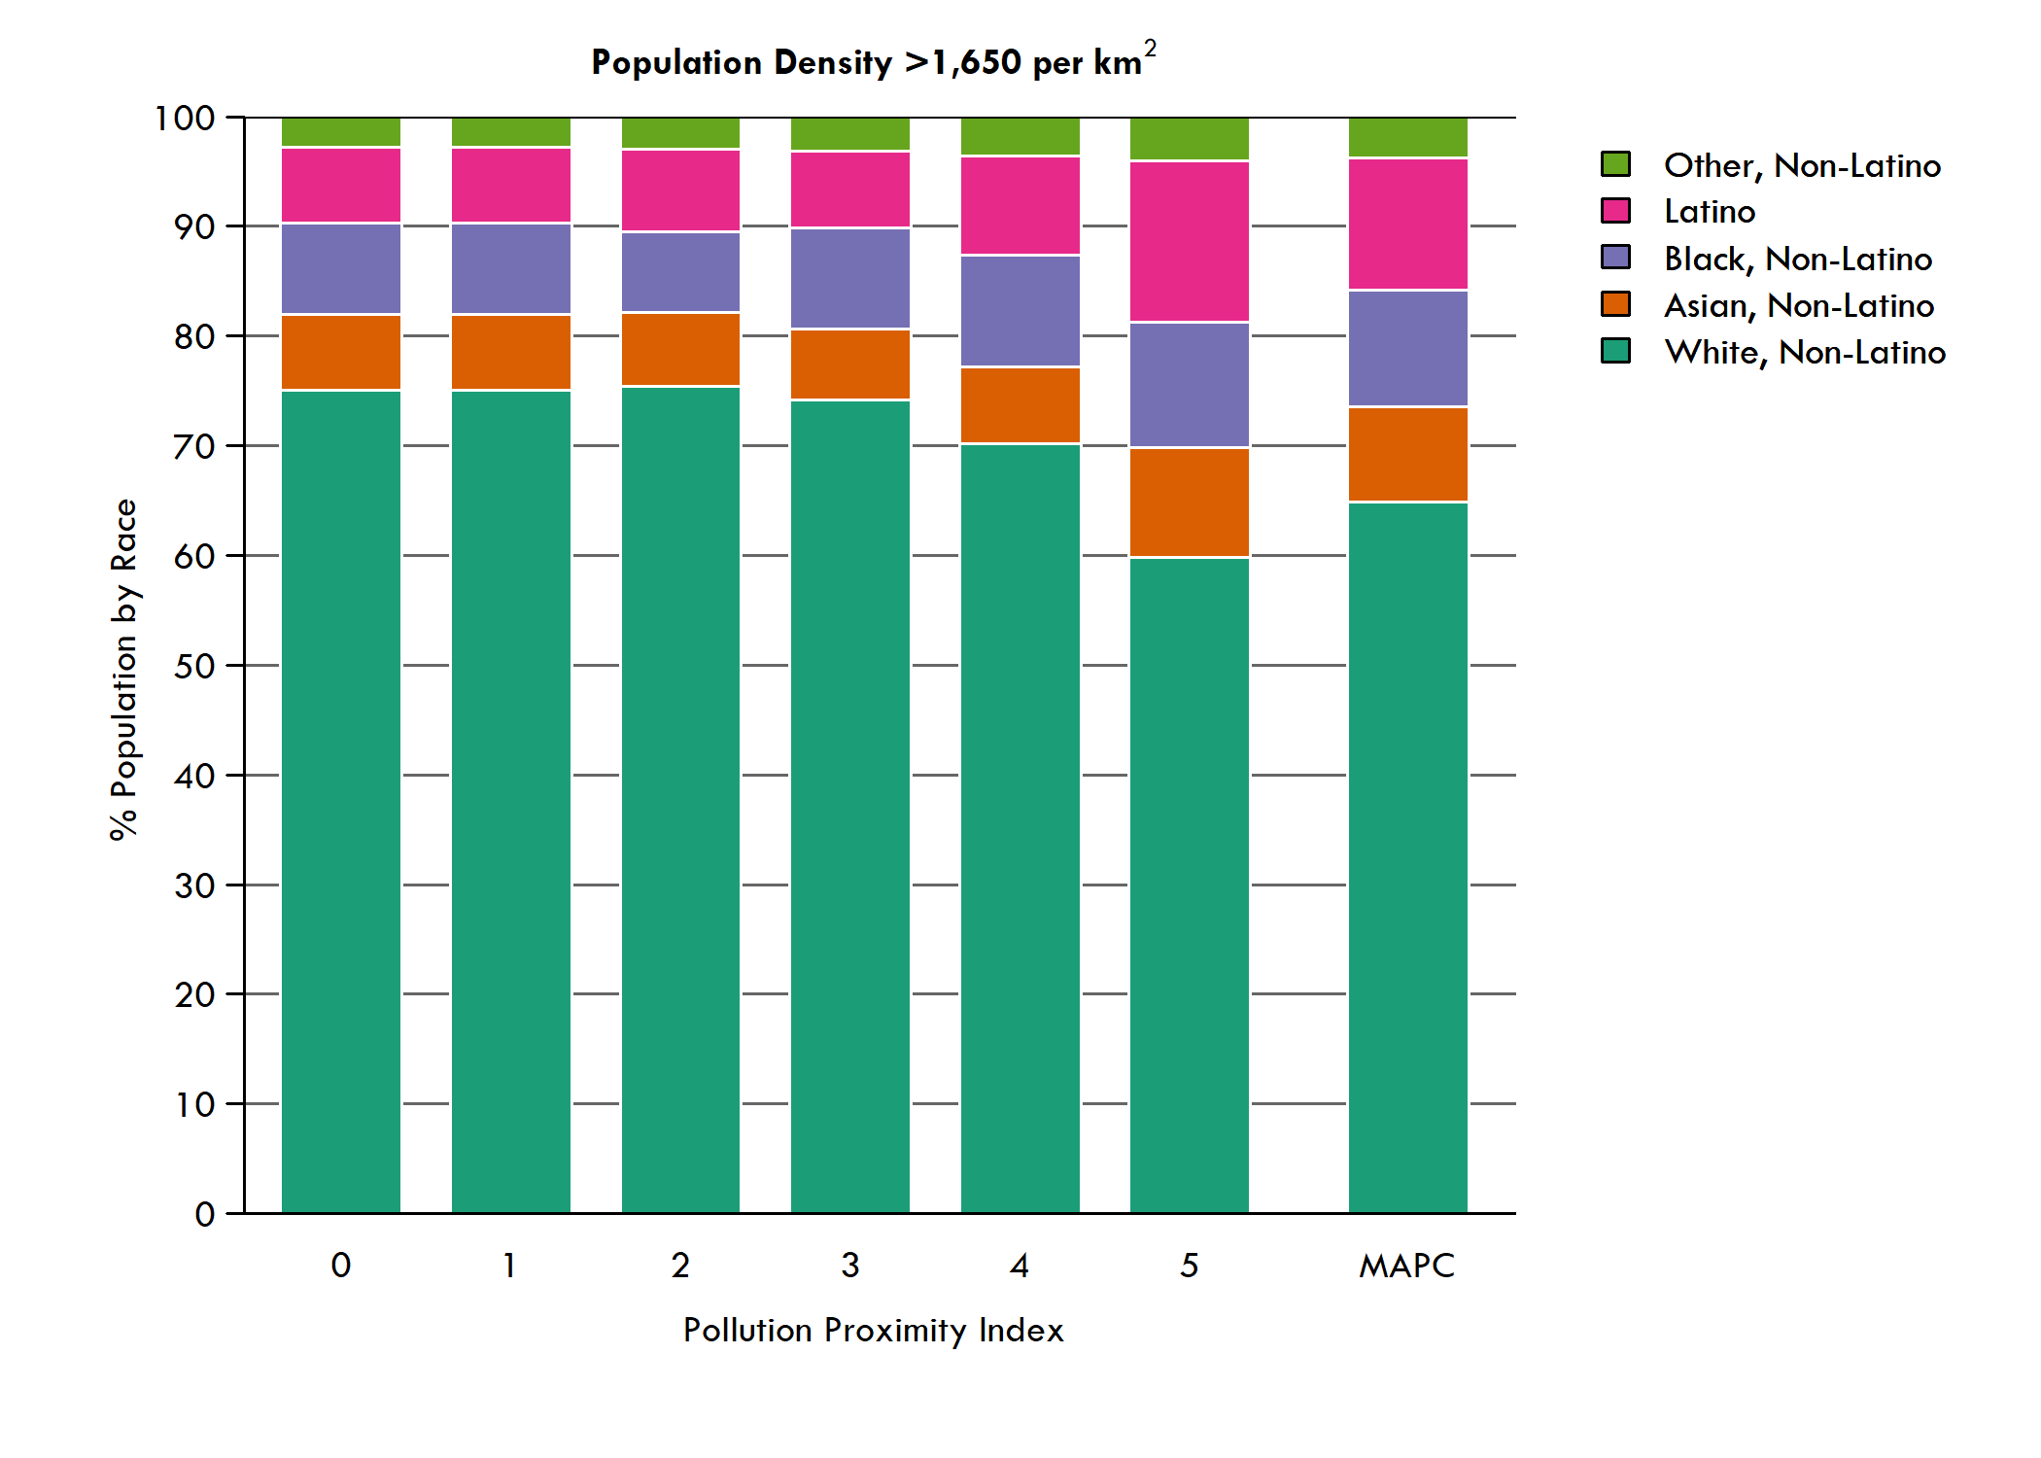
The pattern is not merely because more people of color live in denser urban neighborhoods.
When we control for population density, the trend persists.
As PPI increases, so too does the share of Latino, Black, and Asian residents living in those areas.

Slide 12
Racial Disparities in Pollution
Our findings are consistent with other studies that have also demonstrated the existence of persistent racial inequities in exposure to ambient air pollution across Massachusetts.
The co-location of pollution and residents of color is not a mere quirk of geography. There are a range of reasons for why the residences of people of color are disproportionately located near to high-polluting roadways, including:
Historical impacts of inequitable zoning and redlining,
Planning and investment decisions on the locations of affordable housing development
Siting of urban freeways and expressways, which were often designed to cut through minority neighborhoods.
These historical inequities continue to impose a disproportionate burden on the health of people of color across the region, as the COVID-19 pandemic has underscored.
Policies and remedies to reduce air pollution must focus on addressing ongoing disparities in environmental justice in our region.

Slide 13
Taking Action
Modifying individual buildings to keep polluted air out by moving ventilation intakes to places protected from road emissions and tightening the building envelope through insulation and soundproofing retrofits.
Ensuring new buildings built near high pollution roads have filters with a Minimum Efficiency Reporting Value (MERV) of 13 or greater and have plans for long-term maintenance.
Expanding access to affordable housing in areas that are at a safer distance from high pollution roads.
Empowering communities of color to have influence on the construction or expansion of new roads in their neighborhoods.
Improving urban design by installing sound and pollution barriers, orienting buildings to improve airflow and allow pollution to disperse quickly, and siting parks, playgrounds, and new development away from roads.
Taking steps toward broad, systemic change of our transportation system to reduce emissions’ root cause: a fossil-fuel powered, largely single-occupant vehicle fleet.
Policies that shift travel to cleaner means of transportation; improving our public transit, pedestrian, and bicycle infrastructure; vehicle electrification; and participating in regional policy initiatives like the Transportation Climate Initiative, a 12-state collaboration aimed at reducing transportation-related emissions.

Slide 14
The Air We Breathe: Vehicle Pollution and Racial Disparities in Greater Boston
May 14, 2021
Full Report:
https://www.mapc.org/pollution-disparities-covid19/
Download the Data: https://datacommon.mapc.org/browser/datasets/413
Thank you for listening. Questions?

