Slide 1
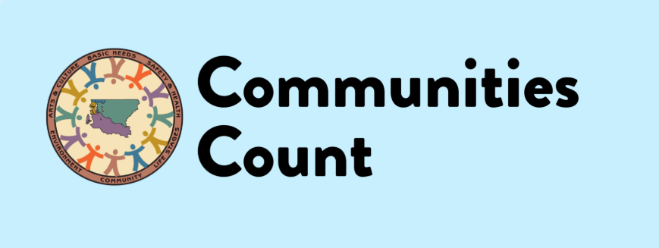
NNIP Idea Showcase
Mariko Toyoji, MPH & Sara Jaye Sanford, MPH
Communities Count, Public Health Seattle and King County
January 23, 2020

Slide 2
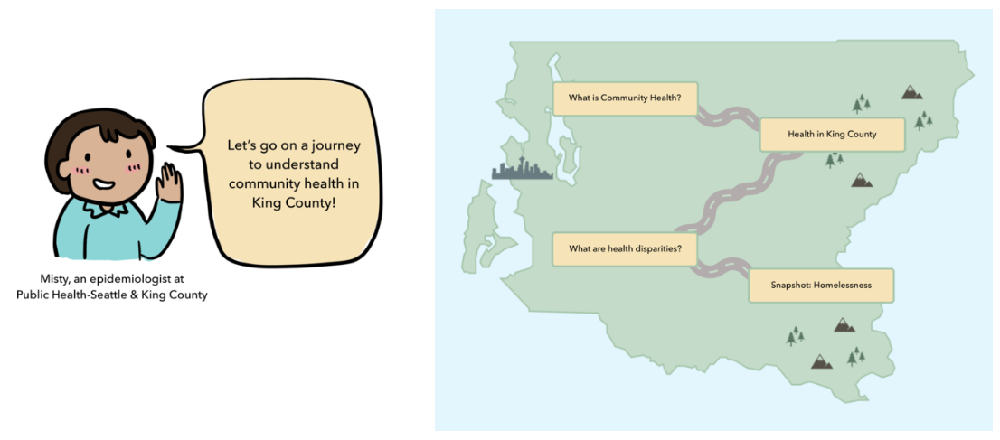
About Communities Count
Communities Count is a resource that supports King County communities in using data and evaluation to support equity work.
Produced by staff at Public Health Seattle and King County
Started over 20 years ago as a population based survey on health and social well being in King County, WA
Transitioned to an online data platform in 2011, with a curated set of health and social indicators with interpretative narrative
Find us at: commmunitescount.org
Provides data and evaluation trainings and support to build capacity and further equity work in King County

Slide 3
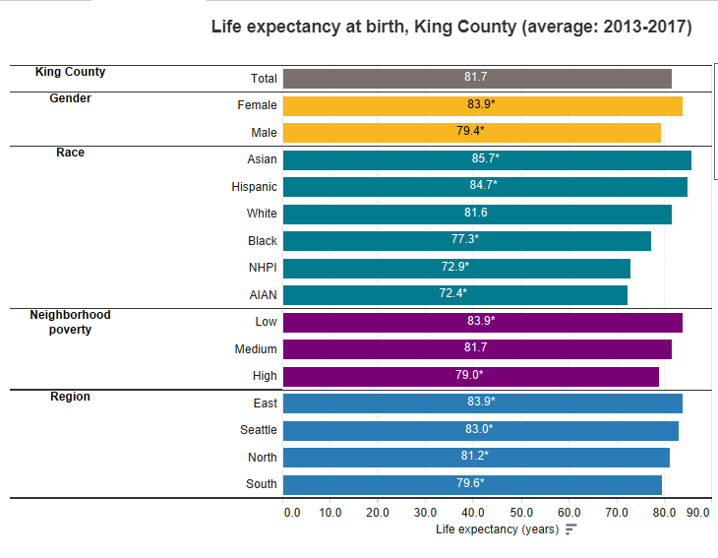
King County ranks among the top counties in the U.S. on measures of health and wealth However… despite high rankings on measures of socioeconomic status and health, county residents continue to experience differences in social and health outcomes by race, income and place
Disparities in King County
^ = Data suppressed if too few cases to protect confidentiality and/or report reliable rates
* = Significantly different from King County average
! = Interpret with caution; sample size is small, so estimate is imprecise
AIAN = American Indian/Alaska Native
NHPI = Native Hawaiian/Pacific Islander

Slide 4
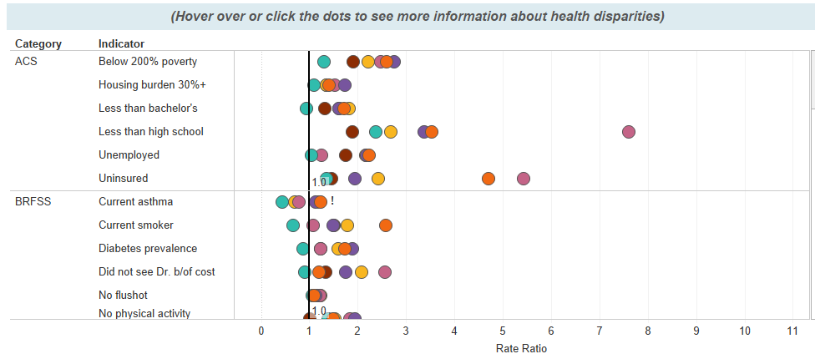
Health Disparities Dashboard: Objectives www.communitiescount.org/health-disparities-dashboard
Provides a data visualization tool to display the magnitude of race/ethnicity differences on over 50 indicators of health and social determinants of health in King County.
Centers health outcomes and social determinants of health data on race, to start conversations on the structural racism and racial bias that cause health inequities
Making local level data on health disparities public and accessible
Notes:
Conducted a search of key indicators, identifying those with salience and disparities by race/ethnicity
Analyzed indicator data to produce rates and rate ratios by race compared to white residents and the King County population
Data sources included:
American Community Survey
Behavioral Risk Factor Surveillance System (BRFSS)
Vital Statistics (Deaths, Births)
WA State Cancer Registry
State Tuberculosis Program

Slide 5
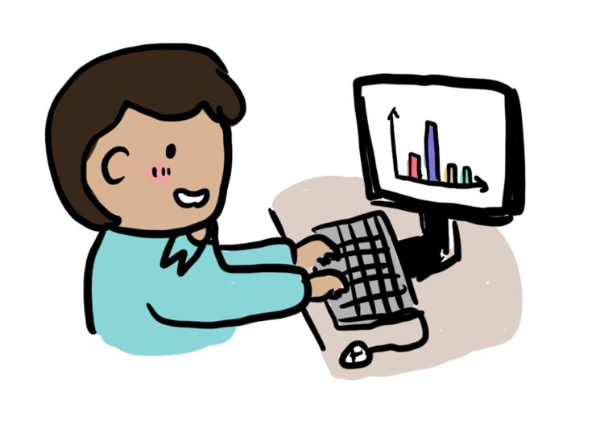
Other data health departments use
Environmental Health Tracking Data
Hospitalizations/Emergency Room Visits
Insurance
Injuries (car accidents, firearms, etc.)
Substance Use
Data on Youth (school based health surveys)
Food Security, Access, Nutrition
Housing
Education
Transportation
Income
Employment

Slide 6
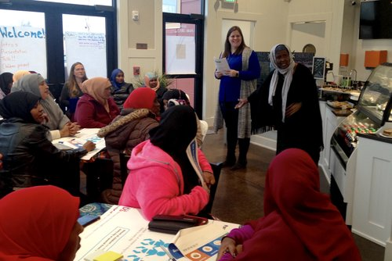
Ideas for collaborating with your local health department
Health departments care about many topics you may not think of as “health data” – we see them as the social determinants of health (housing, transportation, employment, education, and more!)
Connect your users to your health department’s data products, such as Community Health Needs Assessments
Not seeing quite what you are looking for? You can likely request data!
Invite your local health department to participate in events like Data Days, Data Dives, Census outreach etc.
Co-host a data training on health data resources, interpretation, visualization etc.
Collaborate on providing local community context for health data and health disparities
Notes:
Be specific, allow for a generous timeline and give some context about how you plan on using requested data.
Health departments may have interest in sharing their data with communities, but may not have the capacity, skills in data communications, or relationships that local data intermediaries have. This could lead to very effective partnerships!

Slide 7
Thank you!
Visit us at: communitiescount.org
Mariko Toyoji: mtoyoji@kingcounty.gov
Sara Jaye Sanford: sjsanford@kingcounty.gov
Or communitiescount@kingcounty.gov

