Slide 1
Health Equity Timeline:
Putting Inequities in Context
Sara Jaye Sanford
8/31/2023
Notes:
SJ
Communities Count is a resource that supports King County communities in the use of data in promoting and achieving equity. Communities Count does this by: Providing data support and trainings to King County communities & Highlighting data on disparities, inequities and strengths in our community.
We are a public – private partnership, with staff based in Public Health – Seattle & King County.

Slide 2
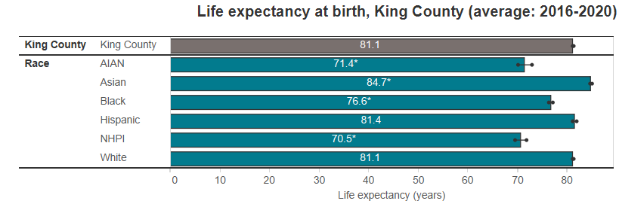
Across indicators, we see similar deep-seated inequities…
Notes:
SJ

Slide 3
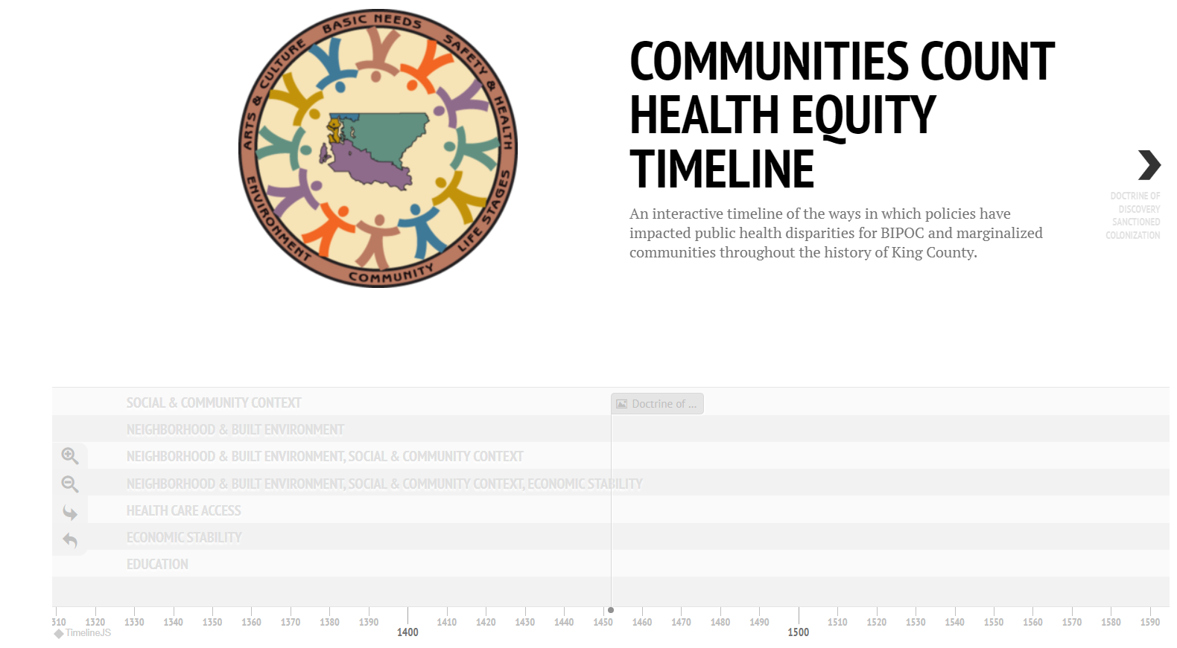
Why?
A way to share context for inequities reflected in our data
Not comprehensive
A starting point for understanding how system exclusion impacted health equity locally
Notes:
SJ

Slide 4
Locally Relevant
Notes:
SJ

Slide 5
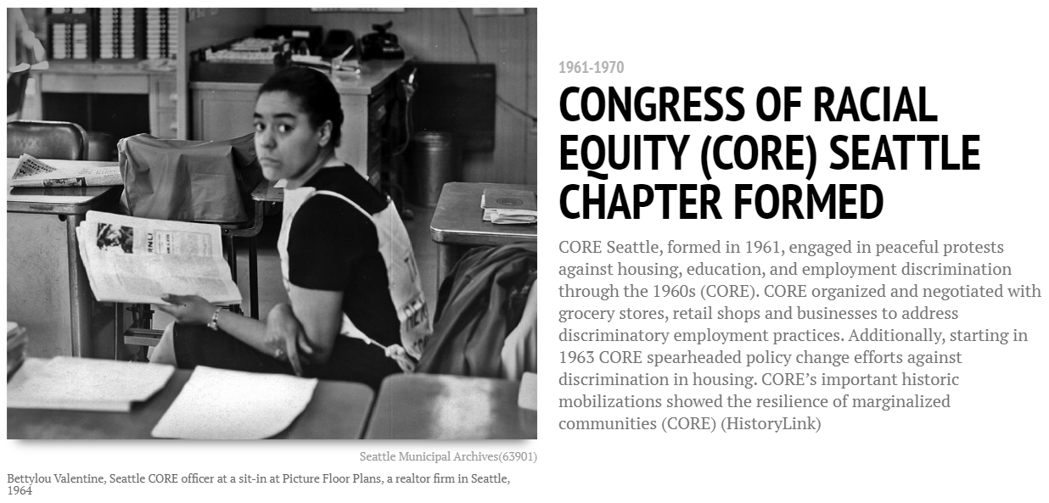
Strengths-Based
Notes:
SJ

Slide 6
Many Communities
Notes:
Centering BIPOC, and while again, it’s far from exhaustive, many communities are included (Jewish, LGBTQ, etc)

Slide 7
Visually Engaging
Notes:
SJ

Slide 8
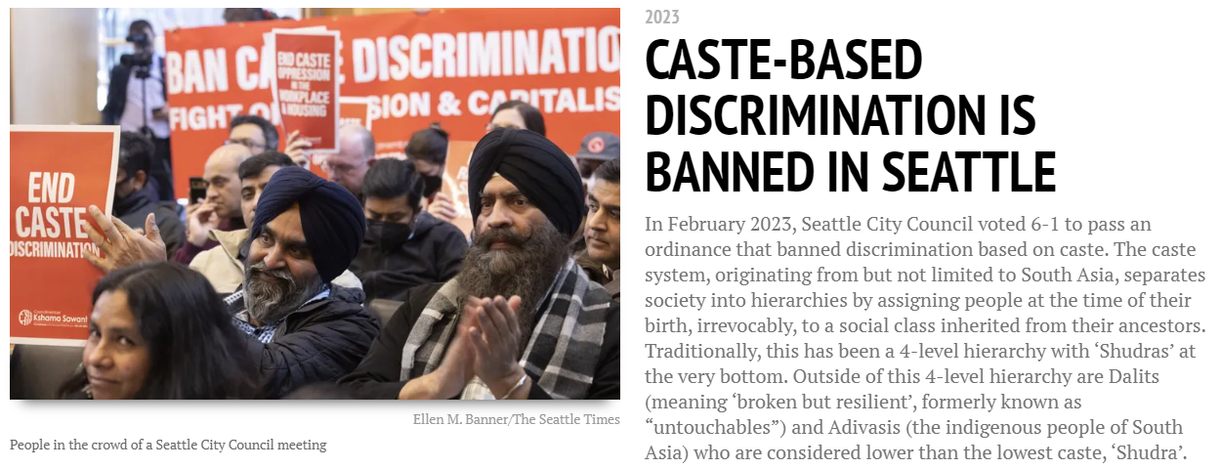
Spans 1452 - 2023
Notes:
SJ

Slide 9
Social Determinant of Health: Neighborhood & Built Environment
Notes:
SJ

Slide 10
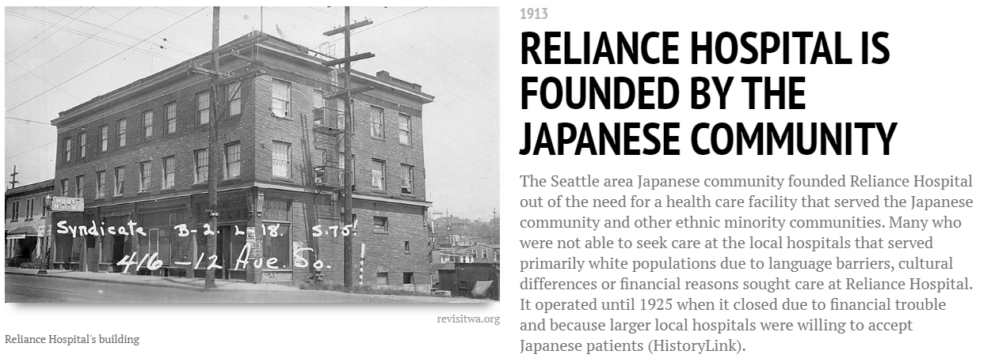
Social Determinant of Health: Healthcare Access
Notes:
SJ

Slide 11
Social Determinant of Health: Social & Community Context
Notes:
SJ

Slide 12
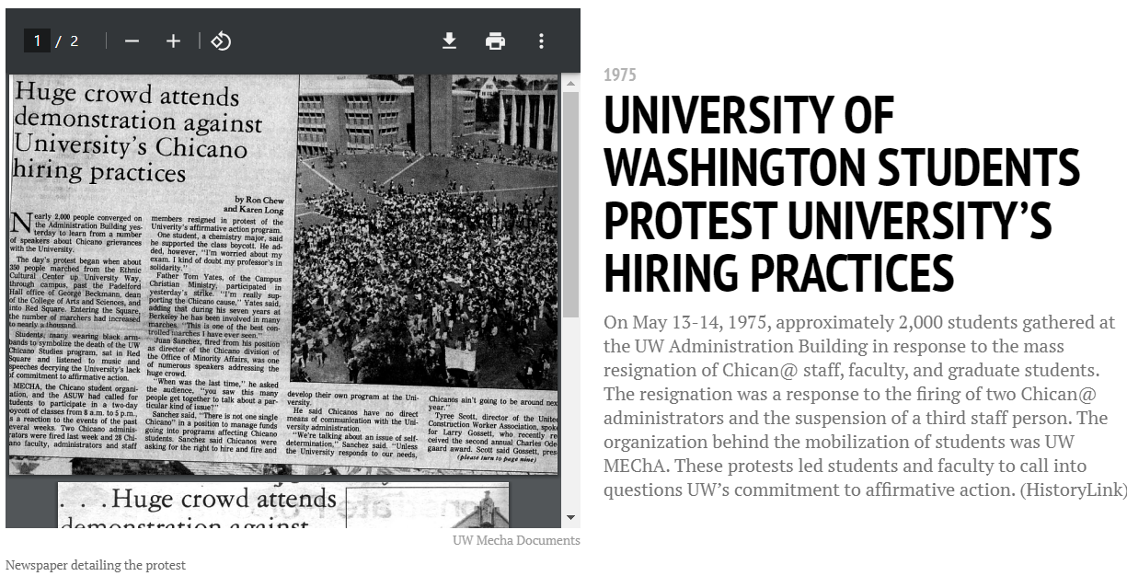
Social Determinant of Health: Education
Notes:
SJ

Slide 13
Social Determinant of Health: Economic Stability
Notes:
SJ

Slide 14
Final Thoughts
Interviews with community and internal partners before publishing
Suggested Resources for learning more
Open source TimelineJS: some limitations on usability changes, but overall easy to maintain, functional, and free to use
Special thanks to Wendy Castillo, Cassidy Chang, Isis Garcia, & Kristin Hong for their work!
www.communitiescount.org/health-equity-timeline
Notes:
SJ

Slide 15
Thank you!
Visit us at: communitiescount.org
Sara Jaye Sanford: sjsanford@kingcounty.gov
Or communitiescount@kingcounty.gov
Notes:
SJ

