Slide 1
Neighborhood data for social change and community outreach
NNIP Conference Atlanta, Georgia
May 11, 2018 33.770332, -84.388061
Ryan Barrett
Principal Geospatial Coordinator
Neighborhood Nexus | Atlanta Regional Commission
Research & Analytics | Center for Livable Communities
Notes:
Good morning everyone. I’m Ryan Barrett and I hope you’ve enjoyed the conference and your visit to Atlanta. At Neighborhood Nexus and the Atlanta Regional Commission I manage the enterprise GIS, Open Data Program, and the Geospatial Community group. Today, I’ll talk about neighborhood data for social change and community outreach.

Slide 2
Looking back
“open” data?
Notes:
Before I talk about where we’re at today, let’s take a quick look back. Now, we all know how important and empowering open data is for data driven decision making, collaboration and everything else. Sounds great but, in 2007, this took the form of static snapshots posted to our webpage, No interactive front end, No live data, No api. Given our mountains of data, this meant considerable data management challenges. Much better than a PDF Table from FOIA request, but far from where we want to be.

Slide 3
New Approach
Open Data Hub
Web maps
Single backend to
publish / sync
Desktop
WEAVE, “New” Weave
Tableau
Any supported front end
Notes:
A new approach was needed which took some time to secure buy in. We deployed a new internal technical framework from the ground up using esri software that is integrated and scalable. This required new policies and standards but enable data owners across the center to DIRECTLY edit and publish internally. With this new foundation, we could then extend data as live, dynamic, completely open web feeds called map and feature services that anyone, anywhere can use. Now we can sync changes automatically all at once both internally AND externally. What we found though, is that these data feeds weren’t enough in 2013.

Slide 4
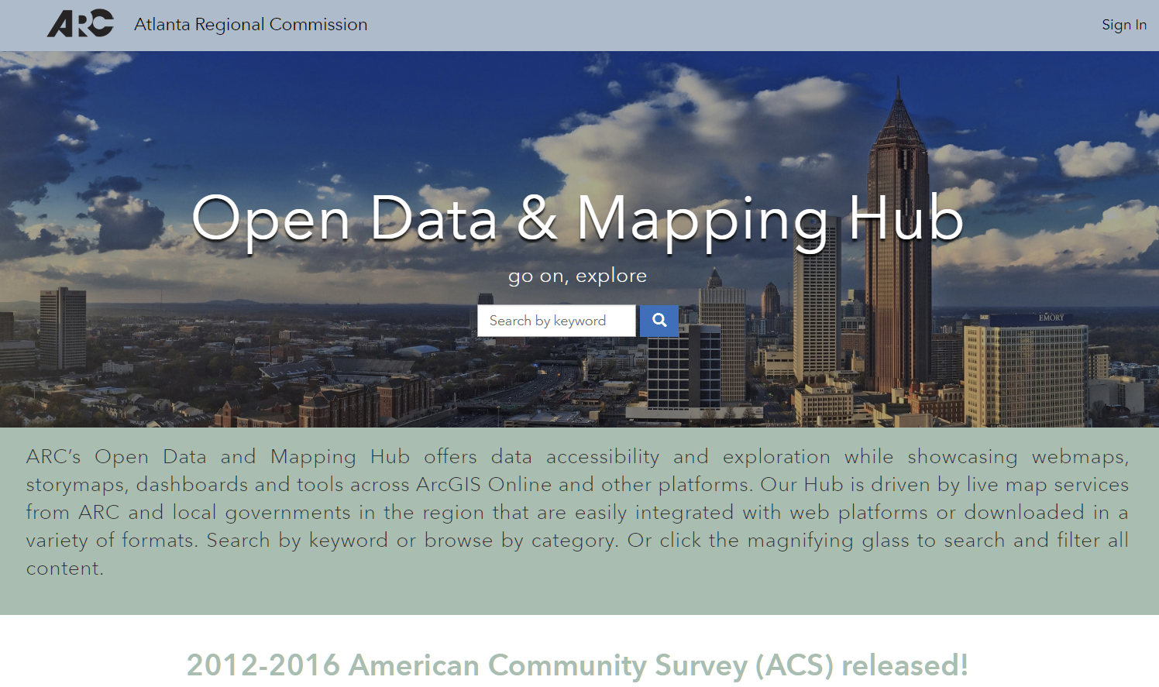
Missing Piece – arcopendata.com
Notes:
Now, back to 2015 when we launched an external open data portal. This is a robust front end website built with ArcGIS Online to engage, explore, and transform data to various formats. It’s built with templates and widges but it’s also open code to customize further and has an API.…About a year ago, we realized that this is flexible enough to also serve as a hub for cross-platform content to give context and meaning to the data, be it a dashboard in the ARC blog, interactive county profiles from NN, story map from ARC, or polling wait time app from local govs So the current hub was born!

Slide 5
Key features: interoperability, scalability
Internal content automatically synced externally
Always live, always current
Multiple data formats- JSON/GeoJSON, REST, SHP, CSV, SHP, KML, some GDB, soon WMS, WFS
Any content format across any platform
Hooks from local government hubs – 2 counties, 7 cities
Now this feels like OPEN DATA
Notes:
Key features to the hub include nteroperability and scalability, Always live, always the latest and greatest. Many different formats listed here and more soon. Any and all content across platforms. Once click hook to local government hubs where all their authoratative data and content is automatically pushed to our hub too. This means when the City of Atlanta published the latest city design data, we get it a the same time. And this works the other way too should the local gov choose. Now this feels like OPEN DATA.

Slide 6
Outreach
Atlanta Region Geospatial Community group
Technical Workshops
One-on-one with local governments
Resource for local governments
Positive feedback for more formal framework
Notes:
We do continual outreach to raise awareness and build the program. We do this through quarterly Atlanta Region Geospatial community group meetings with members of local government around the region as well as nonprofit and academic entities. We’ve hosted technical workshops and met one on one with local governments to walk through data prep and setting up a hub. And we’re here anytime to support open data from local governments.

Slide 7
Open Data Council
Under ARGC, report back
All local governments currently contributing content
Peer review to inform governance and technical deployment
Initial goals: closer collaboration, mission statement, establish governance, metadata and category standards, revamped front end, expand network
Notes:
Through the geospatial community group and our partnerships with local governments we’ve made progress, but if we collaborate in a more formal capacity we can have a greater impact. We’ve heard that being able to point to our embrace of open data has helped secure buy in. In formalizing these relationships around a mission statement informed by a peer review to establish governance, policies, standards and revamped front end, we hope to ramp up, strengthen and expand our network. We would love to hear any ideas you have.

Slide 8
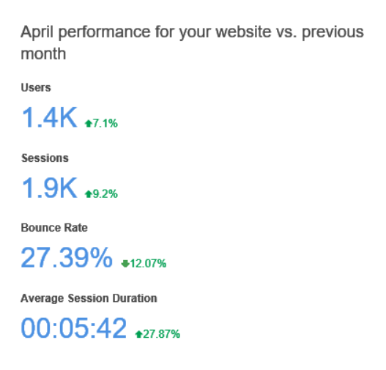
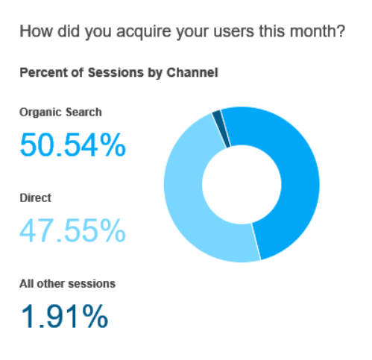
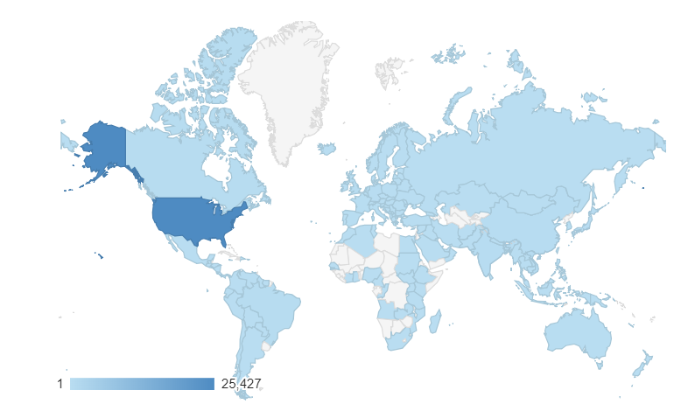
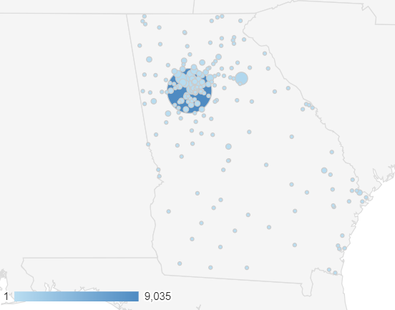
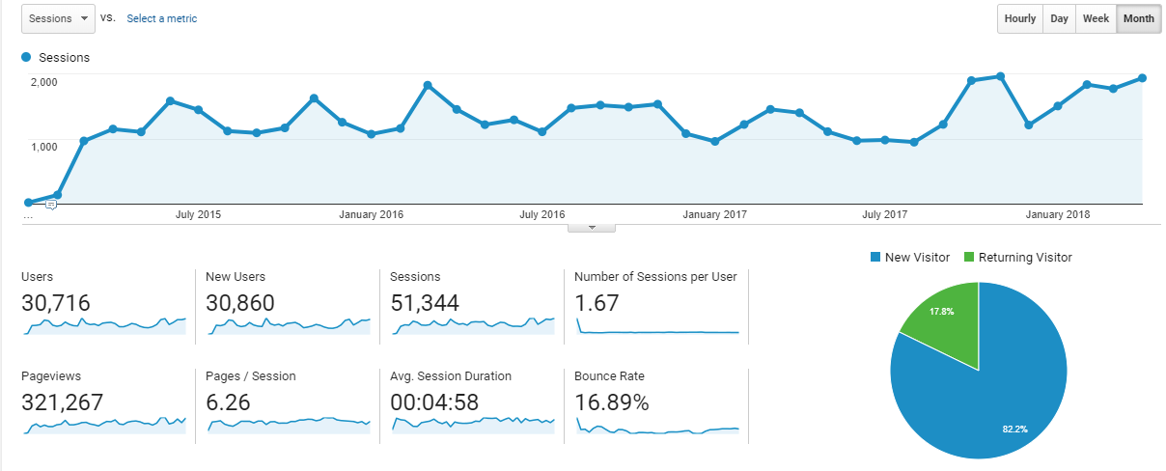
Traffic & engagement
Notes:
Google Analytics gives us insight in to how are folks are using our hub. Since 2015, we’ve had nearly 31k users and 320k page views and we’re still growing. Each visit is about 5 minutes across 6 pages. Last month we saw 1400 users across nearly 2000 sessions. About half of our traffic is direct where the other half is from search. We were surprised to see users from all across Georgia and the globe.

Slide 9
Looking ahead
Evolution of Open Data Council
More, more, more data – all WEAVE data soon to be published
More, more, more context and meaning to tell stories around data
Innovate: better/ smarter/ faster
Notes:
In looking ahead, we’re excited to see where the open data council takes us and look forward to growing our network. Always more data of course, BTW, if familiar with WEAVE, ALL of that data will soon be fully migrated and published to the hub. We will continue to build context and meaning to tell the story, and to innovate to make things not just new, but better along the way too.

Slide 10
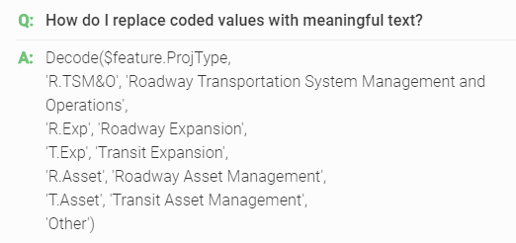
Arcade expressions
Append to feed
Save as new
Notes:
Quickly, there is one new tool we’re bringing to bear to work with web feeds. Ever wished for a percent or density field in looking at a webmap? There’s a new expression language by esri called Arcade. This can perform mathematical calculations, manipulate text, and evaluate logical statements to append to a web feed, or save new and reuse. This offers increased flexibility to work with existing data to create derived data. These are just a few examples form from web development resource documentation we created to help our users.

Slide 11
You can too
FREE software through esri nonprofit program
Single ArcGIS Online named user licenses now available
Thank you!
Ryan Barrett
rbarrett@atlantaregional.org arcopendata.com
Notes:
That was a super quick tour of what we’ve done. If you’re a non-profit, all this can be accomplished with free software from esri. If not so nonprofit, recent changes to ArcGIS online allows for full access for $500 per year that includes 500 credits. We have many editors so we have a sql server backend, but it’s possible to have esri do the hosting and publish data to a configured open data hub like ours. Thank you and please get in touch with any thoughts and questions. And please check out arcopendata.com!

