Slide 1
Communicating with Communities about 2020 Census Data Quality
August 5, 2021

Slide 2
Hooray! The data are almost here!
Thanks to all of you and the community groups who worked so hard on Get Out the Count efforts!

Slide 3
Today’s topic
How do we communicate about data quality and fitness for use to our various audiences?
Other possible future topics: sharing ETL tips, analytic products, online displays, other?

Slide 4
What is in the redistricting file?
Housing unit counts
Occupancy status for housing units (occupied or vacant)
Population totals
Population totals by race
Population totals by race and Hispanic/Latino origin
Voting-age population (age 18+) by race and Hispanic/Latino origin
Population totals in group quarters by major type

Slide 5
Sources of Error: Operational and Processing
Undercount
Types of households (African-Americans, Hispanics, renters)
People in a household (young children, non-citizens, complex households)
Unreliable reporting of missing households by proxies (e.g. neighbors)
De-duplication (greater role with non-ID responses allowed)
Household imputation (occupancy and number of people)
Characteristic imputation (larger issue in 2020 than 2010)
Group quarters imputation (introduced in 2020)
Notes:
Operations - did not plan for 6 month data collection.
De-Duplication
First, there's the duplication of addresses on the MAF (like in 2000).
Second, there's multiple records per MAFID (heightened levels of this compared to 2010 was predicted due to non-ID and planned for... questions are about the efficacy of their planning here).
Third, there's the duplication of individual people across MAFIDs within a given state (which is the unit of analysis for most things).
Fourth, there's the duplication of individual people across MAFIDs outside of a given state.
Household imputation is notable for both the status imputation (occupied or vacant) as well as the count imputation for occupied units.
GW - all count imputation requires characteristic imputation.
new use of administrative records. AdRec may be a better alternative to proxies and imputation, but not as good as self-response or full interview NRFU.
:
- Proxies are unreliable in many cases, both in terms of total pop count and in terms of item information. For example, they tend to bucket age (e.g., "about 40")
- There's a notable tendency for householders to self-respond or respond to enumerators without including everyone in the household (most notably, missing children, non-citizens, transient residents, and residents who comprise a complex household).
Mention new use of administrative data
Fill in details for group quarters

Slide 6
Sources of Error: 2020 Census
Extended time of data collection to six months
People not at their “primary” residence (college students, second homes, moving in with family)
People being afraid to open door to strangers
Fear from proposed addition of immigration question
Natural disasters
Housing units destroyed or uninhabitable
Access to the area prevented during NRFU
Disrupted access to power
Notes:
Operations - did not plan for 6 month data collection.
Mention new use of administrative data
Fill in details for group quarters
Natural disasters
Housing units destroyed or uninhabitable
Access to the area prevented during NRFU
Access to power in the area stymied systems

Slide 7
Sources of Error: Disclosure Avoidance System
Past decennial data was also adjusted to protect privacy – just in an undisclosed way. (swapping, top-coding, grouping)
Change motivated from increased amount of external data and greater computer power (see video)
Differential privacy
a mathematical method that quantifies the precise amount of privacy risk (i.e. risk of reconstruction or re-identification).
Protection for all calculations, tables, and data products no matter what external data is available.
Notes:
Note new method driven by concern about re-identification with incr data/computing power available.
Reconstruction - The recreation of individual-level data from tabular or aggregate data.
Reidentification - Linking public data to external data sources to re-identify specific individuals within the data
*** I am not going to dig into this, but we can share more resources ***
Privacy-loss budget (PLB) for the redistricting data product (represented by “ε,” the Greek letter “epsilon”) of ε=19.61, ε=17.14 for the persons data and ε=2.47 for the housing data. This is much higher than the Census Bureau published in its earlier test files in response to user response. Whether it is high or not depends on your perspective.
DHC will inherit PLB spent on PL file. Experiments of DHC give DSEP an approximation. Won't be establishing final assignment for data products.
LH
Slide 8 DAS/differential privacy
Based on what you’ve told me in the past – helpful to mention calculation is weighing the tradeoff between privacy and accuracy?
Invariants bullet –I’m not 100% sure I have this right but could you say something like (potentially on the slide)– there are 3 counts that are reported “as is” or “true count”: (and then list them #1, 2, 3 in separate lines)
Talking point – which means of course that everything else is allowed to vary – or will have noise inserted in it.
Privacy loss budget- assuming you’ll explain what that means. Does 19.6 mean the weight is towards more private/less accurate? (is that a big number, small) What does it mean that the persons data gets the bulk of the budget? The slide mentions the redistricting file -will there be different privacy loss budgets for the other data products?

Slide 8
DAS Step 1: Set parameters
Invariants – numbers that are reported without noise infusion
Total population at the state level
Total housing units at the block level
Number of group quarters facilities by type at the block level
Privacy loss budget
Decision point on tradeoff of accuracy and privacy protection
Epsilon (ε)=19.6, 17.14 for the persons data and 2.47 for the housing data (for redistricting data product)
See presentation and detailed distribution tables
Notes:
Note new method driven by concern about re-identification with incr data/computing power available.
Reconstruction - The recreation of individual-level data from tabular or aggregate data.
Reidentification - Linking public data to external data sources to re-identify specific individuals within the data
*** I am not going to dig into this, but we can share more resources ***
PLB - This is much higher than the Census Bureau published in its earlier test files in response to user response. Whether it is high or not depends on your perspective.
DHC will inherit PLB spent on PL file. Experiments of DHC give DSEP an approximation. Need to continue to provide remaining budget for other products
LH
Slide 8 DAS/differential privacy
Talking point – which means of course that everything else is allowed to vary – or will have noise inserted in it.
Privacy loss budget- assuming you’ll explain what that means. Does 19.6 mean the weight is towards more private/less accurate? (is that a big number, small) What does it mean that the persons data gets the bulk of the budget? The slide mentions the redistricting file -will there be different privacy loss budgets for the other data products?

Slide 9
Sources of Error: Disclosure Avoidance System
Step 2: Inserting of noise per parameters
Step 3: Post-processing
Processed sequentially through each geographic levels, i.e. the first pass of the algorithm determines the population for each unit within that geography (e.g., for all census tracts within a county)
Make sure there’s no fractions, negative numbers, etc.
Note “quality” tuned to redistricting case
Example: For areas with 500+ population, threshold set for when the share of largest racial group within +/- 5 percentage points 95% of the time.
Notes:
Additional changes to the parameters for the TopDown Algorithm (TDA) included changes to the implementation of geographic spine optimization.
For future - FILL IN EXPLANATION OF GEOG SPLINE – check - Does the analysis in sequential passes so tract population sums to county, county sums to state, etc.
pop constraints for legal jurisdictions
Give some examples of scale – look up - https://www2.census.gov/programs-surveys/decennial/2020/program-management/data-product-planning/2010-demonstration-data-products/ProductionSettings20210608/2021-06-08-data-metrics-tables_production-settings.xlsx
Note metrics table
https://www.census.gov/newsroom/blogs/research-matters/2020/06/modernizing_disclosu.html
https://content.govdelivery.com/accounts/USCENSUS/bulletins/2924168

Slide 10
Some data will be impossible or improbable
Occupancy status doesn’t match population counts.
100% housing units occupied, but no people, or vice versa
Children appear to live alone.
There are people under 18, but no people 18 and older.
Households appear unusually large.
Blocks with 45 people, but only three housing units
And likely others to come…
Notes:
This is by design.
Occupancy status doesn’t match population counts. Some blocks may show that the housing units are all occupied, but the population count is zero. Other blocks may show the reverse: the housing units are vacant, but the population count is greater than zero.
Children appear to live alone. Some blocks may show a population count for people under age 18 but show no people age 18 and older.
Households appear unusually large. For example, you may find blocks with 45 people, but only three housing units.
Source: https://www.census.gov/newsroom/blogs/director/2021/07/redistricting-data.html
Insert shares if time

Slide 11
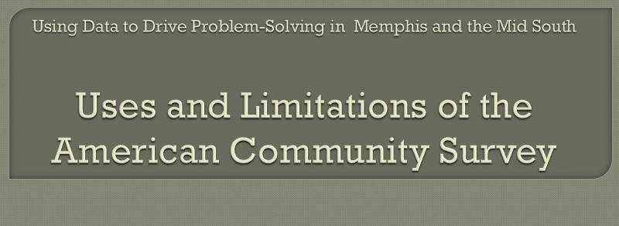
In transition to ACS, we learned faster together.
Notes:
We’ve been in a similar position before with a new methodology moving from the long-form to the ACS
NNIP shared lessons about transition from long-form to ACS meeting sessions, worried bar conversations, and a lot of angst from 2008-12
We worked through what our communities needed to make the most from the data while understanding the limitations.

Slide 12
So you found weird results in Census 2020 data? Don’t panic!
Consider what geography/accuracy needed for your use case
Aggregate up – accuracy increases with summing geographies
Triangulate with other national and local data sources
Use ACS characteristics with Census totals
Pair with qualitative data
Other ideas?

Slide 13
Messaging
Be a good consumer – use other data and local knowledge to review data and decide on fitness for use.
Weird results do not invalidate the entire decennial census – result of steps needed to balance privacy and accuracy.
DP method has advantage of being more transparent, measurable (compared to adjustments made for privacy protections in past Censuses).

Slide 14
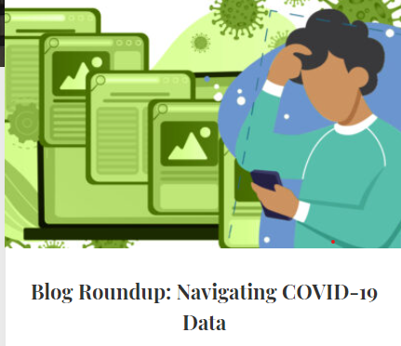
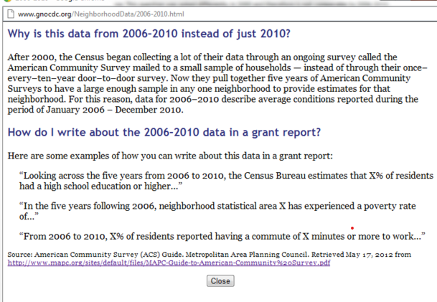
How Can NNIP Partners Help?
Notes:
Data Literacy/Explainer Blogs

Slide 15
In progress: Detroit/Grand Rapids plan
Guiding Principles
Be inclusive
Be empathetic
Be honest
Key Elements: trust-building, storytelling, direct support to users
Consultation with Complete Count Committee, media
Example products: blogs, webinars, workshops, online platforms, etc.
Notes:
We've been co-creating it with CDRL in Grand Rapids and our statewide nonprofit membership association. It's still awaiting their feedback so some of the details might change, but the general framework has held pretty steady throughout our initial conversations.
https://docs.google.com/document/d/1ftio5jCw28IL0UXmmbBezeGTyapCYtfEb9-671uFsiE/edit

Slide 16
Discussion Questions
Have you heard concerns from community stakeholders about the quality of the Census data?
How have you been educating yourself/your staff about the issues around the new Census data?
Have you been planning for the redistricting data (products, help desks, media prep)?
What other conversations or activities would you like NNIP to organize?

Slide 17
Stay Up-to-Date with Newsletters
Census Data Products
American Statistical Association
Association of Public Data Users
IPUMS

Slide 19
Extra Reference Slides

Slide 20
Resources
Differential Privacy in the 2020 Census (Georgetown Center on Poverty and Inequality)
IPUMS Changes to Census Bureau Data Products
ADD OTHERS

Slide 21
Forthcoming Resources
American Statistical Association State-Level Quality Report (August)
Urban Brief on Balancing Data Privacy and Data Utility
Carolina Population Center “Explainer”
Guide(s) from Population Reference Bureau
Similar to ACS Users’ Guides
Describes differential privacy, redistricting case
Recommendations for calculations, fitness of use

Slide 22
Census 2020 data products
Apportionment – released April 26
Redistricting – Legacy Format on August 16; Updated Format – September 30
Demographic Profiles (2022 - Place-level: Age, Sex, Race, HH Type, HH relationships, Occupancy, Tenure)
Demographic and Housing Characteristics File (2022 – detailed geography, more crosstabs, tables by race)
Post Enumeration Survey and Demographic Analysis (2022 - evaluating over/undercounts)
Notes:
DP - critical demographic and housing characteristics about local communities as soon after the release of the Redistricting file as possible
DHC - Equivalent to a subset of tables from 2010 SF1. Very trimmed back about 170 fewer tables in this than SF

Slide 23
Group 2 Products
Former Summary File 1 Tables that include
Detailed Race and Hispanic Origin
Family/Household by Person Characteristics Tables
Former Summary File 2
American Indian and Alaska Native Summary File
Tribal consultations underway
Public Use Microdata Sample (PUMS) File
Notes:
Differences
post-processing for Group 1 - had to produce microdata output which then produces tabulations.
Group2 - not producing microdata that feed in tabulations - producing tables directly

Slide 24
Technical Resources for Legacy Format Files
Redistricting Data Program Management Website
Phase 3: Delivery of the 2020 Census P.L. 94-171 Redistricting Data Files and Geographic Products
Technical documentation
Prototype files for testing
Import scripts

Slide 25
Supplemental Products in August
Privacy-Protected Microdata Files for Redistricting
2010-2020 geographic crosswalks
2020 GIS boundary files
Privacy-protected 2010 demonstration data based on the production system for 2020 data

