Slide 1
Flow Charts, Web Maps, and Block Teams
Addressing the nuisance Property Issue in St. Louis
OCTOBER 2014
Eleanor Tutt

Slide 2
PROJECT BACKGROUND
Dutchtown South Community Corporation received a Collaborative Grant from Rise to improve data systems
DSCC & Rise began work by creating a map of nuisance properties for the DSCC service area
Work designed to connect to existing DSCC programs: Neighborhood Ownership Model public safety program and Block Teams community engagement program

Slide 3

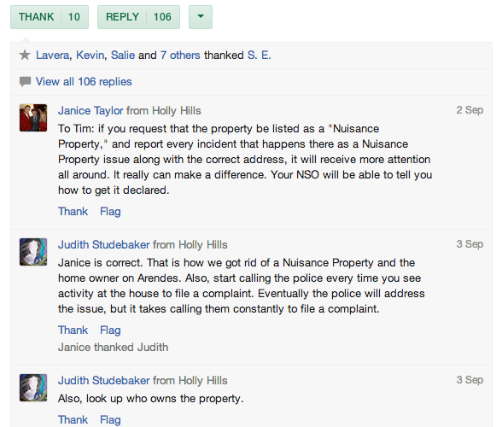
NUISANCE PROPERTIES IN DUTCHTOWN

Slide 4
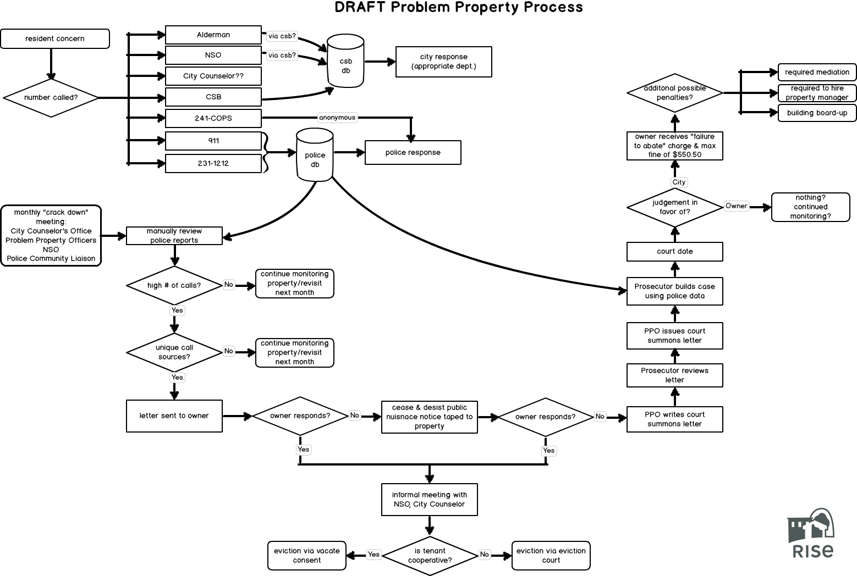
DRAFT NUISANCE PROPERTY PROCESS

Slide 5
DRAFT NUISANCE PROPERTY PROCESS

Slide 6
DRAFT NUISANCE PROPERTY PROCESS

Slide 7
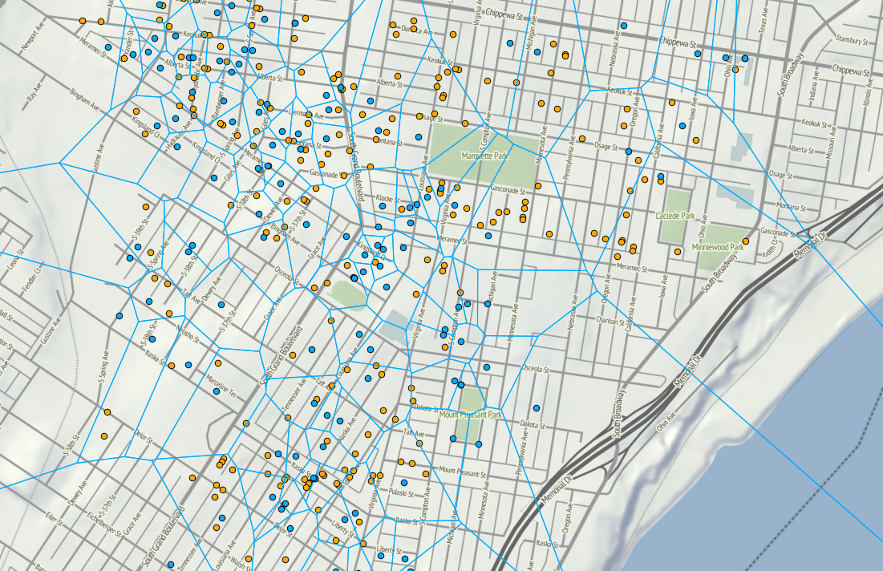
NUISANCE PROPERTIES & BLOCK TEAMS

Slide 8
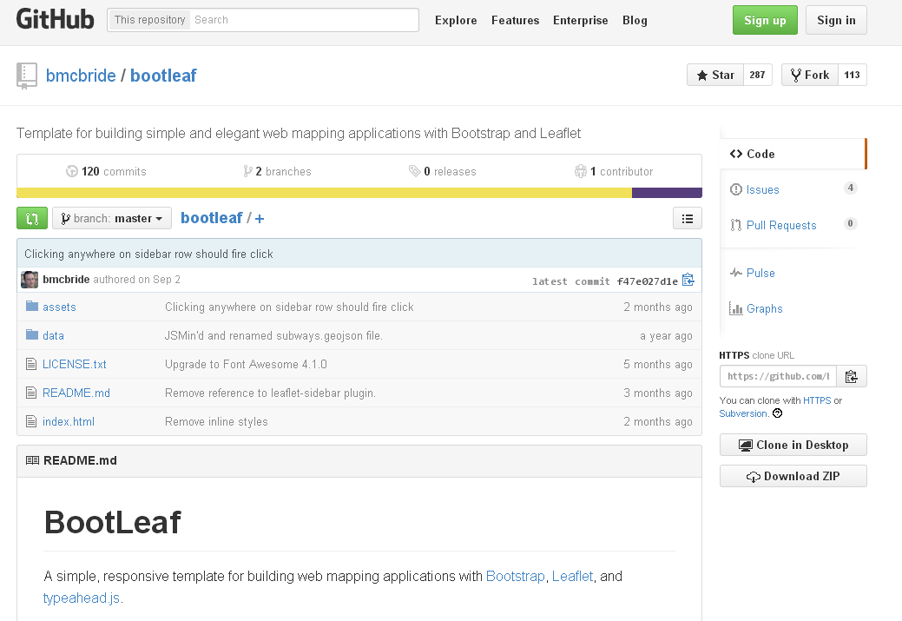
BOOTLEAF
(LET’S MAKE AN INTERACTIVE MAP!)

Slide 9
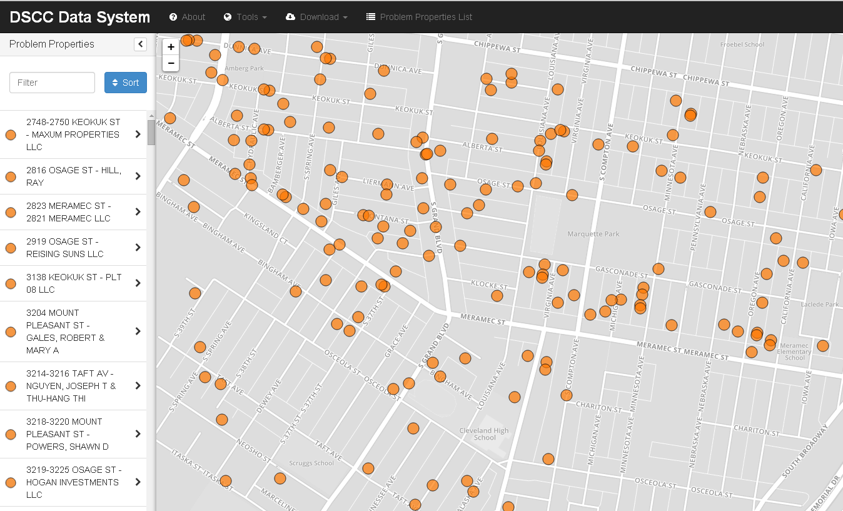

NUISANCE PROPERTY DATA IN BOOTLEAF

Slide 10
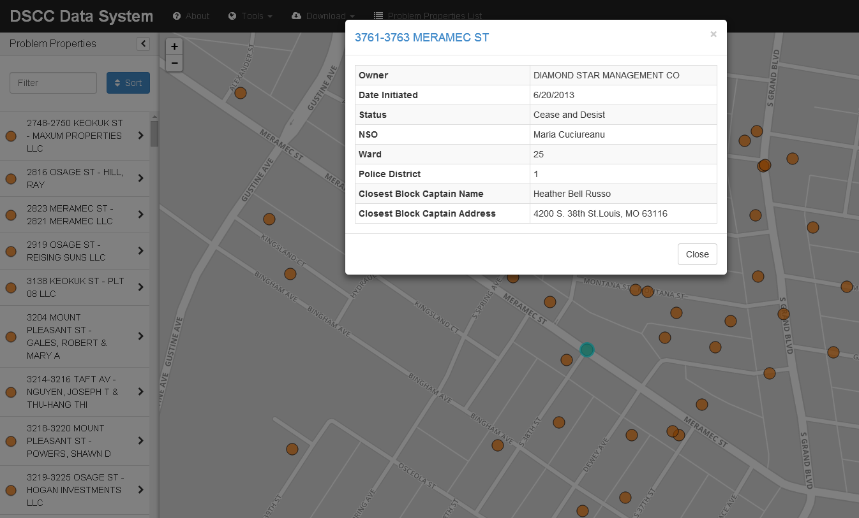
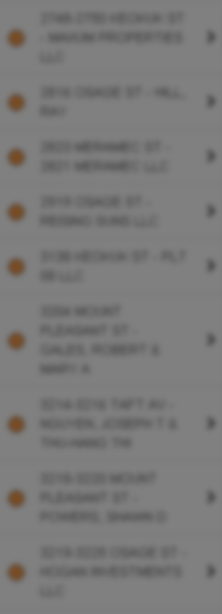
PROPERTY IDENTIFICATION
(VIA MOUSE CLICK ON MAP)

Slide 11
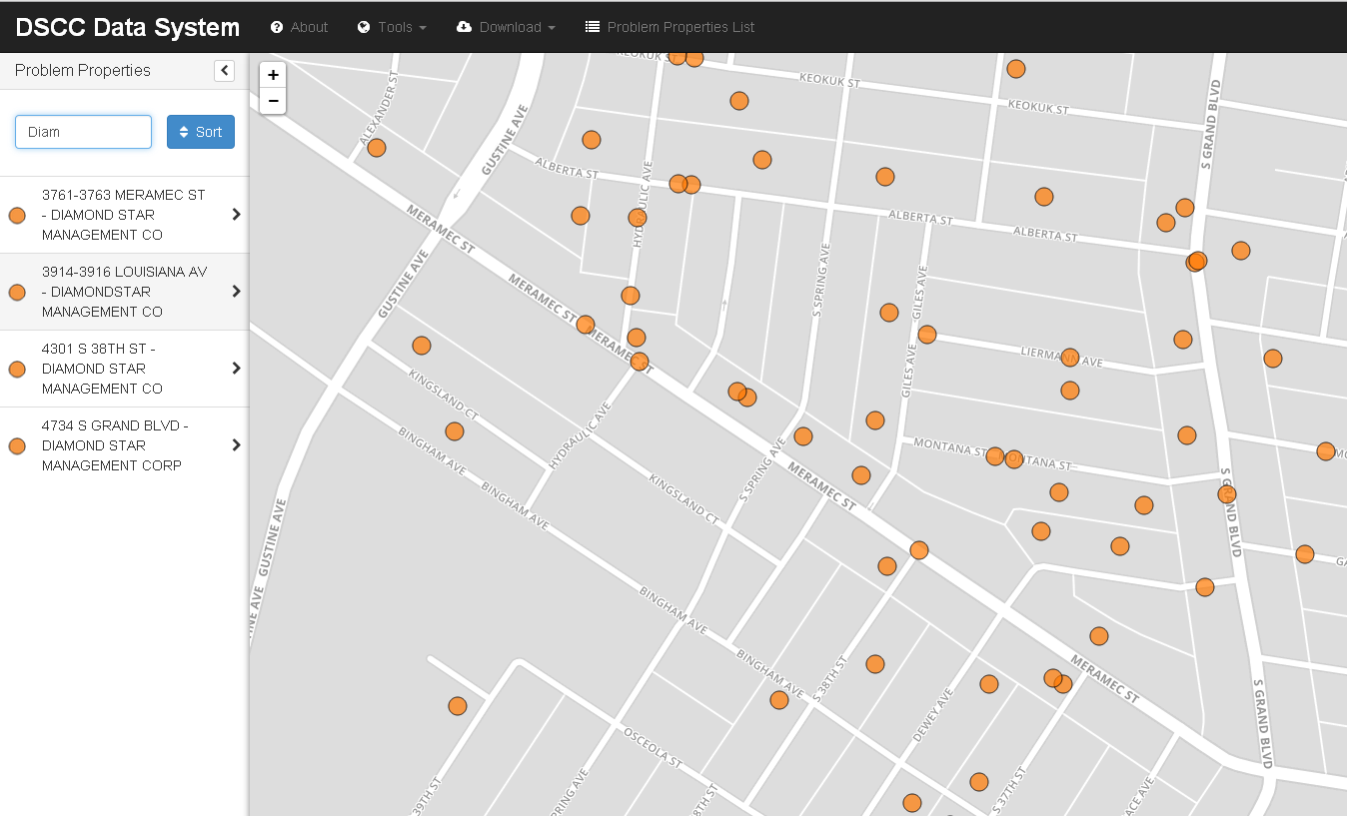

ADDRESS/OWNER LOOKUP
(VIA SIDEBAR SEARCH)

Slide 12
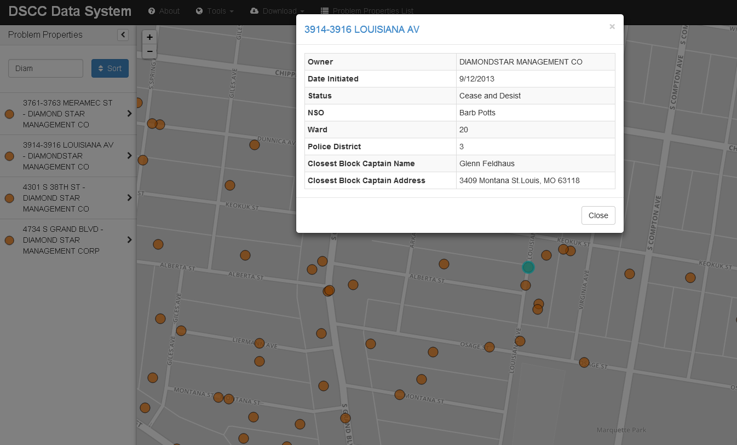
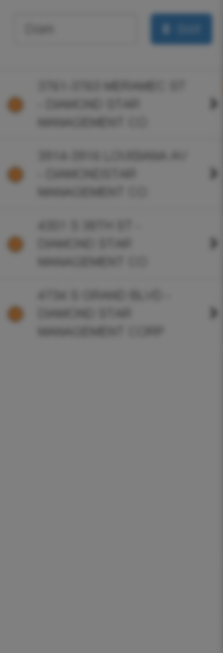
PROPERTY IDENTIFICATION
(VIA OWNER LOOKUP)

Slide 13
IMPROVED ENFORCEMENT
Better coordination among NSOs/focus limited resources on “worst offender” owners
Target Neighborhood Ownership Model patrol teams to areas with high numbers of nuisance properties & low Block Team engagement

Slide 14
BEYOND ENFORCEMENT
Landlord training programs, especially for landlords with history of nuisance properties
Connecting residents to needed public services
Targeted community engagement and Block Team support
“Who are we accountable to?” Vision is to improve public safety and quality of life for ALL residents.

Slide 15
BEYOND ENFORCEMENT
Landlord training programs, especially for landlords with history of nuisance properties
Connecting residents to needed public services
Targeted community engagement and Block Team support
“Who are we accountable to?” Vision is to improve public safety and quality of life for ALL residents.
THANK YOU!
QUESTIONS/SUGGESTIONS → eleanor@risestl.org

