Slide 1
COVID-19 Urban Vulnerability Data Dashboard
Amy Carroll-Scott & Danny Galpern
Supported by a grant from Drexel University to Félice Lê-Scherban and Amy Carroll-Scott

Slide 2
Background
Purpose:
To provide contextual information for COVID tracking
To inform COVID-19 relief and recovery efforts
To provide communities with access to data for advocacy and funding
Supported by Drexel COVID-19 Rapid Response Research funding
Leverages West Philly Promise Neighborhood indicator work
Notes:
Amy

Slide 3
What do we mean by “vulnerable”?
Vulnerability describes an area’s level of risk for a negative impact
More vulnerable
Less access to resources
Result of historic and systemic inequities, including racism and classism
Potentially more exposure to COVID-19, other co-morbidities, worse outcomes for disease, higher rates of death, worse economic impacts
Less vulnerable
More access to resources
Higher likelihood of recovering from economic and social impact of COVID-19, less exposure, fewer co-morbidities, lower rates of death

Slide 4
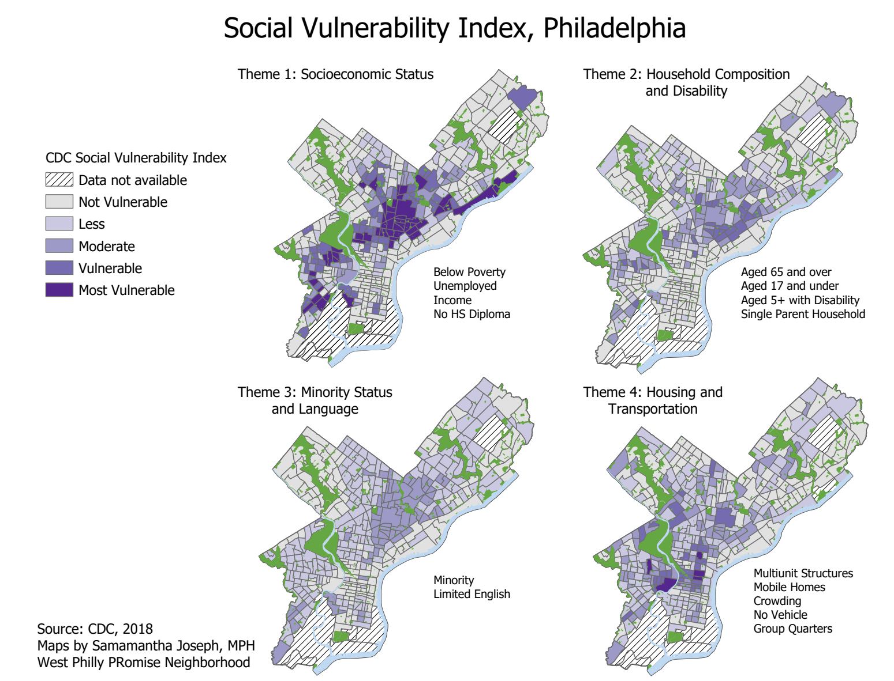
How was the tool developed?
Based on CDC SVI
Identified indicators based on criteria
Publicly available
Available city-wide
Relevant to urban context and COVID
Data sources
Census data from American Community Survey, 2018
Public Use Microdata Sample
LODES (LEHD Origin-Destination Employment Statistics)
500 Cities (CDC)
US Dept of Housing & Urban Development
EvictionLab

Slide 5
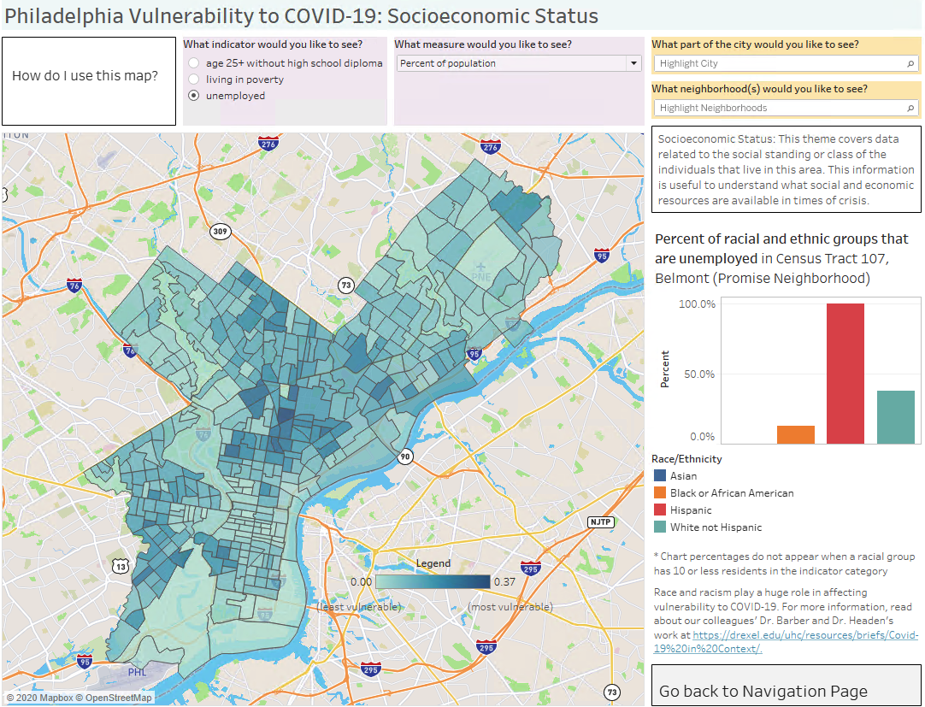
Dashboard 1: CDC Social Vulnerability Index Data
Socioeconomic Status
Age 25+ without high school diploma
Living in poverty
Unemployed
Household Composition and Disability
Age 17 or younger
Age 65+, 85+
Disabled
Single-parent household
Minority Status and Language
Minority
Speaks English “less than well”
Housing and Transportation
Crowding
Multi-unit structures
No vehicle
Group quarters

Slide 6
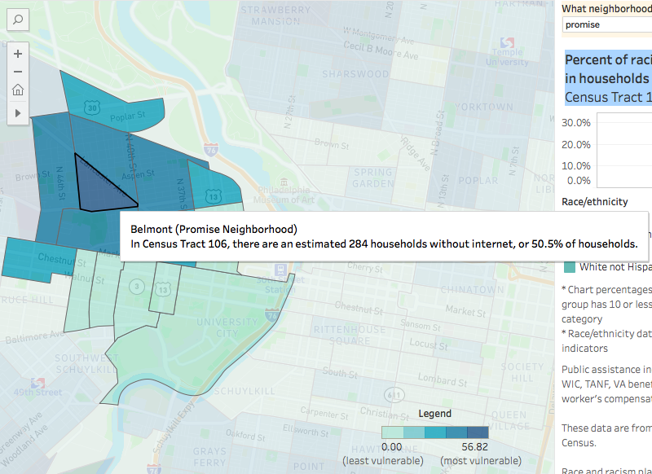
Dashboard 2: Additional COVID-19 Vulnerabilities
Access to Resources
Households receiving food
stamps/SNAP, public assistance
No internet
No health insurance
Health Conditions
High blood pressure
Obesity
Diabetes
Coronary heart disease
Asthma
Lung disease
Housing
Eviction rate
Housing units with rent or
mortgage more than 35% of
household income
Subsidized housing units

Slide 7
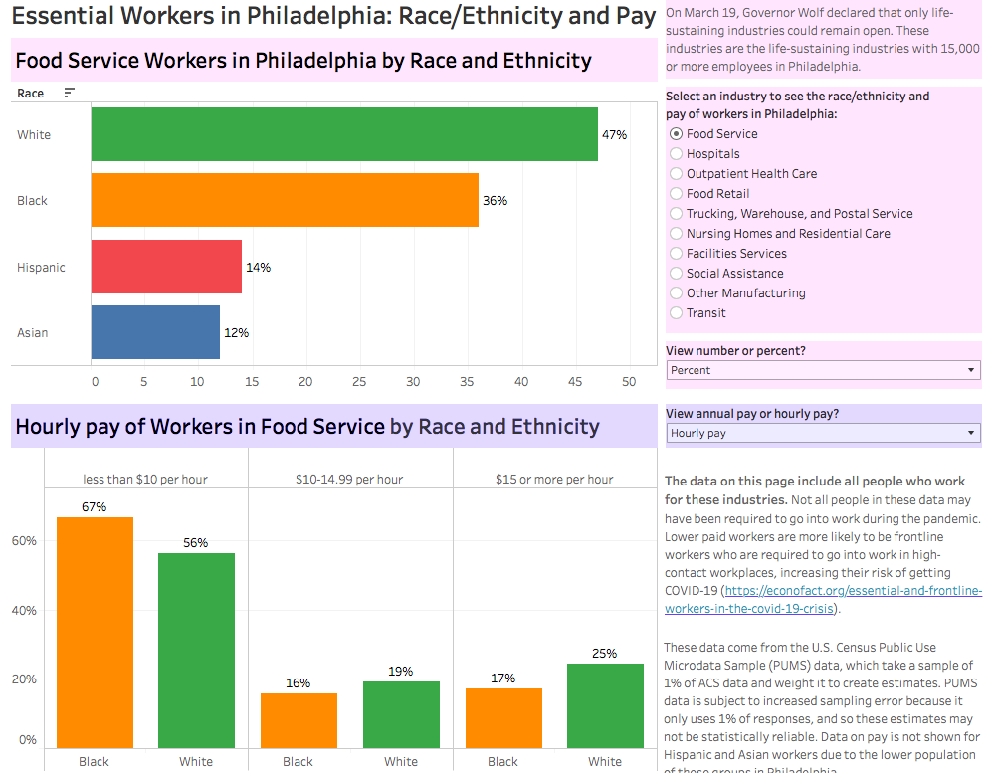
Dashboard 3: Essential Worker Data
Essential Workers
Industry
Race/ethnicity
Pay
Where essential workers live
Essential industries include wide range of occupations
Food service includes restaurant workers, cooks, executives, lawyers, marketing and sales
Lower-paid employees are more likely to be frontline workers at higher risk for COVID-19

Slide 8
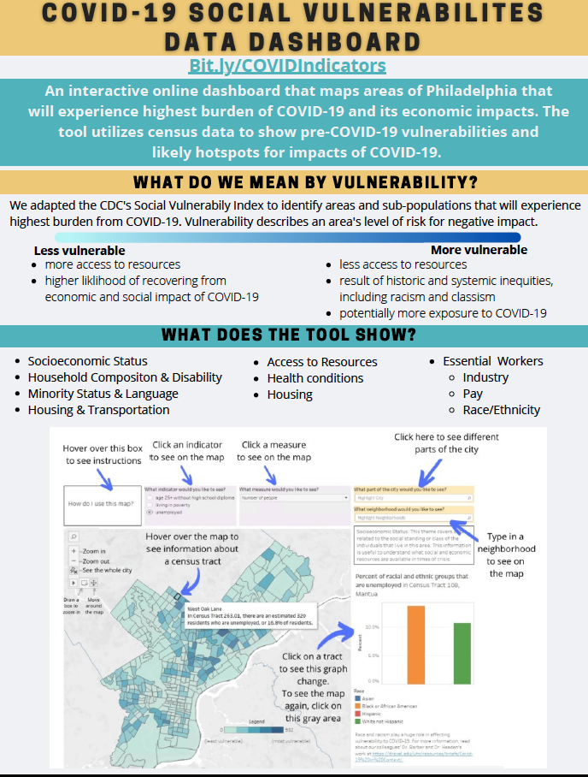
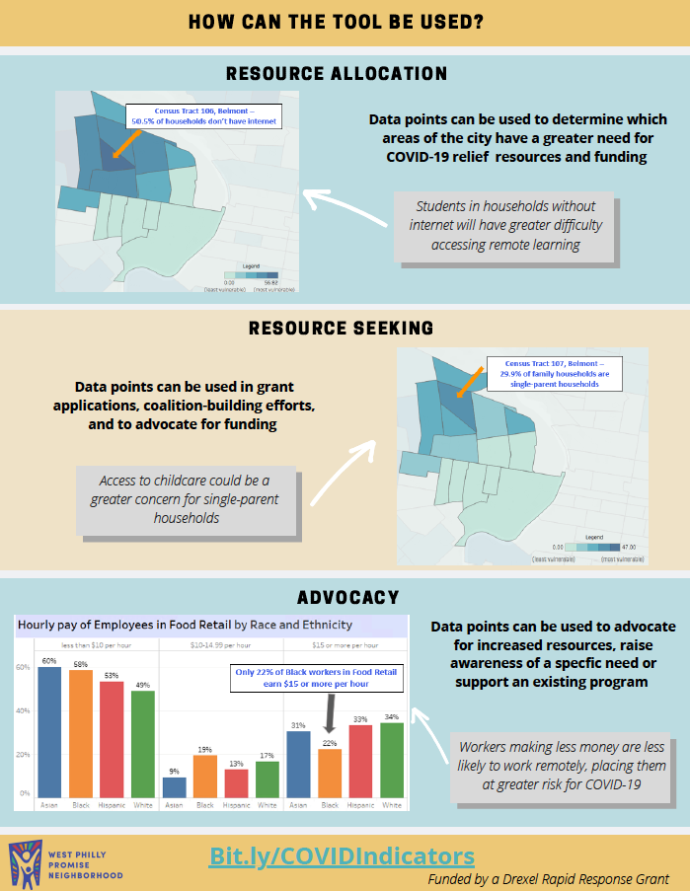
Dissemination Plan
Tool is first step for facilitating the use of data for decision-making and advocacy
Beta testing with community leaders
Urban Health Collaborative Webpage: Bit.ly/COVIDIndicators
Promote to data users, health care delivery partners, community leaders, city agency staff, and advocates throughout the city
One-on-one and group demos

Slide 9
Next Steps
Working with City partners to identify and include real-time data and show impacts of COVID through spikes & restrictions
Expand housing and behavioral health indicators for new dashboard with Philadelphia LISC (funded by RWJF Using Data to Inform Local COVID-19 response and recovery)
Violence dashboard
Notes:
Has anyone has mapped disruptions to city agency services or benefits throughout COVID? We would like to use this to build a use case for our city data partners to enter into a data use agreement for those data.
Has anyone identified other, public-available data sources that allow for within-year comparisons, or are being updated at a smaller geographic level during the pandemic than the metropolitan area (like Census Pulse survey)? Obviously the ACS 5-year estimates and the 500 Cities data do not.

Slide 10
Questions or Suggestions?
Amy Carroll-Scott, PhD, MPH
Associate Professor, Dept of Community Health & Prevention
Co-Lead, Policy and Community Engagement Core, Urban Health Collaborative
amy.carroll-scott@drexel.edu
Félice Lê-Scherban, PhD
Assistant Professor, Dept of Epidemiology & Biostatistics
Lead, Training Core, Urban Health Collaborative
f.lescherban@drexel.edu
Danny Galpern, MPH
Project Coordinator
West Philly Promise Neighborhood Data & Research Core
dg862@drexel.edu

