Slide 1

How Zip codes drive people mad
NNIP Fall Idea Showcase
November 2017

Slide 2


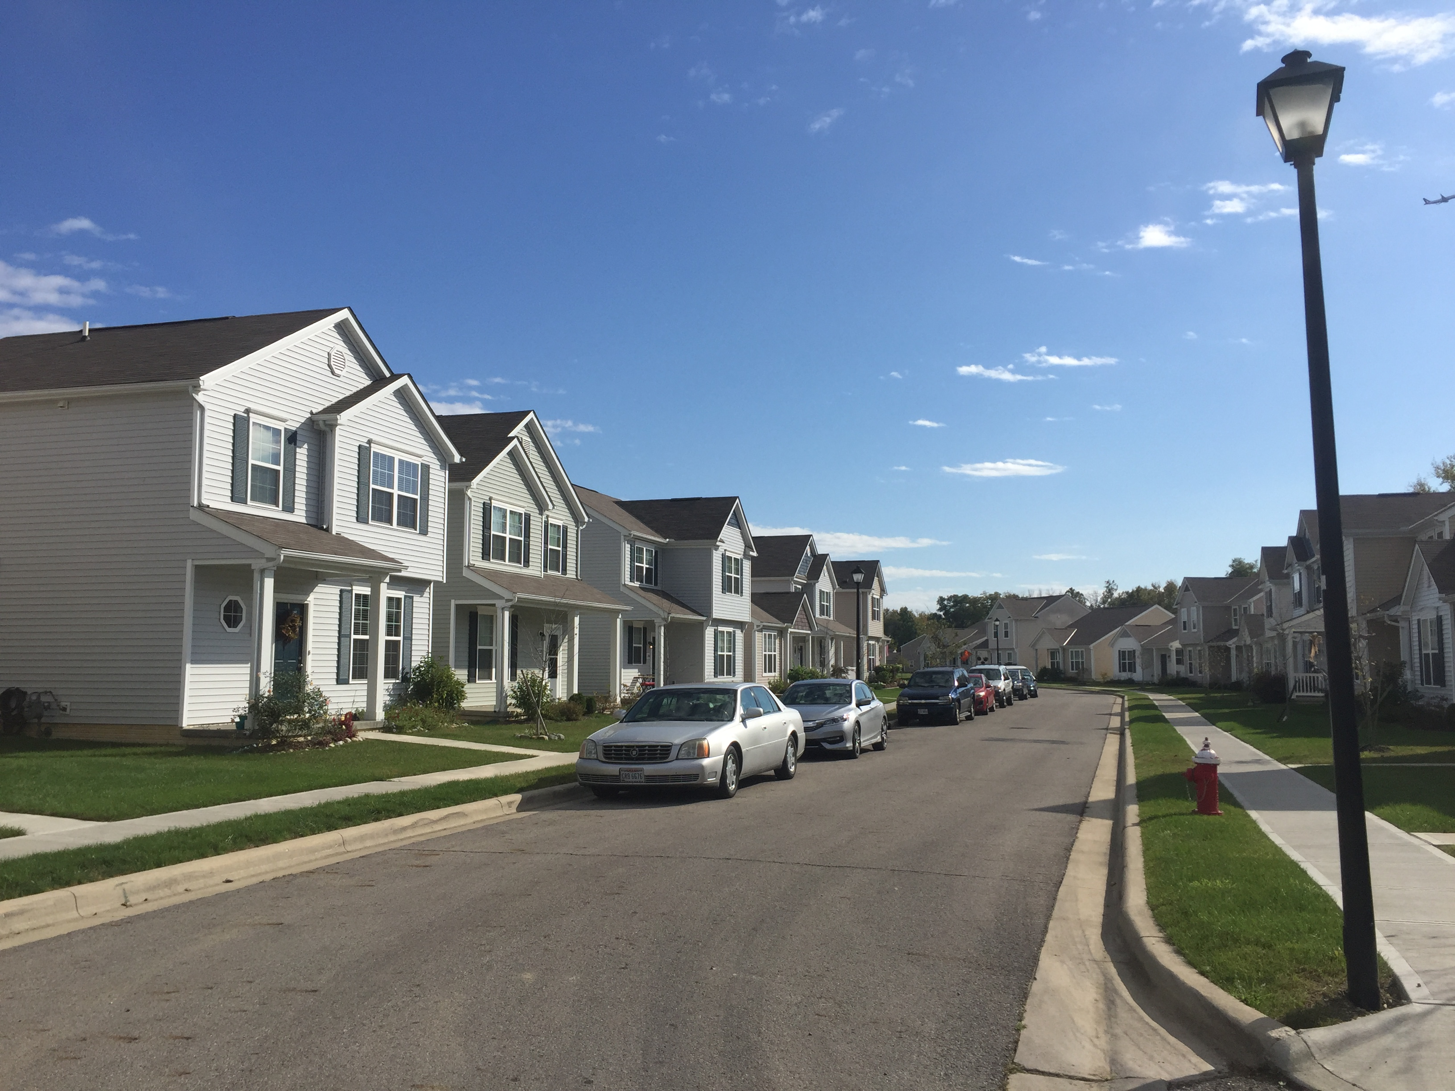
It started with a simple idea: “Benchmarking goes local”

Slide 3
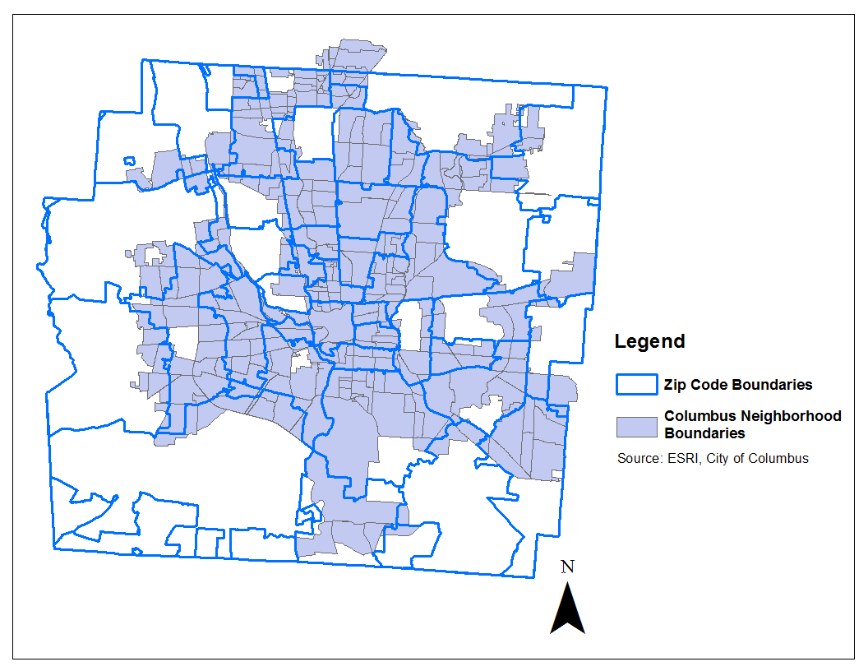

Easier said than done
Zip code/ZCTA boundaries are imperfect- we know!
Uneven boundaries
Transcend natural, political barriers
Who defines a neighborhood, anyway?
They also have undeniable strengths
The public knows its Zip code, not its Census Tract
Ability to incorporate local data

Slide 4
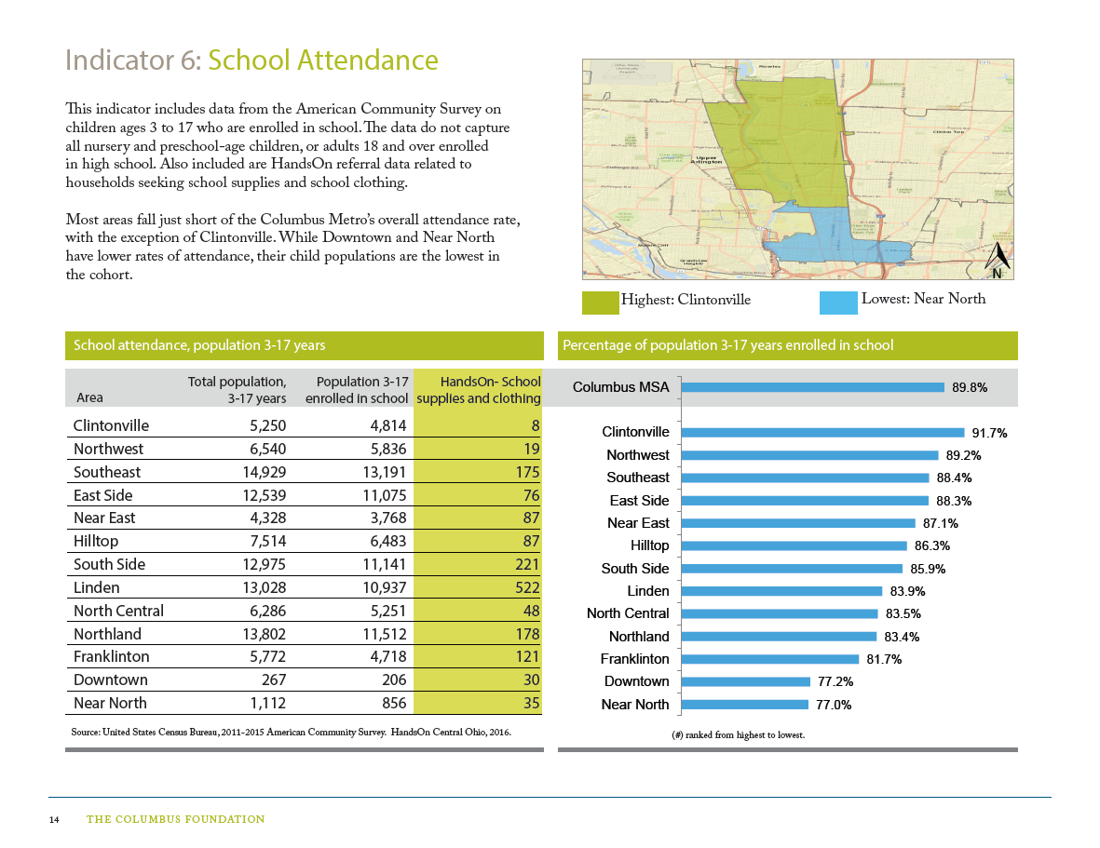
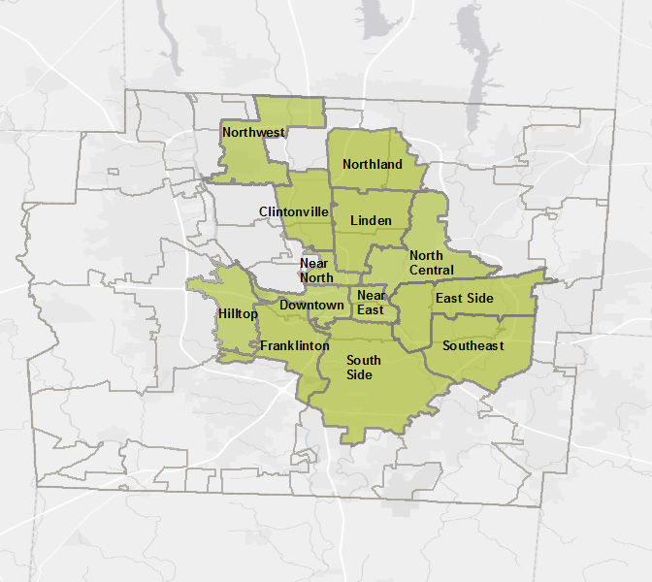
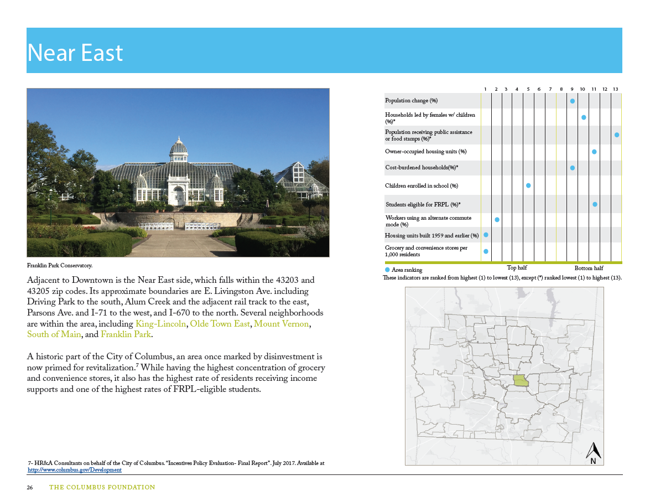
But we went ahead
Defined 13 geographies, 10 indicators
Incorporated HandsOn data
Brief place profiles

Slide 5

And then the feedback rolled in
Disputes over names
Disputes over how ZCTAs were presented, combined
Concerns about ACS 5-year estimates keeping up with current happenings
Interestingly, the data itself were not a major concern

Slide 6

Frustration, but…
This was the conversation we wanted to have!
Affirmed there is interest in local, high quality data
Made some edits, and soon to be released to the public

Slide 7
Conclusions
Producing local data for a wide audience- it can happen!
ZCTAs are flawed, but cannot be dismissed
Keep in mind: who defines a neighborhood, anyway?
Notes:
.

Slide 8


Thank you!
399 E. Main St, Ste. 100
Columbus, OH 43215
www.thoughtwell.org
LinkedIn | @ThoughtwellData
Marc Rostan
Senior Research Associate
mrostan@thoughtwell.org
LinkedIn | @MarcRostan

