Slide 1
NDSC Criminal Justice Data Initiative

Slide 2
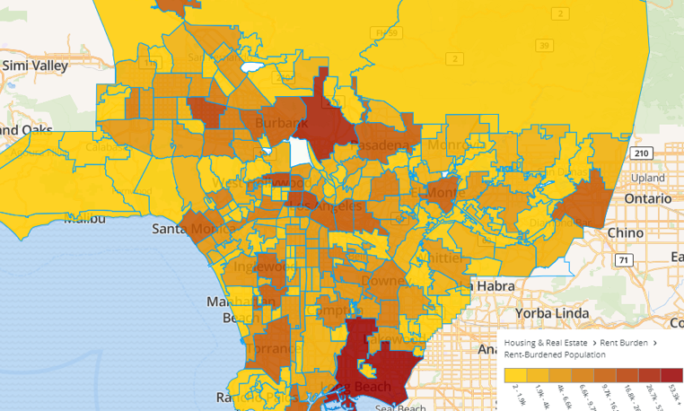
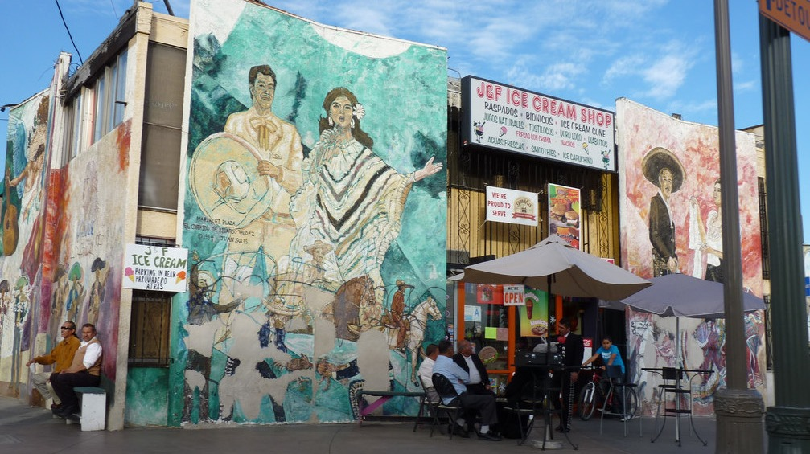
Free, publically available online resource for civic actors to learn about their neighborhoods
Interactive Mapping
Data Stories
Community Training

Slide 3
Criminal Justice Data Initiative
Community engagement, including stakeholder convenings and listening sessions
Data collection, aggregation & dissemination
Data storytelling

Slide 4
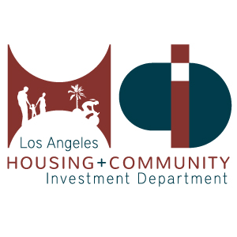
Key Project Partners

Slide 5
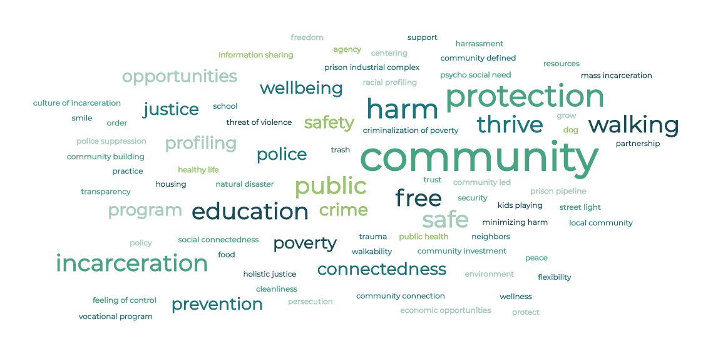
Defining Public Safety

Slide 6
Defining Public Safety

Slide 7
Defining Public Safety

Slide 8
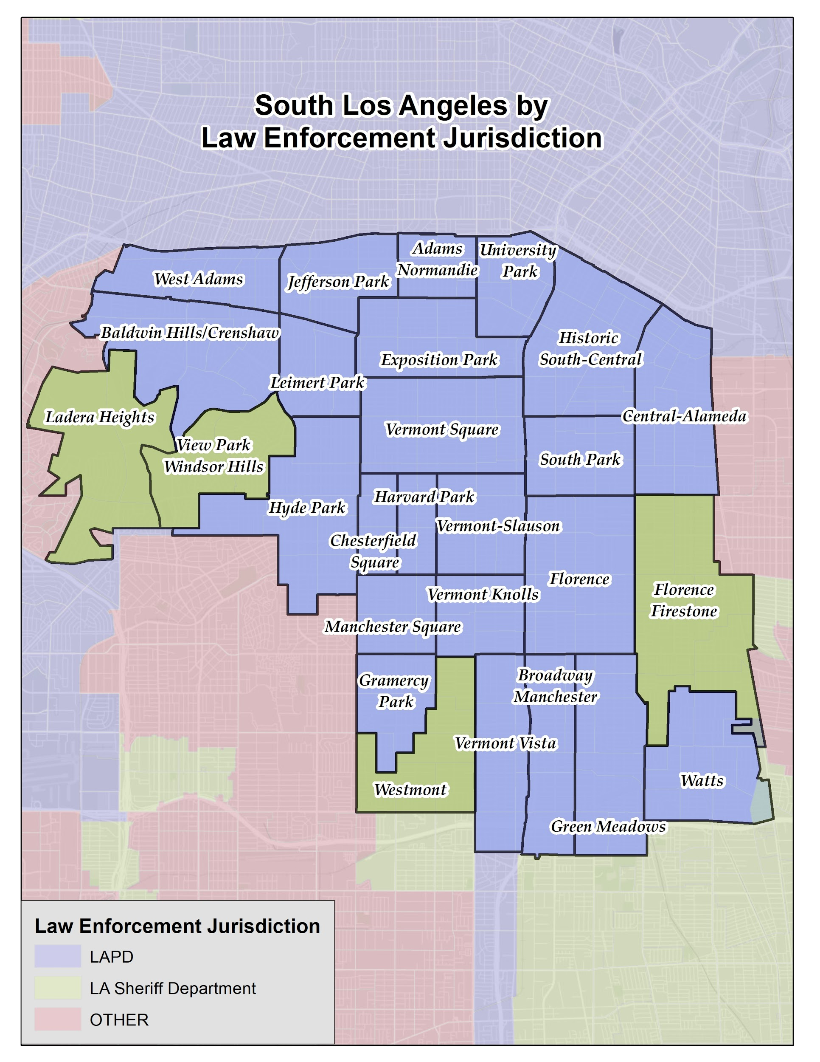
About South LA
Total Population: 777,284
Latinx: 66%
Black: 28%
White: 3%
Asian: 2%

Slide 9
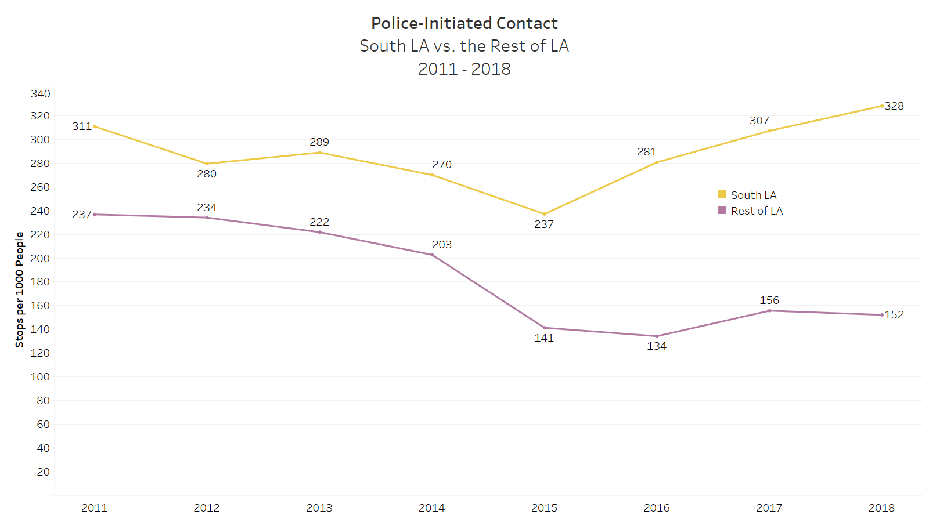
Geographic Disparities

Slide 10
Geographic Disparities

Slide 11
Geographic Disparities

Slide 12
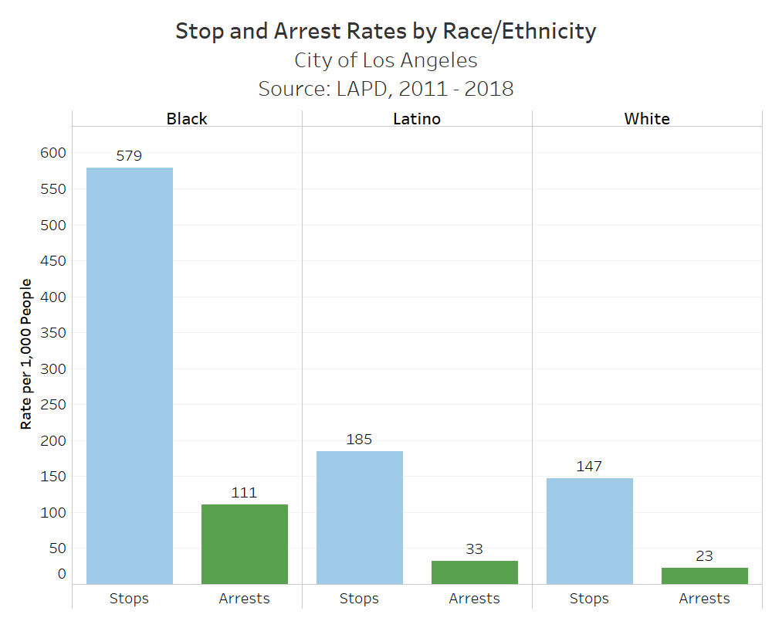
Citywide Racial Disparities

Slide 13
Citywide Racial Disparities

Slide 14
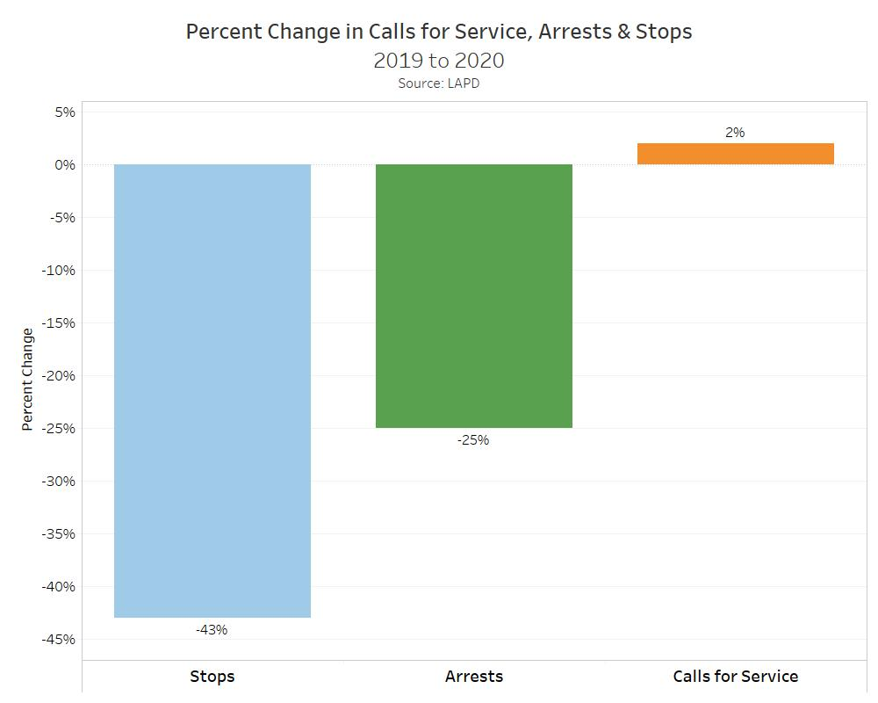
Future Directions
Racial disparities in who is stopped and arrested remain unchanged.

Slide 15
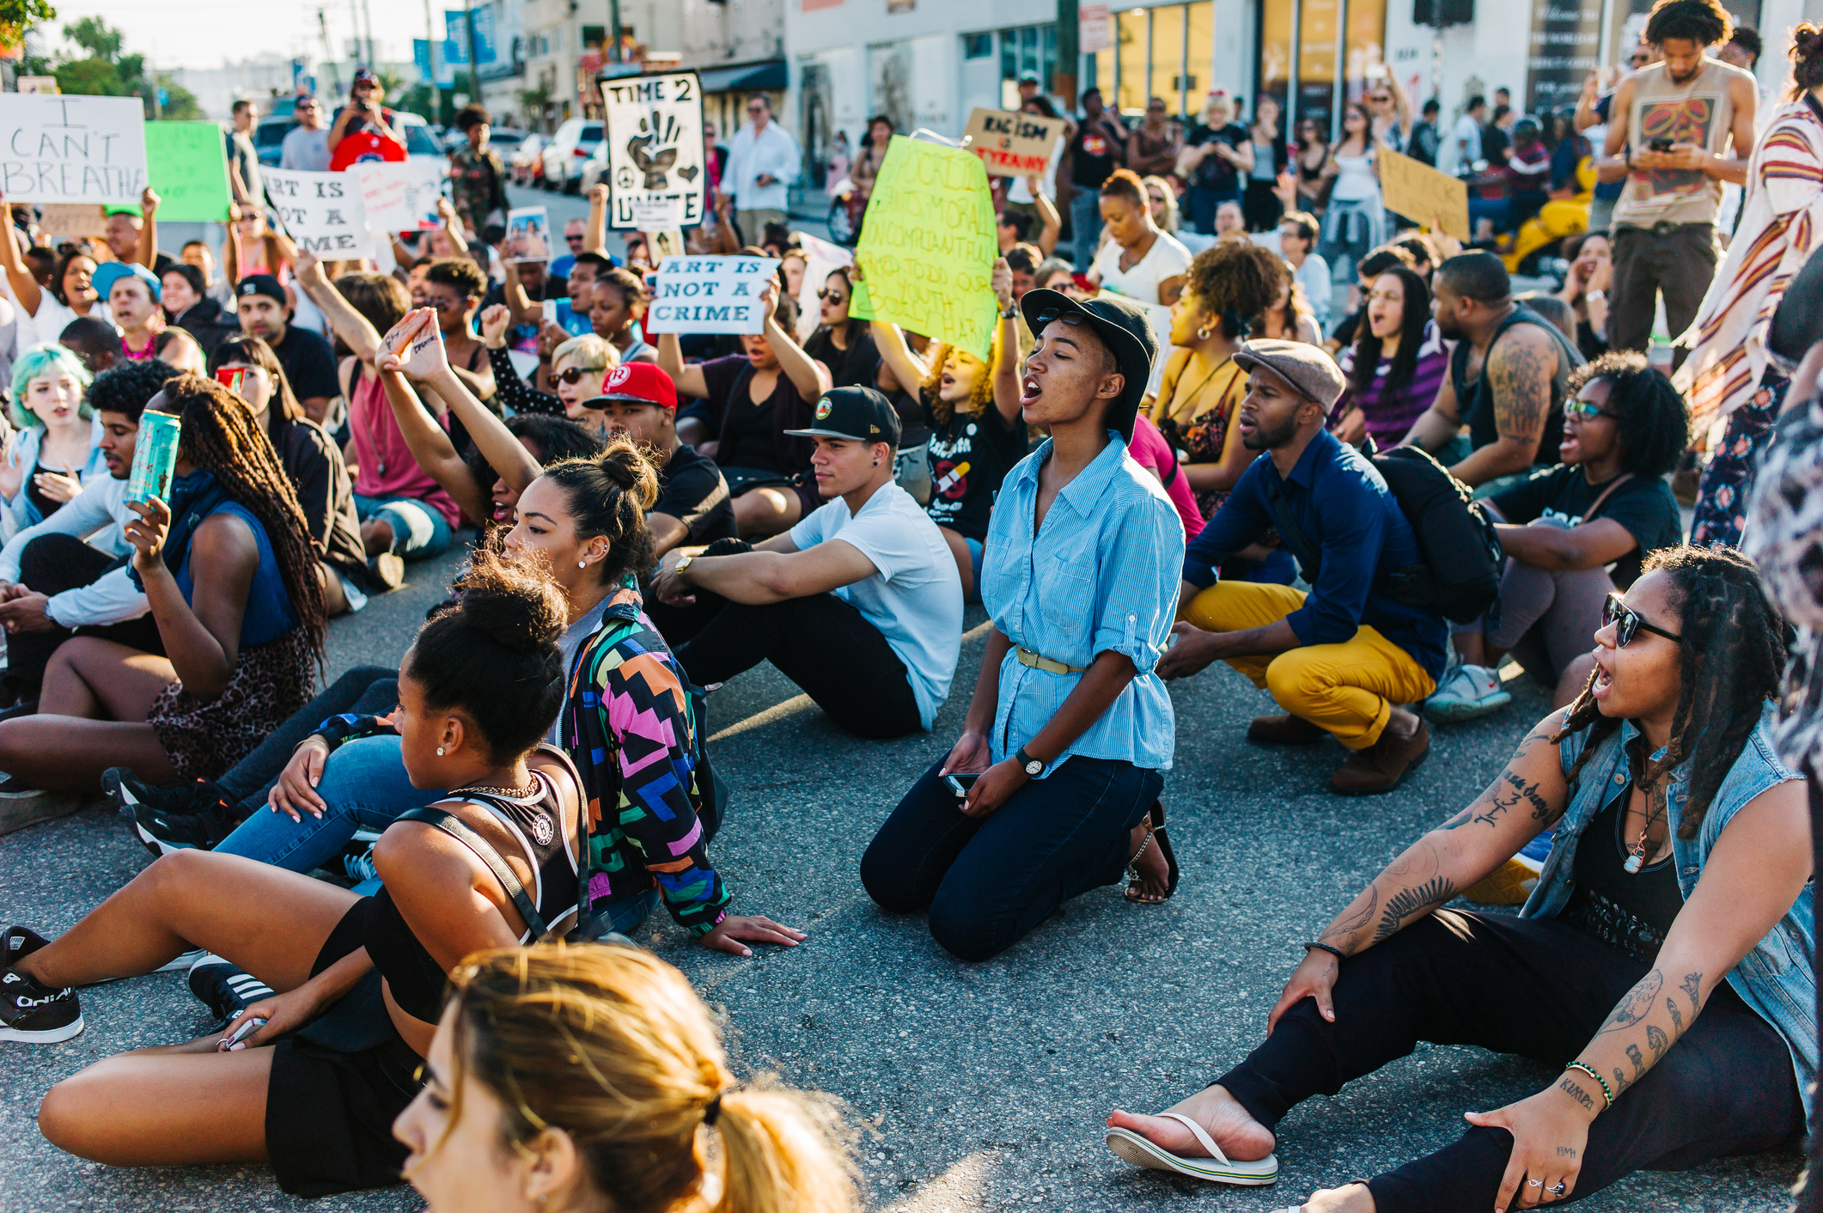
Future Directions
Why do people in Los Angeles call the police?

