Slide 1
Expanding Use of Local Wealth Data for Local Action
NNIP Webinar
Lamar Gardere – lamarg@datacenterresearch.org
Haleigh Tomlin – haleight@datacenterresearch.org

Slide 2
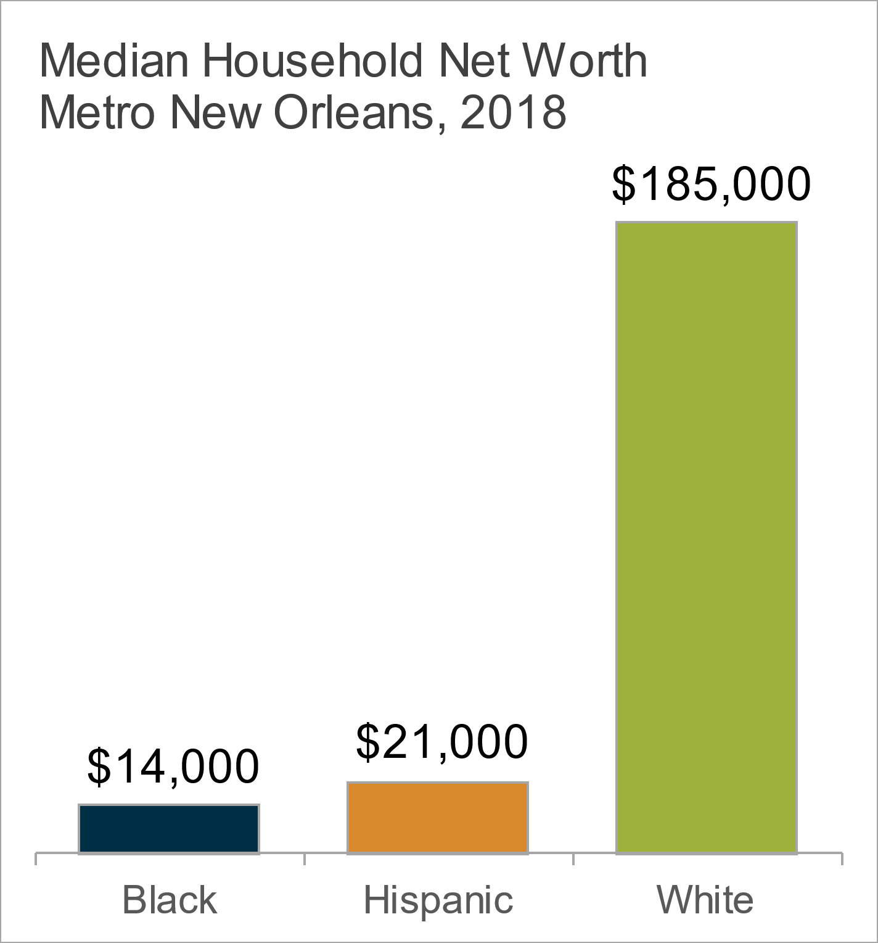
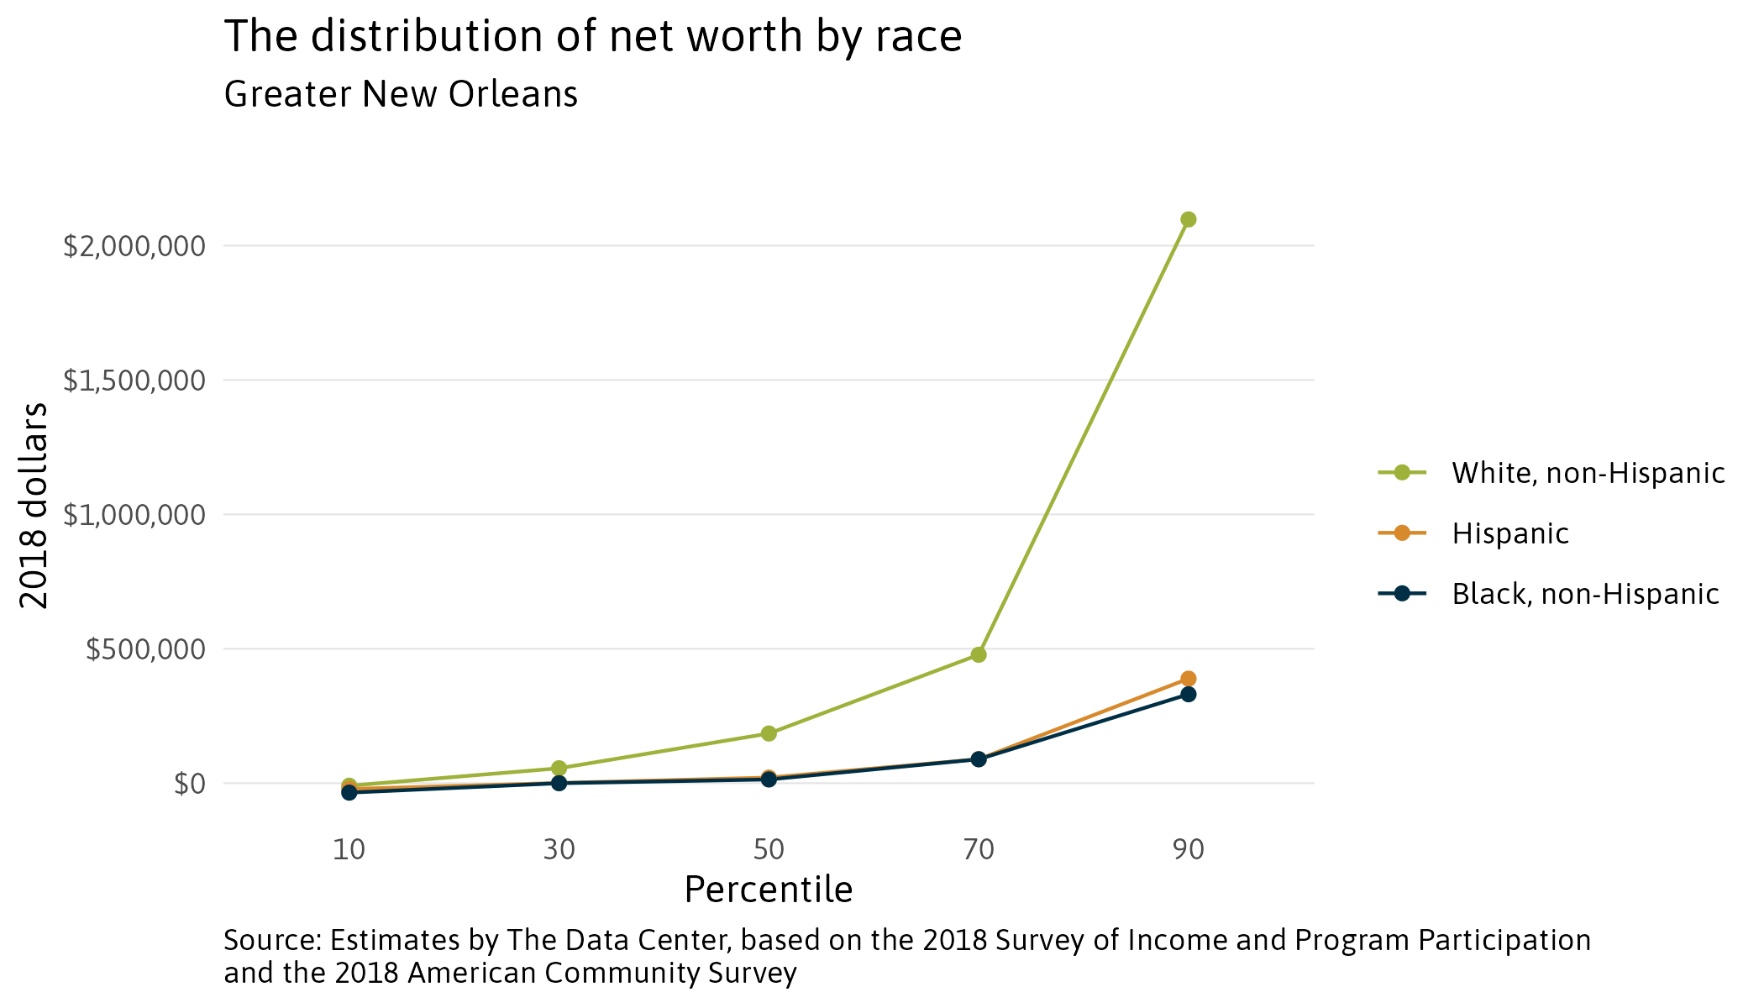
The Data Center’s wealth data was built to facilitate action. By providing the distribution of wealth for each race we see not only disparities across races in New Orleans, but also within races. Each reality suggests different but equally important solutions.
Very little disparity at the lower third of the distribution.
Relatively affluent Black and Hispanic people only have as much wealth as the typical White person.
Notes:
Source: Estimates by The Data Center, based on the 2018 Survey of Income and Program Participation and the 2018 American Community Survey
This graphic illustrates why I don’t call it the racial wealth gap. Wealth disparities transcend race though are still well predicted by race. The lower third of the wealth distribution looks the same regardless of race, though some of that may have to do with age.
Target solutions that close the wealth gap broadly but ensure they do indeed benefit people of color
Build the middle class for Black and Brown people
Consider broadening support for safety net programs that help address, for example, child poverty or increasing the minimum wage
Use the tax code to fund programs to support growth of a middle class

Slide 3
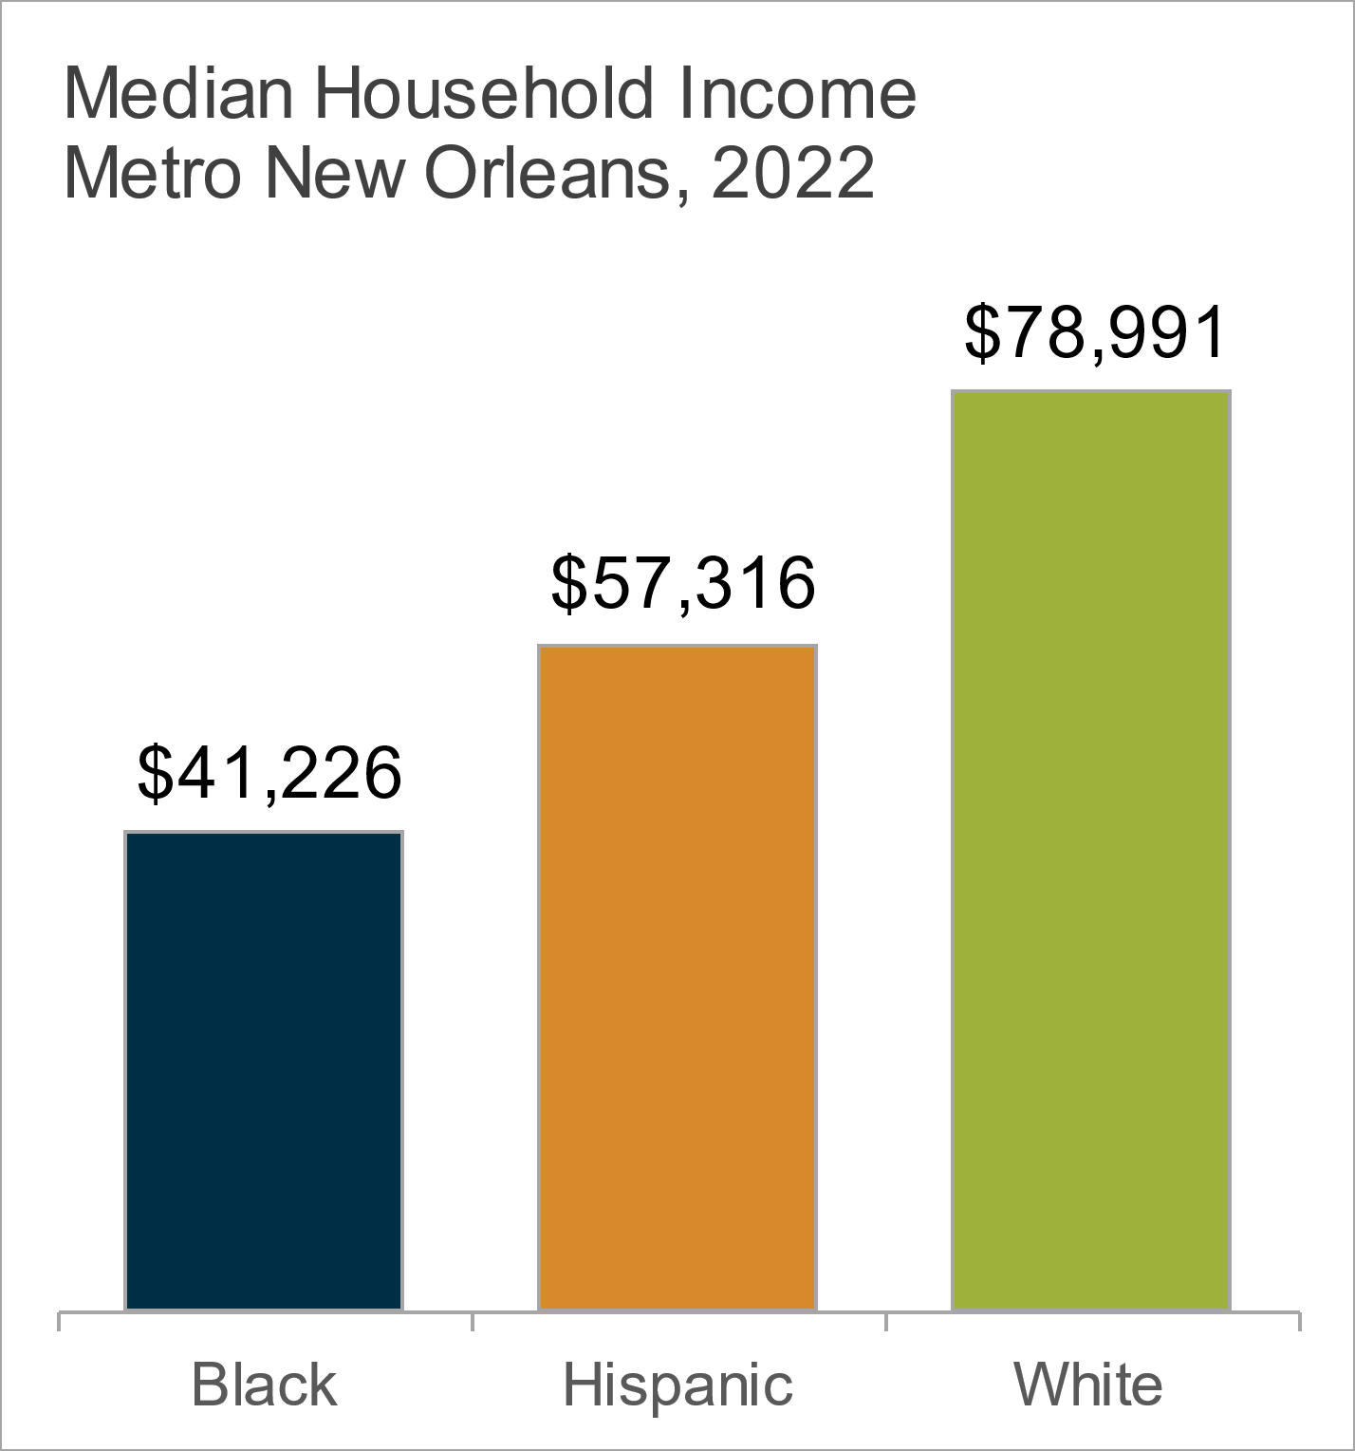
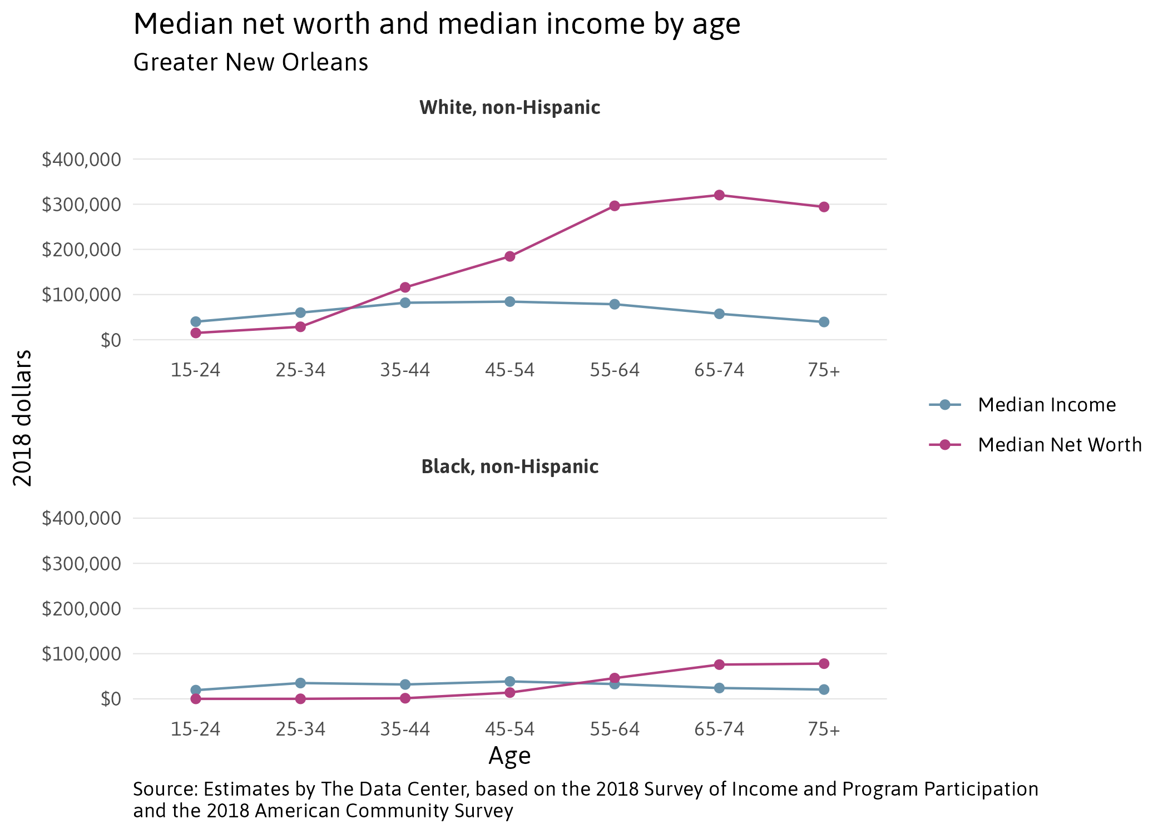
Wealth generally accumulates with age. Median net worth for White households peaks 3X higher than Black households, but differentiation doesn’t show up in significant ways until about 35yrs old. Suggests a need for improvements in both early wealth building and generational wealth building.
Notes:
Source: Estimates by The Data Center, based on the 2018 Survey of Income and Program Participation and the 2018 American Community Survey
Major differences in wealth appear after 35
Ensure younger Black folks are getting into good jobs early in life at the same rate as White people
Disposable income to invest or buy a house, jobs with retirement accounts, jobs with a greater variety of benefits (ex: bonuses or good medical coverage), etc
Programs to help younger Black households address debt early
Greater first-time home buying support for Black folks
Better childcare support so starting a family is less burdensome
Strengthen retirement accounts for older Black households to ensure young folks don’t have to support financially and have inheritance
Fix policies and laws that make inheriting assets burdensome, particularly for people of color.
Improved support for business ownership and revenue development for younger Black households.

Slide 4
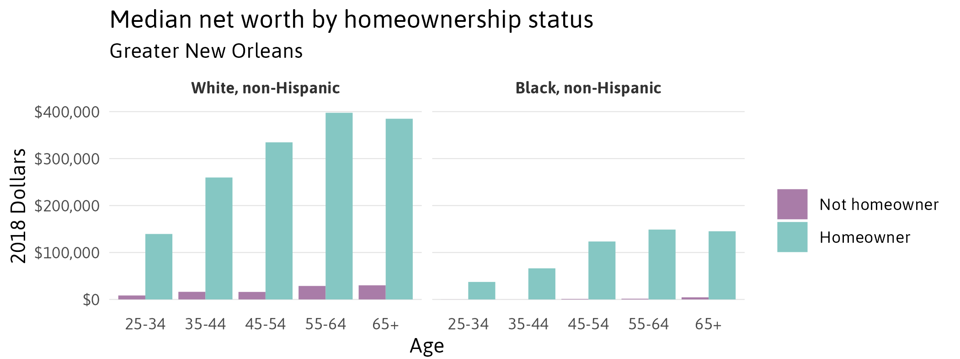
Black homeowners have far more wealth than Black non-homeowner households but also far less than White homeowner households. Though homeownership is a good goal, this suggests better support for property ownership broadly is important, including ensuring wages keep up with increasing ownership costs. Also hints at the conditions of neighborhoods in which Black people typically own houses.
Notes:
Improve equitable valuation of homes
Facilitate wealth generation beyond homeownership for Black households
Ensure incomes are keeping up with the cost of housing
Consider programs funding maintenance of housing stock in lower income neighborhoods to raise the value of homes
Implement policies to minimize displacement
Implement policies to prevent rising home values from creating property tax burdens that harm lower income households
Ensure public infrastructure in lower income neighborhoods matches that of higher income neighborhoods to facilitate higher home values.
Invest in lower income neighborhoods to raise quality of life while minimizing displacement
Loan forgiveness programs for people below certain incomes who have maintained mortgages

Slide 5
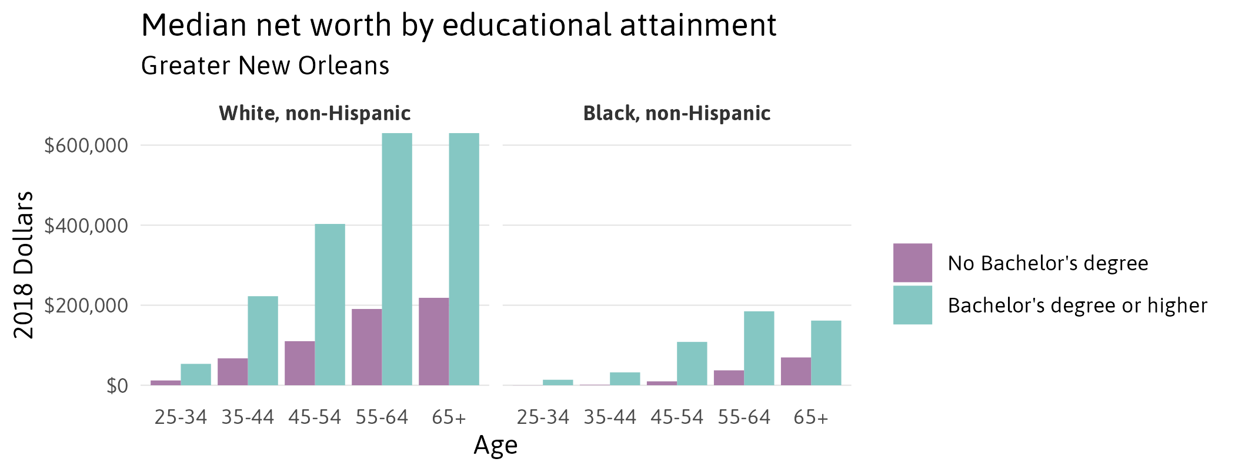
College graduates tend to be wealthier, but wealth among Black college graduates in Greater New Orleans is comparable to that of White householders with no college degree. Decisionmakers can’t just focus on socio-economics, barriers to leveraging education and other systemic factors must be resolved.
Notes:
Source: Estimates by The Data Center, based on the 2018 Survey of Income and Program Participation and the 2018 American Community Survey
Expand programs that make free college available.
Study racial makeups and salaries of industries supporting local White graduates vs Black graduates
If there is a mismatch in degree types then create programs to grow specific degree types. (How might this look? Maybe many local black graduates went to local HBCU’s but those universities don’t provide good access to the degree types needed for the jobs and higher salaries available locally. Work with HBCU’s to expand degree types.)
Grow economy to retain and attract black graduates in preferred degree types
Programs to address hiring disparities in certain industries
Study industries that don’t require degrees to identify racial disparities.
Hiring practices
Access to vocational programs
How is incarceration impacting access to jobs despite having a degree?
Address revenue gap in business ownership

Slide 6
How to get started with producing local wealth data
Identify organizations and community questions related to the wealth gap in your metro area
Determine your organization's desired capacity to estimate the local wealth gap
  Produce local wealth estimates*
    Replication of the forthcoming GitHub
    Collaborate with The Data Center to learn the method and adapt to your metro area with guidance – typically in the form of some partnership agreement
  Simply obtain local wealth data from The Data Center
    Contract with The Data Center to receive estimates such as what we provide on our website, but for your metro area
Ensure that local wealth estimates reflect reality
* Requires the ability to run computationally intense statistical models and store results

Slide 7
What might the two main collaborative paths to obtaining local wealth estimates look like?
Develop the capacity to produce local wealth estimates in-house
  Meet with The Data Center to discuss:
    The flexibility of the method to meet your desired use cases
    The limitations of the data in your metro area and adjustments to the method to address them
    A plan to produce your own local wealth estimates with The Data Center as a resource
  Develop your local estimates
    The Data Center will help validate results based on the method
    Your organization will validate results based on local context
Obtain ready-to-use local wealth data from The Data Center
  The Data Center assesses the limitations of the data in your metro area
  Meet with The Data Center to discuss:
    Proposed adjustments to the data or method to provide quality data that meets your use cases
  The Data Center prepares the data and passes it off to your organization
  Your organization validates results based on local context

Slide 8

Any Questions?
Lamar Gardere – lamarg@datacenterresearch.org
Haleigh Tomlin – haleight@datacenterresearch.org
datacenterresearch.org/local-wealth-profiles/

