Slide 1
NNIP Showcase: Lake Street Recovery web map
February 18, 2021
Jeff Matson
jmatson@umn.edu

Slide 2
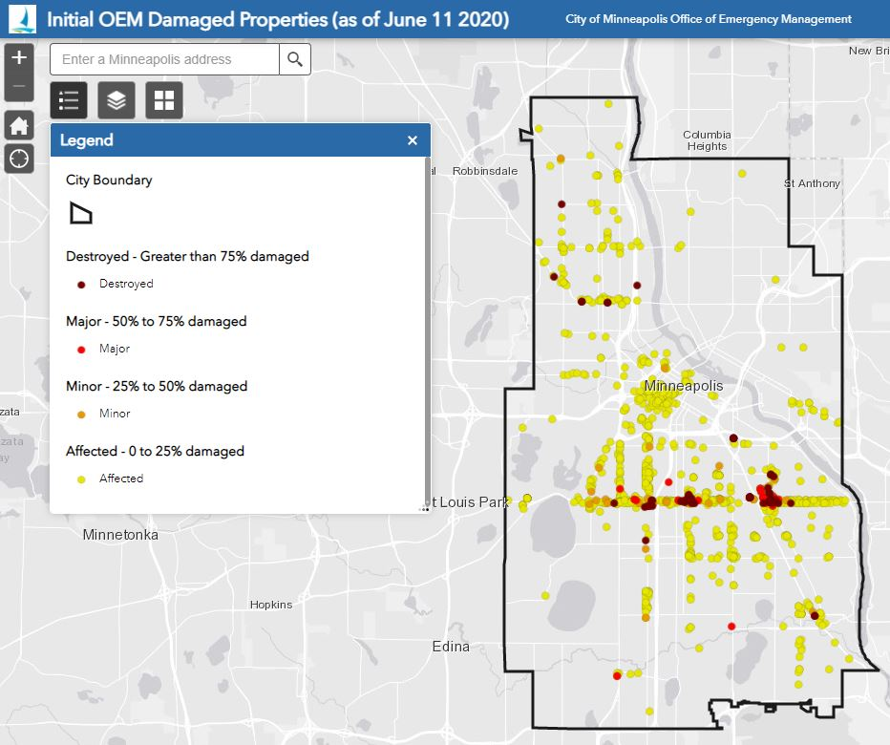
Overview
City’s Office of Emergency Management initial damage survey
Notes:
A week after the uprising and riots that followed the murder of George Floyd the city found more than 1,000 businesses and buildings had suffered damage of some sort including 53 buildings that were completely destroyed, mainly by fire.
Significant damage occurred along one of our city’s recently established Cultural Corridors (East Lake) which features 100’s of immigrant owned businesses, restaurants, retail, services and grocery. Predominantly Latinx and East African, but also SE Asian.

Slide 3
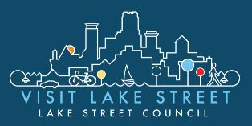
Project in Brief
Broad interest in rebuilding efforts
Need for a central data repository
Create a user-friendly editable mobile map
Notes:
As you might imagine there are a lot of hands in the pot. Lots of activity and lots of duplication of effort.
The Metropolitan Consortium of Community Developers, The Lake Street Council (lead CDC focused on the corridor and controller of the recover funds that were pouring in) along with our local LISC office asked for our help in data collection
The ultimate goal was a user-friendly mobile app that you can update in the field and share broadly among a number of user groups

Slide 4
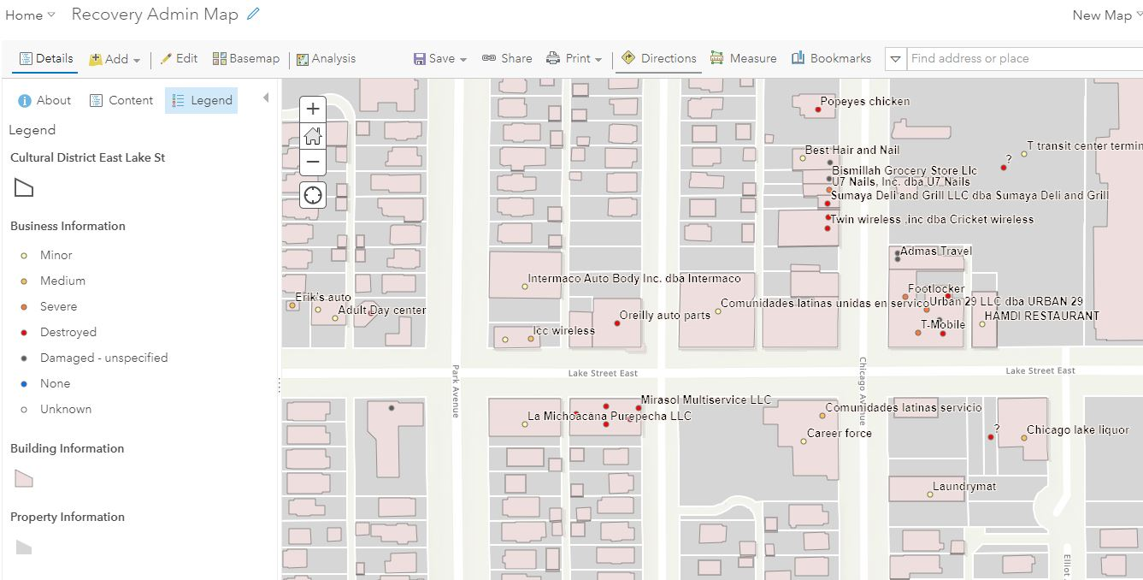
Data Layers
Notes:
Three layers make up the heart of the map: Businesses, buildings, Parcels
You might have multiple businesses in a building, multiple buildings on a parcel, and multiple businesses in multiple buildings in parcel. Or you might even have adjacent parcels that are part of the same building (e.g. Somali mall and parking lot)
Different levels of ownership among the parcels, buildings and businesses. Questions of site control remain

Slide 5
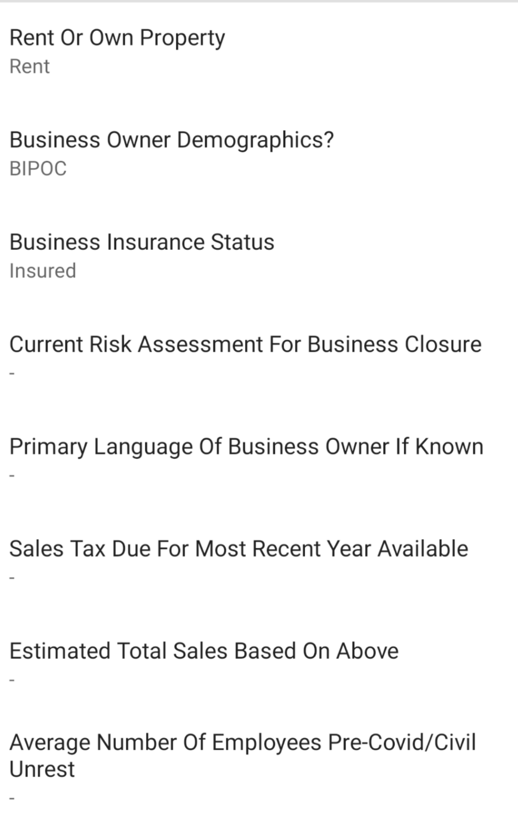
Collector App
Loan/Grant applied for?
Business Status
open
Notes:
Editing & Viewing limited to only those fields a particular user needs
Various levels of user groups (City, CDC, public)
CDC contact
Future plans

Slide 6
Panorama
Mplspanorama.com
Notes:
Graduate students and a professor in land use planning captured a panorama along the corridor shortly after the unrest. These have been integrated into the web map
Choose you corridor, orientation then scroll across the screen for a virtual drive down one of these streets. Hundreds of photos – I don’t even know how many.

Slide 7
Panorama
Mplspanorama.com
Notes:
You can see not only the photos but also land use and zoning, whether or not you’re inside one of the cultural corridors, the former business address and a damage symbol

Slide 8
Google Streetview
Notes:
Google Streetview photos and stills from the panorama website have been added

Slide 9
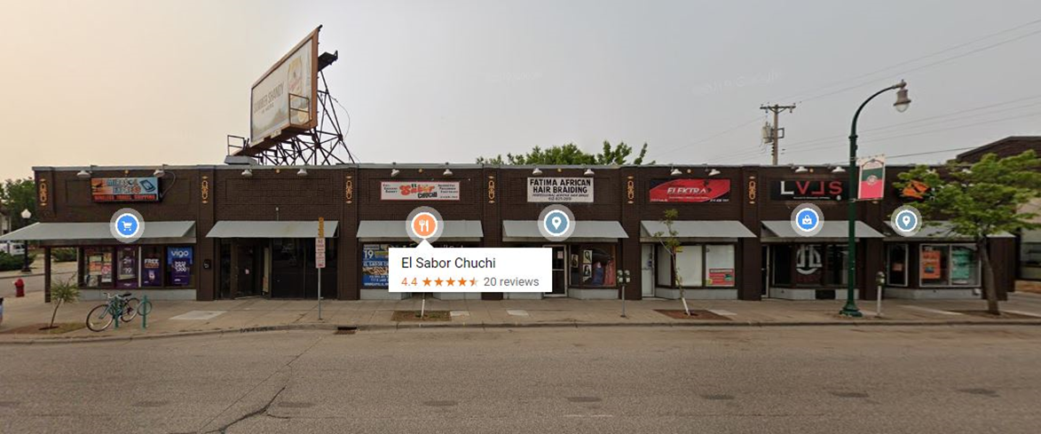
Google Streetview
Notes:
So you have the before…

Slide 10
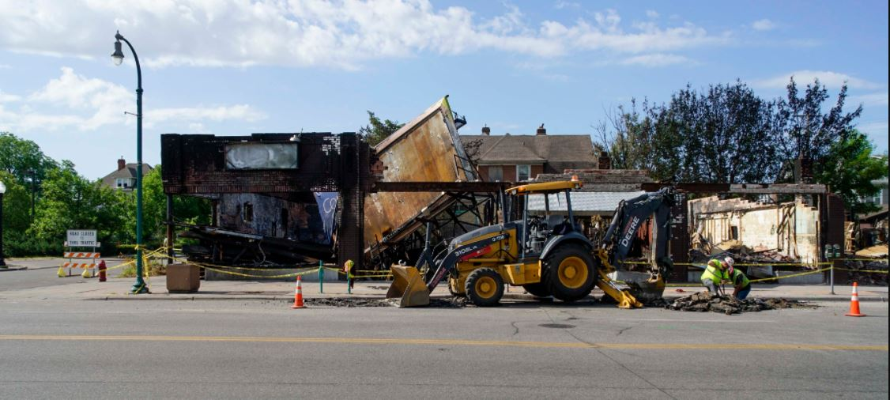
Google Streetview
Notes:
The immediate aftermath… and hopefully someday, the after or the new. Idea is to preserve all of these

Slide 11
What’s Next?
Collecting Community Stories
City’s 2040 Development Plan
Concern for Small Business
Notes:
Finally, we’re working with the planning school to capture community needs, wishes and stories of was once there
Recognition that the City’s development goals are not always aligned with the community
Concern that small immigrant-owned businesses will not be able (by choice or cost) to re-open in new spaces.

