Slide 1

NNIP Showcase
Data User Groups
June 9, 2016
Bob Gradeck rmg44@pitt.edu
University of Pittsburgh

Slide 2
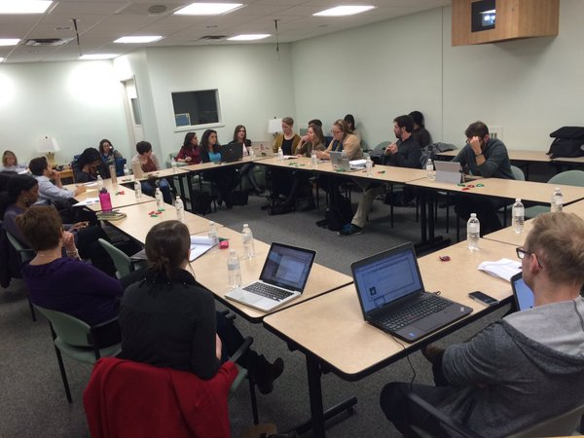
What is a Data User Group
Shared data conversation and learning activities
Open to everyone
Organized around topics
Starts with a listening session

Slide 3
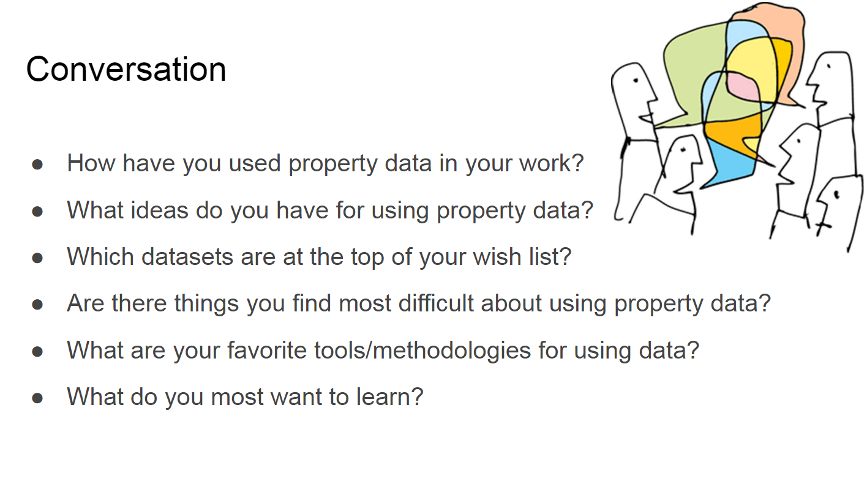
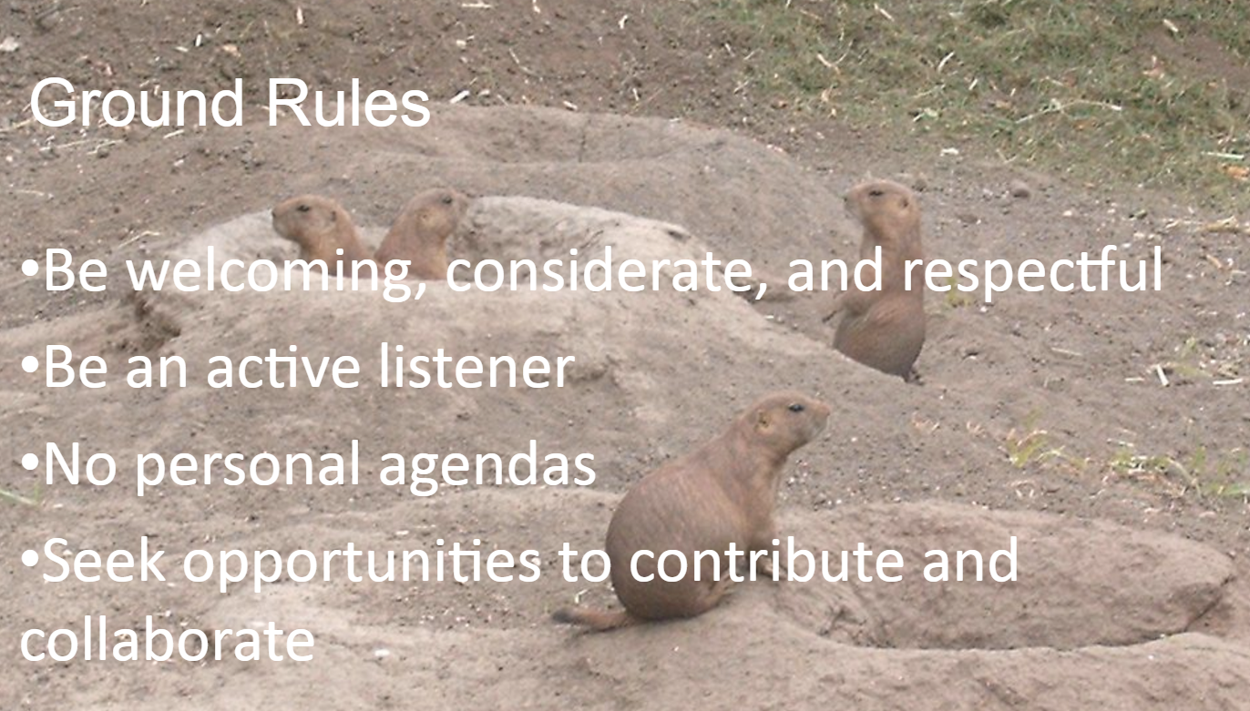
March 3: Property Data User Group Meeting

Slide 4
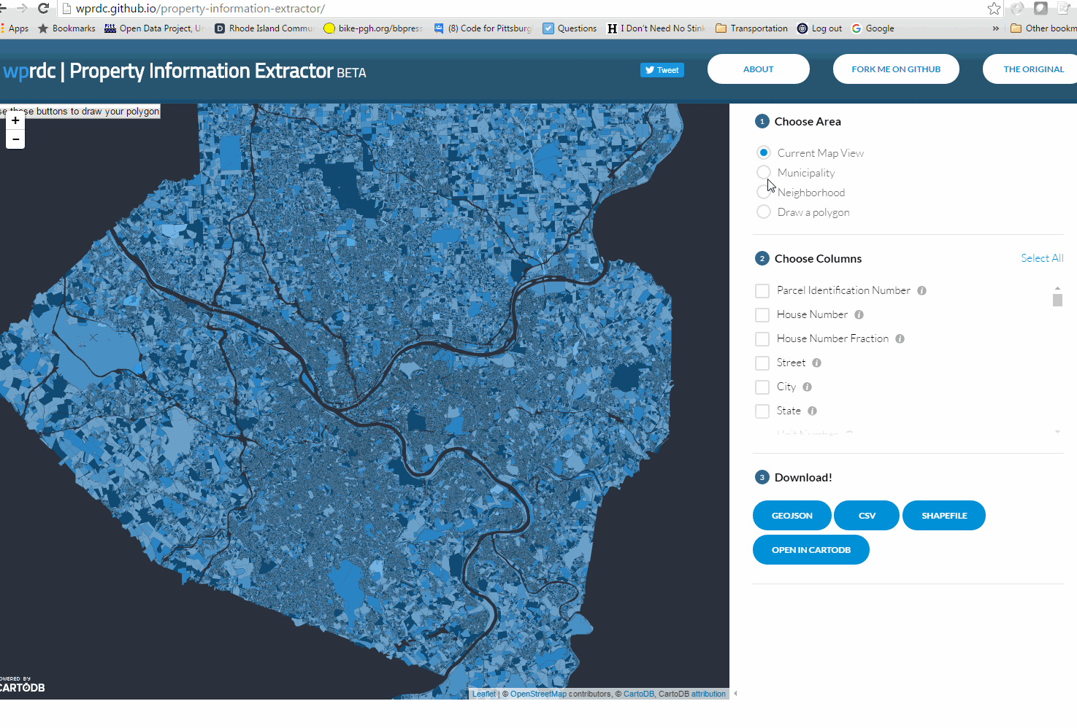
“It’s tough to extract raw parcel data for my neighborhood”

Slide 5
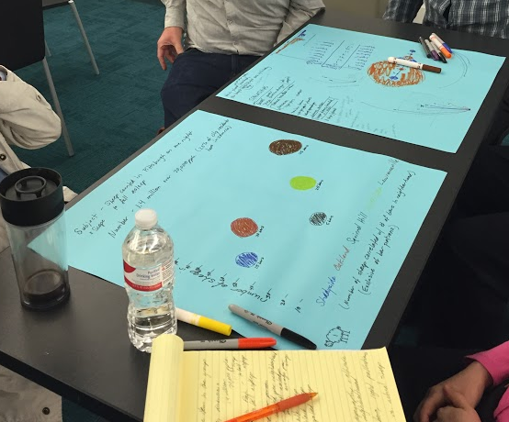
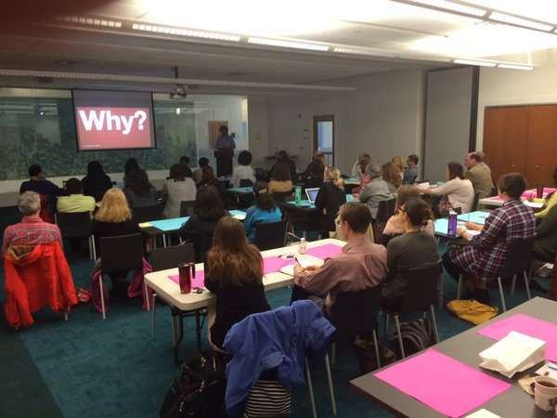
“I need help getting started with data”
Data 101 Training Series with the Carnegie Library of Pittsburgh

Slide 6
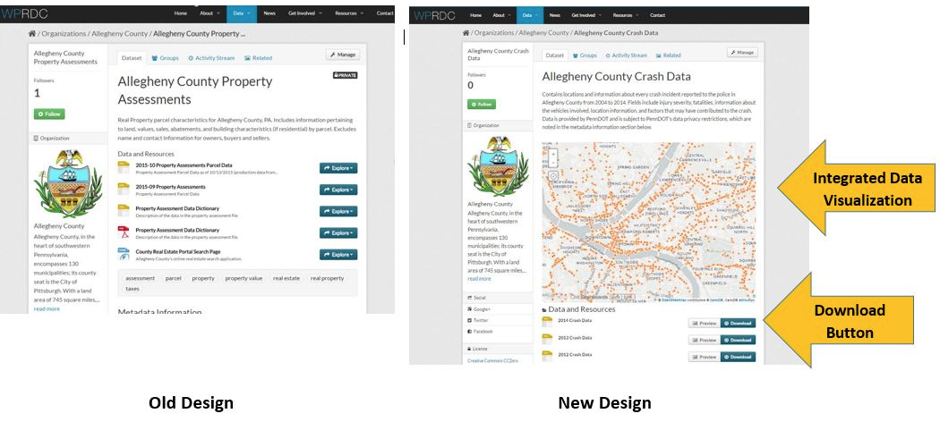
“It would be nice to view data on the Website”

Slide 7
Why We Did This...
Publishers need to hear from data users
Publishing priorities, uses/impacts, and data quality improvements
Data users need to hear from publishers
Provide insight into the publishing process, constraints, and learn about data
Publishers need to hear from other publishers
Learn about data management, data standards, and shared purchasing
Data Users need to hear from other data users
Collaborate on data applications, analytic techniques, and tool development

Slide 8
Set-up the meeting
Choose a topic
Pick a neutral location - libraries are great!
Invite everyone, with special focus on key stakeholders
Create a welcoming environment
Keep the conversation moving
Follow-up

Slide 9
Things we learned...
Feedback matters, and your work benefits from it
Are you listening?
Where do you listen?
Who are you listening to?
Keep engaging your users
Make everyone comfortable.

Slide 10
Links
User Group Blog Post
Property Data User Group Story, Recap, and Slides
Environmental Justice User Group Recap 1st Meeting, 2nd Meeting

