Slide 1

The Urban Displacement Project:
An Introduction and New Projects!
June 13, 2019
NNIP
Miriam Zuk, Ph.D.
Urban Displacement Project, UC-Berkeley

Slide 2
About the Urban Displacement Project
The Urban Displacement Project (UDP) is a research and action initiative at UC Berkeley. UDP conducts community-engaged, data-driven, applied research to help move cities towards more equitable and inclusive futures.
The goal of UDP is to produce rigorous research to reframe conversations, empower advocates and policymakers, and to train and inspire the next generation of leaders in equitable development.

Slide 3
In the beginning

Slide 4

Notes:
●Our journey really started in October 2008, Gov Schwarzenegger signed Senate Bill 375, the sustainable communities act, the nation’s first law to reduce greenhouse gas emissions by controlling sprawl.
TOD/smart growth and the demand for the study.

Slide 5
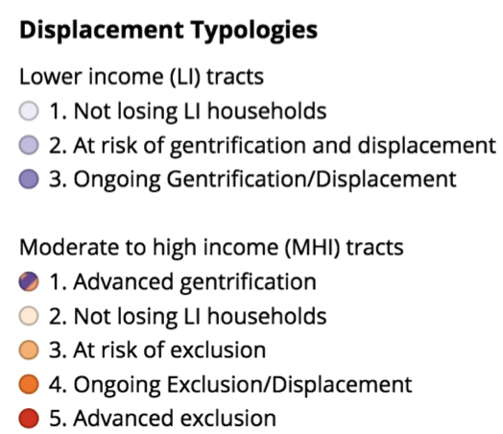
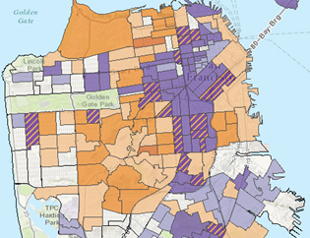
Multi-method Approach
Partnerships with state, regional, local gov and community groups
Mixed method approach (case studies, data analysis, qualitative)
Redefine gentrification as a process, not an event
Incorporate exclusion
Retrospective and prospective maps

Slide 6
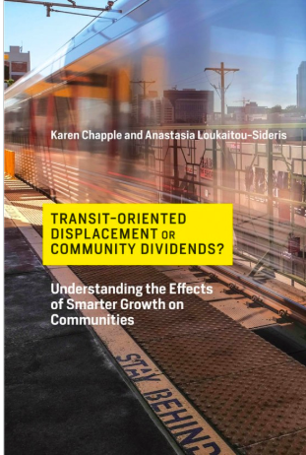
Transit-induced gentrification
Our research shows -- rail station areas areas more likely to experience gentrification and displacement than areas without a transit stop.
Notes:
When new transit is located in low-income communities of color, tends to attract more affluent in-movers → neighborhood transformation
Impacts vary depending on location within region, specific local contexts
TOD without caring about gentrification / displacement may be self-defeating (environmental and equity goals):
Displacing people to further away
Only 5% of neighborhoods near rail have seen significant housing built
Need development to accommodate growing populations, meet GHG reduction goals
Transit station areas more likely to experience gentrification and displacement than neighborhoods without a transit stop – even after the development of TODs and new market rate housing
Since the enhanced accessibility offered by transit proximity is often capitalized into land and housing prices, many express concern that new transit investments will result in the displacement of the low-income populations likely to benefit most from transit access, a phenomenon which we term transit-induced gentrification. Others argue that even if TODs see an increase in housing prices, the total location affordability of locations near transit, factoring in housing and transportation costs, may still be lower, compared with locations in transit-poor suburban areas. In response to these concerns, policy advocates have proposed a variety of interventions designed to ensure that affordable housing for low- to moderate-income households is produced and preserved in areas proximate to transit stations. (Dawkins 2016).
Does transit-induced gentrification lead to displacement? To our knowledge, while a number of studies have discussed the potential for displacement as a result of transit investments (Pollack, Bluestone, and Billingham 2010; Greenwich and Wykowski 2012), no empirical study has been able to measure the extent of any transit-induced displacement. Nevertheless, since researchers have found that transit neighborhoods tend to have higher concentrations of renters (Greenwich and Wykowski 2012), and transit investments have been shown to increase property values and rents, there are enough reasons for community advocates to worry about transit-induced displacement (Rayle 2015; Dawkins and Moeckel 2016).

Slide 7
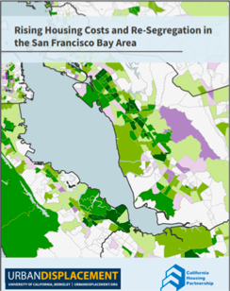
Studying the impacts of Displacement
Notes:
~One in three displaced households reported some period of homelessness or marginal housing in the two years following their displacement. Several of these households remained homeless even months after they were displaced.
After being displaced, only 20 percent of households reported staying in the same neighborhood (within one mile of their previous home). Thirty-three percent of households left San Mateo County, generally moving to the Central Valley or eastern communities in the East Bay.
After being displaced, households moved to neighborhoods with fewer job opportunities on average, leading to longer, more costly commutes for households who left the county. These new neighborhoods also had more environmental and safety concerns as well as fewer healthcare resources.
Displacement was a significant disruption and trauma for respondents and their children. Two out of three children in displaced households had to change schools.
Source: Marcus, Justine and Miriam Zuk, “Displacement in San Mateo County, California: Consequences for Housing, Neighborhoods, Quality of Life, and Health,” (2017).
Forthcoming expansion of the study in Santa Clara County, preliminary results show:
Similar disparities in experiences of homelessness/marginally housed
More crowded; more rent burdened
More folks staying within the city, but still a significant proportion who leave the city (1/3) and 1 in 5 leave the county
Participants who were displaced were significantly less likely to be able to rely on neighbors to lend or exchange things or favors or to be willing to take collective, political action.
These individual impacts are in addition to the potential community/city impacts of displacement, such as less racial and economic diversity, workforce shortages, etc.

Slide 8
Disseminating our Work and Reframing Conversations

Slide 9
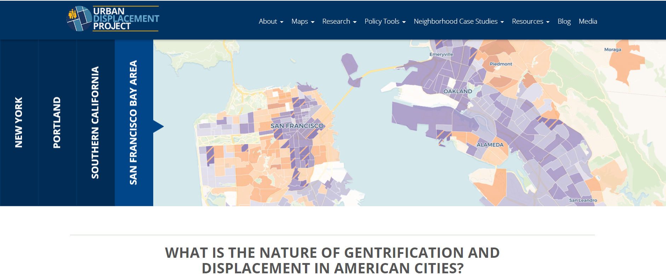
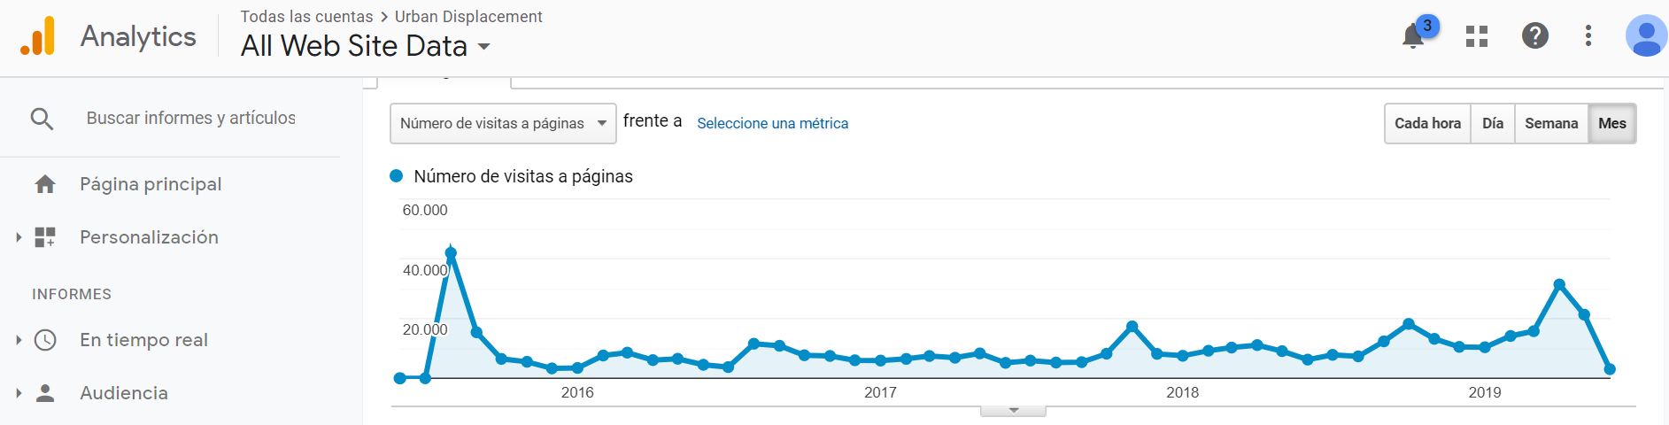
In 2015 we made a website.
By summer 2019, nearly half a million people have visited.

Slide 10
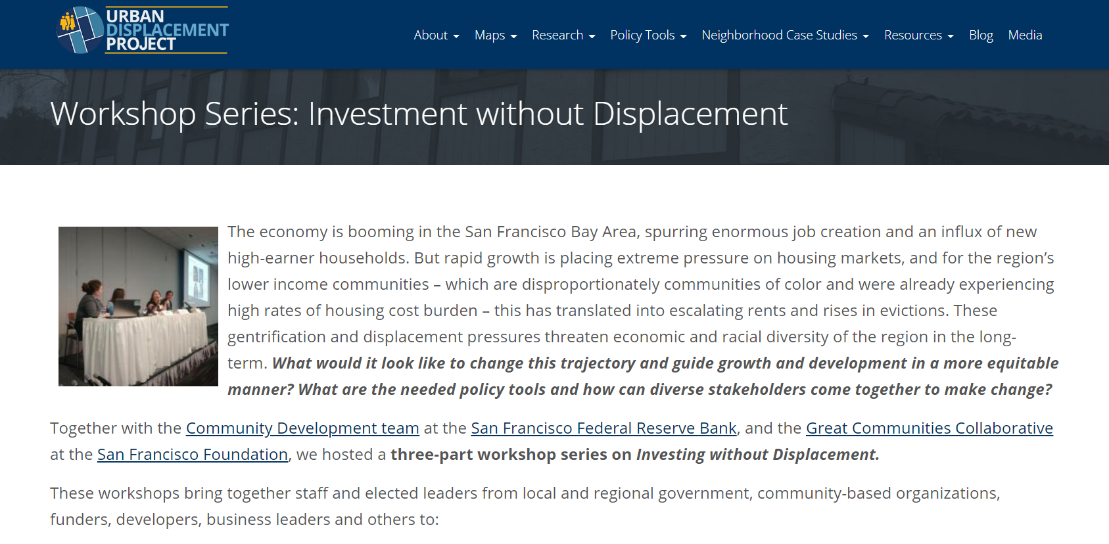

Slide 11
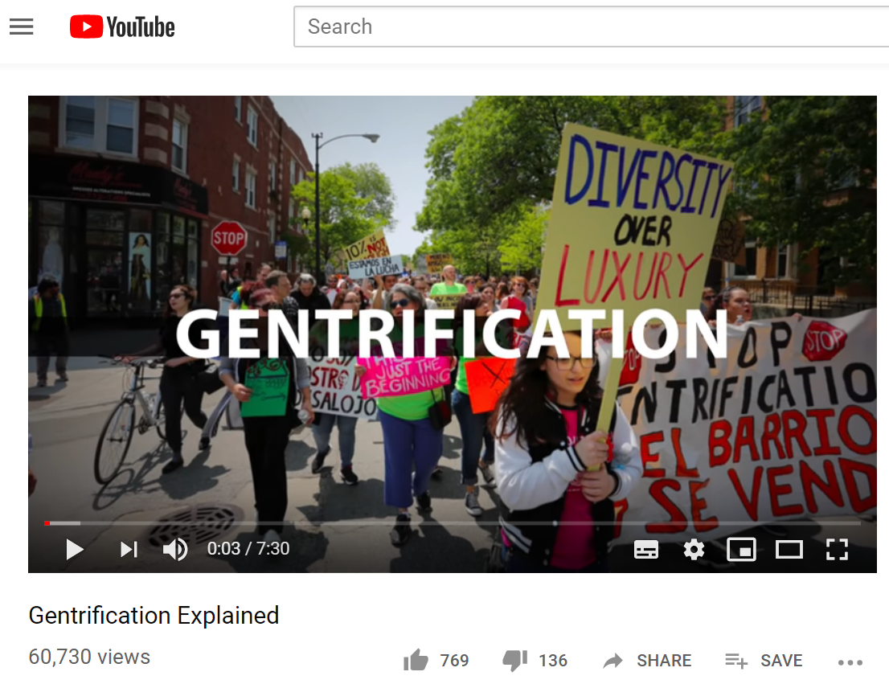
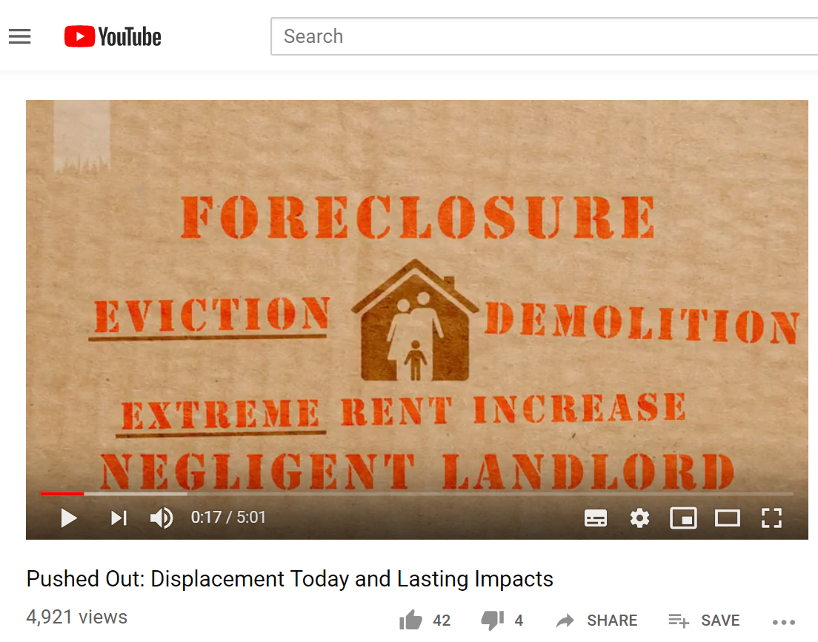
Explainer Videos
urbandisplacement.org/pushedout
~/gentrification-explained

Slide 12
Informing Policy

Slide 13
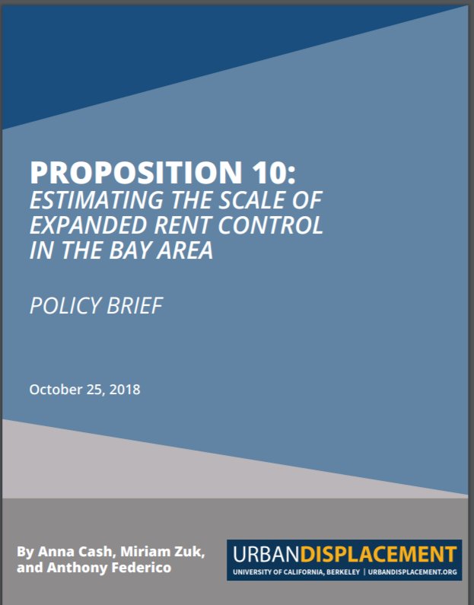
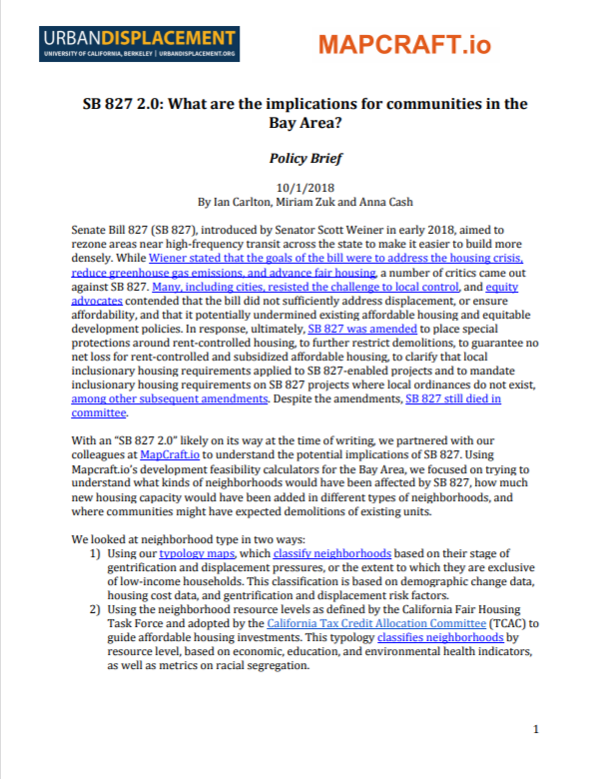
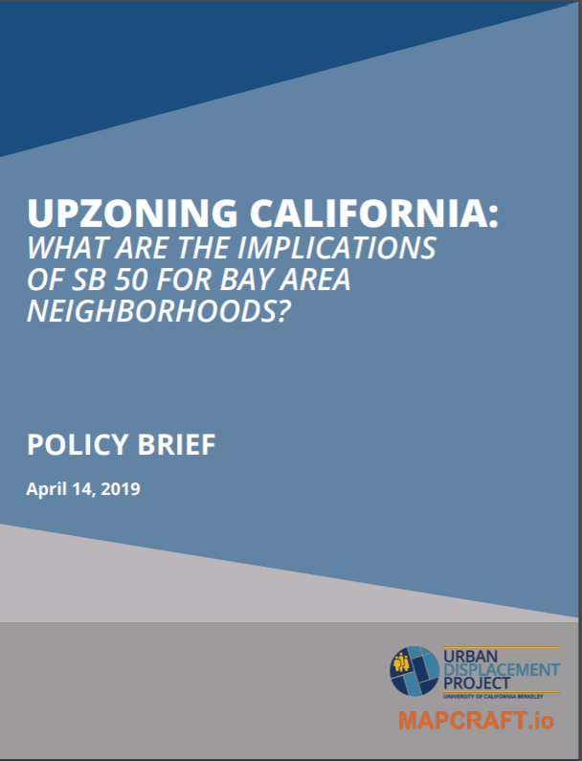
Policy Briefs

Slide 14

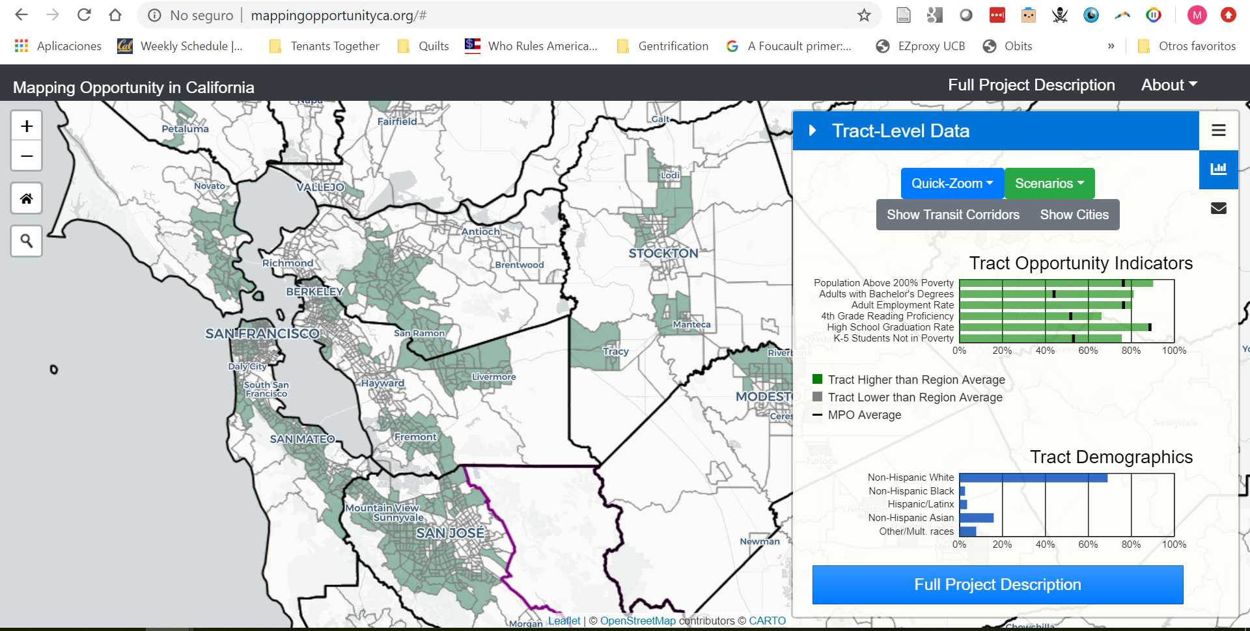
Technical Assistance and Task Forces

Slide 15
Analyzing Solutions

Slide 16
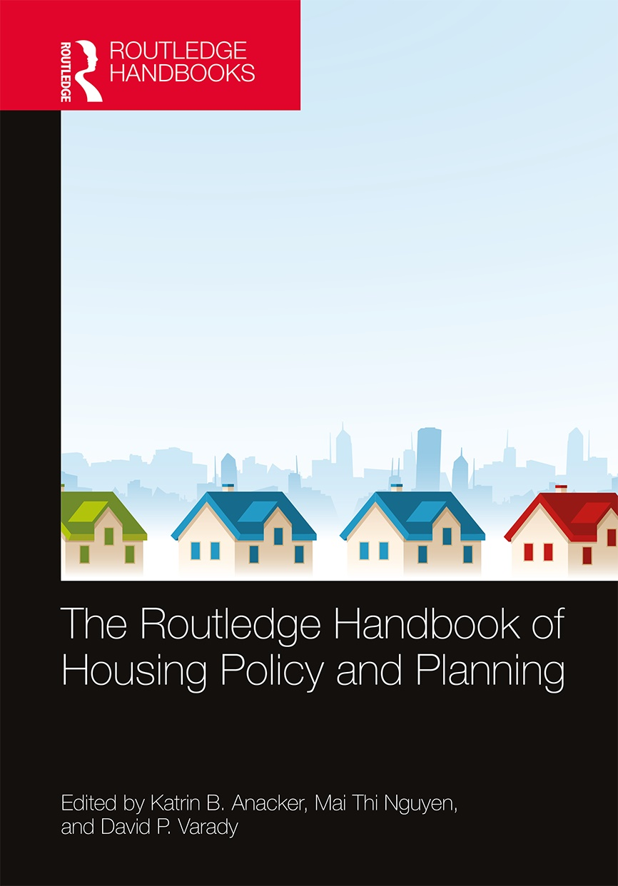
Anti-Displacement Policy Book Chapters

Slide 17
New Projects!
Analysis of the displacement impacts of policy:
  Rent control and just cause evictions protections (funded by SVCF)
  New housing production – affordable and market rate (funded by CZI)
  Climate investments (funded by SGC)
Collaboration with Prof. Jackelyn Hwang (Stanford) and Federal Reserve Bank of San Francisco
  Using Federal Reserve Bank of New York Consumer Credit Panel/Equifax (CCP)

Slide 18
Thank you!
mzuk@berkeley.edu
http://www.urbandisplacement.org

