Slide 1
Utilizing Youth Voice to Inform Health Planning at the Neighborhood-Level
Ashley Levulett
NNIP Idea Showcase
Thursday, July 25, 2019
www.cohtx.org alevulett@cohtx.org

Slide 2
Youth-led Community Health Learning Initiative (YLCHLI)
As part of Austin and Travis County's CHA-CHIP work, a Youth-led Community Health Learning Initiative (YLCHLI) was proposed with the aim to:
Assist high school-aged students in building their knowledge and skills in identifying health issues
Better inform health planning efforts in Del Valle and Montopolis by working with student leaders to identify health needs and assets within their communities
The partners, collaborators, and supporters listed above have helped to make this initiative possible.

Slide 3
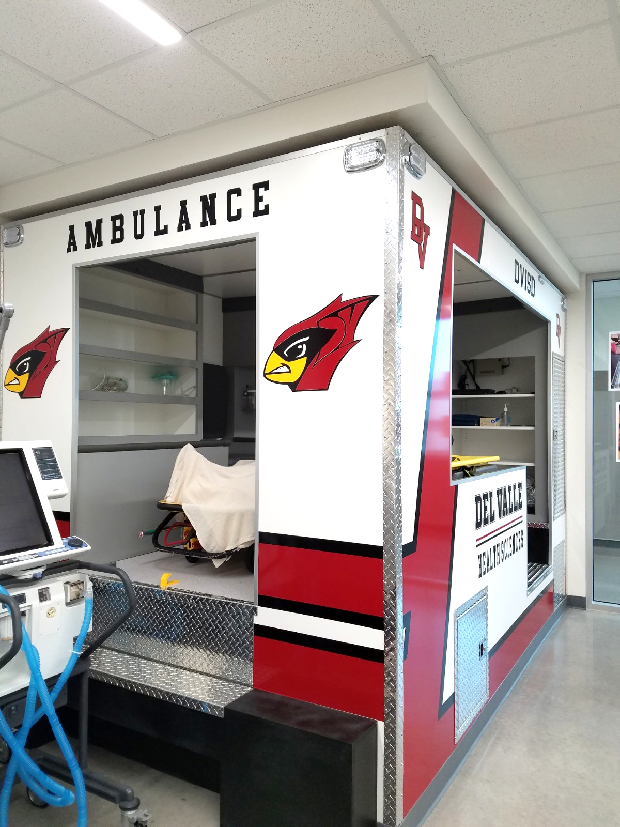
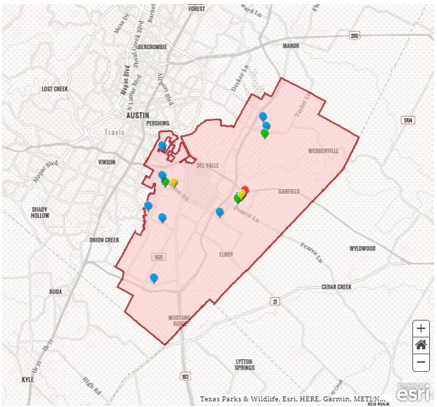
About Del Valle
Del Valle is an unincorporated community located in southeastern Travis County
Del Valle Independent School District (DVISD) serves as the primary defining entity of the community
84% Hispanic, 84% economically disadvantaged
Approximately 760 students in the Health Sciences Program at Del Valle High School
Students participate in one of the five areas of concentration
Graduate with at least one industry certification and college credit

Slide 4
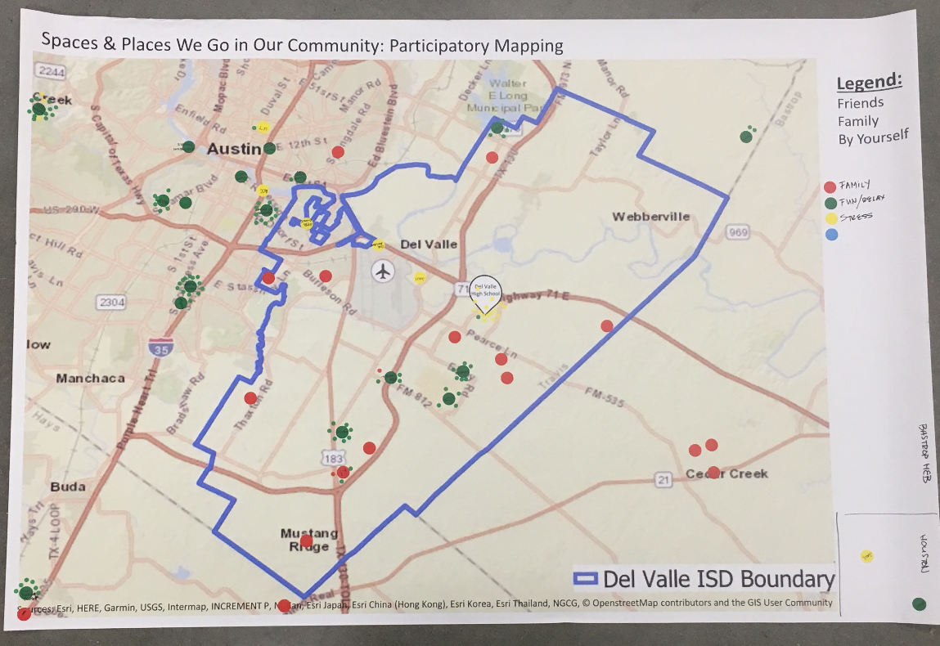
YLCHLI Curriculum
Define Del Valle Community
Participatory Mapping
Establish assets and needs
Data Gallery Walk
Identify individual and environmental factors that influence health
Health Equity – how to make positive change
Dotmocracy (Health Topic Prioritization)
Physical Activity
Healthy Eating
Mental Health
Access to Health Services
PhotoVoice

Slide 5
YLCHLI Curriculum: PhotoVoice
Utilize imagery and perspectives from participants to better understand or gain insights into a topic or community
Provides a way to effectively communicate to stakeholders, decision-makers, policy-makers
Framing questions
Why is (health topic) a problem in your community?
What in your community could prevent (health topic)?
What are ways we can promote (health topic) in your community?
What are resources/strengths in your community that can help teens make healthy choices around (health topic)?
“Mental health issues like depression are a problem because it can make us feel different from others – like we are upside down and we don’t fit in with society”

Slide 6
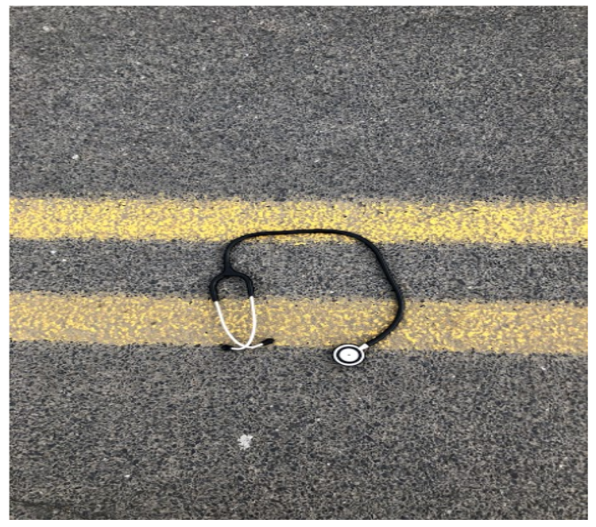
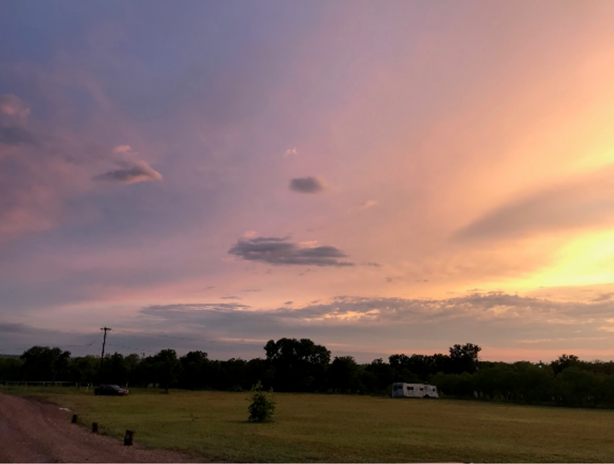
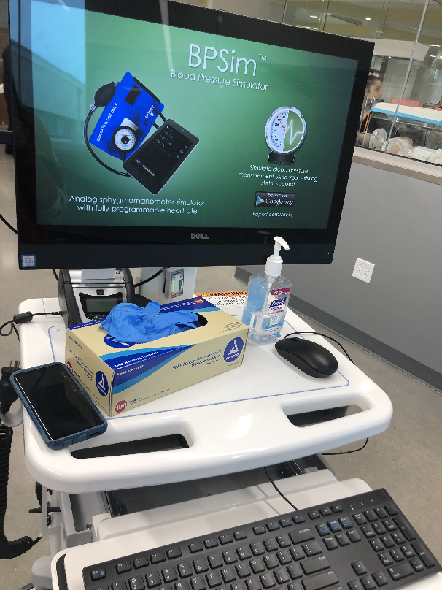
Del Valle Student PhotoVoice Work Examples
“…there aren’t much resources for us to actually get out and do things that are active, although we do have a lot of open land, that isn’t always a reason for us to go outside.”
“Clinics have certain hours and are not open all the time. Many people don’t have a flexible schedule and can’t fit it into their day.”
“There isn’t a hospital nearby so if we have an emergency, we have to leave town.”

Slide 7
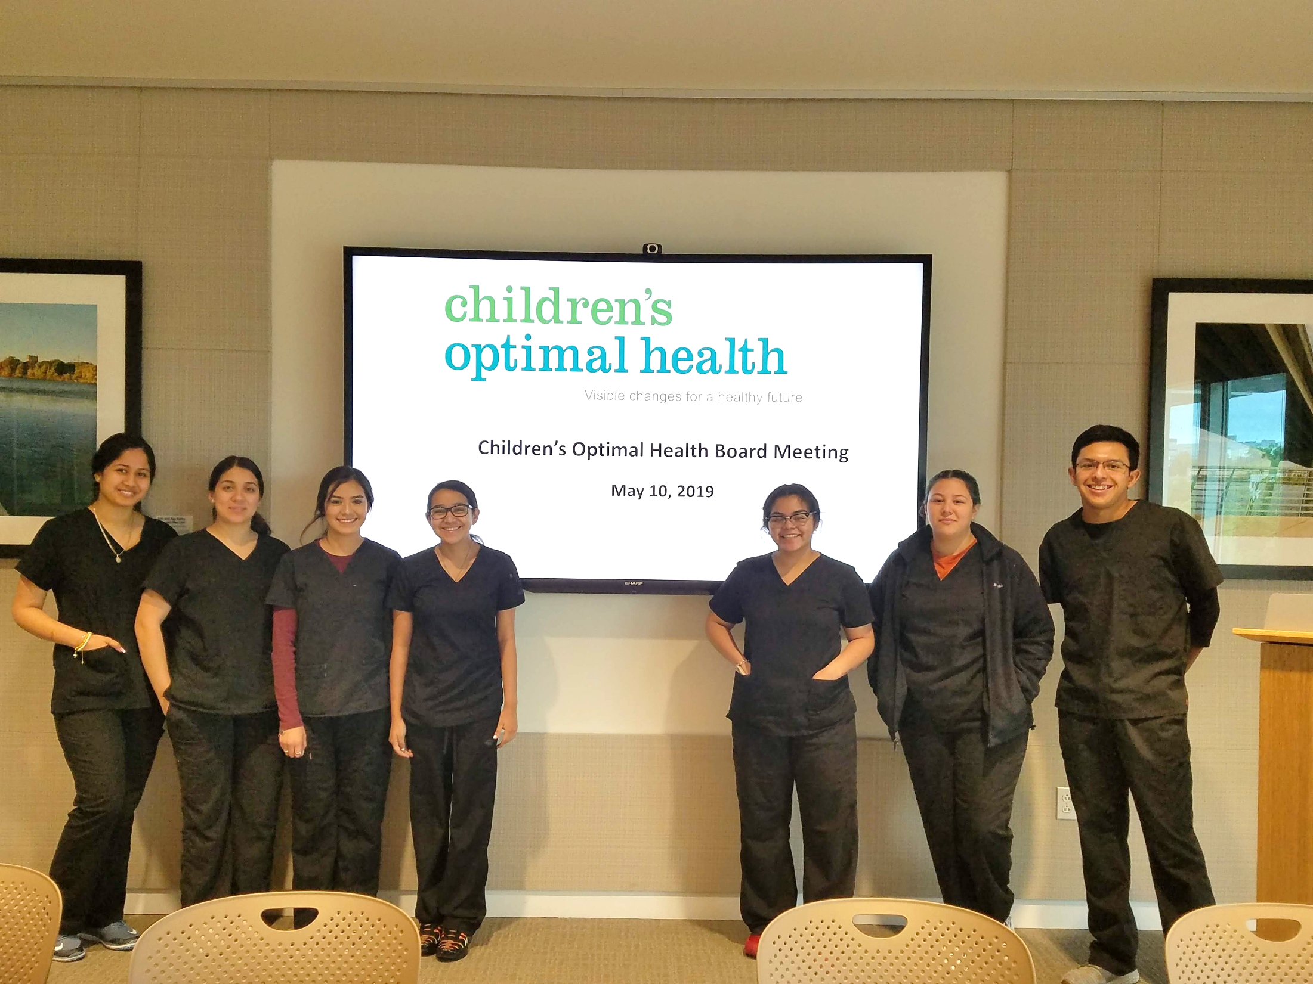
Outcomes
Community Presentations – chance to convey work to local stakeholders, decision-makers, and policy-makers
Youth Leader PhotoVoice Gallery
Children’s Optimal Health Board Meeting
Impacted student’s decisions around future careers
Raised student’s awareness of local health needs and assets
Empowered students to make positive local change
Informed health planning efforts for Austin Public Health and Travis County
Gave students the chance to define and tell the stories of their community

Slide 8
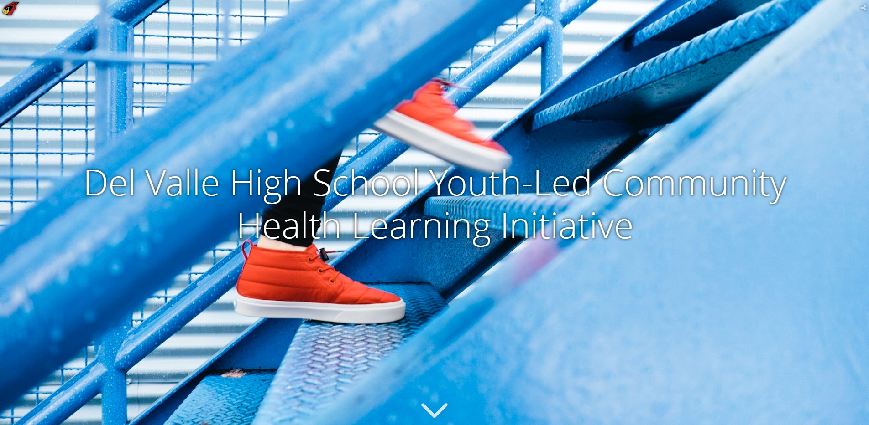
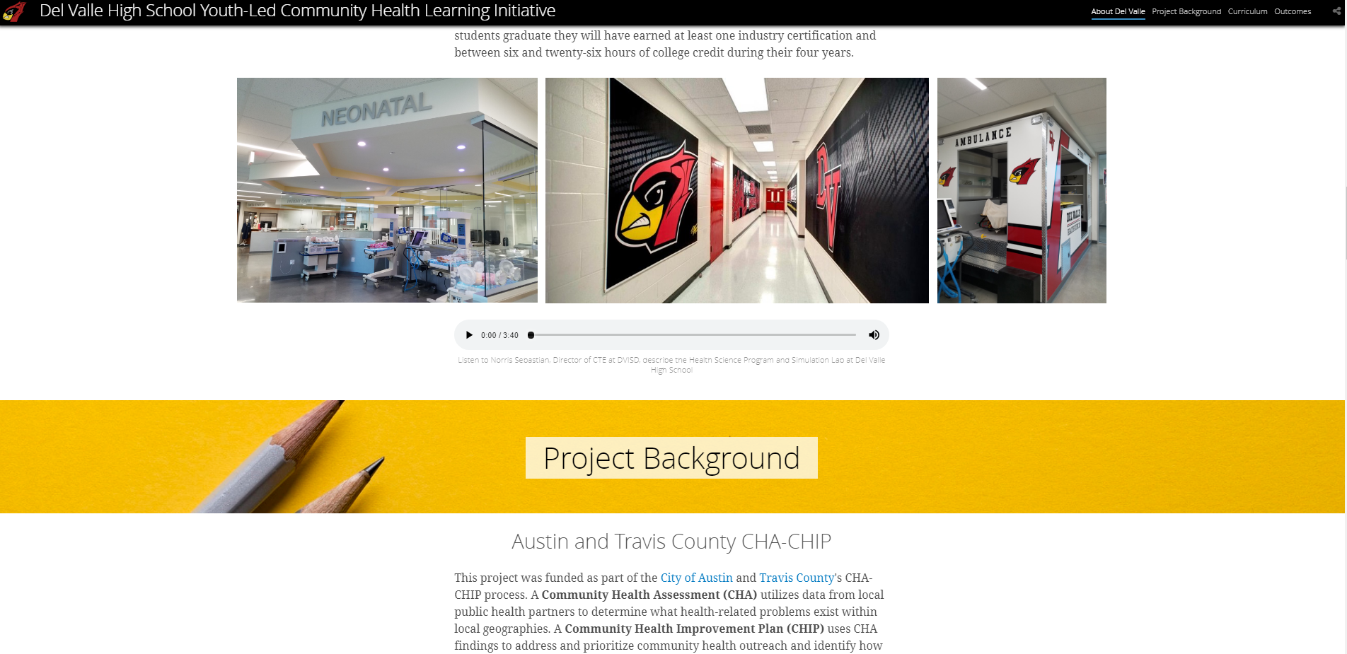
Outcomes: StoryMapping
Project by Children's Optimal Health detailing the story of the Del Valle Youth-Led Community Health Learning Initiative
Combines data, maps, mixed media, student work, and narrative so the community can tell their own story
Provides a way to publically showcase student work and continue discussion around health equity

