Slide 1
Data Behind the Data:
Using Metadata to Inform Data Collection Process Improvement
Clarissa Reneé Ozuna
Community Information Now (CI:Now)
San Antonio, Texas

Slide 2

How does metadata differ from data?
Source: google.com

Slide 3
CI:Now’s Regular Data Collection Activities
Activity | Description | Data Collected | Metadata Produced
EPN Neighborhood Survey | sample of 2,000 residences surveyed during 2-week period | survey responses | geographic information device & interviewer information number of contact attempts survey language response timestamps
EPN School Climate Survey | ~1,400 students surveyed during 1-week period | survey responses | campus information number of student log-in attempts response timestamps
PaCT Data-Sharing Consent Forms | 3,100+ program participants asked to complete annually with year-round collection | individual identifiers & consent choices | form version & language collecting organization information information sheet returned violation of 8 form validity criteria

Slide 4
CI:Now’s Regular Data Collection Activities
Activity | Description | Data Collected | Metadata Produced
EPN Neighborhood Survey | sample of 2,000 residences surveyed during 2-week period | survey responses | geographic information device & interviewer information number of contact attempts survey language response timestamps
EPN School Climate Survey | ~1,400 students surveyed during 1-week period | survey responses | campus information number of student log-in attempts response timestamps
PaCT Data-Sharing Consent Forms | 3,100+ program participants asked to complete annually with year-round collection | individual identifiers & consent choices | form version & language collecting organization information information sheet returned violation of 8 form validity criteria

Slide 5
PaCT Data-Sharing Agreement
What is EastPoint PaCT?
EastPoint PaCT (Promise and Choice Together) is a group of community partners like Eastside Promise, SAHA, SAISD, Goodwill, and others working to make sure that eastside families have good schools, safe and long-term housing, good jobs and careers, good health care, and a safe neighborhood.
Why are you asking me to fill out this form?
This form is how you choose whether or not to allow PaCT partners to share different kinds of information about your family members with each other or with funders. Sharing information makes it easier for partners to provide good services and allows funders to tell whether services are making a difference.

Slide 6
Data Quality & Entry
Data quality above that of results reporting
All information collected recorded -- 1 intentional mark = 1 new record
Collection and entry information recorded -- who, what, when, where, & why
Consent choice and form validity summary fields calculated
18
items collected
on form
54
fields recorded
in final data

Slide 7
Assessing Form Validity – 8 Criteria
4 issue areas assessed using 8 criteria
Missing Basic Required Fields
⇉ first or last name missing
⇉ consent choices not indicated
Decision-Making Authority Unreliable
⇉ name of consenter not given
⇉ same name for consenter and
consentee with unacceptable
date of birth
⇉ … or date of birth of minor
No Agreement Entered
⇉ signature missing
⇉ signature date missing or
unacceptable
Missing Linking Identifiers
⇉ date of birth missing or
unacceptable AND alternative
identifier not given

Slide 8
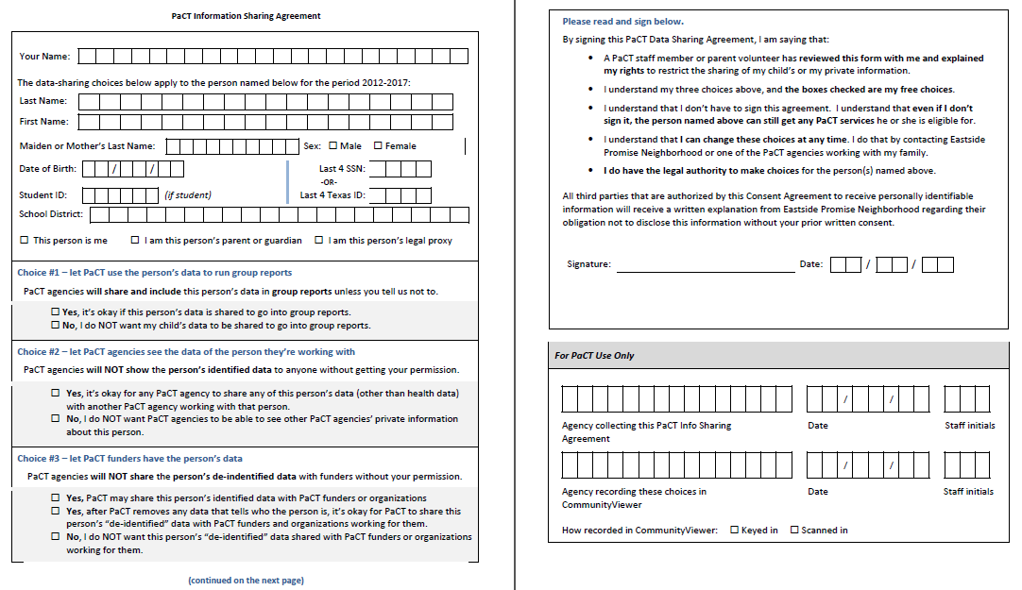
PaCT Data-Sharing Agreement
15 organizations
3,346 forms collected
1,221 forms violated 1 or more criteria
36.5% forms collected
could not be used

Slide 9
PaCT Data-Sharing Agreement

Slide 10
Recommended Revisions
Data Informed
Independent Focus Group
Move signature line to a more prominent position so it cannot be overlooked.
Form is too long. Make it 1-page so I don’t have to turn it over.
Organize choice fields so they are not embedded between text.
I wish there was an easier way to say ‘YES’ to all the choices without having to go one-by-one.
Separate required fields based on consentee (student or non-student) so it is easier to understand which fields are applicable.
It is confusing. I don’t know if you are asking about me or my child.

Slide 11
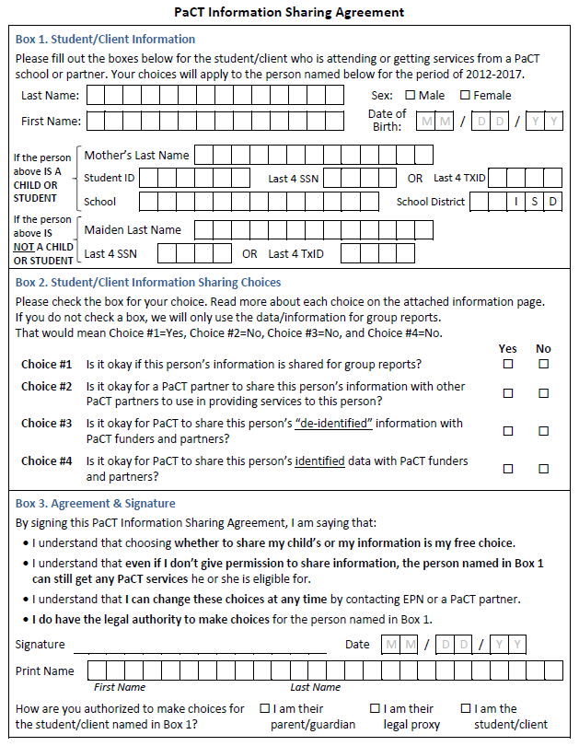
Revised PaCT Data-Sharing Agreement
14 organizations
1,460 forms collected (4 months)
407 forms violated 1 or more criteria
27.9% forms collected
could not be used

Slide 12
Revised PaCT Data-Sharing Agreement

Slide 13
Comparison

Slide 14
Next Steps

Slide 15
Thank you!
Clarissa Reneé Ozuna
Clarissa.R.Ozuna@uth.tmc.edu

