Slide 1
NNIP Network Update and Idea Showcase
December 3, 2020

Slide 2
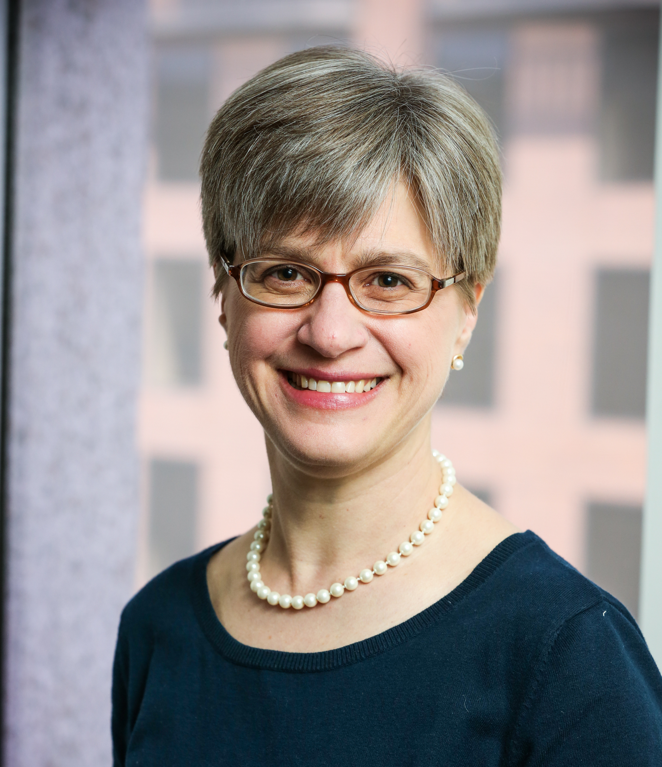
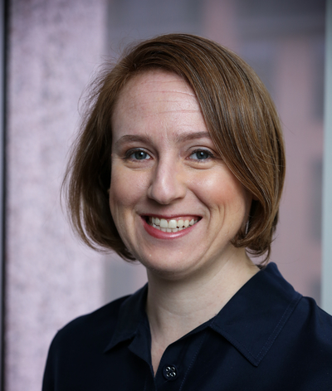
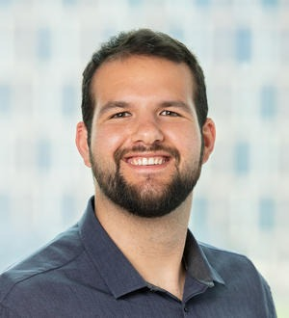
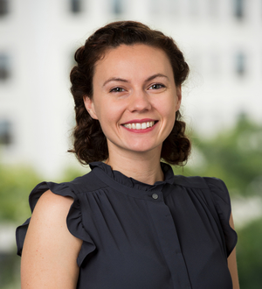
Urban Institute NNIP Staff
Kathy Pettit
Leah Hendey
Camille Anoll
Sonia Torres Rodriguez
Alex Peffley

Slide 3
NNIP HQ 2020 Reflections
Thank you from the bottom of our hearts for all your hard work during 2020.
Notes:
So proud and amazed at partners creatively responding to helping their communities get through the multiple crises we have experienced this year. Thought it was a sprint and now more a marathon and damage to people’s lives and the local economies won’t go away with a vaccine.
Come together – helped each other innovate faster.
Thanks to the Executive Committee – John Cruz, Noah Urban, Caroline Bhalla, Katie Pritchard, John Killeen, & Jie Wu
They didn’t know they were signing up for helping us pivot through the pandemic.
- we made fewer mis=steps because of them

Slide 4
Vote for the Executive Committee!
One vote per city (notes went out to “business list”)
We want 100% turnout.
Thanks to 7 partners who voted so far!
Three amazing candidates!
Tommy Pearce (Atlanta)
Geoff Smith (Chicago)
Mariko Toyoji (Seattle)

Slide 5
Elevate Data for Equity https://www.urban.org/elevate-data-equity
Principles of Equitable Data Practice (brief)
Philanthropy on investing in local data capacity (brief)
15 Stories of local funder capacity investments
“Community Data Capacities” Handout
Individual, Organizational, Collective
Resource links for equitable data practice and data capacity

Slide 6
NNIP Stories
Using an Equity Lens to Track Capital Investments in Baltimore
Aligning Investments with Needs of Atlanta’s Children and Families
Residents Inform Priorities of Oakland’s Department of Violence Prevention
Using Data to Advocate for Safer Walking Conditions in Houston
Other recommendations welcome!

Slide 7
Rapid Response COVID grants
RWJF Data for COVID-19 Response & Recovery
Chicago, Cleveland, Dallas, Houston, Los Angeles, Milwaukee, Philadelphia, San Antonio
AECF Engaging Youth with Data for COVID-19 Response and Recovery
Chicago, Durham, San Antonio
New! Local Data For Equitable Recovery Blog
https://medium.com/local-data-for-equitable-recovery

Slide 8
Civic Switchboard https://civic-switchboard.github.io/
Managed by Pittsburgh team
Durham, NC, Hacking into History: Discovering Racial Covenants in Durham’s Property Deeds
Partners: The School of Library and Information Sciences Library at NCCU with DataWorksNC and the County of Durham
Indianapolis, IN, Data and Drafts: A New Audience for Civic Data and Community Research
Partners: Indianapolis Public Library with the Polis Center at Indiana University – Purdue University Indianapolis and WFYI Public Radio
Notes:
Two NNIP Partners’ projects were funded!

Slide 9
Racial Equity Plans, Winter 2021
Peer discussion sessions:
Racial equity work in a university context
Building new partnerships
Data life cycle stage small series
External Presenter: Equity in algorithms (invited)
Also exploring based on interest
Accountability Groups

Slide 10
Other Virtual Engagement Plans In Progress
We need your input!
Topical discussions
Birds of a feather (directors, technology, early-career, etc.)
Idea Showcases
Pilot new formats
NNIPHQ coffee hour with Kathy/Leah
Social hours or cross-site project development groups on gather.town
Alternatives to Spring in-person meeting

Slide 11
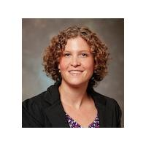
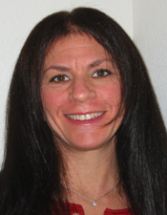
Thank You to our Showcase Panelists!
Amy Carroll-Scott
Urban Health Collaborative
Phyllis Resnick
The Colorado Futures Center
Erik Woodworth
Neighborhood Nexus
Sonia Torres-Rodriguez
Urban Institute
Notes:
Questions

Slide 12
Upcoming Events
Complete list of conferences Google Doc
All In Data for Community Health National Virtual Meeting, December 8-10, 2020-Virtual
Attendees: Camille Anoll, Amy Rohan, Susan Millea, Amy Hawn Nelson, Paul Sorenson
Annual Conference on the Science of Dissemination and Implementation in Health December 15-17, 2020-Virtual

Slide 13
Questions or ideas? Email: nnip@urban.org

Slide 14
Participate in the Network
There are many ways to participate in the network:
Submit updates online on recent partner activities at least semi-annually
Recognize and promote the network in presentations to local and national audiences
Submit annual updates to your local data inventory
Attend annual meetings
Follow @NNIPHQ and use #NNIP for your NNIP-related tweets
Check out the Participation Handout for all of the ways you can get involved: http://bit.ly/ParticipationHandout
Notes:
KP rearranged – many attendees are junior people and partners can’t afford to send everyone to meetings, so I didn’t want that one first.
Added forthcoming b/cThe data inventory request hasn’t gone out I think so I put that as

