Slide 1
NNIP Network Update and Idea Showcase
January 23, 2020
Notes:
Camille to open

Slide 2
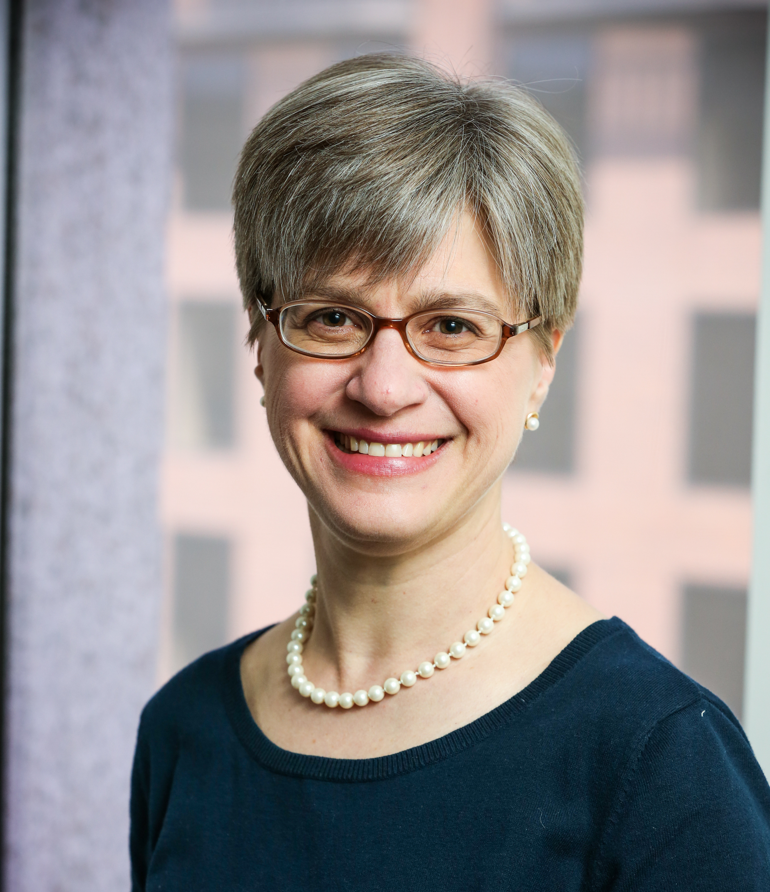
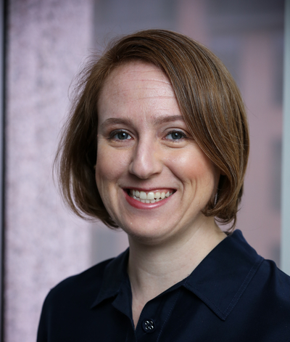
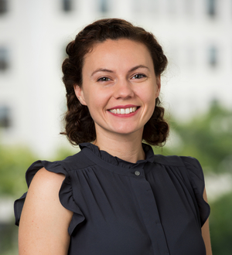
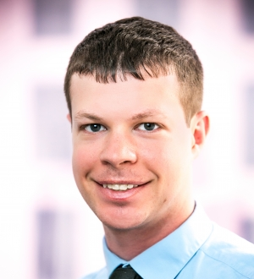
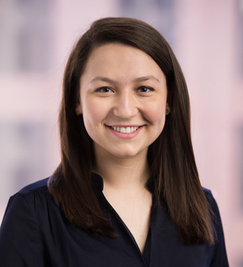
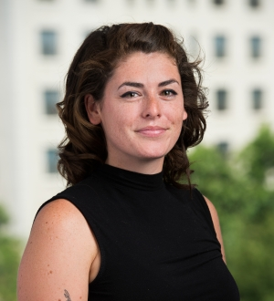
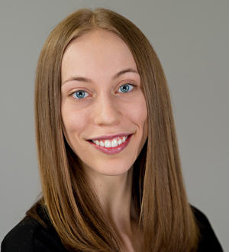
Urban Institute NNIP Staff
Kathy Pettit
Leah Hendey
Camille Anoll
Olivia Arena
Kassie Scott
Rob Pitingolo
Kelley Hanni
Notes:
Camille
Kathy--Mention Rob will be transitioning to a new role.

Slide 3
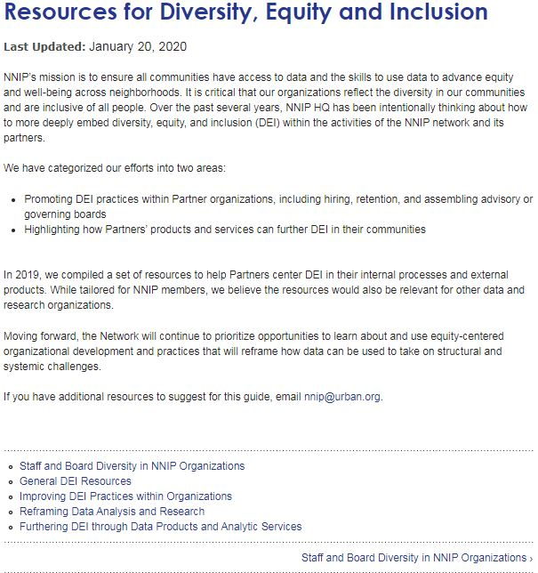
Diversity Brief and Guide
Analyzed the results of Partner diversity survey
Published brief “A Look At The Diversity of NNIP” highlighting diversity within the Network
Compiled resources into online guide to support DEI efforts:
Internal DEI best practices
How Partner products can further DEI in our work
Notes:
Kathy

Slide 4
Mission and Vision
Our Mission:
To ensure all communities have access to data and the skills to use information to advance equity and well-being across neighborhoods.
Our Vision:
A future where people use data to increase racial and economic equity and well-being in their communities.
Notes:
Leah

Slide 5
Our Work
Using their local expertise and data, our partners connect residents, nonprofits, government, and other stakeholders to build a shared understanding of community issues and develop solutions together.
To better serve our communities, we:
• Strengthen the ability of local organizations to expand the use of data.
• Learn about innovative methods and practices from one another and outside experts.
• Elevate insights and innovations from our communities to share with local and national audiences.
Notes:
Leah

Slide 6
Recent NNIP Publications
Dallas Story: Training Dallas’s Youth to Make Change in their Communities
Philadelphia Story: Building Youth Job Readiness and Self-Efficacy through Health Impact Assessments
Milwaukee Story: Milwaukee’s Amani Neighborhood Uses Data to Target Traffic Safety and Build Trust
Urban Blog: Three Tips for Planning Community Events to Prepare for the 2020 Census
Highlight of Mobilizing Youth brief by the Annie E. Casey Foundation
Notes:
Camille

Slide 7
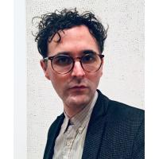
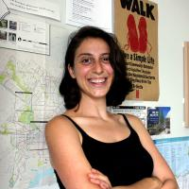
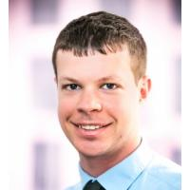
Thank You to our Showcase Panelists!
Erik Woodworth
Neighborhood Nexus
Jana Hirsch
Urban Health Collaborative
Mariko Toyoji
& Sara Jaye Sanford
Public Health – Seattle & King County
Rob Pitingolo
NNIP Coordination Team
Notes:
Questions
Camille

Slide 8
Publications Coming Soon
Briefs on Children’s Hospitals and Social Determinants of Health
Collection of work for RWJF
Encouraging philanthropy to invest in local data capacity (Brief and vignettes)
Setting out principles for equitable use of data from collection to disposition
Resources on building data capacity and equitable use of data
Notes:
Kathy

Slide 9
Upcoming Events
Complete list of conferences
Health Data-polooza, February 10-11, Washington, DC
2020 National Interagency Community Reinvestment Conference, March 9-12, 2020, Denver, CO
Code for America, March 11-13, Washington, DC
Urban Affairs Conference, April 2-4, 2020 Washington, DC
NNIP Meeting, April 28—May 1, Washington DC
Collective Impact Forum, May 6-8, Denver, CO
Notes:
Kathy? Or Camille can cover if need be

Slide 10
Questions or ideas? Email: nnip@urban.org
Notes:
Kathy? Or Camille can cover if need be

Slide 11
Participate in the Network
There are many ways to participate in the network:
Submit updates online on recent partner activities at least semi-annually
Recognize and promote the network in presentations to local and national audiences
Submit annual updates to your local data inventory
Attend annual meetings
Follow @NNIPHQ and use #NNIP for your NNIP-related tweets
Check out the Participation Handout for all of the ways you can get involved: http://bit.ly/ParticipationHandout
Notes:
Kathy? Or Camille can cover if need be

