Slide 1
NNIP Network Update and Idea Showcase
July 25, 2019

Slide 2
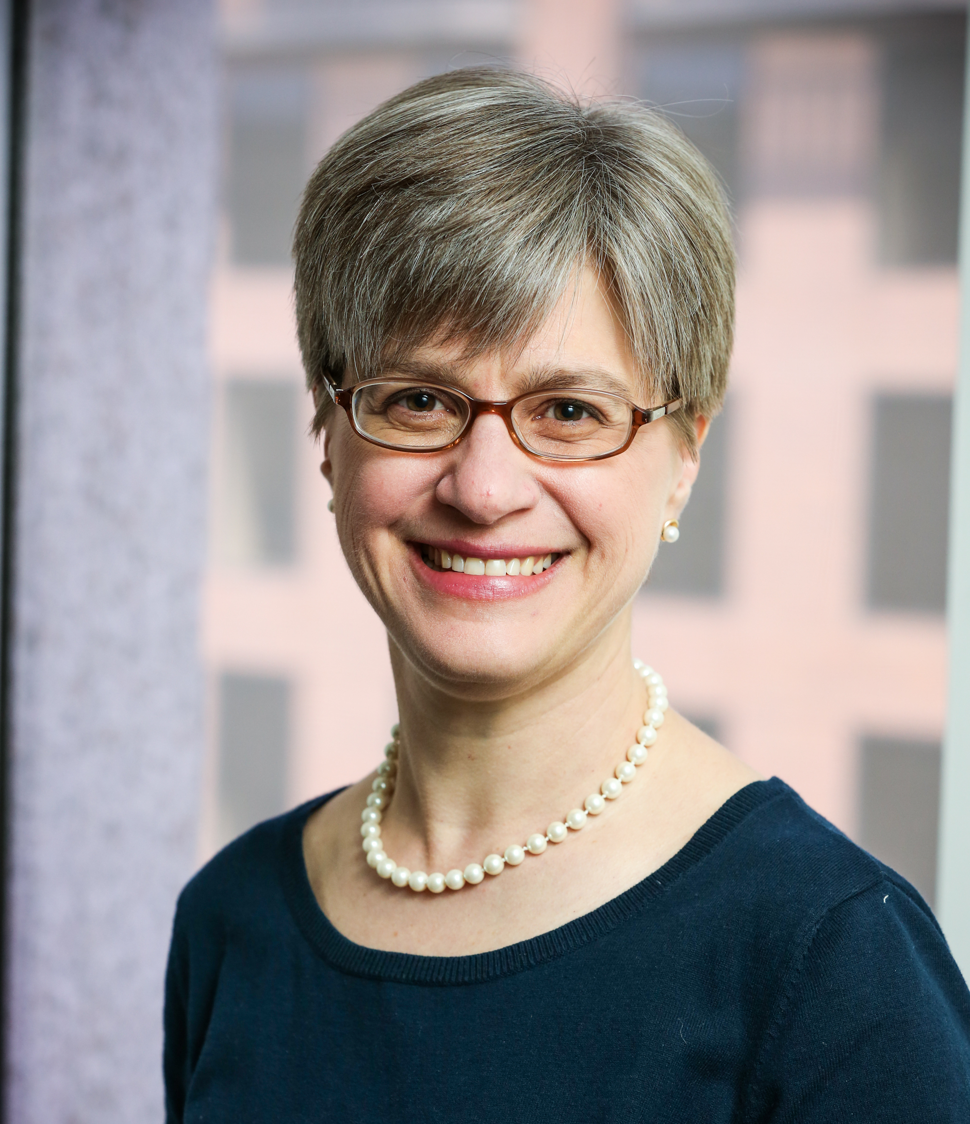
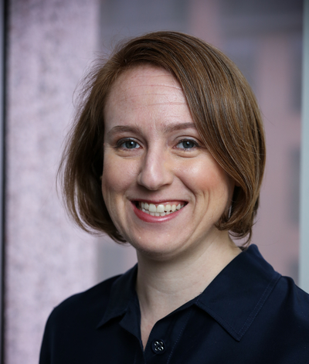
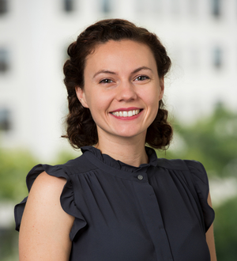
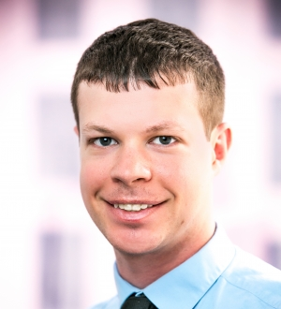
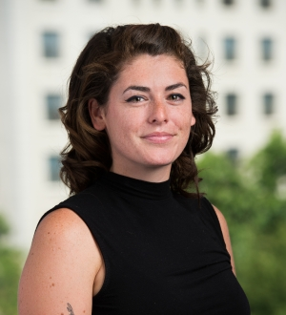
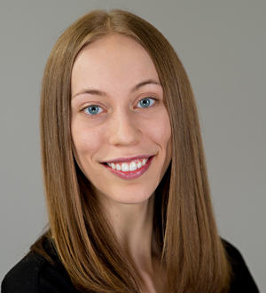
Urban Institute NNIP Staff
Kathy Pettit
Leah Hendey
Camille Anoll
Olivia Arena
Kassie Scott
Rob Pitingolo
Kelley Hanni
Notes:
ADD MARCUS & KASSIE?

Slide 3
2020 Census Cross-Site Project
Administered a survey to Partners on involvement; producing a factsheet
31 Partners responded, all said they were planning to participate in 2020 Census in some way
Held NNIPCamp Session
Planning to have a Partner call in the fall to exchange ideas and updates
Produced blog and brief
Resources listed on our cross-site page
Notes:
Survey
Half of NNIP Partners responded that they were involved in 2010 Census activities compared with all Partners responding that they plan to participate in 2020 Census efforts.
Over 75% of respondents said their city, county, or community had an established Complete Count Committee in place

Slide 4
2020 Census Cross-Site Project

Slide 5
2020 Census Cross-Site Project
Notes:
Partners can help support activities focused on families with young children

Slide 6
2020 Census Cross-Site Project

Slide 7
2020 Census Upcoming Work
Partners peer exchange call – September
Webinar for Code for America brigades
Potential other fact sheets
We need small and large examples from all of you!
Which groups are you reaching?
What analysis is helping the outreach planning? (especially with local data)
Notes:
Survey
Half of NNIP Partners responded that they were involved in 2010 Census activities compared with all Partners responding that they plan to participate in 2020 Census efforts.
Over 75% of respondents said their city, county, or community had an established Complete Count Committee in place

Slide 8
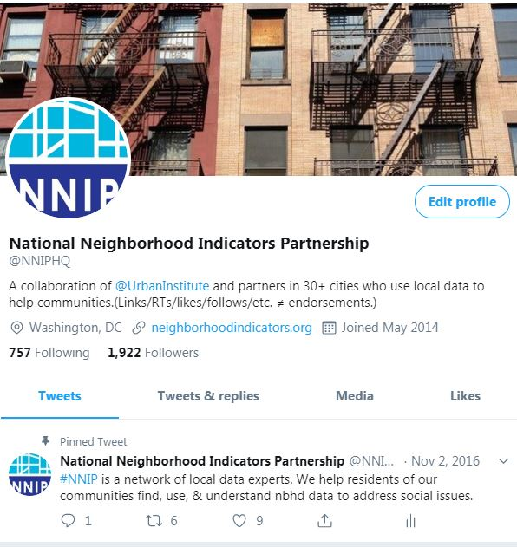
Social Media (Twitter)
Met with Urban’s social media coordinator
Brainstormed goals for social media, specifically Twitter
Created Twitter Guidelines for @NNIPHQ and #NNIP
Refining Twitter strategies and reporting metrics
Notes:
The Twitter content will include:
highlighting partner projects and events
circulating opportunities, resources, and examples from relevant networks and organizations outside of the network, including non-partner organizations within NNIP cities; and
engaging with influencers in the field of community data and information.
Guidelines: The following principles guide NNIPHQ’s use of Twitter. We ask that Partners also follow these guidelines when using #nnip.
Tweets will follow other NNIP policies, such as our codes of conduct or non-endorsement policies.
Tweets will avoid disparaging or disrespectful remarks.
Tweets will not endorse a specific political party or agenda.
Retweets do not equal endorsements. This practice is explicitly stated in the NNIPHQ twitter bio.
Tweets will always credit work. This may look like tagging Partners, naming Partners, or explicitly naming the city and Partner (#NNIP Chicago Partner) to credit work. For external content, NNIP HQ will include “via” or tag authors or organizations.
Comments on tweets will not be responded to unless they are asking for additional resources.
Tweets will not be deleted unless they have inaccuracies.

Slide 9
Social Media (Twitter)
NNIP’s goal for its use of Twitter is: to promote the work and principles of the NNIP network and partner organizations, particularly to external audiences.
Strategic use of Twitter
National platform should elevate Partner work to reach additional audiences
Plug into topics in the news to show relevancy
Engage with other networks, practitioners, thought leaders
Notes:
Content will include:
highlighting partner projects and events
circulating opportunities, resources, and examples from relevant networks and organizations outside of the network, including non-partner organizations within NNIP cities; and
and engaging with influencers in the field of community data and information.

Slide 10
Social Media (Twitter)
Tag @NNIPHQ or use the #NNIP to reference Network content
Follow NNIP’s Twitter Guidelines when using the hashtag or handle
Highlight fellow Partner tweets on your website or social media (for example Dallas’s homepage has a feed using the NNIP Partner Twitter List).
Send organizations or thought leaders to NNIPHQ
Notes:
Send material you want tweeted or highlighted directly to Olivia Arena (oarena@urban.org) with the requested material or constructed tweet.
If appropriate, promote others following @NNIPHQ.
Send along suggestions for our influencers list.

Slide 11
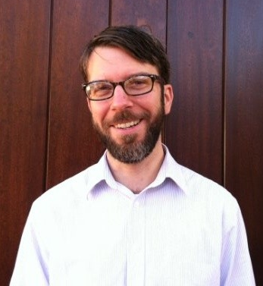
Thank You to our Showcase Panelists!
Jeff Matson
Jordan Ayala
John Killeen
Ashley Levulett
Notes:
Questions

Slide 12
Publications coming soon
Summary of NNIP staff/board diversity survey
Stories from the Impact Award applicants
Indianapolis
Chicago
San Antonio
Milwaukee
Collections on engaging youth, children’s hospitals

Slide 13
Publications coming soon – RWJF project
Community Data Ecosystems
Community Data Capacities
Individual Skills and Expertise
Organizational Practices
Community Infrastructure
Collective Practices

Slide 14
Upcoming Events
Complete list of conferences
LED Workshop, September 4-5, 2019, Suitland, MD
MetroLab 2019 Annual Summit, September 19-20, Boulder, CO
URISA GIS-Pro conference, September 28-October 2, New Orleans, LA
Community Indicators Consortium, October 10-11, Denver, CO
Reclaiming Vacant Properties October 2-4, Atlanta, GA
All In National Meeting, October 15-17, Baltimore, MD
2019 Alliance for Strong Families and Communities Conference, October 16-18, Indianapolis, IN
CfA Brigade Congress, October 18, Cleveland, OH
APPAM, November 7-9, Denver, CO

Slide 15
Questions or ideas? Email: nnip@urban.org

Slide 16
Participate in the Network
There are many ways to participate in the network:
Submit updates online on recent partner activities at least semi-annually
Recognize and promote the network in presentations to local and national audiences
Submit annual updates to your local data inventory
Attend annual meetings
Follow @NNIPHQ and use #NNIP for your NNIP-related tweets
Check out the Participation Handout for all of the ways you can get involved: http://bit.ly/ParticipationHandout
Notes:
KP rearranged – many attendees are junior people and partners can’t afford to send everyone to meetings, so I didn’t want that one first.
Added forthcoming b/cThe data inventory request hasn’t gone out I think so I put that as

