Slide 1
NNIP Network Update and Idea Showcase
February 21, 2019

Slide 2
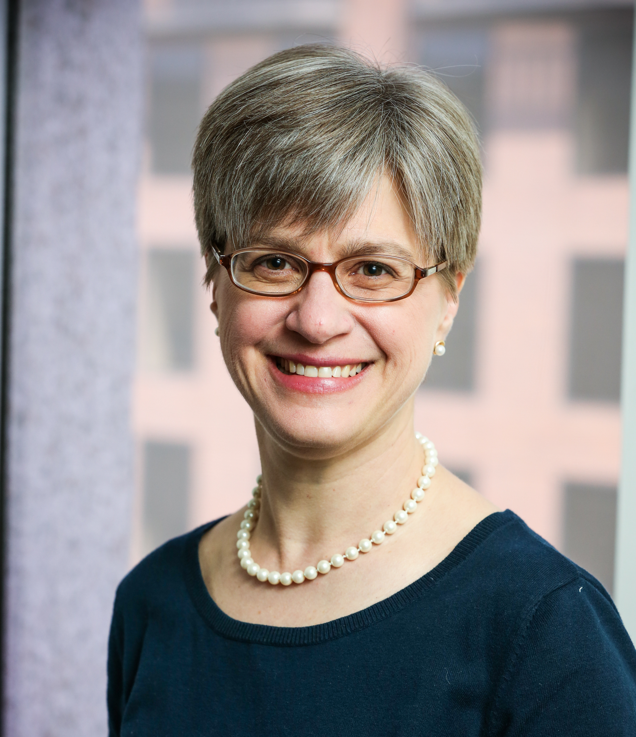
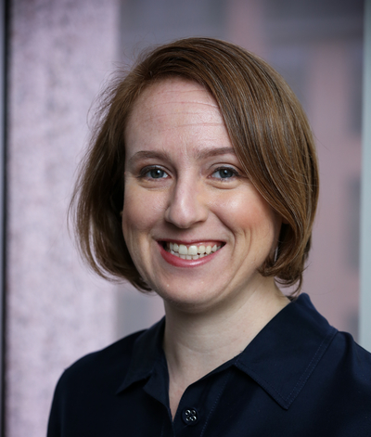
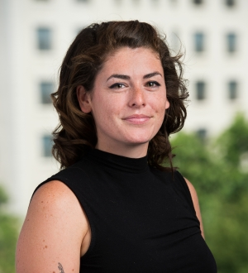
Urban Institute NNIP Staff
Kathy Pettit
Leah Hendey
Rob Pitingolo
Olivia Arena
Kelley Hanni
Notes:
ADD MARCUS & KASSIE?

Slide 3
Building Local Capacity to Use Data to Improve Health and Equity
15-month Robert Wood Johnson grant
Guidance on principles and directions for RWJF’s investments related to data and data capacity
Understanding and supporting small and medium cities’ capacity to use data for community health
Supporting the NNIP network, particularly how local data can inform efforts to improve health and equity

Slide 4
Recent Publications
The Potential for Catalyzing Community Criminal Justice Reform with Data (Microsoft)
Fact sheet and project listing
Harnessing the Power of Open Data for Children and Families (Casey/KIDS COUNT)
Brief, 2 fact sheets, and state open data portal scan

Slide 5
Publications coming soon
Data and technology groups can improve the 2020 Census count (brief)
Turning the Corner (titles tbd)
Implications of Neighborhood Revitalization for Public Safety, Small Businesses, and Capital Investments (brief)
Lessons from Five Cities on Displacement Risk (brief)
Experiences of Five Cities Exploring Displacement
Measuring Neighborhood Change to Understand and Prevent Displacement (data guide)

Slide 6
Participate in the Network
There are many ways to participate in the network:
Submit updates online on recent partner activities at least semi-annually
Recognize and promote the network in presentations to local and national audiences
Submit annual updates to your local data inventory
Attend annual meetings
Follow @NNIPHQ and use #NNIP for your NNIP-related tweets
Check out the Participation Handout for all of the ways you can get involved: http://bit.ly/ParticipationHandout
Notes:
KP rearranged – many attendees are junior people and partners can’t afford to send everyone to meetings, so I didn’t want that one first.
Added forthcoming b/cThe data inventory request hasn’t gone out I think so I put that as

Slide 7
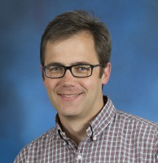
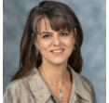
Thank You to our Showcase Panelists!
Bob Gradeck
rmg44@pitt.edu
Laura McKieran
Laura.c.Mckieran@uth.tmc.edu
Jake Cowan
jake@jakecowan.com
Notes:
Questions

Slide 8
Upcoming Events
Complete list of conferences
Nonprofit Technology Conference, March 13-15, Portland, OR
2019 Health Datapalooza, March 27-28, Washington, DC
American Association of Geographers, April 3-7, Washington, DC
People & Places - April 15-17, Arlington, VA
FOSS4G North America, April 16-18, San Diego, CA
csv conference, May 8-9, Portland, OR
Renewing the Promise of the Middle Class, May 9-10, 2019, Washington DC
American Community Survey Users’ Conference, May 14-15, Washington DC
Code for America Summit, May 29-31, Oakland
NNIP Partners’ Meeting, June 12-14, Milwaukee

Slide 9
Questions or ideas? Email: nnip@urban.org

