Slide 1
NNIP Network Update and Idea Showcase
October 24, 2019

Slide 2
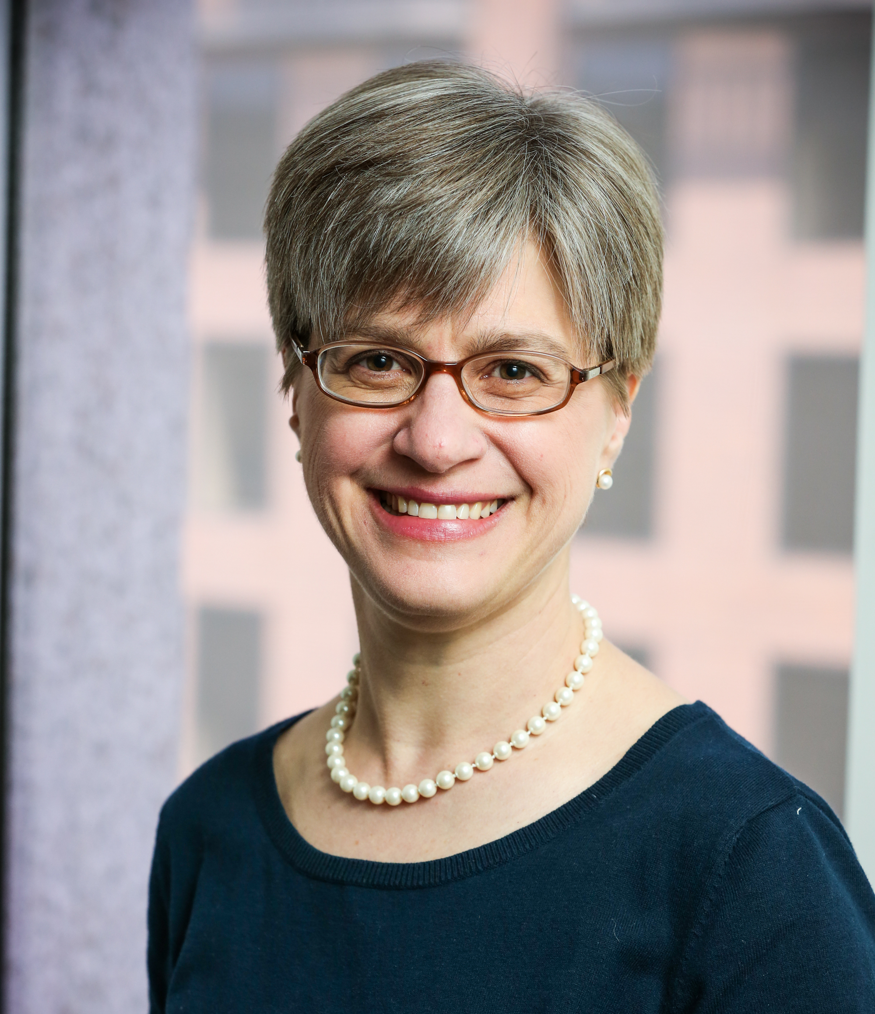
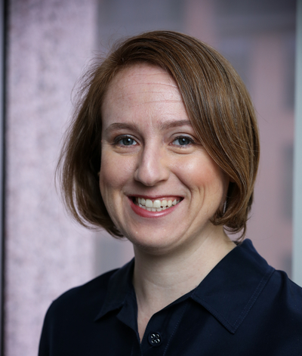
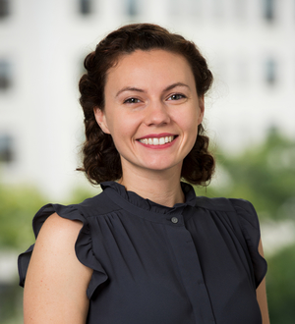
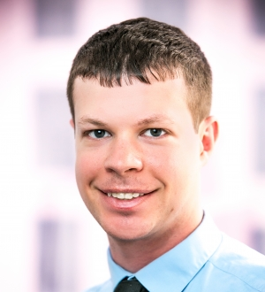
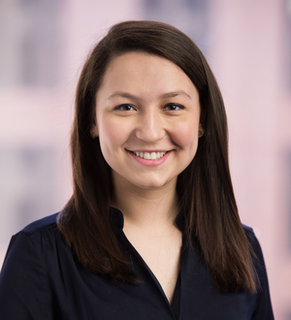
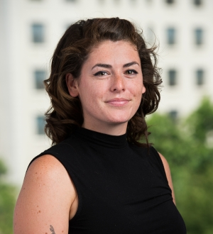
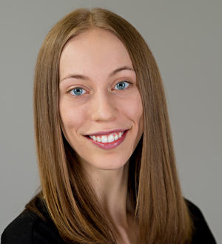
Urban Institute NNIP Staff
Kathy Pettit
Leah Hendey
Camille Anoll
Olivia Arena
Kassie Scott
Rob Pitingolo
Kelley Hanni

Slide 3
Mission and Vision Update
Solicited Feedback from Business List (Sept./Oct.)
Review by Urban Communications (Nov.—Dec.)
Update website and other collateral (Dec. and onward)
Partners’ Webinar (February)

Slide 4
Thank you for Responding to the NNIP Partners’ Survey
100% participation for our partner cities!
84% of our partners connect outside of the annual meetings.
92% of respondents felt that the partners’ meetings were important to their organization and all respondents felt NNIP did a good job hosting these meetings.
93% of respondents value NNIP for opportunities for peer support.
Notes:
All respondents responded 3, 4, and 5 to the importance of partner meetings to their organization (on a 1—5 scale)
All respondents responded 3, 4, and 5 to value of peer support through the network

Slide 5
Reminder about Data Inventory
Thanks to the 16 partners who have responded already!
Look forward to new results on policing, environment, and health data.
If you haven’t answered, please do so by October 31st (Halloween)!
Email Rob Pitingolo, rpitingolo@urban.org with questions or concerns.

Slide 6
Recent NNIP Publications
Engaging Youth: Mobilizing Young People for Community Change (8 partner examples)
Indianapolis: Understanding Domestic Violence in Marion County (story)
Chicago: IHS Helps Shape Key Chicago Housing Plan (story)

Slide 7
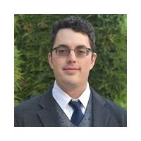
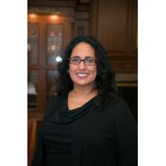
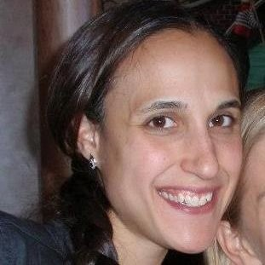
Thank You to our Showcase Panelists!
Peter Ciurczak
Boston Indicators
Geoff Smith
Institute for Housing Studies
Caroline Bhalla
Sol Price Center for Social Innovation
Amy Confair
Urban Health Collaborative
Notes:
Questions

Slide 8
Publications coming soon
Summary of NNIP staff/board diversity survey
Stories from the Impact Award applicants
San Antonio
Milwaukee
Collections on children’s hospitals
Other ideas?

Slide 9
Publication coming soon – RWJF project
Community Resources
Community Data Capacities
Individual
Organizational
Collective

Slide 10
Upcoming Events
Complete list of conferences
APPAM, November 7-9, Denver, CO
Tableau Conference November 12-15, Las Vegas
2020 National Interagency Community Reinvestment Conference, March 9-12, 2020, Denver
Urban Affairs Conference, April 2-4, 2020 Washington DC

Slide 11
Questions or ideas? Email: nnip@urban.org

Slide 12
Participate in the Network
There are many ways to participate in the network:
Submit updates online on recent partner activities at least semi-annually
Recognize and promote the network in presentations to local and national audiences
Submit annual updates to your local data inventory
Attend annual meetings
Follow @NNIPHQ and use #NNIP for your NNIP-related tweets
Check out the Participation Handout for all of the ways you can get involved: http://bit.ly/ParticipationHandout
Notes:
KP rearranged – many attendees are junior people and partners can’t afford to send everyone to meetings, so I didn’t want that one first.
Added forthcoming b/cThe data inventory request hasn’t gone out I think so I put that as

