Slide 1
NNIP Network Update and Idea Showcase
February 15, 2018

Slide 2
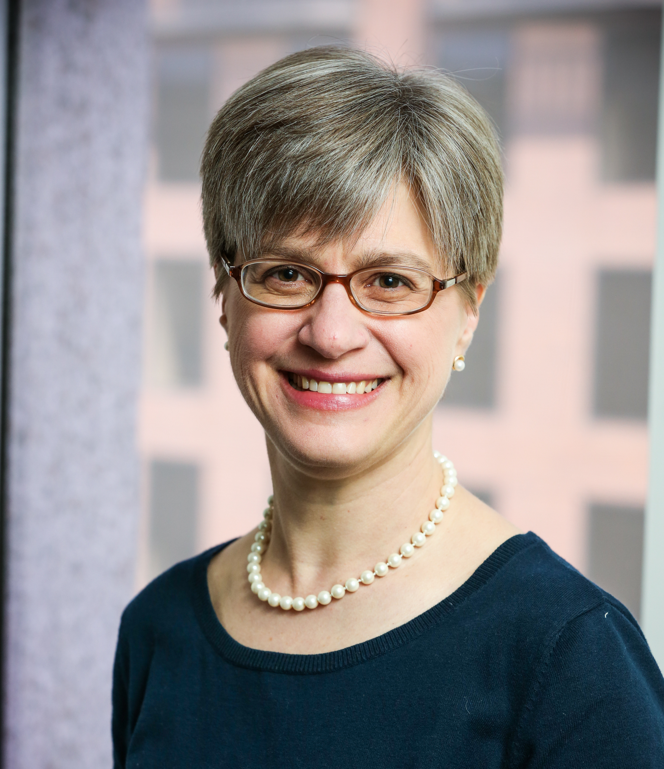
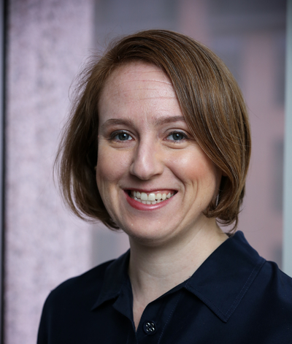
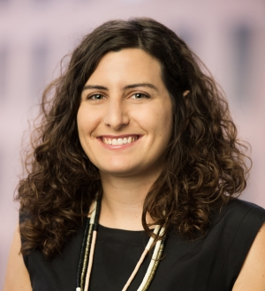
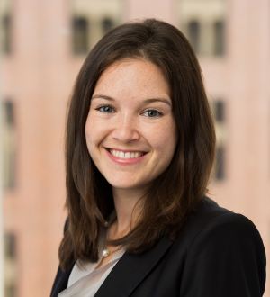
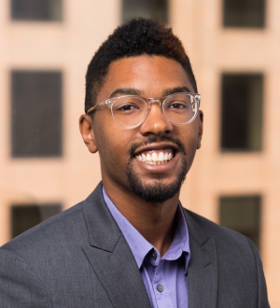
Urban Institute NNIP Staff
Kathy Pettit
Leah Hendey
Rob Pitingolo
Olivia Arena
Sara
McTarnaghan
Amanda Gold
(IDS)
Mychal
Cohen
(Turning the Corner)
Notes:
How to handle Tom?

Slide 3
In Memoriam
www.neighborhoodindicators.org/kingsley

Slide 4
Our Newest NNIP Partner: Durham!!
Check out their website at www.dataworks-nc.org
Notes:
John has been a longtime friend and contributor.

Slide 5
Participation Report: Coming Soon
Please post that you are a NNIP member & the Partner Badge on your website.
See email for self-reporting contributions.
Follow @NNIPHQ and use #NNIP for your own NNIP-related tweets
Notes:
Rob has or will shortly send out reminders if you don’t have a badge…

Slide 6
NNIP Partner Shout-Out
bit.ly/NNIPshoutout

Slide 7
Content In Development
Short video guides to NNIP website (February)
New page to list NNIP alumni consultants (March)
NNIP Partners & Local Government: overview & case studies on Baltimore, Columbus, Oakland (March)
Guide to Involving Students (April)
Brief on the role of neighborhood data and engagement in the 2020 Census (April/May)
Stories about Community Health Needs Assessments (CNHAs) (ongoing)
Other story ideas?
Notes:
Leah

Slide 8
Content In Development: Integrated Data Systems
Thanks to everyone who has already shared examples of MOUs to update our collection!
Email Leah if you have others you’d be willing to share.
Resource Guide to Data Governance and Security
Focuses on confidential data but relevant to all data
Curates resources related to protecting privacy and human subjects, data security (plans, audits, breaches, etc.) and handling data appropriately throughout the data life cycle (acquisition to destruction).
Notes:
Leah covers

Slide 9
Cross-Site Projects Civic Tech and Data Collaborative
Upcoming Items from National Team
Site Case Studies
Cross-site Synthesis
Resources Toolkit
Guidance for Partners
Blogs from Local Partners
April Urban: Civic Tech and Open Data in Cleveland
Bob Gradeck: Data Day
Louise Carter: 5 Lessons for Harnessing Data and Tech to Meet Community Needs & Leveraging Data to Address Community Needs
Others on the way….
Notes:
Olivia covers this?

Slide 10
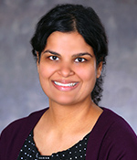
Thank You to our Showcase Panelists!
Matt Nowlin
minowlin@indiana.edu
Steve Saylor
steven.saylor@pitt.edu
Zafreen Jaffery
zafreen@thechildrenstrust.org
Notes:
Questions

Slide 11
Upcoming Events
2018 National Interagency Community Reinvestment Conference, March 18-21, Miami
Urban Affairs Association, April 4-7, Toronto
PolicyLink Equity Summit, April 11-13, Chicago
NNIP Partners Meeting, May 9-11, Atlanta
Code for America Summit, May 30-June 1, Oakland
Notes:
KP to mention Cfa Discount

Slide 12
Questions or ideas? Email: nnip@urban.org

